Slide 1

SALES FORECASTING
ACROSS MULTIPLE RETAIL STORES
Rossmann Pharmaceuticals — From Raw Records to a Live Forecasting Dashboard
Yousuf S. R. Sakkaf
Notes:
Project Brief
Rossmann Pharmaceuticals' finance team needs daily sales forecast six weeks ahead across 1,115 stores in several cities.
Today, individual store managers forecast using years of experience and personal judgement alone — there is no shared, quantitative baseline. The data team identified promotions, competition, school and state holidays, seasonality, and locality as the factors worth modelling. The deliverable is an end-to-end product that puts these predictions in analysts' hands, not just a model in a notebook.
This deck covers four analysis notebooks and one deployed dashboard as a single connected pipeline, and closes on one verdict: the tuned Random Forest is the best model across every approach tried, because richer per-store input features beat model sophistication consistently.
Presentation Flow
- Business Context & Dataset Overview
- Analytical Framework
- EDA — Sales, Customers & the Promotion Effect
- EDA — Store Structure Sets the Baseline
- EDA — Holidays Start Before the Holiday
- ML Modeling — The Winning Model
- ML Modeling — What Drives the Prediction
- Deep Learning — LSTM vs. GRU, Per-Store
- Deep Learning — Where the Error Concentrates
- Time Series — ARIMA Alone Is Not Enough
- Time Series — One Seasonal Term Changes Everything
- Aggregate Deep Learning — Best Fit, Worst RMSPE
- Full Model Comparison — Richer Features Win
- Project KPIs — By the Numbers
- The Dashboard — Serving the Predictions
- Business Recommendation
- Limitations
- References & Appendix
- Thank You

Slide 2
Business Context & Dataset Overview
1,115
1,017,209
41,088
6 Weeks
Stores Across Several Cities
Daily Training Records
Held-Out Test Records
Forecast Horizon
Store Identity & Structure
Timing & Calendar
Promotions & Targets
Store ID, StoreType (4 models: a–d)
Assortment level: basic, extra, extended
CompetitionDistance (metres to nearest rival)
CompetitionOpenSince Month / Year
Date spanning 2013–2015 (~3 years)
DayOfWeek, Open / closed indicator
StateHoliday: public, Easter, Christmas
SchoolHoliday closure flag
Promo (day-level) and Promo2 (continuing)
Promo2Since Week / Year, PromoInterval
Target 1 — Sales, the daily turnover
Target 2 — Customers, the daily footfall
This is not one time series — it is 1,115 interleaved series sharing a calendar.
That single structural fact is what the entire model comparison later in this deck turns on.
Notes:
WHAT:
Rossmann Pharmaceuticals operates 1,115 drug stores across several cities.
The finance team wants sales forecast six weeks ahead of time so it can plan staffing, stock and cash flow; today, individual store managers forecast on experience and personal judgement, which means no two stores forecast the same way and none of it rolls up into a number finance can trust.
The modelling data is 1,017,209 daily store-level training records spanning roughly three years of history (2013–2015), with a 41,088-record held-out test set covering the six-week forecast window. Each record is one (Store, Date) pair.
The three cards break the fields into the categories that actually matter for modelling rather than listing every column:
Store Identity & Structure — the store's fixed characteristics: its ID, its StoreType (four distinct store models, a through d), its Assortment level (basic, extra, extended), the distance in metres to its nearest competitor, and the approximate month and year that competitor opened.
Timing & Calendar — the Date itself plus DayOfWeek, the Open/closed indicator, StateHoliday (public holiday, Easter, Christmas or none) and the SchoolHoliday flag.
Promotions & Targets — Promo, the day-level promotion flag; Promo2, the continuing consecutive promotion some stores participate in, with its start week/year and the PromoInterval naming the months each round restarts; and the two prediction targets, Sales and Customers.
Two prediction targets is a deliberate choice: the dashboard serves both, because a store manager planning a week needs to know footfall as well as turnover.
WHY:
The scale matters to the modelling approach.
A million rows across 1,115 stores is not one time series — it is 1,115 interleaved time series sharing a calendar.
Three years of history is enough to see each seasonal event (Christmas, Easter, summer) repeat multiple times, which is what makes holiday and seasonality features learnable rather than memorised.
HOW:
The three raw files (daily training records, held-out test records, and the per-store metadata) were merged into a two store-level modelling table (test and trained), then cleaned and feature-engineered before any analysis ran.
Missing-value treatment –
CompetitionOpenSinceMonth/Year were median-filled on their raw calendar values, while Promo2SinceWeek/Year were converted into a duration feature instead of being filled, because their missingness is structurally tied to Promo2 = 0 rather than being a true measurement gap.
Eleven missing Open values in the test set, all belonging to a single store, were filled as open based on that store's confirmed Sunday-only closure pattern in the training history.
ALSO, IN THE NOTEBOOK (not shown on this slide):
The complete missing-value audit across every raw column with per-column missingness percentages and the verification of missingness patterns, the duplicate check, and the full univariate distribution and outlier-treatment work — see 01_salesfc_preprocessing.ipynb, sections "Missing Value Audit", "Verifying Missingness Patterns", "Missing Value Treatment", and "Outlier Treatment — Decision Summary".
The feature-engineering validation summary listing every derived feature (holiday proximity features, the Promo2 active-month flag, CompetitionOpen_Duration_Months, Promo2_Duration_Weeks) — see 01_salesfc_preprocessing.ipynb, "Feature Engineering: Validation & Summary".

Slide 3
Analytical Framework
Four notebooks and one dashboard — each stage's output is the next stage's input, not five separate analyses.
01
02
03
04
05
EDA &
Preprocessing
Machine
Learning
Deep Learning
(Per-Store)
Time Series &
Aggregate DL
Live
Dashboard
▸
▸
▸
▸
Clean, engineer, and
understand the drivers
Per-store RF pipeline —
the project's best model
LSTM vs. GRU on
store-aware sequences
ARIMA, SARIMA, and an
aggregate LSTM
Streamlit app serving
Sales + Customers
One question carried through all five stages
Does a more sophisticated model beat a simpler model given richer inputs?
Every stage re-tests this on the same data, the same final-six-weeks validation split, and the same primary metric (RMSPE) — so the comparison across notebooks is genuine rather than five unrelated scoreboards.
Notes:
WHAT:
The five stages are sequential rather than independent.
EDA & Preprocessing cleans the merged data, engineers the derived features (holiday proximity, competition and promo durations, calendar flags), and establishes which factors genuinely move sales — before any model is fit.
Machine Learning builds the sklearn Pipeline, defends RMSPE as the primary loss metric, and produces different models.
Deep Learning (Per-Store) asks whether a sequence model does better on the same per-store data, comparing a two-layer LSTM against a two-layer GRU on store-aware sliding-window sequences.
Time Series & Aggregate Deep Learning changes the question: on the network-wide aggregate series with no per-store features at all, how far can classical ARIMA/SARIMA get, and does an aggregate LSTM beat them?
Live Dashboard serves the winning models to the finance team through a Streamlit app handling both single-store what-if lookups and bulk CSV scoring.
WHY:
Because every stage uses the same underlying data, the same time-based final-six-weeks validation split, and the same primary metric, the numbers from Notebook 2, Notebook 3 and Notebook 4 can be placed on one chart and compared directly.
The deliberate design is that model sophistication increases across stages while input richness decreases: Notebook 2 has the richest per-store feature set and the simplest model family; Notebook 4's classical models have the most specialised time-series machinery and the poorest inputs (one aggregate series, no store features). If sophistication won, Notebook 4 would beat Notebook 2. It does not — and that is the finding.
HOW:
The time-based split is the same throughout: the final six weeks of history are held out as validation, matching the six-week forecast horizon the business actually needs. This is not a random split, which would leak future information backwards into training and inflate every score.
RMSPE (root mean squared percentage error) is the primary defended metric across all stages, with R², MAE and RMSE retained as supplementary. The justification for that choice is argued explicitly rather than assumed — see the notes on the ML modeling slide.
ALSO, IN THE NOTEBOOK (not shown on this slide):
Each notebook closes with its own Executive Summary section and a bridge into the next stage, which together form the written version of this framework — see 01_salesfc_preprocessing.ipynb "Executive Summary: EDA & Feature Engineering", 02_salesfc_ml_modeling.ipynb "Executive Summary: ML Modeling Pipeline", 03_salesfc_deep_learning.ipynb "Executive Summary: Deep Learning Pipeline", and 04_salesfc_time_series.ipynb "Final Summary".

Slide 4
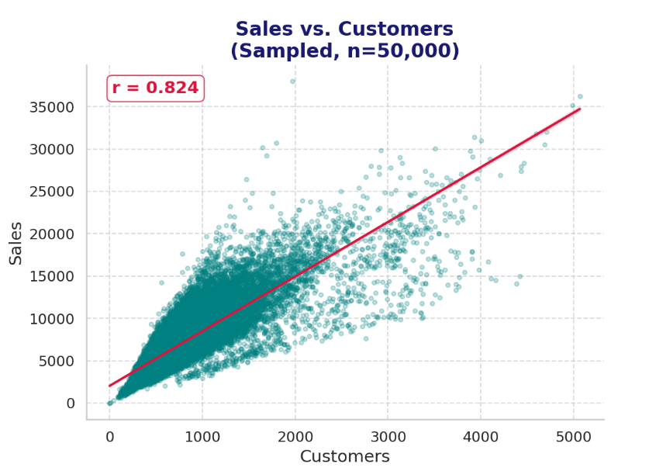
EDA — Sales, Customers & the Promotion Effect
Footfall explains most of sales, but not all of it — and promotions are why.
r = 0.824
Sales–Customers correlation
Promo Days Lift All Three
Sales +38.77% (5,929 → 8,228)
Customers +21.18% (697 → 844)
Spend per customer +14.52% (8.51 → 9.74)
Why It Matters
Promotions pull in extra footfall AND enlarge the basket — two separate effects, not one
So, the Sales–Customers relationship shifts under promo; footfall alone can't predict Sales
The spread widens as stores get busier — spend per customer varies far more on busy days than quiet ones.
That widening is largely promotional, which is why Promo ranks among the model's top features.
Notes:
This is the one chart that ties BOTH prediction targets together before anything else is examined.
Sales and Customers are the two outputs the dashboard serves — starting the EDA story here, rather than with any single-variable pattern, is the correct opening move regardless of which findings get highlighted afterward.
WHAT:
Sales and Customers correlate at r = 0.824 across the training data — a strong positive linear relationship: more customers reliably means more sales.
But the relationship is not perfect, and the scatter shows exactly where it breaks down. The spread widens at higher customer counts, meaning spend-per-customer varies far more when stores are busy than when they are quiet.
The promotion analysis explains a large part of that widening.
On promotion days versus non-promotion days:
Average Sales rise 38.77% (5,929 to 8,228).
Average Customers rise 21.18% (697 to 844).
Average spend per customer rises 14.52% (8.51 to 9.74).
Those three numbers do not tell the same story.
If promotions worked purely by attracting more shoppers, the sales lift and the customer lift would be roughly equal and spend-per-customer would be flat.
Instead, the sales lift is nearly double the customer lift, with the remainder showing up as a genuine increase in basket size.
WHY:
This is the finding that justifies the entire feature-rich modelling approach used in Notebook 2, and it is why Promo lands among the top features later.
Promotions do two distinct things simultaneously — they bring additional people through the door, and they make the people already coming spend more. Because both effects fire at once, the Sales–Customers correlation is not stable: it shifts under promotion. A model given only footfall to work with would systematically under-predict promotional days.
A note on interpretation: the dataset carries no customer ID, so it cannot distinguish genuinely new customers attracted by a promotion from existing customers simply shifting the timing of a visit they would have made anyway.
HOW:
The correlation was computed via Pearson correlation on the training data, with the scatter plot sampled to 50,000 points (fixed random state) purely for rendering speed — the correlation coefficient itself is computed on the full population, not the sample.
The promotion comparison groups the full training set by the day-level Promo flag and computes mean Sales, mean Customers, and mean Sales-per-Customer for each group.
ALSO, IN THE NOTEBOOK (not shown on this slide):
The three-panel promotion chart itself (Avg Sales, Avg Customers, Avg Spend per Customer side by side) with the full insight annotations — see 01_salesfc_preprocessing.ipynb, "Bivariate Analysis — Promo Effect on Sales & Customer Acquisition".
The promo deployment effectiveness analysis, which goes further and asks which specific stores promotions should be concentrated in, and is genuinely one of the strongest business-facing charts in the whole notebook — see 01_salesfc_preprocessing.ipynb, "Multivariate Analysis — Promo Deployment Effectiveness".
The full correlation heatmap across all numeric features — see 01_salesfc_preprocessing.ipynb, "Multivariate Analysis — Correlation Heatmap".

Slide 5
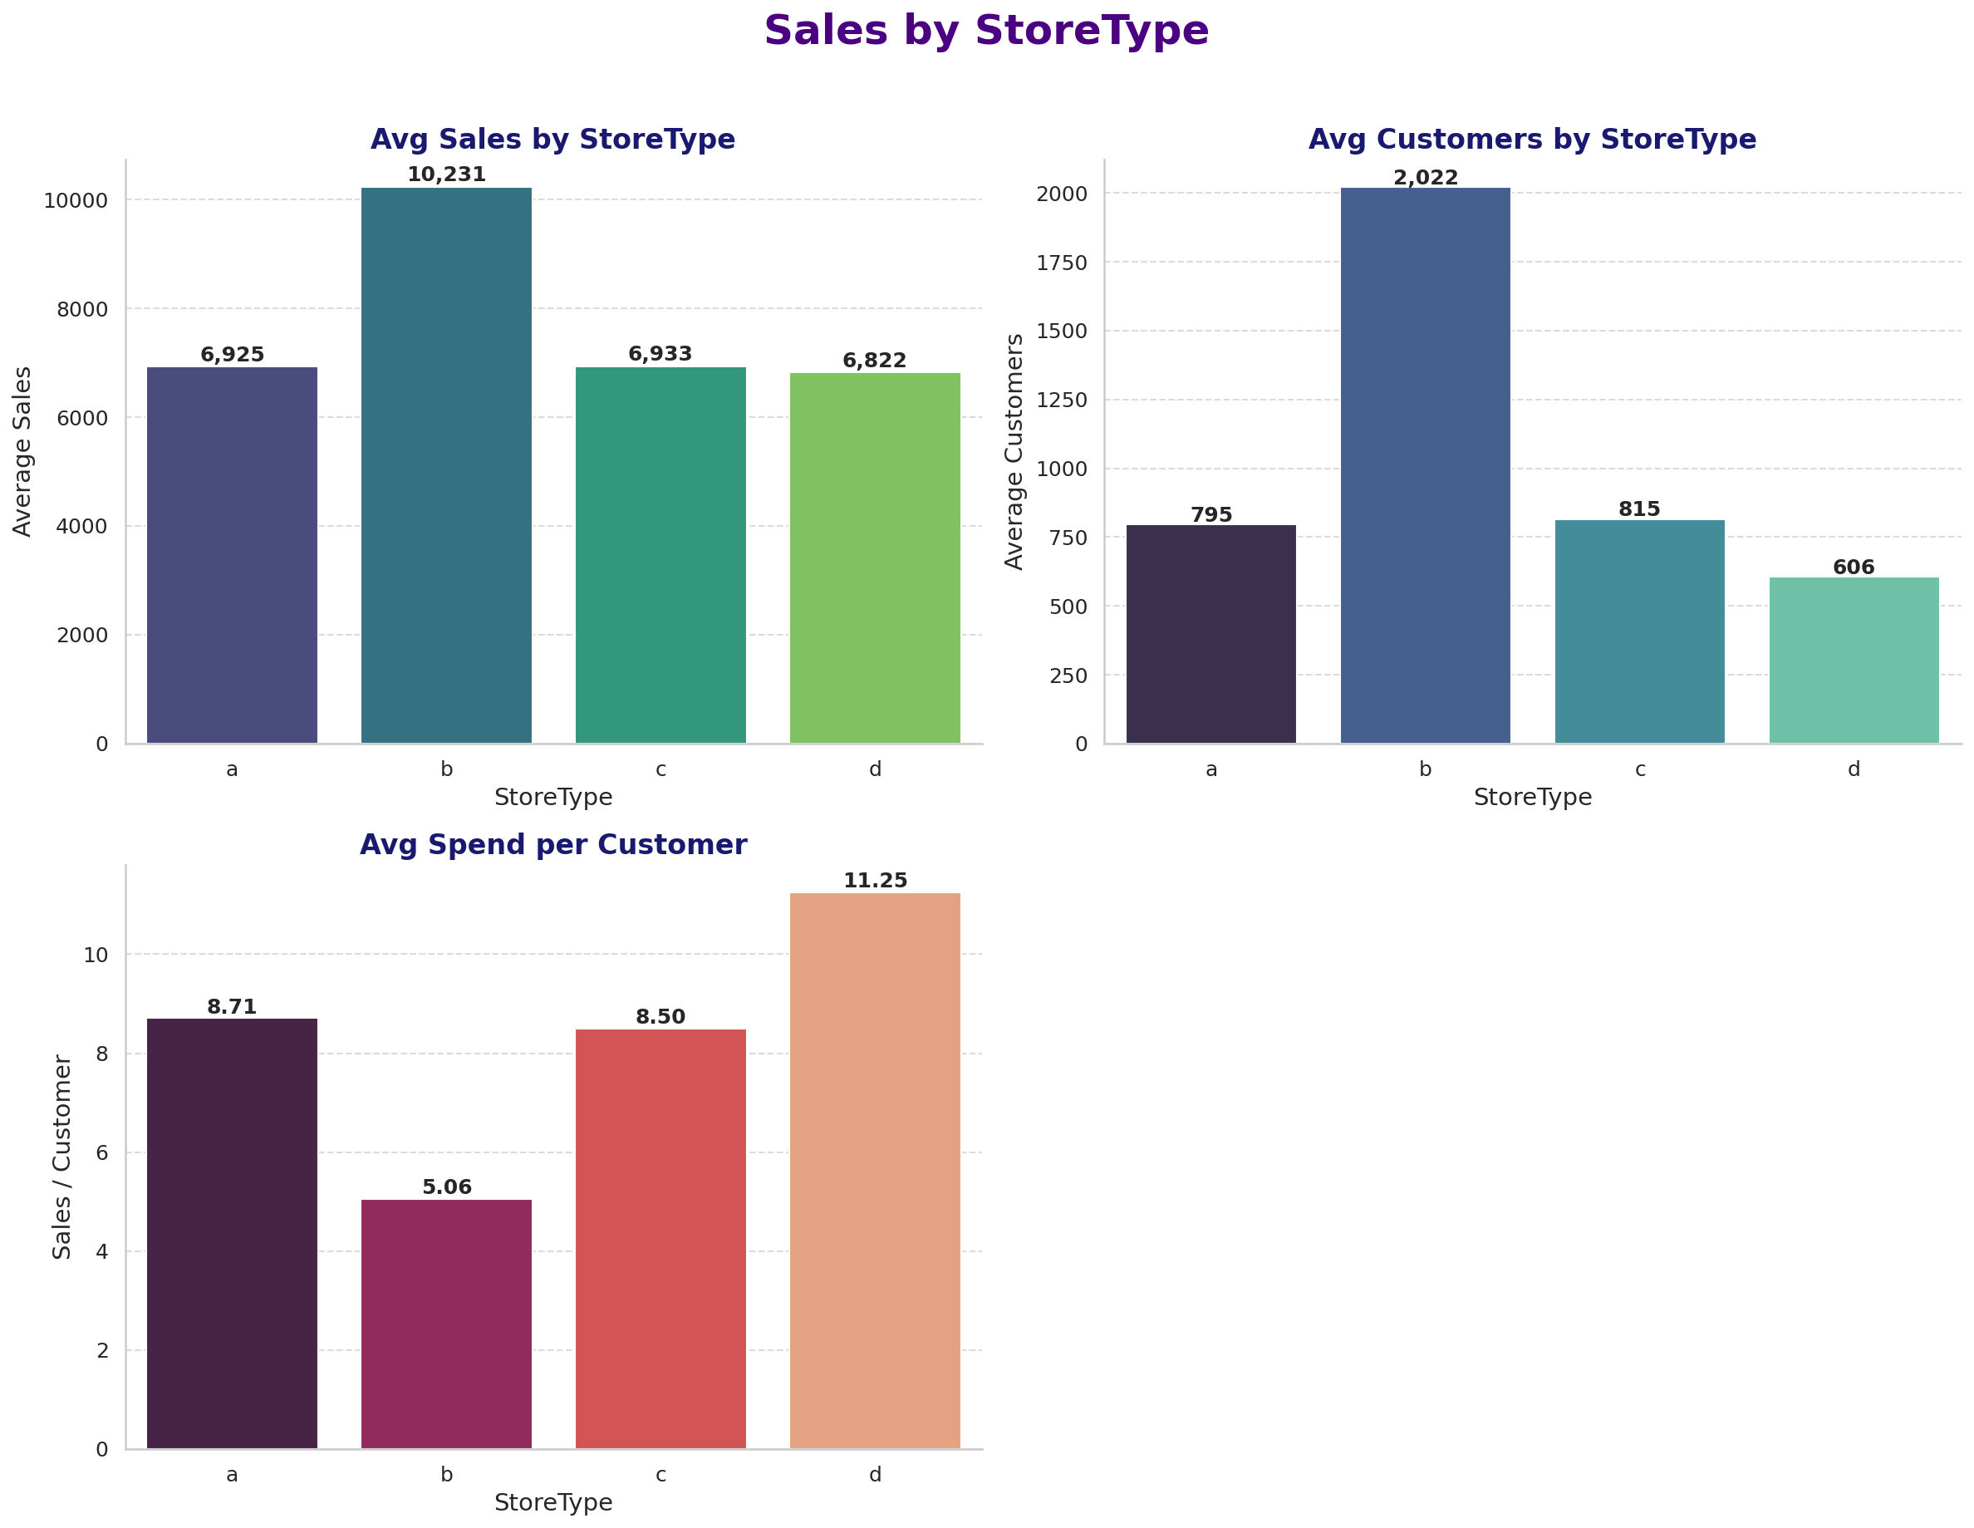
EDA — Store Structure Sets the Baseline
StoreType and Assortment move baseline sales on their own — independent of any promotion.
StoreType b Is a Different Business
Highest avg sales (10,231) — but driven almost entirely by footfall (2,022 customers, ~2.5x any other type)
LOWEST spend per customer (5.06) of all four types
StoreType d is the mirror image: fewest customers (606), highest spend per customer (11.25)
Assortment Shifts It Too
Extra (8,639) > Extended (7,301) > Basic (6,621) on average sales
Note: StoreType b is only 17 stores and Assortment 'Extra' only 9 — trust the direction, treat the magnitudes with caution.
Notes:
WHAT:
By StoreType: Type b averages 10,231 in sales, far ahead of a (6,925), c (6,933) and d (6,822). But that lead is almost entirely a footfall story: type b averages 2,022 customers, roughly 2.5 times any other type, while posting the LOWEST spend per customer of all four at 5.06. Type d is the exact mirror image — fewest customers (606) but highest spend per customer (11.25).
By Assortment level: Extra averages 8,639, Extended 7,301, and Basic 6,621.
WHY:
The mechanism differs by store type, and a forecasting model needs to know which store it is looking at to get that mechanism right. Type b's high sales come from volume of visits, not richer baskets; type d's come from richer baskets, not volume. A model without a Store or StoreType feature would learn an average of the two mechanisms and fit neither well — a direct, concrete reason why Store and StoreType turn out to be top-ranked features later.
The honesty note matters here and is stated rather than buried: StoreType b comprises only 17 stores, and Assortment 'Extra' only 9 out of 1,115. The direction of these findings is reliable; the exact magnitudes rest on a small sample.
HOW:
Both breakdowns group the full training set by the relevant categorical feature and compute mean Sales, mean Customers, and mean Sales-per-Customer. Unique store counts per group were checked before any claim was written.
ALSO, IN THE NOTEBOOK (not shown on this slide):
The full three-panel Assortment chart (Avg Sales, Avg Customers, Avg Spend per Customer by Assortment level) with per-group store counts — see 01_salesfc_preprocessing.ipynb, "Bivariate Analysis — Assortment Impact".
The competition-distance analysis — a genuinely interesting companion finding: distance to the nearest competitor has almost no LINEAR correlation with sales (r = -0.036) yet becomes the single strongest feature in the Random Forest, because the real relationship is non-linear (a "city-center proxy" effect where close competition marks high-footfall commercial zones, not competitive pressure) — see 01_salesfc_preprocessing.ipynb, "Bivariate Analysis — Competition Distance Impact".
The weekday-open and weekend-effect analysis, which is where the StoreType b Sunday-opening pattern was confirmed — see 01_salesfc_preprocessing.ipynb, "Bivariate Analysis — Weekday-Open Stores & Weekend Effect".

Slide 6
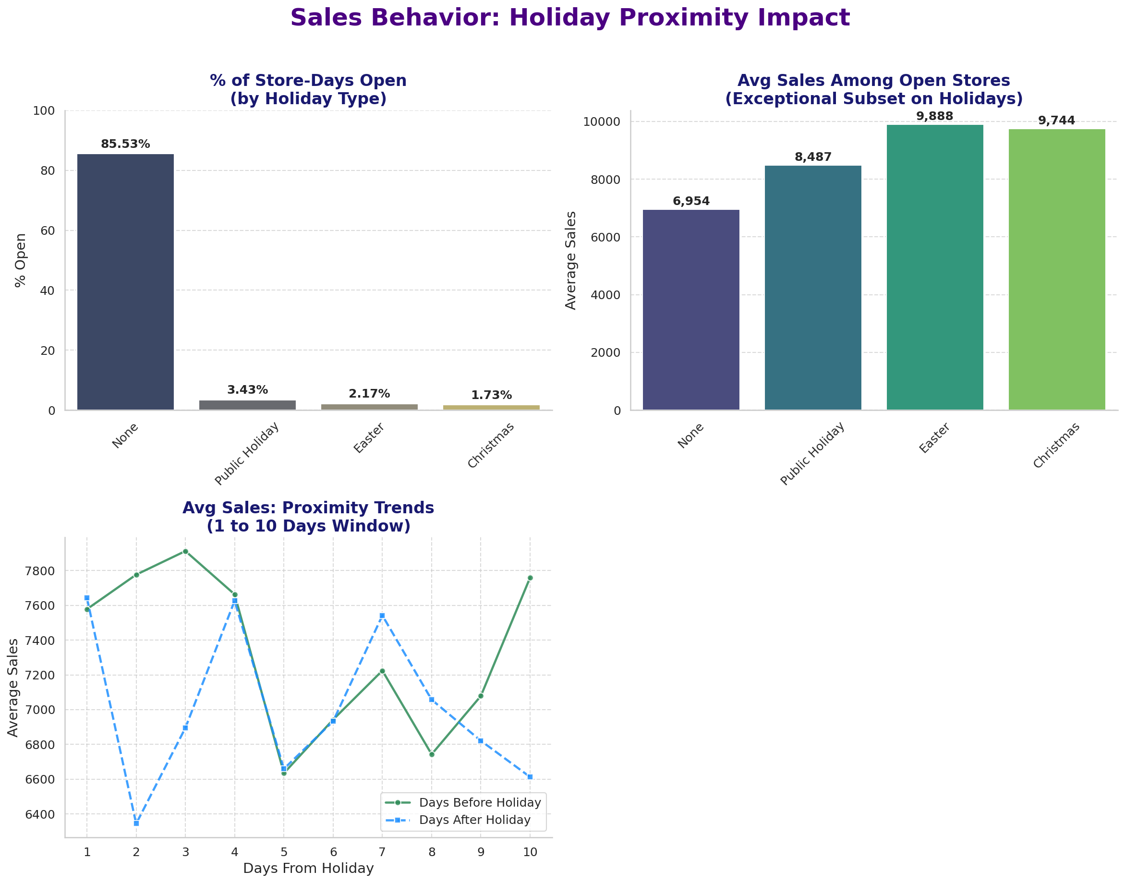
EDA — Holidays Are Closures, Not Sales Spikes
The Closure Norm
85.53% of store-days are open on an ordinary day
Under 3.5% stay open on ANY holiday type (Public 3.43%, Easter 2.17%, Christmas 1.73%)
The Exceptional-Subset Trap
Stores among the few staying open post 9,744–9,888 avg sales vs. 6,954 baseline
That's a tiny, atypical group — not representative demand
Before & After
Sales climb in the 1–3 days leading into a holiday, then drop sharply right after
Notes:
WHAT:
Three panels, one finding: holidays are, for almost every store, a closure event rather than a sales event.
Panel 1 — nearly all stores close on state holidays. 85.53% of store-days are open on an ordinary day; that figure collapses to 3.43% on Public Holidays, 2.17% on Easter, and 1.73% on Christmas.
Panel 2 — the small, atypical subset of stores that do stay open shows notably higher average sales on holidays (8,487 on Public Holiday, 9,888 on Easter, 9,744 on Christmas) versus 6,954 on an ordinary day. That looks like a holiday sales surge, but it is not representative demand — it is a tiny, self-selected group of stores that chose or were permitted to open.
Panel 3 — the proximity trend across the ten days before and after a holiday shows sales climbing in the run-up (peaking around two to three days before), then a sharp drop the day immediately after, before gradually recovering toward baseline.
WHY:
The naive reading of holiday sales — "holidays are big sales days" — is wrong for the vast majority of the network, and this chart corrects that reading in one image. The real behaviour is closure. Any store-level or network-level forecast that doesn't explicitly account for the Open flag around holidays will badly misread what a holiday does to sales, because for 96%+ of stores the answer is "nothing, because we're closed," not "a spike."
The exceptional-subset panel is included specifically as a guardrail against a tempting but wrong conclusion. Without the closure-rate panel alongside it, a viewer could easily read "sales among open stores are ~40% higher on Christmas" as evidence that holidays drive demand. The two panels together tell the true, more useful story: a very small, non-representative group of stores stays open and does well, while the network norm is to close entirely.
The proximity trend is the panel that keeps the "beyond the holiday day itself" insight your original three findings called for — it shows the effect is a multi-day window (build-up before, sharp drop-off after), which is exactly why DaysToNextHoliday and DaysSinceLastHoliday were engineered as standalone features rather than relying on the raw StateHoliday flag alone.
HOW:
Panel 1 computes, for each holiday type, the percentage of store-days where Open = 1. Panel 2 restricts to that open subset and computes mean Sales by holiday type, with an explicit note that this is not compared directly to the "None" baseline population. Panel 3 computes mean sales by day-distance from the nearest holiday, split into the ten days before and the ten days after, using the full population (not just open stores).
ALSO, IN THE NOTEBOOK (not shown on this slide):
The day-of-week-controlled version of this same question, which isolates the anticipation effect from ordinary weekday variation and finds excess sales peaking two days before a holiday — a good next-level chart for anyone who wants the more rigorous cut — see 01_salesfc_preprocessing.ipynb, "Bivariate Analysis — Holiday Anticipation Effect (Day-of-Week Controlled)".
The seasonal and weekly pattern analysis (Sales by month, Sales by day-of-week, and the Sunday-anomaly finding among the few stores that legally stay open) — see 01_salesfc_preprocessing.ipynb, "Bivariate Analysis — Seasonal Patterns".
The holiday proximity feature construction referenced above — see 01_salesfc_preprocessing.ipynb, "Holiday Proximity Features".

Slide 7
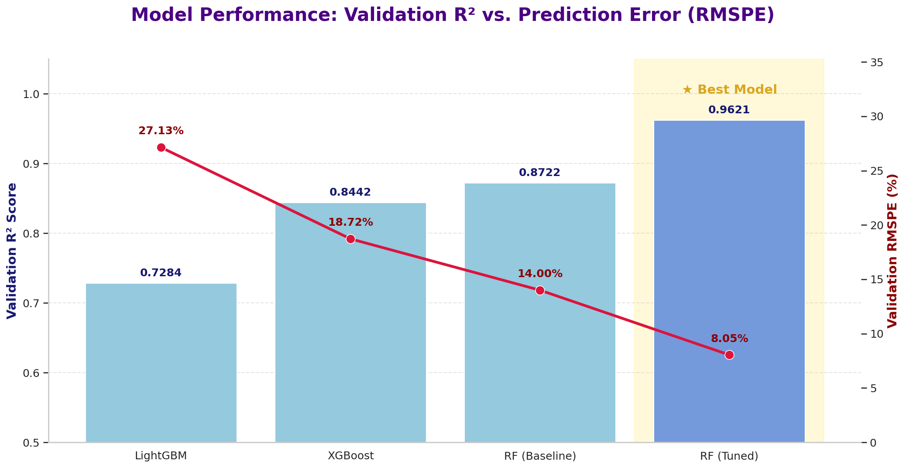
ML Modeling — The Winning Model
Tuned Random Forest, validated on the final six weeks. Best model of the entire project.
0.9621
8.05%
Validation R²
Validation RMSPE
€389.83
€594.54
MAE
RMSE
Why RMSPE Is the Defended Metric
A €500 miss means something different at a 3,000-sales store than at a 15,000-sales store
RMSPE scores every store on its own scale — so one big store can't dominate the loss
R², MAE and RMSE retained as supplementary, not headline
Tuning moved RMSPE from 14.00% to 8.05% — and the tuned Random Forest beat both XGBoost (18.72%) and LightGBM (27.13%) on identical inputs.
Notes:
WHAT:
The tuned Random Forest achieves, on the held-out final-six-weeks validation window:
R² = 0.9621
RMSPE = 8.05%
MAE = €389.83
RMSE = €594.54
The chart shows the full progression across the four architectures tried on identical inputs and the identical split.
LightGBM scores R² 0.7284 / RMSPE 27.13%.
XGBoost scores 0.8442 / 18.72%.
The baseline (untuned) Random Forest scores 0.8722 / 14.00%.
The tuned Random Forest scores 0.9621 / 8.05%.
Random Forest was already ahead of both gradient-boosting alternatives before tuning.
Tuning nearly halved the error again, from 14.00% to 8.05% — a larger improvement than the gap between any two architectures.
WHY:
The loss-function choice is defended rather than assumed.
The brief allows any loss function but requires the choice to be justified.
RMSPE was selected because sales magnitudes differ enormously across 1,115 stores. A €500 forecasting error at a store averaging 3,000 in daily sales is a serious miss; the same €500 error at a store averaging 15,000 is close to noise. An absolute metric like RMSE or MAE treats those two errors as identical, which means optimising for it quietly prioritises the largest stores and lets small-store forecasts drift. RMSPE scores each store's error relative to its own scale, so the model is held to a consistent standard network-wide — which is exactly what the finance team needs, since they are planning per store.
R², MAE and RMSE are all still reported alongside, because RMSPE has a known weakness: it becomes unstable when actual values approach zero. That weakness does not bite here (closed days are handled separately) but it does become the central story on the aggregate time-series slides later in this deck, so it is worth having the metric's behaviour already established in the audience's mind.
HOW:
All preprocessing runs inside the sklearn Pipeline with a ColumnTransformer — StandardScaler on numeric features, OneHotEncoder on categoricals, and Store passed through unscaled as an identifier. Keeping this in a Pipeline rather than as loose preprocessing steps is what makes the whole thing reproducible and directly portable into the dashboard.
The train/validation split is time-based, holding out the final six weeks, matching the business forecast horizon.
A random split would leak future information backwards and inflate every score reported here.
Tuning used RandomizedSearchCV scored directly on RMSPE (not on a default metric), via a PredefinedSplit so each candidate is evaluated once against the same held-out window rather than through expensive repeated cross-validation.
ALSO, IN THE NOTEBOOK (not shown on this slide):
The full written loss-function justification, which is the argued version of the summary given above — see 02_salesfc_ml_modeling.ipynb, "Why RMSPE Over RMSE/MAE".
The complete three-way architecture comparison with all metrics per model — see 02_salesfc_ml_modeling.ipynb, "Large-Model Comparison: RF vs. XGBoost vs. LightGBM" and "Final Model Selection: Architecture & Tuning Comparison".
The 90% confidence-interval estimation, derived from the percentile spread across the forest's individual trees, with its own chart — see 02_salesfc_ml_modeling.ipynb, "Confidence Interval Estimation".
The timestamped model serialization scheme and the prediction/submission export with the explicit Open = 0 to Sales = 0 business-logic split — see 02_salesfc_ml_modeling.ipynb, "Final Model Serialization" and "Final Predictions & Submission Export".

Slide 8
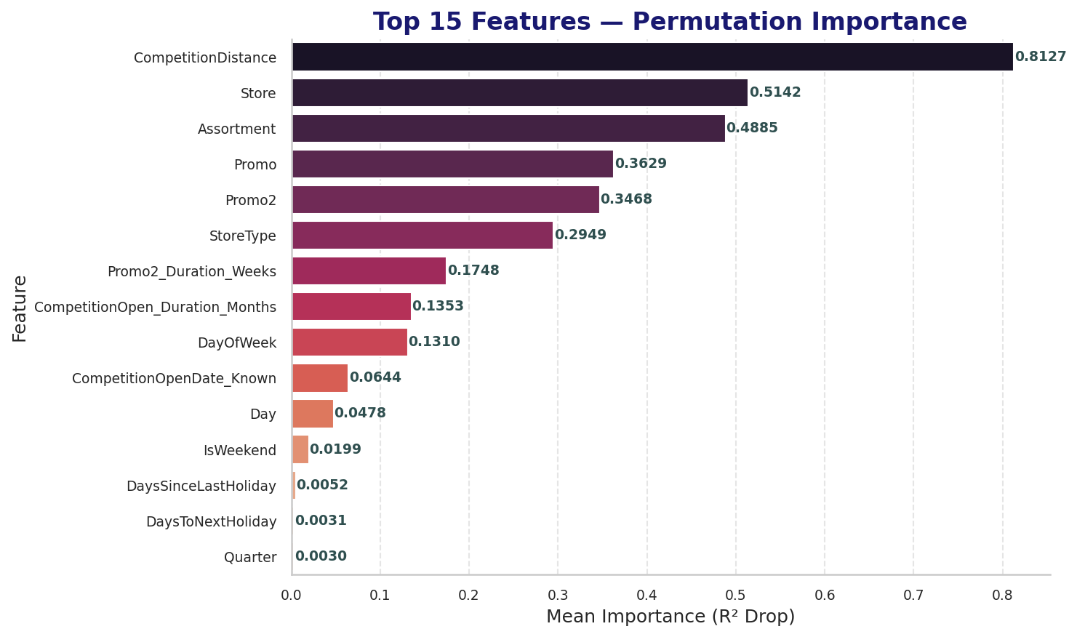
ML Modeling — What Drives the Prediction
Store identity and structure outrank the calendar — and the same architecture predicts Customers too.
Top Features (Both Methods Agree)
CompetitionDistance — the single strongest driver
Store — identity itself carries real signal
Promo, Assortment and StoreType
CompetitionOpen_Duration_Months
Second Model — Customers
0.9467
11.95%
R²
RMSPE
Same tuned architecture, retargeted — this is what lets the dashboard serve both predictions.
Notes:
WHAT:
Feature importance was computed by two independent methods and aggregated to the original-feature level.
Ranked by average position across both methods, the top features are:
CompetitionDistance — the single strongest driver.
Store — the store identifier itself.
Promo.
Assortment and StoreType.
CompetitionOpen_Duration_Months.
The permutation-importance panel shown here puts CompetitionDistance at 0.8127 mean R² drop, Store at 0.5142, Assortment at 0.4885, Promo at 0.3629, Promo2 at 0.3468 and StoreType at 0.2949 — with the pure calendar features (Day, IsWeekend, DaysSinceLastHoliday, DaysToNextHoliday, Quarter) trailing far behind at 0.05 and below.
Separately, a second Random Forest using the same tuned architecture was trained to predict Customers rather than Sales. It achieves R² = 0.9467 and RMSPE = 11.95%.
WHY:
The ranking is the analytical heart of this deck's core argument, so it is worth being explicit about what it says.
Structural, per-store features dominate. Where a store sits relative to its competition, which store it is, what assortment it carries and what type it is — these outrank every calendar feature by a wide margin. Promotional state matters too, as the EDA predicted. But raw temporal position in the year contributes comparatively little once the store's own identity and structure are known.
That is precisely why the aggregate time-series models in Notebook 4 struggle. Those models have access to the calendar and to the sales history, and to nothing else. The features doing most of the work here are exactly the ones an aggregate series cannot represent. The model-comparison finding later in this deck is not a mysterious result — it is visible in this chart.
Store appearing this high is itself informative: even after StoreType, Assortment and CompetitionDistance are accounted for, the identity of the individual store still carries substantial independent signal. Individual stores have persistent idiosyncrasies the structural features do not capture, which is a strong argument for per-store modelling over any network-level approach.
The Customers model exists because the brief requires the dashboard to output both predicted sales amount and predicted customer numbers. Its RMSPE of 11.95% is meaningfully worse than the Sales model's 8.05%, which is expected — customer counts are smaller integers with proportionally more day-to-day volatility, so percentage error is naturally higher on the same underlying data quality.
HOW:
Two methods were used deliberately rather than one.
Built-in (impurity-based) importance is fast but biased toward high-cardinality features — and with 1,115 store IDs in play.
Permutation importance measures the actual drop in validation R² when a feature's values are shuffled, which is model-agnostic and immune to that cardinality bias. Running both and aggregating to the original-feature level (recombining one-hot expansions back into their source feature) is what makes the ranking trustworthy.
The Customers model reuses the identical tuned hyperparameters and the identical Pipeline, retargeted onto the Customers column, so its result is directly comparable rather than being a separately optimised model.
ALSO, IN THE NOTEBOOK (not shown on this slide):
The full dual-method feature importance chart — this slide shows only the permutation panel; the built-in impurity-based panel and the side-by-side aggregated comparison are in 02_salesfc_ml_modeling.ipynb, "Feature Importance (Dual Method)".
The complete Customers model build, tuning verification and metrics — see 02_salesfc_ml_modeling.ipynb, "Customer Volume Prediction Model".
The confidence-interval work that accompanies these predictions — see 02_salesfc_ml_modeling.ipynb, "Confidence Interval Estimation".

Slide 9
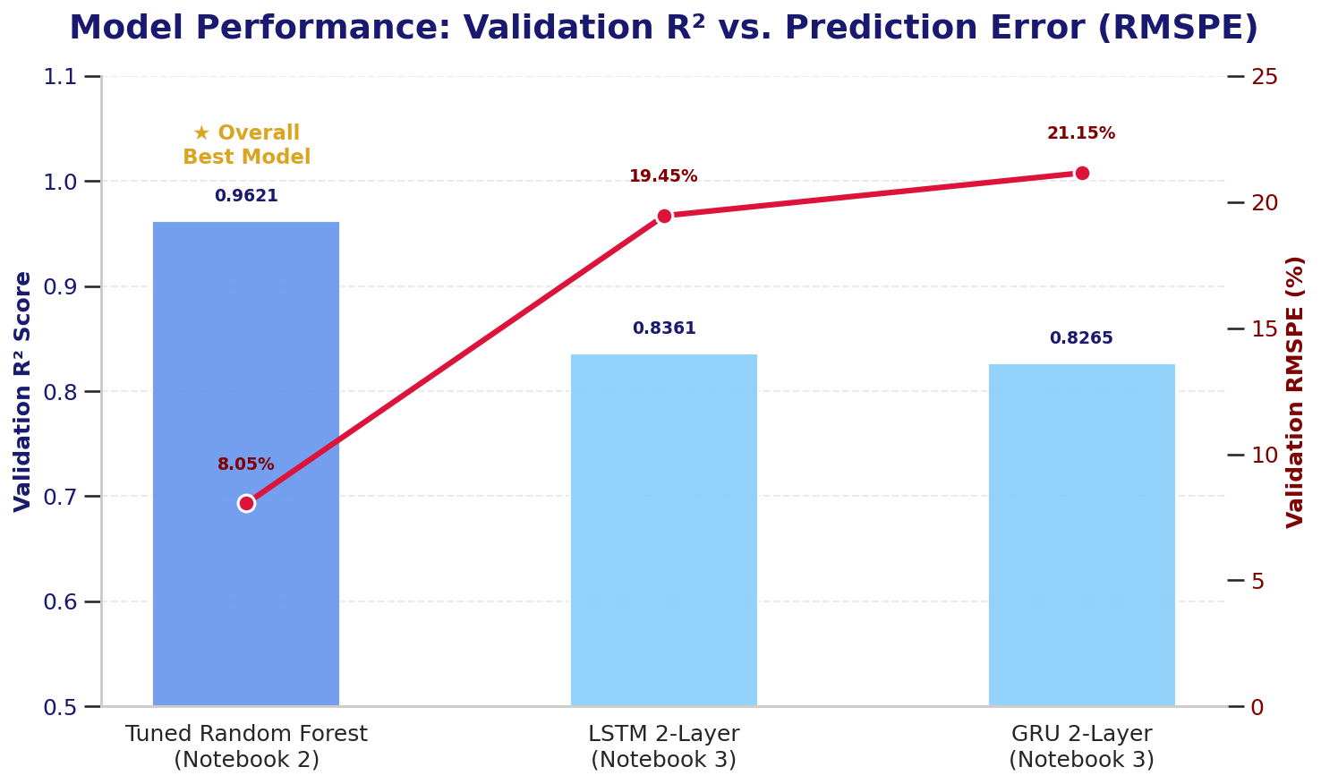
Deep Learning — LSTM vs. GRU
Two sequence models on the same per-store data. Both trail the Random Forest.
0.8361
19.45%
LSTM R²
LSTM RMSPE
0.8265
21.15%
GRU R²
GRU RMSPE
Observations:
The LSTM edges the GRU, but both sit ~2.4x the Random Forest's 8.05% RMSPE
This is expected, not a failure — trees handle high-cardinality categorical inputs natively; an LSTM would need embedding layers to match
Same data, same split, same metric as Notebook 2 — the comparison is fair
Notes:
WHAT:
Two-layer LSTM: R² ≈ 0.8361, RMSPE ≈ 19.45%.
Two-layer GRU: R² ≈ 0.8265, RMSPE ≈ 21.15%.
Tuned Random Forest, for reference: R² 0.9621, RMSPE 8.05%.
The LSTM slightly outperforms the GRU on both metrics.
Both trail the Random Forest substantially — roughly 2.4 times its percentage error.
WHY:
This result should be presented as an expected finding, not as a disappointment, and the reason is structural rather than about effort or tuning.
Tree ensembles handle high-cardinality categorical features natively. Store is a 1,115-level categorical and, as the feature importance work showed, it is one of the strongest predictors available. A Random Forest splits on it directly. An LSTM consumes a numeric matrix, so store identity enters as one-hot columns or as a raw numeric code — neither of which is a good representation. Getting a sequence model to exploit store identity properly would require learned embedding layers, which is a materially different architecture from the two-layer network the brief specifies.
The second reason is that the strongest signal in this data is cross-sectional rather than temporal. The features doing the heaviest lifting — competition distance, store identity, assortment, promotional state — describe what a store is and what is happening today, not what happened in the preceding fourteen days. Sequence models are built to exploit temporal dependency, and here the temporal dependency is the smaller part of the story.
The LSTM edging the GRU is consistent with expectation: the GRU is the lighter architecture, trading a small amount of capacity for speed, and on this data that trade costs about 1.7 percentage points of RMSPE.
HOW:
Categorical features were encoded via get_dummies with train and test aligned, since a sequence model needs a plain numeric matrix rather than a fitted transformer object.
Time series were constructed store-aware, so sequences never span a boundary between two different stores — a subtle but critical detail, since a naive sliding window over a store-sorted table would silently manufacture sequences that run off the end of one store and into the next.
Stationarity was verified with an Augmented Dickey-Fuller test (p = 0.000064), confirming the series is stationary and no differencing was required. ACF/PACF analysis showed autocorrelation dominated by the weekly cycle — a finding that becomes directly relevant in Notebook 4.
A 14-day sliding window transforms the series into supervised sequences. Both inputs and targets were scaled to the (-1, 1) range using training-set statistics only, never validation statistics, to avoid leakage.
The LSTM is two layers with 39,329 parameters, matching the brief's requirement that the network be shallow enough to run comfortably in a standard notebook environment.
Worth mentioning if asked: an early version of this model accidentally excluded Store from the deep-learning feature columns. R² sat at roughly 0.58 until that was caught and fixed, at which point it jumped above 0.83 — independent confirmation, from a completely different model family, of how much signal store identity carries.
ALSO, IN THE NOTEBOOK (not shown on this slide):
The LSTM training-versus-validation loss curve across epochs, showing convergence behaviour — see 03_salesfc_deep_learning.ipynb, "Training & Evaluation".
The ADF stationarity test output and the ACF/PACF plots — see 03_salesfc_deep_learning.ipynb, "Stationarity Check (Augmented Dickey-Fuller Test)" and "ACF/PACF Analysis".
The sliding-window construction and the scaling procedure — see 03_salesfc_deep_learning.ipynb, "Sliding-Window Supervised Transform" and "Train/Validation Split & Scaling (Sequences)".
The full GRU build and its own training curve — see 03_salesfc_deep_learning.ipynb, "GRU Variant Comparison".

Slide 10
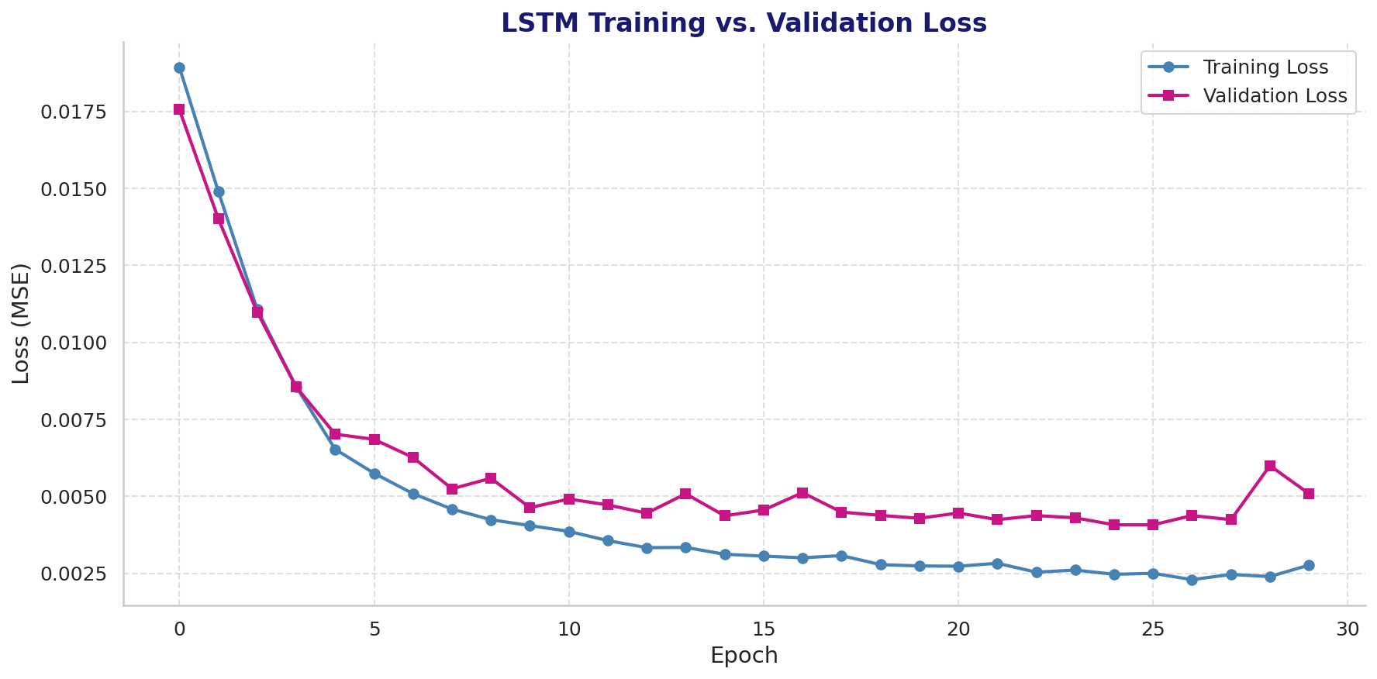
Deep Learning — Where the Error Concentrates
11.28%
21.07%
~1.9x
39,329
Best StoreType — RMSPE
Worst StoreType — RMSPE
Gap Between Them
LSTM Parameters (2 Layers)
The Per-StoreType Breakdown
RMSPE ranges 11.28% to 21.07% across the four store types
The model is nearly twice as wrong on some store types as on others
Why That's the Whole Argument
Store structure is the thing the LSTM handles weakly — and it's exactly where its error lives
The Random Forest splits on that structure directly, which is why it doesn't carry the same gap
LSTM training vs. validation loss — clean convergence, no runaway overfitting.
Notes:
WHAT:
Model error was broken down by StoreType rather than reported only as a single network-wide figure.
Across the four store types, the per-StoreType RMSPE ranges from 11.28% to 21.07% — the model is close to twice as wrong on some store types as on others.
The training curve shown alongside confirms the model itself is healthy: training and validation loss both fall steeply and then flatten, with validation loss tracking training loss closely and no sustained divergence. The gap in per-StoreType performance is therefore not an artefact of overfitting or undertraining — it is a real, structural property of what the model can and cannot represent.
WHY:
This slide is where the deck's central argument gets its cleanest supporting evidence, so it deserves emphasis in delivery.
If the LSTM's shortfall against the Random Forest were simply a matter of insufficient capacity or training, the error would be roughly uniform across store types — the model would be a bit worse everywhere.
Instead, the error is concentrated, and it is concentrated along precisely the dimension the LSTM represents most weakly: store structure.
Recall from the EDA that StoreType b behaves like a fundamentally different business from StoreType d — high footfall and low basket size versus low footfall and high basket size. Those are different sales-generating mechanisms.
A tree ensemble splits on StoreType and learns each mechanism separately.
The LSTM sees store type as one-hot columns appended to a sequence and must infer the distinction from temporal patterns, which it does only partially.
So, the per-StoreType spread is not a footnote about model diagnostics.
It is direct evidence for the thesis: the gap between these model families is about how well each represents per-store structure, not about which has more sophisticated temporal machinery.
The best-performing store type at 11.28% is also worth noting for its own sake — it shows the LSTM is genuinely capable on this data when store heterogeneity is low.
The architecture is not the limiting factor; the input representation is.
HOW:
Validation predictions were grouped by the store's StoreType and RMSPE computed within each group independently, using the same metric definition applied network-wide elsewhere, so the per-group figures are directly comparable to the headline number.
The training curve is standard Keras history output across epochs, with mean squared error as the training loss (RMSPE is computed post-hoc on inverse-scaled predictions rather than used as the training objective, since it is not well-behaved as a gradient target near zero).
Both the LSTM and the GRU were serialized with timestamped artifacts and mirrored to persistent storage rather than left in ephemeral session storage.
ALSO, IN THE NOTEBOOK (not shown on this slide):
The full per-StoreType error table with all four store types listed individually and their exact RMSPE values, alongside the aggregate-versus-per-store evaluation comparison — see 03_salesfc_deep_learning.ipynb, "Aggregate vs. Per-Store Evaluation".
The GRU's own training curve and evaluation, for comparison against the LSTM curve shown here — see 03_salesfc_deep_learning.ipynb, "GRU Variant Comparison".
The complete three-model comparison table and the Final Verdict callout declaring the tuned Random Forest the overall winner at this stage — see 03_salesfc_deep_learning.ipynb, "Comparison vs. Notebook 2's ML Models".
The serialization scheme for both deep-learning models — see 03_salesfc_deep_learning.ipynb, "Model Serialization (Deep Learning)".

Slide 11
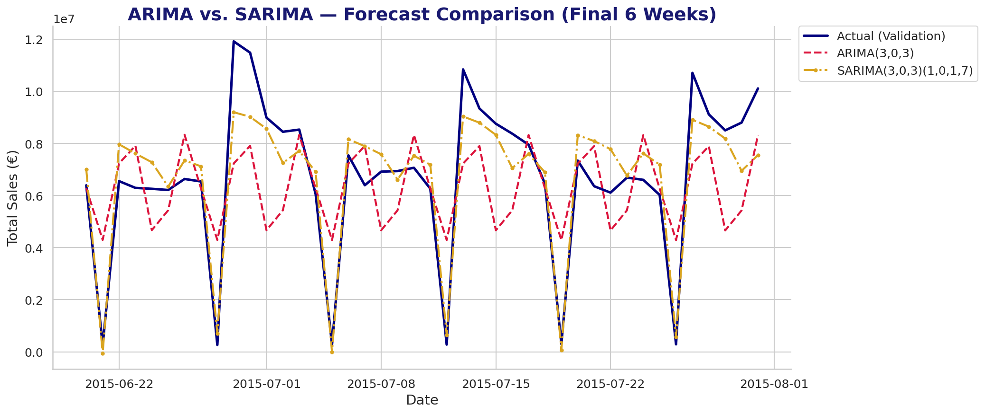
Time Series Comparison
On the network-wide aggregate series, with no per-store features at all. One Seasonal Term Changes Everything
ARIMA(3,0,3)
SARIMA(3,0,3)(1,0,1,7)
The Lesson
R² 0.2957 · RMSPE 557.87%
R² 0.8558 · RMSPE 47.90%
>10x
Oscillates on its own cycle and never locks onto the weekly rhythm — the red line is out of phase with reality.
Adding a single weekly seasonal term improves RMSPE more than tenfold and snaps the forecast into phase.
RMSPE improvement from one seasonal term. Not more model — more of the right structure. The same theme as the rest of the project.
Notes:
WHAT:
Instead of 1,115 stores with rich structural features, the classical time-series models see only one thing: the network-wide daily aggregate sales series. No store identity, no assortment, no competition distance, no promotional flags. Just sales over time.
Plain ARIMA(3,0,3) on that series: R² = 0.2957, RMSPE = 557.87%.
SARIMA(3,0,3)(1,0,1,7) — the same model plus one weekly seasonal component: R² = 0.8558, RMSPE = 47.90%.
The chart makes the failure mode visible in a way the numbers alone do not. The navy line is the actual validation series, showing a hard weekly rhythm with deep troughs where the network is largely closed. The red dashed ARIMA line oscillates on a cycle of its own that never locks onto the real one — at several points it peaks precisely when actuals trough. It is not merely inaccurate; it is out of phase. The gold SARIMA line, by contrast, sits in phase with the actual series throughout, tracking the weekly troughs correctly even where it underestimates peak magnitudes.
WHY:
This pair of results is the cleanest demonstration in the project of the deck's central thesis, restated in a completely different model family.
Plain ARIMA has substantial machinery — three autoregressive terms and three moving-average terms, a well-specified model by any conventional standard. What it lacks is any representation of the seven-day cycle, and that single structural omission is catastrophic. Adding one seasonal term of period 7 improves RMSPE by more than a factor of ten. No amount of increasing p or q would have achieved that, because the missing ingredient was never model capacity — it was the right structure.
That is the same lesson the machine-learning and deep-learning stages taught from the other direction. There, richer per-store features beat more sophisticated architectures. Here, the right structural term beats more autoregressive terms. The theme is consistent: what you give the model to work with matters more than how elaborate the model is.
The second point to make is about where SARIMA still lands. Even at its much-improved 47.90% RMSPE, SARIMA remains far behind the Random Forest's 8.05%. It has correctly learned the calendar. What it cannot learn, because it was never given it, is that 1,115 different stores with different types, assortments, competitive positions and promotional calendars are generating that aggregate. An aggregate series is not a modelling convenience — it is an information loss, and no time-series method recovers what the aggregation discarded.
A technical honesty note worth having ready: ARIMA and SARIMA parameters are fit by maximum-likelihood optimisation, which can produce slightly different results across identical reruns on the same data — ARIMA's R² has been observed between 0.2915 and 0.2957 and its RMSPE between 557.87% and 589.87%. This is a characteristic of optimisation on a poorly-conditioned likelihood surface, and it is documented rather than hidden — the same category of finding as the GPU non-determinism noted for the LSTM.
HOW:
The aggregate series was constructed by summing Sales across all stores per date. The validation window is the same final six weeks used in every other notebook, keeping the comparison apples-to-apples.
Model orders were selected via AIC/BIC over a bounded p/d/q search range rather than an exhaustive grid, a deliberate compute-budget decision. The seasonal period of 7 was not guessed — it follows directly from the ACF/PACF analysis in Notebook 3, which showed autocorrelation dominated by the weekly cycle.
Both models were fit on the training portion only and evaluated on the held-out window, with RMSPE computed identically to every other model in the project.
ALSO, IN THE NOTEBOOK (not shown on this slide):
The order-selection work, including the AIC/BIC comparison across candidate orders that justifies (3,0,3) and the seasonal (1,0,1,7) specification — see 04_salesfc_time_series.ipynb, "Order Selection".
Each model's individual diagnostic forecast plot and residual behaviour, shown separately before this combined comparison — see 04_salesfc_time_series.ipynb, "ARIMA Model" and "SARIMA Model".
The time-series preparation, including the aggregate series construction and its decomposition plots — see 04_salesfc_time_series.ipynb, "Time Series Preparation".
The full side-by-side metric table for ARIMA versus SARIMA — see 04_salesfc_time_series.ipynb, "ARIMA vs. SARIMA Comparison".

Slide 12
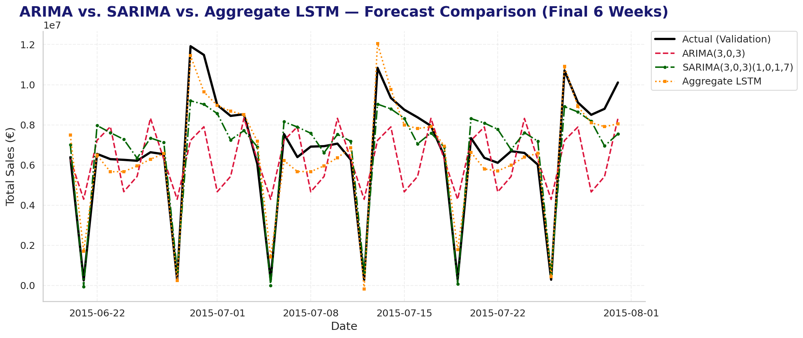
Aggregate Deep Learning
A new LSTM trained on the aggregate series — beating SARIMA on R² while scoring far worse on RMSPE. Best Fit, Worst RMSPE
0.9266
€651,332.88
€822,374.17
137.76%
Aggregate LSTM R² (best of the three)
MAE (best of the three)
RMSE
RMSPE (worse than SARIMA)
Why one model can win on R² and MAE while losing on RMSPE?
Percentage error explodes on near-zero days.
The aggregate LSTM fits the shape of the series best — it just misses hardest where the denominator is smallest.
Notes:
WHAT:
To complete the aggregate-series comparison fairly, a new LSTM was built and trained specifically on the network-wide aggregate daily sales series — the same univariate target ARIMA and SARIMA see.
Aggregate LSTM results: R² = 0.9266, MAE = €651,332.88, RMSE = €822,374.17, RMSPE = 137.76%.
Placed against the other two aggregate-series models, this produces a genuinely split verdict.
The aggregate LSTM has the best R² of the three (0.9266 against SARIMA's 0.8558 and ARIMA's 0.2957) and the best MAE. But its RMSPE of 137.76% is nearly three times worse than SARIMA's 47.90%.
Looking at the chart, the orange dotted aggregate-LSTM line tracks the actual series closely through the peaks — arguably more closely than SARIMA does, particularly at the high points where SARIMA consistently underestimates. The divergence is at the troughs, where the aggregate LSTM sometimes predicts slightly negative values against near-zero actuals.
WHY:
This is the nuance slide of the time-series section, and it is worth slowing down for, because it demonstrates something important about metric selection that the rest of the project depends on.
RMSPE divides the error by the actual value. When the actual value is close to zero — which happens on every near-total-closure day in this network, and those days are visible as the deep troughs in the chart — even a small absolute error produces an enormous percentage error. A single such day can dominate the entire RMSPE calculation for the whole validation window.
So, the two metrics are answering different questions, and both answers are correct. R² and MAE say the aggregate LSTM captures the shape and typical magnitude of this series better than SARIMA does. RMSPE says the aggregate LSTM's errors are concentrated exactly where percentage error is most punishing. Neither metric is wrong; they are measuring different things.
This is also a fair test of RMSPE as the project's chosen primary metric. RMSPE was selected in Notebook 2 for a good reason — it prevents large stores from dominating the loss. Here, its known weakness surfaces in the one context where it genuinely bites: near-zero actuals. Reporting that openly, rather than quietly switching metrics when the chosen one produces an inconvenient number, is the honest way to handle it.
HOW:
A deliberate design decision: this is a new LSTM, not a reuse of Notebook 3's trained weights. Notebook 3's model predicts per-store sales from many features; ARIMA and SARIMA predict aggregate sales from the series alone. Reusing the per-store model here would have compared two structurally different tasks and produced a meaningless result. Notebook 3's saved model was referenced only as an architectural template.
The new model mirrors Notebook 3's design philosophy — two layers, 64 then 32 units — with a 14-day input window, trained on the aggregate series with the same final-six-weeks validation split used throughout the project.
The aggregate LSTM's final artifact is persisted to durable storage, so the load-first check picks up this exact trained model on every rerun and these figures remain stable rather than drifting between sessions.
ALSO, IN THE NOTEBOOK (not shown on this slide):
The aggregate LSTM's full build, training curve and evaluation alongside the statistical models — see 04_salesfc_time_series.ipynb, "Forecast Evaluation: Statistical vs. Deep Learning (Aggregate)".
The serialization of the ARIMA and SARIMA models — see 04_salesfc_time_series.ipynb, "Model Serialization".
The complete metric table for all three aggregate-series models with every metric side by side — see 04_salesfc_time_series.ipynb, "Final Model Comparison".

Slide 13
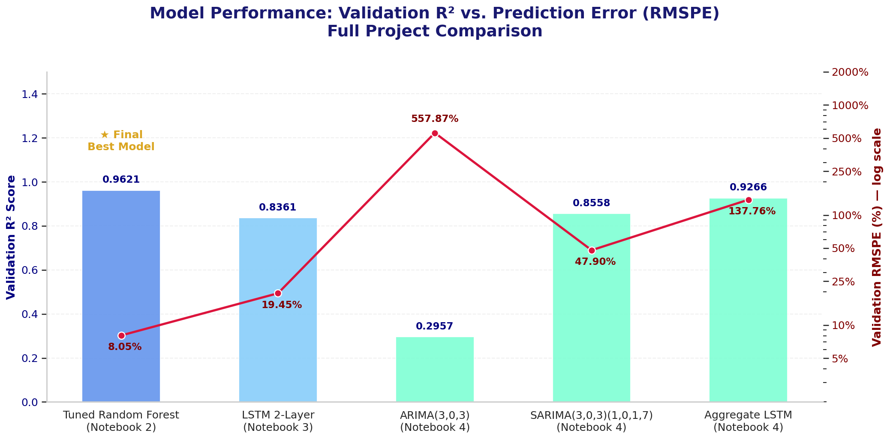
Full Model Comparison
Five models, three approaches, one validation split. The pattern holds every time.
Rich Per-Store Inputs
Tuned Random Forest — 0.9621 / 8.05%
LSTM 2-Layer — 0.8361 / 19.45%
Aggregate Series Only
ARIMA(3,0,3) — 0.2957 / 557.87%
SARIMA(3,0,3)(1,0,1,7) — 0.8558 / 47.90%
Aggregate LSTM — 0.9266 / 137.76%
Richer per-store input features beat model sophistication — consistently, across ML, deep learning and time series alike.
RMSPE axis is log-scaled — the values span 8.05% to 557.87%.
Notes:
WHAT:
Five models, three distinct methodological approaches, one shared validation window — the final six weeks — and one shared primary metric.
Tuned Random Forest (Notebook 2, per-store features): R² 0.9621, RMSPE 8.05%.
LSTM 2-Layer (Notebook 3, per-store sequences): R² 0.8361, RMSPE 19.45%.
ARIMA(3,0,3) (Notebook 4, aggregate series): R² 0.2957, RMSPE 557.87%.
SARIMA(3,0,3)(1,0,1,7) (Notebook 4, aggregate series): R² 0.8558, RMSPE 47.90%.
Aggregate LSTM (Notebook 4, aggregate series): R² 0.9266, RMSPE 137.76%.
Note the RMSPE axis on the chart is logarithmic — it has to be, because the values span from 8.05% to 557.87%, a range of nearly two orders of magnitude that a linear axis would render unreadable.
The verdict: the tuned Random Forest is the best model overall, across every approach tried.
WHY:
Within the per-store approaches, the simpler model wins. The Random Forest and the LSTM see identical data with identical features on an identical split. The tree ensemble beats the neural network by a factor of roughly 2.4 on RMSPE. Model sophistication did not help.
Within the aggregate approaches, structure beats capacity. ARIMA(3,0,3) has substantial autoregressive and moving-average machinery but no weekly seasonal term, and it fails completely at 557.87%. Adding one seasonal component improves RMSPE more than tenfold. The winning change was structural, not a capacity increase.
Across approaches, input richness dominates.
The best aggregate-series model is nowhere near the best per-store model. Even the aggregate LSTM — a neural network, the most flexible function approximator in this comparison — cannot overcome the information destroyed by aggregating 1,115 heterogeneous stores into a single series. No amount of modelling recovers information the inputs never contained.
Richer per-store input features beat model sophistication, consistently, across machine learning, deep learning and time series alike. This is not a single result that happened to favour one model. It is the same pattern appearing independently in three different model families, tested three different ways.
The practical implication for Rossmann: investment in data — better per-store attributes, more complete competitor information, richer promotional metadata — will yield more forecasting improvement than investment in more elaborate model architectures. That is a concrete, actionable finding, and it points at a cheaper lever than the obvious one.
Worth anticipating as a question: is this just saying tree models beat neural networks? No, and it is important to be precise. The LSTM with rich per-store features (19.45%) comfortably beats SARIMA with poor inputs (47.90%) and the aggregate LSTM (137.76%). Input richness, not model family, is what orders the results. Two neural networks sit at opposite ends of this comparison, separated by what they were fed.
HOW:
Every figure on this chart comes from its source notebook's own evaluation on the same held-out final-six-weeks window, using the same RMSPE implementation, rather than being recomputed or re-estimated for this slide. This is a synthesis view, not a new calculation.
The per-store models are evaluated at store-day level; the aggregate models at network-day level. That difference is inherent to what each approach models and is stated rather than glossed over — but the validation period, the metric definitions and the underlying data are identical throughout, which is what makes the comparison legitimate.
ALSO, IN THE NOTEBOOK (not shown on this slide):
The complete five-model comparison table with all four metrics for every model, plus the Final Verdict callout box that states this conclusion in full — see 04_salesfc_time_series.ipynb, "Final Model Comparison".
The earlier three-model version of this comparison, covering the Random Forest against the LSTM and GRU before the time-series models were added — see 03_salesfc_deep_learning.ipynb, "Comparison vs. Notebook 2's ML Models".
The architecture-and-tuning comparison that produced the winning model in the first place — see 02_salesfc_ml_modeling.ipynb, "Final Model Selection: Architecture & Tuning Comparison".
The closing synthesis of the whole pipeline — see 04_salesfc_time_series.ipynb, "Final Summary".

Slide 14
SALES FORECASTING ANALYSIS
1,115
1,017,209
41,088
6 Weeks
Stores Analyzed
Training Records
Test Records
Forecast Horizon
2
7
557.87%
47.90%
Prediction Targets (Sales + Customers)
Models Trained Across 4 Notebooks
Plain ARIMA RMSPE — Seasonality Missing
SARIMA RMSPE — One Seasonal Term Added
0.9621
8.05%
0.9467
Tuned RF
Best Model R² (Tuned Random Forest)
Best Model RMSPE
Customers Model R² (RMSPE 11.95%)
Final Recommendation
Richer per-store features beat model sophistication — across every approach tried.
Notes:
WHAT:
This is the synthesis view before the dashboard and the recommendation — the entire project's headline numbers on one screen, grouped into three tiers.
Row one, the scale of the problem: 1,115 stores, 1,017,209 daily training records, 41,088 held-out test records, a six-week forecast horizon.
Row two, the scope of the work and the seasonality story: two prediction targets (Sales and Customers, both served by the dashboard), seven models trained across four notebooks, and the ARIMA-to-SARIMA contrast — 557.87% RMSPE without a weekly seasonal term, 47.90% with one.
Row three, the outcome: the tuned Random Forest at R² 0.9621 and RMSPE 8.05%, the companion Customers model at R² 0.9467 and RMSPE 11.95%, and the final recommendation.
The seven models are: baseline Random Forest, XGBoost, LightGBM, tuned Random Forest, the Customers Random Forest, the per-store LSTM, and the per-store GRU — with ARIMA, SARIMA and the aggregate LSTM added in the time-series stage on top of that.
WHY:
The three rows are deliberately ordered as problem, process and outcome, so the slide reads as a narrative rather than a wall of figures.
The ARIMA and SARIMA figures are included in the middle tier rather than buried in the time-series section because they are the project's most striking single demonstration of the core thesis. A more-than-tenfold improvement from adding one structural term, shown next to the dataset scale, makes the point that this project's gains came from giving models the right information rather than from escalating model complexity.
Placing the Customers model alongside the Sales model matters for the dashboard conversation that follows: the brief requires the interface to output both predicted sales amount and predicted customer numbers, and this slide shows both are actually backed by a validated model rather than one being an afterthought.
HOW:
Every figure here is pulled directly from its source notebook's own evaluation output rather than recomputed for this slide — this is a synthesis view, not a new calculation.
All model metrics come from the same held-out final-six-weeks validation window and the same RMSPE implementation used throughout.
ALSO, IN THE NOTEBOOK (not shown on this slide):
Every number on this slide traces back to a specific notebook section — the dataset figures to 01_salesfc_preprocessing.ipynb "Importing and Inspecting the Data", the model metrics to 02_salesfc_ml_modeling.ipynb "Final Model Selection: Architecture & Tuning Comparison" and "Customer Volume Prediction Model", and the time-series figures to 04_salesfc_time_series.ipynb "ARIMA vs. SARIMA Comparison" and "Final Model Comparison".

Slide 15
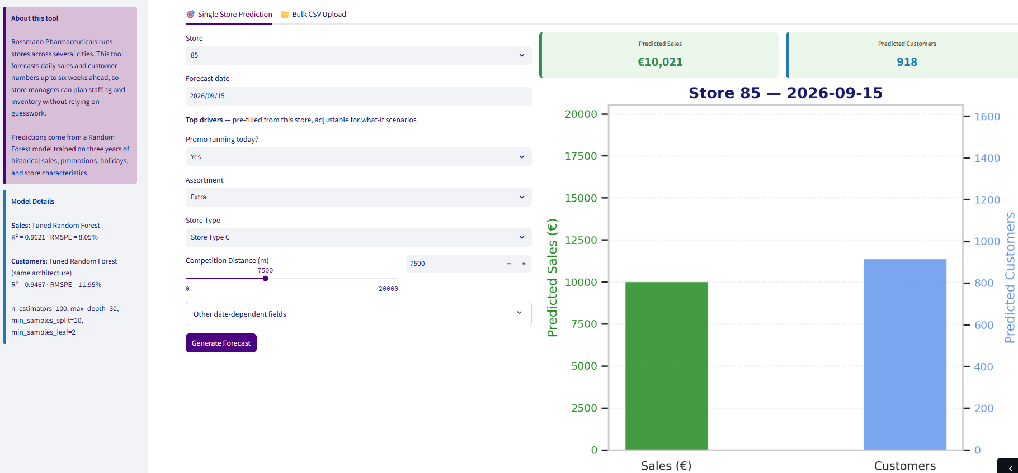
The Dashboard — Single-Store
rossmann-pharmaceuticals-sales-forecasting.streamlit.app · Tab 1 of 2
What the User Sets
Store ID and forecast date
Promo running today?
Assortment and Store Type
Competition distance slider
Further date-dependent fields
What It Returns
Predicted Sales and Predicted Customers, side by side
A dual-axis chart plotting both on their own scales
Inputs pre-fill from the selected store's own record, then stay adjustable — so a manager can ask “what if we run a promo?” rather than only receiving a number.
Notes:
NOTE ON THIS CAPTURE:
Taken at 67% zoom without the purple header banner, so the full chart (both bars and both axis labels) fits in frame rather than being cropped.
A header+full-chart capture was tried and the chart lost its bottom axis labels — the complete chart was judged more important than the header for this slide.
The purple sidebar accent and the "Model Details" panel still carry the brand identity and, more importantly, the model metrics quoted throughout this deck, which is the visible link between the analysis and the deployed product.
WHAT:
This is the first of the dashboard's two workflows, and the one aimed at an individual store manager.
The user selects a Store ID and a forecast date. The interface then exposes the model's top drivers as editable controls — whether a promotion is running that day, the store's assortment level, its store type, and its competition distance on a slider — plus an expander holding the further date-dependent fields. Pressing Generate Forecast returns two figures side by side: Predicted Sales and Predicted Customers, with a dual-axis chart plotting both on their own scales, since euros and customer counts are not comparable magnitudes.
In the example capture, Store 3 on 16 September 2026 with no promotion running, basic assortment, store type A and a competition distance of 1,270 metres returns roughly €3,679 in predicted sales against 707 predicted customers.
The left sidebar carries the model provenance: the tuned Random Forest at R² 0.9621 and RMSPE 8.05% for Sales, the companion Random Forest at R² 0.9467 and RMSPE 11.95% for Customers, with the tuned hyperparameters listed (n_estimators 100, max_depth 30, min_samples_split 10, min_samples_leaf 2).
WHY:
The design decision worth drawing attention to is that the controls are pre-filled but editable, rather than either fixed or blank.
Pre-filling them from the selected store's own record means the default forecast is the honest one — the model's prediction for that store as it actually is. Leaving them editable turns the tool from a lookup into a scenario tester. The brief describes managers currently forecasting on years of experience and personal judgement; what that judgement is actually doing is answering questions like "what happens if we promote next Tuesday?" A static forecast does not answer that. An adjustable one does, which is why this is the workflow that genuinely replaces the existing practice rather than sitting alongside it.
The specific controls exposed are not an arbitrary selection. They are the model's own top-ranked features from the dual-method importance analysis — competition distance, store identity, promotional state, assortment and store type. The interface surfaces exactly the levers that move the prediction most, and leaves the low-importance calendar fields tucked into an expander. That is the feature-importance work translated directly into interface design.
Showing the model metrics in the sidebar is deliberate too. A forecast presented without its error rate invites false confidence. A manager who can see that the model runs at roughly 8% typical percentage error will treat a prediction as a planning baseline to adjust from, which is the correct use, rather than as a guarantee.
HOW:
The application loads the serialized tuned Random Forest pipelines produced in the machine-learning notebook — the same artifacts whose metrics appear throughout this deck, not retrained or simplified versions. Because all preprocessing lives inside the sklearn Pipeline, the serialized object carries its own scaling and encoding, so the dashboard applies exactly the transformations the model was trained under and cannot drift from the training code.
Two separate models are called per request: one for Sales, one for Customers, both of the same tuned architecture.
The closed-day rule is applied as explicit business logic rather than left to the model — where a store is closed, predicted Sales is set to zero directly. This is the same handling used in the notebook's prediction export, and it is why the model itself was retrained excluding the Open indicator.
ALSO, IN THE NOTEBOOK (not shown on this slide):
The serialization scheme this app consumes, including the timestamped artifact naming that lets any prediction be traced to the model version that produced it — see 02_salesfc_ml_modeling.ipynb, "Final Model Serialization".
The closed-day business logic the dashboard reuses — see 02_salesfc_ml_modeling.ipynb, "Final Predictions & Submission Export".
The feature-importance analysis that determined which controls are surfaced here — see 02_salesfc_ml_modeling.ipynb, "Feature Importance (Dual Method)".
The Customers model behind the second output — see 02_salesfc_ml_modeling.ipynb, "Customer Volume Prediction Model".

Slide 16
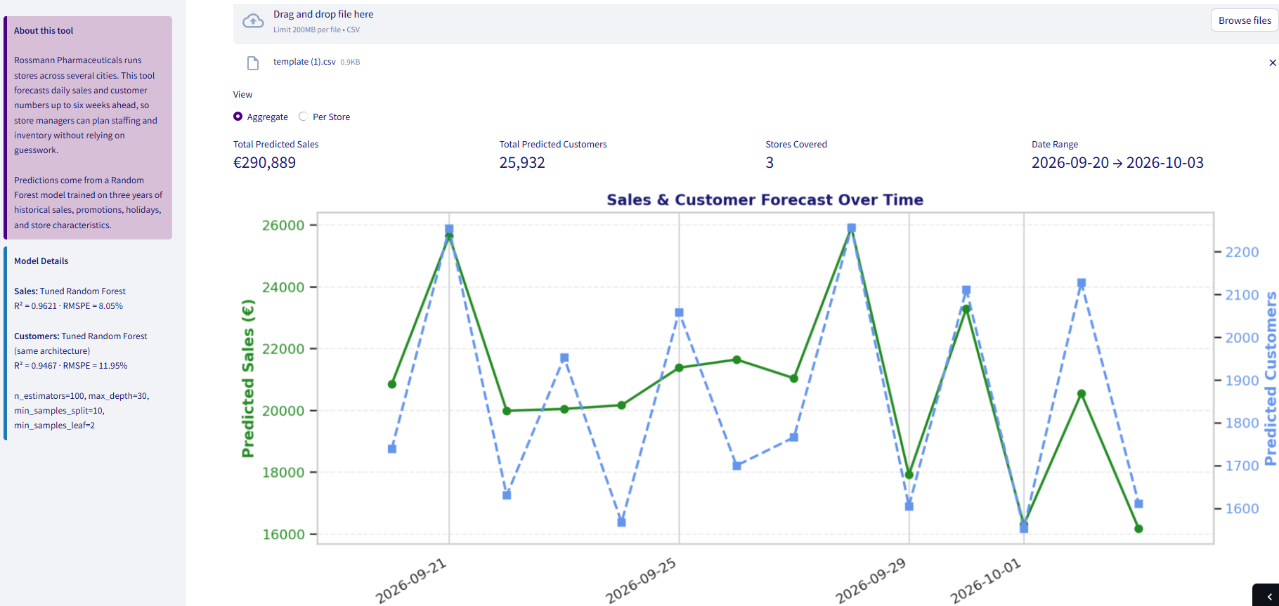
The Dashboard — Bulk Forecasting at Scale
rossmann-pharmaceuticals-sales-forecasting.streamlit.app · Tab 2 of 2
Upload Once, Score Everything
Drag-and-drop CSV, up to 200 MB
Downloadable template fixes the expected column format
Any number of store-days in one pass
Two Ways to Read It
Aggregate — network totals across the whole upload
Per Store — the same window filtered to one store
Predictions exportable as CSV
Example run: 3 stores across 2026-09-20 → 2026-10-03 returns €290,889 total predicted sales and 25,932 predicted customers — the finance-team view, not the store-manager view.
Notes:
NOTE ON THIS CAPTURE:
Aggregate view, at 67% zoom — shows the upload widget, the view toggle, all four summary figures and the full chart in one frame, which demonstrates the entire workflow end to end.
Per Store (Store 17) is described in the notes below rather than shown, since it is a filtered version of the same view.
A separate scroll on the live app also confirms a "Download predictions as CSV" button and the underlying prediction table (Store, Date, Predicted_Sales, Predicted_Customers) sit just below this frame — so the CSV-export claim in this slide's footer and body text is confirmed against the live app, not assumed. Note for the room: this tab scores whatever CSV is uploaded (here, the demo template's 3 synthetic stores), while Slide 16A predicts from the full 1,115-store reference table — so a shared store number between the two tabs is not expected to agree, by design, and is not a bug if asked.
WHAT:
This is the second workflow, aimed at a finance analyst rather than an individual store manager.
The user uploads a CSV of store-days by drag-and-drop or file browser, up to 200 MB. A downloadable template is provided so the expected column format is unambiguous rather than something the user has to infer. Every row in the file is scored in one pass.
Results are then readable two ways, controlled by the Aggregate / Per Store toggle.
Aggregate rolls the whole upload into network-level totals: Total Predicted Sales, Total Predicted Customers, the number of stores covered, and the date range spanned. In the example capture, three stores across 20 September to 3 October 2026 return roughly €290,889 in total predicted sales against 25,932 predicted customers, with a dual-axis chart tracing both series across the forecast window.
Per Store adds a store selector and redraws the same window filtered to a single store — in the example, Store 17 — so an analyst can move from the network number to the individual store driving it without re-uploading anything. The summary figures stay on screen, so the per-store detail is always read against the network context rather than in isolation. Scrolling past the chart in either view surfaces the row-level prediction table itself — Store, Date, Predicted_Sales, Predicted_Customers — and a "Download predictions as CSV" button beneath it.
The predictions are exportable as a CSV table.
WHY:
The two workflows exist because they serve genuinely different questions, and that distinction drove the design rather than being a feature-list exercise.
A store manager asks a narrow, forward-looking question about one store and wants to test a scenario — that is the single-store tab. A finance analyst asks a wide question across the network over a planning window and needs the answer in a form that feeds an existing model. That is this tab.
The aggregate-to-per-store toggle matters more than it looks. A network total is what finance plans against, but the moment a number looks wrong, the immediate question is which store is responsible. Making that a toggle rather than a separate upload means the diagnostic path is one click from the headline figure.
The CSV export is the feature that makes this usable rather than merely viewable. The Download predictions as CSV button exports exactly the row-level table shown on screen — one row per store-day, both predicted targets included — so a forecast that would otherwise only be readable in a browser can be retyped, screenshotted, or copy-pasted into whatever planning spreadsheet or model finance already runs. Exportable output means these predictions land inside the existing workflow instead of becoming another destination analysts have to visit.
The template download addresses the most common practical failure mode for an upload interface: a file that is nearly right. Publishing the exact expected schema up front is cheaper than error handling for every way a column name can differ.
HOW:
The same two serialized tuned Random Forest pipelines back both tabs — Sales and Customers — so a bulk-scored prediction and a single-store prediction for the same store-day are identical by construction, not merely similar. There is no separate batch model.
Because preprocessing is contained inside the sklearn Pipeline, an uploaded CSV needs only the raw columns; the scaling and encoding are applied by the loaded artifact itself.
The closed-day rule is applied here as well — where a store is closed, predicted Sales is set to zero as explicit business logic rather than left to the model.
The app was built in a local development environment rather than a notebook, and deployed to Streamlit Community Cloud.
ALSO, IN THE NOTEBOOK (not shown on this slide):
The prediction and submission export logic that this bulk workflow mirrors, including the closed-day split — see 02_salesfc_ml_modeling.ipynb, "Final Predictions & Submission Export".
The serialization scheme both tabs load from — see 02_salesfc_ml_modeling.ipynb, "Final Model Serialization".
The confidence-interval estimation, which is the natural next addition to this view so that bulk forecasts can be presented as ranges rather than point values — see 02_salesfc_ml_modeling.ipynb, "Confidence Interval Estimation".

Slide 17
Business Recommendation
Recommendation: Adopt the tuned Random Forest as the production forecasting model for both Sales and Customers, at 8.05% RMSPE across the six-week horizon.
Replaces Judgement With a Baseline
Spend on Data, Not on Architecture
Plan Holidays as a Window
Treat Promotions as Two Effects
Managers currently forecast on experience alone, with no common standard
8.05% RMSPE gives finance one consistent, auditable number per store
Competition distance, store identity, assortment and type dominate every model
Better per-store attributes will beat a more elaborate algorithm — proven three times over in this project
Anticipation peaks two days before the holiday, not on it
Stock and staffing decisions taken only for the holiday itself miss the demand
Promotions raise footfall (+21.18%) AND basket size (+14.52%) separately
Forecast and evaluate them on both, not on total sales alone
The instinct when forecasts disappoint is to ask for a more advanced model.
This project tested that instinct in three model families and it did not hold — the cheaper lever is better per-store data.
Notes:
WHAT:
The core recommendation: adopt the tuned Random Forest as the production forecasting model for both Sales and Customers, delivering 8.05% RMSPE across the six-week horizon the finance team plans against.
Four supporting recommendations follow from the analysis.
First, this replaces judgement with a baseline. The brief states plainly that managers currently forecast on years of experience and personal judgement. That is not worthless — local knowledge is real — but it is unauditable, inconsistent between stores and impossible to roll up. An 8.05% RMSPE model gives finance one consistent number per store, computed the same way everywhere, that managers can then adjust with local knowledge rather than replace.
Second, spend on data rather than on architecture. This is the recommendation most directly grounded in the model comparison. Competition distance, store identity, assortment and store type dominate every model that has access to them. Improving those inputs — more complete competitor records, richer store attributes, better promotional metadata — will yield more forecast improvement than a more elaborate algorithm. The project demonstrated this three separate times, in three different model families.
Third, plan holidays as a window. Anticipation excess peaks two days before the holiday, and nearly every day in the ten-day run-up sits above its day-of-week baseline. Stock and staffing decisions scoped to the holiday itself are aimed at the wrong days.
Fourth, treat promotions as two distinct effects. A promotion raises footfall by about 21% and basket size by about 15%, and those are separate mechanisms. Planning and post-hoc evaluation should track both, because a promotion that raised footfall without raising basket size performed differently from one that did the reverse, even if total sales moved identically.
WHY:
The second recommendation is the one that carries real commercial weight, so it is worth emphasising in the room.
The instinctive response to "our forecasts are not good enough" is to ask for a more advanced model. This project tested that instinct directly and it did not hold. The most sophisticated approaches applied to the poorest inputs — ARIMA, SARIMA and even a neural network on the aggregate series — all lost decisively to a well-tuned ensemble with rich per-store features. Meanwhile the single largest improvement anywhere in the project came from adding one structural term to SARIMA, not from adding capacity.
For a business deciding where to invest, that reframes the question from "which algorithm" to "which data", and the second question is usually both cheaper to act on and more durable in its benefit.
The first recommendation is worth framing carefully too. The model is not proposed as a replacement for store managers. It is proposed as the shared starting point they adjust from — which turns their local knowledge into a documented adjustment rather than an invisible input.
HOW:
Each recommendation traces to specific evidence in the deck rather than to general reasoning: the deployment recommendation to the five-model comparison; the data-investment recommendation to the dual-method feature importance and the cross-approach comparison together; the holiday recommendation to the day-of-week-controlled anticipation analysis; and the promotion recommendation to the three-panel promo effect analysis with its spend-per-customer breakdown.
ALSO, IN THE NOTEBOOK (not shown on this slide):
The promo deployment effectiveness analysis, which goes further than this slide and identifies which specific stores promotions should be concentrated in — see 01_salesfc_preprocessing.ipynb, "Multivariate Analysis — Promo Deployment Effectiveness".
The competition-distance analysis underlying the data-investment recommendation — see 01_salesfc_preprocessing.ipynb, "Bivariate Analysis — Competition Distance Impact".
The confidence-interval estimation, which supports presenting forecasts to the business as ranges rather than point values — see 02_salesfc_ml_modeling.ipynb, "Confidence Interval Estimation".

Slide 18
Challenges & Key Learnings
1 — Target Leakage via Open
2 — A Missing Feature Column
3 — Asymmetric Holiday Calendar
Challenge: The first Random Forest included the Open indicator, which trivially inflated every score — closed days always have Sales = 0.
Challenge: Store was accidentally excluded from the deep-learning feature set. The LSTM sat at R² ≈ 0.58 with no obvious error anywhere.
Challenge: Holiday proximity features were built per-dataset, so DaysSinceLastHoliday had different missingness in train than in test.
Learning: Retrained without Open and handled closed days as explicit business logic at prediction time. Suspiciously good scores get audited, not celebrated.
Learning: Adding it back lifted R² above 0.83. Silent feature-set mismatches don't raise exceptions — the feature list itself now gets verified, not assumed.
Learning: Rebuilt the calendar from the combined train + test date range. Any feature derived from a date range must be built once, across the full span.
4 — ARIMA's Total Failure
5 — Results That Won't Sit Still
6 — Confident Claims, Tiny Samples
Challenge: Plain ARIMA(3,0,3) returned 557.87% RMSPE — not merely imprecise but out of phase with the weekly cycle entirely.
Challenge: GPU-trained LSTM/GRU results varied run to run (cuDNN float ordering), and ARIMA's maximum-likelihood fit didn't converge identically either.
Challenge: StoreType b is 17 stores and Assortment 'Extra' just 9 — early write-ups stated their gaps as findings without flagging the sample.
Learning: One seasonal term improved RMSPE more than tenfold. Diagnose what the model is missing structurally before reaching for more capacity.
Learning: Reported stable ranges rather than false constants, and persisted final artifacts so the load-first path locks the published numbers in place.
Learning: Group sizes are now checked before any claim is written. Direction is reportable; magnitudes from self-selected minorities are not.
Notes:
WHAT:
Six challenges encountered, each paired with the practice it left behind. These are real incidents from the four notebooks, not generic lessons.
1 — Target leakage via Open. The first Random Forest included the Open indicator as a feature. Because closed days always have Sales = 0, the model was effectively handed the answer for a large share of rows, and performance looked far better than it was.
2 — A missing feature column. Store was accidentally left out of the deep-learning feature list. The LSTM trained cleanly, threw no error, and simply sat at R² ≈ 0.58.
3 — Asymmetric holiday calendar. Holiday proximity features were originally built from each dataset's own date range, so DaysSinceLastHoliday carried different missingness patterns in training than in test.
4 — ARIMA's total failure. Plain ARIMA(3,0,3) returned 557.87% RMSPE — a model that was not merely imprecise but genuinely out of phase with the weekly cycle.
5 — Results that won't sit still. GPU-accelerated LSTM and GRU training is non-deterministic because cuDNN's parallel float reductions don't guarantee identical ordering even under a fixed seed. Separately, ARIMA and SARIMA are fit by maximum likelihood on a poorly-conditioned surface and don't converge identically across reruns either.
6 — Confident claims, tiny samples. StoreType b is 17 stores and Assortment level 'Extra' just 9, out of 1,115. Early write-ups quoted their gaps against the majority as findings without flagging how small those groups are.
WHY:
Several of these are worth dwelling on because of what they say about the discipline rather than the incident.
The Open leakage is the most instructive. The failure mode was not an error message — it was a good result. That is the dangerous kind, because nothing prompts you to look. The learning generalises: a score that jumps unexpectedly is a reason to audit the feature set, not a reason to move on.
The missing Store column is the same category of silent failure, and it produced an unexpected bonus. When adding Store back lifted R² from roughly 0.58 to above 0.83, that was independent confirmation — from a completely different model family — of how much signal store identity carries. A bug ended up corroborating the deck's central thesis.
The ARIMA failure is the clearest demonstration of the project's core argument. The instinct on seeing 557.87% is to add autoregressive terms. The actual fix was one seasonal component, which improved RMSPE more than tenfold. Structure beat capacity — the same lesson the machine-learning comparison taught from the other direction.
The non-determinism is included because the alternative — quoting deep-learning figures as exact reproducible constants — would mislead anyone who reran the notebooks. Disclosing it, and then persisting the final artifacts so the published numbers stop drifting, is the honest resolution rather than a cosmetic one.
The small-sample issue recurs whenever a comparison group is a self-selected minority: the gap against the majority is confounded by store selection itself, not purely by the variable being tested. Checking group sizes before writing a claim is now a step, not an instinct.
HOW:
Each was caught in a different way, which is itself the point — no single check would have found all six. The Open leakage surfaced from an implausibly high score. The Store omission surfaced from an implausibly low one. The holiday asymmetry surfaced during the verification step at the start of the machine-learning notebook, after preprocessing had already been declared complete. The ARIMA failure surfaced from the forecast plot rather than the metric — the out-of-phase behaviour is visible in the chart in a way 557.87% alone doesn't convey. The non-determinism surfaced from repeated reruns. The sample-size issue surfaced from deliberately checking unique store counts per group before writing.
RESIDUAL LIMITATIONS worth stating aloud if asked — these are constraints of the data rather than things that were fixed:
No customer identifier exists, so the 21.18% promotional footfall lift cannot be split into genuinely new customers versus existing customers shifting visit timing.
Every model is scored on a single final-six-weeks window; a different season could reorder the closely-spaced models, though not the headline gap.
CompetitionDistance is highly predictive but the data cannot establish direction — proximity may depress sales, or competitors may open near already-busy locations.
All models assume 2013–2015 patterns persist; structural change is outside what this data can anticipate.
ALSO, IN THE NOTEBOOK (not shown on this slide):
The Open-exclusion correction and its effect on every downstream result — see 02_salesfc_ml_modeling.ipynb, "Baseline Model - Random Forest Regressor" and "Final Model Selection: Architecture & Tuning Comparison".
The holiday calendar rebuild and the post-export verification that caught it — see 02_salesfc_ml_modeling.ipynb, "Technical Verification — Reloaded Data", and 01_salesfc_preprocessing.ipynb, "Holiday Proximity Features".
The non-determinism notes recorded at the point each model was trained — see 03_salesfc_deep_learning.ipynb, "Training & Evaluation", and 04_salesfc_time_series.ipynb, "ARIMA Model".
The sample-size notes on the affected charts — see 01_salesfc_preprocessing.ipynb, "Bivariate Analysis — Assortment Impact" and "Bivariate Analysis — Beyond-Ask: StoreType-Level Sales Patterns".

Slide 19
Conclusion & Future Scope
Conclusion
Future Scope
Tuned Random Forest — R² 0.9621 · RMSPE 8.05%
Store embeddings in the LSTM — the fair test of whether sequence models can close the gap once store identity is properly represented.
Per-store ARIMA/SARIMA rather than one aggregate series, to separate the seasonality finding from the aggregation penalty.
Retraining cadence and drift monitoring, so the six-week forecast stays calibrated as competitors and promotions change.
Richer inputs before richer models: fuller competitor records, weather, and local event calendars — the lever this project showed pays best.
The best model of the entire project — ahead of XGBoost, LightGBM, LSTM, GRU, ARIMA, SARIMA and an aggregate LSTM, on the same data, split and metric.
The thread that held every time: richer per-store input features beat model sophistication — across ML, deep learning and classical time series alike.
A companion Random Forest predicts Customers (R² 0.9467 · RMSPE 11.95%), so the dashboard serves both targets the brief requires.
All five objectives met: customer purchasing behaviour explored, store sales predicted, ML and deep-learning approaches both delivered, and predictions served on a live web interface.
Descoped by Agreement — Deliberate, Not Oversights
Rossmann's finance team can stop forecasting on intuition. The lever for improving this forecast further is better per-store data — not a more elaborate model.
MLflow experiment tracking (superseded by the Streamlit app as the single serving surface) · Docker containerisation · Heroku deployment · unit tests and CI/CD.
Notes:
Conclusion.
The project set out to answer one business question: can Rossmann's finance team replace manager intuition with a six-week sales forecast it can plan against? The answer is yes, and the model is the tuned Random Forest at R² 0.9621 and RMSPE 8.05%.
It is the best model of the entire project — ahead of XGBoost and LightGBM within the machine-learning stage, ahead of the LSTM and GRU in the deep-learning stage, and ahead of ARIMA, SARIMA and the aggregate LSTM in the time-series stage. Every one of those comparisons ran on the same data, the same final-six-weeks validation split and the same primary metric, which is what makes the ranking meaningful rather than convenient.
The thread that held throughout: richer per-store input features beat model sophistication, consistently, across machine learning, deep learning and classical time series alike.
A companion Random Forest of the same tuned architecture predicts Customers at R² 0.9467 and RMSPE 11.95%, so the deployed dashboard serves both prediction targets the brief requires rather than treating footfall as an afterthought.
All five of the brief's objectives are met: customer purchasing behaviour explored, store sales predicted, a machine-learning approach delivered, a deep-learning approach delivered, and predictions served on a live web interface.
Future Scope.
Store embeddings in the LSTM. This is the most interesting open question the project raises. The deep-learning models trailed largely because store identity — a 1,115-level categorical and one of the strongest predictors available — enters a sequence model poorly. Learned embedding layers would give the LSTM a proper representation of it and would be the genuinely fair test of whether sequence architecture can close the gap. This project could not run that test, because the brief specifies a shallow two-layer network.
Per-store ARIMA/SARIMA. The classical models were run on the network-wide aggregate only, which confounds two separate effects: the value of seasonal modelling, and the penalty for aggregating 1,115 heterogeneous stores. Fitting them per store would separate the two and give a cleaner read on how much of their shortfall is aggregation rather than method.
Retraining cadence and drift monitoring. The model is trained on 2013–2015 and assumes those patterns persist. An operational deployment needs a defined retraining schedule and monitoring that flags when live error drifts away from the 8.05% validation baseline.
Richer inputs before richer models. This follows directly from the project's own central finding. Fuller competitor records, weather data and local event calendars would likely deliver more forecast improvement than any architecture change — and are typically cheaper to obtain than the modelling effort they would replace.
Descoped items. MLflow experiment tracking was dropped in favour of the Streamlit dashboard as the single serving surface. Docker containerisation, Heroku deployment, and unit tests with CI/CD were also explicitly out of scope. These were agreed decisions taken for the deliverable, not oversights, and are stated here so that is unambiguous.
ALSO, IN THE NOTEBOOK (not shown on this slide):
The full five-model comparison table and the Final Verdict callout that this conclusion summarises — see 04_salesfc_time_series.ipynb, "Final Model Comparison" and "Final Summary".
Each stage's own executive summary — see the closing section of all four notebooks.

Slide 20
References & Appendix
Project Repository
Live Dashboard
All four analysis notebooks, the shared prerequisites module, the dashboard source, DVC-tracked assets and the README — NHIS Project 6.
Streamlit app serving Sales and Customers predictions — single-store what-if lookup and bulk CSV scoring with export.
github.com/S-Yousuf-S/NHIS_Project6
rossmann-pharmaceuticals-sales-forecasting.streamlit.app
Supplementary detail by notebook — not shown on slides
01_salesfc_preprocessing — missing-value audit, outlier decisions, all EDA sections (seasonality, competition distance, open/close trends, promo deployment), correlation heatmap.
02_salesfc_ml_modeling — RMSPE justification, three-way architecture comparison, dual-method feature importance, 90% confidence intervals, serialization, Customers model.
03_salesfc_deep_learning — ADF stationarity test, ACF/PACF, sliding-window construction, both training curves, per-StoreType error table, three-model verdict.
04_salesfc_time_series — AIC/BIC order selection, individual ARIMA and SARIMA diagnostics, aggregate LSTM build, five-model comparison table with Final Verdict box.
Dataset & Brief
Technical References
Rossmann store sales data — train, test and store metadata, 2013–2015.
Nexthikes IT Solutions — “Sales Forecasting Across Multiple Retail Stores” project brief.
Analysis in Google Colab / Jupyter; dashboard built in VS Code, deployed on Streamlit Community Cloud.
Time Series Prediction with LSTM Recurrent Neural Networks in Python with Keras — MachineLearningMastery
logging — Logging facility for Python — Python 3 documentation
Serialize and Deserialize an Open File Object in Python — GeeksforGeeks
Future Forecasting of Time Series using LSTM: A Quick Guide for Business Leaders — K. Tarek, Data Science Collective
THANK YOU — Sales Forecasting Across Multiple Retail Stores — Yousuf S. R. Sakkaf
Notes:
This slide points to everything the deck summarises but does not show, in four blocks.
The project repository holds all four analysis notebooks, the shared prerequisites module imported across them, the Streamlit dashboard source, the DVC-tracked asset versions, and the README.
The live dashboard is deployed on Streamlit Community Cloud and serves both prediction targets through the two workflows shown earlier in the deck.
The supplementary-detail block lists, per notebook, what exists there that no slide displays — so a reviewer can go straight to the relevant section rather than hunting for it.
The dataset and brief block documents provenance, and the technical references block lists the four external sources that directly informed the implementation.

