Slide 1
DISASTER TWEET CLASSIFICATION
Telling real emergency reports from everyday language
Yousuf S. R. Sakkaf
Notes:
Disaster Tweet Classification:
A project that teaches a computer to tell a genuine emergency report from everyday use of the same dramatic words, and then puts the best model behind a plain-language dashboard.

Slide 2

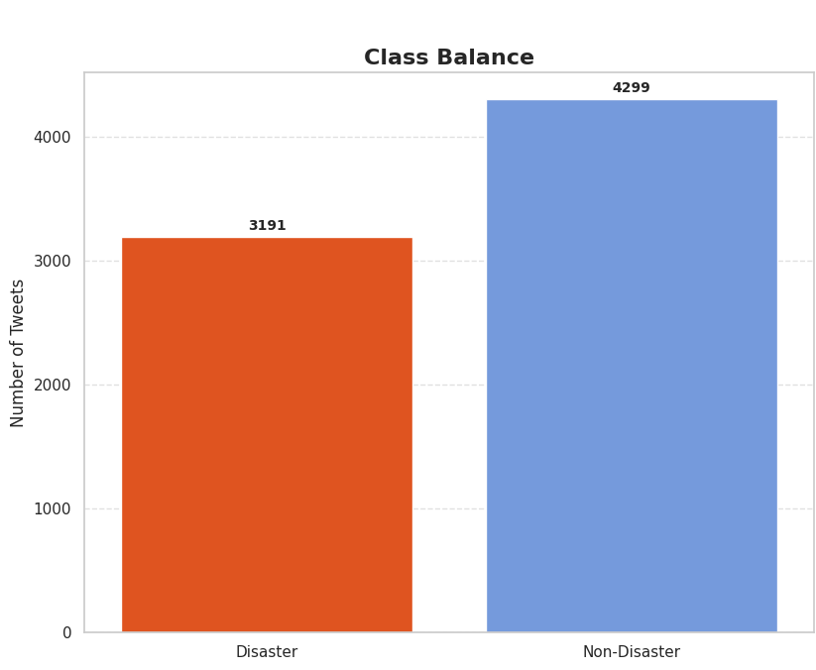
Problem & Dataset
7,613
7,490
Tweets collected
5 columns: id, keyword, location, text, target
After cleaning
123 repeats & conflicts removed
42.6%
57.4%
Real disaster tweets
3,191 of 7,490
Majority-class baseline
Always guessing "not a disaster"
Why it is hard
"Fire", "flood" and "Armageddon" appear in jokes, songs and exaggeration as often as in real reports.
Any real model has to beat the 57.4% baseline by a clear margin.
Notes:
WHAT:
The dataset is 7,613 tweets with five columns: id, keyword, location, text and target (1 = real disaster).
After cleaning, 7,490 tweets remain: 4,299 non-disaster (57.40%) and 3,191 disaster (42.60%).
A model that always answers "not a disaster" is already right 57.4% of the time, so every real model has to clear that bar by a meaningful margin to show it has learned anything.
WHY:
The class balance is mild, not severe, so no resampling was needed.
But it is real enough that Accuracy should be read next to F1, Precision and Recall, which is why the project reports all of them.
HOW:
Class balance was computed after cleaning, on the 7,490 tweets used for modelling.
The raw split was 4,342 non-disaster and 3,271 disaster (57.03% and 42.97%).
ALSO, IN THE NOTEBOOK (not shown on this slide):
Missing-value audit:
location is missing in about 33% of rows (2,476) and keyword in 56 rows (0.75%).
Keyword has 222 unique values.
The raw data inspection tables, data types and the first rows are in the importing and inspection section.

Slide 3
Analytical Framework
01
02
03
04
05
06
Clean
Engineer & Explore
Represent Text
Build Models
Evaluate Once
Deploy
Duplicates, labels, locations
24 columns, full EDA
6 ways to turn words into numbers
6 tiers, 6 finalists
Held-out test tweets
Streamlit dashboard
The one rule that governs everything
5,992
1,498
5-fold CV
Training tweets (80%)
All fitting and selection happen here
Held-out test tweets (20%)
Untouched until final evaluation
Model selection inside each tier
Training data only, Accuracy first
Notes:
WHAT:
One notebook, six stages, each stage's output feeding the next:
1. Clean the data
2. Engineer and explore features
3. Represent the text in several ways
4. Build six model tiers
5. Evaluate once on the held-out test set
6. Deploy the winner.
WHY:
The point of a single flow is that every model is compared on identical data, an identical split and the same primary metric.
That is what makes the final comparison fair.
The one rule that governs everything: the test set (1,498 tweets, 20%) is held out before any modelling and is not used for fitting, tuning or selection.
Every vectorizer, encoder and embedding that learns from data was fitted on the training tweets only and then applied to the test tweets.
ALSO, IN THE NOTEBOOK (not shown on this slide):
A leakage and reproducibility table showing the shape of every representation on train and test, the categorical encoding step (13 disaster types and 3 location sources, 16 one-hot features), and the assembly of the 29 structured modelling features (13 numeric plus 16 encoded).

Slide 4
Data Cleaning
123
412
56
Tweets removed (1.6%)
7,613 → 7,490 uniquely labelled tweets
Locations recovered from text
2,064 stay honestly "unknown"
Missing keywords → "unknown"
Not invented
Duplicate type | Tweets
Exact duplicate texts | 52
Texts with conflicting labels | 18
Further repeats of kept texts | 45
Total removed | 123
The key lesson
The id column is unique per row, so an all-column duplicate check finds nothing.
Judged on the text itself, 123 tweets were repeats or contradictions.
Place names found by named-entity recognition were filtered: spans over three words, or containing symbols such as # @ /, were rejected.
Notes:
WHAT:
The cleaning stage removed 123 tweets (1.6%), recovered 412 locations from the tweet text, and gave every missing value an explicit treatment.
WHY:
The first lesson is that duplicates must be judged on content. The id column is unique per row, so an all-column duplicate check can never find anything. Judged on the text itself there were 52 exact duplicates, 18 texts with conflicting labels, and 45 further repeats of kept texts. Leaving them in would let near-copies sit on both sides of the split and would teach the model contradictory answers.
For conflicting labels the rule was: where a text had a clear majority label that label was kept; where the labels split evenly the text was dropped.
Missing keywords (56) were labelled "unknown" rather than invented.
Missing locations (2,476, 33.06%) were handled with named-entity recognition on the tweet text, which recovered 412 real place names; 2,064 remain genuinely unknown and are marked as such.
HOW:
spaCy's English model was used for place recognition, with a filter that rejects spans longer than three words, non-ASCII text, or symbols such as # @ /,, so that junk is not promoted to a location.
A location_source column records whether each location is original, extracted or unknown, so downstream work can tell them apart.
ALSO, IN THE NOTEBOOK (not shown on this slide):
Post-cleaning validation (zero missing values, no label mismatches, no repeated texts), the data type corrections, and the df_refined checkpoint that all later work builds on.

Slide 5
Feature Engineering
7 → 24
Structure
Characters, words, hashtags, mentions, links, capitals, punctuation, digits
Sentiment
VADER positive / neutral / negative scores and an overall label
Columns
New columns kept permanently
107
Disaster type
13 rule-based themes, e.g. Severe Weather, Fire & Wildfire
Clean text
Lowercased, stop words removed, lemmatised tokens
Median characters
15 words per tweet
What the features show
Created is not the same as useful
Each feature is only a candidate. The EDA slides test whether it relates to the target before any modelling.
49% of tweets are negative
vs 26% positive, 25% neutral
0 missing values
in any of the 17 new columns after validation
Notes:
WHAT:
Feature engineering expanded the dataset from 7 to 24 columns.
The 7 are the 5 original columns plus target_label and location_source, both added during cleaning.
The 17 new columns fall in four groups: structure (9), sentiment (5: four VADER scores and a label), disaster type (1) and cleaned text (2: the token list and the cleaned string).
WHY:
Models cannot use the shape of a tweet unless it is turned into numbers.
The structural and sentiment features were computed from the raw text, because text cleaning removes capital letters, links and punctuation, which are useful signals in themselves; VADER, for example, partly relies on punctuation and capitalization for tone.
Structure: The median tweet is 107 characters and 15 words; hashtags, mentions, URLs and digits are sparse (mean 0.43 hashtags and 0.36 mentions per tweet).
Sentiment (VADER) leans negative: 49.19% negative, 25.82% positive and 24.99% neutral, with a mean compound score of about -0.14.
Disaster type is a rule-based category taken from the keyword, with a text fallback when the keyword is unknown. It gives 13 categories, and General Disaster and Emergency Language is the largest at 1,674 tweets (22.35%). It is a feature-only analytical grouping, not a second ground truth and not independently verified.
Validation: Every new feature was checked and none has a missing value.
ALSO, IN THE NOTEBOOK (not shown on this slide):
The structural and sentiment summary tables (minimum, quartiles, maximum), the full disaster-type distribution (for example Structural Damage and Collapse 9.31%, Casualties and Injuries 9.27%, Conflict and Terrorism 9.20%, Earthquake and Seismic Events 2.00%, Volcanic Activity 0.80%), and the feature validation table with a five-row preview.

Slide 6
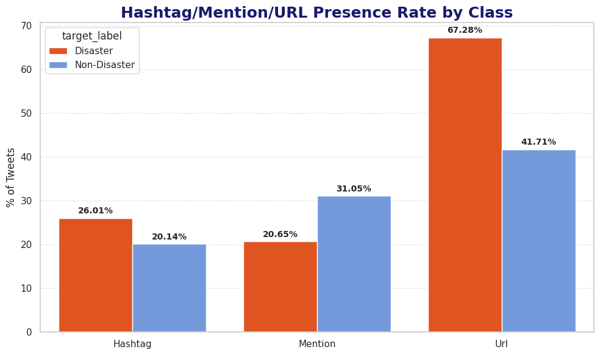
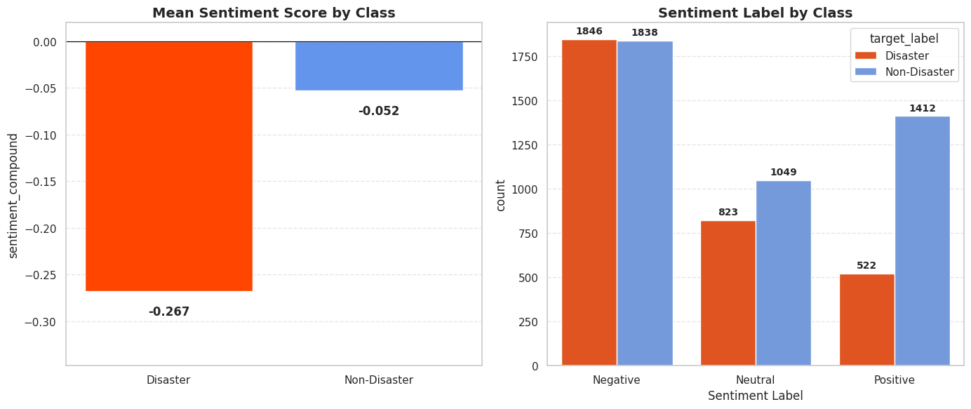
EDA — What Separates Disasters
67% vs 42%
31% vs 21%
−0.27 vs −0.05
Disaster vs other tweets with a link
Other vs disaster tweets with a mention
Average sentiment, disaster vs other
Notes:
BEFORE THE COMPARISONS:
Four numeric features with a long tail were capped at their 99th percentile: average word length (73 rows), hashtag count (56), uppercase ratio (75) and digit count (73).
That replaced 277 values in total and dropped no rows.
Mention count and positive sentiment were checked and deliberately kept uncapped, because they are plausible genuine content.
Capping pulls an extreme value back to the cap, for example a tweet with an unusually high digit count.
The full outlier decision table (IQR against Z-score) is in the notebook.
WHAT:
Two clear differences between real disaster tweets and the rest: they link out far more, and they sound more negative.
Links: 67.28% of disaster tweets contain a URL, against 41.71% of non-disaster tweets, a gap of 25.6 points.
Mentions run the other way: 31.05% of non-disaster tweets tag someone, against 20.65% of disaster tweets.
Hashtags are a smaller gap (26.01% against 20.14%).
On sentiment, disaster tweets average -0.267 against -0.052 for the rest, and non-disaster tweets are about twice as likely to be scored positive.
WHY:
These are plausible patterns: genuine reports link to news or photos, while casual chatter tags friends and sounds lighter.
But none of them is a strong signal on its own.
A negative tweet is not necessarily a real report, and a real report can sound neutral.
The value of these features is that they add information the words alone do not carry.
ALSO, IN THE NOTEBOOK (not shown on this slide):
Tweet length distributions by class (both concentrate near 130 to 145 characters, with a lot of overlap), the sentiment-versus-length scatter, the location frequency chart (USA 106, New York 74, with "unknown" the single largest category at 27.56%), and the class balance of the sentiment and location source labels.

Slide 7
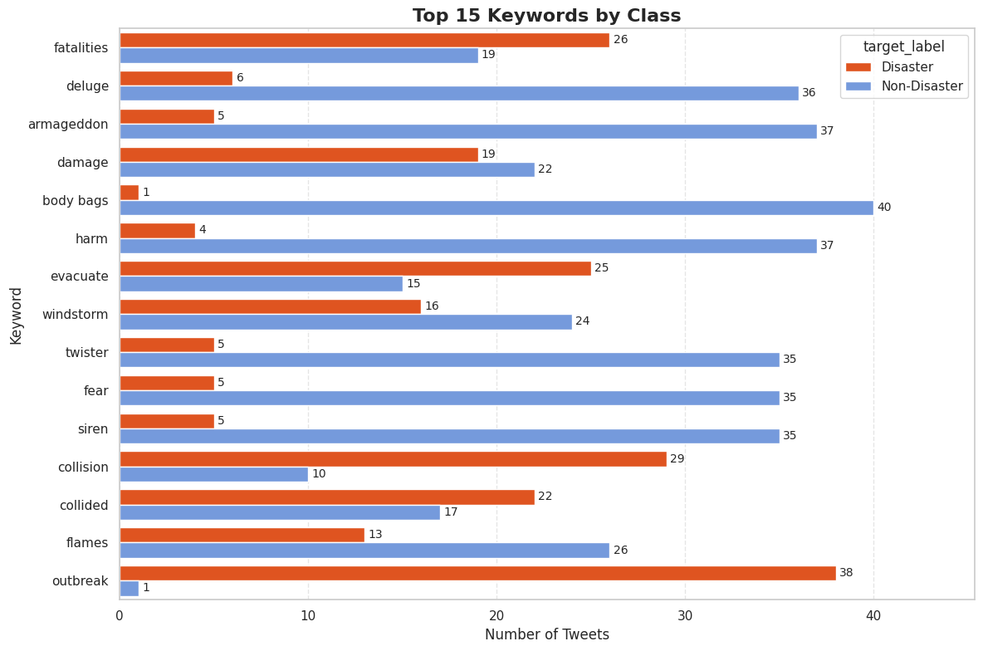
EDA — Keywords
Strong signal
“outbreak”: 38 disaster vs 1 other
“collision”: 29 vs 10
Misleading alarm words
“body bags”: 40 other vs 1 disaster
also armageddon, deluge, twister, siren
Coin-flip words
“fatalities”: 26 vs 19
“damage”: 19 vs 22
Notes:
WHAT:
Keywords carry real signal but mislead as often as they help. The chart shows the top 15 keywords split by class.
Strong disaster signals: "outbreak" appears in 38 disaster tweets and 1 non-disaster tweet; "collision" 29 against 10; "evacuate" 25 against 15.
Misleading alarm words: "body bags" appears in 40 non-disaster tweets and 1 disaster tweet; "armageddon", "deluge", "harm", "twister", "fear" and "siren" each have 35 or more non-disaster tweets and 6 or fewer disaster tweets.
Mixed words such as "fatalities" (26 against 19) and "damage" (19 against 22) are close to a coin-flip.
WHY:
This is the central problem of the project in one chart.
People use dramatic words for jokes, song lyrics, sports and exaggeration.
A keyword alone cannot say whether a tweet is a real report, so the surrounding wording and context matter.
That is why a model that reads context is worth testing.
HOW:
Counts are tweets per keyword and class on the cleaned data.
"Unknown" (the 56 tweets with no keyword) is excluded from the ranking because it is a placeholder, not a real term.
ALSO, IN THE NOTEBOOK (not shown on this slide):
The keyword frequency chart (fatalities is the most frequent at 45 tweets, and the top keywords cluster tightly between 39 and 45).

Slide 8
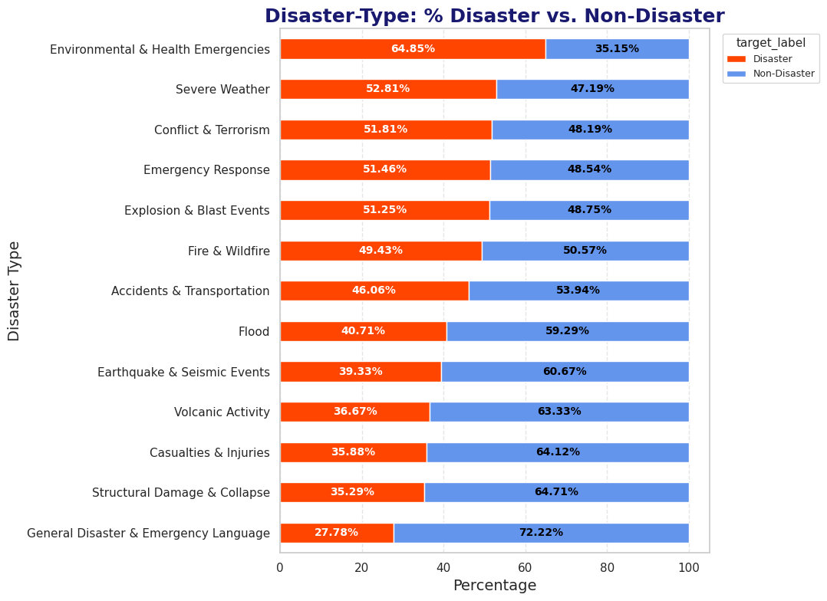
EDA — Disaster Types
5 of 13
Themes where most tweets are real
Even Fire & Wildfire is only 49% real
65% → 28%
Range of real-disaster share
highest to lowest theme
Rule-based themes
Grouped by keyword matching, so read them as analytical categories, not verified labels.
Notes:
WHAT:
The chart ranks the 13 disaster themes by the share of their tweets that are real disasters.
The range is wide, from 64.85% for Environmental and Health Emergencies down to 27.78% for General Disaster and Emergency Language.
Only 5 of the 13 themes are mostly real: Environmental and Health Emergencies (64.85%), Severe Weather (52.81%), Conflict and Terrorism (51.81%), Emergency Response (51.46%) and Explosion and Blast Events (51.25%).
Fire and Wildfire is 49.43%, Flood 40.71%, Earthquake and Seismic Events 39.33%, Casualties and Injuries 35.88% and Structural Damage and Collapse 35.29%.
WHY:
Even themes that sound like emergencies contain many tweets that are not real ones.
About half of the Fire and Wildfire tweets are not real emergencies, and that is the project's central problem in a second form: a topic or a word does not settle whether a tweet is a genuine report.
It also anticipates the figurative-language weakness found later, where words like "fire" and "flood" fooled the model.
The themes are rule-based, built from keyword and text matching. They are analytical groupings, not independently verified labels, so read the percentages as a guide to the data and not as ground truth.
IN PLAIN WORDS:
Every bar is split at 100%.
The orange-red part is the share of that theme's tweets that are real disasters and the blue part is the share that are not. If a theme were a reliable sign of a real emergency, the bar would be almost all red.
HOW:
The share is the percentage of tweets in each theme whose target is 1, computed on the 7,490 cleaned tweets.
Themes come from the cleaned keyword, with a text-based fallback when the keyword is unknown.
ALSO, IN THE NOTEBOOK (not shown on this slide):
The disaster-type frequency chart (the middle themes each hold about 8 to 9% of the data, while Earthquake and Seismic Events holds 2.00% and Volcanic Activity 0.80%).

Slide 9
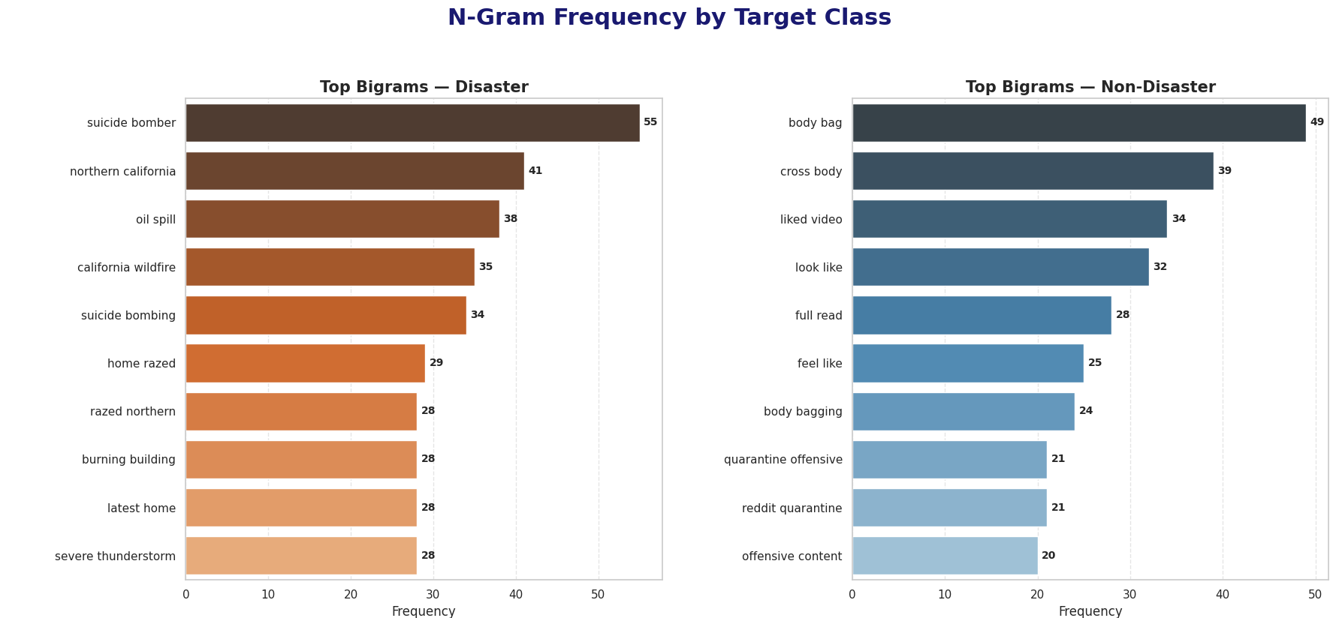
EDA — Beyond Simple Features
−0.229
+0.202
0.838
Word pairs add the context
“Body bag” and “cross body” top the non-disaster list: fashion items, not casualties.
Sentiment compound vs target
the strongest of 13 features, and still weak
URL count vs target
the strongest positive: more links, more likely real
Character count vs word count
the features overlap, as expected from how they are built
Notes:
WHAT:
Individually, no engineered feature separates the classes.
The strongest correlation with the target is sentiment compound at only -0.229; the strongest positive is URL count at 0.202.
The two classes also overlap heavily in the sentiment-versus-length scatter.
Frequent word combinations do show real structure: among disaster tweets, "suicide bomber" (55), "northern california" (41), "oil spill" (38) and "california wildfire" (35); among non-disaster tweets, "body bag" (49), "cross body" (39), "liked video" (34) and "look like" (32).
WHY:
This is the argument for the fuller language pipeline.
If a handful of scalar features were enough, a text model would not be needed.
They are not, and the n-grams show that meaning lives in word combinations and context ("body bag" and "cross body" are fashion items, not casualties).
IN PLAIN WORDS:
A correlation is a number from -1 to +1 that says how closely a feature moves with the target.
Near 0 means little relationship, and +1 or -1 means a perfect one.
Every feature here sits between about -0.23 and +0.20, so none of them is a strong signal on its own.
An n-gram is a run of neighbouring words: a bigram has two and a trigram has three.
HOW:
The correlations come from the full correlation heatmap in the notebook, which covers all 13 numeric features and the target on the cleaned data after capping.
N-grams were counted per class on the cleaned text.
The slide shows the bigram panels (top row) of the notebook's n-gram figure; the trigram panels are in the notebook.
The 0.838 card comes from the same heatmap: character count and word count are strongly correlated with each other because both measure length.
A few other pairs are also strongly related by construction: sentiment negative and sentiment compound (-0.758), sentiment positive and sentiment compound (0.675), and URL count and punctuation count (0.693), since URLs contain punctuation. None of this is a data problem; it is structurally expected.
ALSO, IN THE NOTEBOOK (not shown on this slide):
The full correlation heatmap and the correlation-with-target table, the trigram panels (for example "northern California wildfire" 29 times, tied to a real 2017 wildfire event), the scatter plots, and the direction of each correlation, which agrees with the earlier comparisons (a more positive tone makes a real disaster less likely; more links, digits and characters make it more likely).

Slide 10
Text Representations
Representation | Type | Size
Bag of Words | Sparse counts | ≈ 5,000 features
TF-IDF | Sparse weighted | ≈ 5,000 features
TF-IDF + word pairs | Sparse weighted | 5,000 (1,651 pairs)
Word2Vec | Dense meaning | 100 numbers
GloVe (pretrained Twitter) | Dense meaning | 25 numbers
FastText | Dense meaning | 100 numbers
YAKE keywords | Extracted phrases | ≈ 4.8 per tweet
Sparse
Count which words appear. Fast, simple, hard to beat on clear clue words.
Dense
Describe meaning with short number vectors, so similar words sit close together.
Every representation was refitted on the training tweets only.
Notes:
WHAT:
Six ways of turning tweets into numbers, plus keyword extraction.
Sparse representations count words (Bag of Words, TF-IDF, TF-IDF with word pairs).
Dense representations describe meaning with short number vectors (Word2Vec, GloVe, FastText).
YAKE adds extracted keywords, about 4.80 per tweet.
WHY:
Different model families work best with different inputs, so each family was paired with a suitable representation, and no representation was crowned a winner at this stage.
HOW:
Sizes: Bag of Words and TF-IDF are sparse matrices of about 5,000 features (4,761 in the training split), TF-IDF with n-grams uses 5,000 features including 1,651 word pairs, Word2Vec and FastText produce 100-dimensional tweet vectors from a vocabulary of 5,583 words trained on the training tweets only, and GloVe uses pretrained 25-dimensional Twitter vectors from a vocabulary of 1,193,514 words.
Tweet vectors are the average of word vectors.
After the split, every representation that learns from data was refitted on the training tweets only.
IN PLAIN WORDS:
Bag of Words counts how many times each word appears.
TF-IDF does the same but gives less weight to words that appear in almost every tweet and more weight to distinctive ones.
Word2Vec, GloVe and FastText instead place each word in a numeric space where words used in similar contexts sit close together.
A tweet vector is the average of its word vectors.
Different model families like different inputs.
Linear models do well on sparse word counts, tree models can use dense vectors, and deep models learn their own representation.
Testing several lets the final comparison be about the whole pipeline and not just one lucky pairing.
ALSO, IN THE NOTEBOOK (not shown on this slide):
Word-frequency analysis, the YAKE keyword tables, the shape table for every representation on train and test, and the note that GloVe is externally pretrained and so was not refitted on the project corpus.

Slide 11
Models & Selection Protocol
Tier | Selected finalist | Selection Accuracy | Selection Basis
Classical baseline | Logistic Regression | 0.8041 | 5-fold CV (training data)
Word-embedding models | GloVe + LightGBM | 0.7981 | 5-fold CV (training data)
Feature-enhanced | TF-IDF + Logistic Regression | 0.8034 | 5-fold CV (training data)
Keyword-enhanced | TF-IDF + YAKE + Logistic Regression | 0.7946 | 5-fold CV (training data)
Neural sequence | BiLSTM | 0.7931 | Validation split (best epoch)
Contextual transformer | DistilBERT | 0.8209 | Validation split (best epoch)
Fixed in advance
Accuracy first, F1 as tie-breaker. The test set stays out of every choice.
An honest negative result
Extra engineered features and YAKE keywords did not beat plain TF-IDF on Accuracy.
Notes:
WHAT:
Six model tiers; one winner from each is chosen by cross-validation on training data, and the two deep models by an internal validation split.
Six finalists go to the test set.
The selection Accuracy values:
1. Logistic Regression 0.8041 (the classical baseline, on TF-IDF word features alone);
2. GloVe + LightGBM 0.7981 (dense embeddings);
3. TF-IDF + Logistic Regression 0.8034 (feature-enhanced: the same TF-IDF text features plus the engineered features from the feature-engineering section);
4. TF-IDF + YAKE + Logistic Regression 0.7946;
5. BiLSTM 0.7931;
6. DistilBERT 0.8209.
WHY:
The selection rule was fixed before looking at results: highest Accuracy, with F1 as the tie-breaker.
That is why GloVe + Random Forest (the highest Precision in its tier) did not win its tier.
It also explains an honest negative result: adding the engineered features or the YAKE keywords did not beat plain TF-IDF on Accuracy.
HOW:
Within each tier the vectorizer sits inside the pipeline, so it is refit within every cross-validation fold on training data only.
Classical tier: Logistic Regression, Linear SVM and Naive Bayes on TF-IDF.
Dense tier: Random Forest and LightGBM on GloVe, Word2Vec and FastText vectors.
Note that the deep-model scores come from a single validation split, whereas the others are 5-fold averages, so the two groups are not directly comparable until the test set.
ALSO, IN THE NOTEBOOK (not shown on this slide):
Naive Bayes 0.8011 and Linear SVM 0.7810 (the SVM has the best Recall in its tier at 0.7199); the feature-enhanced result (Accuracy 0.7982 but Recall up from 0.6577 to 0.6921); the per-tier comparison charts; and the planned-models overview table.

Slide 12
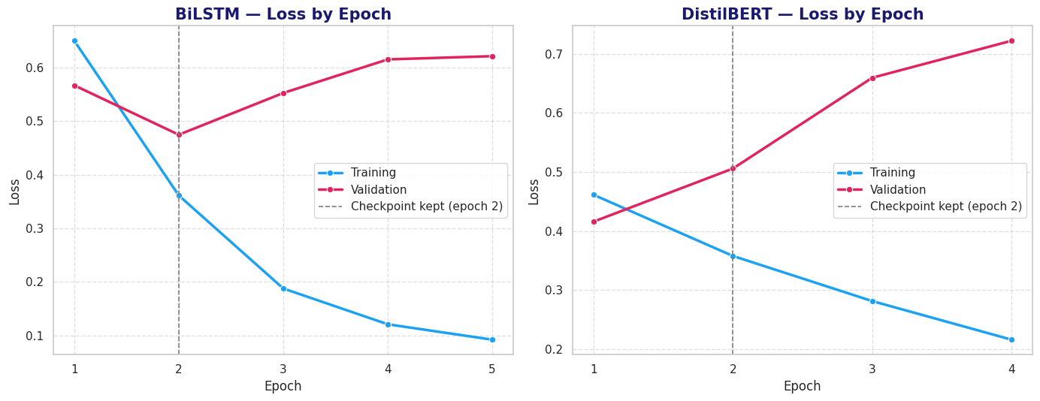
Deep Learning Training
0.8209
DistilBERT validation Accuracy
Best epoch 2 · F1 0.7785
0.7931
BiLSTM validation Accuracy
Best epoch 2 · validation loss 0.4744
Chosen by Accuracy
Not by loss alone — the primary metric decides
Training loss keeps falling
DistilBERT 0.46 → 0.22 over four epochs
Validation loss rises
0.42 → 0.72, so the best checkpoint is kept
Notes:
WHAT:
Both deep models learn quickly and then overfit.
Each peaked at epoch 2 and the best checkpoint was kept: BiLSTM validation Accuracy 0.7931, DistilBERT 0.8209 (F1 0.7785).
WHY:
Training loss kept falling while validation loss rose, which is the standard overfitting signal.
DistilBERT's training loss fell from 0.4615 to 0.2163 over four epochs while its validation loss rose from 0.4160 to 0.7222.
So stopping early and keeping the best state was necessary, not a precaution.
DistilBERT's best state was chosen by validation Accuracy, the project's primary metric, rather than by loss alone.
Its lowest validation loss came a little earlier (epoch 1), but Accuracy peaked at epoch 2.
HOW:
BiLSTM: tokenizer fitted on training text only, padded sequences, early stopping on validation loss, resumable checkpointing.
DistilBERT: pretrained tokenizer, maximum length 128, early stopping on validation Accuracy.
A full DistilBERT training run on CPU is slow, so the weights are saved to Hugging Face and the notebook reloads them in seconds.
IN PLAIN WORDS:
Overfitting is memorizing instead of learning.
Training loss keeps falling because the model is getting better at the tweets it has seen.
Validation loss rises because it is getting worse at tweets it has not seen.
The point where validation Accuracy is highest is where to stop, and that checkpoint is the one saved.
Why DistilBERT and not full BERT?:
DistilBERT is a smaller, faster version of BERT that keeps most of its language understanding.
It is far cheaper to train on a CPU and to serve in a dashboard, which suits a project of this size.
ALSO, IN THE NOTEBOOK (not shown on this slide):
Epoch-by-epoch tables for both models (BiLSTM training accuracy climbs from 0.6248 to 0.9719 while validation Accuracy falls to 0.7753), the checkpoint logic, and the note that DistilBERT's probabilities look somewhat over-confident on its mistakes, so the dashboard describes them as model scores, not calibrated probabilities.

Slide 13
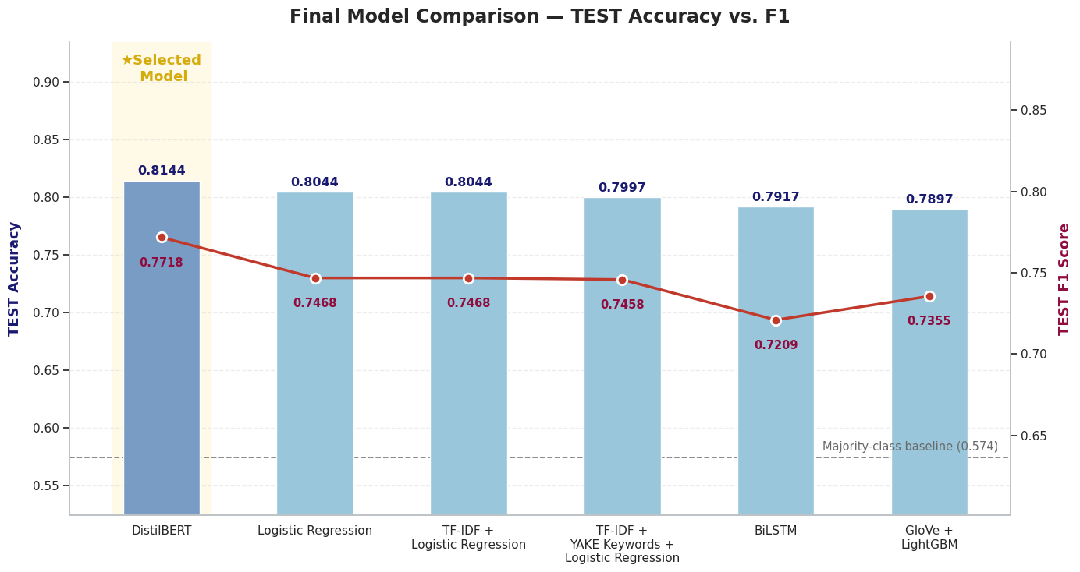
Test Results — The Leaderboard
0.8144
DistilBERT test Accuracy
F1 0.7718
+0.0100
Lead over Logistic Regression
About 15 of 1,498 tweets
0.574
Majority-class baseline
All six models clear it
Notes:
On the 1,498 held-out test tweets, DistilBERT is first on both the primary metric (Accuracy 0.8144) and the secondary one (F1 0.7718).
All six finalists are far above the 0.574 majority-class baseline.
Ranking by Accuracy: DistilBERT 0.8144; Logistic Regression 0.8044; TF-IDF + Logistic Regression 0.8044; TF-IDF + YAKE + Logistic Regression 0.7997; BiLSTM 0.7917; GloVe + LightGBM 0.7897.
Accuracy is the share of all tweets answered correctly.
F1 balances two questions: of the tweets called disasters, how many really were (Precision), and of the real disasters, how many were found (Recall).
The majority-class baseline of 0.574 is what you would score by always answering "not a disaster".
Is 81% good?:
It is well above the 57% baseline, and all six finalists land within about 1.5 points of each other.
That is a typical result for this noisy, short-text dataset.
ALSO, IN THE NOTEBOOK (not shown on this slide):
The full consolidated table: Precision DistilBERT 0.8103, Logistic Regression 0.8324, BiLSTM 0.8396 (highest); Recall 0.7367, 0.6771 and 0.6317; ROC AUC 0.8749 against 0.8618. Every finalist predicts fewer disaster tweets than the roughly 638 in the test set (480 to 580), meaning they are cautious rather than alarmist.

Slide 14
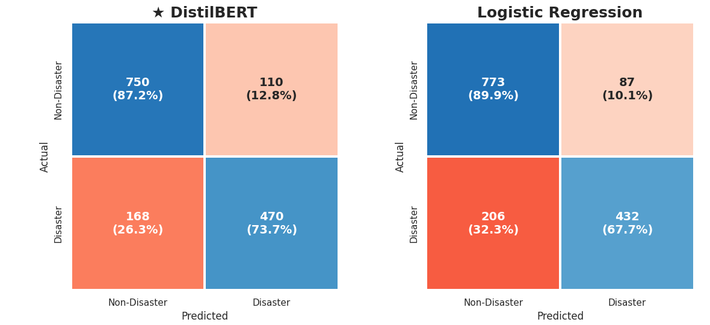
Beyond Accuracy
470 / 638
Disasters caught
73.7% · 168 missed
110
False alarms
vs 87 for Logistic Reg.
0.875
ROC AUC
Highest of six
0.863
DistilBERT (left) and Logistic Regression (right), from the notebook's test-set confusion matrices. Rows are the actual class, columns the predicted class; blue = correct, red = errors. All six matrices and the ROC and Precision-Recall curves are in the notebook.
Average Precision
Highest of six
Notes:
WHAT:
Accuracy alone hides the trade-off between missed disasters and false alarms.
The confusion matrices show it directly:
DistilBERT correctly identifies 470 of the 638 real disaster tweets (73.7%) and misses 168, the fewest of any finalist.
Logistic Regression finds 432 and misses 206.
WHY:
The gain has a cost.
DistilBERT raises 110 false alarms against 87 for Logistic Regression and 77 for the BiLSTM. Compared with Logistic Regression, it catches 38 more real disasters for 23 more false alarms.
For disaster monitoring, a missed event usually costs more than a false alert, which favours the higher-Recall model, although the extra false alarms add review work for a human.
HOW:
The slide shows the DistilBERT and Logistic Regression confusion matrices, the two being compared; the other four matrices and the ROC and Precision-Recall curves are in the notebook, and their key numbers are the cards.
ROC AUC does not depend on the 0.5 threshold, so it checks whether DistilBERT's edge is just a threshold effect: it has the highest AUC (0.875 against 0.862 for Logistic Regression and 0.852 for the BiLSTM) and the highest Average Precision (0.863 against 0.853).
Precision-Recall curves separate the models most in the high-recall region.
FIGURES NOT SHOWN ON THIS SLIDE (all in the notebook):
The notebook has all six, each with counts and row percentages (the share of each actual class). Tweets caught / missed / false alarms: DistilBERT 470 / 168 / 110; Logistic Regression 432 / 206 / 87; TF-IDF + Logistic Regression 432 / 206 / 87 (the same four counts as Logistic Regression); TF-IDF + YAKE + Logistic Regression 440 / 198 / 102; BiLSTM 403 / 235 / 77; GloVe + LightGBM 438 / 200 / 115. So DistilBERT misses the fewest real disasters, the BiLSTM raises the fewest false alarms but misses the most, and GloVe + LightGBM raises the most false alarms.
Every finalist misses more disasters than it falsely flags, meaning all of them are cautious rather than alarmist.
The ROC curves compare the six finalists across every possible threshold.
The ROC AUC values are DistilBERT 0.8749, Logistic Regression 0.8618, TF-IDF + Logistic Regression 0.8618, TF-IDF + YAKE + Logistic Regression 0.8568, GloVe + LightGBM 0.8535 and BiLSTM 0.8525.
The Precision-Recall curves show Precision falling as Recall rises, with a dotted no-skill baseline at 42.6% (the share of real disasters in the test set). DistilBERT's Average Precision is 0.863 against 0.853 for Logistic Regression, and the curves separate most in the high-recall region.
The Precision-Recall view is useful here because the classes are not balanced (42.6% disasters).

Slide 15
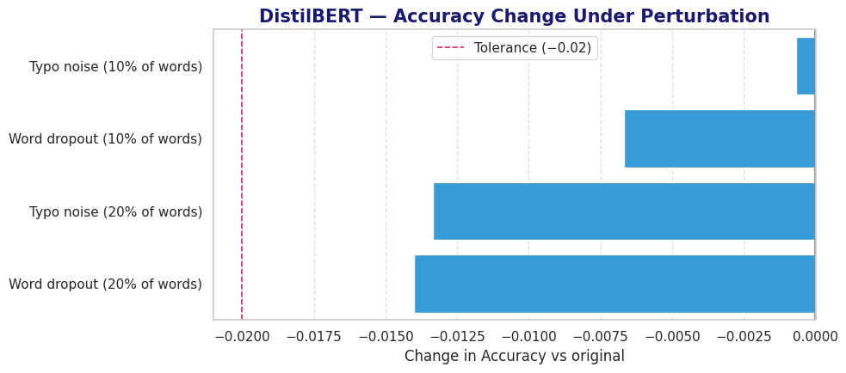
Recommendation & Trust
Recommended: DistilBERT
Metric | DistilBERT | Logistic Reg.
Test Accuracy | 0.8144 | 0.8044
Test F1 | 0.7718 | 0.7468
Recall (disasters found) | 73.7% | 67.7%
ROC AUC | 0.875 | 0.862
False alarms | 110 | 87
Finds 38 more real disasters for 23 more false alarms.
A missed event usually costs more than a false alert.
Noise test: Accuracy falls by at most 0.014, well inside the −0.02 tolerance.
Pass
Near-tie
Pass
Selection vs test gap
Every finalist within 0.01
Lead over Logistic Regression
95% interval [−0.005, +0.026]
Robustness to noisy text
Worst drop only 0.014
Notes:
Recommendation:
Use DistilBERT as the model behind the dashboard, and keep Logistic Regression on TF-IDF as a simple, lightweight alternative.
The slide pairs the recommendation with the three checks of whether the lead can be trusted.
Metrics (DistilBERT against Logistic Regression):
Test Accuracy 0.8144 against 0.8044; F1 0.7718 against 0.7468; Recall 73.7% against 67.7%; ROC AUC 0.875 against 0.862; false alarms 110 against 87.
DistilBERT finds 38 more of the 638 real disaster tweets for 23 more false alarms.
The three checks:
(1) Selection versus test: every finalist's test Accuracy is within 0.01 of its selection Accuracy, so selection did not overfit (Pass).
(2) Uncertainty: DistilBERT's Accuracy is 0.8144 with a 95% interval of [0.7937, 0.8344], and its lead over Logistic Regression has an interval of [-0.0053, +0.0260] that includes zero (Near-tie).
(3) Robustness: Accuracy falls by at most 0.014 under heavy noise (Pass).
The chart on the slide shows the Accuracy change under each noise setting against the tolerance line at -0.02.
The honest verdict is a near-tie, and the recommendation is worded to match.
DistilBERT is highest on Accuracy, F1, Recall, ROC AUC and Average Precision, and on the rule agreed in advance (highest test Accuracy, then F1) it wins.
It led in 90.8% of the paired resamples, which is suggestive but short of the conventional 95%, so the evidence that it is better than Logistic Regression on Accuracy is moderate, not conclusive. Reporting that is a strength.
The extra Recall is why DistilBERT is still preferred:
In a monitoring setting a missed event usually costs more than a false alarm.
The trade-offs: the Accuracy lead is small (+0.0100), it raises 23 more false alarms, and it is a larger model (about 268 MB, the size of the weights file on Hugging Face) that is slower to load.
If speed, size or cost matter more than the extra Recall, Logistic Regression is a reasonable choice: Accuracy 0.8044, 87 false alarms, and it runs almost instantly.
A bootstrap re-draws the 1,498 test tweets with replacement 2,000 times and recomputes the score each time.
The spread of those scores shows how much luck is in the number.
"Interval includes zero" means that on some resamples the other model is just as good or better, so the gap is not proven.
The noise test asks a different question: if some words are mistyped or missing, does the score collapse?
It does not; it drops by about one percentage point at most.
So is DistilBERT better or not?:
It is the highest-scoring model, and it catches more real disasters, but the Accuracy lead is not statistically conclusive.
The honest wording is "best on the agreed rule, near-tie with Logistic Regression on Accuracy".
ALSO, IN THE NOTEBOOK (not shown on this slide):
The two bootstrap charts: a histogram of DistilBERT's Accuracy across the 2,000 resamples (centered near 0.81 to 0.82, with the 95% interval marked at 0.7937 and 0.8344), and a histogram of the Accuracy difference against Logistic Regression, whose spread straddles the zero line (the lead is positive in 90.8% of resamples).
Also the selection-versus-test table for all six finalists with Consistent flags; the loss-curve table (the validation loss rise after the kept epoch: 0.1464 for BiLSTM and 0.2163 for DistilBERT); the validation verdict table (Pass, Near-tie, Pass); the reasoning for dropping two perturbations (uppercasing and hashtag removal) that would not have tested anything; the winner declaration; the final comparison chart and consolidated table; and the serialization of the final evaluation bundle that the dashboard reads.

Slide 16
Deployment Readiness
1.1%
Stress test: five hand-written sentences
Sentence | Disaster chance | Answer
The students dance performance rocked the atmosphere | 4% | Not a disaster
The mob flood the residency gates for the protest | 99% | Disaster (wrong)
She danced like a fire | 18% | Not a disaster
Wildfire spreading fast near the highway, evacuations ordered | 99% | Disaster
FATALITY! | 54% | Inside the "Not sure" band
Tweets in the "Not sure" band
17 of 1,498 score 45–55%
0.41
0.82
Accuracy inside
Accuracy outside
Why "Not sure"
Inside the band the model is close to guessing, so the dashboard says so instead of forcing a yes or no.
Known limitation
In the training tweets "fire" and "flood" mostly mean real events, so figures of speech can fool the model. A retrain on lightly cleaned text did not fix it.
Notes:
WHAT:
Before building the dashboard the model was checked on the kinds of messages real users will type. Two findings.
First, the "Not sure" band. Only 17 of 1,498 test tweets (1.1%) score between 45% and 55%.
Accuracy there is 0.4118, against 0.8190 outside it (1,481 tweets), so the dashboard shows "Not sure" instead of forcing a confident answer where the model is close to guessing.
This only changes how an answer is shown; the reported Accuracy is unchanged.
Second, a known limitation.
A stress test of five hand-written sentences showed that the model handles genuine reports and similes well ("Wildfire spreading fast near the highway, evacuations ordered" 99%, "She danced like a fire" 18%, "The students dance performance rocked the atmosphere" 4%) but calls "The mob flood the residency gates for the protest" a disaster (99%).
The one-word message "FATALITY!" scored 54%.
At the 0.5 cut-off that is a Disaster answer, but it falls inside the "Not sure" band, so the dashboard would show "Not sure" for it.
WHY:
In the training tweets, words such as "fire" and "flood" mostly appear in real reports, so the model learned them as signals.
It is a limit of the training data, not a deployment bug.
A trial tested whether removing common words was the cause: a second DistilBERT trained on lightly cleaned original text (keeping words like "on" and "the") reached validation Accuracy 0.8309 against 0.8209, a difference within the roughly 1.3 point noise of about 900 validation tweets, and it still called the mob sentence a disaster (92%).
It scored "FATALITY!" much lower (4% against 54%), but that is a single example.
So the trial was documented, not adopted: it did not remove the weakness, and adopting it would have meant re-running the whole evaluation.
IN PLAIN WORDS:
The "Not sure" band works like a referee saying "too close to call".
When the model gives 45% to 55%, it is right only about 41% of the time, which is worse than a coin flip on this data, so the dashboard declines to give a confident verdict.
HOW:
Band: tweets with a predicted disaster probability from 0.45 to 0.55, with Accuracy computed inside and outside it.
Stress test: five hand-written sentences run through the selected model, an illustration and not a score.
ALSO, IN THE NOTEBOOK (not shown on this slide):
The full trial table, saved model against trial model: "The students dance performance rocked the atmosphere" 4% to 6%, "The mob flood the residency gates for the protest" 99% to 92%, "She danced like a fire" 18% to 7%, "Wildfire spreading fast near the highway, evacuations ordered" 99% to 100%, and "FATALITY!" 54% to 4%.
Very short messages are easy to over-read, which is why the dashboard shows a warning for them.

Slide 17
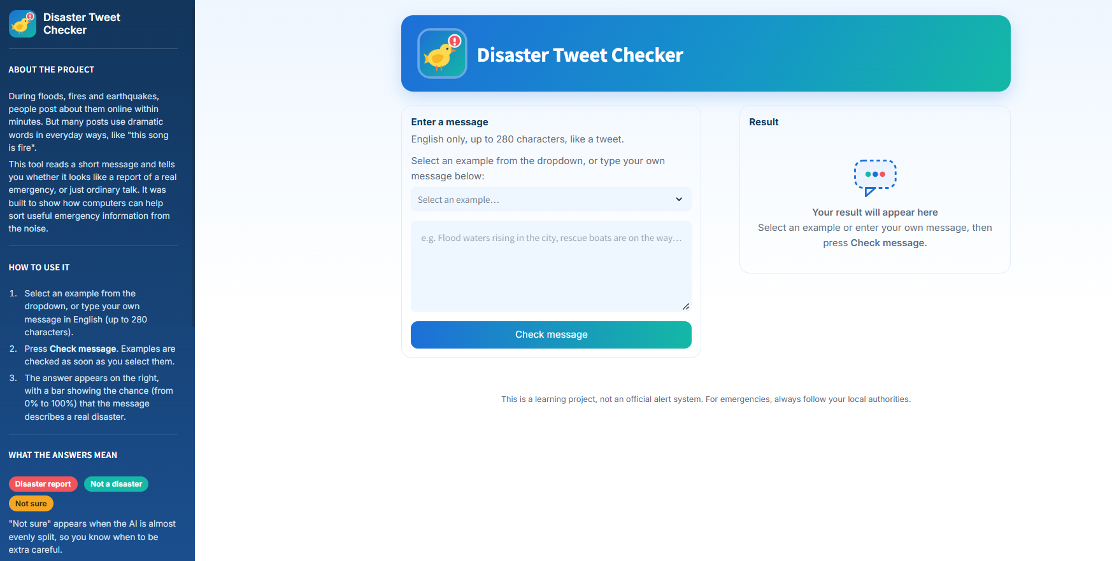
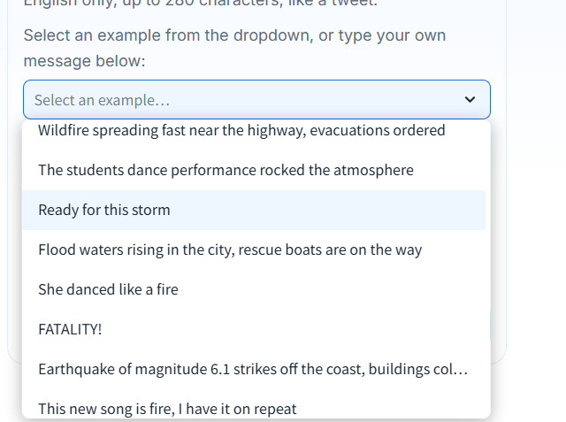
The Dashboard
Choose or type a message
Pick one of eight examples from the dropdown, or type up to 280 characters of English.
Three possible answers
Disaster report · Not a disaster · Not sure, with a likelihood bar.
Sidebar (left) explains the project and how reliable it is (about 81 in 100); the result appears on the right after a check.
Live dashboard: disaster-tweet-checker.streamlit.app
Notes:
The Streamlit dashboard:
Select one of eight examples from a dropdown, or type an English message of up to 280 characters, and it answers Disaster report, Not a disaster or Not sure, with a likelihood bar and a plain-language explanation.
WHY:
The audience in most cases is a non-technical person, so the page uses plain words.
The sidebar explains the project, how to use it, what the three answers mean and how reliable it is ("correct about 81 times out of 100"), including the limitation on figures of speech.
The dropdown lists only the sentences, not the expected answers, so the user chooses freely and sees the result for themselves.
HOW:
The dashboard loads the saved DistilBERT from the local folder or from Hugging Face, cleans the text with the same steps as the notebook, and reads the probability of the disaster class.
The "Not sure" band is 45% to 55%.
Selecting an example fills the box and runs the check at once; a typed message runs when the user presses Check message.
Built with Streamlit and CPU-only PyTorch.
ABOUT THE SCREENSHOTS:
Large image: the page before any check, so the result area still says "Your result will appear here".
Left: the sidebar with About the project, How to use it and What the answers mean.
Centre: the header, the message box and the Check message button, with the example dropdown above the box.
Small image: the dropdown opened, showing the eight examples with no hint of the answer.
The footer reminds users that this is a learning project and not an official alert system.
ALSO, ON THE DASHBOARD (not shown on this slide):
The "Recent checks" list of the last five messages with their percentages, the reliability warning shown for very short messages, and the lower part of the sidebar.

Slide 18
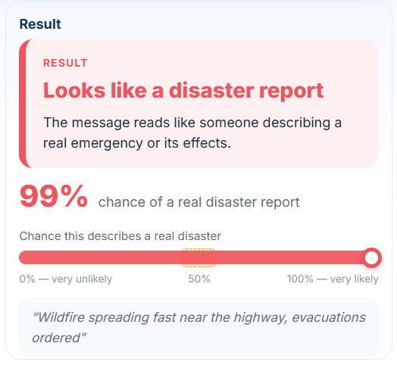
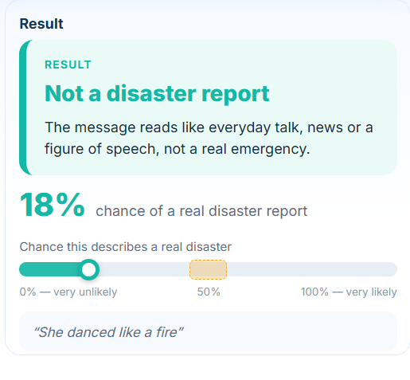
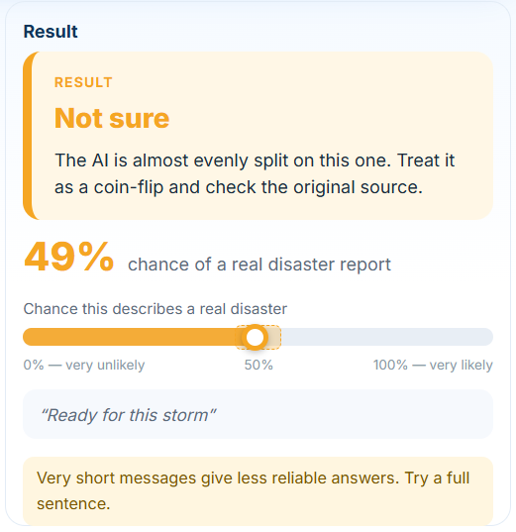
The Dashboard in Action
Disaster
Not a disaster
Not sure
99% · confident: a real emergency
18% · a figure of speech, recognized
49% · inside the 45–55% band
Notes:
Three examples picked from the dropdown show the three possible answers.
Disaster: "Wildfire spreading fast near the highway, evacuations ordered" gives 99% and "Looks like a disaster report".
Not a disaster: "She danced like a fire" gives 18% and "Not a disaster report".
Not sure: "Ready for this storm" gives 49% and "Not sure", with a message to treat it as a coin-flip and check the original source, plus a warning that very short messages are less reliable.
Each example tests something different: a genuine report, a figure of speech the model handles, and a short ambiguous message that lands in the 45% to 55% band.
The third is also honest about the limits.
The dropdown shows only the sentence, not the answer, so the user is not told what to expect.
HOW:
Select an example from the dropdown and the box fills and the check runs at once; or type your own message and press Check message.
The colour of the result card (red, teal, amber) matches the answer.
The screenshots show the Result panel; the selected sentence is repeated in the grey quote at its foot.
ALSO, ON THE DASHBOARD (not shown on this slide):
The dropdown holds eight examples.
Disaster: the wildfire sentence (99%), "Flood waters rising in the city, rescue boats are on the way" (99%) and "Earthquake of magnitude 6.1 strikes off the coast, buildings collapsed" (99%).
Not a disaster: "The students dance performance rocked the atmosphere" (4%), "She danced like a fire" (18%) and "This new song is fire, I have it on repeat" (9%).
Not sure: "Ready for this storm" (49%) and the one-word "FATALITY!" (54%).

Slide 19
Challenges & Key Learnings
1 · Duplicates hidden by an id
Challenge The id is unique, so a full-row check finds nothing.
Learning Define duplicates by content.
2 · A third of locations missing
Challenge 2,476 tweets had no location.
Learning Recover with NER; label the rest unknown.
3 · Sentiment on cleaned text
Challenge Cleaning strips the punctuation VADER reads.
Learning Score the raw text, then clean.
4 · Leakage into the test set
Challenge Fitting on all data would peek at test tweets.
Learning Split first; refit on training only.
5 · Overfitting after epoch 2
Challenge Both deep models got worse on validation.
Learning Keep the best checkpoint by Accuracy.
6 · Slow CPU training
Challenge The GPU failed, so DistilBERT trained on CPU.
Learning Save checkpoints everywhere; reload, never retrain.
7 · Context beats keywords
Challenge “The mob flood…” scored 99% as a disaster.
Learning Test, document and show the limit.
8 · A near-tie
Challenge The lead was only 0.0100 Accuracy.
Learning Bootstrap it; call it a near-tie.
Notes:
Eight real challenges from the project, each with what it taught us.:
1. Duplicates hidden by an id.
The id column is different on every row, so a check across all columns finds nothing.
The cleaning section checks on content in three passes (52 exact duplicates, 18 texts with conflicting labels, then remaining repeats).
The dataset went from 7,613 to 7,490 tweets, 123 rows removed.
Learning: define duplicates by content, and clean before modelling.
2. A third of the locations missing.
2,476 tweets (33.06%) have no location.
Instead of leaving them empty, the notebook runs named-entity recognition (spaCy) on the tweet text and keeps only place-type results that are short and clean (at most three words, plain ASCII, no symbols such as # @ /).
This recovered 412 real place names; 2,064 stay "unknown", and a location_source column records which is which.
Learning: recover what can be recovered, and be honest about the rest.
3. Sentiment on cleaned text.
The sentiment tool (VADER) partly relies on punctuation and capital letters for tone, and our cleaning removes both.
So sentiment is scored on the raw tweet before cleaning, and the original text column is kept for that reason.
Learning: the order of steps changes the feature. Honest note: the notebook explains this choice but does not measure how different the scores would have been, so do not quote a number.
4. Leakage into the test set.
If vectorizers or encoders are fitted on all the data, the test tweets quietly influence the features.
The notebook splits first, refits every vectorizer and embedding on the training data only, drops id and the label columns from the features, and fits the categorical encoders on training only. Learning: split first, fit later.
5. Overfitting after epoch 2.
The BiLSTM's best epoch is also its lowest validation loss (0.4744), and its loss then rises.
DistilBERT's validation loss goes 0.4160 (epoch 1), 0.5059 (epoch 2, the kept checkpoint), 0.6596 (epoch 3), 0.7222 (epoch 4).).
Learning: keep the best checkpoint by the primary metric (Accuracy), not the last epoch.
6. Slow CPU training.
The Colab GPU failed to initialise, so the notebook has a FORCE_CPU switch and DistilBERT trained on the CPU (batch size 8, no FP16).
The wait was long, and the model had to be saved properly once it finished.
Training now saves checkpoints, resumes from the last one if interrupted, backs the model up to Hugging Face when a token is available, and every later step reloads saved artifacts through the Local, Drive, GitHub cascade instead of retraining.
Result: the notebook can be rerun in seconds on CPU or GPU, and the saved model is what the dashboard loads.
Learning: persist everything expensive, then reload.
7. Context beats keywords.
The most frequent bigram in the non-disaster class is "body bag", so disaster words alone do not decide the label. In the stress test, "The mob flood the residency gates for the protest" scores 99% as a disaster, while "She danced like a fire" (18%) and the students dance sentence (4%) are handled correctly.
Learning: it is a limit of the training data, so test it, document it and show it.
8. A near-tie.
DistilBERT's Accuracy lead over the runner-up is 0.0100 (about 15 of 1,498 test tweets).
The bootstrap interval for that lead is [-0.0053, +0.0260], which includes zero.
Learning: do not oversell a small lead; report the interval, and say the choice also rests on the other metrics and the cost of errors.

Slide 20
Conclusion & Future Scope
Conclusion
Future Scope
DistilBERT 81.44% · F1 0.7718
Handle figures of speech
Add labelled figurative examples (new data); re-test
Docker & an API
Package the app in a container; serve it through an API
Six model families compared on the same unseen tweets.
The winner is validated: consistent, stable under noise, but only a near-tie over a simple baseline.
The dashboard says "Not sure" where the model is close to guessing.
A documented weakness remains: figures of speech.
Live monitoring
Feed live posts and alert response teams
Batch upload & map view
Check a CSV of tweets; plot reports by place
Retrain & monitor
Refresh with new events; track drift over time
More languages
A multilingual model and labelled tweets
Notes:
Conclusion:
DistilBERT is the best-performing model (test Accuracy 0.8144, F1 0.7718), by a margin small enough that Logistic Regression remains a reasonable alternative, with a documented weakness on figurative language.
Six model families were compared on the same held-out tweets, the winner was validated, and the dashboard says "Not sure" where the model is close to guessing.
Future scope :
1. Handle figures of speech. Fixing this properly means adding labelled figurative examples to the training data. That is new data and outside this project's scope, so the project tests the weakness, documents it, shows it on the dashboard and lists it as future work. If added, the extra data must be clearly disclosed and the model re-tested on the same untouched test set.
2. Docker and an API. The dashboard is deployed on Streamlit with the model weights on Hugging Face. A next step is to package the dashboard and model in a Docker container, so it runs the same on any server, and to expose the model through a REST API so other systems can call it without the dashboard.
3. Live monitoring (business use). Connect the model to a live stream of public posts and alert an emergency-response or news team when disaster-like reports rise. This needs a data feed and an agreed alert rule, and the model's "Not sure" band would route uncertain posts to a human reviewer.
4. Batch upload and map view. Upload a CSV of many messages at once and get a result for each. Where a place is available (the notebook recovers place names from the text), plot the reports on a map so responders see where messages cluster.
5. Retrain and monitor. Language and events change, so the model should be refreshed with new labelled events and checked over time for drift, comparing fresh results with today's test results (Accuracy 0.8144). Refreshing is also the natural point to re-check the near-tie with several training seeds.
6. More languages. The dashboard and model are English only; a multilingual model and multilingual labelled tweets would extend coverage to other regions.
Smaller dashboard idea: the one-word message "FATALITY!" scored 54%, inside the "Not sure" band, so single words are easy to over-read. A minimum-length warning would help.

Slide 21
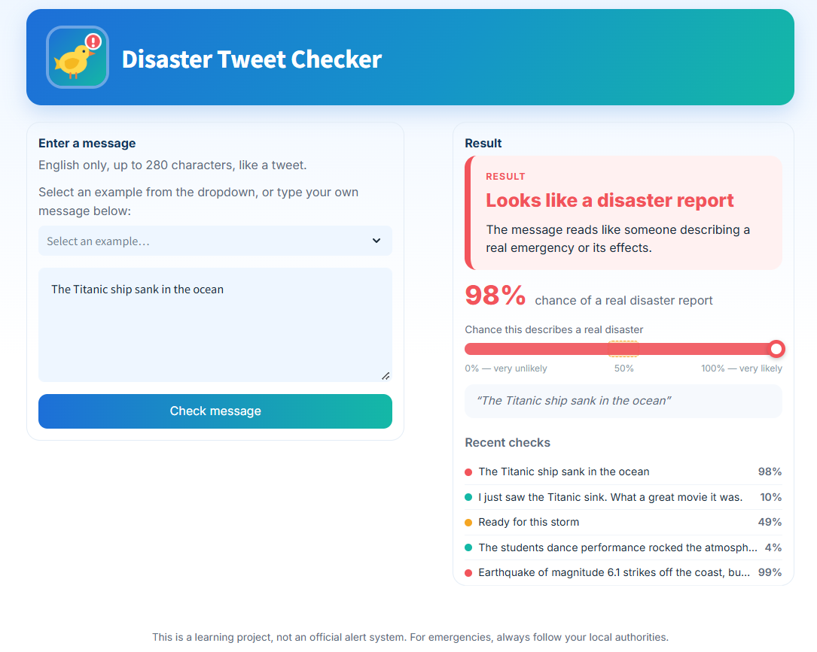
References & Appendix
Links
GitHub https://github.com/S-Yousuf-S/NHIS_Project7
Live dashboard https://disaster-tweet-checker.streamlit.app/
Hugging Face https://huggingface.co/ysakkaf/nhis-project7-distilbert
Dataset twitter_disaster.csv, 7,613 tweets, from the project brief
References
GeeksforGeeks. DistilBERT in Natural Language Processing.
Hutto & Gilbert (2014). VADER: a rule-based sentiment model.
Campos et al. (2020). YAKE! Keyword extraction.
Jain, A. Text Classification in NLP. Medium.
A message typed by the user, with the “Recent checks” list
THANK YOU
Disaster Tweet Classification · Yousuf S. R. Sakkaf
22
Notes:
The links are clickable:
GitHub (github.com/S-Yousuf-S/NHIS_Project7: notebook, shared utility module, dashboard, requirements files and README), the live dashboard (disaster-tweet-checker.streamlit.app) and the model weights on Hugging Face (ysakkaf/nhis-project7-distilbert, the selected model).
A second repository, ysakkaf/nhis-project7-distilbert-raw, holds the trial model that was documented but not adopted.
The dataset is twitter_disaster.csv (7,613 tweets), supplied with the project brief.
References (four, two with links): the GeeksforGeeks article on DistilBERT in NLP, which explains the model the project fine-tunes; Hutto and Gilbert (2014) for VADER, the sentiment scores; Campos et al. (2020) for YAKE, the keyword extraction; and Abhishek Jain, "Text Classification in NLP", on Medium, a general guide to text classification.
APPENDIX SCREENSHOT: A MESSAGE TYPED BY THE USER
Instead of choosing an example, the user typed "The Titanic ship sank in the ocean", which scores 98% and "Looks like a disaster report". The "Recent checks" list below the result keeps the last five messages with a coloured dot (red disaster, teal not a disaster, amber not sure) and the percentage: the Titanic sentence 98%, "I just saw the Titanic sink. What a great movie it was." 10%, "Ready for this storm" 49%, the students' dance performance 4% and the earthquake example 99%.
The pair shows what the model actually reads. It judges the words in the message, not whether an event is happening now; a historical event written like news scores as a disaster, and the same event framed as a comment on a film scores low. It is two sentences, not a test, and should not be read as more than an illustration.
Licences: the project's code is MIT; DistilBERT is Apache 2.0; the pretrained GloVe Twitter vectors used in one experiment are published for public use. Tweets belong to their original authors.
Thank you.

