Slide 1
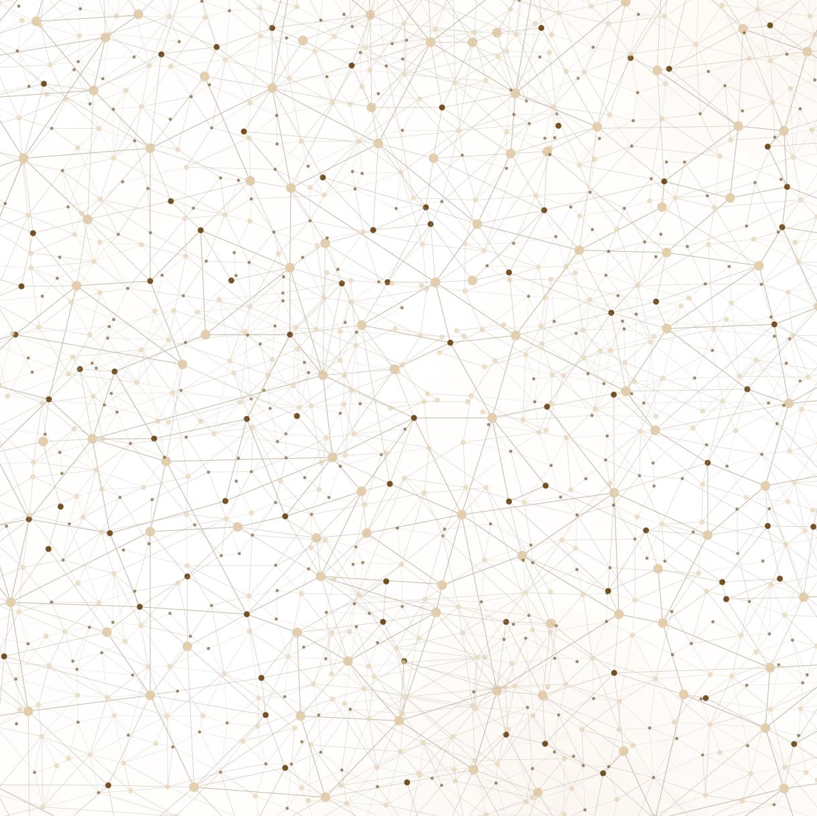
Automated Glaucoma Detection using U-Net Model
BY
Shazaib
Arham
Jamal

Slide 2
Introduction to Glaucoma
1. Glaucoma is a progressive eye disease characterized by damage to the optic nerve, often leading to irreversible vision loss if left untreated.
2. Despite being the second leading cause of blindness globally, early detection remains challenging due to the absence of noticeable symptoms in the early stages.
3. The lack of symptoms emphasizes the critical need for automated systems that can detect glaucoma early, enabling timely intervention and preventing vision loss.

Slide 3
Project Objectives
Develop an automated glaucoma detection system leveraging deep learning techniques to enhance early diagnosis.
Specifically, focus on segmenting the optic disc and cup regions from retinal fundus images, as these are crucial indicators for glaucoma diagnosis.
Aim to improve efficiency and objectivity in glaucoma detection, reducing reliance on subjective visual assessments by ophthalmologists.

Slide 4
Methodology Overview
Utilize the U-Net architecture, a convolutional neural network (CNN) known for its effectiveness in biomedical image segmentation.
Data preprocessing involves resizing and normalization of images, along with augmentation techniques to increase the diversity of training data and improve model generalization.
Model training and evaluation include compiling the model with custom loss functions and metrics, training with early stopping to prevent overfitting, and evaluating performance using accuracy and sensitivity metrics.

Slide 5
U-Net Model Architecture
U-Net is a fully convolutional network consisting of an encoder-decoder architecture with skip connections.
The encoder extracts features from the input images, while the decoder upsamples these features to generate segmentation masks.
Skip connections help preserve spatial information during upsampling, facilitating accurate segmentation.

Slide 6
Data Preprocessing and Augmentation
Data preprocessing involves resizing images to a standard size and normalization to ensure consistency across the dataset.
Augmentation techniques such as random brightness/hue adjustment, flipping, and rotation are applied to increase the variability of training data and improve model robustness.

Slide 7
Model Training and Evaluation
Model training involves compiling the U-Net model with appropriate loss functions and optimizers, followed by training on the labeled dataset.
Evaluation metrics include accuracy, sensitivity, and specificity, as well as performance measures specific to glaucoma detection such as Cup-to-Disc Ratio (CDR) calculation.

Slide 8
Key Findings
Segmentation Performance:
The developed U-Net model achieved segmentation accuracy and sensitivity within the specified project requirements, with accuracy ranging between 90-95% and sensitivity between 80-90%.
Accurate segmentation of the optic disc and cup regions is essential for calculating the Cup-to-Disc Ratio (CDR), a vital parameter for glaucoma diagnosis.
Cup-to-Disc Ratio (CDR) Calculation:
The algorithm successfully calculated the Cup-to-Disc Ratio (CDR) from segmented optic disc and cup regions, providing a quantitative measure for glaucoma diagnosis.
CDR calculation accuracy is crucial for identifying abnormalities indicative of glaucoma progression, enabling early intervention and treatment.

Slide 9
Impact of The Project
Impact on Clinical Practice:
The developed automated glaucoma detection system has the potential to significantly impact clinical practice by improving efficiency and accuracy in glaucoma diagnosis.
Automation reduces reliance on subjective visual assessments by ophthalmologists, leading to more consistent and objective diagnoses.
Early Diagnosis and Patient Outcomes:
Early detection of glaucoma through automated systems allows for timely intervention and treatment, ultimately improving patient outcomes and quality of life.
By facilitating early diagnosis, the system helps prevent irreversible vision loss and reduces the burden on healthcare systems.

Slide 10
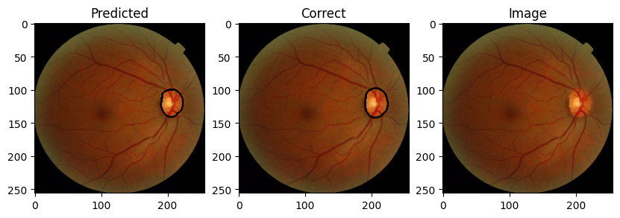
Overview of outputs

Slide 11
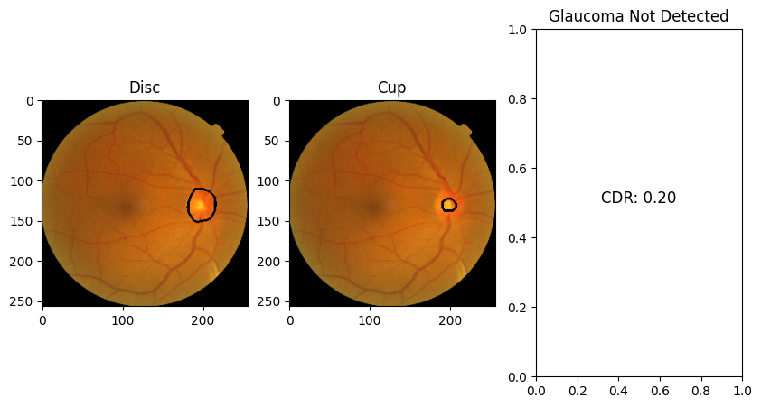
Overview of outputs

Slide 12
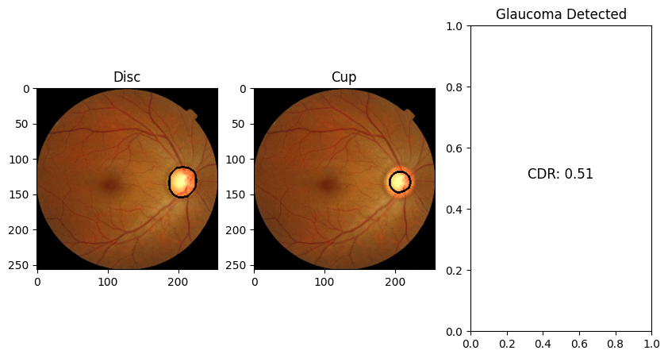
Overview of outputs

Slide 13
Conclusion
Project Contributions:
The project has made significant contributions to the field of automated glaucoma detection by developing a robust U-Net model for optic disc and cup segmentation.
Achieving segmentation accuracy and sensitivity within specified ranges demonstrates the effectiveness of the developed system in accurately identifying glaucomatous changes in retinal images.
Impact on Healthcare:
The automated glaucoma detection system has the potential to revolutionize clinical practice by enhancing early diagnosis and improving patient outcomes.
By providing objective and consistent assessments, the system reduces diagnostic variability among healthcare professionals, leading to more reliable treatment decisions.

Slide 14
Future Directions
Model Refinement:
Continued refinement of the U-Net model architecture will be pursued to enhance segmentation performance and generalization to diverse retinal images.
Exploration of advanced deep learning techniques and algorithms may further improve the system's ability to detect subtle glaucomatous changes.
Clinical Integration:
Efforts will be made to integrate the automated glaucoma detection system into existing clinical workflows, allowing for seamless integration into routine eye examinations.
Collaboration with healthcare professionals and ophthalmologists will be essential to validate the system's efficacy and ensure compatibility with existing diagnostic protocols.

Slide 15

ANY QUESTIONS?

