Slide 1

CATERPILLAR HACKATHON · SMART OPERATOR ASSISTANT
ARC
CAT MACHINE
The intelligent operator companion for CAT machinery
thousands of signals
Sense less. Understand more. Operate better.
ARC
From thousands of machine signals to the one thing that matters right now.
Predict
Prioritize
Assist
Learn
OPERATOR
One action
SUPERVISOR
Full visibility
Notes:
ARC stands for Attention & Risk Compression. One idea: the machine should understand more so the operator has to deal with less. Thousands of signals go in; the operator gets the one thing that matters, and the supervisor still sees everything.

Slide 2





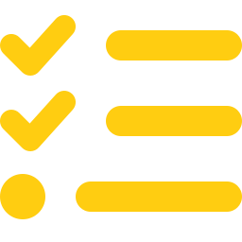
01 · THE PROBLEM
Machines are getting smarter.
Operators are still overloaded.
Every machine continuously reports on…
Every 30 seconds
~30 machine signals per machine
Safety
Machine health
Operator behaviour
Multiple alerts, all competing
Productivity
Environment
Task progress
Operator must decide: “What matters NOW?”
The problem isn't lack of information. It's deciding what deserves the operator's attention.
ARC
02
Notes:
Modern machines already report on safety, health, behaviour, productivity, environment and task progress. The usual answer is another alert or another dashboard. But every alert competes for the same attention while the operator is controlling a 20-tonne machine. The real problem is deciding what deserves attention right now.

Slide 3
02 · OUR SOLUTION
ARC: a decision layer between the machine and the operator
INSTEAD OF
Sensor
Alert
Operator
ARC DOES
Machine
telemetry
Understand
context
Predict risk &
task outcomes
Personalize
to operator
ARBITRATE
What should the
operator see?
ARC doesn't maximize alerts.
Nothing
One action
STOP
It minimizes unnecessary interruption.
Silent
Assist
Intervene
Act or log quietly
One plain-language line
Unmissable, must acknowledge
Principle: everything is recorded — only what matters reaches the operator.
ARC
03
Notes:
Instead of wiring each sensor to its own alert, ARC puts one decision layer in between. It understands context, predicts risk and task outcomes, personalises to the operator, and then arbitrates: nothing, one action, or STOP. The key principle: everything is recorded, only what matters is shown.

Slide 4


03 · WHAT MAKES ARC DIFFERENT
We don't just detect events.
We decide what to do about them.
CONVENTIONAL APPROACH
ARC
More alerts
Fewer, prioritized interventions
Machine understands the complexity.
Fixed thresholds
Context + ML + personal baseline
Same warnings for everyone
Personalized assistance
Prediction ends at the alert
Prediction → action → feedback
Operator gets the simplicity.
Dashboard-heavy
Operator-first
Alerts compete for attention
At most one important intervention
Historical analytics
Closed-loop learning
ARC
04
Notes:
This is where we differ. Conventional systems add alerts with fixed thresholds, the same for everyone, and stop at the alert. ARC prioritises, uses context plus ML plus a personal baseline, personalises delivery, and closes the loop by checking whether each intervention worked.

Slide 5
04 · HOW ARC THINKS
From raw telemetry to one operator decision
Risk model
Silent
XGBoost + SHAP
ARBITRATION
ENGINE
26 context
features
Task model
Assist
Quantile gradient boosting
rules + ML
Machine
telemetry
STOP
Fatigue
Controls
Personal baseline
Proximity
Seatbelt
Operator digital twin
Terrain
Machine
Environment
Personal deviation
Same feature code in training and live: the model never sees data computed differently from how it learned.
ARC
05
Notes:
Every 30 seconds per machine: raw telemetry becomes 26 engineered features over 5- and 10-minute windows (fatigue, controls, proximity, seatbelt, terrain, machine, environment, personal deviation). Three models read them, and the Arbitration Engine combines rules and ML into one decision.

Slide 6



05 · THE INTELLIGENCE LAYER
Three models. Three questions.
01
02
03
Risk trajectory
Task intelligence
Personal baseline
XGBoost + SHAP
Quantile gradient boosting
Operator digital twin
“Will an unsafe event happen in the next 15 minutes?”
“How long will this task really take?”
“Is this unusual for THIS operator?”
OUTPUT
OUTPUT
OUTPUT
Risk probability 0 → 1
+ the signals driving it
10th / 50th / 90th percentile
→ delay probability
Personal z-score vs
their own normal
ARC
06
Notes:
Risk model: XGBoost predicting an unsafe event in the next 15 minutes, with SHAP values explaining which signals pushed risk up. Task model: three gradient-boosting quantile models giving a likely time and a range, from which we compute delay probability. Personal baseline: each operator's own normal for jerk, cycle time and idling, so we flag deviation from them, not from a fleet average.

Slide 7
06 · THE HEART OF ARC
The Arbitration Engine
TIER 5
Intervene now
STOP: full screen, audio, must acknowledge
ROUTING · FIRST MATCH WINS
1
Hard safety rule, or risk ≥ 0.85
T5
TIER 4
Act now
One plain-language action card
2
Risk ≥ operator's own threshold
T4
TIER 3
Be aware
Ambient colour indicator, no words
3
Task very likely to overrun
T4
4
Checklist mismatch / inefficiency
T2
TIER 2
Supervisor decision
Logged for the supervisor, no interruption
5
Deviation from personal baseline
T3
TIER 1
Handle silently
Automatic action, logged
6
Otherwise
T1
Hundreds of signals in.
At most ONE thing out.
ARC
07
Notes:
This is the heart of ARC. Every tick, every machine, the engine picks one of five tiers. Routing is readable: hard safety rules and the 0.85 hard floor first, then the operator's personal soft threshold, then task delay, then supervisor-only issues, then personal deviation. A gate on top enforces one card at a time, cooldowns, and holds non-safety messages when the operator's attention budget is low.

Slide 8

07 · EXAMPLE
Same situation. Two very different systems.
CONVENTIONAL SYSTEM
ARC
Rain detected
Person approaching → risk increasing
Visibility low
CREW AREA CLOSE.
SLOW TO WALKING PACE.
Control jerk high
if the situation escalates · risk > 0.85 hard floor
Task delayed
STOP
Person nearby
Rain, visibility, jerk and task delay are still logged for the supervisor.
Five alerts. Which one matters?
ARC
08
Notes:
Same moment, two systems. A conventional HUD fires five alerts at once. ARC combines them: the risk model sees the person approaching plus the rain plus rougher controls, so the operator gets one action. If it escalates past the 0.85 hard floor, STOP. Nothing else is lost: it's all in the supervisor log.

Slide 9

08 · THE DUAL FEEDBACK LOOP
ARC learns whether its assistance worked
Detect
LOOP 1 · Did it work? (from telemetry)
LOOP 2 · Did they understand? (ack / dismiss / “why”)
Calibrate future assistance
Intervene
Effective
Partial
Corrected + returned to baseline
Only one of the two achieved
Measure effectiveness
Observe next 5 min
Ineffective
Ignored
Acknowledged, but behaviour didn't change
No acknowledgement, no correction
Did operator understand?
Did behaviour improve?
ARC
09
Notes:
Prediction is not the finish line. Every shown message is followed for 5 minutes of machine time. Loop 1 reads telemetry: did the operator stop, slow down, buckle up, and did the risk return to their baseline? Loop 2 reads the HUD: did they acknowledge, dismiss, or open 'why'? Each message gets one of four labels, and that feeds calibration.

Slide 10

09 · PERSONALIZATION
The same warning doesn't work equally well for everyone
OPERATOR A · Op. Alvarez
OPERATOR B · Op. Dube
WHAT CAN MOVE
Hard floor
0.85
Fast & confident
Low trust, often dismisses
62%
0%
26 s
43%
55%
120 s
effective
ignored
to react
effective
acknowledged
to react
0
1
Personal threshold
0.35 – 0.65
ARC LEARNS
ARC LEARNS
“Visual nudges work — nudge earlier and quieter.”
“Speak less often, but use stronger audio.”
Calibration tunes when and how ARC nudges. The tier-5 safety floor never moves.
Threshold 0.35 · visual only
Threshold 0.65 · visual + audio
ARC adapts the delivery — not the safety floor.
ARC
10
Notes:
Real numbers from our two-week history. Operator A acts on nudges, so ARC nudges earlier and quieter: threshold 0.35, visual only. Operator B ignores or dismisses a lot, so ARC speaks less often but louder: threshold 0.65 with audio. Architecturally a contextual bandit, implemented as transparent rules with every change logged. The tier-5 floor at 0.85 can never be calibrated.

Slide 11
10 · RESULTS
Does ARC actually work?
Performance on our synthetic benchmark, evaluated on shifts the models never saw.
0.72
0.30
7.8 min
61%
ROC-AUC
PR-AUC
Task prediction error
Unsafe events warned
Risk-trajectory model on unseen shifts
vs an 8.5% unsafe-event base rate (≈3.5× random)
vs 12.7 min for the planner's own estimates
in the 15 min before · median lead 4.5 min
Synthetic benchmark: 6 machines, 8 operators, 12 shifts (69,120 telemetry ticks); held-out shifts S10–S12. Not field-validated on Caterpillar data.
ARC
11
Notes:
Honest numbers. Risk model: ROC-AUC 0.72 and PR-AUC 0.30 against an 8.5% base rate, about 3.5 times better than random at finding risky moments. Task model: 7.8 minutes average error versus 12.7 for the planner. And 61% of real unsafe events had an ARC warning in the preceding 15 minutes, median 4.5 minutes ahead. All synthetic and held-out; not field-validated.

Slide 12
11 · TASK INTELLIGENCE
ARC predicts task time better than the plan
38.6%
lower average error than the planner baseline
(12.7 − 7.8) ÷ 12.7
Every prediction also carries a 10–90% range, and a delay probability that feeds the foreman trade-off.
Synthetic benchmark
ARC
12
Notes:
On held-out shifts the task model's average error is 7.8 minutes versus 12.7 for the planner: 38.6% lower. It also gives a range, not just a point, and a probability of a material overrun, which drives the foreman trade-off.

Slide 13
12 · EARLY WARNING
ARC detects risk before the event
ARC warning
Unsafe event
61%
of unsafe events had a preceding ARC tier-4/5 warning
4.5 min
median warning lead time
time
median lead 4.5 min
Definition: a tier-4/5 message actually shown in the 15 minutes before a real (synthetic) unsafe event. Illustrative timeline.
ARC
13
Notes:
Early warning means: for each real unsafe event in the data, was a tier-4 or tier-5 message shown to the operator in the 15 minutes before? 61% of the time yes, with a median lead of 4.5 minutes. That's the difference between a reactive alarm and a predictive assistant.

Slide 14
13 · INFORMATION COMPRESSION
ARC reduces interruptions without hiding data
69,120
telemetry ticks evaluated
2,541
events logged for the supervisor
456
tier-4/5 messages shown to operators
≈ 6 per 8-hour machine-shift
~82% of logged events never became an operator interruption — and none of them were discarded.
ARC
14
Notes:
This is the core idea in one picture. Across 72 machine-shifts ARC evaluated 69,120 ticks, logged 2,541 events for the supervisor, and interrupted operators only 456 times: about six per shift. Roughly 82% of logged events never became an interruption, but they were all kept. 'Held' tier-4s are cards the one-at-a-time rule deferred; they're still in the log.

Slide 15

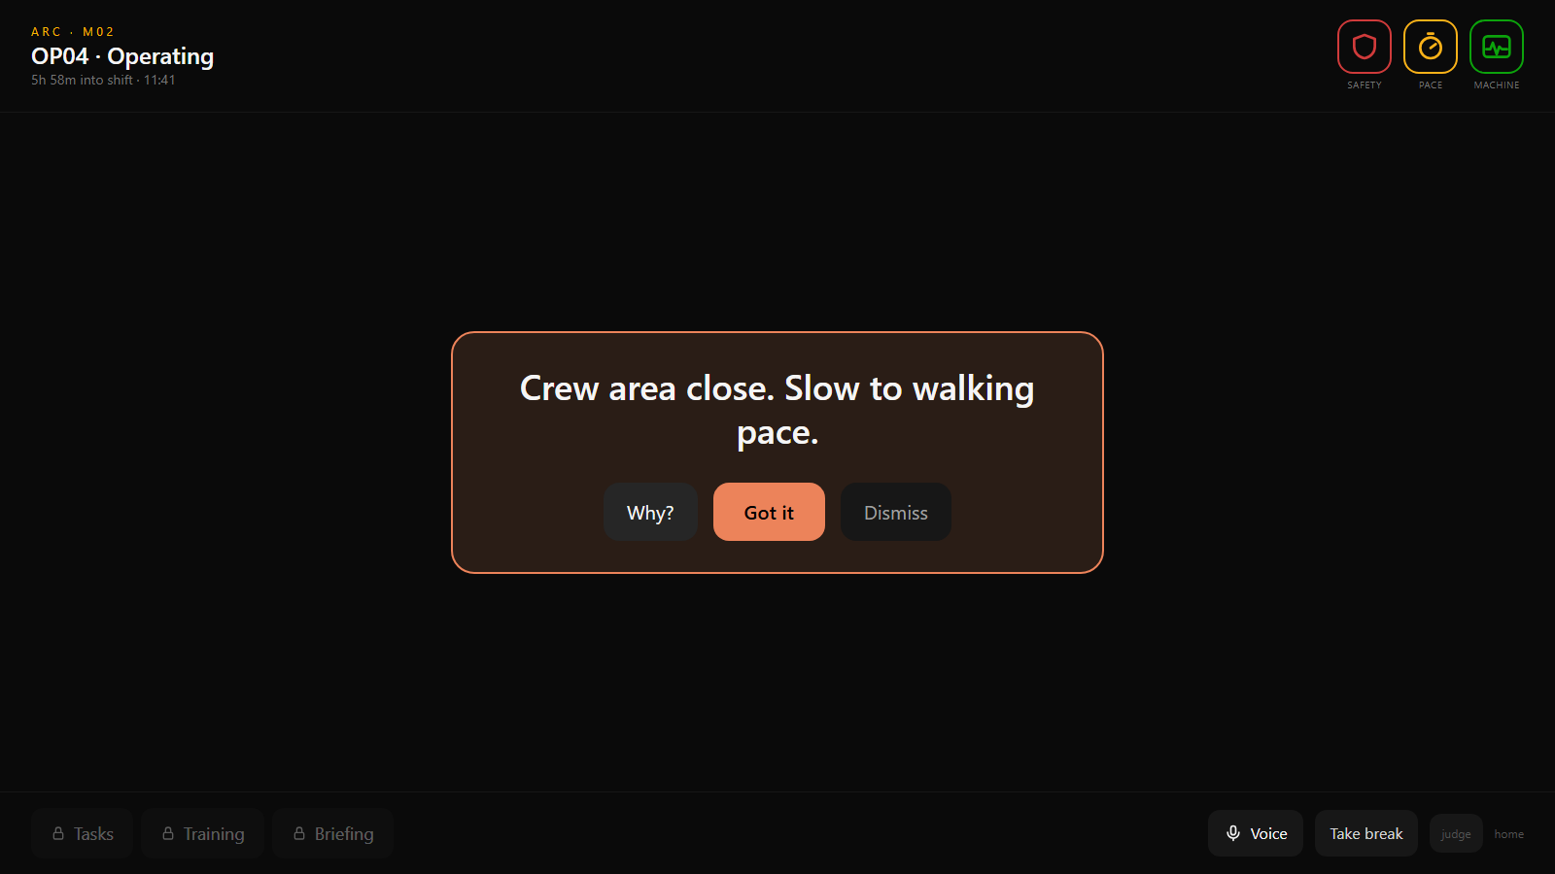
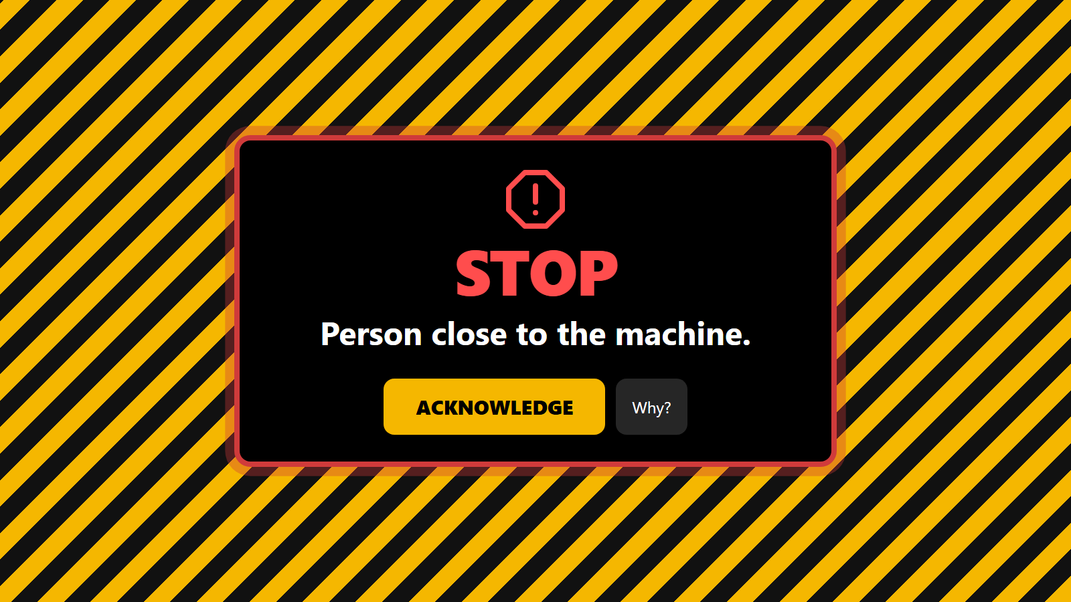
14 · THE OPERATOR EXPERIENCE
What the operator actually sees
Normal
Important
Critical
Three colour-only icons. Nothing else.
One plain-language action.
STOP. Must be acknowledged.
The operator doesn't need to understand the model. They only need to understand the action.
ARC
15
Notes:
These are real screenshots from our running prototype. Most of the time the operator sees three colour icons and a clock. When something matters: one plain-language action, with 'why' available on request. When it's critical: STOP, audio, and it can only be acknowledged. Tasks, training and briefing are locked while the machine is operating.

Slide 16
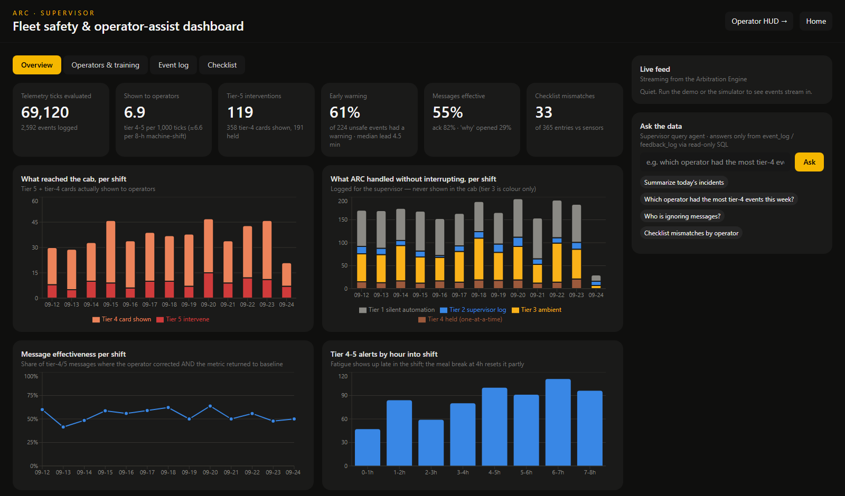
15 · SUPERVISOR EXPERIENCE
What ARC spares the operator, it shows the supervisor
OPERATOR
SUPERVISOR
Simple
Complete
Current state
Risk trajectory
One intervention
SHAP explanations
Ambient safety
Full event history
Break screens
Held alerts
Training
Operator response
Voice commands
Calibration
Training gaps
Task prediction
Checklist mismatches
ARC
16
Notes:
Everything the operator was spared lands here: two weeks of events, what reached the cab versus what ARC handled silently, early-warning rate, per-operator comprehension and calibration history, training gaps, checklist mismatches, and a natural-language query agent grounded in the logs through read-only SQL.

Slide 17
16 · LIVE DEMO
One 90-second story
01
Normal
Late shift, digging. All green.
02
Environment changes
Rain starts, visibility drops.
Tier 4 card
STOP
03
Risk builds
Approaching crew area, object closing, rougher controls.
04
ARC assists
“Crew area close. Slow to walking pace.”
05
Risk escalates
Crosses the 0.85 hard floor.
06
STOP
Everything else waits. Must be acknowledged.
07
ARC measures
Machine stops, person clears, risk falls.
08
ARC learns
Effective? How fast? Understood?
ARC
17
Notes:
The live demo on machine M02 with operator OP04, who tends to dismiss nudges, so ARC has them on fewer-but-louder settings. The chart is the real risk score from our demo run: flat and calm, then the rain and the approaching object push it past OP04's 0.65 threshold (card with audio) and then past the 0.85 hard floor (STOP). After acknowledgement the machine stops, risk decays, and both feedback loops are scored.

Slide 18

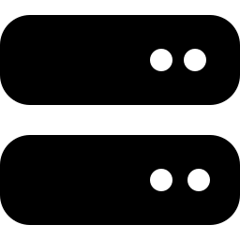



17 · TECHNOLOGY
Built as an end-to-end intelligence system
Intelligence
Backend
Frontend
AI agents
Simulation
Python
XGBoost + SHAP
Gradient boosting (quantile)
Statistical baselines
FastAPI
WebSockets
SQLite
One engine for live + history
React + Tailwind
Operator HUD
Supervisor dashboard
Voice + pre-recorded audio
Google Gemini
In-cab “why” (2 sentences)
Stationary-only briefing
Supervisor SQL query
Synthetic telemetry
Historical replay
Scripted live demo
LLMs explain and guide — they never make safety-critical decisions.
ARC
18
Notes:
Python ML stack, FastAPI with WebSockets, React. Google Gemini powers three narrow agents: an in-cab explainer capped at two sentences, a briefing guide only available when the machine is stationary, and a supervisor query agent that answers only from read-only SQL. Every decision that affects safety comes from the models and rules, never from the LLM.

Slide 19



18 · FEASIBILITY
Designed for real deployment, not just a demo
Model-agnostic
Explainable
Consumes standard telemetry fields; swap synthetic data for real machine feeds without changing the engine.
Risk → SHAP reasons → fixed message → action. Every decision is logged with its reason.
Safety-first
Closed-loop
Hard safety rules and a 0.85 floor override learned behaviour and can't be calibrated away.
Measures whether each intervention worked and was understood, then adapts per operator.
Synthetic data today → real CAT telemetry tomorrow.
Not yet validated in the field.
ARC
19
Notes:
Why this could go further: the engine is agnostic to where telemetry comes from, every decision is explainable and logged, safety rules sit above the ML, and the system measures its own effectiveness. We're clear this is synthetic data today; the next step is real telematics.

Slide 20
ARC CHANGES THE ROLE OF MACHINE INTELLIGENCE
Sense
Instead of
Understand
“Here are 30 things happening with your machine.”
Predict
Prioritize
ARC says
↺
“Here is the one thing you need to know right now.”
Assist
Observe
And when nothing matters, it stays silent.
Measure
Learn
ARC — Intelligence that knows when to speak.
Notes:
Close: machine intelligence shouldn't mean more things on the screen. ARC's job is to know when to speak, and when to stay silent. Thank you.

