Slide 1





Exposed using LoadBalancer Service
Managing Services of Book sample application through Gateway and Virtual Service
EKS Cluster
Visualization traffic management
Visualizing canary deployment
Created using eksctl
Istio
Visualizing the entire cluster
Istio inside eks cluster
Exposed using LoadBalancer Service

Slide 2
Exposed using LoadBalancer Service
Managing Services of Book sample application through Gateway and Virtual Service
EKS Cluster
Visualization traffic management
Visualizing canary deployment
Created using eksctl
Istio
Visualizing the entire cluster
Istio inside eks cluster
Exposed using LoadBalancer Service

Slide 3
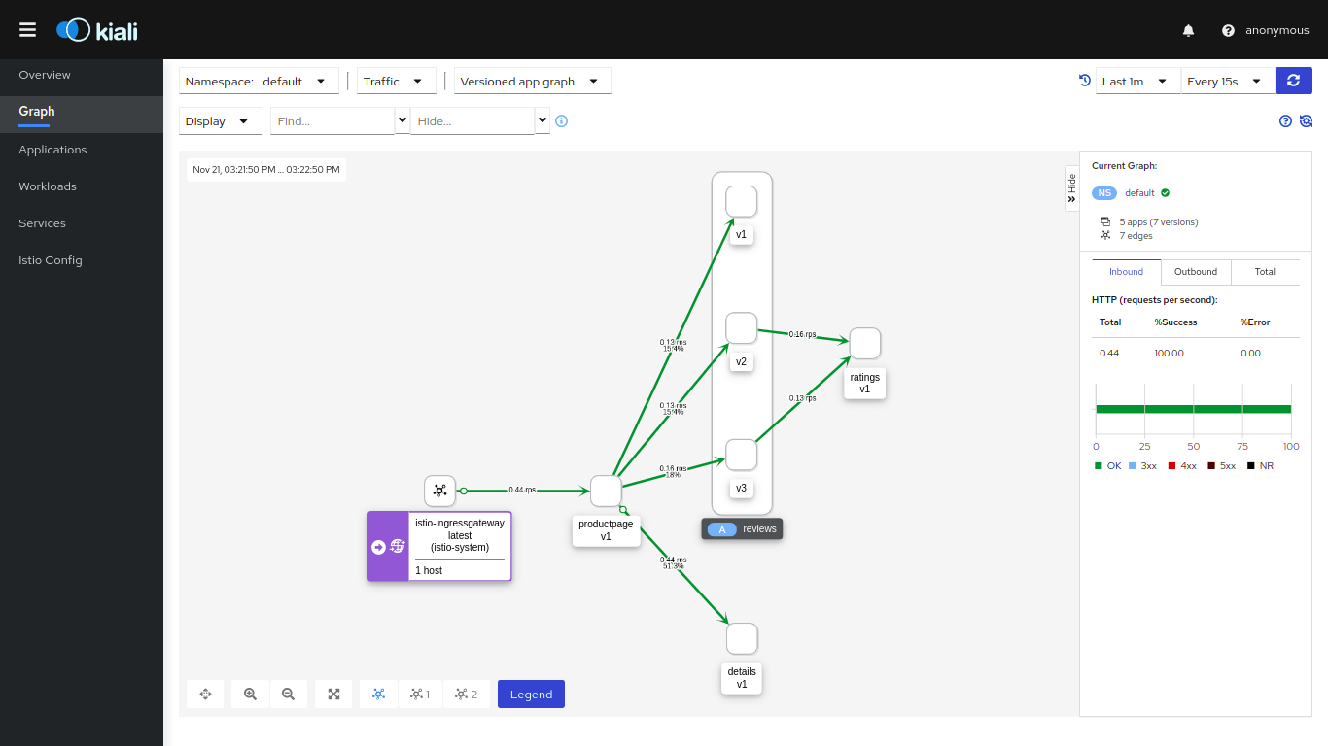

Slide 4
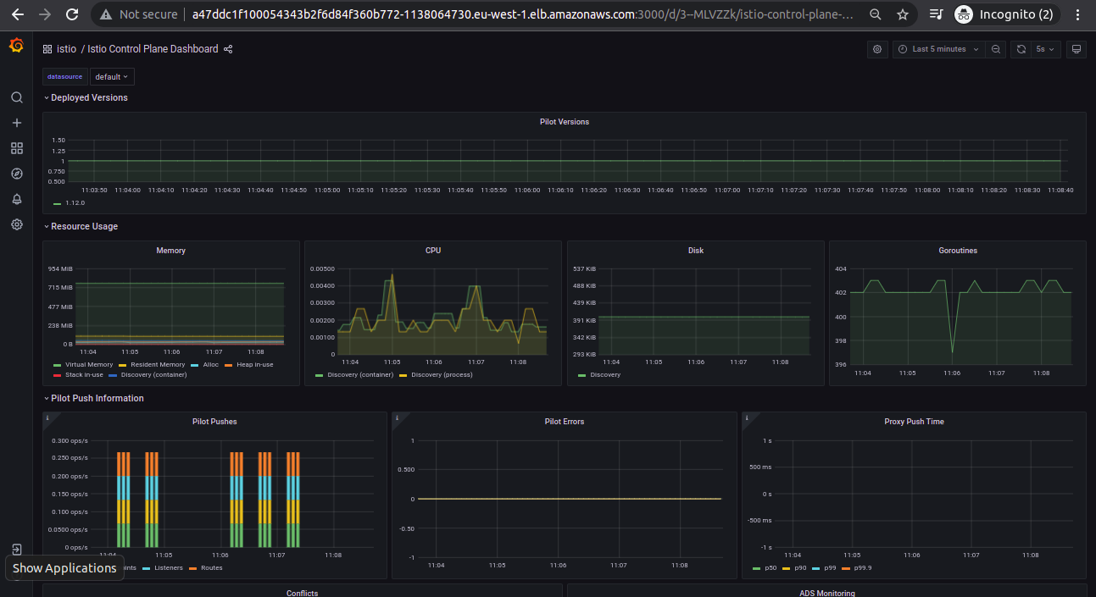

Slide 5
