Slide 1
DATA COMMUNICATION & NETWORKING | GROUP 3
Network Requirements Analysis & Design
Organisation modelled: Nigel Law Firm
Victoria University Kampala

Slide 2
Group 3 members
1. Senabulya Elijah
2. Happy Ategeka Wilfred
3. Tumusiime Judiya
4. Mirembe Bathshebah
5. Tumukundane Ambrose
6. Kemigisha Chicky Abigail
7. Naiga Kevin Nana
8. Katongole Jordan Happy
9. Mawanda Isaac Newton
10. Kimbugwe Collin
11. Lubega Paul
12. Kharbino Diing Lual
Data Communication & Networking | Victoria University Kampala

Slide 3
The organisation and what it needs
22
30
3
6
users
end devices
floors + server room
departments / VLANs
Required services
Why it is not a generic office network
Internet for all staff through one NAT gateway
File sharing on a central File Server
Centralized printing: 3 network printers
DHCP and DNS from one server
VoIP between 5 IP phones (Call Manager Express)
The firm handles confidential client case files. Privacy comes first: only authorised staff may reach them, and reception and guests must stay away from the file server.
Data Communication & Networking | Victoria University Kampala

Slide 4
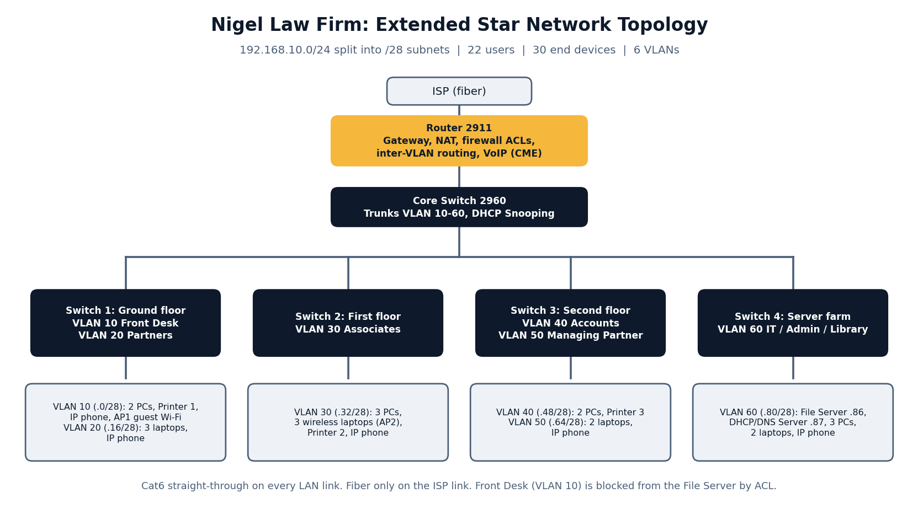
Topology: extended star
Data Communication & Networking | Victoria University Kampala

Slide 5
Addressing plan: 192.168.10.0/24 in /28 blocks
VLAN | Department | Network | Gateway | Usable range
10 | Front Desk | 192.168.10.0/28 | 192.168.10.1 | .2 – .14
20 | Partners Chambers | 192.168.10.16/28 | 192.168.10.17 | .18 – .30
30 | Associates / Legal | 192.168.10.32/28 | 192.168.10.33 | .34 – .46
40 | Accounts & Finance | 192.168.10.48/28 | 192.168.10.49 | .50 – .62
50 | Managing Partner | 192.168.10.64/28 | 192.168.10.65 | .66 – .78
60 | IT / Admin / Library + Servers | 192.168.10.80/28 | 192.168.10.81 | .82 – .94
Mask 255.255.255.240: 16 addresses per block, 13 usable once network, broadcast and gateway are counted. File Server is 192.168.10.86, DHCP/DNS Server is 192.168.10.87.
Data Communication & Networking | Victoria University Kampala

Slide 6
How the network protects client data
ACLs
Firewall
Front Desk (VLAN 10) is denied access to the File Server
Router only lets in return traffic for connections started inside
Encryption
Isolation
Case files are encrypted at rest on the File Server
Reception and guest Wi-Fi sit in their own VLAN
WPA2-PSK
DHCP Snooping
Both wireless access points encrypt traffic
Blocks rogue DHCP servers on the core switch
Data Communication & Networking | Victoria University Kampala

Slide 7
Key design decisions
Extended star: a fault on one floor does not take down the others
Cat6 inside the building, fiber only on the shared ISP link
VLANs and ACLs keep case files away from reception and guests
One /24 split into /28 blocks: tidy, and enough for the largest department
Packet Tracer file (.pkt): included in the project repository

