Slide 1
Conducting a comparative study on the Health Indicators of Afghanistan and Senegal across two year
Project 1 Group 4

Slide 2
Aim:
Our project's objective was to meticulously choose an appropriate dataset containing pertinent information, enabling us to perform a comparative analysis of two distinct countries over a span of two years. Our aim was to investigate the presence of any changes during this period and ascertain the subsequent influence on other key indicators.
Hypothesis:
We hypothesis that the relevant health indicators of a country will play an essential role in contributing to the mortality rate of the population.

Slide 3
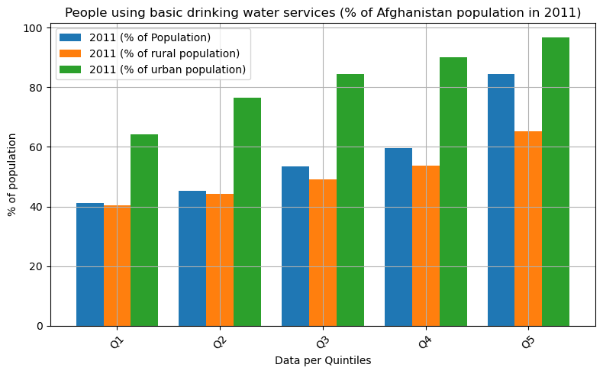
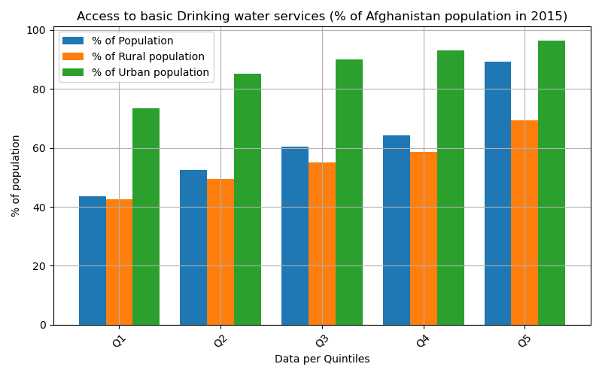
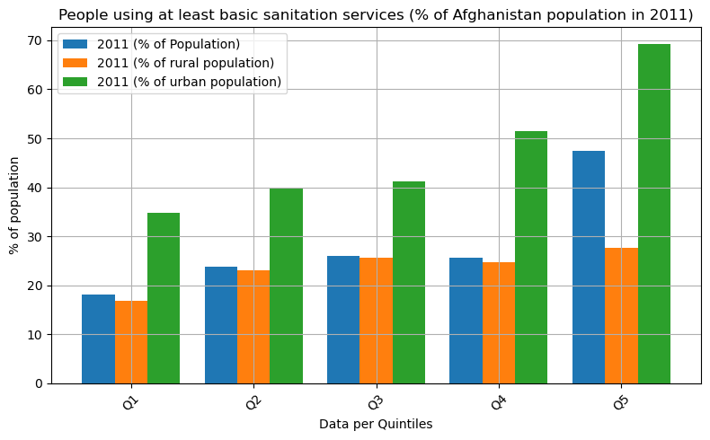
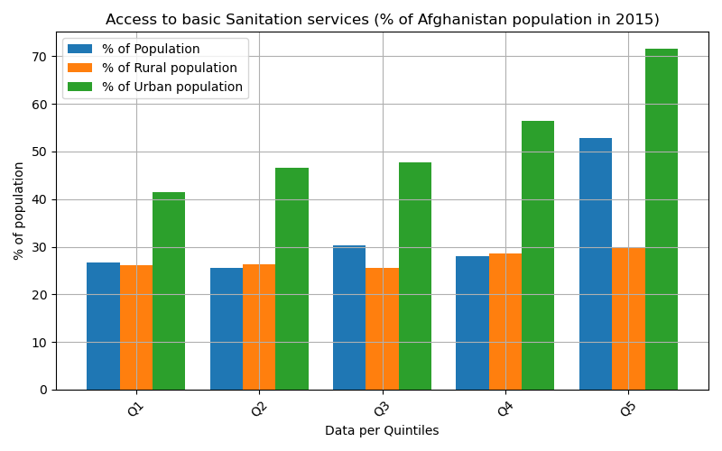
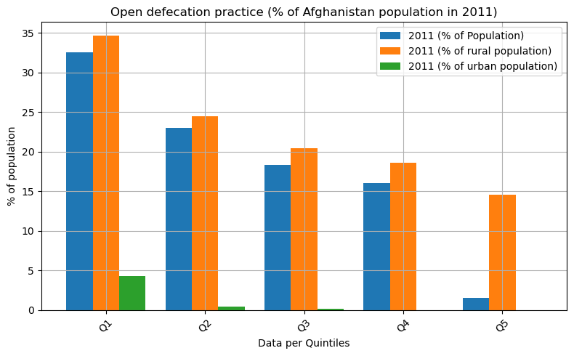
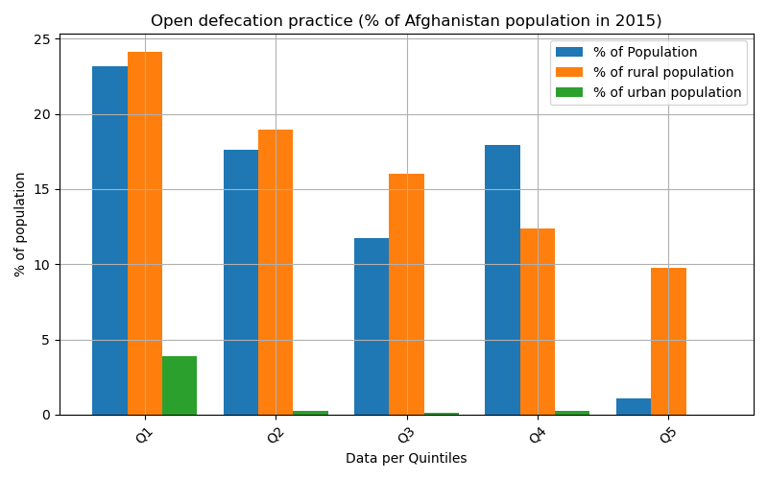
Rural access to bathroom facilities, basic drinking water and sanitation services are significantly lower (orange) than that of the population in urban areas (green).
The difference of access to such basic human needs between both areas are significant enough to be alarming, especially in the practice of open defecation. The percentage of rural population practicing this due to lack of bathroom facilities is around 15-35% as opposed to in urban being below 5%.
Such important indicators, or lack of can have big consequences on the general health and mortality of the population.
Unfortunately, such indicators were not reported on in the chosen dataset.
On a more positive note, from 2011 to 2015, the trend of public access to such essential factors have improved, for both rural and urban areas.

Slide 4
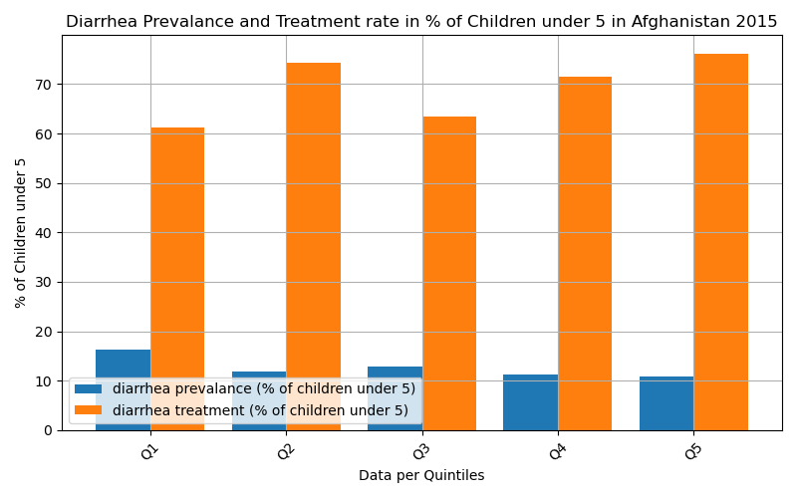
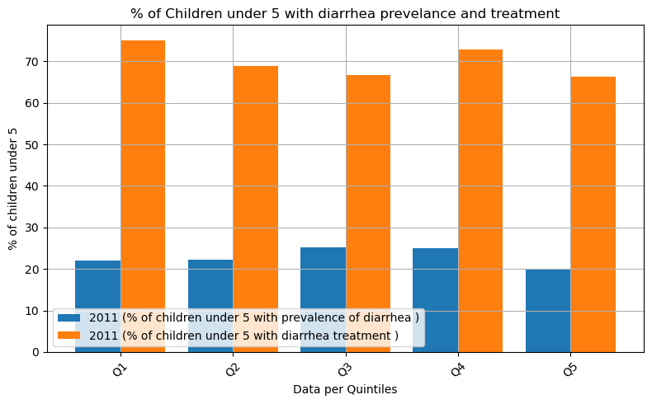
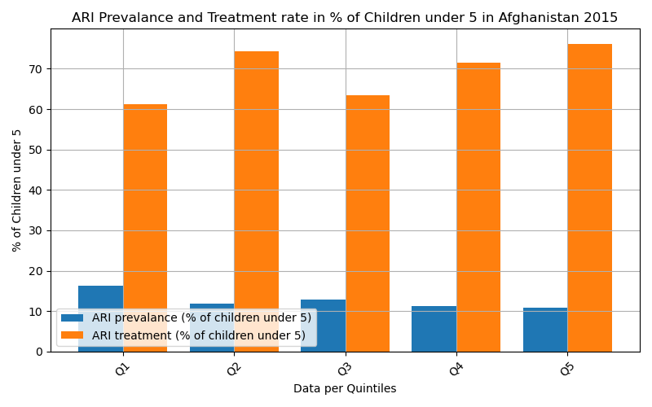
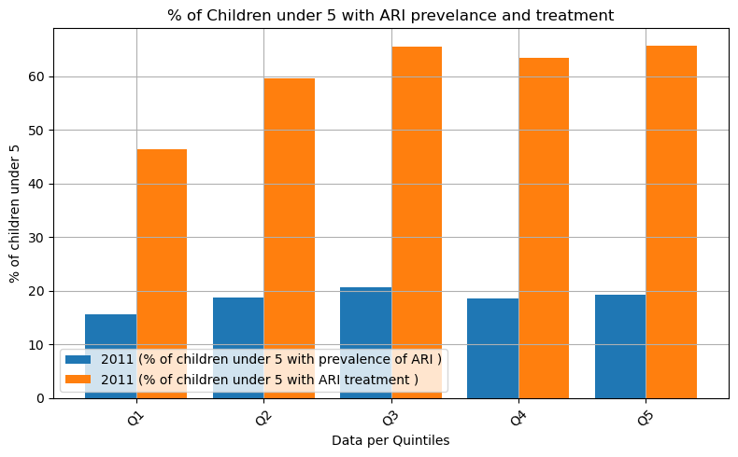
Prevalence of Acute Respiratory Infection and Diarrhea in Children Under 5; 2011 vs 2015
Due to the indicators discussed in the previous slide, the effects on children under 5 can be analyzed.
Prevalence of ARI (due to lack of sanitary services and access to bathroom facilities) are around 18-20% in 2011, which has reduced to 10-18% in 2015.
Prevalence of diarrhea (due to lack of access to drinking water, amongst other things not discussed here) was reported to be around 20% in 2011 across the quintiles, which has since dropped to 10-15% in 2015.
Treatments of both diseases are reported to be provided to only ~50-70% of the affected children, leaving the rest without proper health care.

Slide 5
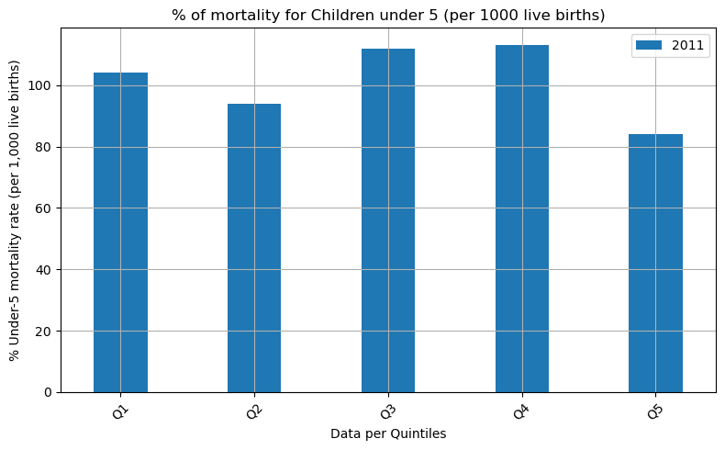
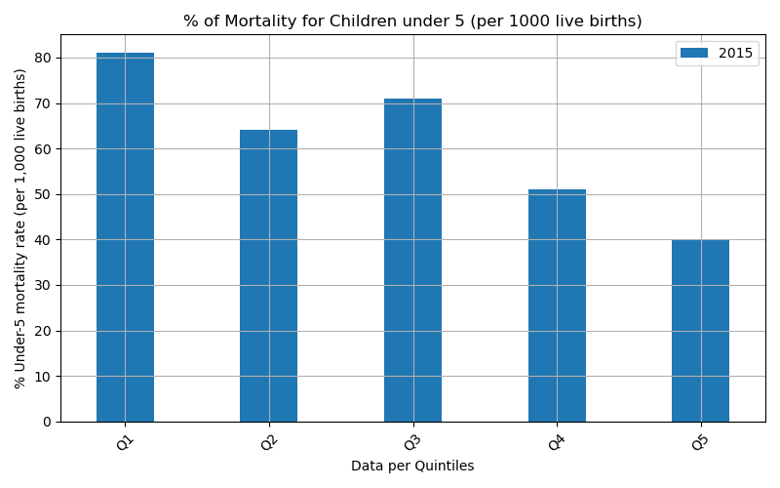
Percentage of Mortality of Children under 5
The prevalence of ARI and diarrhea, combined with the low level of treatment provided to the affected patients and lack of clean water and sanitary services access to the population has resulted in a devastating blow on the mortality of children under 5 in Afghanistan. 2011 consistently illustrates the percentage of mortality (per 1,000 live births) being from 85-118% while 2015 shows the numbers to fall to 40-80% mortality.

Slide 6
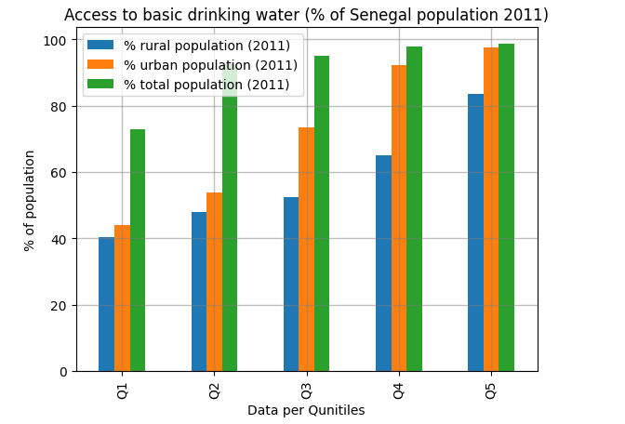
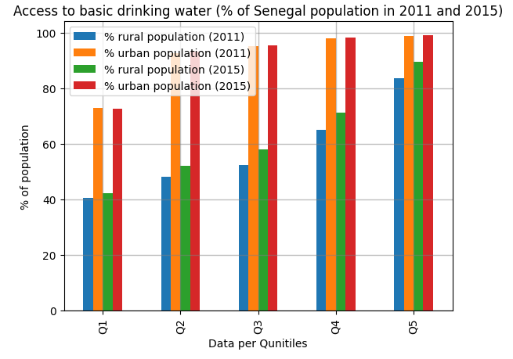
Access to Basic Drinking Water for population in Senegal
As the population is divided in the Qunitiles, we can clearly see the significant increase in the access to drinking water over the period of four years. The urban population is already having the access but there is increase of 5-7% for the rural population.

Slide 7
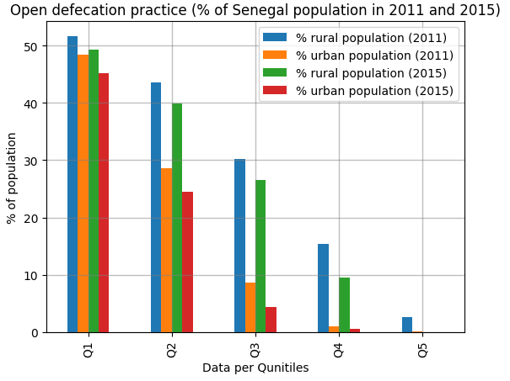
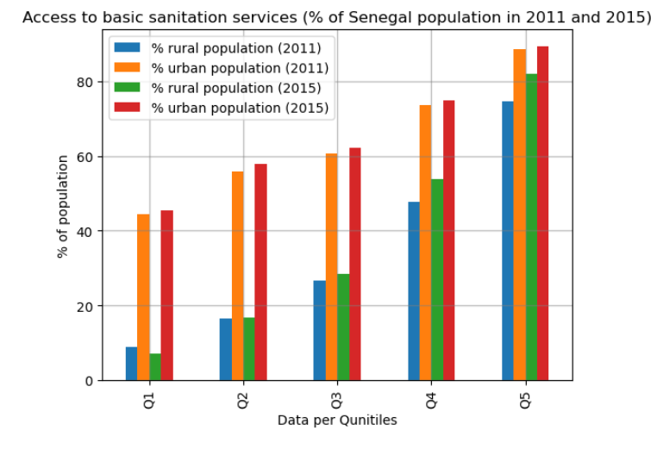
Comparison of Basic Services (Sanitation and Open Defecation)
The charts clearly depict the correlation between the open defecation practices and access to sanitation services over the time period of 2011-2015. Since the sanitation services improved for both urban and rural population, open defecation practices decreases in Senegal.

Slide 8
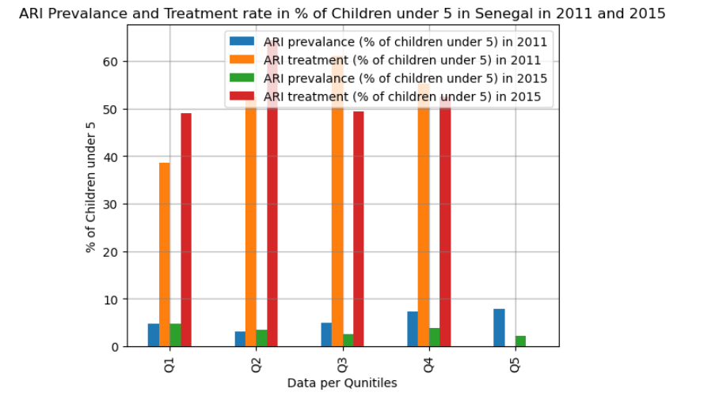
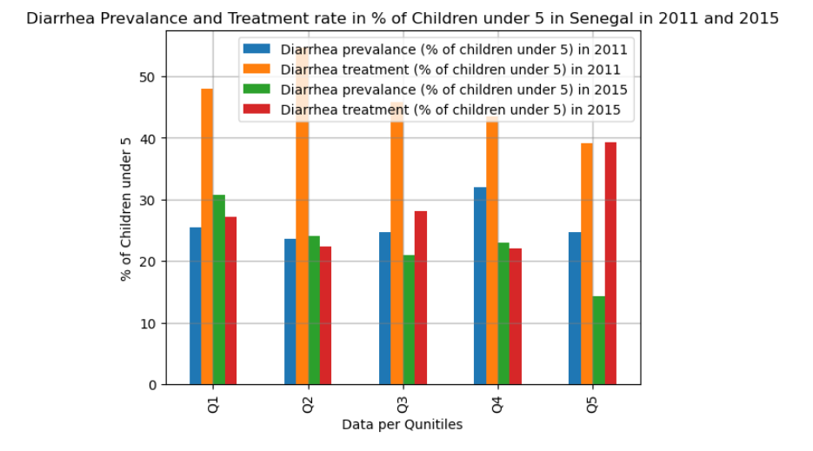
Prevalance and Treatment of Acute Respiratory and Diarrhea in children under 5 Senegal
Due to lack of the basic services, we have shown in above slides. The Prevalence of diseases like ARI and Diarrhea increases during the 2011 but there is slight decrease of about 5-7% during 2015.
Due to upgradation of health system and basic practices, we have seen significant number of treatment in ARI cases over the period of 2011-2015 whereas Diarrhea prevalence and treatment decreased in 2015 as the access to basic drinking water and sanitation services increased.
Note: we don’t have the data for the treatment of ARI for Q5.

Slide 9
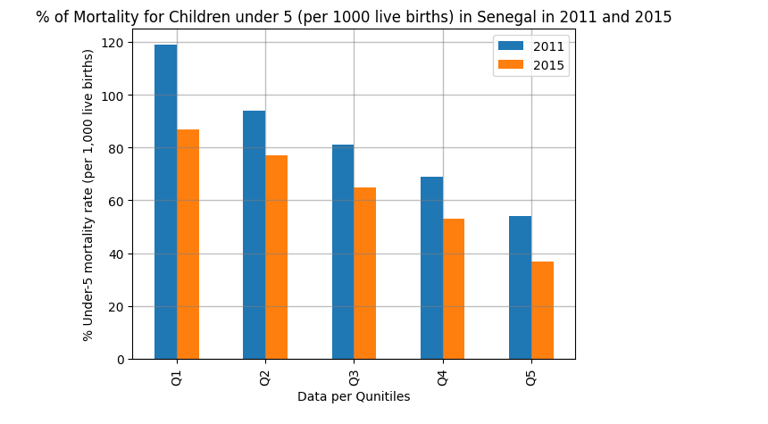
Percentage of Mortality of Children under 5 in Senegal
Low basic sanitation and drinking water services in 2011 contribute to the mortality rate under 5 (per 1000 live births) in Senegal, there might be other contributing factors, but we have seen decline in 2015 that showcase positive point. The first Qunitile shows 119% mortality rate in 2011 that decreased to about 85% in 2015.

Slide 10
Conclusion
Selected data indicators from the dataset effectively demonstrated the critical role of access to clean water, sanitation services, and bathroom facilities in influencing a country's population mortality. In the year 2011, access to these vital services was limited for a significant portion of the population, leading to a higher mortality rate. Conversely, in 2015, there was a substantial improvement, with a noticeable decrease in mortality rates.
The data we gathered did not include specific numerical values or means, necessitating the use of a time series approach to analyze how these factors evolved over time. This methodology was chosen as the most suitable means of examining the temporal impact.

Slide 11
Limitation and Other Factors
Time Constraint
The dataset we work on was depicted the real-world data, however it contains all the countries of the world but some of them does not contains any of the data.
Some of them does not have the dataset for every indicator for every year.
It does not include, how the population divides during in Quntitles example based on region, ethnicity etc.
The other factors for the mortality rate in the children under 5 can be study of the following indicators:
Problems in accessing health care (any of the specified problems) (% of women)
Malnourished children (stunting, -2SD) (% of children under 5)
Unmet need for family planning (for limiting) (% of married women)
Median birth interval (months)
Heard family planning on radio and television (% of women)
Knowledge of diarrhea care (% of mothers)
Malnourished women (BMI is less than 18.5) (% of women) etc.

Slide 12
References
https://datacatalog.worldbank.org/search/dataset/0037652/Health-Nutrition-and-Population-Statistics
https://stackoverflow.com/
User Guide — pandas 2.1.1 documentation (pydata.org)
Python Pandas DataFrame – GeeksforGeeks
Python Pandas Tutorial (pythonexamples.org)
Group 4 Collaborative Efforts

