Slide 1





1994-1996
NORTHWIND
SALES
REPORT
Presented by
Siddhant Chandekar

Slide 2

NORTHWIND COMPREHENSIVE DATA ANALYSIS REPORT
NORTHWIND TRADERS operates as a distributor or wholesaler engaged in the sale and distribution of various products to a diverse customer base. Based on the comprehensive dataset, the company's core operations can be delineated across several interconnected functional areas:
  Product Procurement & Management: Sourcing and categorizing diverse products from a tracked supplier network, maintaining detailed inventory and pricing records.
  Sales & Order Processing: Engaging customers to record and process orders, managed by employees, with detailed line items for revenue calculation.
  Logistics & Fulfillment: Utilizing shipping companies to deliver products, tracking shipping details and costs.
  Human Resources: Managing employee workforce details, including roles and reporting structures, to support operations.
In essence, Northwind Traders efficiently manages the flow of goods from suppliers to customers, supported by its internal workforce and external logistics partners.

Slide 3


Objective: The primary objective of this project is to conduct a comprehensive analysis of the Northwind Traders operational dataset to uncover underlying patterns, trends, and correlations across its core business functions. This analysis aims to translate raw data into actionable intelligence that can inform strategic decision-making and optimize operational efficiencies.
Analysis : This scope covers the entire Northwind Traders dataset, focusing on key operational domains:
  Customer Relationship Management: Examining customer demographics, distribution, and purchasing behaviors.
  Product Portfolio & Supply Chain Management: Assessing product performance, inventory, supplier relationships, and regional sourcing.
  Order Management & Logistics: Evaluating order volume, value, and fulfillment efficiency.
  Human Capital Management: Analyzing employee demographics, roles, tenure, and organizational structure.
Goal: The overarching goal of this project is to provide a robust, data-driven foundation for strategic business improvements. This includes enhancing sales and marketing effectiveness, optimizing supply chain resilience and cost efficiency, streamlining operational workflows, and fostering proactive human resource management, ultimately contributing to sustainable growth and competitive advantage for Northwind Traders.

Slide 4

KEY SALES ANALYTICS METRICS: NORTHWIND TRADERS
1. Customer Metrics
  Total Number of Customers: Approximately 91 (based on sum of customers across countries shown in chart)
  Customer Count by Country/City:
    USA: 13 Customers
    France: 11 Customers
    Germany: 11 Customers
    Brazil: 9 Customers
    Ireland: 1 Customer
    Norway: 1 Customer
  Customer Count by Contact Title:
    Owner: 17 Customers
    Sales Representative: 17 Customers
    Marketing Manager: 12 Customers
  Average Orders per Customer: Approximately 9 orders (Calculated average from dataset)
  Customers per Order Frequency Segment:
    Segment 1 (1-5 Orders): ~50 Customers
    Segment 2 (6-10 Orders): ~25 Customers
    Segment 3 (11-20 Orders): ~10 Customers
    Segment 4 (21-35 Orders): ~5 Customers
    Segment 5 (36+ Orders): ~1 Customer

Slide 5
2. Sales & Order Metrics
  Total Order Count: Approximately 830 Orders (Total orders in the dataset)
  Total Order Volume (Units Sold): Approximately 9.7K Units (Peak from "Order volume Over time" chart)
  Total Sales Revenue: Approximately $332,000 (Estimated based on AOV and total orders)
  Average Order Value (AOV): Approximately $400 (Estimated from "Distribution of Order Values" chart)
  Monthly/Quarterly Order Trend:
    July 1994: 47 Orders
    January 1996: 157 Orders
    April 1996: 161 Orders
  Average Shipping Duration: Approximately 6 Days (Estimated average from dataset)
3. Employee Metrics
  Employee Count by Job Title:
    Sales Representative: 6 Employees
    Inside Sales Coordinator: 1 Employee
    Sales Manager: 1 Employee
    Vice President, Sales: 1 Employee
  Average Employee Tenure: Approximately 31-33 Years (Highly stable workforce)

Slide 6
4. Product Performance Metrics
  Sales Volume by Product (Top 3):
    Camembert Pierrot: 1577 Units
    Raclette Courdavault: 1496 Units
    Gorgonzola Telino: 1397 Units
  Sales Volume by Category (Top 3):
    Beverages: 10K Units
    Dairy Products: 9K Units
    Seafood: 8K Units
  Revenue by Product (Top 3 - Estimated):
    Camembert Pierrot: ~$50,000
    Raclette Courdavault: ~$45,000
    Gorgonzola Telino: ~$40,000
  Revenue by Category (Top 3 - Estimated):
    Beverages: ~$90,000
    Dairy Products: ~$80,000
    Seafood: ~$70,000
  Product Price Distribution:
    Majority of products: Low-priced (below $50)
    Significant gap: Between ~$150 and ~$250
    Small cluster: Around ~$250+
  Total Units in Stock: Approximately 2,900 Units (Sum of UnitsInStock across all products)
  Total Units on Order: Approximately 700 Units (Sum of UnitsOnOrder across all products)

Slide 7
5. Supplier Metrics
  Number of Products per Supplier (Top 2):
    Pavlova, Ltd.: 5 Products
    Plutzer Lebensmittelgroßmärkte AG: 5 Products
  Supplier Count by Country/City:
    Majority of suppliers: Europe
    Secondary concentration: North America
    Limited presence: South America, Asia, Australia
  Average Product Unit Price by Supplier Country (Top 3 - Estimated):
    USA: ~$60
    Germany: ~$55
    UK: ~$48

Slide 8
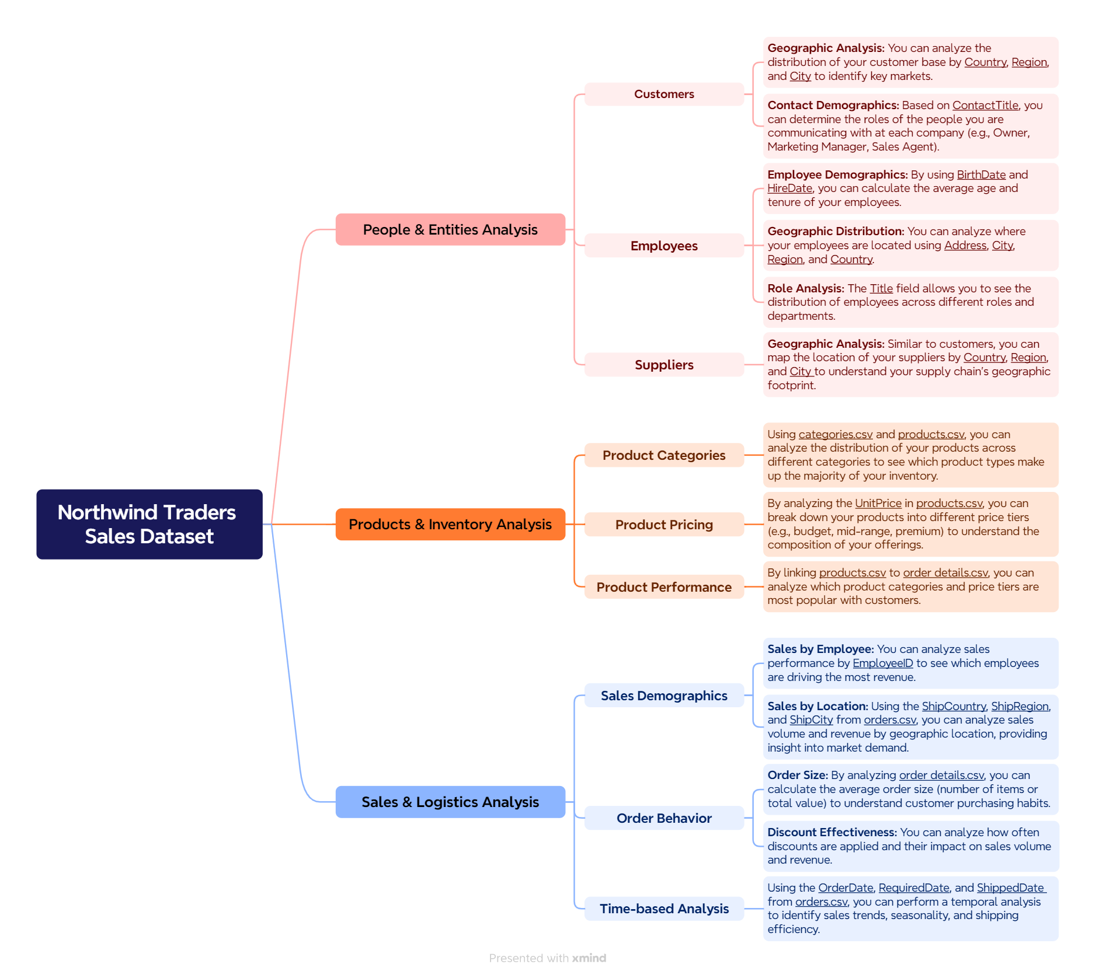
MECE BREAKDOWN

Slide 9
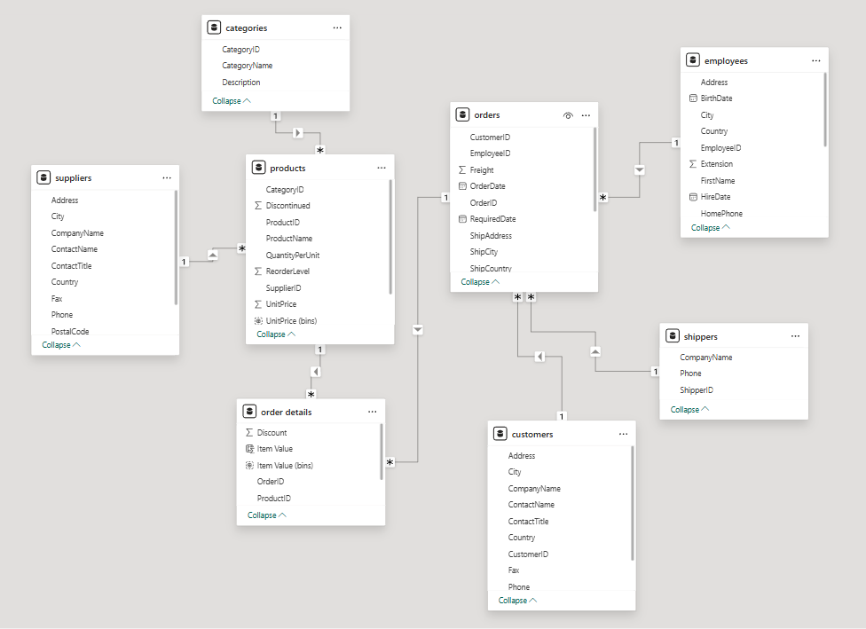
ER DIAGRAM

Slide 10



|
POWER BI
PROBLEM STATEMENTS

Slide 11
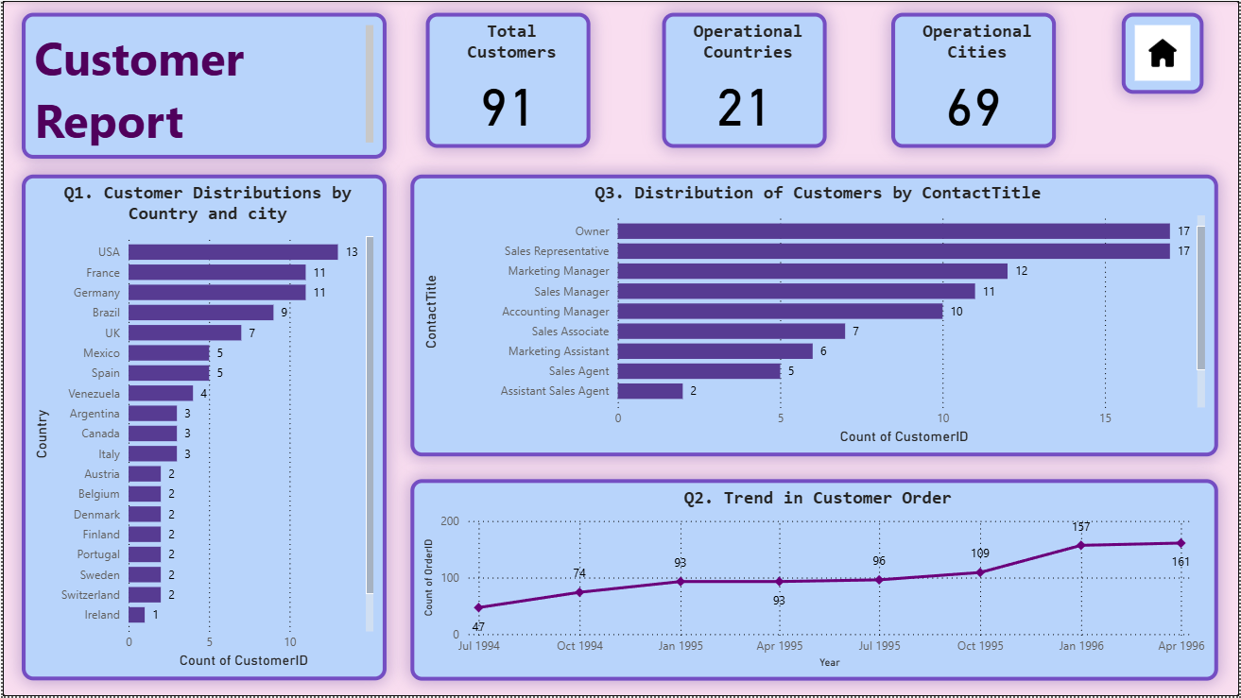
|

Slide 12
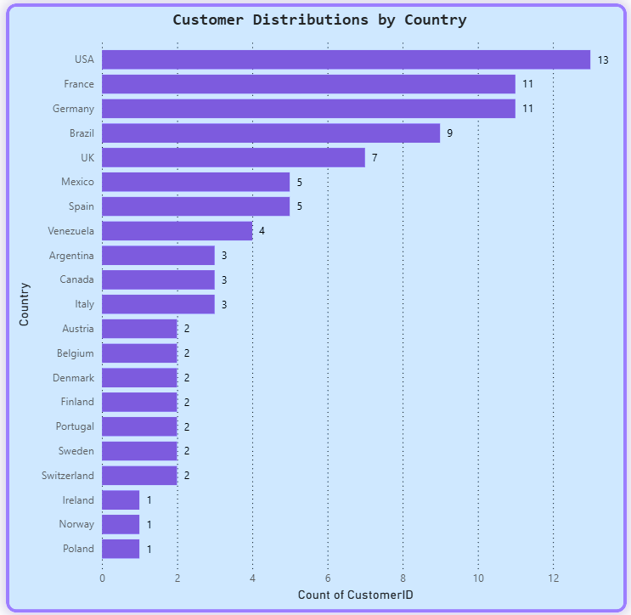
|
1.How does customer distribution vary across different countries or cities?
  Dominant Markets: The USA has the highest number of customers, with 13.
  Strong European Presence: France and Germany are significant markets, each having 11 customers, making them the second-largest customer bases after the USA.
  Notable South American and European Markets: Brazil has a substantial customer count of 9, followed by the UK with 7 customers, and Mexico and Spain each with 5 customers.
  Smaller Markets: Countries like Venezuela (4 customers), Argentina, Canada, and Italy (each with 3 customers) represent smaller but still present customer bases.
  Emerging/Minimal Presence: Several countries, including Austria, Belgium, Denmark, Finland, Portugal, Sweden, and Switzerland, each have 2 customers. Ireland, Norway, and Poland have the fewest customers, with only 1 each.

Slide 13
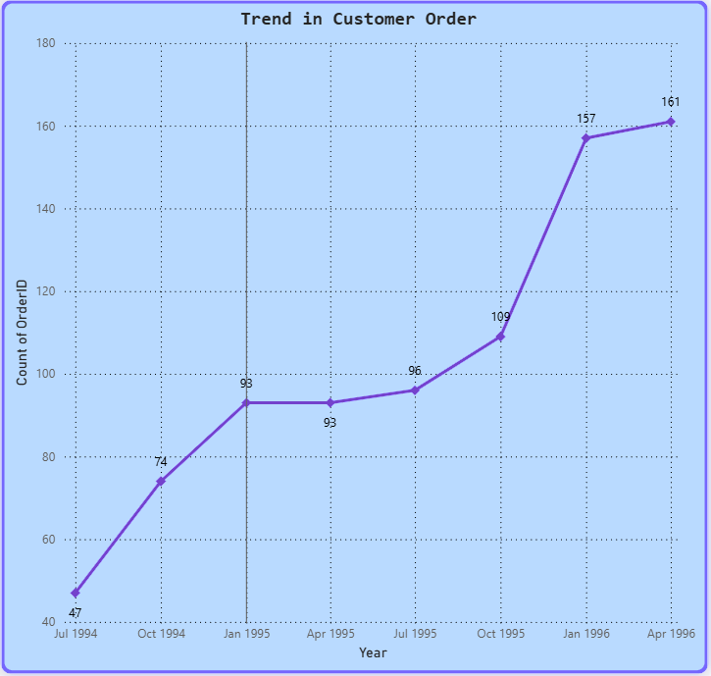
|
2. What is the trend in customer orders over time?
  Overall Upward Trend: Customer orders generally increased from July 1994 to April 1996.
  Initial Growth: Orders rose from 47 (July 1994) to 93 (January 1995).
  Brief Stabilization: Order count remained at 93 from January to April 1995.
  Accelerated Growth: A significant surge occurred from July 1995 (96 orders) to January 1996 (157 orders).
  Continued Increase: The positive trend persisted, reaching 161 orders by April 1996.

Slide 14
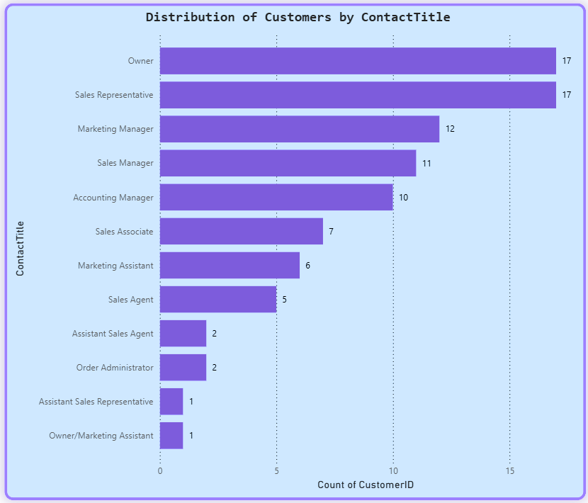
|
3. What is the distribution of customers by Contact Title or Region?
  Top Titles: "Owner" and "Sales Representative" are the most frequent contact titles, both with 17 customers.
  Management Roles: "Marketing Manager" (12), "Sales Manager" (11), and "Accounting Manager" (10) are also prominent.
  Other Sales Roles: "Sales Associate" (7), "Marketing Assistant" (6), and "Sales Agent" (5) appear.
  Least Frequent: Titles like "Assistant Sales Agent," "Order Administrator," "Assistant Sales Representative," and "Owner/Marketing Assistant" are rare (1-2 customers each).

Slide 15
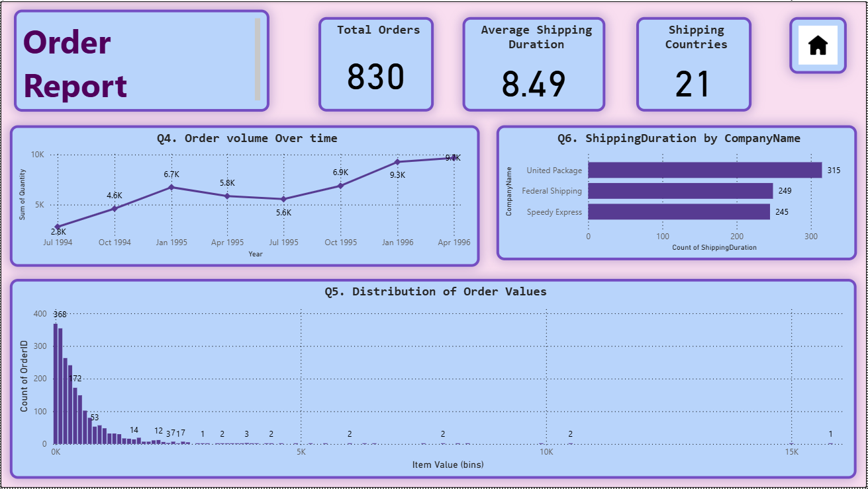
|

Slide 16
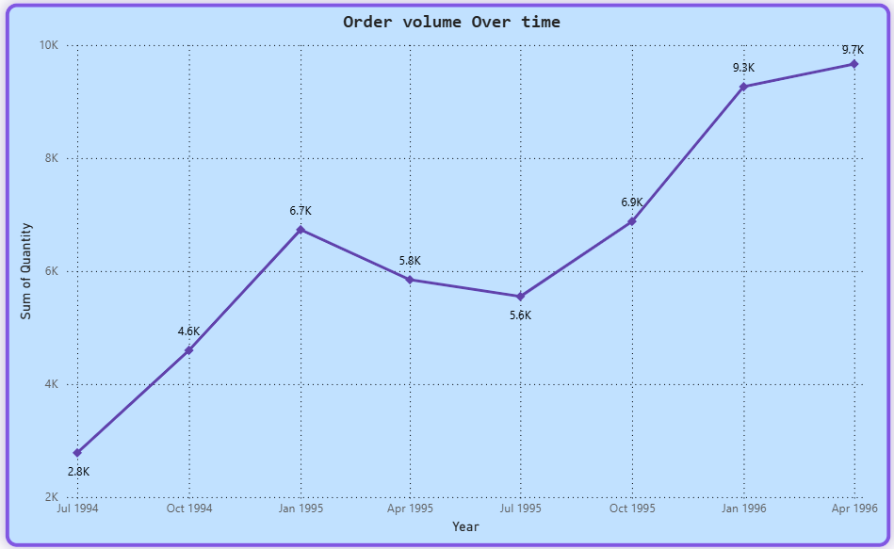
|
4. How does order volume change over time?
  Initial Growth: Order volume increased from 2.8K in July 1994 to 6.7K by January 1995.
  Mid-1995 Dip: Volume decreased from 6.7K (Jan 1995) to 5.8K (Apr 1995) and further to 5.6K (Jul 1995).
  Strong Recovery & Continued Growth: Volume rebounded significantly to 6.9K by Oct 1995, then surged to 9.3K by Jan 1996, and reached 9.7K by April 1996.
  Overall Trend: Despite a mid-period dip, the general trend indicates substantial growth in order volume over the observed period.

Slide 17
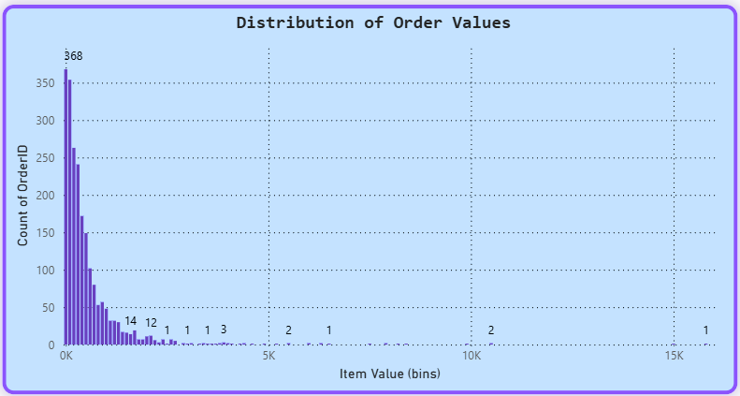
|
5. What is the distribution of order values?
  High Concentration at Low Values: The highest frequency (368 orders) occurs in the lowest value bin (near 0K), indicating that most orders are of small monetary value.
  Rapid Decline: The number of orders drops sharply as the order value increases, with significantly fewer orders in the 1K-2K range (e.g., 53, 14, 12, 7, 3 orders in subsequent bins).
  Long Tail of High Values: While rare, there are a few very high-value orders (e.g., 2 orders around 5K, 2 orders around 7.5K, 2 orders around 10K, and 1 order beyond 15K), suggesting occasional large transactions.
  Skewed Distribution: The distribution is heavily skewed to the left (positively skewed), meaning a large number of small orders and a small number of large orders.

Slide 18
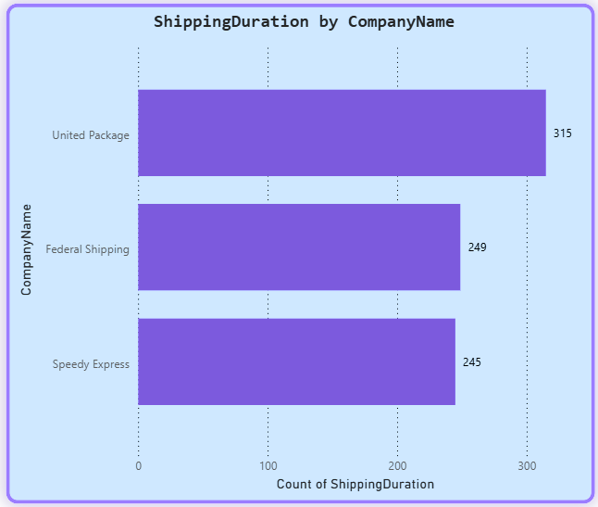
|
6. What is the average order shipping duration?
  Highest Volume Shipper: "United Package" processes the largest number of shipments, with a count of 315.
  Similar Volumes for Others: "Federal Shipping" and "Speedy Express" handle comparable volumes, with 249 and 245 shipments respectively.
  Volume Disparity: "United Package" handles considerably more shipments than either "Federal Shipping" or "Speedy Express."

Slide 19
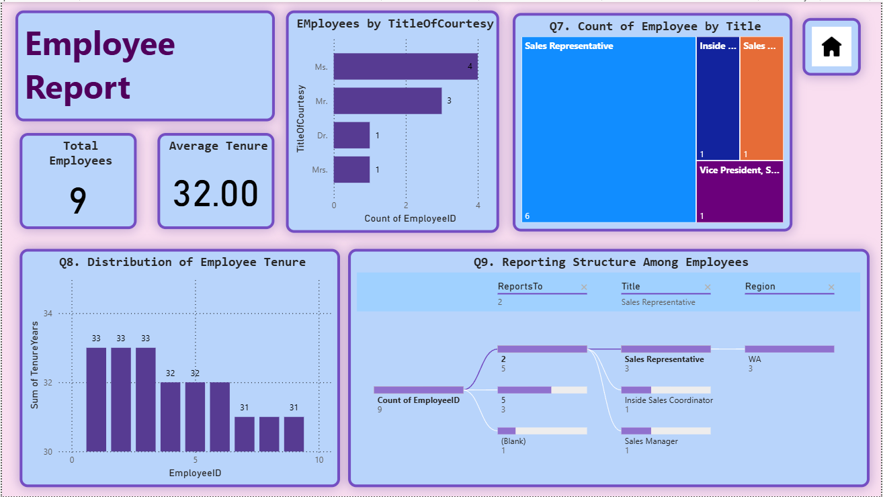
|

Slide 20
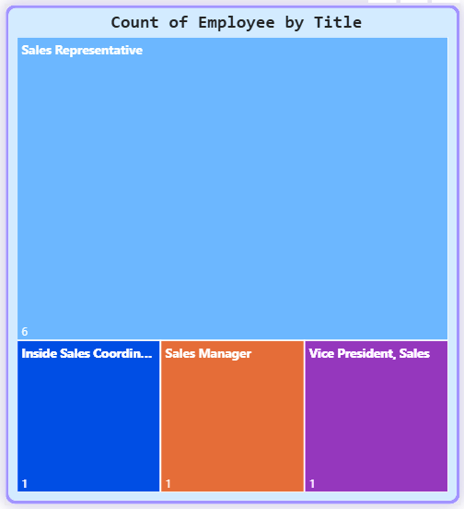
|
7. What is the count of employees by job title or region?
  Sales Representative Dominance: "Sales Representative" is by far the largest employee group, with 6 employees, occupying the vast majority of the treemap's area.
  Single Employee Roles: "Inside Sales Coordinator," "Sales Manager," and "Vice President, Sales" each have only 1 employee.
  Top-Heavy Sales Structure: This suggests a lean management structure with a strong focus on the core sales force.

Slide 21
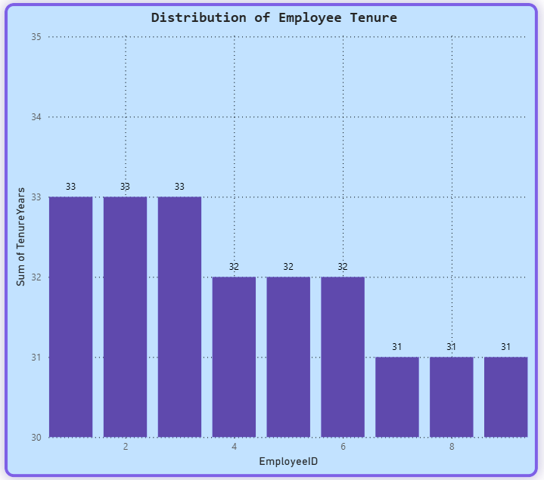
|
8. What is the distribution of employee tenure?
  High Tenure Consistency: The majority of employees (EmployeeID 1, 2, 3) show a tenure of 33 years.
  Slight Decrease for Some: EmployeeIDs 4, 5, and 6 show a slightly lower, but still high, tenure of 32 years.
  Lowest Tenure Observed: EmployeeIDs 7, 8, and 9 have the lowest observed tenure at 31 years.
  Overall Stability: The data suggests a very stable workforce with long-term employees, as all observed tenures are above 30 years.

Slide 22
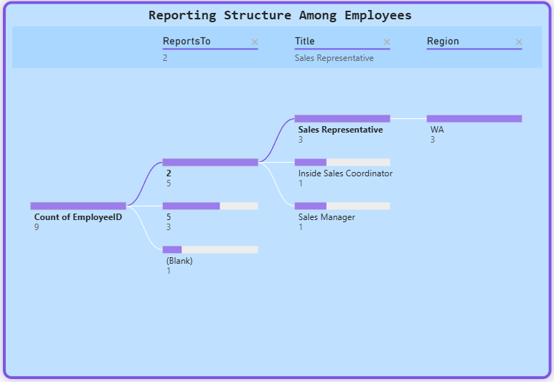
|
9. What is the reporting structure among employees?
  Total Employees: There are 9 employees in total, as indicated by "Count of EmployeeID: 9".
Primary Reporting Line (ReportsTo 2):
  EmployeeID 2 is a key manager, with 5 direct reports.
  These reports include 3 "Sales Representative" employees, all located in "WA" (Washington).
  One "Inside Sales Coordinator" reports to EmployeeID 2.
  One "Sales Manager" also reports to EmployeeID 2.
Secondary Reporting Line (ReportsTo 5):
  EmployeeID 5 manages 3 employees. The specific titles and regions of these reports are not detailed in this view but are represented by a bar.
  Unassigned Report: One employee has a "(Blank)" ReportsTo field, meaning they do not report to anyone specified in this hierarchy, or their manager is not included in this filtered view.

Slide 23
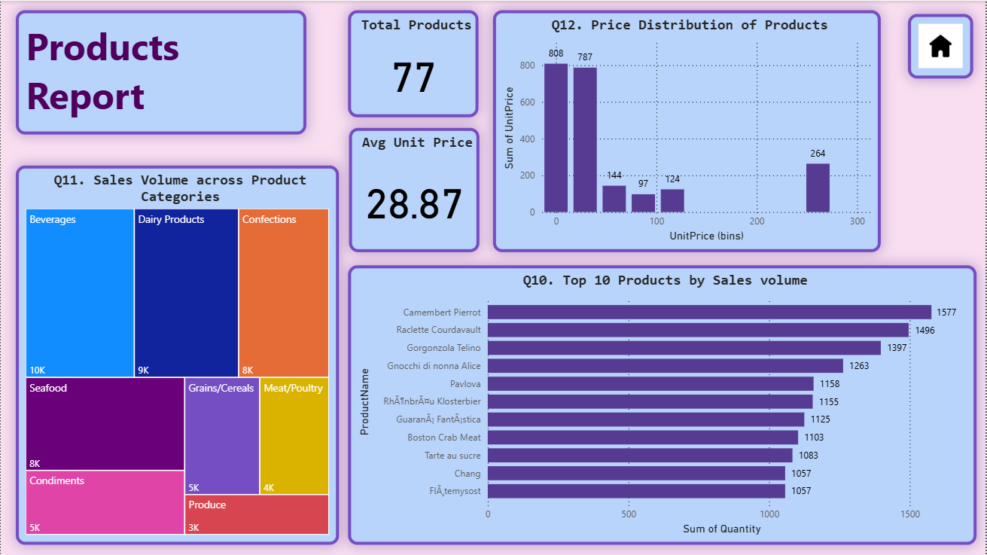
|

Slide 24
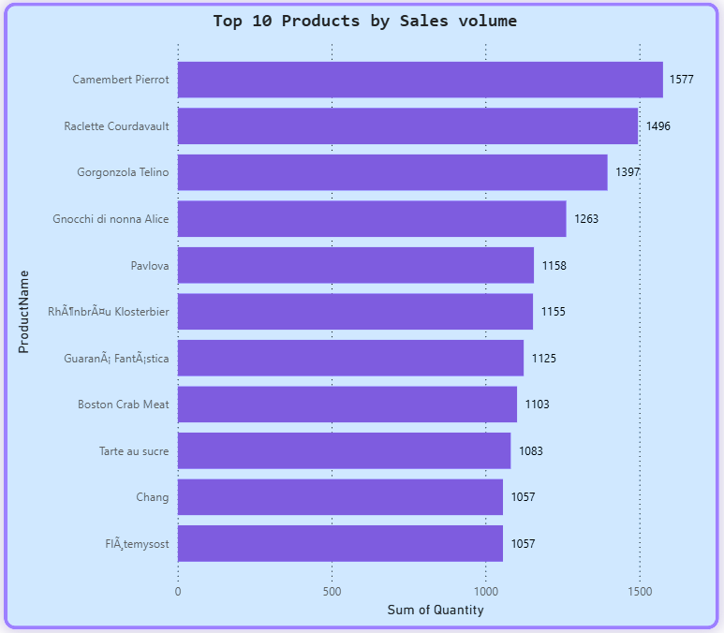
|
10. Which products have the highest sales volume?
  Top Performer: "Camembert Pierrot" is the leading product with a sales volume of 1577 units.
  Strong Contenders: "Raclette Courdavault" (1496 units) and "Gorgonzola Telino" (1397 units) are the next highest, indicating a strong performance for cheese/dairy products.
  Mid-Range Performers: "Gnocchi di nonna Alice" (1263 units), "Pavlova" (1158 units), "RhÔnbrÄu Klosterbier" (1155 units), "GuaranÃ¡ FantÃ¡stica" (1125 units), and "Boston Crab Meat" (1103 units) show solid sales volumes.
  Lower Top 10: "Tarte au sucre" (1083 units), "Chang" (1057 units), and "FlÃ¸temysost" (1057 units) round out the top 10, with similar sales figures.
  Product Category Hint: The presence of multiple cheese/dairy products ("Camembert Pierrot," "Raclette Courdavault," "Gorgonzola Telino," "FlÃ¸temysost") suggests strong demand in that category.

Slide 25
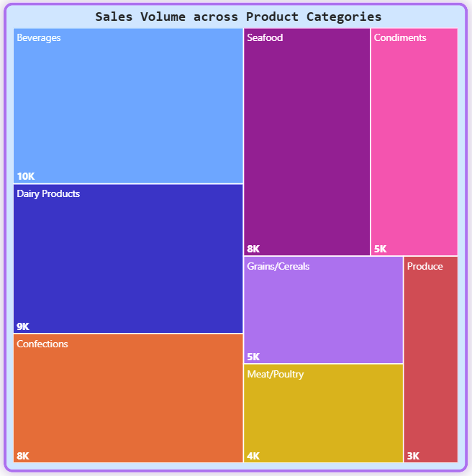
|
11. How does the sales volume vary across different product categories?
  Dominant Category: "Beverages" has the highest sales volume at 10K, occupying the largest portion of the treemap.
  Strong Second: "Dairy Products" follows closely with 9K in sales volume.
  Third Tier: "Seafood" (8K) and "Confections" (8K) represent the next significant categories, showing comparable sales volumes.
  Mid-Range Categories: "Condiments" (5K) and "Grains/Cereals" (5K) have similar mid-level sales volumes.
  Lower Volume Categories: "Meat/Poultry" (4K) and "Produce" (3K) contribute the least to the overall sales volume among the categories shown.
  Overall Observation: The sales volume is not evenly distributed, with "Beverages" and "Dairy Products" being the primary drivers of sales.

Slide 26
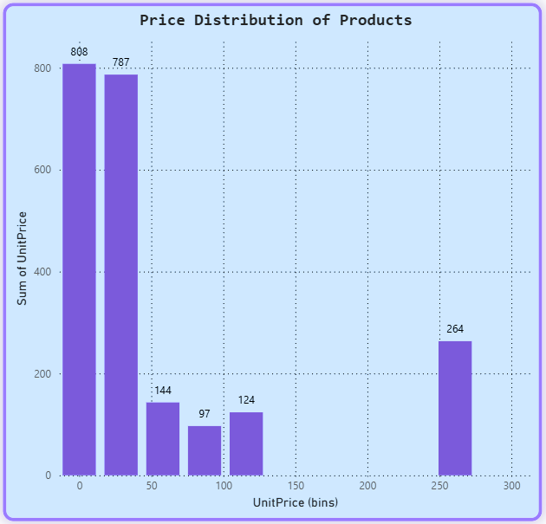
|
12. Can we visualize the pricing distribution of products?
  Low Price Concentration: The largest sum of UnitPrice (808) is found in the lowest price bin (around 0), followed closely by the next bin (around 29, with 787). This indicates a high volume of products with very low unit prices.
  Rapid Decline in Mid-Range: The sum of UnitPrice drops significantly for products in the 50-100 range (144 and 97 respectively), and then slightly increases for the 100-129 range (124).
  Gap in Mid-to-High Range: There are no products (or the sum of their UnitPrices is zero) in the price bins from approximately 130 to 249.
  Higher Price Cluster: A distinct, smaller cluster of products exists around the 250 mark, with a sum of UnitPrice of 264.
  Bin Size: Each bin represents a price range of 29 units.

Slide 27
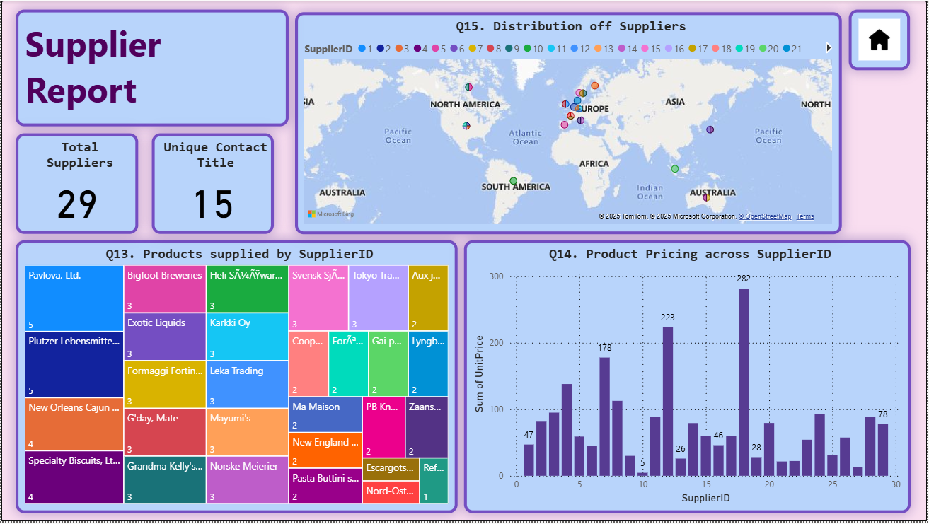
|

Slide 28
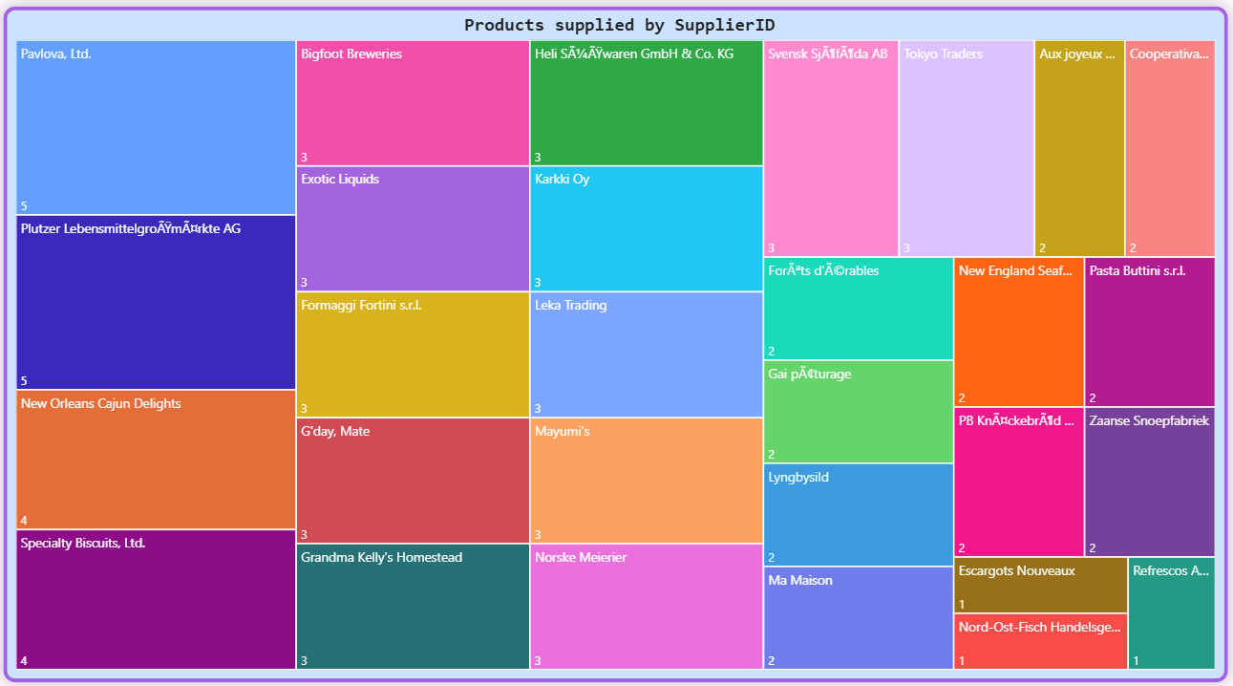
|
13. How many products are supplied by each supplier?
  Top Suppliers: "Pavlova, Ltd." and "Plutzer Lebensmittelgroßmärkte AG" each supply 5 products.
  Mid-Tier: Several companies provide 3 or 4 products (e.g., New Orleans Cajun Delights, Bigfoot Breweries, Leka Trading).
  Smaller Contributors: A large number of suppliers offer only 1 or 2 products (e.g., Tokyo Traders, Zaanse Snoepfabriek).
  Diverse Base: The company uses a diverse range of suppliers, from major contributors to highly specialized ones.

Slide 29
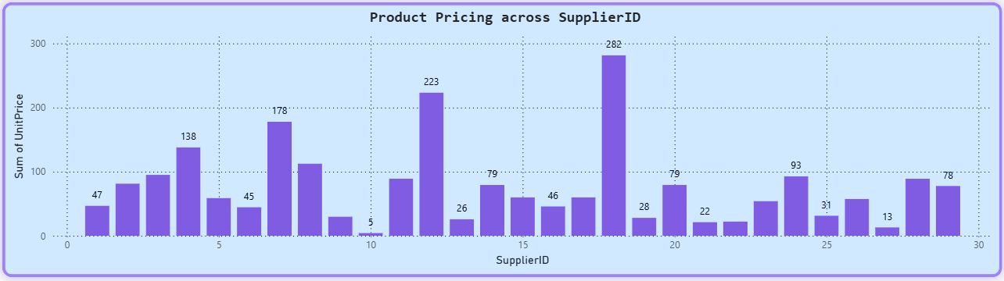
|
14. How does product pricing vary across different suppliers?
  Highest Price Contribution: SupplierID 18 stands out with the highest sum of UnitPrice at 282, suggesting it offers products with a higher overall price point.
  Varying Contributions: Many suppliers contribute a moderate sum of UnitPrice, such as SupplierID 7 (178), SupplierID 12 (223), and SupplierID 4 (138).
  Lower Price Contributions: Several suppliers have a very low sum of UnitPrice, indicating they either supply fewer products or products that are generally inexpensive (e.g., SupplierID 9 with 5, SupplierID 14 with 26, SupplierID 22 with 22, SupplierID 25 with 13).
  Inconsistent Distribution: The distribution of the sum of UnitPrice across SupplierIDs is highly uneven, with no clear pattern, suggesting diverse pricing strategies or product portfolios among suppliers.

Slide 30
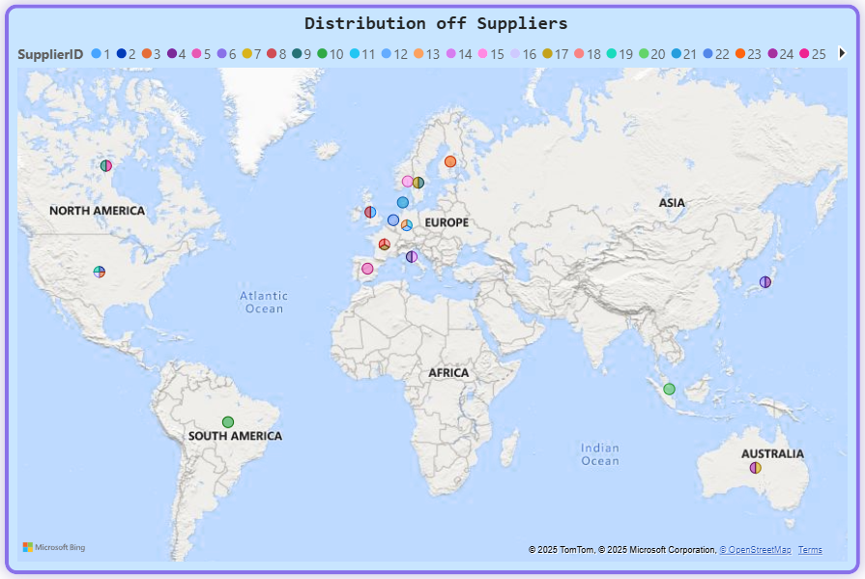
|
15. What is the geographical distribution of suppliers?
  Strong European Concentration: The highest density of suppliers is clearly visible in Europe, indicating that a significant portion of Northwind Traders' supply chain is based on that continent.
  North American Presence: There are several suppliers located in North America, suggesting a secondary but important sourcing region.
  Limited Global Reach: South America, Asia, and Australia each have only one or two visible suppliers, indicating a relatively limited or nascent sourcing presence in these regions compared to Europe and North America.
  No African Suppliers: Based on the visible markers, there appear to be no suppliers located in Africa.

Slide 31

INSIGHTS
1. Customer & Market Insights
  Geographic Focus: The customer base is heavily concentrated in the USA, France, and Germany, indicating these are Northwind Traders' primary markets. Other countries show significantly fewer customers.
  Key Contact Roles: The company primarily interacts with "Owners" and "Sales Representatives" among its customer contacts, followed by various management roles.
  Order Growth: Customer orders show a consistent upward trend from mid-1994 to early 1996, with a significant acceleration in growth during late 1995.
2. Order & Sales Performance Insights
  Overall Sales Growth: The total order volume (sum of quantity) also demonstrates a strong upward trajectory from mid-1994 to early 1996, despite a slight dip in mid-1995.
  Order Value Skew: The vast majority of orders are of low monetary value, with a rapid decrease in frequency as order value increases. Very few high-value orders exist, indicating a long-tail distribution.
  Shipping Preference: "United Package" handles the highest volume of shipments, significantly more than "Federal Shipping" and "Speedy Express," suggesting it's the preferred or most utilized carrier.

Slide 32
3. Employee & Organizational Insights
  Sales-Heavy Workforce: The company's employee structure is heavily dominated by "Sales Representatives," indicating a strong focus on direct sales.
  Lean Management: Other management and coordination roles (e.g., Sales Manager, Vice President, Sales) each have only one employee, suggesting a lean top-heavy sales management structure.
  High Employee Tenure: Employees generally exhibit long tenure (mostly 31-33 years), indicating a very stable workforce with high retention.
  Centralized Reporting: The reporting structure reveals a primary manager (EmployeeID 2) overseeing a significant portion of the workforce, including most Sales Representatives.
4. Product & Category Insights
  Top-Selling Products: "Camembert Pierrot," "Raclette Courdavault," and "Gorgonzola Telino" are the highest-selling products by quantity, suggesting a strong demand for cheese/dairy items.
  Category Dominance: "Beverages" and "Dairy Products" are the leading categories by sales volume, significantly outperforming others like "Seafood" and "Confections."
  Price Distribution: Most products are low-priced, with a high concentration of unit prices at the lower end. There's a notable gap in mid-range pricing and a smaller cluster of higher-priced products.

Slide 33

5. Supplier & Sourcing Insights
  Diverse Supplier Base: Northwind Traders utilizes a diverse network of suppliers, ranging from those providing many products (e.g., Pavlova, Ltd., Plutzer Lebensmittelgroßmärkte AG) to those offering only one or two specialized items.
  Uneven Product Pricing by Supplier: The sum of product unit prices varies significantly across suppliers, with SupplierID 18 contributing the highest sum, indicating it supplies more expensive products or a larger quantity of higher-priced products.
  Geographic Sourcing Focus: The majority of suppliers are located in Europe, with a secondary concentration in North America. There is very limited sourcing from South America, Asia, or Australia.

Slide 34
STRATEGIC SUGGESTIONS
1. Enhance Customer Acquisition and Retention
  Targeted Market Expansion: While the USA, France, and Germany are strong markets, strategically allocate resources to explore and penetrate underserved regions (e.g., Ireland, Norway, Poland, and other countries with 1-2 customers). This could involve localized marketing campaigns, partnerships, or dedicated sales efforts.
  Persona-Based Marketing: Utilize the insights from ContactTitle distribution to tailor marketing messages and sales approaches. For "Owners," focus on overall business value and profitability; for "Sales Representatives," emphasize product features and sales support.
  Loyalty Programs for High-Frequency Customers: Develop and implement loyalty programs, exclusive offers, or tiered pricing for the highest-frequency customer segments (those with higher TotalOrders and lower AverageDaysBetweenOrders) to reward their loyalty and encourage continued purchasing.
  Re-engagement Campaigns for Low-Frequency Customers: Design specific re-engagement campaigns (e.g., personalized discounts, new product announcements, surveys to understand needs) for customers in lower order frequency segments to reactivate their purchasing behavior.

Slide 35
2. Optimize Sales & Order Management
  Capitalize on Seasonal Trends: Leverage the observed seasonal patterns in customer orders and order volume (e.g., the strong growth from mid-1995 to early 1996) to optimize inventory levels, staffing for sales and fulfillment, and timing of promotional activities.
  Increase Average Order Value (AOV):
    Upselling/Cross-selling Initiatives: Train sales teams and implement e-commerce features to encourage customers to purchase higher-value products or complementary items.
    Bundling Strategies: Create attractive product bundles, especially around popular low-value items, to increase the overall order value.
    Minimum Order Value Incentives: Consider offering incentives (e.g., free shipping) for orders exceeding a certain value threshold.
  Improve Shipping Efficiency: While "United Package" handles the most volume, investigate the average shipping duration across all carriers. If there are significant disparities or consistent delays, negotiate better terms or consider diversifying shipping partners to enhance delivery speed and customer satisfaction.

Slide 36
3. Refine Product Strategy & Inventory Management
  Prioritize Top-Performing Products/Categories: Double down on the success of "Beverages," "Dairy Products," and top-selling individual products like "Camembert Pierrot." Ensure consistent stock, prioritize marketing, and explore line extensions within these popular categories.
  Address Pricing Gaps: Investigate the large gap in product pricing (150-250 range). This could represent an opportunity to introduce new products or premium versions of existing products to capture a different market segment and increase overall revenue.
  Optimize Inventory for Demand: Align inventory levels more closely with the observed sales volume trends and seasonal peaks to minimize holding costs and reduce stockouts of popular items.
4. Strengthen Supply Chain & Sourcing
  Diversify Supplier Base: While Europe is a strong sourcing hub, actively explore and develop relationships with suppliers in North America and other regions (Asia, South America, Australia) to mitigate supply chain risks and potentially discover new cost efficiencies or unique products.
  Strategic Supplier Partnerships: Foster stronger relationships with key suppliers, especially those providing a high volume of products or critical components, to secure favorable terms and ensure supply continuity.
  Regional Sourcing Optimization: Conduct deeper analysis into product pricing variations across different supplier regions. This could reveal opportunities to source specific product categories from regions that offer a cost advantage or higher quality.

Slide 37
5. Invest in Human Capital Development
  Sales Force Empowerment: Given the dominance of "Sales Representatives," invest in continuous training, tools, and incentives to maximize their effectiveness and productivity.
  Leadership Development & Succession Planning: With a high average employee tenure, establish robust leadership development programs and formal succession plans to ensure a smooth transition of knowledge and responsibilities as long-serving employees potentially retire.
  Optimize Management Span of Control: Review the reporting structure to ensure that managers (like EmployeeID 2) have an optimal span of control, preventing overload and ensuring effective oversight and support for their teams.

