Slide 1






|
SAKILA MOVIE RENTAL
Analytics
#
#
PRESENTED BY
Siddhant Chandekar

Slide 2
#
SAKILA MOVIE RENTAL DATA ANALYSIS REPORT
Sakila Movie Rentals operates as a DVD rental store business. Their core activity revolves around providing customers with physical DVD movies for rent.
Here's a detailed breakdown of what they do, based on the analysis report:
Core Service: Sakila Movie Rentals' primary service is the rental of physical DVD films to customers. This implies that they maintain a collection of movies that customers can borrow for a specified period for a fee.
Product Catalog Management: They manage an extensive film catalog, which includes:
A variety of film titles (e.g., "BUCKET BROTHERHOOD," "ROCKETEER MOTHER").
Films categorized into various genres (e.g., Sports, Animation, Action, Sci-Fi, Family).
Information about the actors who appear in these films.
Films available in different languages.
They keep track of individual physical copies (inventory) of each film, noting which copy is available at which store.
#
#

Slide 3
3. Store Operations: Sakila Movie Rentals operates out of physical store locations. The analysis report specifically mentions two stores:
Store 1 in Lethbridge, Canada.
Store 2 in Woodridge, Australia.
Each store is managed by a single staff member who handles operations, including processing rentals and payments.
4. Customer Interaction and Transactions:
Customer Accounts: They manage customer accounts, including personal details like names, emails, and addresses, and track when customer accounts were created.
Rental Transactions: They facilitate the rental process, recording details such as the rental_date, the specific inventory_id (which film copy was rented), the customer_id, and the staff_id of the employee who processed the rental. They also track the return_date of the rented films.
Payment Processing: They process and record all financial transactions related to rentals, including the amount paid and the payment_date.
5. Staff Management: They employ staff members who are responsible for managing the stores and interacting with customers, processing both rentals and payments. The report highlights two key staff members, Mike Hillyer and Jon Stephens, who are also the store managers.
#
#

Slide 4

Objective: The objective of this project is to develop a comprehensive data analytics solution for the Sakila Movie Rental database. By utilizing SQL and Excel for exploratory data analysis, and Power BI for visualization, the project seeks to generate actionable insights. These insights will focus on customer behavior, sales, inventory, staff, and store operations, with the goal of improving overall business performance.
Analysis Scope: The analysis will use tables related to customers, rentals, and payments to understand buying patterns. Film, category, and inventory tables will be used to identify popular titles and manage stock. Staff and payment tables will evaluate employee productivity, and store-related tables will compare performance across locations.
Goal: The primary goal is to use the dashboard's insights to optimize film inventory, boost customer satisfaction, improve staff performance, and streamline store operations for better business growth.
#
#

Slide 5
KEY METRICS SAKILA MOVIE RENTAL
1. Customer Performance Metrics
Total Number of Customers: There are a total of 599 customers in the database.
New Customers vs. Repeat Customers: The analysis shows 0 new customers and 599 repeat customers. This suggests that all customers in the dataset have made at least two rentals.
Average Customer Lifetime Value (CLTV): The average revenue expected per customer is $112.53.
Average Amount Per Purchase:
New Customers: The average purchase amount for a new customer is $4.19.
Repeat Customers: The average purchase amount for a repeat customer is $4.20.
Average Rental Frequency (for Repeat Customers): The average time between rentals for repeat customers is approximately 5 days, 2 hours, and 3 minutes.
2. Film & Inventory Performance Metrics
Total Number of Films: The catalog contains 1000 unique films.
Number of Rentals per Film: The average number of rentals per film is approximately 16.75.
Top 3 Most Rented Films: BUCKET BROTHERHOOD (34 rentals), ROCKETEER MOTHER (33 rentals), RIDGEMONT SUBMARINE (32 rentals)
Top 10 Most Rented Categories: Sports (1179 rentals), Animation (1166 rentals), Action (1112 rentals)
Average Rental Duration: The average time a film is rented is 5 days and approximately 36 minutes.
#
#

Slide 6
3. Store & Staff Performance Metrics
Total Revenue per Store:
Store 1 (Lethbridge, Canada): $33,679.79
Store 2 (Woodridge, Australia): $33,726.77
Number of Rentals per Store:
Store 1 (Lethbridge, Canada): 7,923 rentals
Store 2 (Woodridge, Australia): 8,121 rentals
4. Financial Performance Metrics
Total Revenue: The overall income generated from rentals is $67,406.56.
Average Rental Rate: The average price charged per rental is $2.98.
Average Replacement Cost per Film: The average cost to replace a damaged or lost film is $19.98.
Revenue Growth Rate: The revenue growth rate from May 2005 to February 2006 is -89.34%, indicating a significant decline in revenue over this period.
Total Revenue per Staff Member:
Staff ID 1 (Mike Hillyer): $33,482.50
Staff ID 2 (Jon Stephens): $33,924.06
Number of Rentals Processed per Staff Member:
Staff ID 1 (Mike Hillyer): 8,040 rentals
Staff ID 2 (Jon Stephens): 8,004 rentals
#
#

Slide 7
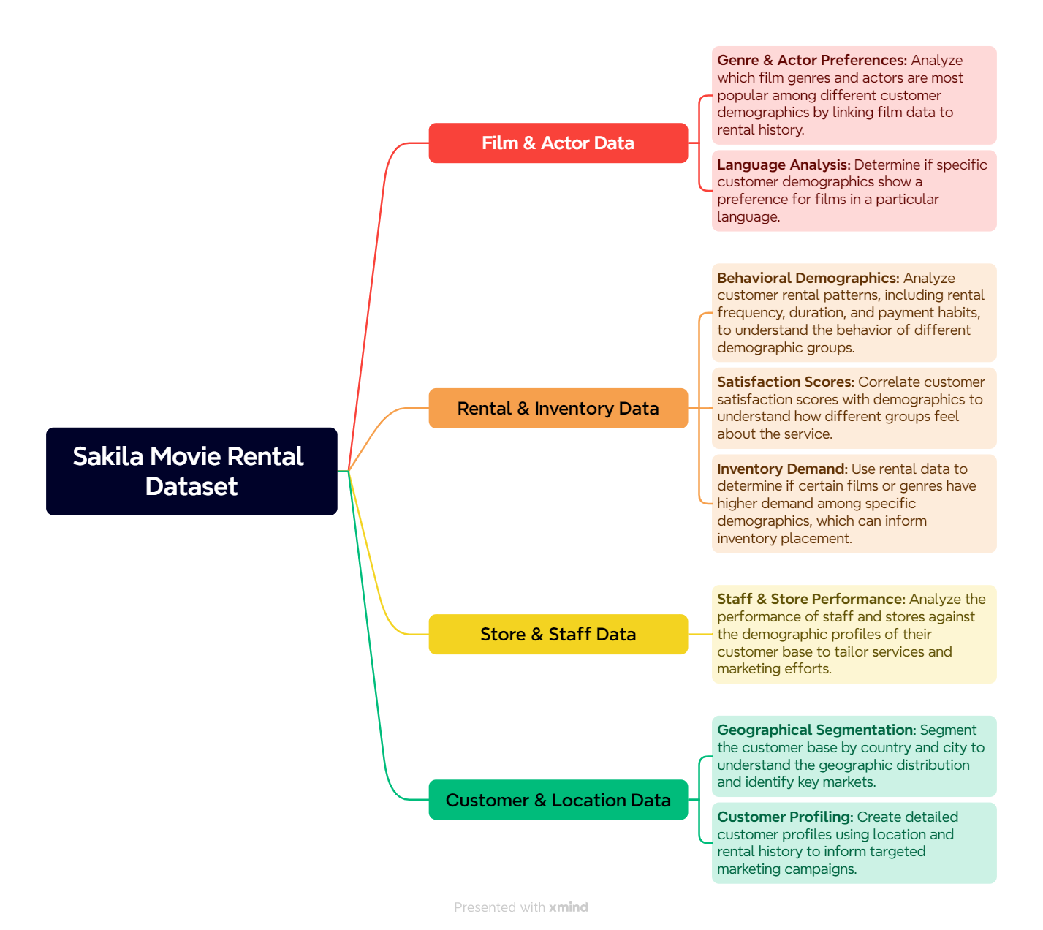
MECE BREAKDOWN
#
#

Slide 8
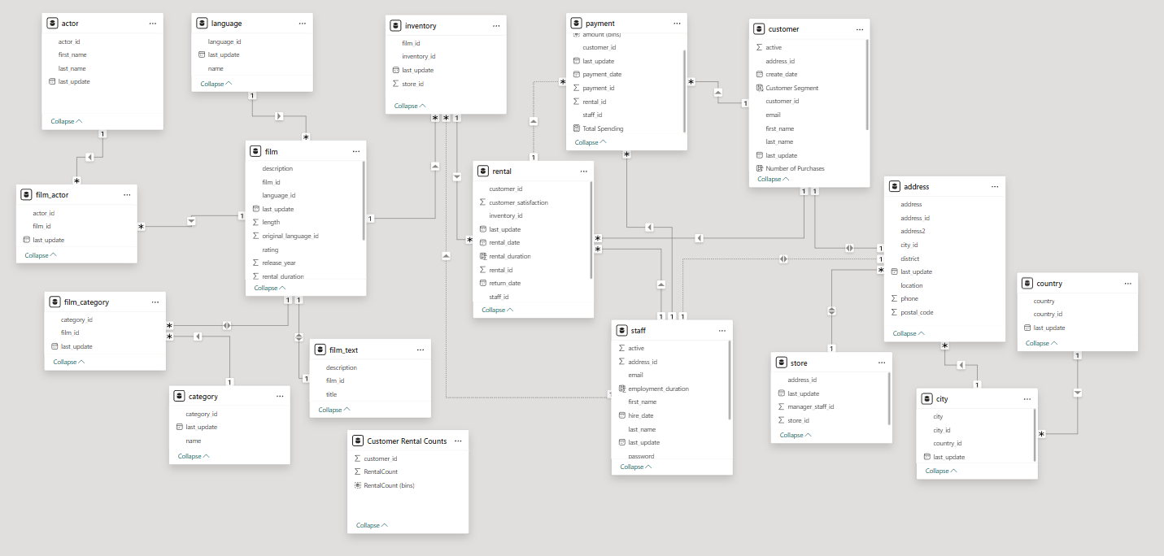
ER DIAGRAM
#
#

Slide 9

#
|
POWER BI
PROBLEM
STATEMENTS
#
#

Slide 10
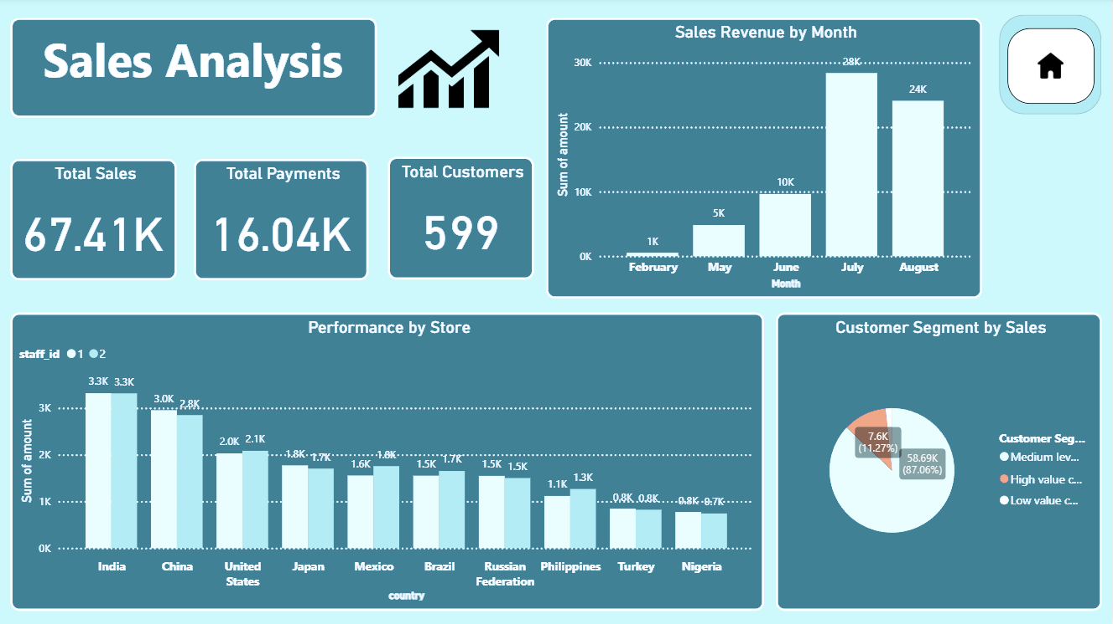
|
#
#

Slide 11
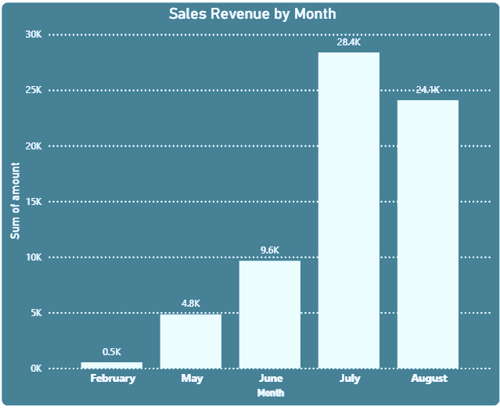
#
|
1.How does sales revenue vary by month?
Significant Growth: Revenue shows a strong upward trend from February to July, indicating successful operations or seasonal peaks.
Peak Month: July is the clear peak month for sales, achieving the highest revenue.
Summer Performance: The period from May to August generally represents the strongest sales performance.
Initial Lows: February had very minimal sales, suggesting a slow start to the year or a period of low activity.
Slight Dip: There was a minor decrease in revenue from July to August, but sales remained robust.
#

Slide 12
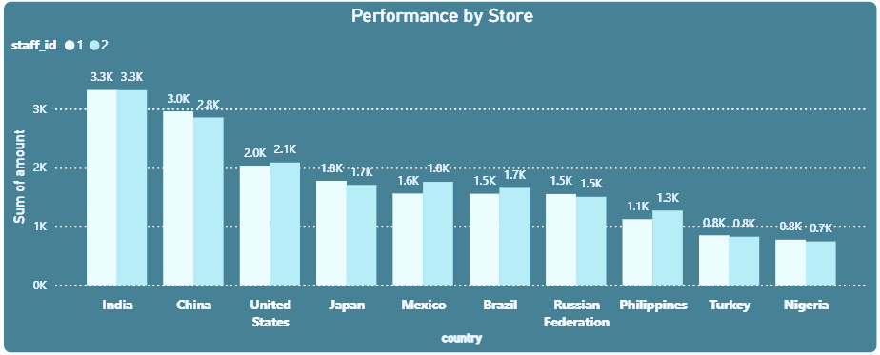
#
|
2. How does the store performance vary by location?
#
#
India and China Lead: These two countries have the highest overall sales revenue.
Staff 1 (Dark Blue) Dominates in India: Staff 1 significantly outperforms Staff 2 in India.
Staff 2 (Light Blue) Leads in China: Staff 2 has higher sales than Staff 1 in China.
Varied Performance by Country: Sales vary significantly across countries, with a general decline from left to right.
Consistent Contribution in Some Countries: In countries like the United States, Japan, and Brazil, both staff members contribute relatively evenly.

Slide 13
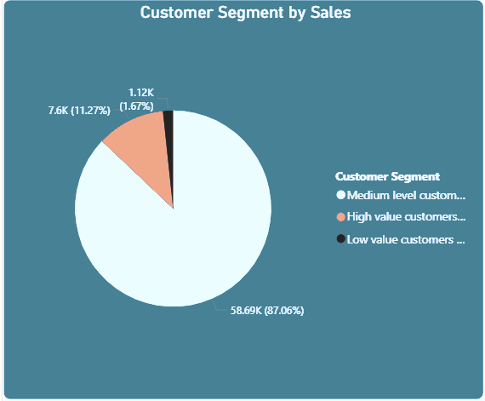
#
|
3. Which customer segments generate the highest sales?
Dominant Medium-Level Customers: The vast majority of sales revenue (87.06%) comes from the medium-level customer segment.
High-Value Customers are Significant: High-value customers, while a much smaller percentage of sales (11.27%), are the second largest revenue source.
Minimal Contribution from Low-Value: Low-value customers contribute a very small portion of sales (1.67%).
Revenue Concentration: The business is heavily reliant on its medium-level customer base for the bulk of its revenue.
#

Slide 14
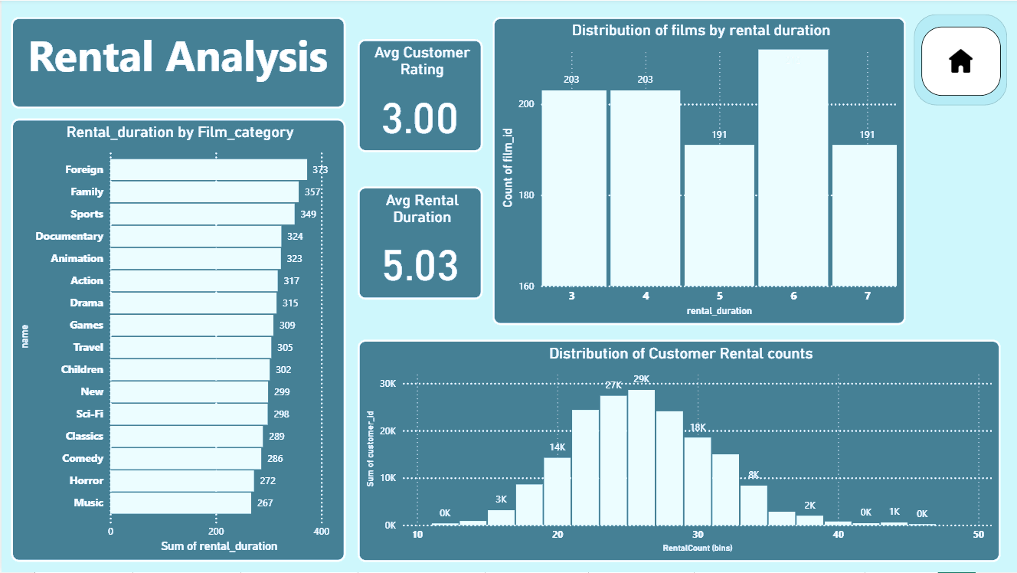
|
#
#

Slide 15
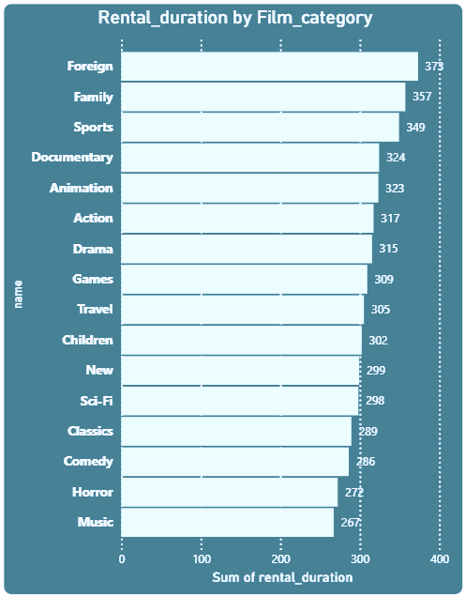
#
|
4. How does the average rental duration vary by film category?
Foreign Films Have the Longest Rentals: The "Foreign" film category has the highest total rental duration, followed closely by "Family" and "Sports." This suggests that customers hold onto these films for longer periods.
Music and Horror Films Have the Shortest Rentals: The "Music" and "Horror" categories have the lowest total rental duration, indicating they are typically rented for shorter periods.
Genre-Specific Engagement: The chart reveals distinct customer behavior patterns based on genre, with some categories (like Foreign films) being associated with longer-term rentals, while others are a quicker turnaround.
Inventory Management Opportunity: Knowing which categories have longer rental durations can help with inventory planning, ensuring there are enough copies of these films to meet demand.
#

Slide 16
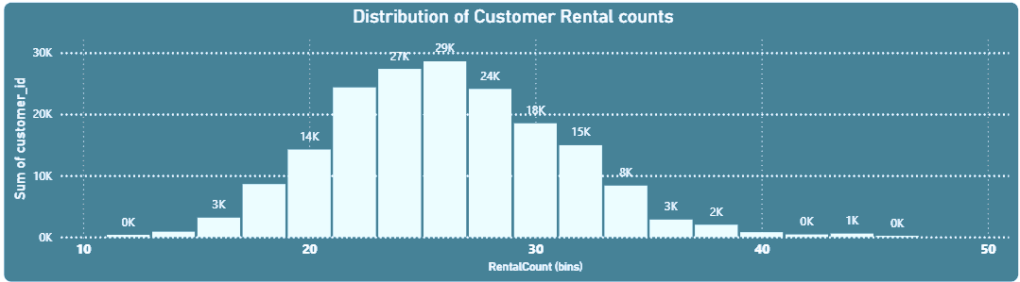
#
|
5. What is the distribution of customers by rental counts?
#
Normal Distribution: The chart shows a bell-curve-like distribution, indicating that the majority of customers have a moderate number of rentals.
Peak Rental Count: The most common rental count for customers is around 25-27, with the highest count of customers at 29K.
Fewer Extremes: Very low (e.g., <15) and very high (e.g., >35) rental counts are much less common.
Customer Base Profile: The data suggests that the typical customer is a frequent, but not extreme, renter. Most of the customer base falls within the central range of rental counts.

Slide 17
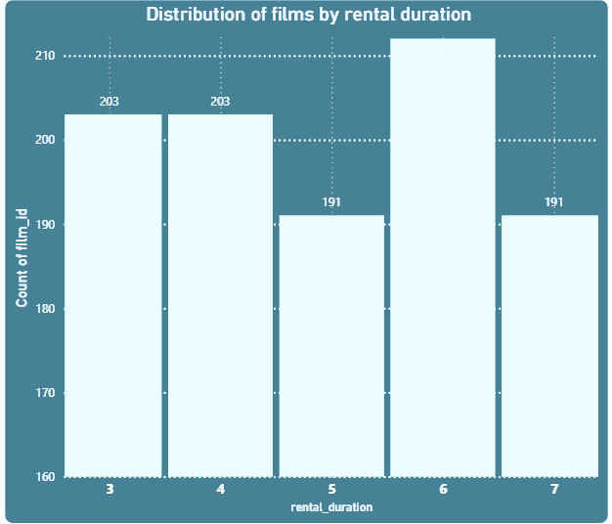
#
|
6. What is the distribution of films by rental duration?
Films with 6-day duration are most common: The majority of films in the catalog are set to a 6-day rental duration (212 films).
3- and 4-day durations are also frequent: There is an equal number of films (203 each) for both 3-day and 4-day rental durations.
5- and 7-day durations are less common: The lowest number of films have a 5-day and 7-day rental duration (191 films each).
Uniform distribution is not present: The distribution of films across different rental durations is not uniform, suggesting a deliberate strategy for setting rental policies.
#

Slide 18
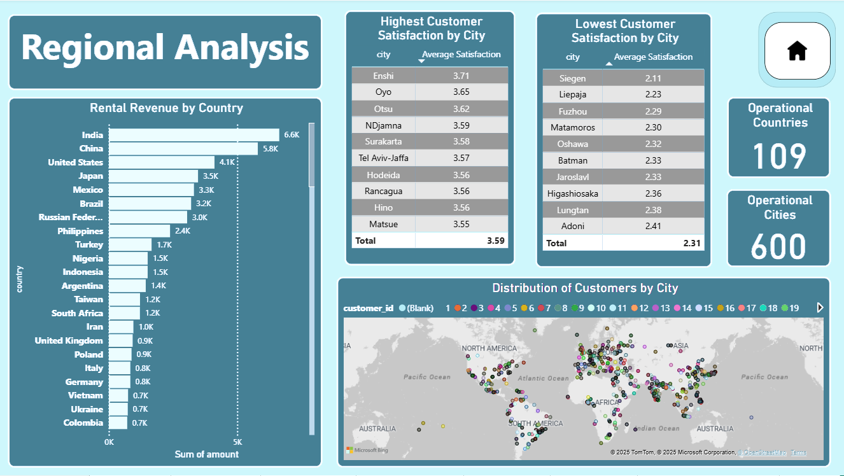
#
|
#

Slide 19
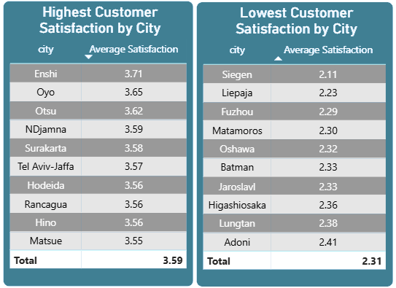
#
|
7. Which locations have the highest and lowest customer ratings?
Varying Satisfaction by Location: Customer satisfaction levels differ significantly across cities.
Top Performers: Cities like Enshi, Oyo, and Otsu have the highest average satisfaction, all above 3.6.
Bottom Performers: Cities like Siegen, Liepaja, and Fuzhou have the lowest average satisfaction, all below 2.3.
Clear Disparity: The overall average satisfaction for the top cities (3.59) is significantly higher than for the bottom cities (2.31), highlighting a large gap in customer experience.
#

Slide 20
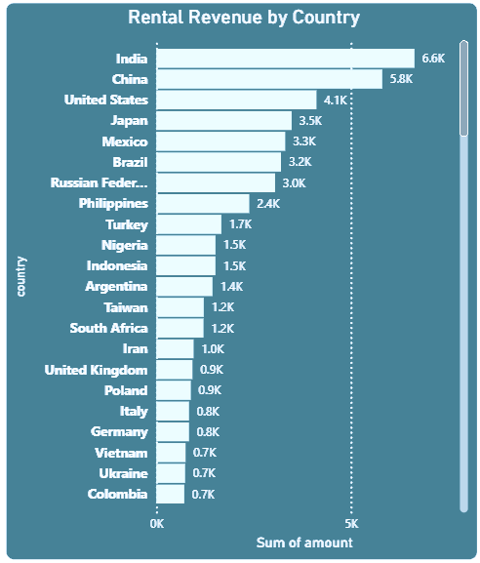
#
|
8. How does the rental revenue vary by country?
India Leads in Revenue: India generates the highest rental revenue at 6.6K, followed by China and the United States.
Top 3 Countries are Major Contributors: India, China, and the United States are the top-performing markets, with significantly higher revenue than other countries.
Steep Drop-off: There is a steep decline in revenue after the top three countries, with a long tail of countries generating lower revenue.
Market Concentration: The business's rental revenue is heavily concentrated in a few key countries, highlighting these markets as the most important for growth and maintenance.
#

Slide 21
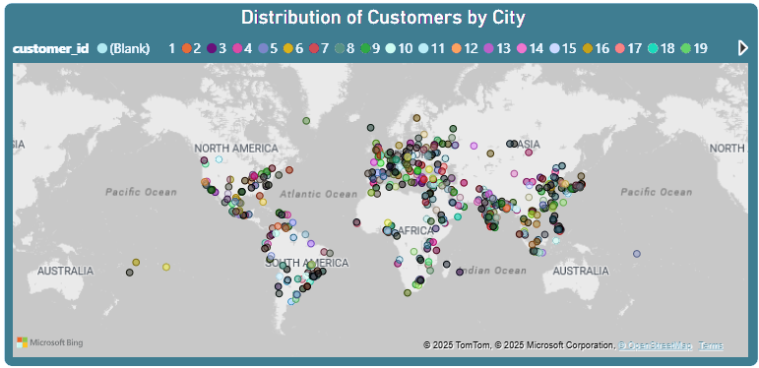
#
|
9. What is the distribution of customers across different cities?
Global Presence: The business has a global customer base, with customers distributed across multiple continents, including North America, South America, Europe, Asia, and Australia.
Geographical Concentration: There is a heavy concentration of customers in specific regions, particularly in Western Europe, the Eastern United States, and parts of Asia.
#
Sparse Distribution in Certain Regions: Some large landmasses, such as Africa and Russia, have a much more sparse distribution of customers, indicating potential for market expansion or a lack of presence there.
No Single Dominant City: The map shows a wide spread of customer locations rather than a single dominant hub, suggesting a decentralized customer base.

Slide 22
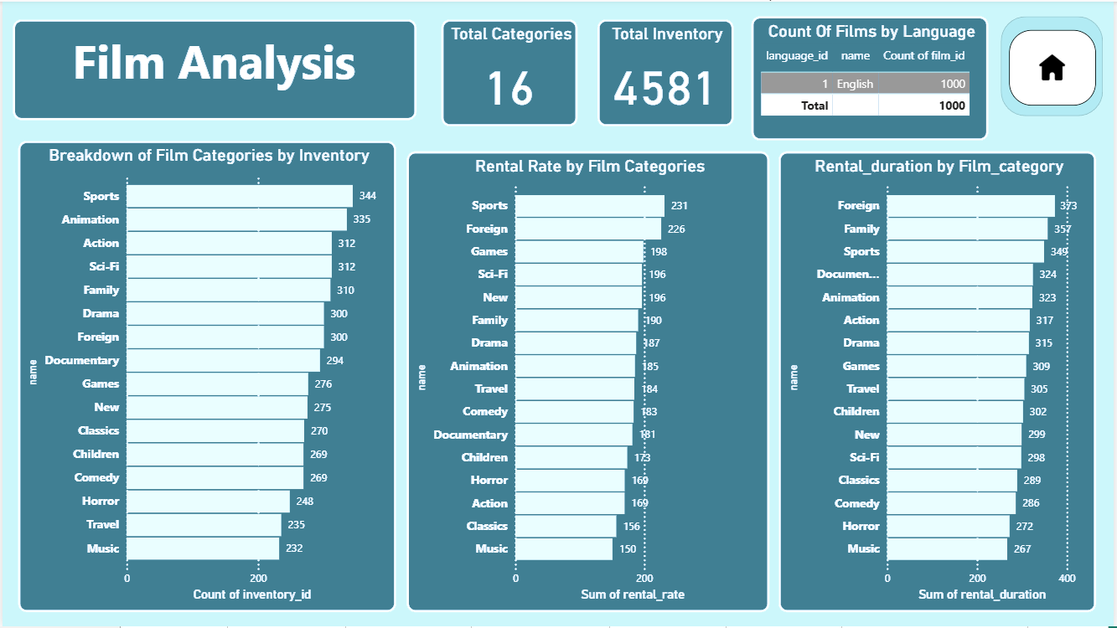
#
|
#

Slide 23
#
|
10. How does the average rental duration vary by film category?
Foreign Films Have the Longest Rentals: The "Foreign" film category has the highest total rental duration, followed closely by "Family" and "Sports." This suggests that customers hold onto these films for longer periods.
Music and Horror Films Have the Shortest Rentals: The "Music" and "Horror" categories have the lowest total rental duration, indicating they are typically rented for shorter periods.
Genre-Specific Engagement: The chart reveals distinct customer behavior patterns based on genre, with some categories (like Foreign films) being associated with longer-term rentals, while others are a quicker turnaround.
Inventory Management Opportunity: Knowing which categories have longer rental durations can help with inventory planning, ensuring there are enough copies of these films to meet demand.
#

Slide 24
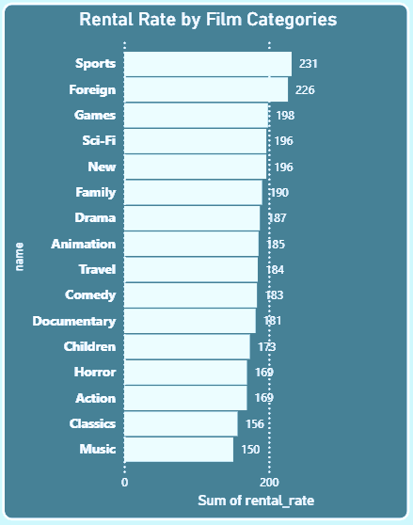
#
|
11. How does the average rental rate vary by film category?
Sports Films have the highest total rental rate, followed by Foreign films.
Music and Classics have the lowest total rental rate.
This indicates that certain film categories command a higher overall rental rate, likely due to a combination of volume and price.
The data can be used to inform pricing strategies, as it shows which categories are most valuable from a rental rate perspective.
#

Slide 25
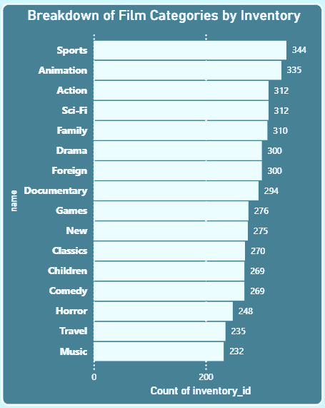
#
|
12. What is the breakdown of film categories in the inventory?
Inventory is Highest for Popular Genres: The largest number of film copies (inventory) is for categories like Sports, Animation, and Action.
Music and Travel Have Least Inventory: The lowest number of film copies are for Music and Travel categories.
Inventory Aligns with Demand: The inventory allocation seems to be well-aligned with what would be popular categories, ensuring more copies of high-demand films are available.
Potential for Optimization: There may be opportunities to adjust inventory for categories with low rental duration or rate to free up space for more popular titles.
#

Slide 26
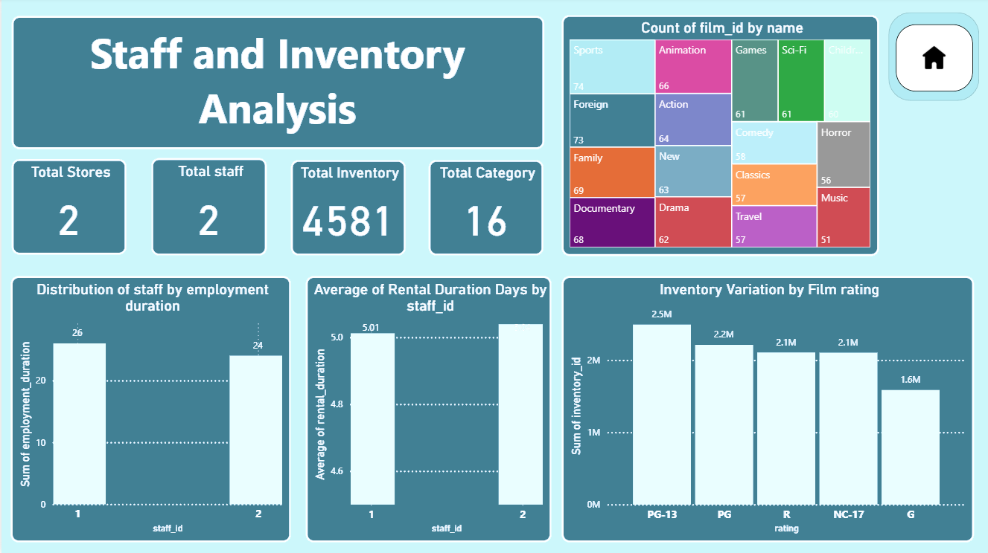
#
|
#

Slide 27
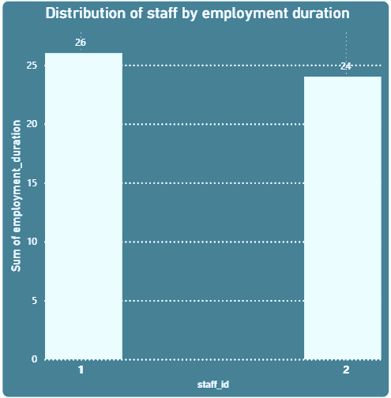
#
|
13. What is the distribution of staff by employment duration?
Staff 1 has a slightly longer employment duration than Staff 2.
The employment durations for both staff members are very similar, with Staff 1 at 26 and Staff 2 at 24.
The chart shows a relatively consistent tenure for the two staff members.
This data suggests low staff turnover and a stable management team for the two stores.
#

Slide 28
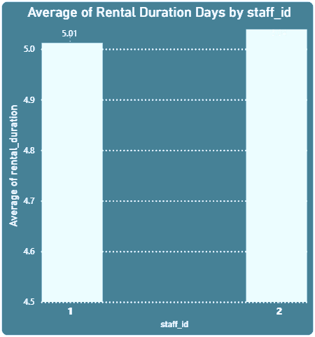
#
|
14. What is the average rental duration by staff member?
Staff 2 has a slightly higher average rental duration than Staff 1 (5.04 days vs. 5.01 days).
The average rental durations are extremely similar for both staff members.
This suggests consistency in customer behavior regardless of which staff member processed the rental.
The difference between the two is negligible, indicating no significant impact from individual staff on rental duration.
#

Slide 29
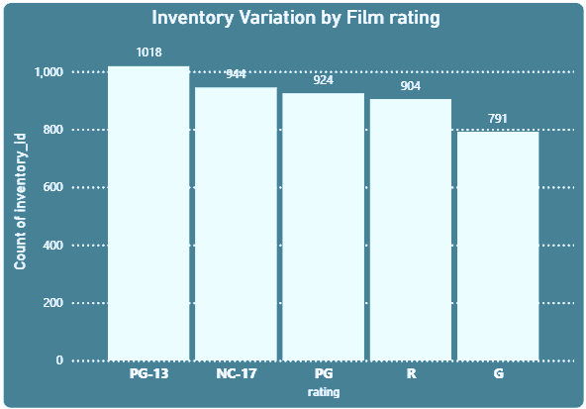
#
|
15. How does the inventory vary by film rating?
PG-13 is the most stocked film rating, with the highest inventory count.
G-rated films have the lowest inventory, suggesting they are the least available.
The inventory count generally decreases from PG-13 to G, showing a descending order of availability.
This indicates a strategic focus on providing a larger selection of PG-13 films, potentially reflecting higher demand for this rating.
#

Slide 30

#
INSIGHTS
1. Sales & Revenue Trends
Significant Growth: Revenue grew dramatically from $500 in February to a peak of $28,400 in July, demonstrating a strong upward trajectory.
Peak Season: May to July is the peak sales season, with revenue consistently increasing.
Sustained Performance: Sales remained strong at $24,100 in August, even after the July peak.
2. Customer Demographics & Behavior
Revenue Concentration: 87.06% of sales revenue comes from "Medium-level customers," while "High-value customers" contribute 11.27%, highlighting the need to retain these segments.
Rental Frequency: The majority of customers are moderate renters, with rental counts between 25 and 27.
Global Presence: The company has a broad customer base, with clusters in North America, Europe, and Asia, though distribution is sparse in some regions.
Satisfaction Disparity: Customer satisfaction varies widely, with cities like Enshi having high scores (above 3.6) and others like Siegen having very low scores (below 2.3).
#

Slide 31
#
3. Store & Staff Performance
Market Leadership: India and China are the top-performing countries in terms of rental revenue.
Balanced Performance: The two stores and their staff members show remarkably balanced performance in both revenue and rental volume.
Consistent Staffing: Staff employment durations are very similar, indicating a stable and experienced team.
No Staff Impact: Staff members do not influence the average rental duration of a film.
4. Film Catalog & Inventory Analysis
Inventory Alignment: The company holds the most inventory for the most popular categories (Sports, Animation, Action).
Rental Duration: Foreign, Family, and Sports films have the longest average rental durations.
Rental Rates: Sports and Foreign films command the highest overall rental rates.
Inventory by Rating: Inventory is highest for PG-13 films and lowest for G-rated films, indicating a focus on an older audience.
#

Slide 32

#
STRATEGIC SUGGESTOINS
Based on the detailed analysis of the Sakila Movie Rentals dataset, here are some strategic suggestions to improve the growth and profitability of the company.
1. Maximize Customer Lifetime Value (CLTV)
Implement a Tiered Loyalty Program: Create a program that rewards customers based on their spending and rental frequency. For example, a "Silver Tier" for medium-level customers and a "Gold Tier" for high-value customers. Offer exclusive benefits like early access to new releases, bonus rentals, or personalized discounts to each tier.
Targeted Outreach for New Customers: Develop an automated email campaign that sends a personalized film recommendation and a "welcome back" discount to new customers a few days after their first rental. The goal is to encourage a second transaction and move them into the "Medium-level customer" segment.
Re-engagement Campaigns: Identify customers who have not rented in a while and send them a promotional offer, such as a "We Miss You" discount, along with a curated list of popular films from their favorite genres.
#

Slide 33
#
2. Optimize Inventory and Pricing
Data-Driven Inventory Management: Use the insights on popular categories (Sports, Animation, Action) and high-rate categories (Sports, Foreign) to strategically increase inventory. Simultaneously, analyze the low-performing categories (Music, Travel) and consider reducing their inventory to free up capital for more popular films.
Dynamic Pricing Strategy: Given that Foreign films have both a high rental rate and a long duration, explore a dynamic pricing model that slightly increases the rental price for these popular and in-demand titles.
Expand into New Segments: The low inventory for G-rated films suggests an untapped market. Increase the number of family-friendly films to attract this customer base and potentially create a new revenue stream.
3. Enhance Operational Efficiency and Resilience
Investigate Customer Satisfaction Discrepancies: Conduct a deeper analysis into the reasons for the low customer satisfaction scores in cities like Siegen and Fuzhou. This could involve surveying customers, reviewing staff performance in those locations, or assessing the quality and variety of the film catalog available there.
Develop a Staffing Redundancy Plan: The reliance on a single staff member per store is a major risk. Cross-train an additional part-time employee or establish a plan for temporary coverage to ensure that the stores can operate smoothly in case of staff absence.
Standardize Best Practices: Formalize the operational procedures and customer service strategies used by Staff 1 and Staff 2, as their balanced performance indicates they are both effective. Share these best practices across all stores to standardize excellence and create a repeatable blueprint for future expansion.
#

Slide 34
#
4. Explore New Market Opportunities
Targeted Expansion: Given the strong performance in India, China, and the USA, prioritize market research for new store locations within these countries. Analyze specific cities and demographics to identify the most promising new markets.
Evaluate Under-Tapped Regions: While the current customer base is sparse in regions like Africa, consider a low-cost entry strategy, such as a pop-up rental service or a partnership with local businesses, to test the market's viability before a full-scale investment.
Introduce a Digital Component: While the core business is physical rentals, consider a simple digital platform to complement it. This could be a website for browsing the catalog, reserving films, or providing personalized recommendations, which would enhance the customer experience without a full shift away from the physical model.
#
#

Slide 35
#
#
Thank
you!
#
#
FOR DETAILS CONTACT
siddhantchandekar2001@gmail.com

