Slide 1

“I’m interested in doing great things with different views.”
Add image that represents this persona
Goals
Increased responsibilities in the office where they work.
Need care and attention to detail in every task
Completing small work tasks.
Frustrations
It’s difficult to make sure the timing is right.
Sometimes large seats are lessly filled.
I have to wait in line or queue for long time till the shop become crowd free.
Name
Age:
Education:
Hometown:
Family:
Occupation:
25
College Student, B.A.
America
2 pets (Dogs)
Marketing Agent.
Harshika is about to complete a B.A. in business Admiration and hopes an Internship will launch their career in marketing. Even though Harshika most enjoys the time spent working with their mentor on a marketing campaign, they also feel that the task of getting tickets for the office is an opportunity to network and to demonstrate being a team player with keen attention to detail. I want to spend my time in online ticket booking.

Slide 2
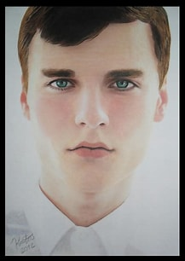
“To work forward and go ahead towards goals”
Goals
To learn advanced English-language experience.
Tend to be new residents in the areas not near to cinema theater serves and are unfamiliar with local shopping options.
To pick food for from different place and send in right time.
Add image that represents this persona
Frustrations
Feel uncomfortable dining in their local restaurants or shopping in the local grocery stores.
To help non native language speakersstanding a long queue and not able to convey his booking.
Name
Age:
Education:
Hometown:
Family:
Occupation:
55
High graduate
Norway
Lives with parents
server
Salim is a server who lives in town and mostly works in night shift. During the daytime, he does the online work and work at Zia’s pizza in our company for 4 hours to learn new skills. He usually comes to café for working peacefully in noise less area. Through he need wi-fi for working on his online courses but in coffee shop the wi-fi connection is less and noise level is more . He was not able to do his work. Where network conncetion is less so booking online was difficult

