Slide 1

HEAPDUMP ANALYZER
Presented by:
Keerthika S

Slide 2
Agenda
WHAT IS HEAPDUMP?
PROBLEM STATEMENT
CONS IN TRADITIONAL METHODOLOGY
SOLUTION
PROS

Slide 3
WHAT IS HEAPDUMP?
client ID
AWS secret key
bearer token
A heap dump is a snapshot of all objects in the JVM heap, which allocates memory for objects.
Username
password
SAT token

Slide 4
PROBLEM STATEMENT
The PSIRT team manually analyses this heap dump submission from external security researchers and searches the above sensitive data to triage with the product team.
As the heap dump file size is enormous, manual searching might lead to missing some sensitive information hidden inside the heap dump.

Slide 5
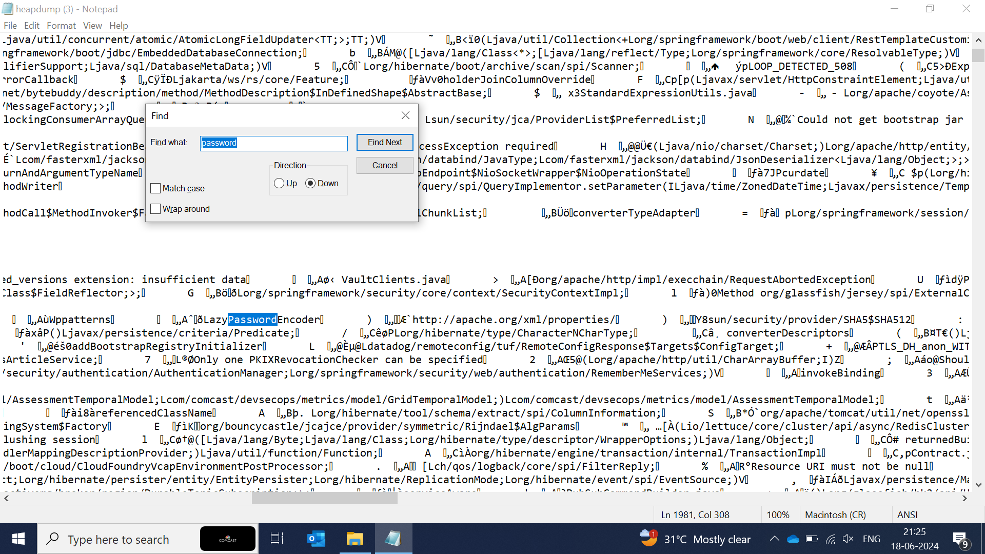
CONS IN TRADITIONAL methodology
Manual searching
Line-by-line analysis
Time-consuming (30+ Minutes)
Search results contain unwanted/junk data
It is possible to miss sensitive information

Slide 6
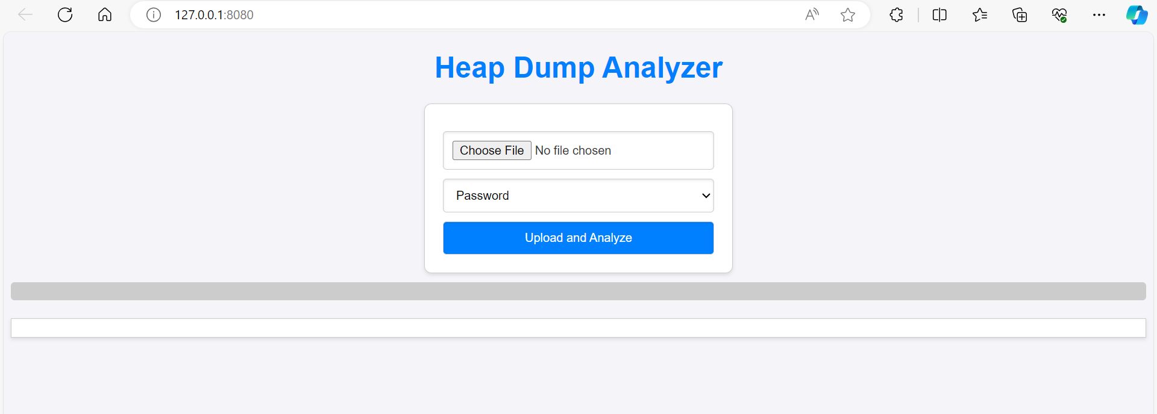
solution
Created a webpage where it will get the heap dump file as input.

Slide 7
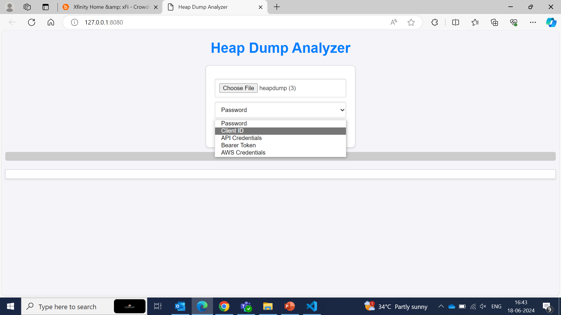
Select the sensitive data which we want to search

Slide 8
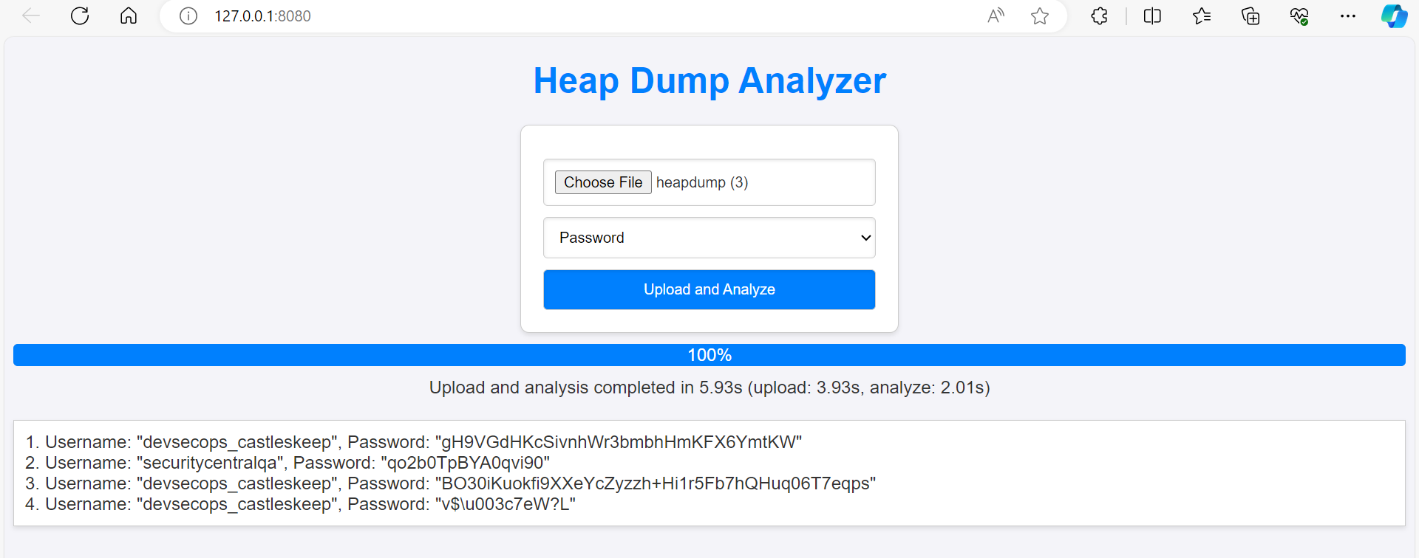
Click on upload and analyze to fetch relevant data.

Slide 9
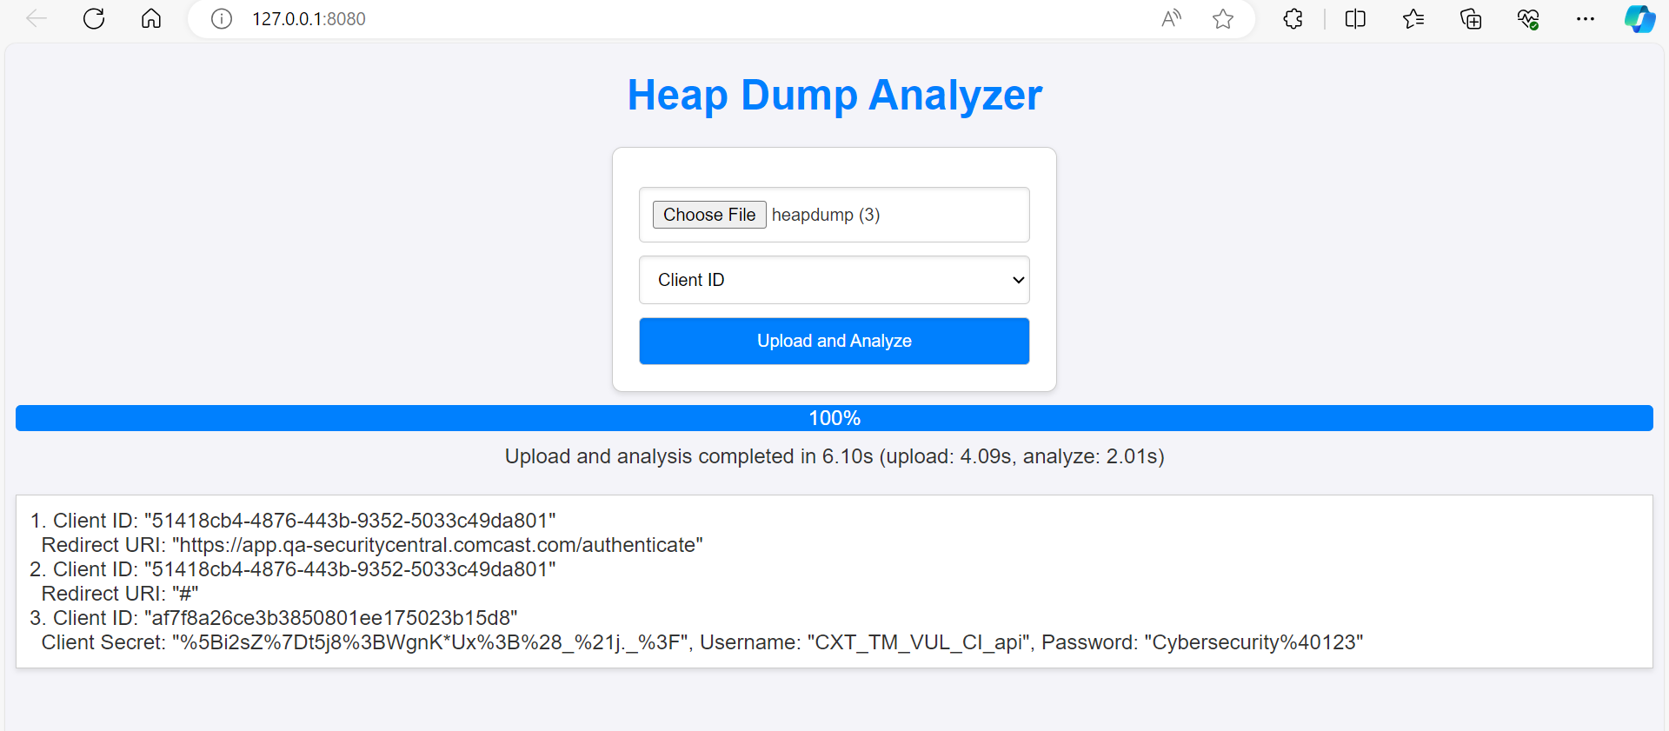
Sample result for Client id

Slide 10
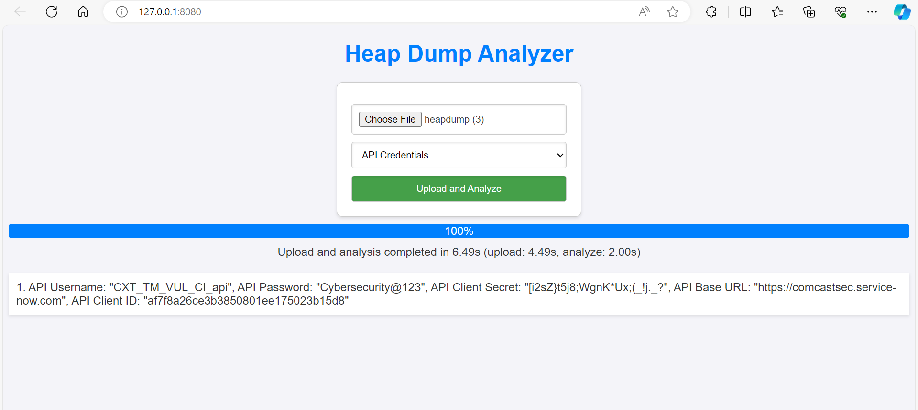
Sample result for API Credentials

Slide 11
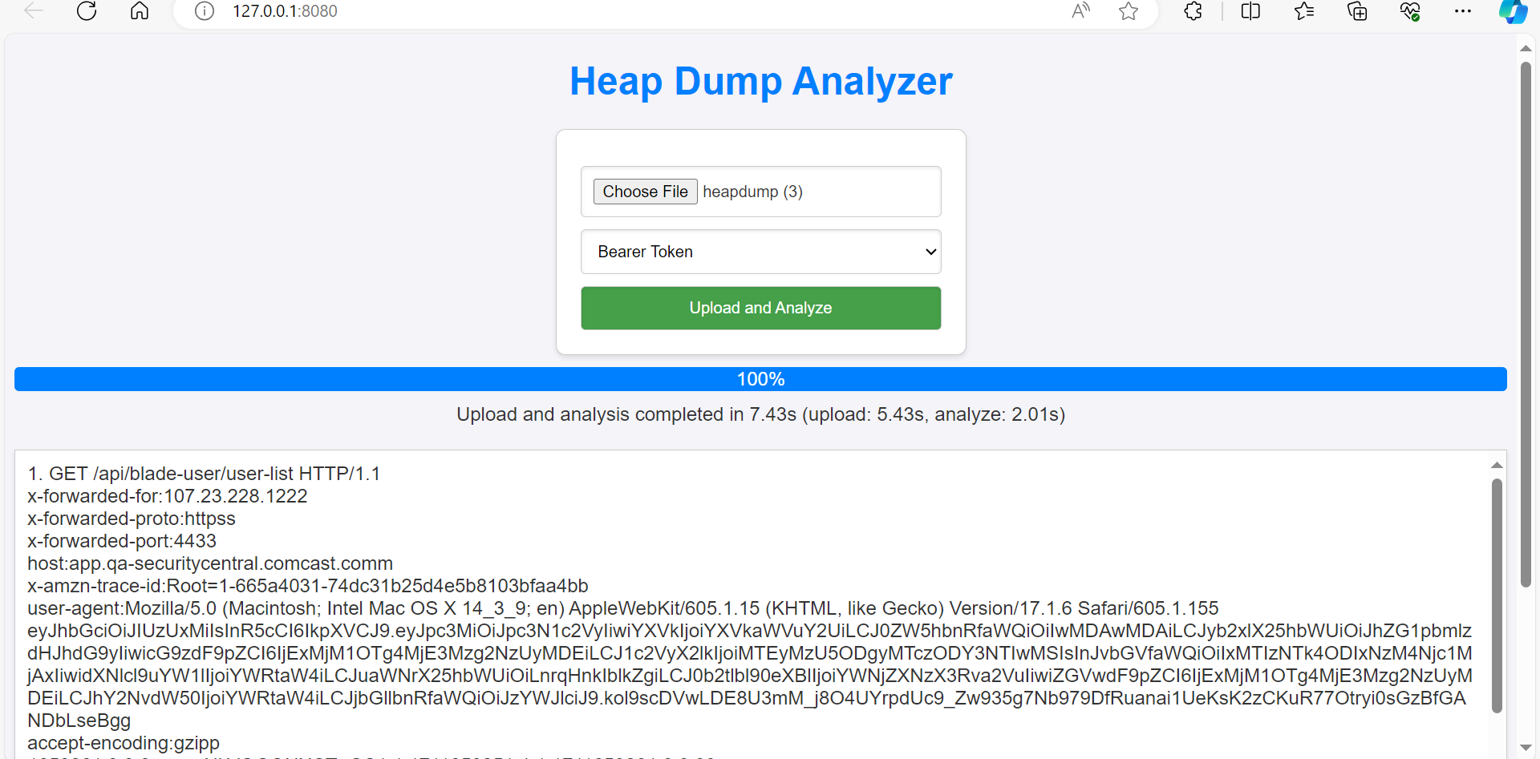
Sample result for Bearer token

Slide 12
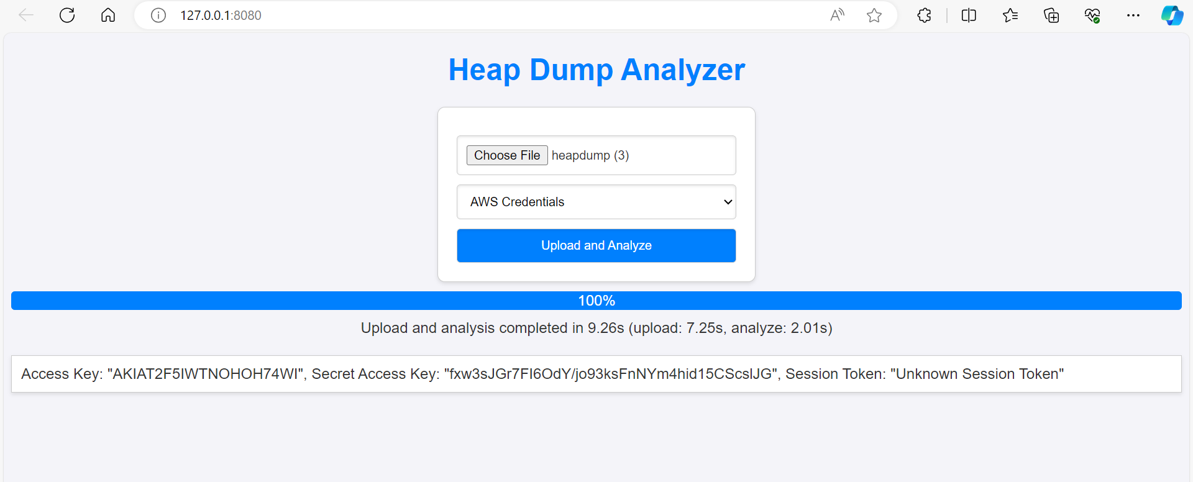
Sample result for AWS Credentials

Slide 13
PROS
Time efficient
Accurate fetching of sensitive data
Efficient analysis of heap dump file

Slide 14

THANK YOU

