Slide 1
Penumbra: day-ahead solar forecasts that know when they're unsure
Calibrated probabilistic forecasting for Belgium's 12.1 GW PV fleet, benchmarked against the grid operator — DataNova 2026 · Sustainability · DN-SU-01
Adrian Issac Mamani Quispe · Arequipa, Peru
Live demo: https://skkippie.me/penumbra-solar-forecast/
Notes:
Penumbra forecasts tomorrow's Belgian solar output with calibrated uncertainty, and is scored against Elia's own operational forecast.

Slide 2
Solar is now Belgium's largest day-ahead uncertainty
12.1 GW
335 MW
1,539 MW
installed PV, up from 9.1 GW
average hourly error of the TSO forecast
P99 shortfall to cover with reserve
Elia monitored capacity, Apr 2024 → Oct 2026
Elia D-1 11h, daylight hours, backtest period
hourly over-forecast, 99th percentile
Day-ahead positions close at 12:00 on D-1: every MW of forecast error is bought back in balancing, mostly from gas plants.
Point forecasts hide how sure they are. Reserves and trading need honest uncertainty — wide when skies are mixed, tight when clear.
Who needs it: TSOs and DSOs (reserve sizing), balance-responsible parties and aggregators (bidding), and grids in emerging solar markets that lack a TSO-grade forecaster.
Notes:
The problem is DN-SU-01: forecast solar generation from weather and plant data to support grid stability and renewable planning.

Slide 3
Real, public, verifiable data — 2.5 years, hourly
Source | What we use | Licence
Elia Open Data (ods032 / ods209 / ods210) | Measured PV output, installed capacity, 11 provinces, 15-min; Elia's D-1 11h forecast with P10/P90 | Elia Open Data Licence
Open-Meteo Previous Runs API | 8 NWP models archived at fixed 24 h / 48 h lead; GHI, direct, cloud, temperature at 11 provincial points | CC BY 4.0
Energy-Charts (Fraunhofer ISE) + Elia ods134 | Day-ahead and imbalance prices — impact analysis only, never model input | CC BY 4.0 / Elia
22,409
hourly targets, none imputed
0.88 % missing hours dropped
12,273
Quarter-hours → hours only when all four exist; numbers stored as text with decimal commas are parsed and validated.
Radiation fields re-labelled to the interval they describe (verified: correlation peaks at zero lag).
Installed capacity lagged 2 days; target = capacity factor, so 33 % fleet growth does not leak.
daylight hours used for scoring
sun elevation > −2°

Slide 4
Pipeline and the no-look-ahead rule
Ingest
Features
Model
Calibrate
Deliver
Elia + 8 NWP models
11 provinces, hourly
capacity-weighted irradiance, clear-sky index (pvlib), POA, model spread, spatial dispersion, trailing performance ratio
LightGBM quantiles P10/P50/P90 (+ Elia 11h in Hybrid)
Mondrian conformal per sun-elevation regime, last 60 days
GitHub Action 10:30 UTC → append-only log → dashboard
Honesty rules (unit-tested)
Strict setting uses weather runs issued 48 h before each hour — all available before Elia's D-1 11:00 forecast.
Rolling-origin backtest: refit every month, predict the next unseen month (19 months, 575 days).
Every method scored on the identical set of daylight hours; significance by Diebold–Mariano + block bootstrap.

Slide 5
Ties the grid operator on accuracy, beats it on uncertainty
2.88 %
29 %
10.4 %
Hybrid nMAE (strict) — Elia 2.87 %
narrower 80 % band than Elia's P10–P90
better Winkler interval score than Elia
optimistic inputs: 2.74 % vs 2.87 %
coverage 81.2 % vs 80.0 %
pinball 0.919 vs 0.969
Weather-only Penumbra, from free data alone: 3.50 % (strict) / 3.08 % (optimistic) — 55 % better than persistence.
Hybrid vs Elia on point error: −0.2 % (strict, DM p = 0.98) and +4.6 % (optimistic, p = 0.01).
The gain is in uncertainty: same coverage, much tighter bands → less reserve held for the same risk.

Slide 6
What the improvement is worth
445 MW
7.45 €/MWh
3.2 M€/yr
narrower average 80 % band
imbalance cost of forecast error
lower imbalance settlement
at today's 12.1 GW, same coverage
Elia's forecast: 7.71 €/MWh
whole fleet, price-taker illustration
Reserve sizing: a TSO dimensions upward/downward reserve from forecast uncertainty — a band that is narrower at equal coverage is directly less capacity held idle (mostly gas).
Trading: a balance-responsible party can bid the quantile that minimises its expected imbalance cost instead of a single number.
Honest caveat: the P99 hourly over-forecast is 79 MW worse than Elia's — concentrated in negative-price hours when PV is curtailed.
Assumptions are explicit (price-taker, hourly settlement); figures are orders of magnitude, not a market simulation.

Slide 7
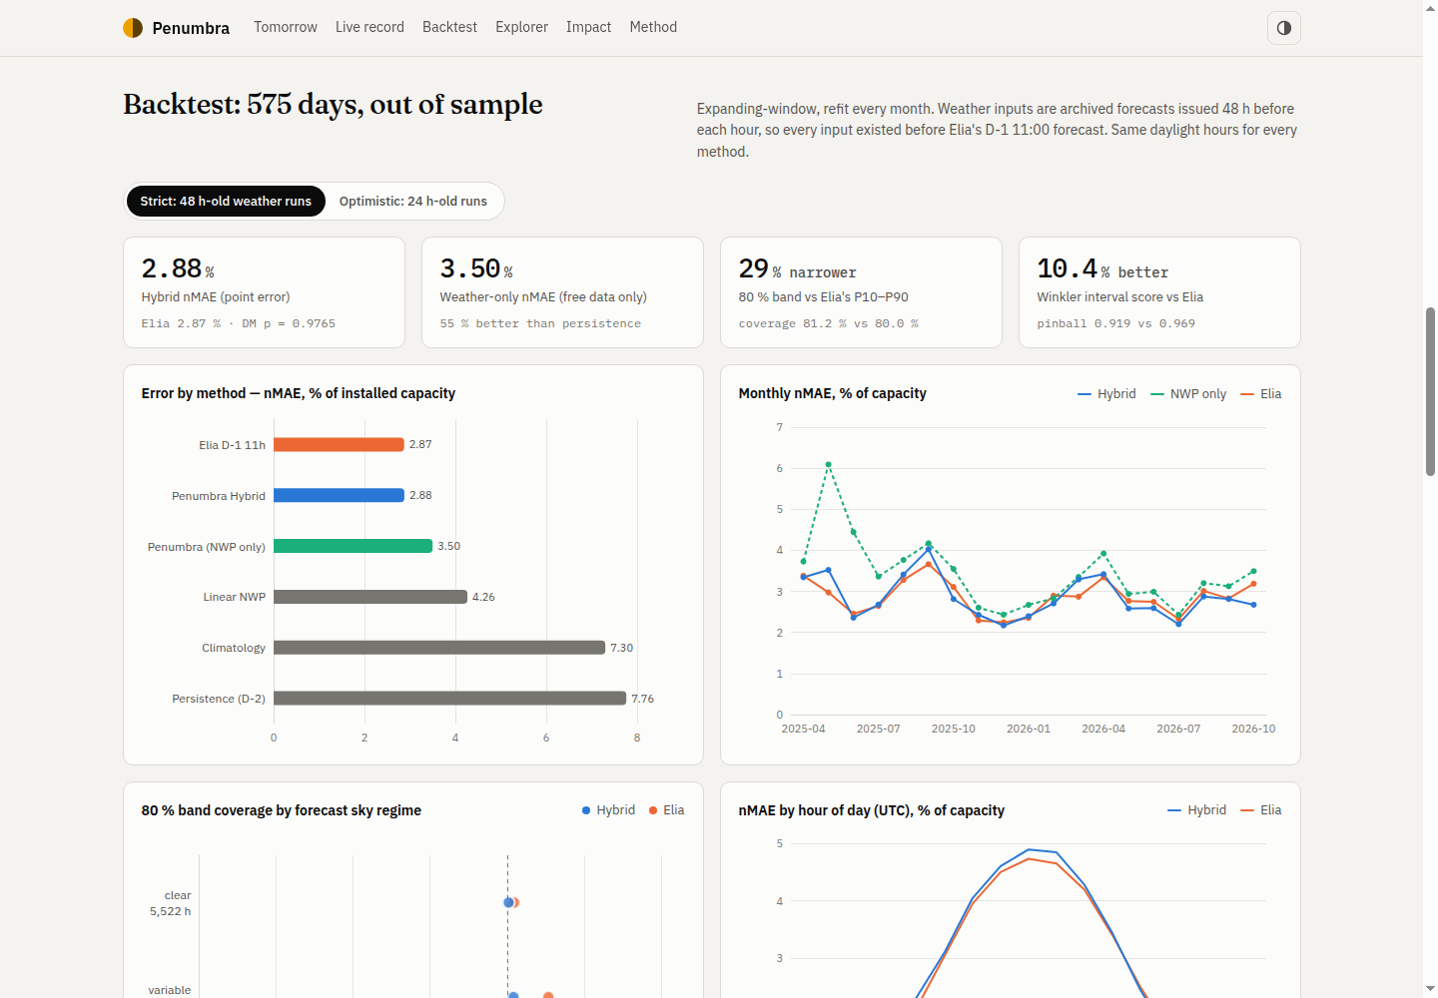
Live dashboard and verifiable track record
Tomorrow: fan chart with P10–P90 band next to Elia's forecast.
Live record: daily error vs Elia, coverage, issue timestamps.
Backtest: method comparison, monthly skill, calibration, significance tests.
Explorer: any of the backtest days, with shortcuts to the hardest ones.
Demo
https://skkippie.me/penumbra-solar-forecast/
Code
https://github.com/S-kkipie/penumbra-solar-forecast

Slide 8
Limits, responsible use and team
Known limits
Responsible data use
Target is Elia's upscaled estimate of the fleet, not metered totals.
Market-driven curtailment at negative prices is only proxied (weekend/holiday flag, trailing ratio).
Accuracy depends on weather-run freshness: 48 h- vs 24 h-old runs cost 0.4 pp nMAE (weather-only).
National aggregate only; per-province models are future work.
Aggregate, non-personal public data under open licences; all sources credited; claims reproducible from the repo; no result is reported without its benchmark and confidence interval.
Team
Adrian Issac Mamani Quispe (Arequipa, Peru) — full-stack / AI engineer: problem framing, data pipeline, modelling, evaluation, live system, dashboard and documentation.

