Slide 1
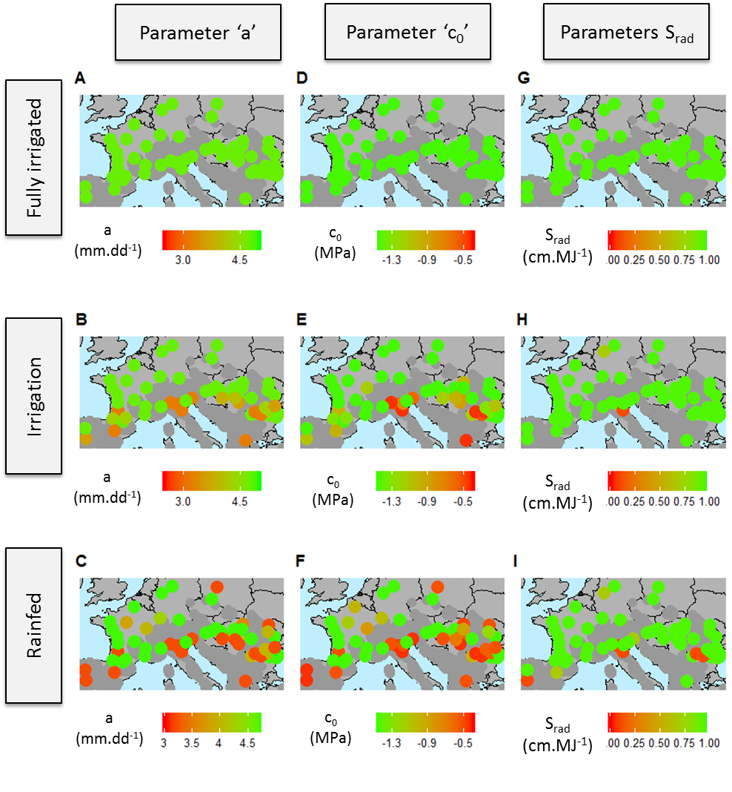
Figure 1 : Best parameter value calculated for each site in the three water scenarios using a grid of parameters values. Colored points : best parameter values for the genotype with the highest mean yield over the 36 years of simulation in each site. Simulation were performed using virtual genotypes defined by a grid of parameters values.
Grid of parameters (a;c0;sR)

Slide 2
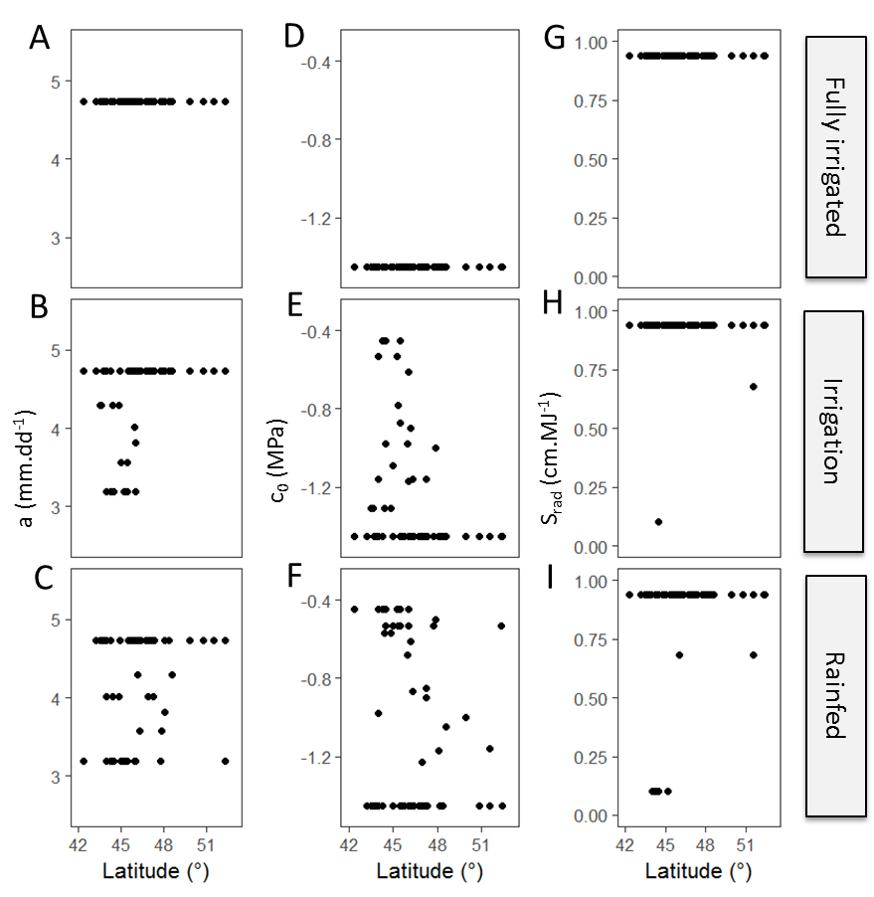
Figure 2 : Evolution with latitude of the best parameters values calculated for each site in the three simulated water conditions. Simulation were performed using 216 virtual genotypes defined by a grid of parameters values, with the three studied parameters : ‘a’ ; ‘c₀’ and ‘s_{R}’.
Grid of parameters (a;c0;sR)

Slide 3
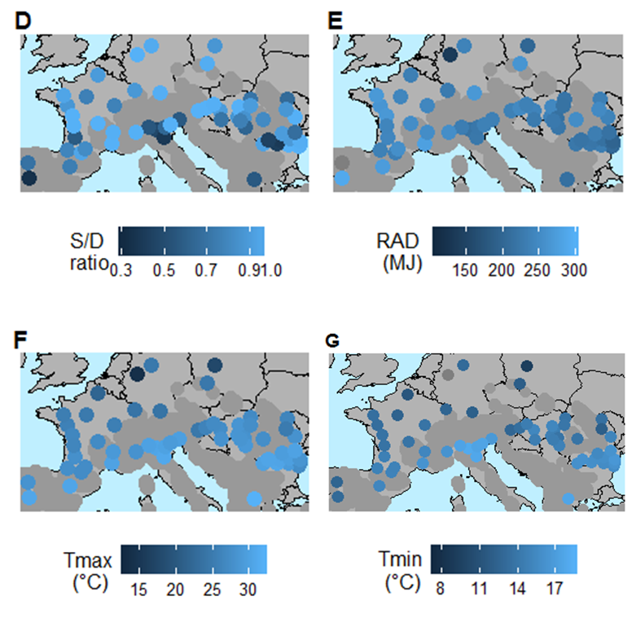
A
B
C
D
Figure 3 : Map of the water supply demand ratio, the incident radiation and the maximum and minimum temperature (A,B and C) calculated for each site in rainfed conditions for the best set of parameter values.

Slide 4
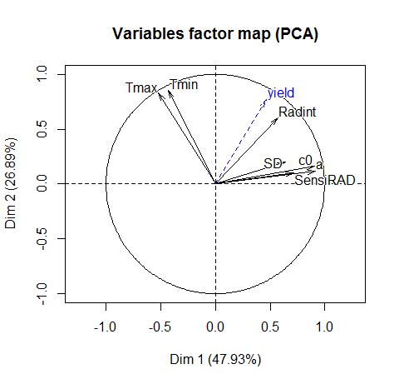
A
B
Variable contribution | Dim 1 | Dim 2 | Dim 3 | Dim 4 | Dim 5
a | 25% | 0% | 1% | 14% | 8%
c0 | 25% | 2% | 2% | 14% | 4%
sensiRAD | 15% | 1% | 2% | 66% | 14%
Tmax | 8% | 37% | 1% | 0% | 3%
Tmin | 6% | 40% | 1% | 1% | 26%
Radint | 10% | 20% | 27% | 4% | 30%
SD | 12% | 2% | 66% | 1% | 15%
Variance Explained | 48% | 27% | 11% | 10% | 3%
Figure 4 : Principal axes (A) of the ACP performed with the best set of parameters values and corresponding mean environmental conditions in each site and table (B) of the contributions of each variable to each axes. Simulation were performed using virtual genotypes defined by a grid of parameters values.
Grid of parameters (a;c0;sR)

Slide 5
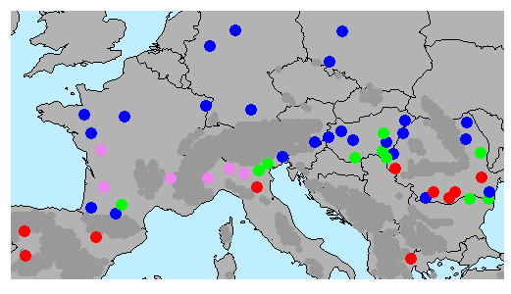
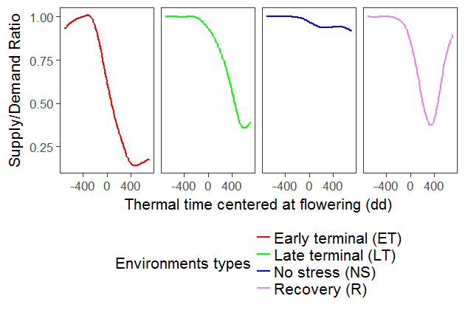
A
B
Figure 5 : Clusters of environment types characterising water stresses in the network of sites. (A) Map of dominant stress in each cluster , colors represent environment types characterised by various hydric stress around flowering (B). The clusters of environment types are defined from the evolution of supply demand ratio (APSIM water stress index) 400 degree.days⁻¹ around flowering. Clusters are estimated from the outputs simulations of the reference hybrid.

Slide 6
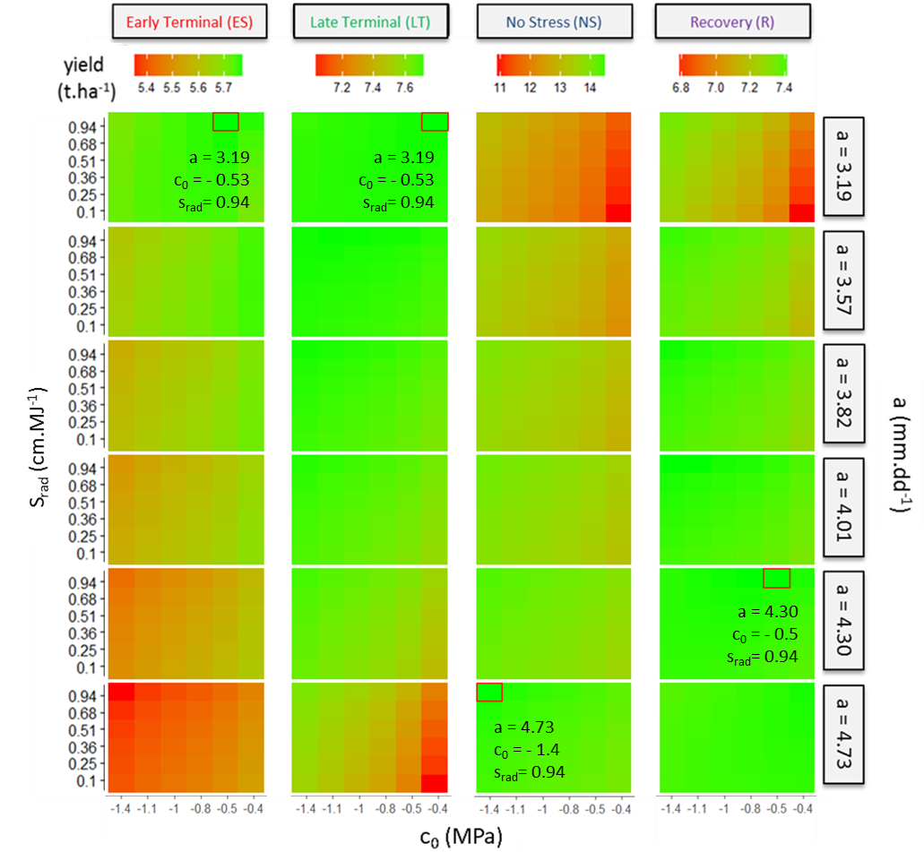
Figure 6 : Heatmap (A) of the effects of the three studied parameters on end of season yield in the four types of water stress in the grid of studied sites. x-axis : parameter ‘c₀’ ; y-axis : parameter ‘s_{rad}‘ ; rows : parameter ‘a’ ; columns : cluster of water stress. Simulation were performed using virtual genotypes defined by a grid of parameters values. The maximum yield in each cluster is represented by a red rectangle, with the associated best parameters values.
Grid of parameters (a;c0;sR)

Slide 7
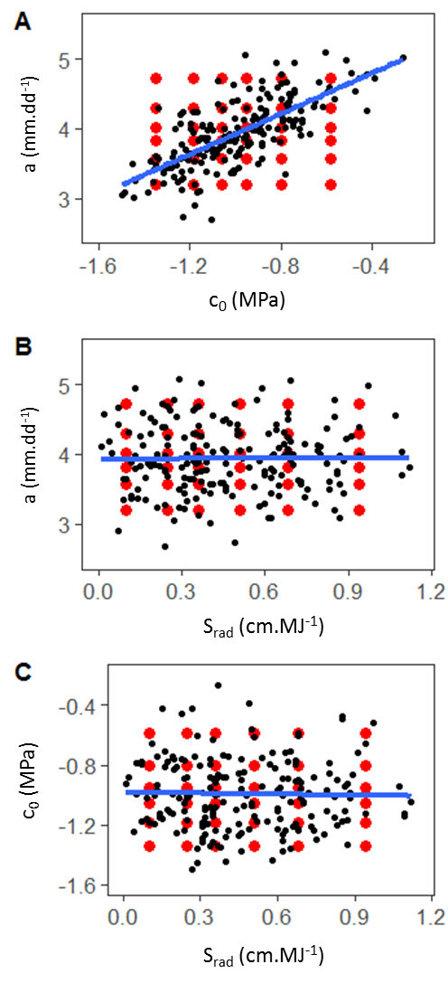
Figure 7 : Scatterplot of the relationships between measured values o the three studied parameters. A : Black points : measured value for the studied panel of 254 hybrids. Blue line : linear regression (method ‘lm’, R software). Red points : grid of 6 x 6 x 6 = 216 vector of values used to define parameters of virtual genotypes.

Slide 8
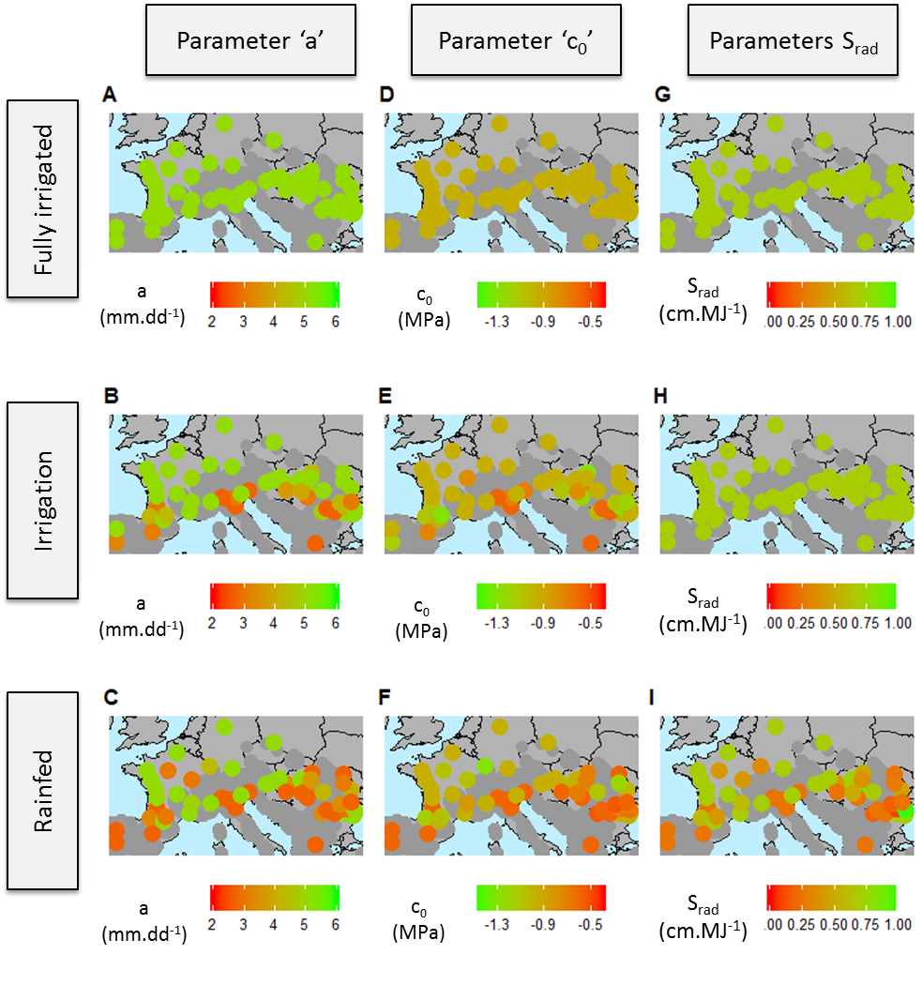
Figure 8 : Best parameter value calculated for each site in the three water scenarios using the parameter values calculated for the 254 hybrids of the studied panel. Colored points : parameters values for the genotype with the highest mean yield in each site.
B73 + (a,c0,sR)

Slide 9
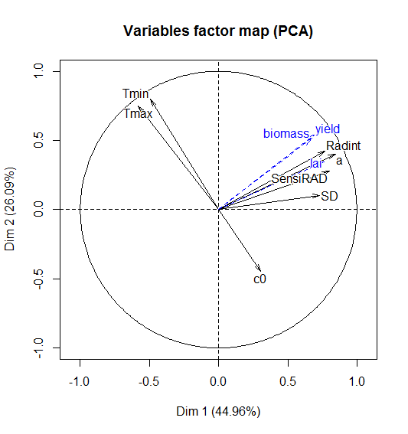
A
B
Variable contribution | Dim 1 | Dim 2 | Dim 3 | Dim 4 | Dim 5
a | 23% | 9% | 4% | 5% | 2%
c₀ | 3% | 11% | 72% | 5% | 0%
S_{rad} | 20% | 1% | 3% | 12% | 51%
Tmax | 11% | 31% | 4% | 3% | 10%
Tmin | 8% | 35% | 6% | 2% | 2%
Radint | 19% | 10% | 6% | 1% | 43%
SD | 17% | 1% | 6% | 73% | 3%
Variance Explained | 45% | 26% | 13% | 8% | 5%
Figure 9 : Principal axes (A) of the ACP performed with the best set of parameters values and corresponding mean environmental conditions in each site and table (B) of the contributions of each variable to each axes. Simulation were performed using parameters values calculated for the 254 genotypes of the studied panel.
B73 + (a,c0,sR)

Slide 10
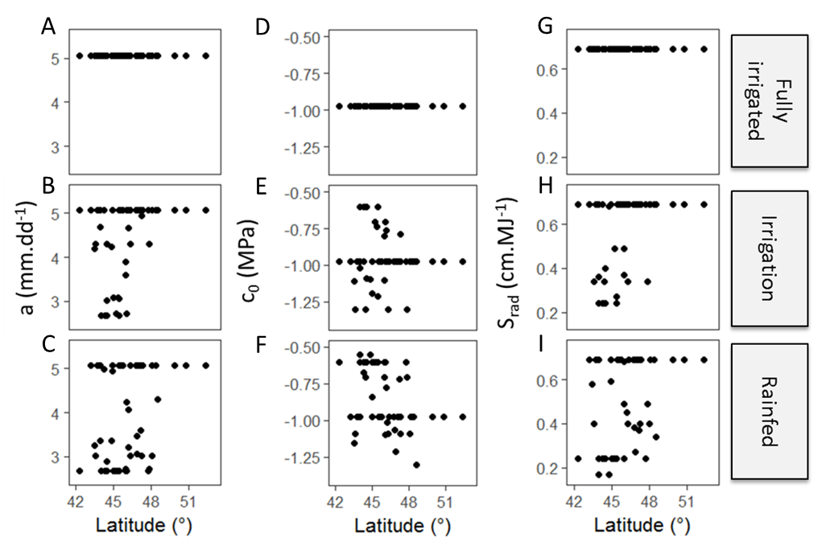
Figure 10 : Evolution with latitude of the best parameters values calculated for each site in the three simulated water conditions. Simulation were performed using parameters values calculated for the 254 genotypes of the studied panel.
B73 + (a,c0,sR)

Slide 11
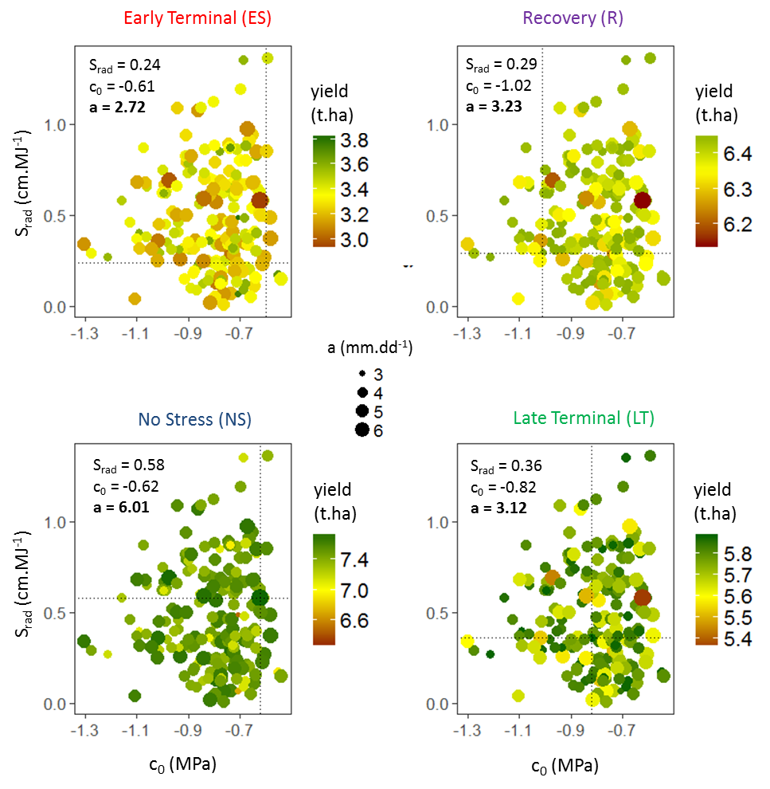
A
B
C
D
Figure 11 : Effect of the three studied parameters on yield for the 254 genotypes of the studied panel, in the four water stress clusters identified in the network of sites. x-axis : parameter ‘c₀’. y-axis : parameter ‘s_{R}’. Each dot represents the parameter values of a genotype of the panel. Colors show the mean yield for a genotype in the four clusters. Point size show the values of the parameter ‘a’ (leaf potential growth). The parameters of the genotype with the best mean yield are written for each cluster.
B73 + (a,c0,sR)

