Slide 1
FINAL PROJECT
IMAGE CLASSIFIATION USING CNN
Presented By:
Ehill Smila J
B. E. Computer Science and Engineering
Email: ehillsmila@gmail.com
NM id: au962821104028
University College of Engineering Nagercoil
3/21/2024 Annual Review

Slide 2
PROJECT TITLE
IMAGE CLASSIFICATION USING CNN WITH
CIFAR-10 DATASET
3/21/2024 Annual Review

Slide 3


AGENDA
Problem Statement
Project Overview
Who are the end users?
Solution and its value proposition
The wow in the Solution
Modelling
Results
Conclusion
3/21/2024 Annual Review

Slide 4

PROBLEM STATEMENT
Developing a CNN with TensorFlow/ Keras for CIFAR-10 image classification into ten categories like 'airplane', 'automobile', 'bird', 'cat', 'deer', 'dog', 'frog', 'horse', 'ship', and 'truck’.
Training involves normalized pixel values and one-hot encoded labels.
Post-training, sample test images with true and predicted labels are visualized to assess model performance.
3/21/2024 Annual Review

Slide 5

PROJECT OVERVIEW
“Image Classification with CNN using TensorFlow/ Keras” aims to develop a model that accurately categorizes CIFAR-10 dataset images into ten classes.
This involves implementing a CNN architecture with normalization, one-hot encoding, and softmax activation for training and evaluation.
The expected outcome is a highly accurate model validated through performance metrics, with room for future enhancements and optimizations.
3/21/2024 Annual Review

Slide 6

WHO ARE THE END USERS?
Researchers and Data Scientists: Interested in studying and experimenting with CNNs for image classification tasks.
Developers and Engineers: Want to integrate image classification capabilities into applications or systems.
Educators and Students: Use the project for learning about machine learning and deep learning concepts.
Industry Professionals: Utilize the model for tasks like automated image tagging or object recognition in various industries.
General Public: Access the model through user-friendly interfaces or applications for image classification needs.
3/21/2024 Annual Review

Slide 7
SOLUTION AND ITS VALUE PROPOSITION
Convolutional Neural Network (CNN): Utilized TensorFlow/ Keras to develop a robust CNN architecture for image classification tasks.
CIFAR-10 Dataset: Trained the model on the CIFAR-10 dataset, consisting of 60,000 32x32 color images across ten categories.
Model Training: Normalized pixel values and applied one-hot encoding to labels for efficient training.
Evaluation Metrics: Evaluated the model using accuracy and loss metrics on a separate test set to measure its performance.
3/21/2024 Annual Review

Slide 8
SOLUTION AND ITS VALUE PROPOSITION (CONT’)
Value Proposition:
Accurate Classification: Achieve precise image classification across diverse categories.
Versatile Application: Suitable for diverse fields from education to industry applications.
Efficiency and Automation: Streamline image categorization tasks for improved efficiency.
Educational Resource: Valuable for learning CNNs and image classification techniques.
Enhanced User Experience: Elevate user experience with advanced image processing capabilities.

Slide 9

THE WOW IN THE SOLUTION
Advanced CNN Architecture: Our cutting-edge Convolutional Neural Network (CNN) architecture not only achieves high accuracy in image classification but also demonstrates the power of deep learning in handling complex visual data. This breakthrough technology enables precise identification of objects across diverse categories, paving the way for revolutionary advancements in image recognition and automated processing.
3/21/2024 Annual Review
9

Slide 10
MODELLING
Architecture Overview:
Utilized a multi-layer CNN for image classification tasks. Layers included convolutional layers, max-pooling layers, flatten layer, and dense layers for classification.
Convolutional Layers:
Used 2D convolutional layers to extract features from input images. Employed ReLU activation for non-linearity and feature mapping.
Max-Pooling Layers:
Applied max-pooling layers for spatial down sampling, reducing computational complexity. Enhanced model's ability to capture essential features while reducing spatial dimensions.
3/21/2024 Annual Review
10

Slide 11
MODELLING (CONT’)
Flatten Layer and Dense Layers:
Flatten layer converted 2D feature maps into a 1D feature vector. Dense layers with ReLU activation performed classification based on extracted features. Final layer utilized softmax activation for multi-class classification, providing probability scores for each class.
Model Optimization:
Used the Adam optimizer for efficient gradient descent during training. Employed categorical cross-entropy loss function for multi-class classification. Monitored training progress with accuracy and loss metrics.

Slide 12
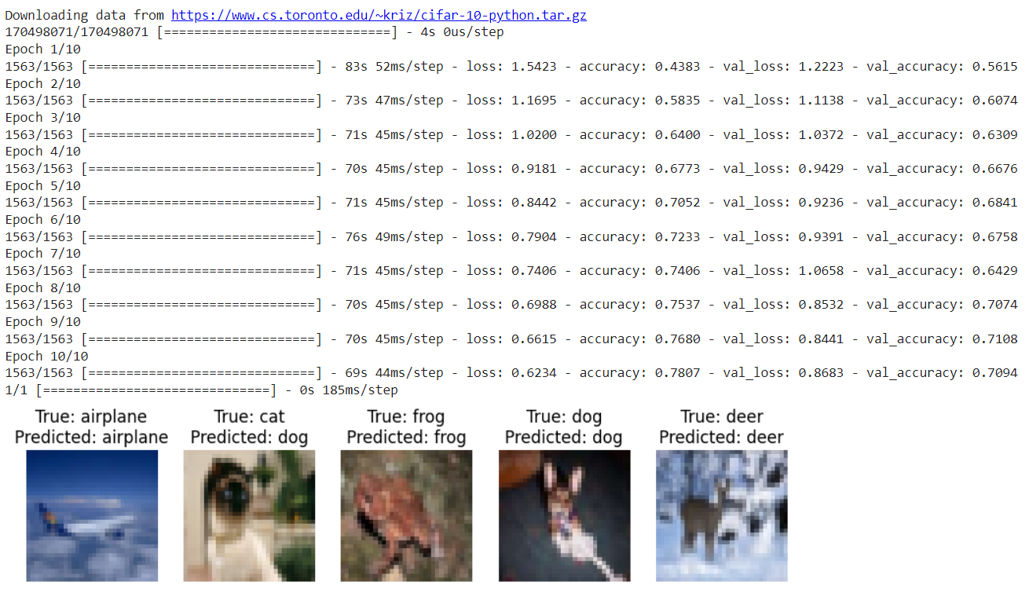
RESULTS

Slide 13
CONCLUSION
Thus, the project successfully created an accurate CNN model for CIFAR-10 image classification using TensorFlow/ Keras.
The model's performance was validated, highlighting the effectiveness of deep learning in image recognition tasks.
Future enhancements are possible based on these results, contributing to ongoing advancements in computer vision.

