Slide 1
Using k-Means Clustering to Determine Ideal Locations to Open an Art Gallery in Research Triangle, North Carolina
IBM Data Science Professional Certificate: Capstone Project
Sam Neubauer
December 15th, 2020

Slide 2
Introduction
This project came to life with a real desire to solve a question me and my partner have been trying to answer for a while: Question:
Where is the best place to open an art gallery in Research Triangle area of NC?
My partner is at a scaling growth stage with her business and wants to open a gallery in the right location of the Research Triangle. This analysis will provide a helpful insight in deciding where to take the next step in her career.

Slide 3
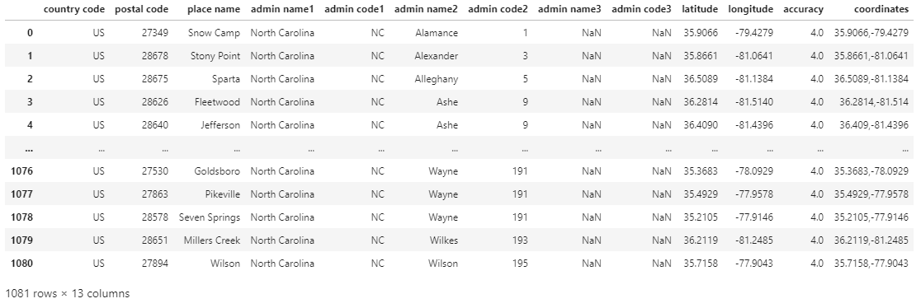
Data (North Carolina Zip Codes)
CSV file with all zip codes in North Carolina source: https://data.opendatasoft.com/explore/dataset/geonames-postal-code@public-us/download/?format=csv&q=&refine.country_code=US&refine.admin_name1=North+Carolina&timezone=America/New_York&use_labels_for_header=true&csv_separator=%3B

Slide 4
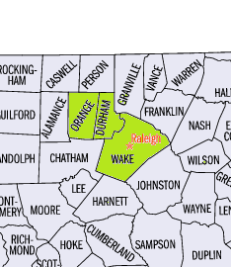
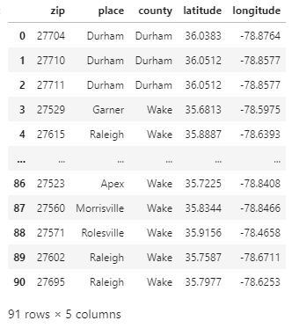
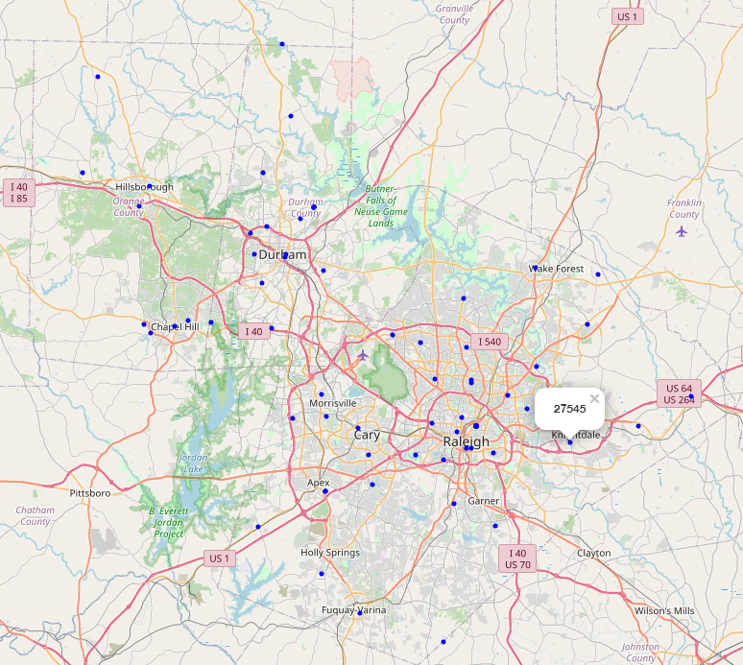
Data (North Carolina Zip Codes)
Data was then cleaned, removing NaN/unneeded columns, and filtered to only include the counties within the Research Triangle area: Wake, Durham, Orange

Slide 5
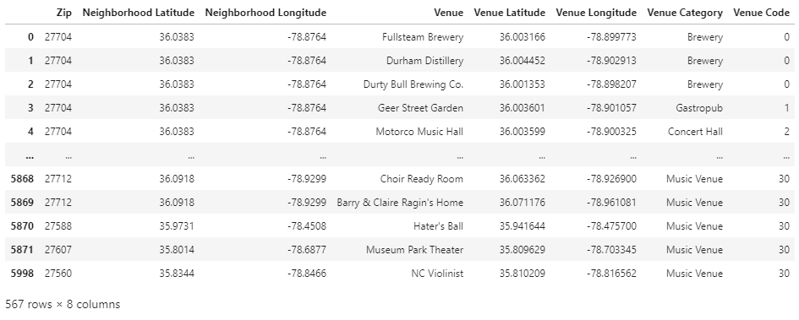
Data (Foursquare API Venues)
Foursquare was utilized to obtain search results for the following queries within a 3-mile radius at each zip code:
brewery
cocktails
distillery
gallery
museum
music venues

Slide 6
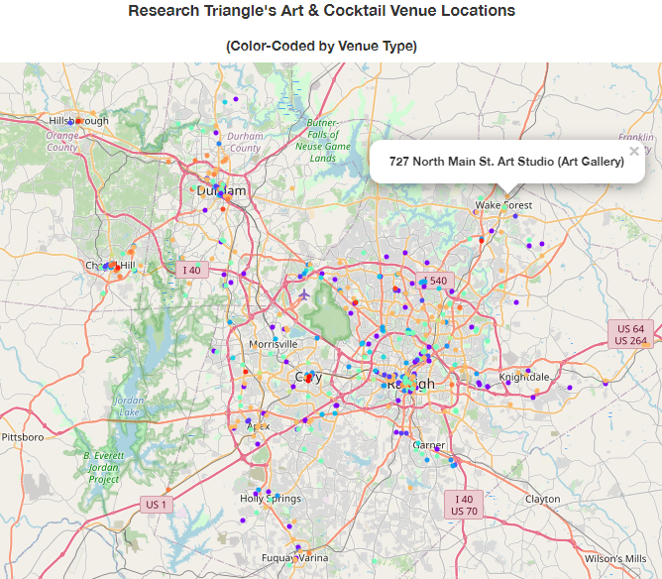
Methodology
The venues were color-coded and mapped for some exploratory data analysis to visually determine where densities of certain venue types exist within the area
There is a noticeable concentration of art galleries (orange) in the Durham, Wake Forest, and Apex towns.
There are also many breweries (purple) in the Research Triangle area

Slide 7
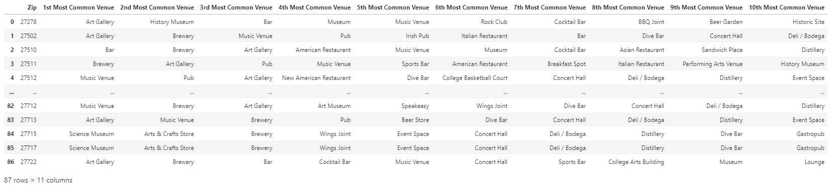
Methodology
One-hot coding functions were utilized to return the top 10 venue types within each zip code
To our excitement we notice many zip codes have art galleries and other social opportunities in the top 3 most common venue types.

Slide 8
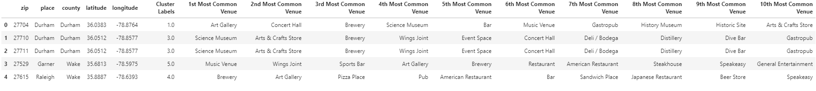
Methodology
We ran the k-means from the SKLearn library to cluster the neighborhood into 6 clusters based on most common venue types.
This machine learning algorithm was chosen due to its speed, ease, and the fact that we must use an unsupervised classification method to group the zip codes since there is not an easy and obvious way to characterize the zip codes via explicit (supervised) training methods.

Slide 9
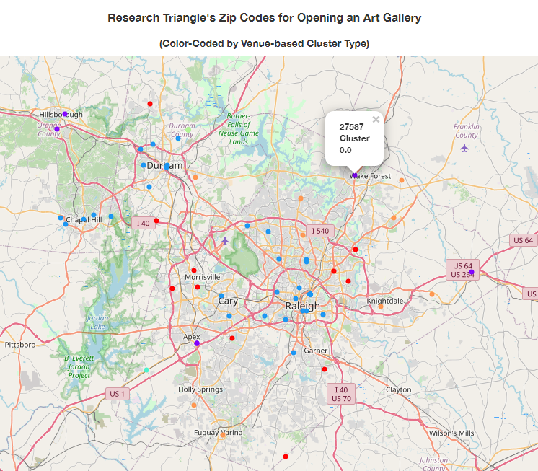
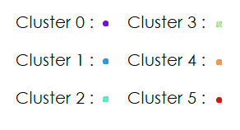
Results
The zip codes were clustered into 6 segments using the K-means algorithm

Slide 10


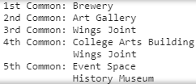



Discussion
Cluster 0 Zip Codes: are by far the most ideal locations to open an art gallery since galleries are the most common venue found in this cluster. The 4 runner-up venue types condone many social opportunities for the perfect day/night out on the town enjoying music, art, and drinks with friends and/or family.
Cluster 1 Zip Codes: are still ideal locations to open an art gallery since galleries are the 2nd most common venue found in this cluster. The other top venue types are rich in socializing and live music options.
Cluster 2 Zip Codes: is unfortunately the least ideal location to open an art gallery since the common venue options lack art, entertainment, and social options. While there is historical destinations, there is not as many cultural opportunities as the other clusters.
Cluster 3 Zip Codes: are not ideal locations for an art gallery since there are not entertainment or other cultural common venue options. The event space may hold event that attract customers for an art gallery, but there’s less cultural venue density than Clusters 0, 1, & 4.
Cluster 4 Zip Codes: like Cluster 1, this cluster still highlights ideal locations to open an art gallery since galleries are the 2nd most common venue found in this cluster. With eating, drinking, historic locations and a vicinity to college art buildings, these locations may attract a diversity of customer demographics.
Cluster 2 Zip Codes: are acceptable locations to open an art gallery. The most common venue type is a music venue which suggests local patrons might appreciate art. However, most of the common venue types include food & drink which doesn't provide much assurance that people going to these venues would frequent an art venue. They are more likely to want to socialize than yearn to experience art.

Slide 11
Conclusion
Analyzing the art, music, and social venues of the Research Triangle area has provided a much clearer understanding of the culture and commerce that occurs within the region. We now know that the 6 zip codes within Cluster 0 are the most ideal zip codes to open an art gallery, while the zip codes in Cluster 1 & Cluster 4 are still ideal, providing ample entertainment and socializing opportunities. The 18 zip codes within Clusters 2, 3, & 5 are not as ideal candidates to open an art gallery due to having less culturally rich venue opportunities.
With this, it would be wise to become more familiar with each of these zip codes in person to help get a realistic idea of what each area feels like, and what kind of overhead costs must be endured to open a store-front location.
It was very exciting to give insight towards a problem I wanted to solve for my partner's business, and I seriously look forward to making this investigation a reality! Thank you for viewing my project!

Slide 12
References
NC Zip Code Geospatial Locations: https://developer.foursquare.com/developer/
NC County Map: https://www.ereferencedesk.com/resources/counties/images/north-carolina-county-map.gif
Foursquare API: https://developer.foursquare.com/developer/

