Slide 1
Project 4
Based on paper 36: Reynolds flocking in reality with fixed-wing robots: communication range vs. maximum turning rate
Due Dec 7, 11:59pm
LATE POLICY: -2% per hour late

Slide 2
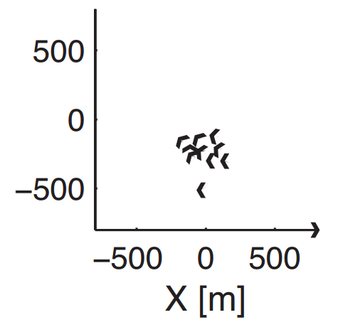
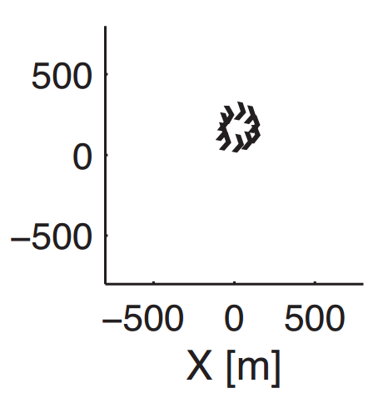
Goals:
Create a flock of 20 robots, which show good heading agreement
Will start in random positions and orientations
Ok to use id and position api
Will give infinite communication range,
You can artificially reduce the communication range by filtering messages by distance
Use center of arena for location of migration force
Use new simulation code, which allows for a larger arena size
Create flocks that look like not

Slide 3
Submission
Due Dec 7 at 11:59 pm
LATE POLICY: -2% per hour late
Submit:
usr_code.py
Image of best flock in action

