Slide 1
Algorithmic Trading With Reinforcement Learning
Siavash Razmi
810100352

Slide 2
Problem Definition:
Goal: Training an Agent to Trade in Market and Make Profit
Challenges: Market Prediction is a Challenging Task, There are a lot of Parameters which Agent should Consider, Environment is highly non-stationary, RL Algorithms need a lot of Data for Training

Slide 3
Key Contribution:
Changing the Any Trade Environment to include Randomness in environment
Adding Ethereum Data for Building the state
Using Deep Recurrent Q network for estimating Q value

Slide 4
Used Resources:
M. Hausknecht and P. Stone, “Deep Recurrent Q-learning for partially observable MDPs,” arXiv [cs.LG], 2015.
E. Ponomarev, I. Oseledets, and A. Cichocki, “Using reinforcement learning in the algorithmic trading problem,” arXiv [q-fin.TR], 2020.
T. Théate and D. Ernst, “An application of deep reinforcement learning to algorithmic trading,” arXiv [q-fin.TR], 2020
A. Saxena, Deep-Recurrent-Q-Networks: Implementation of Deep Recurrent Q-Networks for Partially Observable environment setting in Tensorflow
.

Slide 5
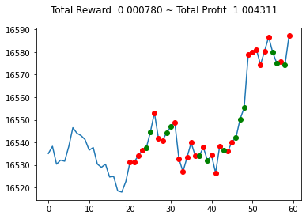
Environment:
We want to Trade Asset BTC/USDT:
There are a lot Environment for RL Trading such as TensorTrade, RLFinlab
And gym-Anytrade
We choose Anytrade because of
Simplicity and ease of use

Slide 6

Data:
Data is directly gathered from Binance , which includes two month worth of data from BTCUSDT and ETHUSDT minute ohlc
We use Historical OHLC of Bitcoin and Ethereum plus two Technical Indicators (MACD, RSI)
We used Min-max for normalization

Slide 7
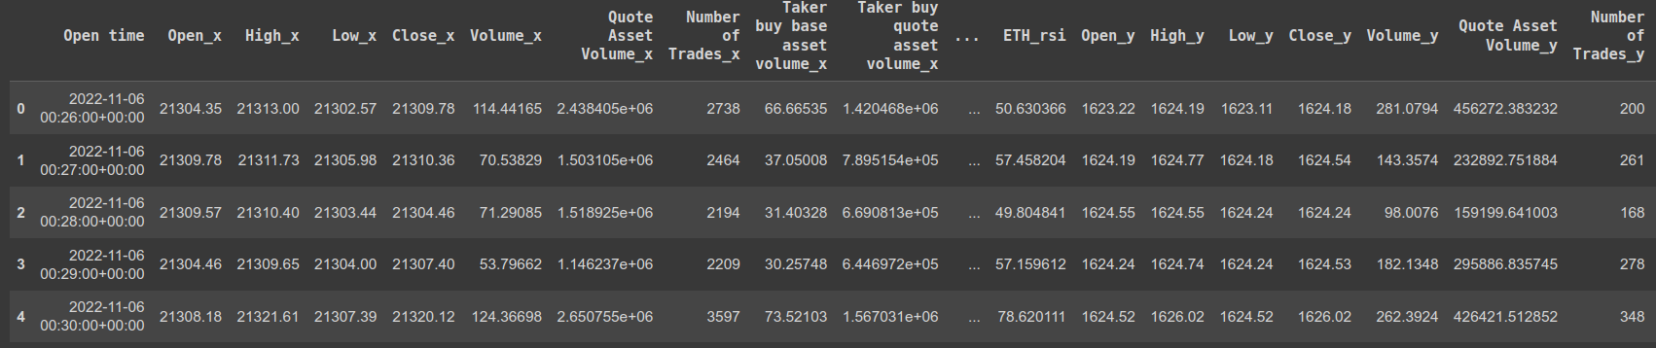
Features:
Used Features for observation are: 'Open_x', 'High_x', 'Low_x', 'Close_x', 'Volume_x',
'Quote Asset Volume_x', 'Number of Trades_x','Taker buy base asset volume_x', 'Taker buy quote asset volume_x','BTC_rsi', 'BTC_md', 'ETH_md', 'ETH_rsi', 'Close'

Slide 8
Method:
Observation in our environment are highly time correlated
Previous works used observation stacking to alleviate this problem
In this project we used DRQN to handle this problem
LSTM modules are used to model temporal relation
2 linear layer and 1 LSTM layer are used
We also implemented Experience Replay for Sample efficiency
Network is implemented using Pytorch
We used DRQ algorithm for Agen

Slide 9
Results:
Model was Trained for 2000 Epoch
Here are the final results:

Slide 10
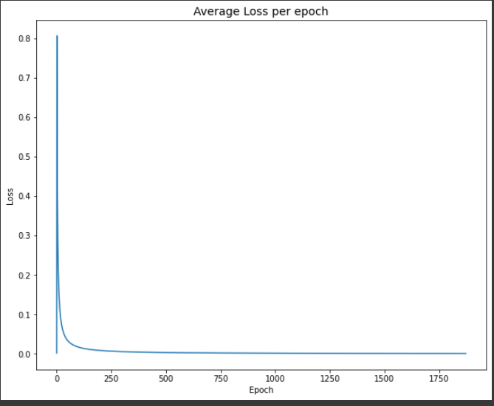
Loss:

Slide 11
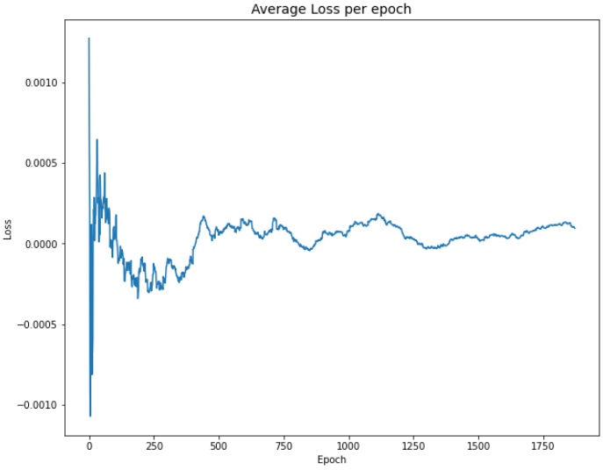
Reward:

Slide 12
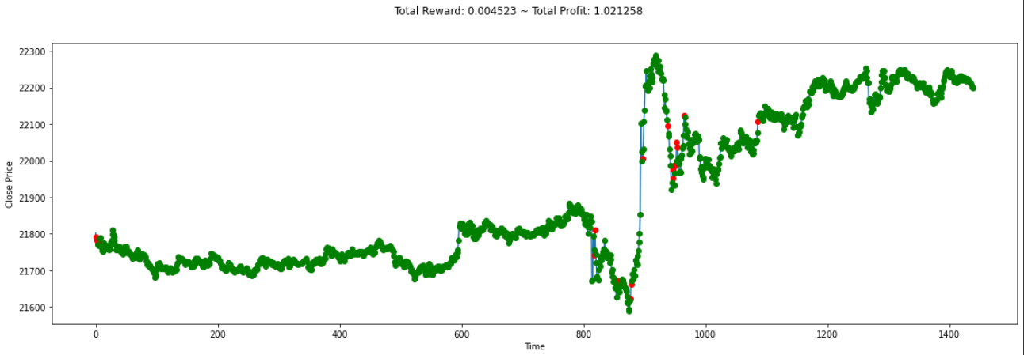
Behaviour in Environment:

