Slide 1
AWS

Slide 2
Who is Amazon !!
American international multibillion dollar electronic commerce company with headquarters in Seattle, Washington, USA.
started in 1995 by Jeff Bezos as an online bookstore.
but soon diversified, selling DVDs, VHSs, CDs, video and MP3 downloads/streaming, software, video games, electronics, apparel, furniture, food, toys, and jewelry.
The company also produces consumer electronics: Kindle e-book reader and the Kindle Fire tablet computer.
In 2006, Amazon officially launched the Amazon Web Services (AWS) to became a major provider of cloud computing services.
2

Slide 3
What is Amazon Web Services ?
Amazon Web Services (AWS) is a collection of remote computing services (web services) that together make up a cloud computing platform, offered over the Internet by Amazon.com.
Website: http://aws.amazon.com
AWS is located in 9 geographical 'Regions‘. Each Region is wholly contained within a single country and all of its data and services stay within the designated Region.
Each Region has multiple 'Availability Zones', which are distinct data centers providing AWS services. Availability Zones are isolated from each other to prevent outages from spreading between Zones. However, Several services operate across Availability Zones (e.g. S3, DynamoDB).
3

Slide 4
What is AWS Offering?
Low Ongoing Cost:, pay-as-you-go pricing with no up-front expenses or long-term commitments.
Instant Elasticity & Flexible Capacity: (scaling up and down) Eliminate guessing on your infrastructure capacity needs.
Speed & Agility: Develop and deploy applications faster Instead of waiting weeks or months for hardware to arrive and get installed.
Apps not Ops: Focus on projects. Lets you shift resources away from data center investments and operations and move them to innovative new projects.
Global Reach: Take your apps global in minutes.
Open and Flexible
Secure: Allows your application to take advantage of the multiple layers of operational and physical security in the AWS data centers to ensure the integrity and safety of your data.
4

Slide 5
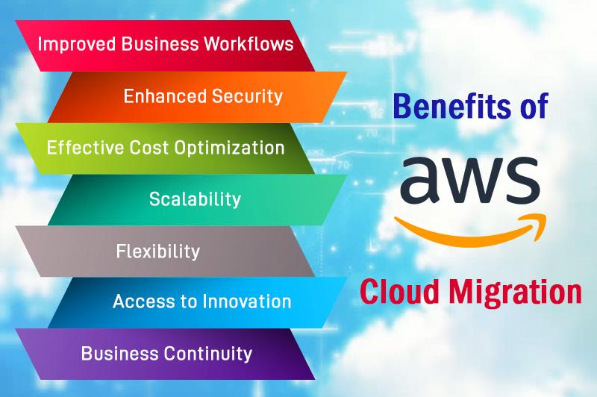

Slide 6
AWS Provides Broad and Deep Services to Support Any Cloud Workload
Deployment & Administration
Application Services
Compute
Storage
Database
Networking
AWS Global Infrastructure

Slide 7
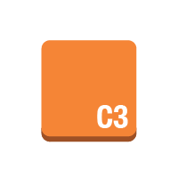

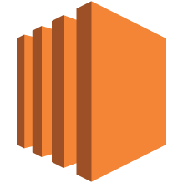






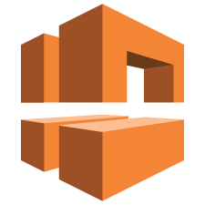





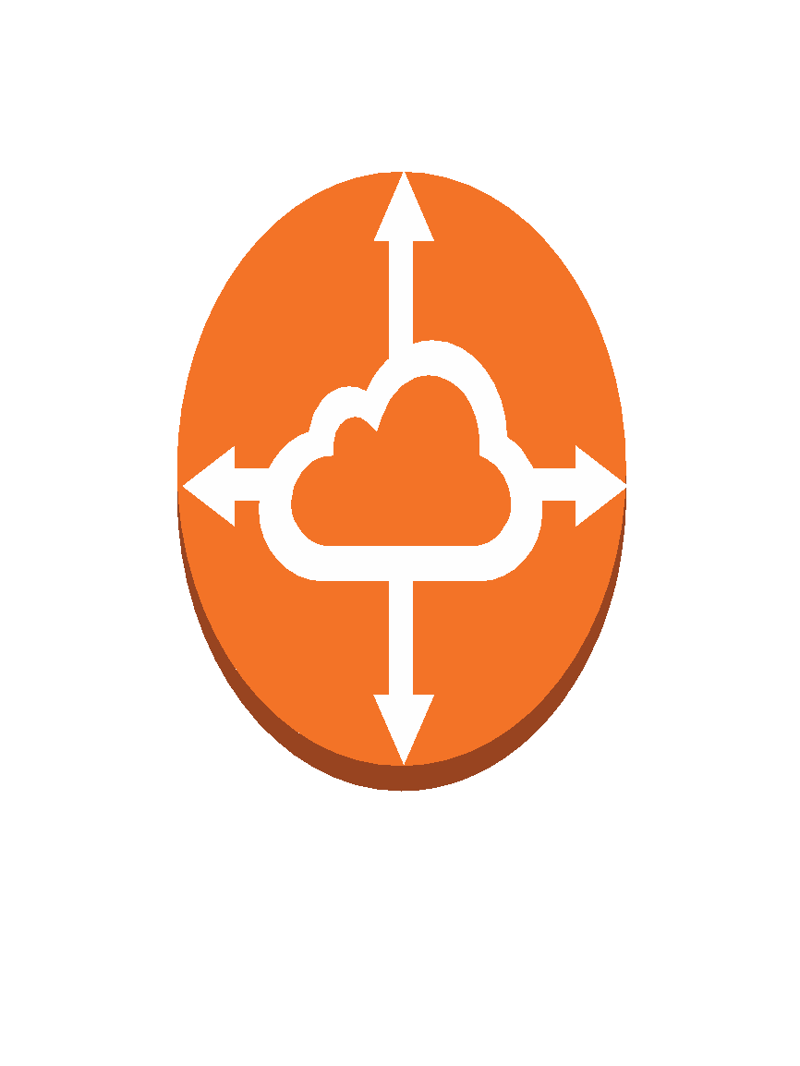
Compute & Networking
Amazon Elastic Compute Cloud
Amazon EC2
instance
instances
AMI
DB on instance
instance with CloudWatch
Elastic IP
optimized
instance
Amazon Lambda
Amazon Virtual Private Cloud
Amazon VPC
router
Internet gateway
customer gateway
virtual private gateway
VPN connection
VPC peering

Slide 8
Amazon Elastic Compute Cloud (EC2)
Amazon Machine Images (AMIs) are the basic building blocks of Amazon EC2
An AMI is a template that contains a software configuration (operating system, application server and applications) that can run on Amazon’s computing environment
AMIs can be used to launch an instance, which is a copy of the AMI running as a virtual server in the cloud.

Slide 9
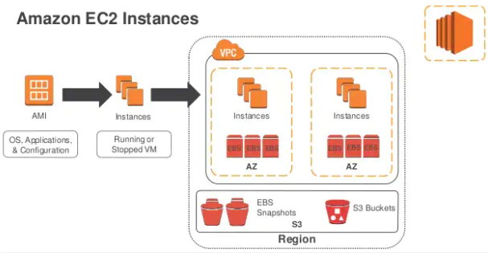

Slide 10
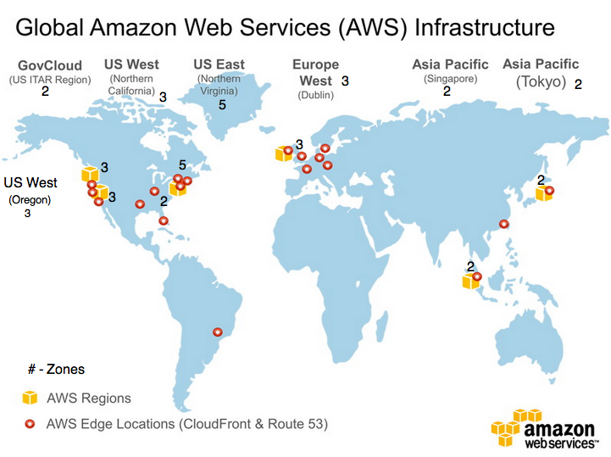

Slide 11
Getting Started with Amazon EC2
Step 1: Sign up for Amazon EC2
Step 2: Create a key pair
Step 3: Launch an Amazon EC2 instance
Step 4: Connect to the instance
Step 5: Customize the instance
Step 6: Terminate instance and delete the volume created

Slide 12
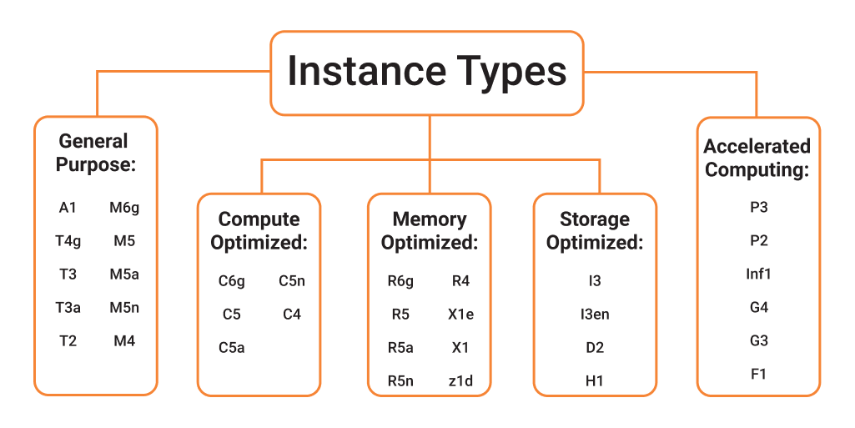

Slide 13
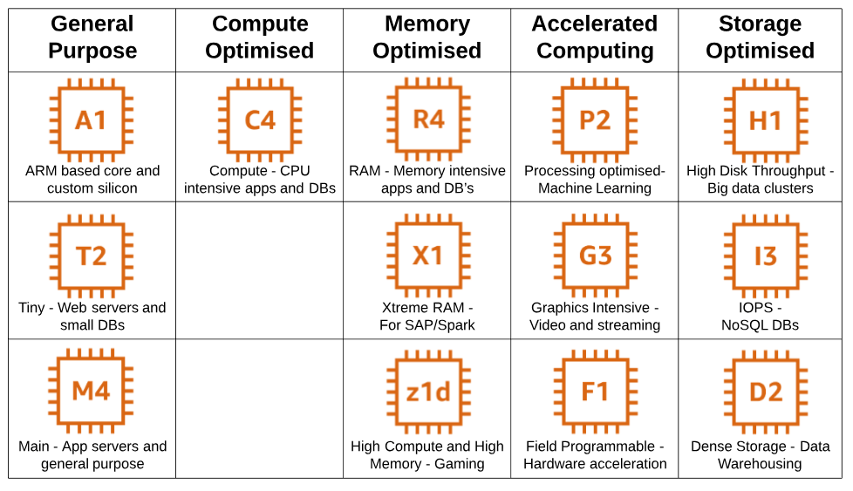

Slide 14
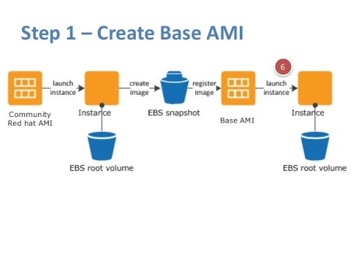

Slide 15
ADVANTAGES
Reliable − Amazon EC2 offers a highly reliable environment where replacement of instances is rapidly possible. Service Level Agreement commitment is 99.9% availability for each Amazon EC2 region.
Designed for Amazon Web Services − Amazon EC2 works fine with Amazon services like Amazon S3, Amazon RDS, Amazon DynamoDB, and Amazon SQS. It provides a complete solution for computing, query processing, and storage across a wide range of applications.
Secure − Amazon EC2 works in Amazon Virtual Private Cloud to provide a secure and robust network to resources.
Flexible Tools − Amazon EC2 provides the tools for developers and system administrators to build failure applications and isolate themselves from common failure situations.
Inexpensive − Amazon EC2 wants us to pay only for the resources that we use. It includes multiple purchase plans such as On-Demand Instances, Reserved Instances, Spot Instances, etc. which we can choose as per our requirement.

Slide 16
AWS Architecture – Lambda
Run code without servers
Supports Node.js, Python, Java, C#, and Go.
Can use existing libraries
Upload functions, configure triggers
Works closely with API gateway via proxy integration
Business logic and data access code goes here
Billed for compute cycles (function run time)

Slide 17
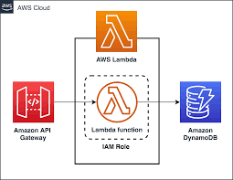

Slide 18
What are the Advantages of AWS Lambda?
AWS Lambda offers a variety of benefits to its users. Here are 3 of the biggest benefits one
should know about when deciding if AWS Lambda is right choice:
• It doesn’t require the user to manage any servers. Since AWS Lambda automatically
runs user’s code, there’s no need for the user to manage the server. Simply write the code
and upload it to Lambda.
• It empowers the user to easily scale. AWS Lambda runs code in response to each
trigger, so user’s application is automatically scaled. The code also runs in parallel
processes, each triggered individually, so scaling is done precisely with the size of the
workload.
• It’s affordable. With AWS Lambda, one doesn’t pay anything when code isn’t running.
The user has to only be charged for every 100ms of code execution and the number of
times his code is actually triggered.

Slide 19
What is SOA?
SOA – Service Oriented Architecture
S – Service is basically an independent component that has a certain function. (e.g. Viewing online bank statement, filling out an app for an account). Emphasis on modularity and loose coupling (implementation hidden)‏
A – Architecture basically means this is not a technology but an approach to software design
Notes:
19

Slide 20
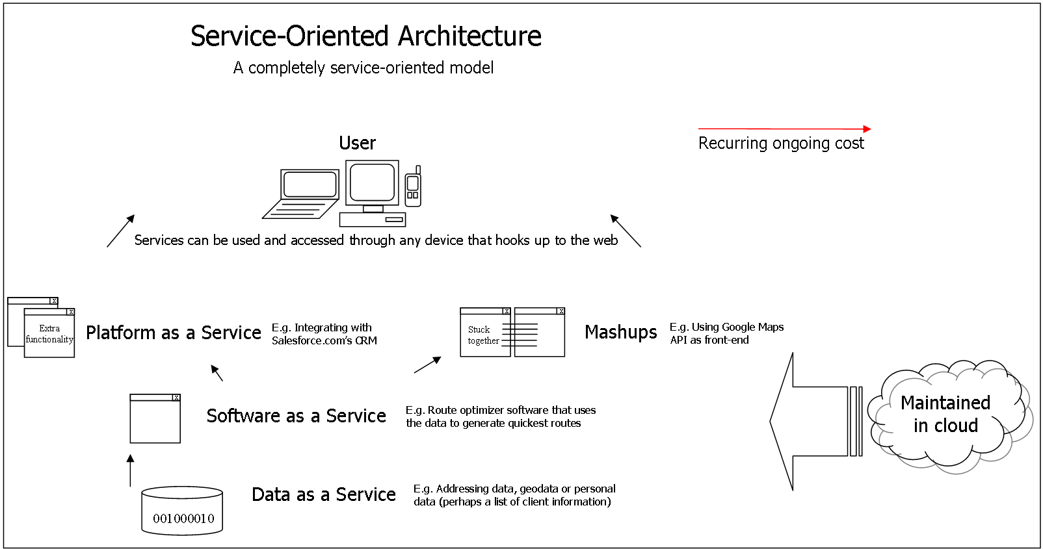
Notes:
20

Slide 21
What is Amazon S3?
S3 = Simple Storage Service
A SOA which provides online storage using web services.
Allows read, write, and delete permissions on objects
Uses REST and SOAP protocols for messaging, so you can use various development toolkits with S3.
Notes:
21

Slide 22
How it Works
Store data on Amazon’s distributed system containing multiple servers within Amazon’s data center locations
Data takes time to propagate
Can store it in North America or Europe
Amazon doesn’t offer you a GUI based tool to access your data. You can use one of the several tools online or build one through APIs
Notes:
22

Slide 23
