Slide 1
Credit card fraud detection using machine learning

Slide 2
THIRUMALAI ENGINEERING COLLEGE DEPARTMENT OF COMPUTER SCIENCE AND ENGINEERING Project team members j. Gayathri 513220104701 v. lavanya 513220104702 s. lavanya 513220104004 COORDINATER MRS,s.hemalatha.M.E.,

Slide 3
Introduction
The online shopping growing day to day. Credit cards are used for purchasing goods and services with the help of virtual card and physical card where as virtual card for online transaction and physical card for offline transaction.
In a physical-card based purchase , the cardholder presents his card physically to a merchant for making a payment.
In online payment mode , attackers need only little information for doing fraudulent transaction (secure code , card number , expiration data etc.).
Credit card fraud is a significant concern for both financial institutions and consumers worldwide. With the increasing prevalence of online transactions and digital payments, fraudulent activities have become more sophisticated, necessitating robust detection mechanisms.
Credit card fraud detection, including supervised learning, unsupervised learning, and hybrid methods. Additionally, it will discuss the challenges faced in fraud detection, such as imbalanced datasets and evolving fraud tactics, and propose strategies to address them.

Slide 4
Abstract
Credit card fraud detection is presently the most frequently occurring problem in the present world. This is due to the rise in both online transactions and e-commerce platforms.
Credit card fraud generally happens when the card was stolen for any of the unauthorized purposes or even when the fraudster uses the credit card information for his use. In the present world, we are facing a lot of credit card problems.
To detect the fraudulent activities the credit card fraud detection system was introduced. This project aims to focus mainly on machine learning algorithms. The algorithms used are random forest algorithm and the Ad boost algorithm.
The results of the two algorithms are based on accuracy, precision, recall.. The ROC curve is plotted based on the confusion matrix.
The Random Forest and the Ad boost algorithms are compared and the algorithm that has the greatest accuracy, precision, recall, is considered as the best algorithm that is used to detect the fraud.

Slide 5
EXISTING SYSTEN
One of the earliest system is CCFD system using Markova model . Some other various existing algorithm used in the credit cards fraud detection system Includes cost sensitive decision tree(CSDT),support vector machine(SVM).
Existing systems for credit card fraud detection typically employ a combination of rule-based methods, statistical techniques, machine learning algorithms, and anomaly detection approaches.
Credit card fraud detection CCFD is also proposed by using neural networks.
DISADVANTAGE
Machine learning algorithm work only for huge sets of data.
For smaller amount of data the results may be not accurate.
It takes significate amount of data for machine.

Slide 6
PROPOSED SYSTEM
In this proposed project we designed a protocol or a model to detect the fraud activity in credit card transactions.
As technology changes , it becomes difficult to track the modelling and pattern of fraudulent transaction.
Random Forest is a powerful machine learning algorithm commonly used in credit card fraud detection due to its ability to handle large datasets with high dimensionality and imbalanced classes.
ADVANTAGE:
Reduction in number of fraud transaction.
User can safely use his credit card fraud online transactions.
Adder layer of security.

Slide 7
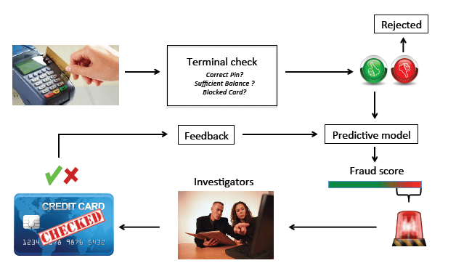
Fraud detection process

Slide 8
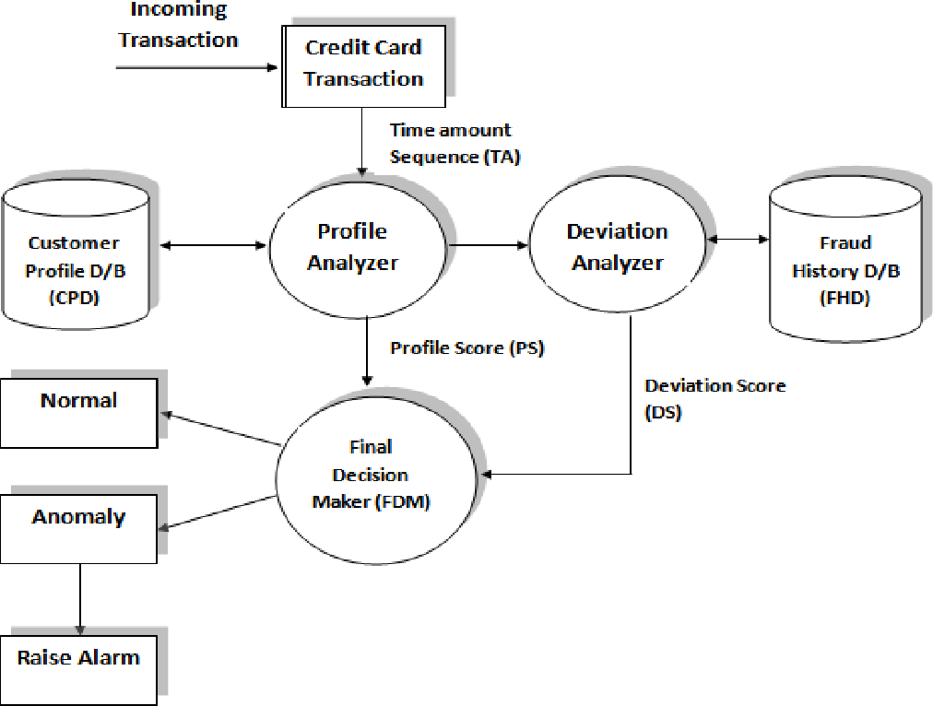
ARCHITECTURE DIAGRAM

Slide 9
ALGORITHM LOGISTIC REGRESSION
It is a statistical model that in its basic form uses a logistic function to model a binary dependent variable, although many more complex extension exist.
In regression analysis, logistic regression(1) (or logit regression) is estimation the parameters of a logistic model (a form of binary regression ).
Mathematically ,a binary logistic model has a dependent variable with two possible values ,such as pass fail which is represented by an indicator variable, where the two values are logistic regression.
Supervised Learning Technique.
Correlation Outperformance PCA (Principal Component Analysis) at low features.
Has a 94.6% accuracy for high features count. Doesn’t exhibit overfitting

Slide 10
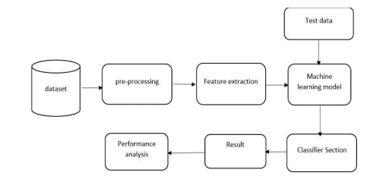
SYSTEM ARCHITECTURE DIAGRAM

Slide 11
PACKAGES
Which are being used for data exploration, pro processing and for using random forest algorithm are:
NumPy: For simple arrays.
Pandas: For reading the file.
SciKit: Learn- for pre-processing.
Matplotlib or Seaborn: For plotting and representing confusion matrix color format.
Tensor flow: For matrix format.

Slide 12
System requirements
Hardware Requirements:
RAM:4GB and Higher
Processor:Intel i3 and above
Hard Disk:500GB: Minimum
Software Requirements:
OS:Windows or Linux
Python IDE:python 2.7.x and above
Jupyter Notebook
Setup tools and pip to be installed for 3.6 and above
Language :python

Slide 13
MODULES
Module 1 : Frame the problem.
Module 2 : Collect raw data.
Module 3 : Import the libraries (pandas,numpy,sklearn
etc.,).
Module 4 : process the data for analysis.(explore the
data).
Module 5 : perform in-depth analysis.
Module 6 : communicate results of the analysis.

Slide 14
DATASET
This dataset presents transactions that occurred in two days, where we have 492 frauds out of 284,807 transactions. The dataset is highly unbalanced, the positive class (frauds) account for 0.172% of all transactions.
It contains only numerical input variables which are the result of a PCA transformation. Unfortunately, due to confidentiality issues, we cannot provide the original features and more background information about the data.
Features V1, V2, … V28 are the principal components obtained with PCA, the only features which have not been transformed with PCA are 'Time' and 'Amount'.
Feature 'Time' contains the seconds elapsed between each transaction and the first transaction in the dataset.
The feature 'Amount' is the transaction Amount, this feature can be used for example-dependent cost-sensitive learning. Feature 'Class' is the response variable and it takes value 1 in case of fraud and 0 otherwise.

Slide 15
IMPLEMENTATION
Data Collection: Gather historical transaction data, including both legitimate and fraudulent transactions.
Data Preprocessing: Clean the data, handle missing values, normalize or scale numerical features, and encode categorical features.
Model Selection: Choose appropriate machine learning algorithms for fraud detection, such as logistic regression, decision trees, random forests, support vector machines, or neural networks.
Deployment: Deploy the trained model into a production environment where it can analyze real-time transactions.
Monitoring and Updating: Continuously monitor the performance of the deployed model and update it periodically to adapt to new fraud patterns or changes in the data distribution.
Integration with Fraud Prevention Systems: Integrate the fraud detection system with other fraud prevention measures such as rule-based systems, anomaly detection, and manual review processes for suspicious transactions.

Slide 16
FUTURE ENHANCEMENT
The future scope of credit card fraudulent detection encompasses several advancements:
Biometric Authentication: Integration of biometric authentication methods such as fingerprint scanning, facial recognition, or voice recognition will add an extra layer of security, making it more difficult for fraudsters to compromise accounts.
Collaborative Data Sharing: Collaboration between financial institutions and payment processors to share data and insights about fraudulent activities can enable quicker detection and response to emerging fraud trends.
Real-time Monitoring: Improved real-time monitoring capabilities will enable instant detection of suspicious transactions, allowing for immediate action to be taken to prevent further fraud.
Regulatory Support: Continued regulatory support and compliance standards will play a crucial role in shaping the future of credit card fraud detection, ensuring that financial institutions adopt robust security measures to protect consumers' financial information.

Slide 17
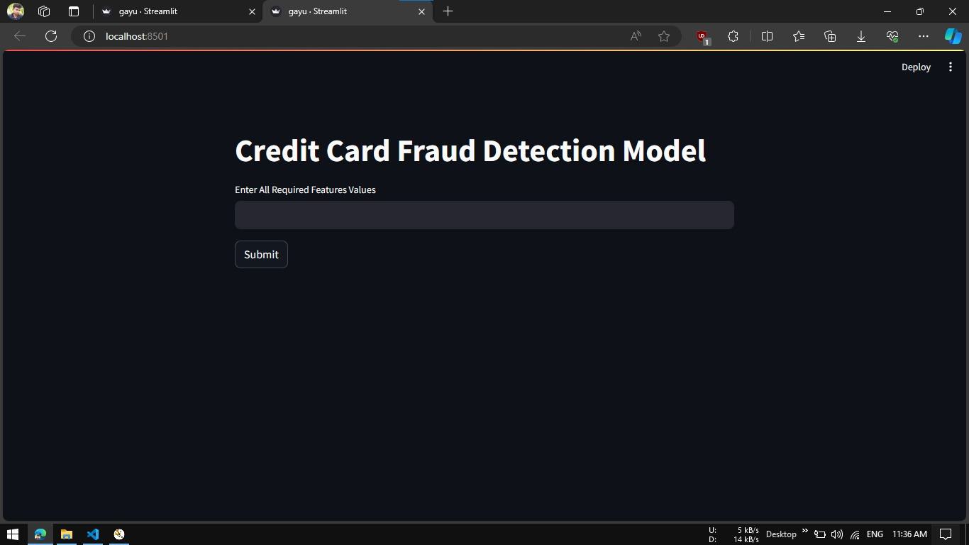
SAMPLE OUTPUT

Slide 18
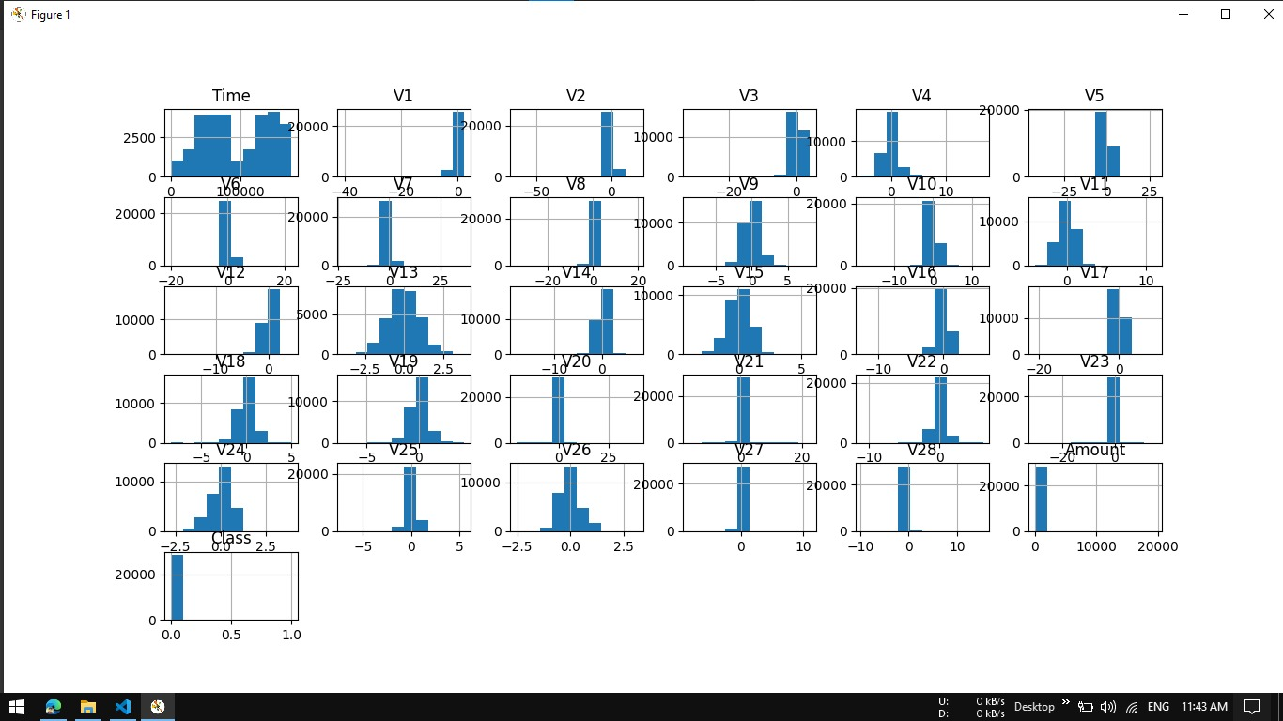
DATA PREPROCESSING

Slide 19
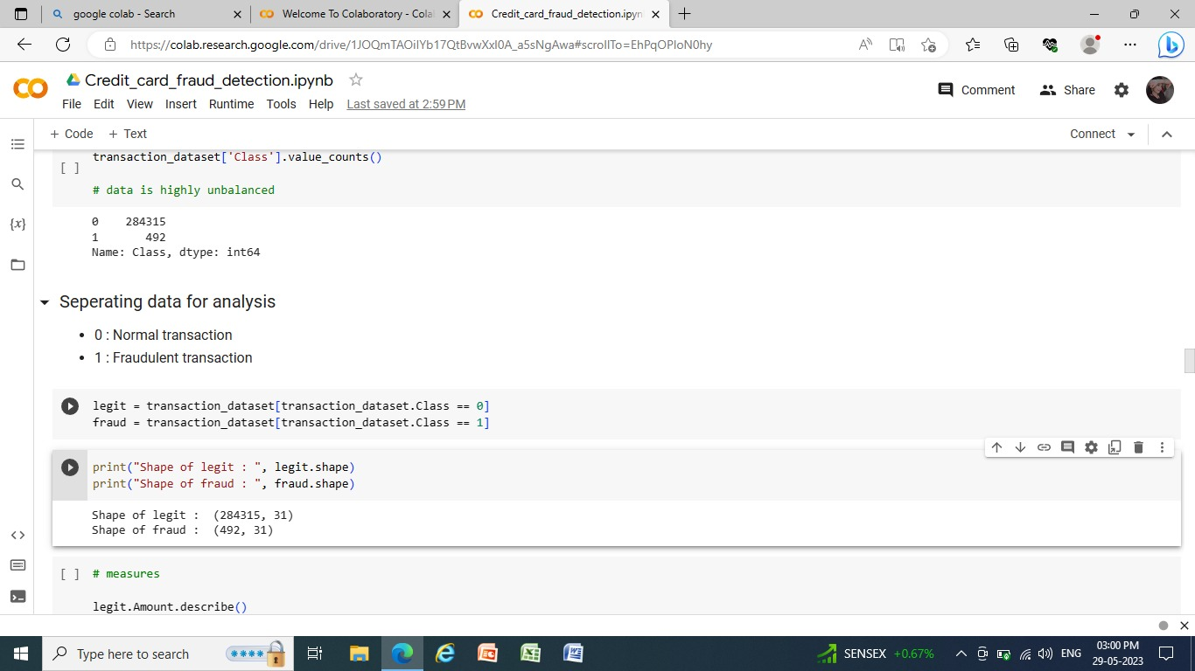
LEGIT 0 & FRUAD1

Slide 20
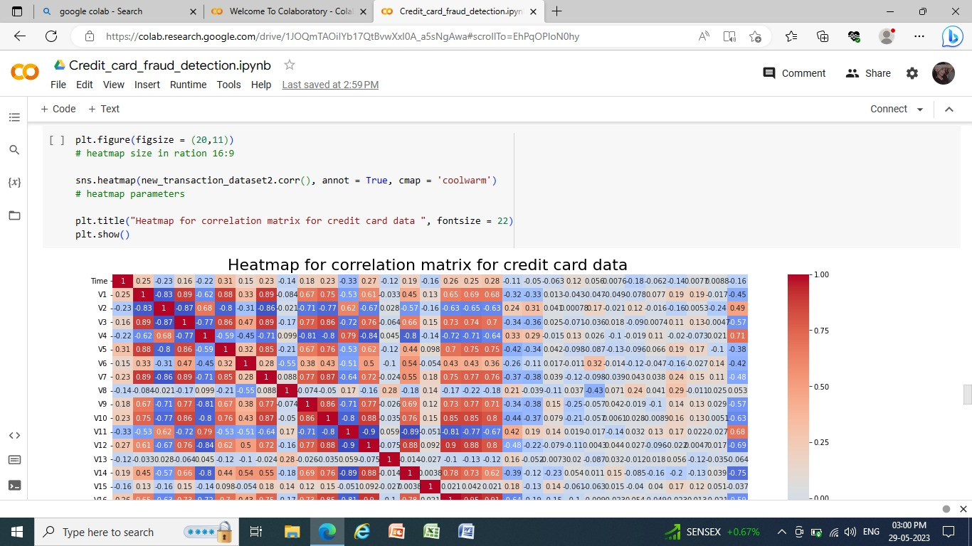
HEATMAP FOR CORRELATION MATRIX FOR CREDIT CARD DATA

Slide 21
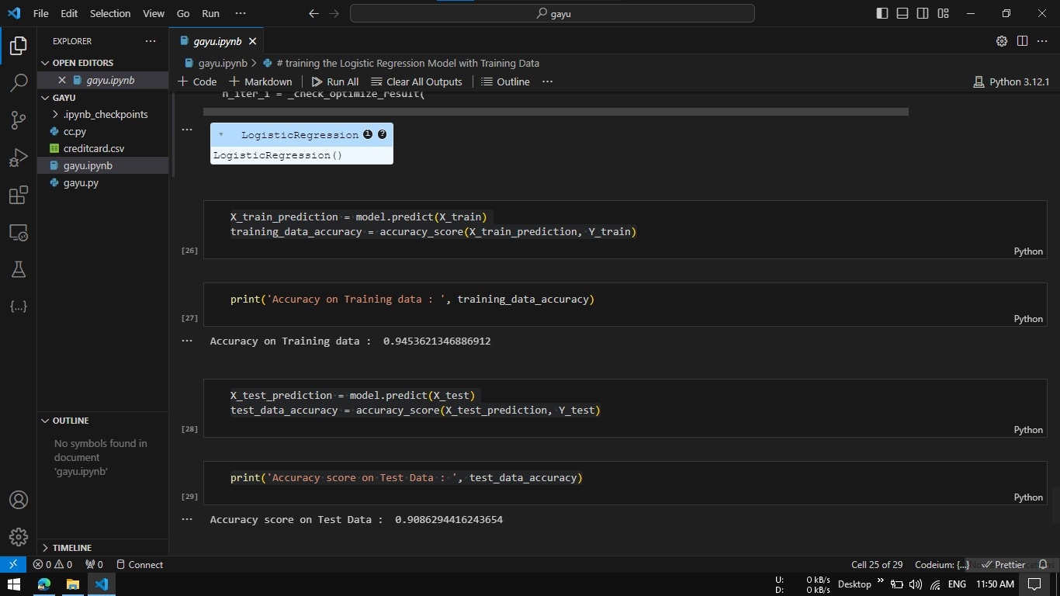
ACCURACY

Slide 22
CONCLUSION
All attributes selected after the elimination process show p values lower than 5% and thereby suggesting significant role in the fraud prediction.
The area under the ROC(Report On Compliance) curve is 95.71 which is good.
Fraud detection system have becomes essential for banks and financial institution ,to minimize their losses.
Fraud detection system have becomes essential for banks and financial institution ,to minimize their losses.
Overall model could be improved with more data.

Slide 23
REFERENCES
[1] Aggarwal,charu C.”Outlier analysis”.Data mining .Springer international
publishing,2015.
[2] Salazar ,Addisson,et. ”Automatic credit card fraud based on non-linear singnal processing “.Securit Technology(ICCST),2012 IEE.
[3] Aurelien gerons,”Hands –on machine learning with scikit –learn, keras and tensorflow”.Shroff/O reiy, 2019.
[4] Gupta, S.C. ”fundamental of staticstics”.Himalaya publishing house,2018.
[5] K.T.B.V. Sam Maes, “Credit cards fraud detection using bayesian and neural networks,”p. 7,August 2002

Slide 24


