Slide 1
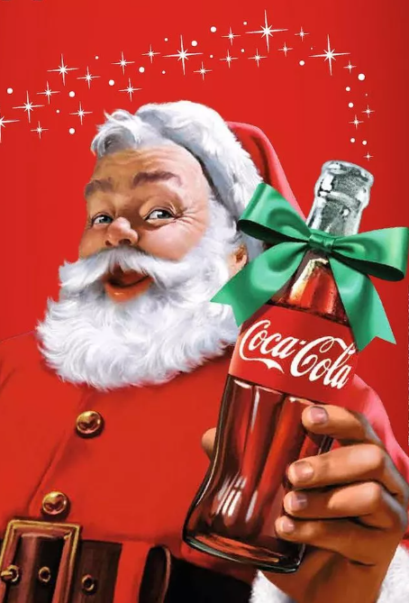

Christmas 2025
Ho Ho Ho!
I am delighted to invite {{NAMES}} to meet me at the Coca-Cola Ballina Children’s Christmas Party,
in The Diamond Coast Hotel on Sunday December 21, 2025 at {{TIME}}
Looking forward to seeing you there!
From Santa xxxxx
{{KOID}}

