Slide 1
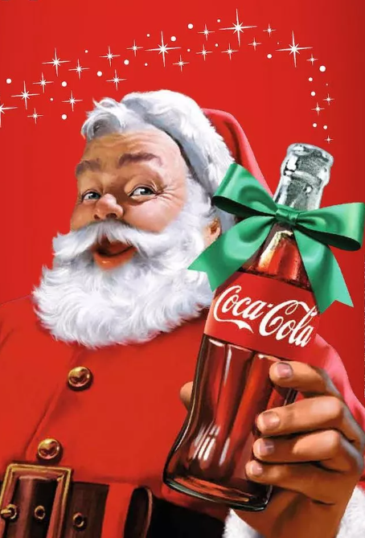

Christmas 2025
Ho Ho Ho!
I am delighted to invite {{NAMES}} to meet me at the Coca-Cola Ballina Children’s Christmas Party, in The Diamond Coast Hotel On Sunday December 20, 2025 at 14:00
Looking forward to seeing you there!
From Santa xxxxx

