Slide 1
JavaScript UI Frameworks
React
Angular
Vue
Svelte
Solid

Slide 2
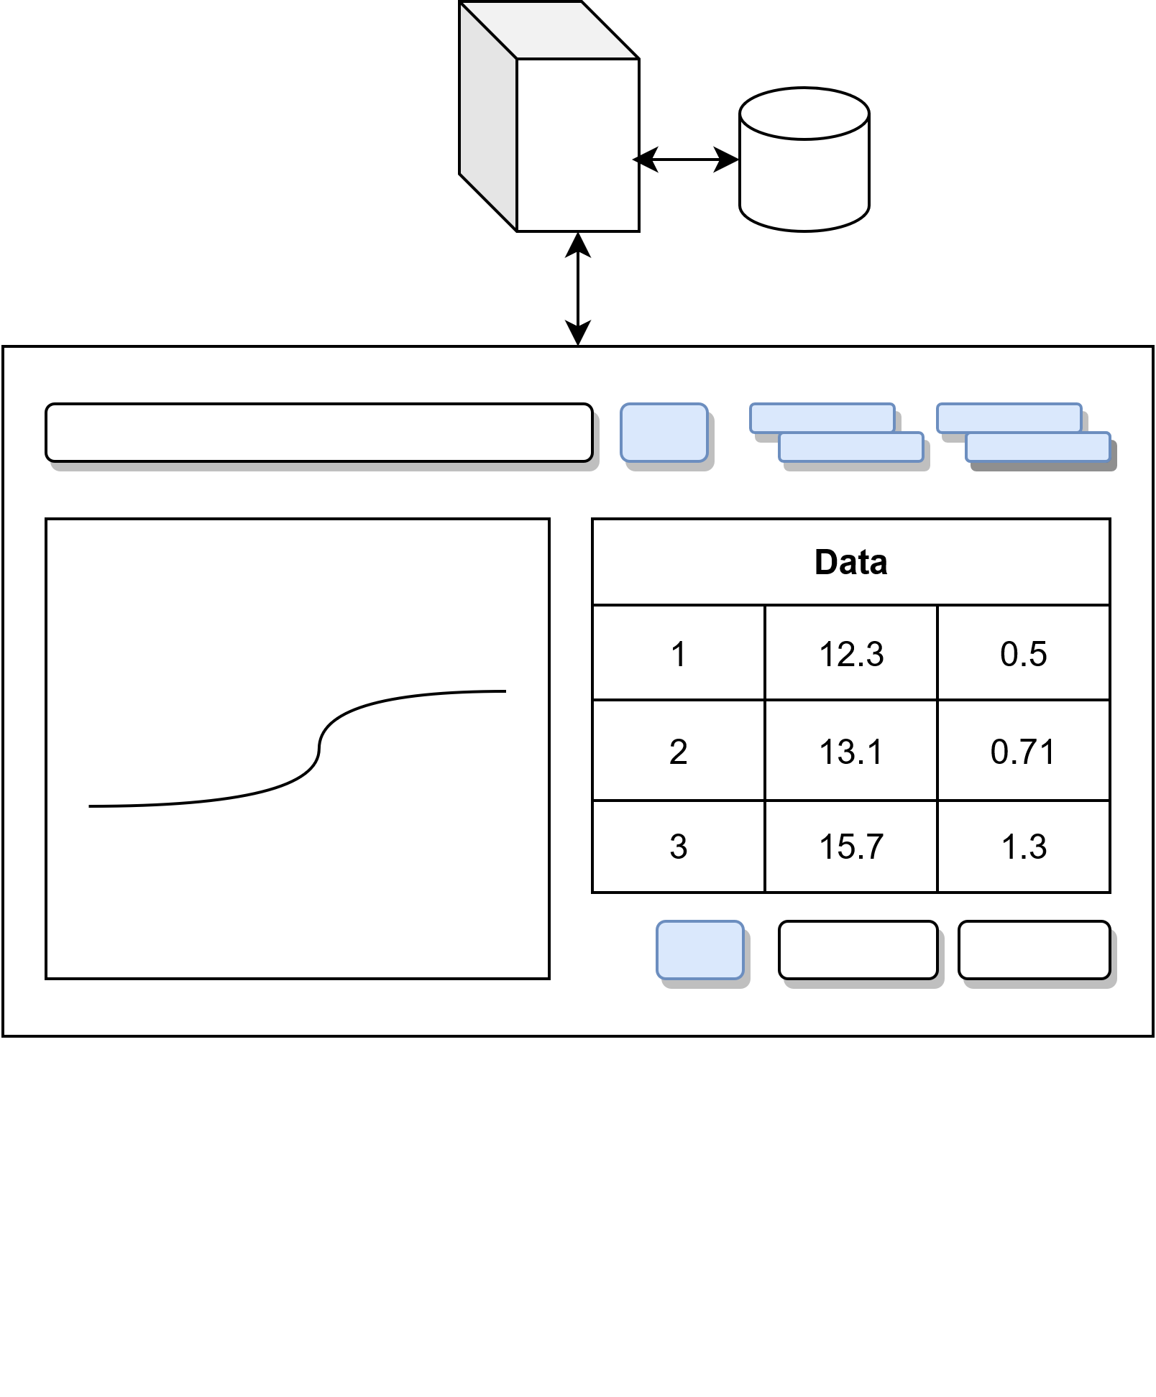

Slide 3
Formal UI Definition
State_{next} = R(State, Event)
UI = F(State)

Slide 4
Formal UI Definition
State_{next} = R(State, Event)

Slide 5
Formal UI Definition
UI = F(State)

Slide 6
Formal UI Definition
UI = F(R(State, Event))
State_{next} = R(State, Event)
UI = F(State)

Slide 7
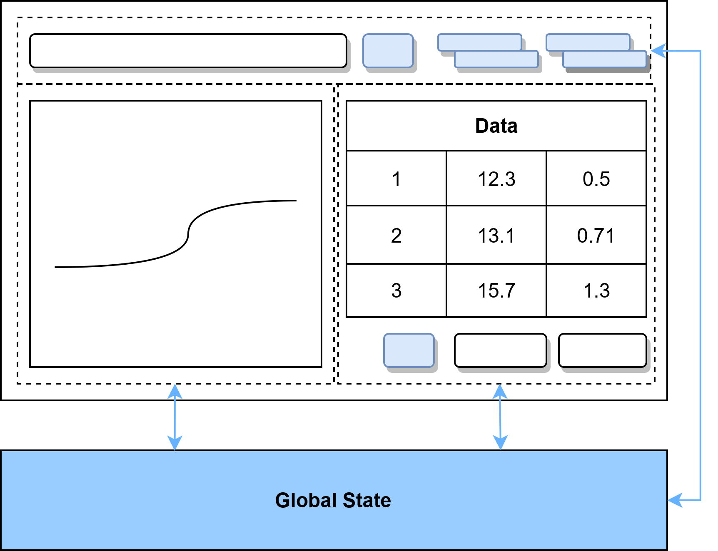

Slide 8
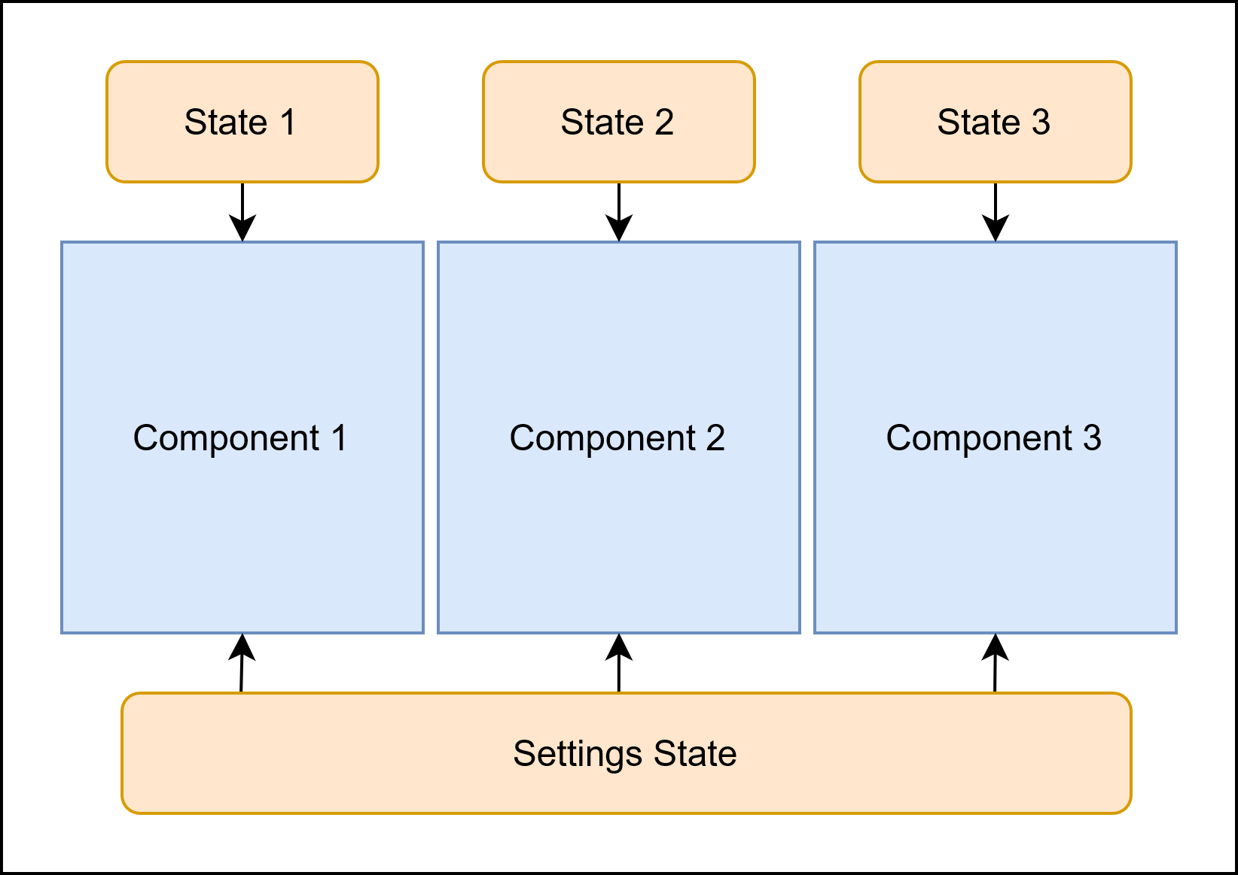

Slide 9
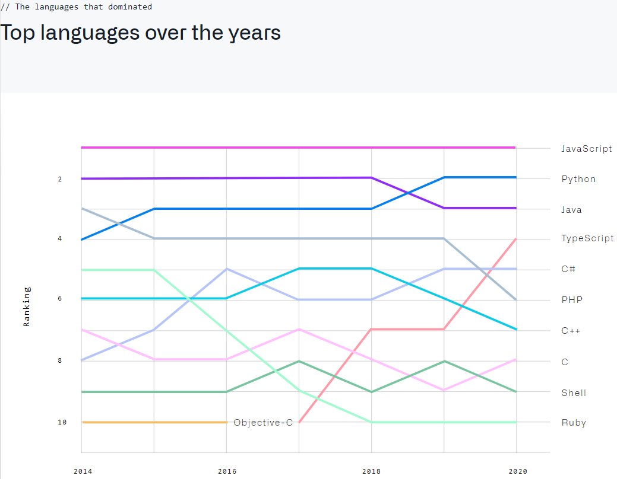

Slide 10
TypeScript Benefits
Optional Strong static typing
Compiler detects type related mistakes
Less bugs found at runtime
Rich IDE support – autocomplete, refactoring
Code is self-documented and more readable
Object Oriented
Classes, interfaces and inheritance
Access restrictions
Support for older browsers
Convenient syntax for common constructs
Enums, Tuples

Slide 11
Include output bundle in HTML file
<script type="text/javascript">window.globalThis = window;</script>
<script type="text/javascript“ src="./typescript/dist/ts-bundle.min.js"></script>

Slide 12
TypeScript exposing functions for legacy JavaScript to call
global-ts-exports.ts:
import { createStore } from "../src/store";
import { renderControl } from "../src/MainControl";
declare var window: any;
window.tsexp = {
createStore,
renderControl
};

Slide 13
Legacy JavaScript calling TypeScript functions
this.store = tsexp.createStore();
const elem = document.getElementById(“solidanchor");
const ctrl = tsexp.renderControl(elem, this.store);

Slide 14
TypeScript declaring types for legacy functions
staticJsTypes.d.ts:
declare namespace xyz.svg_button {
function getImageUrl(iconColor: string, iconIndex: number): string;
var IconImage: { [key: string]: number };
}
declare namespace xyz.rpc_data_client {
type SettingPropertyType = {timestamp:number, description:string, value:number};
function getSettingsByTimestamp(id: number, timestamp: number): Promise<SettingPropertyType[]>;
function sendLogMessage(message: string): void;
}
declare namespace xyz.util {
function html2Clipboard(topCtrlRef: HTMLElement | undefined, id: number): Promise<void>;
}

Slide 15
TypeScript calling legacy functions
declare namespace xyz.util {
function html2Clipboard(topCtrlRef: HTMLElement | undefined,
id: number): Promise<void>;
}
xyz.util.html2Clipboard(topCtrlRef, state.id).finally(finishNotify);

