Slide 1
Video classification
BY:
K.KEERTHI HUMSIKA(N161299)
M.SRAVANI(N160564)
V.JHONY(N160476)
A.JAGADEESH KUMAR(N160179)
L.VIKASH(N160098)
CH.AJAY KUMAR(N160219)
PROJECT MENTOR:
NAGARJUNA DEVI MAM

Slide 2
CONTENTS
ABSTRACT
SYSTEM REQUIREMENTS
TECHNOLOGIES
LIBRARIES
EXISTING SYSTEM
PROPOSED SYSTEM
STEPS TO IMPLEMENT THE PROJECT
OUTPUT
CONCLUSION
FUTURE SCOPE

Slide 3
ABSTRACT
Today's rapidly growing internet era has also increased the data in a very large amount for which the classification of the data has become more Important than ever before. As daily millions of video are been uploaded on the internet usually it is being classified based on the title of the video, which is not enough as the content of the video may be different than that of the title. Thus, this project highlights a system that would classify the video based on real-time data which takes the content of the video as the input and accordingly it gives the output. The major crux of this system is the usage of deep learning, in which the collection of the image is been taken from the video and compared with the pre-trained model and accordingly the result showed.

Slide 4
Hardware and Software Requirements:
Hardware requirements:
- PC with minimum 16GB RAM
- i7 with 64 bit processor.
Software requirements:
- Visual studio
- Windows 10.

Slide 5
TECHNOLOGIES
Python is the programming language that we use to develop this project.
The main domain that we chosen to develop this project is Deep-learning.
The reason we choose the python language is it is a platform independent and it has many inbuilt packages to implement this project.

Slide 6
LIBRARIES USED IN THE PROJECT:
Numpy
Keras
Open CV2
Tensor flow
Sklearn
Pickle

Slide 7
Numpy:
Numpy offers comprehensive mathematical functions, random number generators, linear algebra routines, Fourier transforms, and more.
Numpy supports a wide range of hardware and computing platforms, and plays well with distributed, GPU, and sparse array libraries.
Keras:
Keras is a powerful and easy-to-use free open source Python library for developing and evaluating deep learning models.
It wraps the efficient numerical computation libraries Theano and TensorFlow and allows you to define and train neural network models in just a few lines of code.

Slide 8
Open CV2:
OpenCV is the huge open-source library for the computer vision, machine learning, and image processing and now it plays a major role in real-time operation which is very important in today's systems.
By using it, one can process images and videos to identify objects, faces, or even handwriting of a human.
Tensor Flow:
TensorFlow is a Python library for fast numerical computing created and released by Google.
It is a foundation library that can be used to create Deep Learning models directly or by using wrapper libraries that simplify the process built on top of TensorFlow.

Slide 9
Sklearn:
Scikit-learn is a library in Python that provides many unsupervised and supervised learning algorithms. It's built upon some of the technology you might already be familiar with, like Numpy, pandas, and Matplotlib.
Pickle:
Pickle in Python is primarily used in serializing and deserializing a Python object structure. In other words, it's the process of converting a Python object into a byte stream to store it in a file/database, maintain program state across sessions, or transport data over the network.

Slide 10
EXISTING SYSTEM
In existing system, we have a problem called ‘Flickering’ where the activity name in the output gets fluctuated.
PROPOSED SYSYTEM
In present system, we have eradicated the problem of ‘Flickering’ by using efficient method called Convolution Neural Networks (CNN).

Slide 11
STEPS TO IMPLEMENT THE PROJECT:
First we need to give input as a video file.
Loop over all frames in the video file.
Classify each frame individually and independently of each other.
Choose the label with the largest corresponding probability that suits with trained data sets.
Label the frame and gives the corresponding name as output.

Slide 12
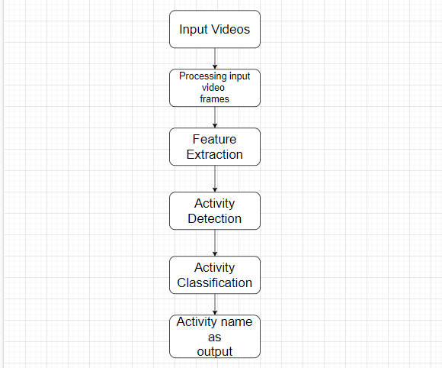
Flow chart for Video Classification:

Slide 13
To classify the Frames we use Convolutional neural networks (CNN):
When performing image classification, we do:
Input an image to our CNN.
Obtain the predictions from the CNN.
Choose the label with the largest corresponding probability.
- A video is nothing but series of frames, where CNN model helps in dividing the video into N – number of frames.
- Now the model tries to match that particular frame with the
trained data sets and gives the corresponding name as output.

Slide 14
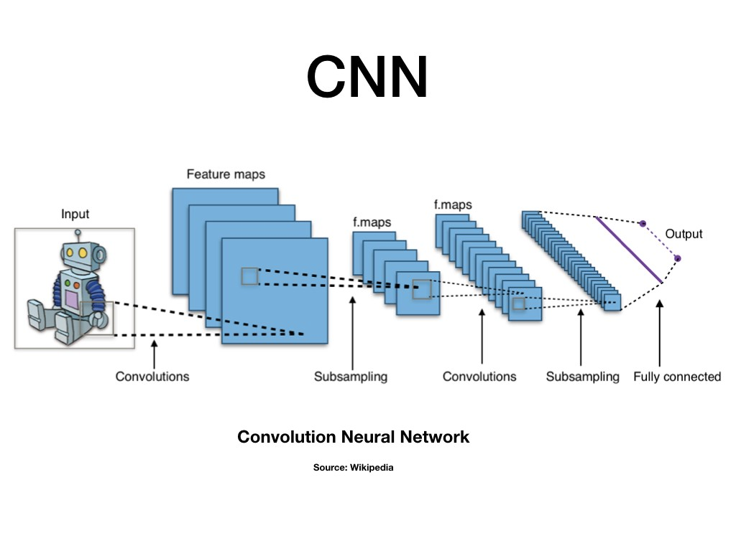
The convolutional neural network that is CNN is a machine learning algorithm and it having different convolutional layers that are input and output layers and many hidden layers that are used for image classification, image processing, other different auto correlated data and also for segmentation. The CNN convolutional neural network is commonly used for image or video classification.

Slide 15

We give the above image as input to CNN model. Then it displays the output as corresponding activity name.

Slide 16
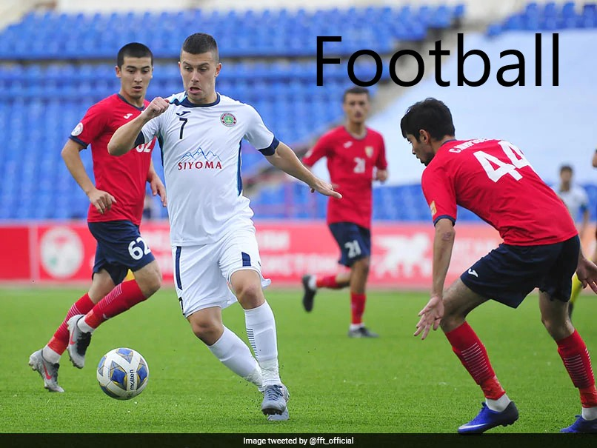
The model displays the activity name as football.

Slide 17
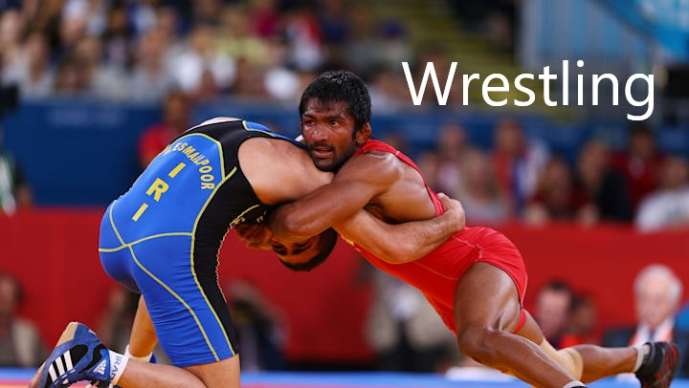
The model displays the activity name as wrestling.

Slide 18
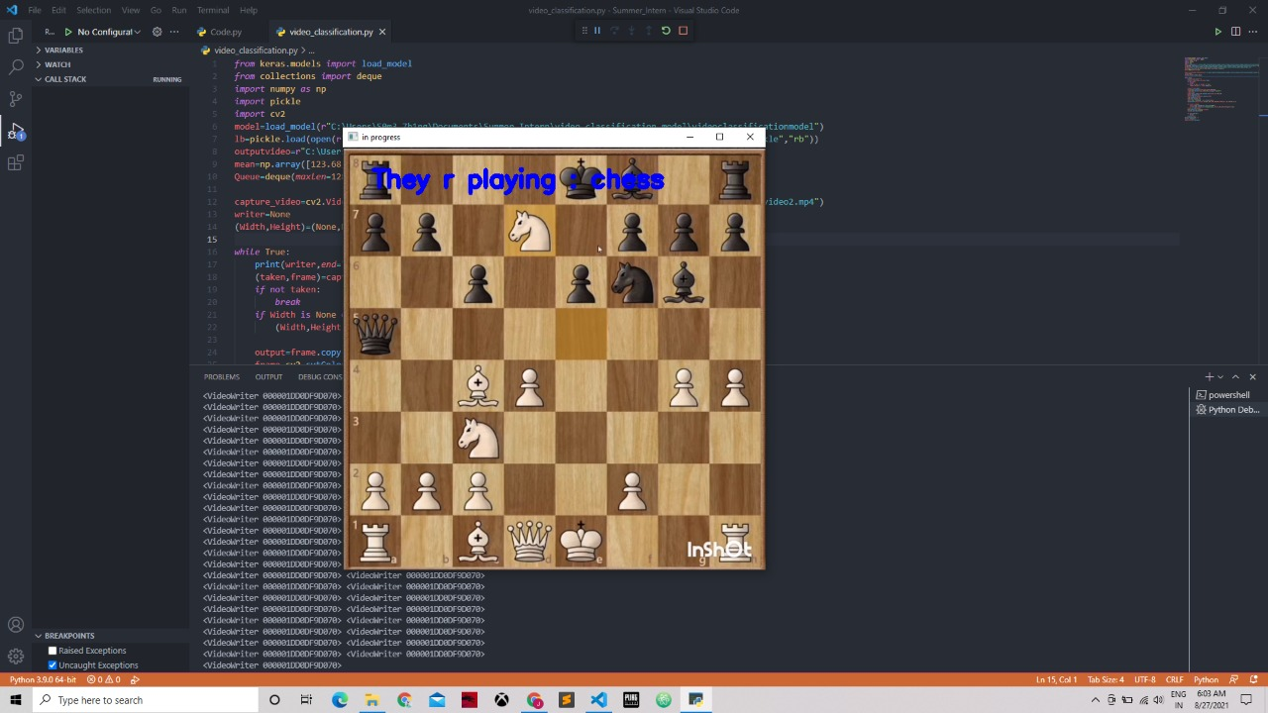
OUTPUT:
CASE 01:

Slide 19
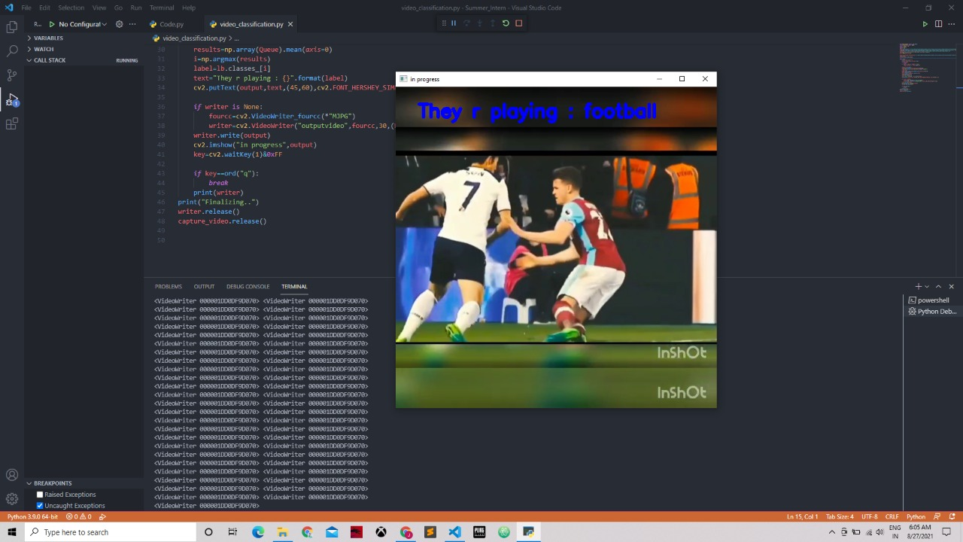
CASE 02:

Slide 20
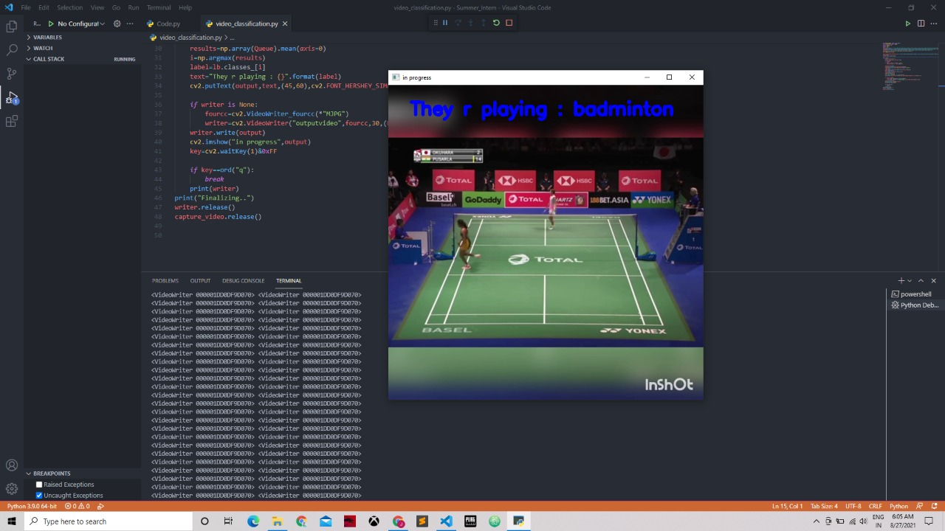
CASE 03:

Slide 21
CONCLUSION
At present and with the passage of time, the amount of sports training video data in the Internet is growing rapidly. In order to effectively manage and retrieve sports training video, accurate classification of sports training video is very important for consideration.
Convolution neural network with deep learning is used for the classification purpose in the proposed model.
After classification, event matching operation is performed, and video classification is realized according to similarity.
The experimental results show that the proposed model can effectively determine all kinds of sports training videos and accurately detect the occurrence of events through convolution neural network(CNN), so as to achieve high-precision classification of sports training videos.
Compared with other models, the proposed model has the advantages of simple implementation, fast processing speed, high classification accuracy, high generalization ability, and adaptability.

Slide 22
FUTURE SCOPE
As many videos are present in the real world, an effective way to classify those videos is very important.
In addition to that, we can improve this model further by the using different ways of classifying video based on video, audio and text.
Video classification model can be used in real time situation like live streaming predictions.

Slide 23
References:
https://www.pyimagesearch.com/2019/07/15/video-classification-with-keras-and-deep-learning/
https://www.youtube.com/watch?v=BllyHlq5SsQ&list=PLxefhmF0pcPl_v-lLsqF3drP6NOoSYJR0
https://www.ijirase.com/assets/paper/issue_11/volume_4/V4-Issue-11-936-939.pdf

Slide 24
THANK YOU

