Slide 1

G2M Case Study EDA
Virtual Internship
20-May-2024

Slide 2
Agenda
Executive Summary
Problem Statement
Approach
EDA
EDA Summary
Recommendations

Slide 3
Executive Summary
XYZ is an investment firm looking to invest int the Cab Industry. Our goal is to provide them with a detailed synopsis of the market and the companies they are considering investing in. To do so we conducted exploratory data analysis on the following datasets.
Cab_Data.csv - this file includes details of transaction for 2 cab companies, pink and yellow.
Customer_ID.csv - this is a mapping table that contains a unique identifier which links the customer’s demographic details.
Transaction_ID.csv - this is a mapping table that contains transaction to customer mapping and payment mode.
City.csv - this file contains list of US cities, their population and number of cab users.
Based on the data provided we recommend that XYZ invest in “Yellow Cab” and focus there investment in the cities, New York, Chicago and Los Angeles.

Slide 4
Problem Statement
XYZ is a private firm in US. Due to remarkable growth in the Cab Industry in last few years and multiple key players in the market, it is planning for an investment in Cab industry and as per their Go-to-Market(G2M) strategy they want to understand the market before taking final decision.
Questions from XYZ we will answer:
How do cab companies generate revenue?
What cities generate the most revenue?
Which company controls the market in the most profitable cities?
Which company has the best profit margins?
Which company makes the most money per KM travelled?
How do users prefer to pay for the company's services?

Slide 5
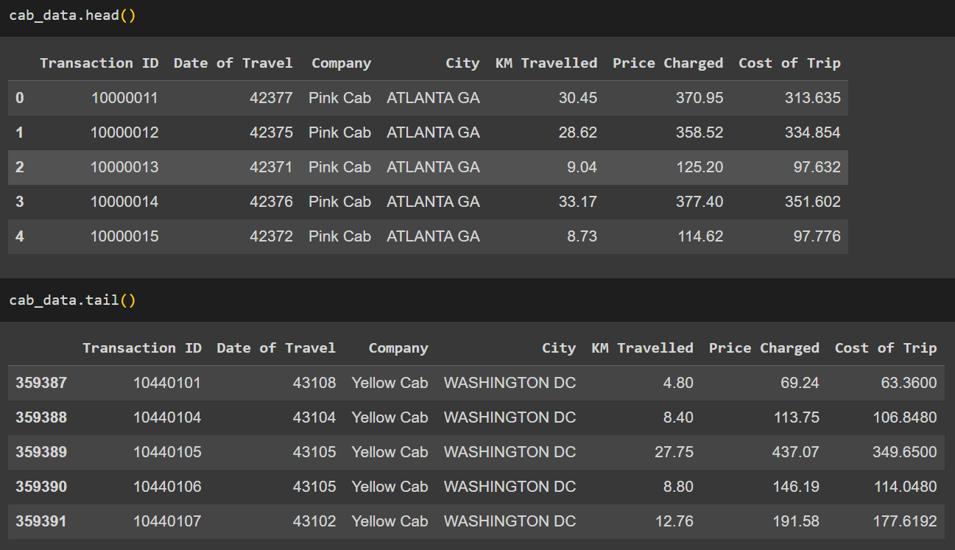
Profit Analysis
EDA Cab_Data.csv
These tables show what features this dataset has and what data is within these features.

Slide 6
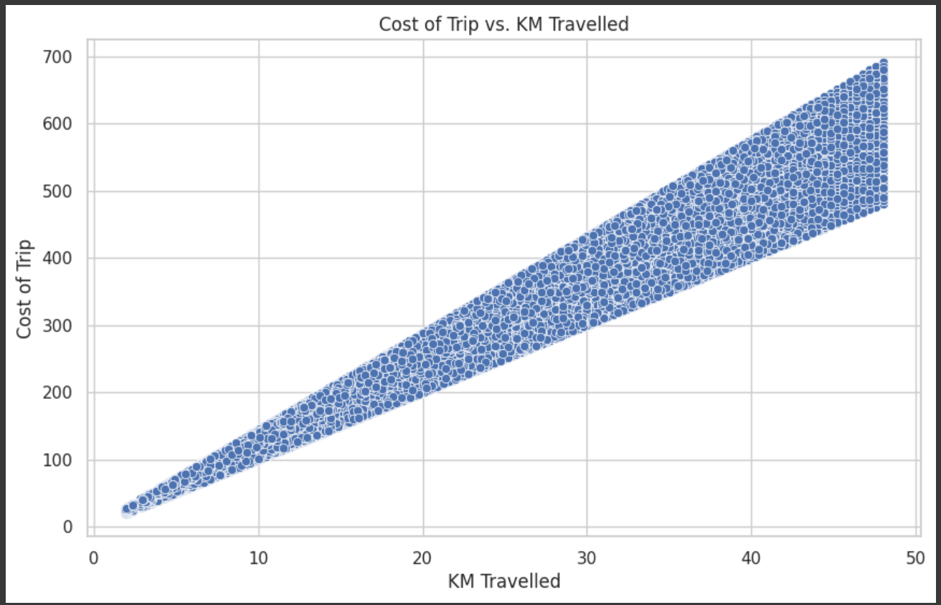
Profit Analysis
EDA Cab_Data.csv
This plot shows the relation between KM Travelled and Cost of Trip.
As to be expected the more KM Travelled the more the trip costs.

Slide 7
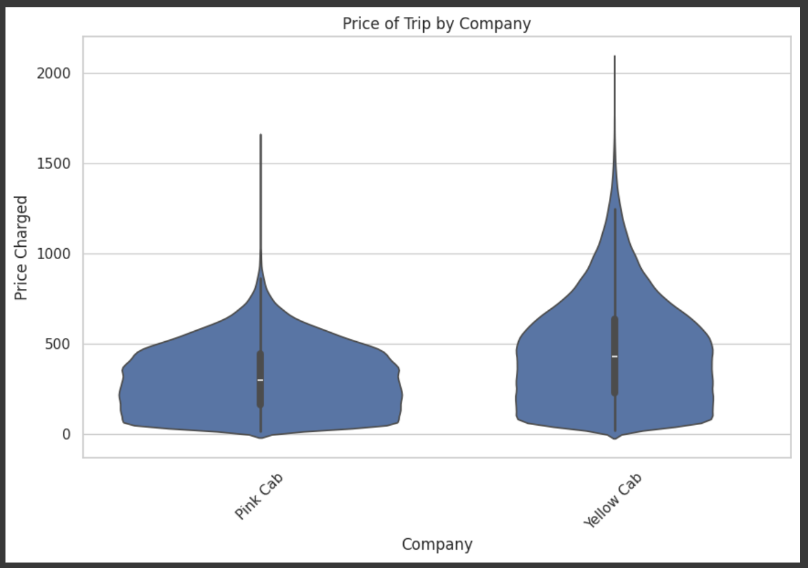
Profit Analysis
EDA Cab_Data.csv
This violin plot shows that “Yellow Cab” has a higher density of transactions that charge the customer more.
This is an early indication of “Yellow Cabs” superior profitability.

Slide 8
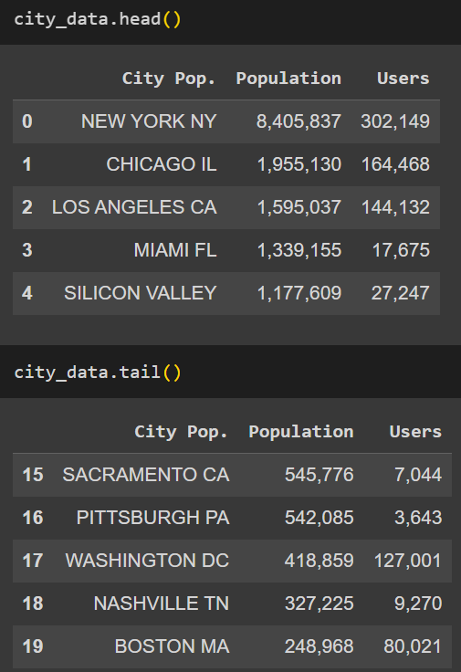
Profit Analysis
EDA City.csv
These tables show what features this dataset has and what data is within these features.
With this data we will be able to see the correlation between each city's population and user amount.
This will help us determine which cities are the most profitable and which hold the highest potential for growth.

Slide 9
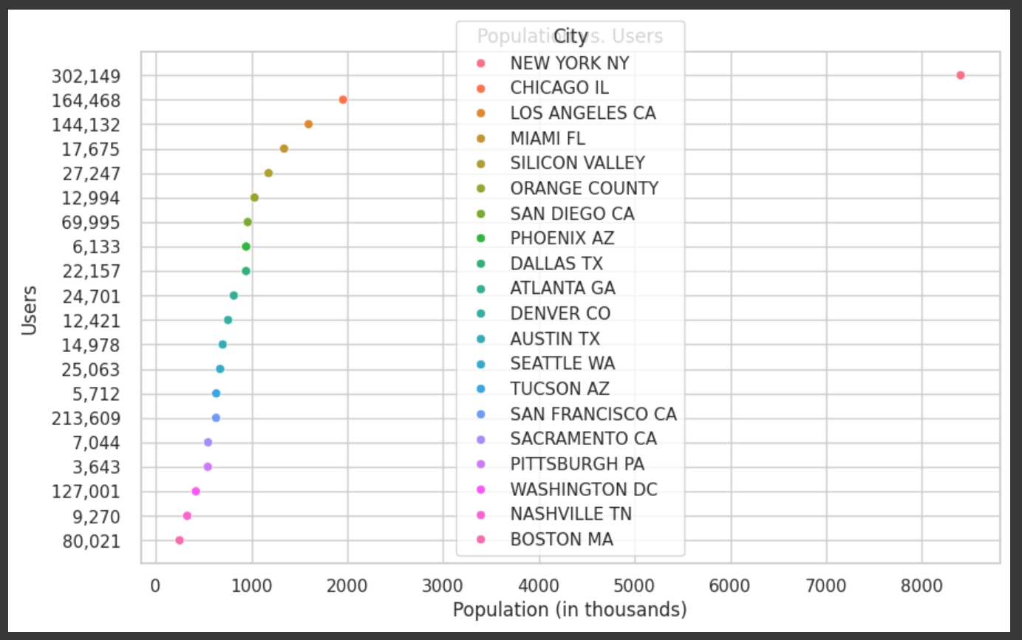
Profit Analysis
EDA City.csv
This chart shows the population of each city and the users each city has.
We see that New York has around five times the population of its nearest competitor Chicago, but only double its users.
This means there is room for growth in New York in terms of expanding user counts.

Slide 10
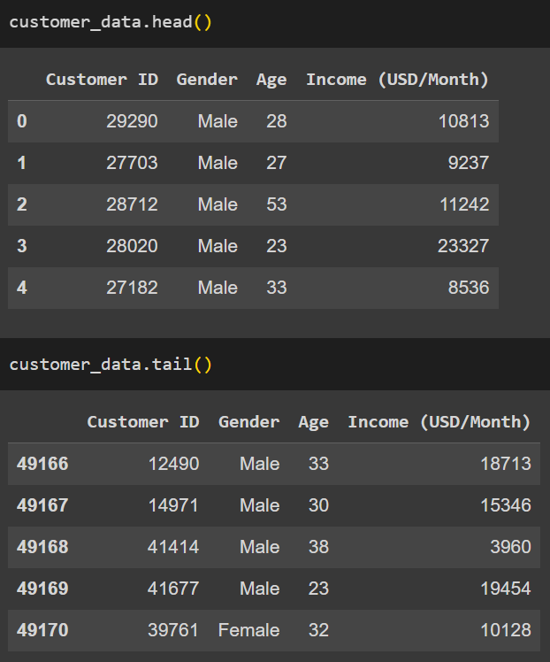
Profit Analysis
EDA Customer_ID.csv
These tables show what features this dataset has and what data is in these features.
With this data we will be able to determine the demographics of each user for the cab companies and draw conclusions based on that.

Slide 11
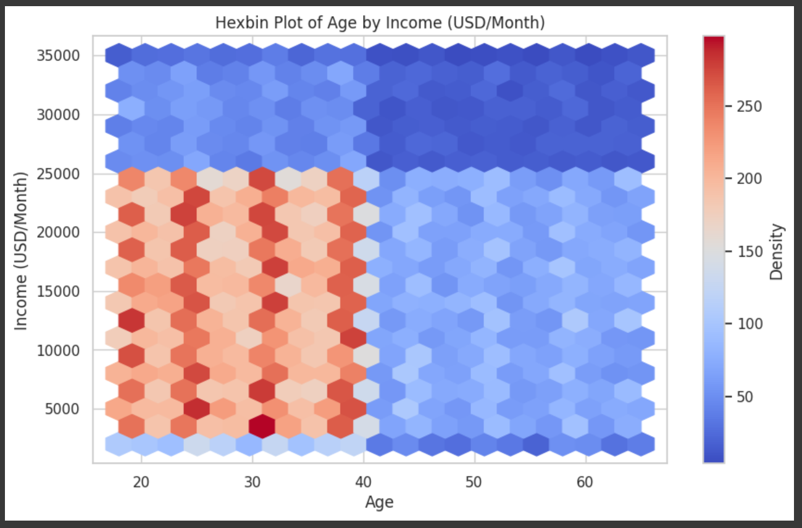
Profit Analysis
EDA Customer_ID.csv
This Hexplot gives us a better understanding of the correlation between these two features.

Slide 12
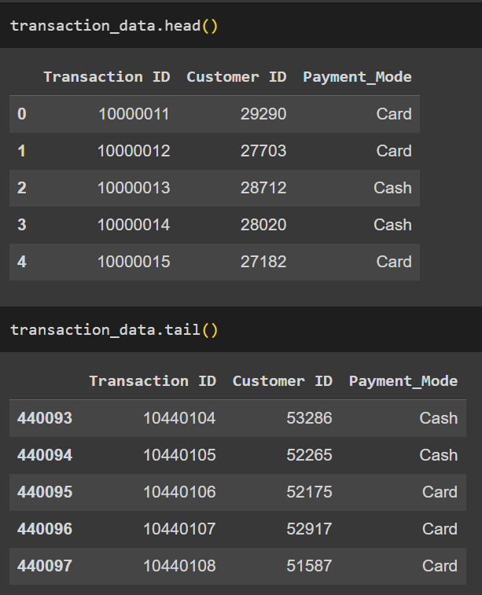
Profit Analysis
EDA Transaction_ID.csv
These tables show what features this dataset has and what data is in this features.
We can use this data to find out which payment method is more popular and what demographic uses each payment method.

Slide 13
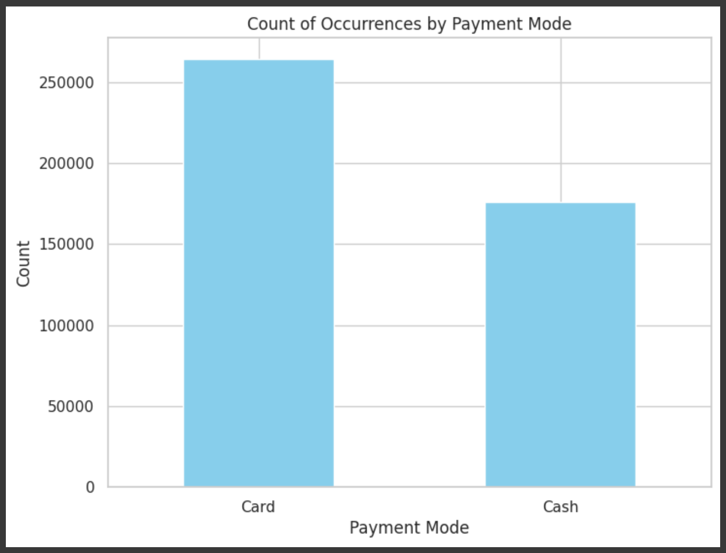
Profit Analysis
EDA Transaction_ID.csv
By this graph we can see that card transactions are more often used than cash.
XYZ should note how technology advances within this industry and anticipate further changes in the ways customers pay.

Slide 14
Profit Analysis
Recommendations
After analyzing the results from our exploratory data analysis, we recommend XYZ to do the following.
Invest in “Yellow Cab” as they have shown to be the more profitable option.
Yellow Cab has wider profit margins, makes more money per KM travelled, has a more robust control of the market and operates more heavily in New York.
Focus their resources on cities with the highest populations, with an emphasis on New York.
New York’s population quadruples Chicago’s, the second largest city in the nation, XYZ should work to expand their influence in this city especially as the user to population ratio still has plenty of room for growth.

Slide 15
Thank You

