Slide 1
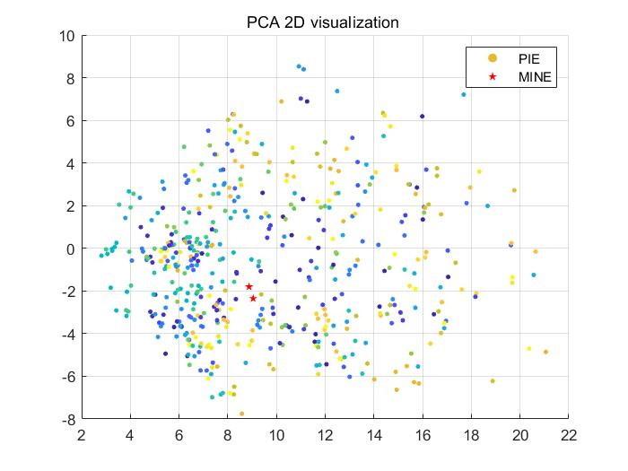
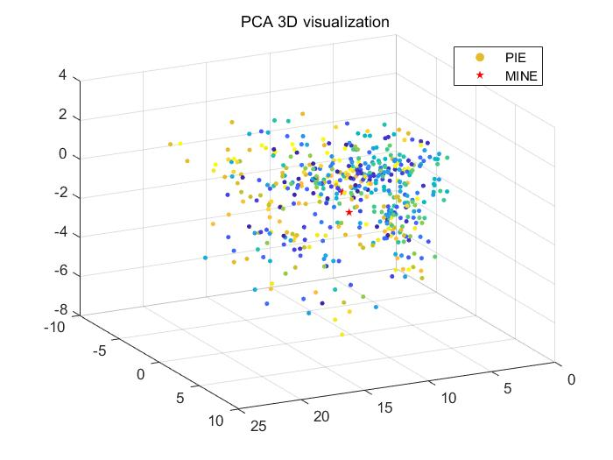
(a) PCA 2D visualization
(b) PCA 3D visualization

Slide 2
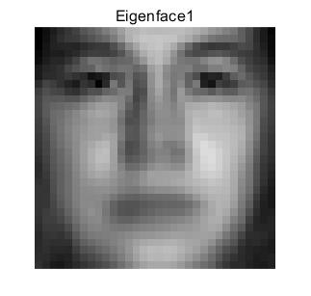
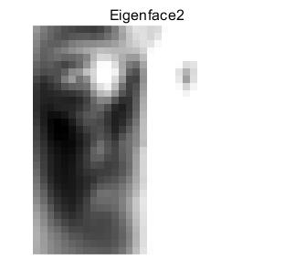
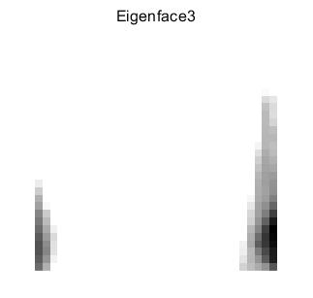
(a) Eigenface 1
(a) Eigenface 2
(a) Eigenface 3

Slide 3
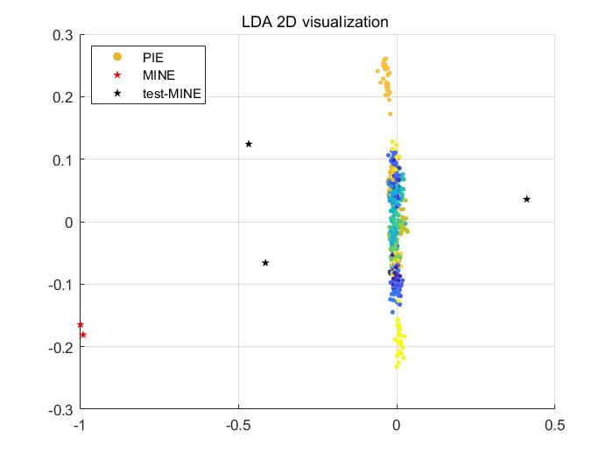
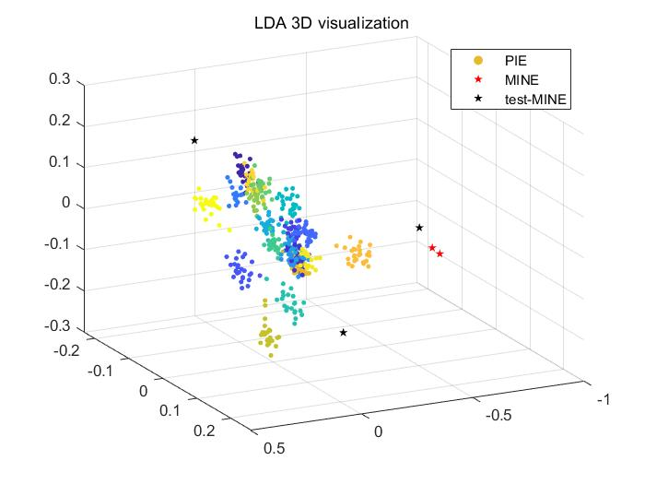
(a) LDA 2D visualization
(b) LDA 3D visualization

Slide 4
