Slide 1

Smart Grid Sensor Network for Industrial Energy Management Using IoT and Machine Learning
“Affordable energy intelligence for small and medium enterprises”
Saeed Sarwar Anas
Student No. 20068400 | Supervisor: Dr Anwar Haq
MSc Computer Science (COM748) | Ulster University
Notes:
Good morning. My project builds a low-cost smart grid monitoring system for SMEs, combining IoT sensing with machine learning for forecasting and anomaly detection.

Slide 2
Contents
1 Introduction
2 Research Background
3 Problem & Research Gap
4 Aim & Objectives
5 Pipeline Architecture
6 Data Collection
7 Key Design Decisions
8 Final System Architecture
9 Algorithmic Workflow
10 Prototype Evidence
11 Generated Output
12 Validation Evidence
13 Results & Evaluation
14 Baseline vs Proposed
15 Performance Benchmarks
16 Validation Flow
17 Critical Reflection
18 Contribution & Future Work
19 References
Notes:
Twenty minutes: problem and gap first, then the system, then the evidence and results.

Slide 3
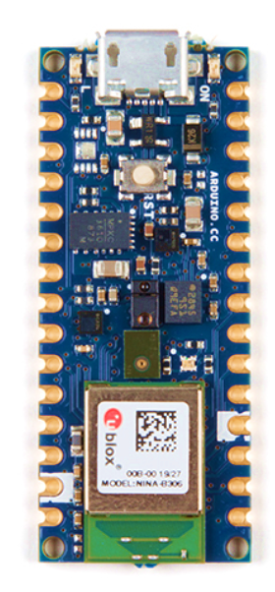
A third of the world’s energy is used by industry
Most small businesses cannot see a single watt of it.
£10,000s
Cost of commercial
monitoring systems
£30
Cost of the hardware
used in this project
0
Labelled fault data
available in practice
Notes:
The hook: energy blindness is not a technology problem any more, it is an affordability problem.

Slide 4
Research Background
01
Traditional grid
One-way flow, no visibility at the point of use
02
Smart grid
Digital sensing, two-way communication, dynamic balancing
03
Industry 4.0 / IIoT
Low-cost networked sensors make fine-grained measurement viable
04
ML & big data
From threshold alarms to predictive, proactive management
Notes:
Four paradigm shifts frame the work: decentralisation, IIoT, and machine learning.

Slide 5
Problem & Research Gap
The Problem
The Gap
SCADA and commercial metering cost tens of thousands of pounds
SMEs therefore operate "blind" — waste goes unseen
Threshold alarms react only after a limit is crossed
Labelled fault data are almost never available
Research concentrates on homes or utility-scale grids — not SMEs
Capable integrated platforms rely on costly edge–cloud infrastructure
Forecasting and anomaly detection studied in isolation
Few studies release a complete, reproducible pipeline
Notes:
The gap is not a missing algorithm; it is a missing affordable, integrated, reproducible system.

Slide 6
Aim & Objectives
Aim: design, implement, and evaluate a low-cost smart grid sensor network that delivers real-time monitoring, short-term forecasting, and anomaly detection for SMEs.
Review
Critically review IoT monitoring, forecasting, and anomaly detection
Data
Build a documented, leakage-free preprocessing pipeline
Sense
Design IoT sensing on a £30 embedded platform
Forecast
Develop an LSTM forecaster; benchmark against baselines
Detect
Implement unsupervised Isolation Forest detection
Release
Publish code, data, and models as a reproducible artefact
Notes:
Eight objectives in the paper; these six carry the technical work.

Slide 7
System Overview: Pipeline Architecture
Ingest
Raw dataset
or sensor feed
Clean
Forward-fill,
resample hourly
Prepare
Scale, window,
chronological split
Model
LSTM forecast +
Isolation Forest
Serve
Streamlit
dashboard
Leakage control: the chronological split happens BEFORE the scaler is fitted — training statistics never see future data.
34,589
34,565
70/15/15
2,075,259
clean hourly rows
24-hour sequences
chronological split
raw UCI records
Notes:
One pipeline serves both models. The ordering of split-then-scale is the single most important methodological control.

Slide 8
Data Collection
UCI Household
Tetouan City
Live Data
Primary benchmark
Cross-validation
Future Work
2,075,259 minute-level records
Dec 2006 – Nov 2010
25,979 missing values (forward-filled)
→ 34,589 hourly records
52,416 ten-minute records (2017)
3 distribution zones + weather
No missing values
→ 8,736 hourly records
Arduino Nano 33 BLE Sense
Environment + appliance
Notes:
Two public benchmarks carry the evaluation; the restaurant deployment is a live proof of concept, honestly reported as not yet executed.

Slide 9
Key Design Decisions
Every choice traces to evidence in the literature.
Mandatory baselines
Isolation Forest
ML does not automatically beat simple methods (Makridakis et al.)
Label-free and lightweight — labelled faults do not exist in practice
24-hour window
Split before scaling
Matches the diurnal cycle evidenced in the data
Closes the data-leakage channel
Simpler LSTM (V1)
Precomputed dashboard
Deeper V2 had lower validation loss but generalised worse
Demo-safe: nothing trains or downloads live
Notes:
This slide is the bridge from literature to build: each decision has a citation behind it.

Slide 10
Final System Architecture
4 Visualisation
Why layered?
Streamlit dashboard — metrics, forecasts, anomaly alerts
Each layer testable alone
Data source swappable
Modelling faults cannot break the UI
One-way data flow
3 Machine learning
LSTM forecaster + Isolation Forest detector
2 Data pipeline
Ingest → clean → resample → window → split
1 IoT sensing
Arduino Nano 33 BLE Sense (£30) — environmental telemetry
Notes:
Data flows strictly downward. That is what lets me swap benchmark files for live sensor data without touching the models.

Slide 11
Algorithmic Workflow
LSTM — demand forecasting
Isolation Forest — anomaly detection
Input: previous 24 hourly readings
LSTM(64) → Dropout 0.2 → LSTM(32) → Dropout 0.2 → Dense(1)
29,857 trainable parameters
Adam (lr 0.001), MSE loss, batch 32
Early stopping (patience 10) — stopped at epoch 43
Output: next-hour demand in kW
Input: all 7 electrical features (multivariate)
Standardised to zero mean, unit variance
200 trees, contamination 1%, seed 42
Score = mean isolation path length
Anomalies isolate in short paths — no labels needed
Output: anomaly flag per hour
Notes:
Two algorithms, one shared pipeline, running in parallel and meeting again at the dashboard.

Slide 12
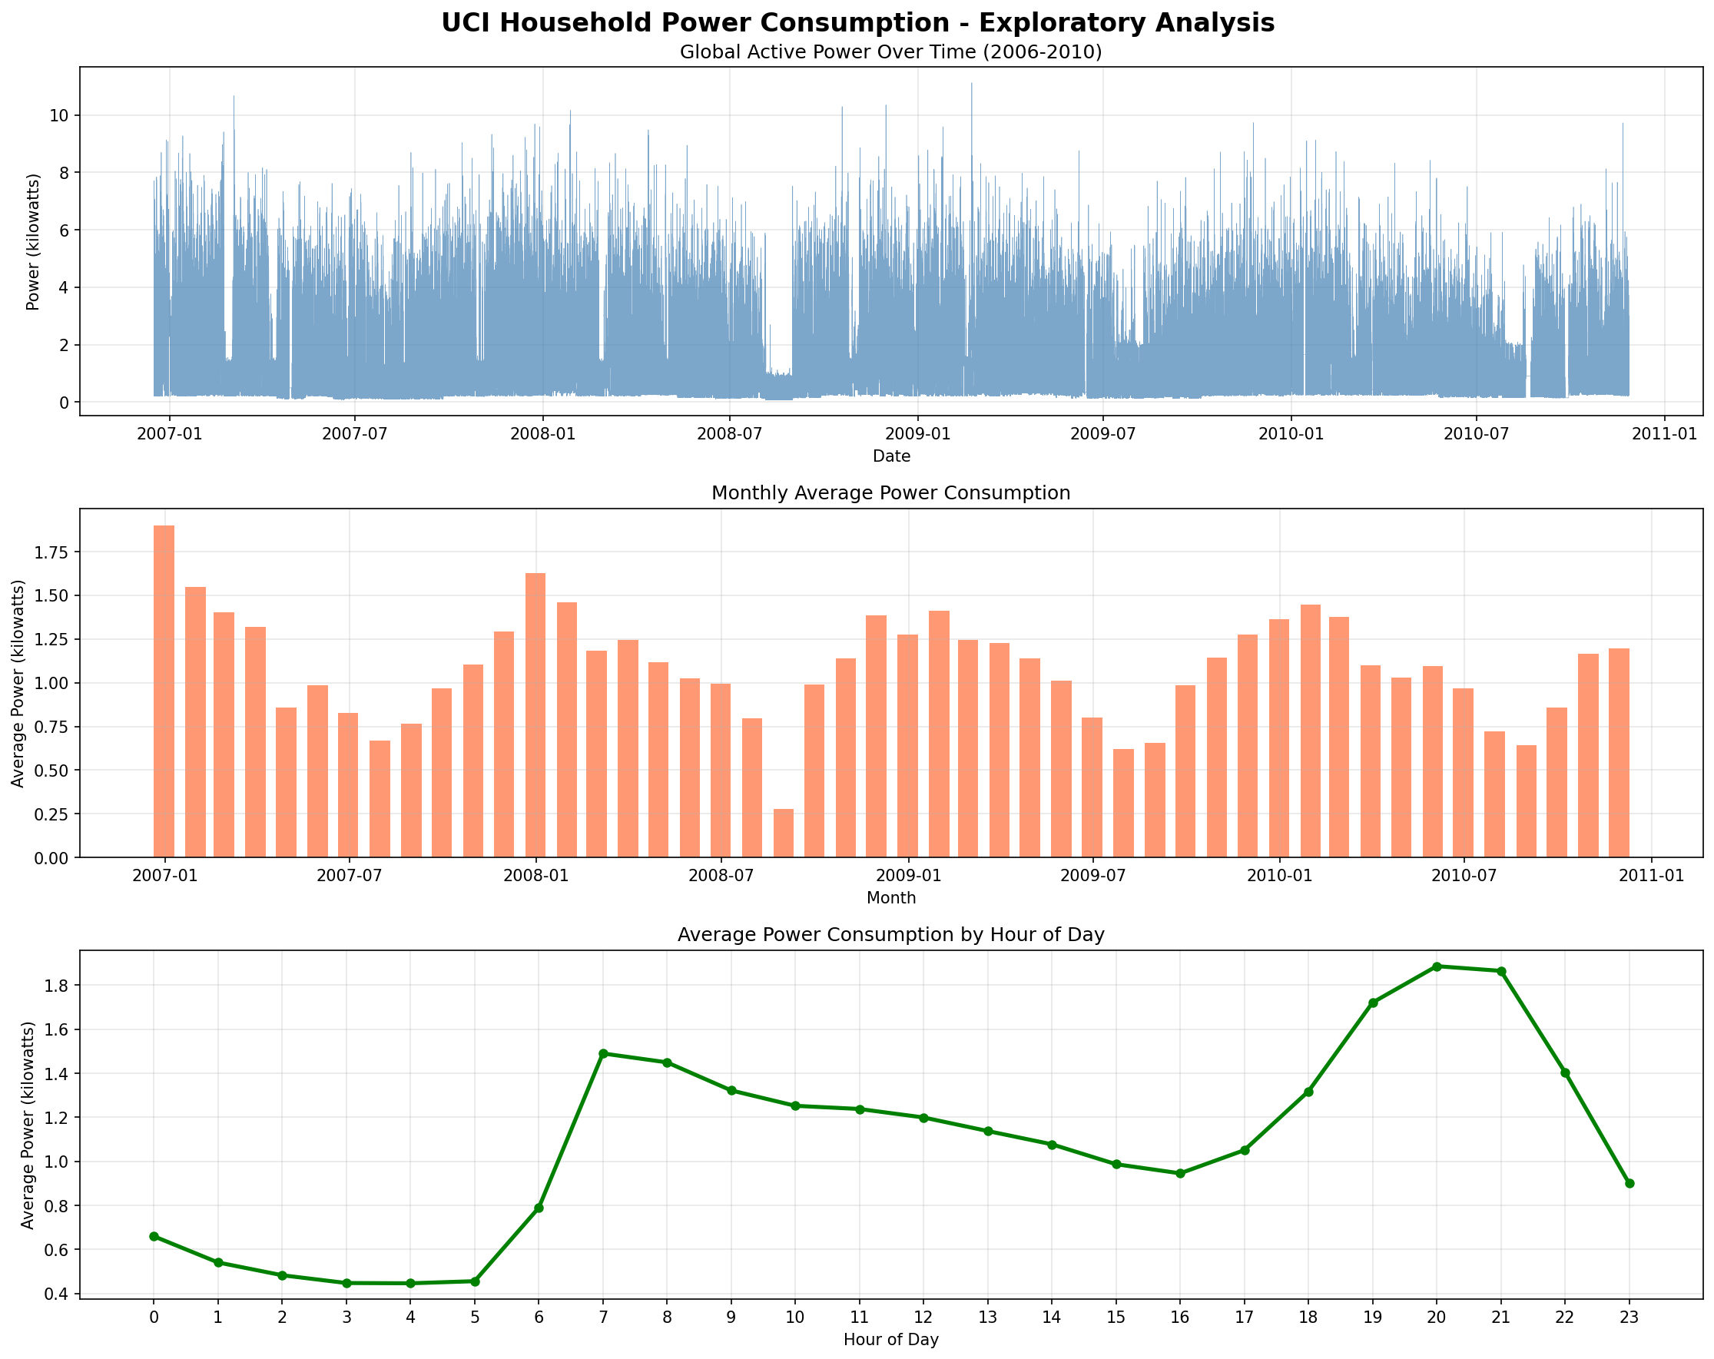
Prototype Evidence
Exploratory analysis
Four years of continuous household demand
Strong daily and weekly periodicity — the structure the LSTM learns
Frequent short spikes from appliance events
Visible gaps → forward-fill imputation
Minute-level noise → hourly resampling
Notes:
This is what justified the preprocessing decisions rather than assuming them.

Slide 13
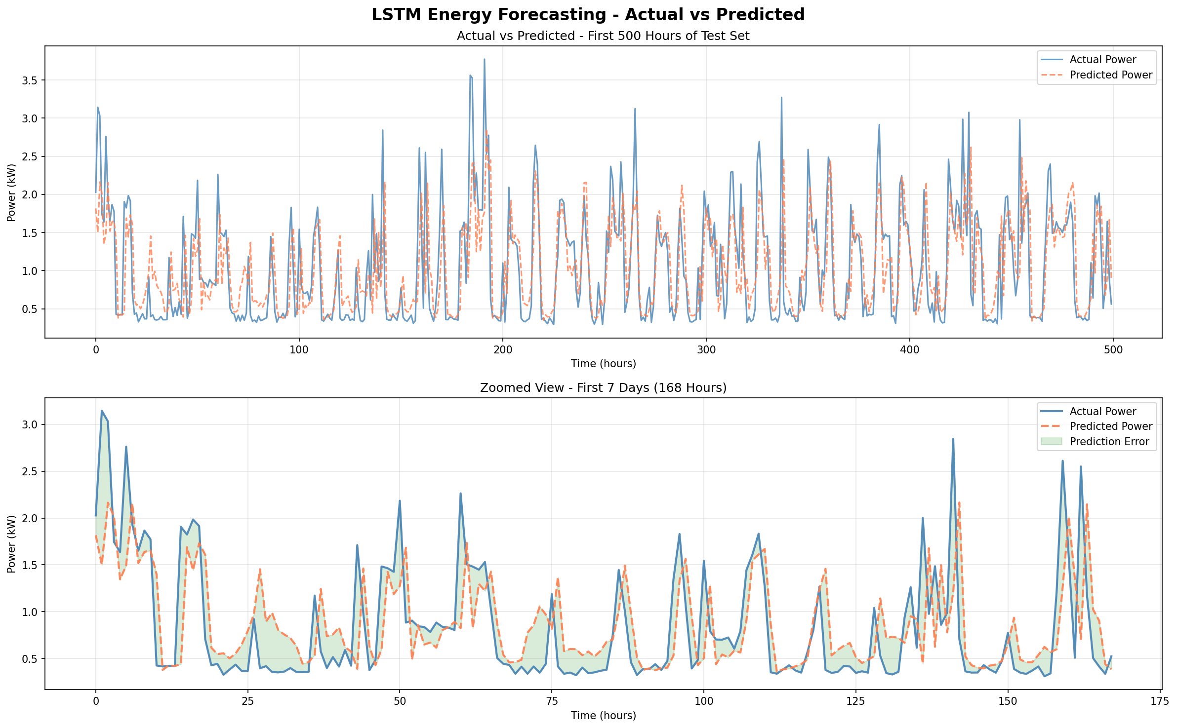
Generated Output
LSTM forecast against actual demand — UCI held-out test window
0.3707
MAE (kW)
0.5421
RMSE (kW)
0.4432
R² explained
Predictions track the daily peaks the baselines smooth over.
Notes:
Average prediction within about 370 watts of true hourly demand.

Slide 14
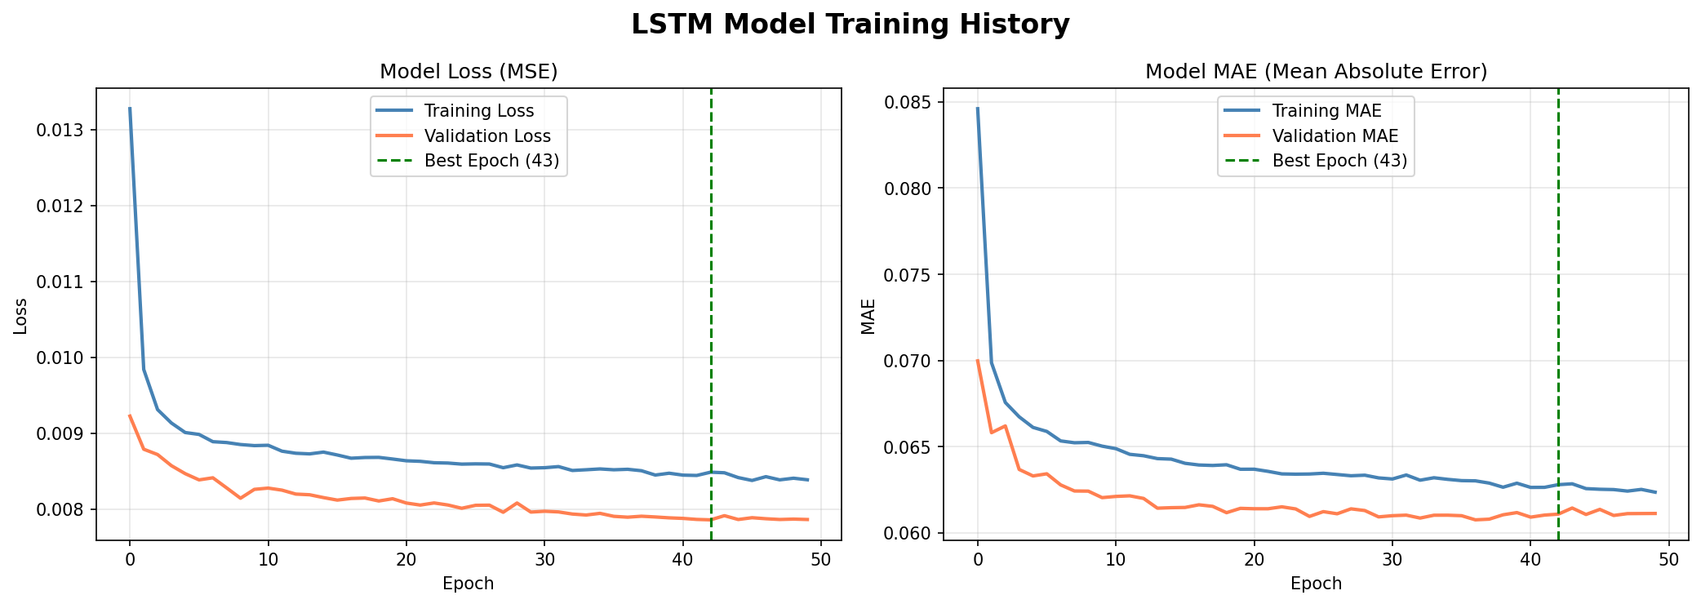
Validation & Repair Evidence
What the curves prove
Validation tracks training — no over-fitting
Early stopping retained epoch 43
Fixed seed 42 → reproducible re-runs
Chronological split asserted in code
Repairs made during development
V2 (deeper) rejected — better val loss, worse generalisation
MAPE found unreliable near zero → rely on MAE / RMSE
Notes:
Validation is not only about passing; it is about what I changed when it failed.

Slide 15
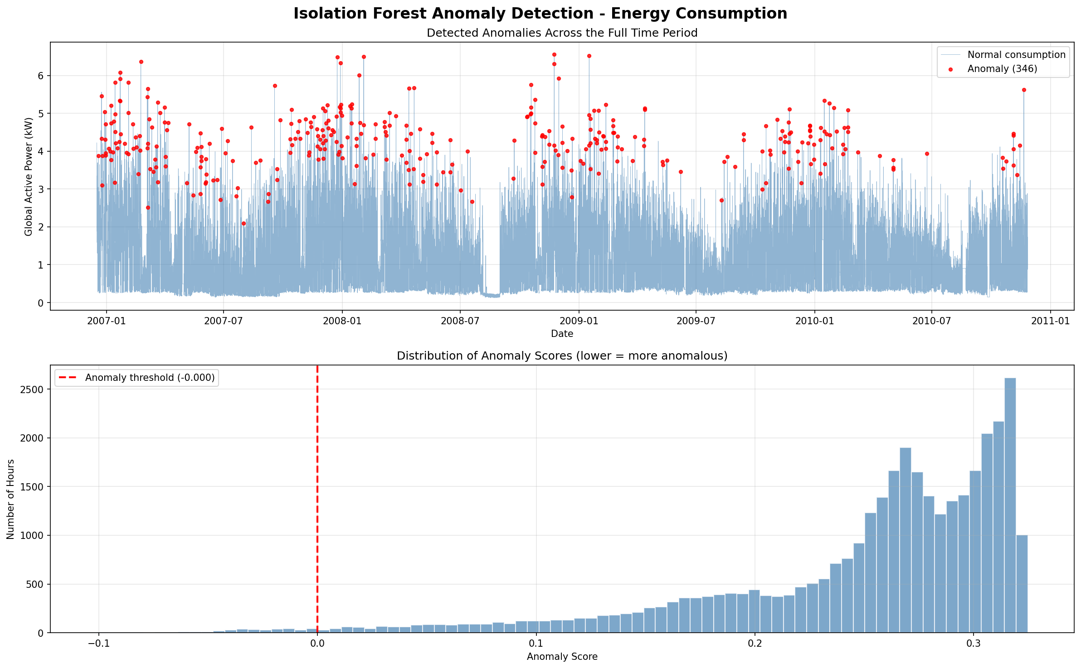
Results & Evaluation
Anomaly detection — UCI
346
flagged by Isolation Forest (1.00%)
440
flagged by Z-score reference
267
agreed by both methods
79
multivariate-only detections
No ground-truth labels exist — these measure AGREEMENT between two methods, not accuracy. The 79 multivariate-only finds are the added value.
Notes:
Be explicit in the viva: agreement, not accuracy. That honesty is a strength, not a weakness.

Slide 16
Baseline vs Proposed Pipeline
Model | MAE (kW) | RMSE (kW) | MAPE (%) | R²
Naive persistence | 0.4054 | 0.6350 | 44.07 | 0.2361
24-h moving average | 0.5768 | 0.7066 | 87.89 | 0.0542
LSTM (proposed) | 0.3707 | 0.5421 | 45.77 | 0.4432
8.6%
35.7%
×2
lower MAE than naive
lower MAE than moving average
variance explained vs naive
MAPE exceeds naive only because household demand approaches zero overnight — dividing by near-zero inflates the percentage. MAE, RMSE, and R² are the reliable measures here.
Notes:
Expect a question on MAPE. The answer is prepared: it is a metric artefact, not a model weakness.

Slide 17
Performance Benchmarks
Cross-dataset validation — Tetouan City (unchanged pipeline)
62.0%
better than naive
87.0%
better than moving average
2.36%
normalised MAE
Efficiency: 29,857 parameters · ~11 minutes training on a laptop CPU · no GPU used at any stage.
Notes:
Same code, different country, different scale. Larger margins because city load is smoother.

Slide 18
Validation Flow
1
Raw data
2
Leakage check
3
Train + early stop
Two public benchmarks
Split before scaling
Seed 42, patience 10
4
Baseline comparison
5
Cross-dataset run
6
Agreement study
Naive & moving average
Unchanged pipeline
IF vs Z-score reference
Every claim in this project is backed by a comparison, a second dataset, or a reproducible artefact.
Notes:
This is the answer to "how do you know it works?"

Slide 19
Critical Reflection
Worked well
Limitations
Lessons learned
Mandatory baselines made results defensible
Unchanged pipeline transferred to a second dataset
Simpler model beat the deeper one
Demo-safe dashboard never fails live
Metrics over a 500-hour window
Agreement study, not true accuracy
Neither dataset is industrial
Forecaster is univariate
Sensing layer not yet run live
Verify every source before citing it
Metric choice must follow data characteristics
Environment discipline saves days
Honest framing turns objections into rigour
Notes:
Naming limitations before the examiner does is what makes the rest credible.

Slide 20
Contribution & Future Work
Contribution
Future work
An affordable, open-source, end-to-end pipeline for SMEs
LSTM forecaster validated against baselines on two datasets
Label-free multivariate anomaly detection
Fully reproducible artefact — code, data, models published
Execute the approved restaurant deployment (hardware ordered)
SHAP explainability for operator trust
Multivariate forecasting using weather signals
Model quantisation for on-device TinyML inference
Capabilities once confined to systems costing tens of thousands of pounds,
demonstrated on £30 of hardware and open-source software.
Notes:
Close on the thesis: this is a distribution problem, and the distribution problem is now solvable.

Slide 21
References
Selected from 43 verified sources
S. Hochreiter and J. Schmidhuber, “Long short-term memory,” Neural Comput., vol. 9, no. 8, pp. 1735–1780, Nov. 1997.
F. T. Liu, K. M. Ting, and Z.-H. Zhou, “Isolation forest,” in Proc. 8th IEEE Int. Conf. Data Mining (ICDM), Pisa, Italy, Dec. 2008, pp. 413–422.
W. Kong, Z. Y. Dong, Y. Jia, D. J. Hill, Y. Xu, and Y. Zhang, “Short-term residential load forecasting based on LSTM recurrent neural network,” IEEE Trans. Smart Grid, vol. 10, no. 1, pp. 841–851, Jan. 2019.
S. Makridakis, E. Spiliotis, and V. Assimakopoulos, “Statistical and machine learning forecasting methods: Concerns and ways forward,” PLoS ONE, vol. 13, no. 3, Art. no. e0194889, Mar. 2018.
Y. Himeur, K. Ghanem, A. Alsalemi, F. Bensaali, and A. Amira, “Artificial intelligence based anomaly detection of energy consumption in buildings: A review, current trends and new perspectives,” Appl. Energy, vol. 287, Art. no. 116601, Apr. 2021.
R. Bin Mofidul, M. M. Alam, M. H. Rahman, and Y. M. Jang, “Real-time energy data acquisition, anomaly detection, and monitoring system: Implementation of a secured, robust, and integrated global IIoT infrastructure with edge and cloud AI,” Sensors, vol. 22, no. 22, Art. no. 8980, Nov. 2022.
S. Baskar et al., “Edge-powered monitoring with Arduino Nano BLE Sense: Real-time industrial wastewater quality assessment,” in Proc. Int. Conf. Commun., Comput., Smart Materials Devices (ICCCSMD), Chennai, India, Dec. 2024.
P. Warden and D. Situnayake, TinyML: Machine Learning with TensorFlow Lite on Arduino and Ultra-Low-Power Microcontrollers. Sebastopol, CA, USA: O’Reilly Media, 2019.
G. Hebrail and A. Berard, “Individual household electric power consumption,” UCI Machine Learning Repository, 2012, doi: 10.24432/C58K54.
A. R. Hevner, S. T. March, J. Park, and S. Ram, “Design science in information systems research,” MIS Quart., vol. 28, no. 1, pp. 75–105, Mar. 2004.
Full 43-entry bibliography in the paper and supporting material · github.com/S1122A/SmartGrid-Dissertation
Notes:
Ten shown; all 43 are verified and cited in both documents.

