Slide 1


Google file system & from file system to key-value store
SE3331-1 (2024 Fall)
IPADS, Shanghai Jiao Tong University
https://www.sjtu.edu.cn
Credits: Niv Dayan， JiFei@IPADS

Slide 2



Key-value storage (KVS): system w/ a simpler API
Storage abstraction:
Each data (Value) is opaque to the underlying storage/database
The K and V can be arbitrary byte-sequence (e.g., JSON, int, string)
Indexed by a key (K), which itself is also a data
Stored on disk (tolerate failure & support a large capacity), but can also be in-memory
Application-level Interface (API)
Get(K) -> V, Scan(K,N)
Update(K,V), Insert(K,V), Delete(K,V)
Notes:
实现这个 + 子集

Slide 3
Naïve solution to implement a KVS atop of filesystem
Storage abstraction remapping:
Key → The file name (may include the path)
Assume the key is not so long
Value → The file content
So we can store each K,V as a file ☺
Application-level Interface (API)
Get(K) -> V is similar to OPEN(…) + READ(…)
Insert(K,V) -> is similar to CREATE(…) + WRITE(…)
Etc.

Slide 4

KVS’s workloads are different than the filesystem
Filesystem is designed for bulk storage
E.g., images, videos KV
For small data, we need a way to store them in one file to improve storage efficiency
But question remains: how can we find the data in a file efficiently?
Key-value store

Slide 5
Naïve implement a KVS on the filesystem is inefficient
Redundant system call caused by mismatched interface
Example
E.g., Get(K,V) needs OPEN(…) + READ(…)
Ideally, we want to query the data in one system call, better 0
Space amplification(放大)
File data are stored in fixed-sized blocks (e.g., 512B – 4096B)
Why? To match the underlying device block size & better meta data management
On the other hand, the value in key-value store can be small (e.g., 64B)

Slide 6
Naïve implement a KVS on the filesystem is inefficient
Redundant system call caused by mismatched interface
Example
E.g., Get(K,V) needs OPEN(…) + READ(…)
Ideally, we want to query the data in one system call, better 0
Space amplification
File data are stored in fixed-sized blocks (e.g., 512B – 4096B)
The value in key-value store can be small (e.g., 8B)
Idea: using one or few file to store key-value store data
Different key-values can pack into the same disk block
Reduce system call overhead: open file once, serve all the requests then
Notes:
// TODO: directory has maximum file entry supported?

Slide 7
Building Key-value Storage on File System
Why builds upon the file system?
We still need a system to interact with the disk hardware!
Though modern KVS may also bypass the file system, but is uncommon
“All problems in computer science can be solved by another level of indirection” -- often attributed to Butler Lampson, who attributes it to David Wheeler
Key-value Store
Key-value files
File system
Notes:
<Hints and Principles for Computer System Design>
David Wheeler： 剑桥大学

Slide 8
A naïve Key-Value Storage (KVS)
Suppose we store all the KV in a single file in the following format:
Key
Value
123456，'{"name":"London","attractions":["Big Ben","London Eye"]}’
42，'{"name":"San Francisco","attractions":["Golden Gate Bridge"]}’
...

Slide 9
Update(K,V) in the naïve KVS
Suppose we store all the KV in a single file in the following format:
Key
Value
123456，'{"name":"London","attractions":["Big Ben","London Eye"]}’
42，'{"name":"San Francisco","attractions":["Golden Gate Bridge"]}’
...
How to implement the update? Two strategies:
1. directly modify the file content
2. append the new updates to the last of the file

Slide 10
How to do the choice? Choose the best performance.
Which one is faster?
Hardware speed matters!
In our case: disk.

Slide 11
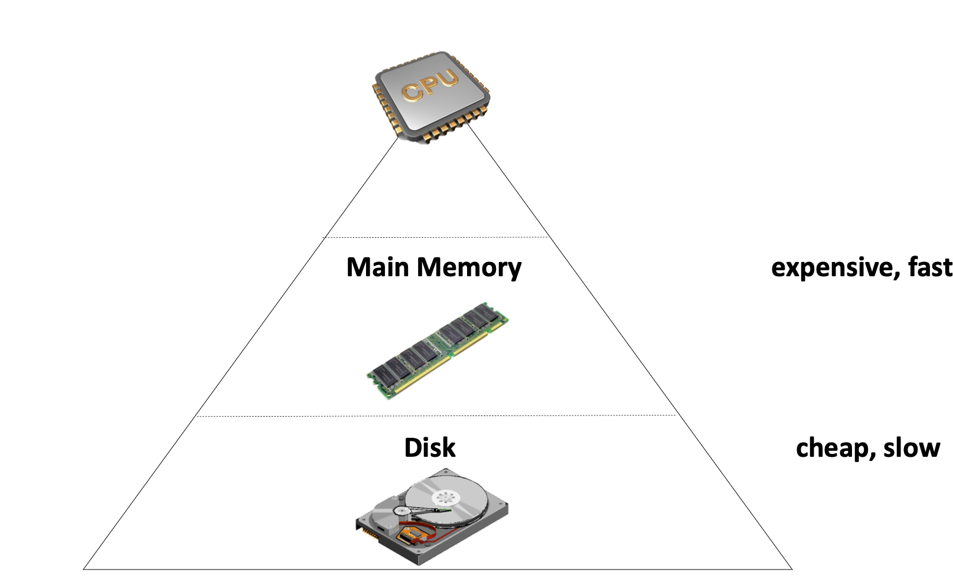
Storage Hierarchy
Fast device (e.g., Main Memory)
Fast, but capacity is limited
Expensive
Volatile
Disk has huge capacity
Cheap & slow
Non-volatile

Slide 12
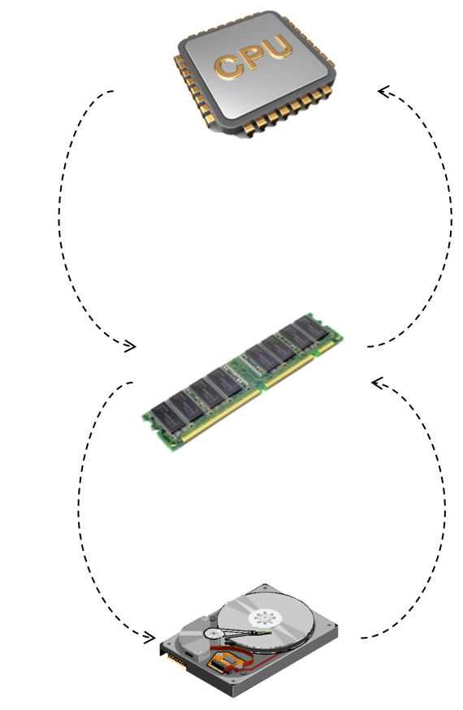
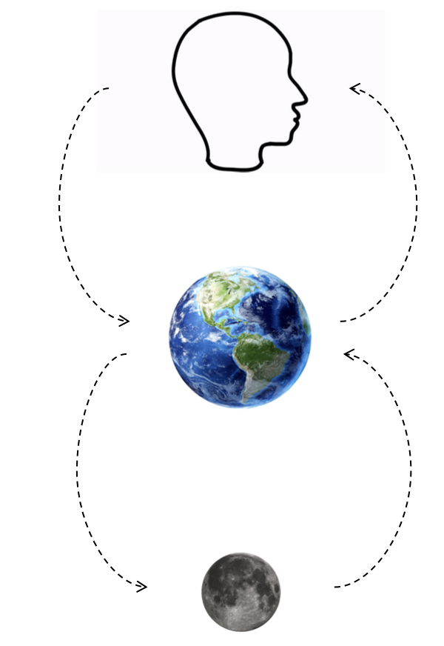
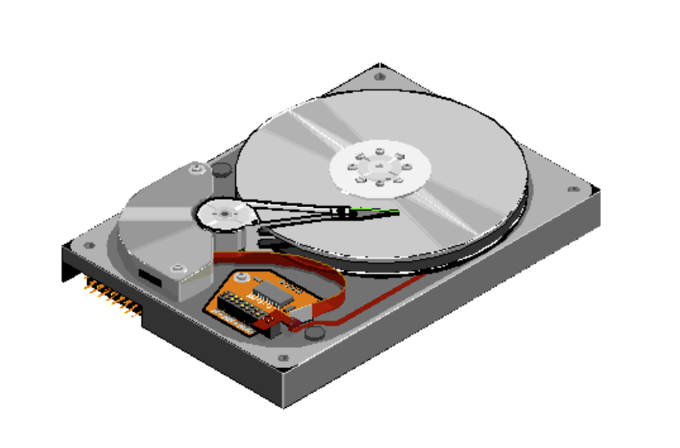
Storage Hierarchy: asymmetric performance of disk
CPU <-> Memory
~= 100ns
Memory <-> Disk
~= 10ms
Why disk is slow at random access?
Random: move disk header
Sequential: disk just spins
Disk Header
Notes:
Can use tools like fio to measure.

Slide 13
Random access vs. Sequential access
HDD performance (for reference)
Sequential: 100 – 200 MB/s
Random: 0.5 – 2 MB
SSD performance (fore reference)
Sequential: 2,000 – 3,500 MB
Random: 200 – 300 MB

Slide 14
Update(K,V) in the naïve KVS
Suppose we store all the KV in a single file in the following format:
Key
Value
123456，'{"name":"London","attractions":["Big Ben","London Eye"]}’
42，'{"name":"San Francisco","attractions":["Golden Gate Bridge"]}’
...
How to implement the update? Append is more efficient
Directly append update to the end of the file
Benefits: update the file is efficient, especially if there are many updates, because disks are good at sequential writes
Overwrite the original content introduce slow random accesses

Slide 15
Insert(K,V) in the naïve KVS
Suppose we store all the KV in a single file in the following format:
Key
Value
123456，'{"name":"London","attractions":["Big Ben","London Eye"]}’
42，'{"name":"San Francisco","attractions":["Golden Gate Bridge"]}’
...
How about the insertion? The same as the update
Question: what about deletion?
Append a NULL entry and later garbage collected (will talk later)
Notes:
Append a null record at the end of the file

Slide 16
File format of naïve KVS & log file
The file format is some kind of log file
We called Log-structured file: an append-only sequence of records
Widely used in computer systems in various scenarios
Suits the performance of underlying hardware (e.g., disk)
E.g., ensure consistency under failure, etc.
We will see more examples in later lectures

Slide 17
Updates work Well, What about Get(K,V)?
Suppose we store all the KV in a single file in the following format:
Key
Value
123456 '{"name":"London","attractions":["Big Ben","London Eye"]}’
42 '{"name":"San Francisco","attractions":["Golden Gate Bridge"]}’
...
Get is much tricky to implement
We need to iterate the file line by line starting at the end of file, and then finds the first line whose key matches K
Terrible performance! Complexity: O(n)

Slide 18
Method: Accelerate Get with index
Index
An additional structure that is derived from the primary data (e.g., log file)
Can be added/removed without affecting the primary data
Only affects the performance instead of correctness
Example of index data structure:
B+Tree, HashTable, etc
The inode table in Lab1 is essentially an index; but is extremely simple. What are the trade-offs of an inode table?
Notes:
Why inode table is insufficient? Integer -> position; what we want: string to string

Slide 19
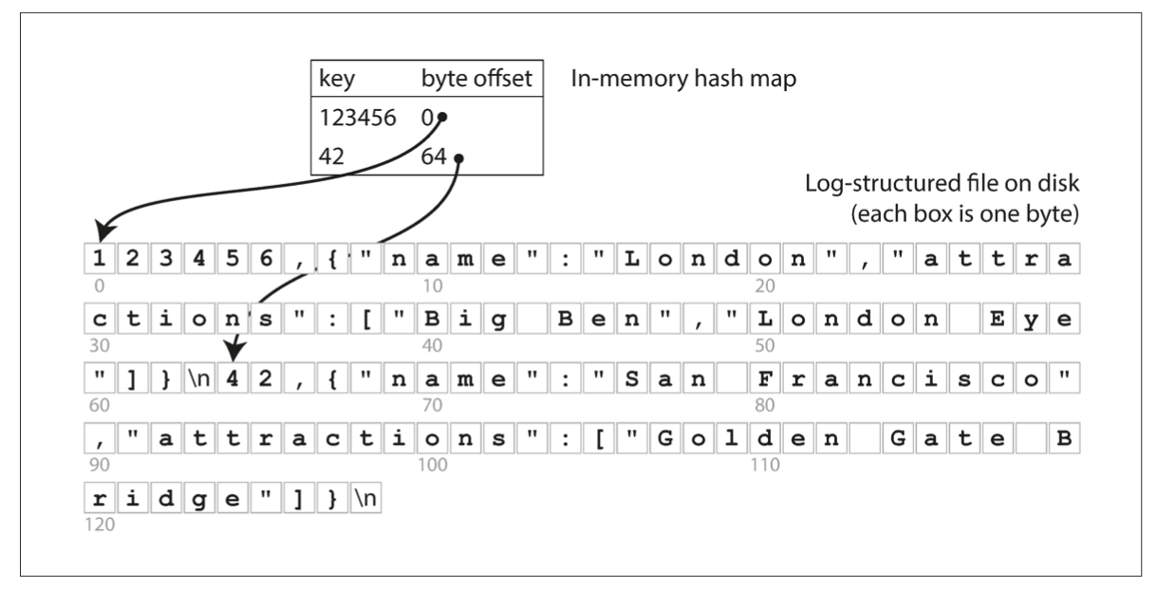
First try of index: an In-memory Hash Index
The simplest possible indexing strategy
Keep an in-memory hash map that map key -> byte offset in the log file

Slide 20

Hash index & log-structured data file
The simplest possible indexing strategy
Keep an in-memory hash map that map key -> byte offset in the log file
A viable solution
Adopted by commercial systems， e.g., Bitcask in riakKV
Benefits
High-performance of reads/writes
Restrictions
Index must fit into the RAM
Only good at: when workloads have many updates but not insertions
E.g., too many insertions will exhaust the RAM
Notes:
// 讲下

Slide 21
Hash Index++: Put it (or partially) on the disk
Question: how to choose the appropriate hash index data structure?
Many hash data structures exist
Their performance differences may not be so different in an in-memory setting for KVS
But on disk, the things are different, because accessing the disk is orders of magnitude slower than the memory
Different hash indexes have different trade-offs when stored on disk
For a specific index, we need make some optimization to make it suit for the disk

Slide 22
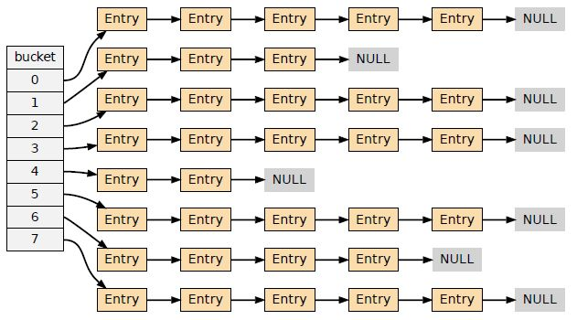
Linked-list based hash index
The simplest data structures
Pros:
Easy for implementation
Cons (of the easiest implementation):
Bad read performance under hash collision
Requires traverse the linked buckets in random I/O
Bad insert performance under hash collision
Similar problem as the read
Question: can you make it better?
Simple idea: put the entries in the same file block to reduce the chain length

Slide 23
Cuckoo hashing
Buckets0
Buckets1
Cuckoo hashing
Maintain two hash buckets
Get()
Using two hash functions H0 & H1
The key must be in Buckets0[H0(key)] or Buckets1[H1(key)]
Example: Get(73)
Buckets0[H0(73)] = 2
value
32
16
73
?
84

Slide 24
Cuckoo hashing
Buckets0
Buckets1
Cuckoo hashing
Maintain two hash buckets
Get()
Using two hash functions H0 & H1
The key must be in Buckets0[H0(key)] or Buckets1[H1(key)]
Example: Get(73)
Buckets0[H0(73)] = 2 & Buckets1[H1(k73)] = 1
value
32
16
73
84

Slide 25
Cuckoo hashing
Buckets0
Buckets1
Cuckoo hashing
Maintain two hash buckets
Update()
Similar as Get()
1. find the bucket
2. update the value
value
32
16
73
84
What about insert?

Slide 26
Cuckoo hashing
Buckets0
Buckets1
Cuckoo hashing
Maintain two hash buckets
Insert()
Much complicated: should insert to Buckets0[H0(key)] or Buckets1[H1(key)]
Question: what if no available space?
value
32
16
73
84

Slide 27
Cuckoo hashing
Buckets0
Buckets1
Cuckoo hashing
Maintain two hash buckets
Insert()
Much complicated: should insert to Buckets0[H0(key)] or Buckets1[H1(key)]
Example: Insert(2)
H0(2) = 0 & H1(2) = 0
value
32
16
73
84

Slide 28
Cuckoo hashing
Can we insert here?
Buckets0
Buckets1
Cuckoo hashing
Maintain two hash buckets
Insert()
Much complicated: should insert to Buckets0[H0(key)] or Buckets1[H1(key)]
Example: Insert(2)
H0(2) = 0 & H1(2) = 0
value
32
16
73
84

Slide 29
Cuckoo hashing
Buckets0
Buckets1
Cuckoo hashing
Maintain two hash buckets
Insert()
Much complicated: should insert to Buckets0[H0(key)] or Buckets1[H1(key)]
Example: Insert(2)
H0(2) = 0 & H1(2) = 0
Insert here!
value
32
2
16
73
84

Slide 30
Cuckoo hashing
Buckets0
Buckets1
Cuckoo hashing
Maintain two hash buckets
Insert()
Much complicated: should insert to Buckets0[H0(key)] or Buckets1[H1(key)]
Example: Insert(9)
H0(9) = 0 & H1(9) = 0
value
32
2
16
73
84

Slide 31
Cuckoo hashing
Both slots are not empty!
Buckets0
Buckets1
Cuckoo hashing
Maintain two hash buckets
Insert()
Much complicated: should insert to Buckets0[H0(key)] or Buckets1[H1(key)]
Example: Insert(9)
H0(9) = 0 & H1(9) = 0
value
32
2
16
73
84

Slide 32
Cuckoo hashing
Buckets0
Buckets1
Cuckoo hashing
Maintain two hash buckets
Insert()
Much complicated: should insert to Buckets0[H0(key)] or Buckets1[H1(key)]
Example: Insert(9)
H0(9) = 0 & H1(9) = 0
Cuckoo hashing will kick others to different place to create space for the new insertions
value
32
2
16
73
84

Slide 33
Cuckoo hashing
Can insert 9 here!
Buckets0
Buckets1
Cuckoo hashing
Maintain two hash buckets
Insert()
Much complicated: should insert to Buckets0[H0(key)] or Buckets1[H1(key)]
Example: Insert(9)
H0(9) = 0 & H1(9) = 0
Cuckoo hashing will kick others to different place to create space for the new insertions
Kick 32 (Buckets0[0]) to another place
Assume: H1(32) = 2
9
2
16
73
32
84
value

Slide 34
Cuckoo hashing
Buckets0
Buckets1
Buckets0
Buckets1
Buckets0
Buckets1
32
2
2
9
2
16
73
16
73
16
73
32
32
84
84
84
Insert(9)
Kick(32)
H0(9) = 0
& H1(9) = 0
H1(32) = 2
Question: what if H1(32) = 3? (which is taken by 84)

Slide 35
Cuckoo hashing
Buckets0
Buckets1
Cuckoo hashing
Maintain two hash buckets
Insert()
Much complicated: should insert to Buckets0[H0(key)] or Buckets1[H1(key)]
Example: Insert(9)
H0(9) = 0 & H1(9) = 0
Cuckoo hashing will kick others to different place to empty
Kick 32 (Buckets0[0]) to another place
Question: what if H1(32) = 2 = 3?
32
2
16
73
84
value

Slide 36
Cuckoo hashing
Buckets0
Buckets1
Cuckoo hashing
Maintain two hash buckets
Insert()
Much complicated: should insert to Buckets0[H0(key)] or Buckets1[H1(key)]
Example: Insert(9)
H0(9) = 0 & H1(9) = 0
Cuckoo hashing will kick others to different place to empty
Kick 32 (Buckets0[0]) to another place
Kick 2 (Buckets1[0]) to another place
9
2
16
73
84
value

Slide 37
Cuckoo hashing
Buckets0
Buckets1
Cuckoo hashing
Maintain two hash buckets
Insert()
Much complicated: should insert to Buckets0[H0(key)] or Buckets1[H1(key)]
Example: Insert(9)
H0(9) = 0 & H1(9) = 0
Cuckoo hashing will kick others to different place to empty
Kick 2 (Buckets1[0]) to another place
Assume: H0(2) = 2
32
9
16
73
2
84
value

Slide 38
Cuckoo hashing
No available slots!
Buckets0
Buckets1
Cuckoo hashing
Maintain two hash buckets
Insert()
Much complicated: should insert to Buckets0[H0(key)] or Buckets1[H1(key)]
Example: Insert(9)
H0(9) = 0 & H1(9) = 0
Cuckoo hashing will kick others to different place to empty
Kick 2 (Buckets1[0]) to another place
Assume: H0(2) = 2 1 What if that happens?
32
2
16
73
84
value

Slide 39
Cuckoo hashing
Buckets0
Buckets1
Cuckoo hashing
Maintain two hash buckets
Insert()
Much complicated: should insert to Buckets0[H0(key)] or Buckets1[H1(key)]
If no available slots, rehashing & repeat the above insert process
Rehashing: enlarge the buckets (typically X2)

Slide 40
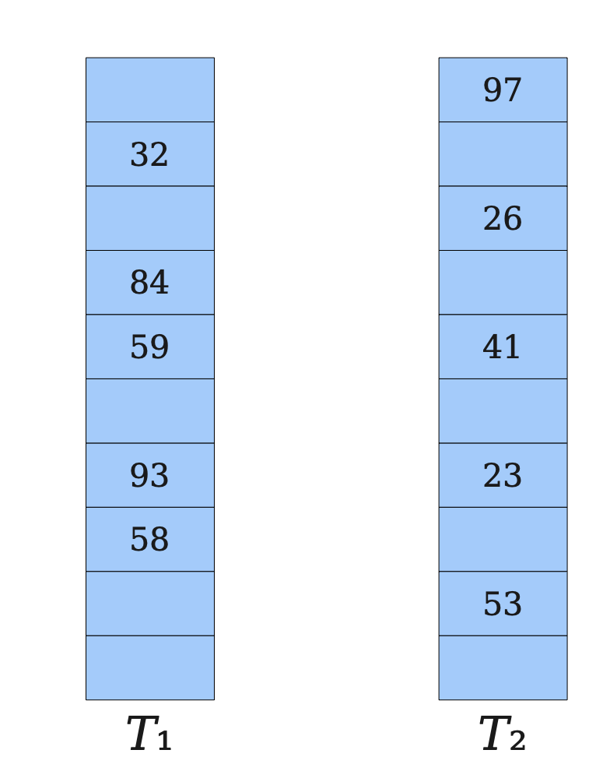
Cuckoo hashing
Cuckoo hashing
Two tables & Two hash functions (H₁, H₂)
The key can only at T₁[H₁(key)] or T₂[H₂(key)]
Pros
Good for read: at most two 2 random I/O for get
Cons
Insertion is complex and can issue many random disk I/O
Rehashing is required if there are many insertions, which is extremely slow
Expanding the table, and re-insert all the keys in the new table (!)
Notes:
We will not cover many details

Slide 41
Selecting a proper index for KV store is non-trivial
Not just choosing a data structure
Trade-offs of selecting indexes （ The RUM Conjecture[1]）
Read performance vs. update performance
An index needs to be updated upon inserts/deletions
Whether index is friendly to the storage?
E.g., random vs. sequential
Others (e.g., storage overhead)
Designing Access Methods: The RUM Conjecture, EDBT’16
Notes:
Read update memory overhead

Slide 42
Issues of using hash index & log file
Naïve in-memory hash index has a limited capacity
Can put it on the disk, but needs to carefully redesign the hash scheme or carefully select an appropriate hash scheme
Log file is growing forever -> running out of disk space
Lack range query support
E.g., scan over all keys between kitty00000 & kitty99999
Notes:
The RUM Conjecture

Slide 43
Issues of using hash index & log file
Naïve in-memory hash index has a limited capacity
Can put it on the disk, but needs to carefully redesign the hash scheme or carefully select an appropriate hash scheme
Log file is growing forever -> running out of disk space
Lack range query support
E.g., scan over all keys between kitty00000 & kitty99999

Slide 44
How to prevent a file from growing forever?
Log-structured design makes updates fast
Only append to the file
However, we will eventually run out of disk space
Since many duplicate records in the log file, we should have space to store more records
A deleted value is also left on the file

Slide 45
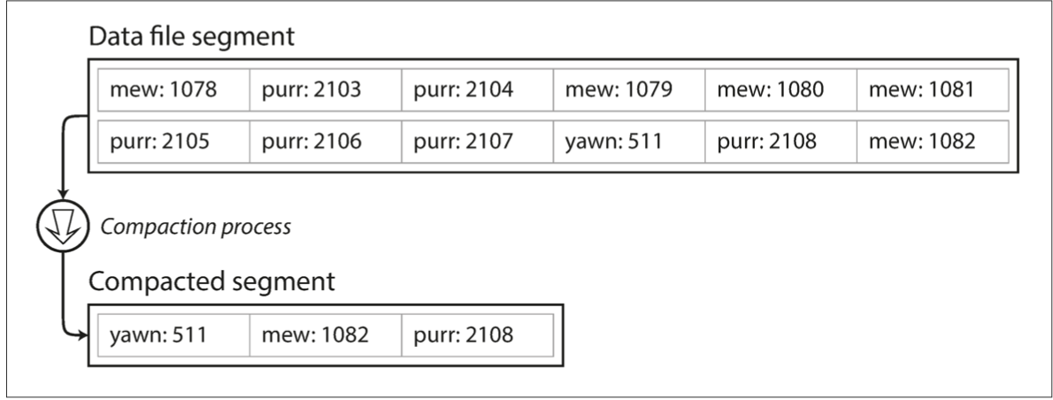
How to prevent a file from growing forever?
Solution: compaction
Scan the whole file, delete duplicate records and write to a new file
Question: what if the file is too large?

Slide 46
How to prevent a file from growing forever?
Solution: compaction with segmentation
Break a file into fixed-sized segments
If a segment is full, then create a new file for insertions
Can control the compaction granularity with the segment size
Notes:
遍历文件后面的block并不高效

Slide 47
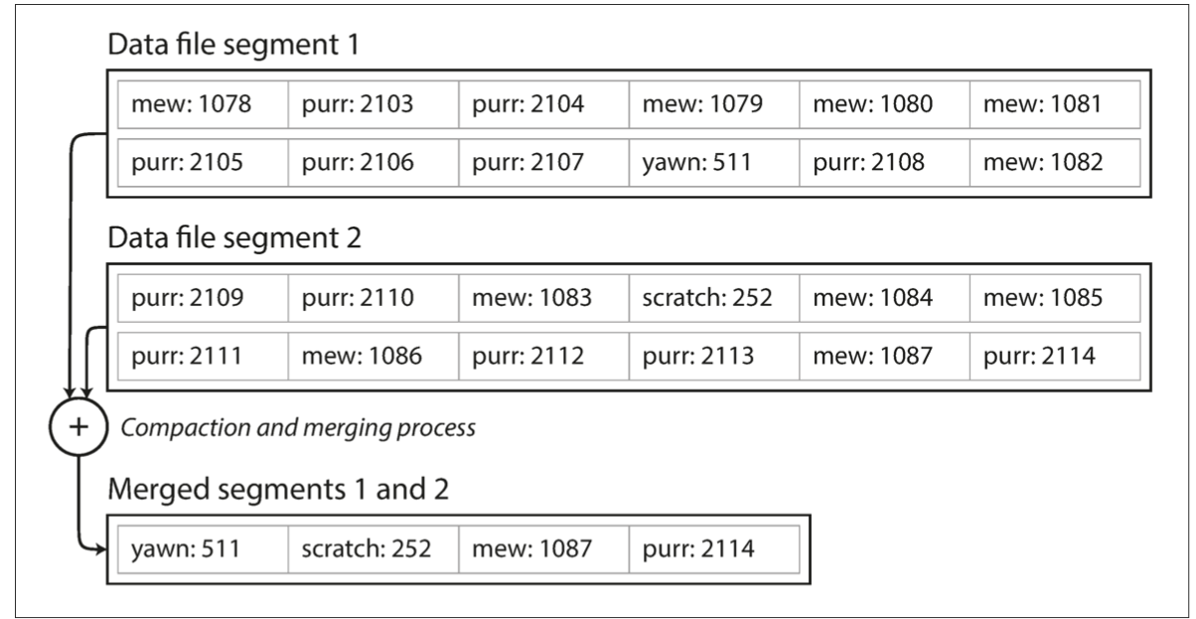
How to prevent a file from growing forever?
Solution: compaction with segmentation + Merge
Compact: remove duplicated records in a segmented file
Merge: merge two compacted segments into a new one
Why? Because compaction makes the segment smaller

Slide 48
Recall: how to handle delete() for log-structed file?
Append a NULL entry
Garbage-collected during compaction!
xxxx: null

Slide 49
Issues of using hash index & segmented log file
Naïve in-memory hash index has a limited capacity
Can put it on the disk, but needs to carefully redesign the hash scheme or carefully select an appropriate hash scheme
Log file is growing forever -> running out of disk space
Lack range query support
E.g., scan over all keys between kitty00000 & kitty99999
Notes:
支持range support的两个问题：
1） hash不支持range
2） log里面是无序的

Slide 50

B-Tree (B+Tree) indexes: a form of ordered index
Introduced in 1970, the “ubiquitous” index 10 years later for disk data
Standard data structures of many databases and key-value stores
“It could be said that the world’s information is at our fingertips because of B-trees”
Goetz Graefe Microsoft, HP Fellow, now Google
ACM Software System Award
Notes:
Fingertips: 唾手可得
Goetz Graefe ： SQL server

Slide 51
B+Tree indexes
A B-tree is a tree-like data structure (one or a few files)
Each node is fixed-sized, can store multiple keys, and keys are sorted
Support efficient range operations (e.g., Scan)
Optimized for large read/write blocks of data
Many variants exist, e.g., B+Tree
All the leaf nodes of the B-tree must be at the same level
Simper to link leaf nodes to support range queries

Slide 52
B+Tree indexes example (fanout = 5)
13
2
3
8
13
27
Notes:
Fanout：指的是child节点的个数

Slide 53
B+Tree indexes example: Get(2)
13
2
3
8
13
27

Slide 54
B+Tree indexes example: Get(2)
13
2
3
8
13
27

Slide 55
B+Tree indexes example: Update(2)
Similar to Get()
1. find the position
2. update the value
13
2
3
8
13
27

Slide 56
B+Tree indexes example: insert(10)
13
2
3
8
13
27

Slide 57
B+Tree indexes example: insert(10)
13
2
3
8
10
13
27

Slide 58
B+Tree indexes example: insert(11)
13
2
3
8
10
11
13
27

Slide 59
B+Tree indexes example: insert(11)
10
13
2
3
8
10
11
13
27
Split the nodes!

Slide 60
B+Tree can support efficient range operations
Add a sibling link between the leaves
e.g., SCAN(3,5)
10
13
2
3
8
10
11
13
27

Slide 61
Question: need a B+Tree to index the values in the log?
No. It can store the values in its leave node
Which does not need compaction & merge
10
13
2
3
8
10
11
13
27

Slide 62
B-Tree indexes on the disk?
Get(K), Insert(K,V) and Update(K,V) are slow
O(log(n)) random disk accesses
Typically, is small, since B-Tree indexes uses large node size. But is still a killer for performance
B+Tree indexes are not good enough for insertion-intensive workloads
Still many random disk I/O involved
Insertions are common for on-disk storages, because reads are served by other system components, e.g., a cache system like Memached
E.g., check lecture 02, step#2 for scaling a website
B+Tree index size can be large
For small values, the index size can be close to the value sizes (in the same order)
Notes:
// 分析B+Tree 索引的好坏
当然，如果insertion都是在最后，那么b树的性能也是很好的。

Slide 63
Can we avoid random access for
index updates and insertions, with small index size, while supporting scans (no brute force) ?

Slide 64
Recall: segmented log file
Compaction & segmentation
Break a file into fixed-sized segments
If a segment is full, then create a new file for insertions
Can control the compaction granularity with the segment size

Slide 65
LSM Trees: SSTables (Sorted String Table)
SSTable is based on the segmented log file described in the hash index
Break a file into fixed-sized segments
If a segment is full, then create a new file for insertion
With two extensions
Key-values in a segment are sorted by the key
Old segment files are immutable and can be compacted to save spaces
Why immutable? Inserting in a SSTable is not append-only
We will come back to this topic later
Notes:
// 分析B+Tree 索引的好坏

Slide 66
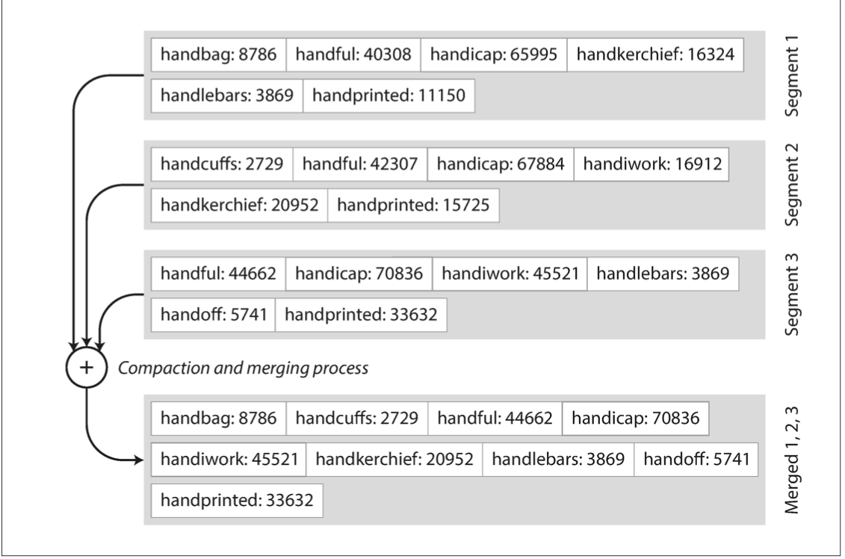
Benefits of SSTable (compared to original log file)
#1. Merging two SSTables is efficient
Even if the two tables are much larger than the available memory
Similar to the mergesort

Slide 67
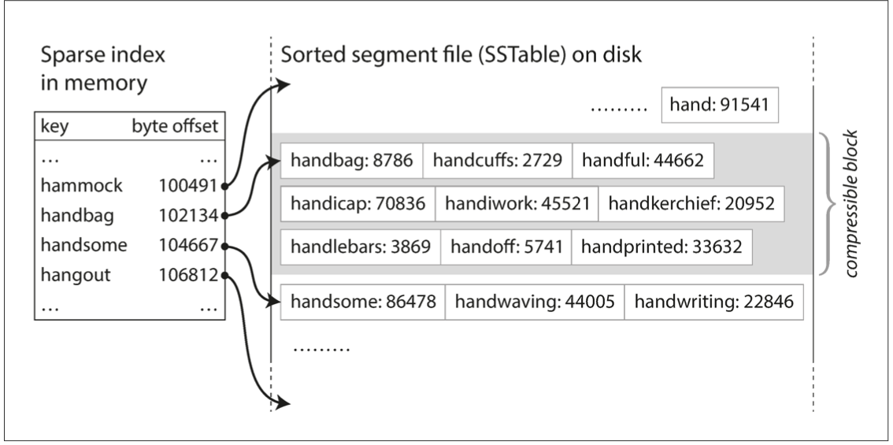
Benefits of SSTable (compared to original log file)
#2. Searching a given key in a SSTable is efficient
We can use binary search to lookup a given key
Or we only need some sparse index for the acceleration, one for each SSTable
E.g., one key in index for every few KB of SSTable is sufficient, since scanning them is quick

Slide 68
Benefits of SSTable (compared to original log file)
#3. Support range operations
Since the KVS are sorted in the file

Slide 69
How to maintain SSTable with sequential writes?
Use a MemTable: an in-memory data structure (e.g., a red-black Tree)
Simple quiz: why not using hash table?
MemTable

Slide 70
How to maintain SSTable with sequential writes?
Use a MemTable: an in-memory data structure (e.g., a red-black Tree)
Example: insert a (K, V) into SSTable
1
Insert the (K,V) into the MemTable
(K,V)
MemTable

Slide 71
How to maintain SSTable with sequential writes?
Use a MemTable: an in-memory data structure (e.g., a red-black Tree)
Example: insert a (K, V) into SSTable
1
Insert the (K,V) into the MemTable
(K,V)
Question: does writing to SSTable sequential?
MemTable
SSTable
2
check whether MemTable exceeds some threshold,
If so, flush it to a new SSTable

Slide 72
How to maintain SSTable with sequential writes?
Use a MemTable: an in-memory sorted data structure (e.g., red-black Tree)
Example: insert a (K, V) into SSTable
3
What if there are too many SSTables?
We can merge & compact them as we have done before with segmented log files
SSTables
Merge & compact

Slide 73
Reads with MemTable + SSTable
Checks the MemTable
If misses, checks the latest SSTable
If still misses, checks the next older SSTable
…
Optimization: keep a sparse index on each SSTable to accelerate the lookup
1
2
3
4
…
MemTable
SSTables

Slide 74
Question: what are the drawbacks of
such a design?

Slide 75
Organizing data sequentially has several drawbacks
#1. Finding the old value is slow
#2. Deduplication is hard
#3. Range query is still inefficient
New
Old
1
2
3
4
…
MemTable
SSTables

Slide 76
LSM Tree organizes SSTables in a hierarchy
The famous Log-structured merge tree
Each layer has the entire KVS data of some time
Each layer has maximum size
Except L0, all files in layers are sorted, and does not have duplicated keys
Except L0, keys in each layer is sorted according to the SSTable
New
MemTable
L0
L1
L2
LSM Tree
Old
Notes:
The keys in a layer is sorted

Slide 77
Hierarchy can speed up old value lookup
Each layer has only one file that store the key (except L0)
So we can search only one file per-layer (not per-file search)
Question: how to find the key file?
Many methods exist
E.g., store a [min, max] per file in memory
Read upon lower layers
First identify the file, then look it!
O(1) access per layer
MemTable
New
L0
L1
L2
LSM Tree
Old
Notes:
Each layer has only one

Slide 78
Hierarchy can speed up range query
Store a [min, max] per file
Range query
Query layer-by-layer
Then merge the results
New
MemTable
L0
L1
L2
LSM Tree
Old
Notes:
Each layer has only one

Slide 79
Range Query in LSM Tree
Search each layer using binary search (or can leverage a sparse index)
Merge the results of each layer
Not as good as B+Tree,
but is much better than hash & logs without hierarchy! !
New
MemTable
L0
L1
L2
LSM Tree
Old

Slide 80
Example: Read in LSM-Tree (Similar to SSTables)
MemTable
Key
Memory
Disk
Level₀
…
…
SSTable
Level₁
KV pairs
(sorted)
…
Level_{k}
…
Metadata

Slide 81
Example: Read in LSM-Tree
MemTable
KV pairs
Memory
Disk
…
Search L0 sequentially
Level₀
…
SSTable
Level₁
KV pairs
(sorted)
…
Level_{k}
…
Metadata

Slide 82
Example: Read in LSM-Tree
MemTable
KV pairs
Memory
Disk
…
Search L0 sequentially
Level₀
…
SSTable
Level₁
KV pairs
(sorted)
…
Level_{k}
…
Metadata
Notes:
为啥L0没有sorted？主要是为了快速将 memtable 刷到 l0里去，不能成为性能瓶颈

Slide 83
Example: Read in LSM-Tree
MemTable
KV pairs
Memory
Disk
Search lower layer using binary search
Level₀
…
…
SSTable
Level₁
KV pairs
(sorted)
…
Level_{k}
…
Metadata

Slide 84
Example: insert/update in LSM-Tree
MemTable
KV pairs
Full
Memory
Disk
Level₀
…
…
SSTable
Level₁
KV pairs
(sorted)
…
Level_{k}
…
Metadata

Slide 85
Example: insert/update in LSM-Tree
MemTable
KV pairs
Memory
Disk
Level₀
…
Compaction
…
SSTable
Level₁
KV pairs
(sorted)
…
Level_{k}
…
Metadata

Slide 86
What about crash?
MemTable is an in-memory data structure
So it is vulnerable to machine failure
Goal: a successful insertion will store the data durably
Solution:
Keep a separate log file the MemTable (may not be sorted)
Before inserting to the MemTable, adding the KV to the log first (also a sequential write); reply if the log is successful
If the machine crashed, reboot it, and reconstruct the MemTable from the log

Slide 87




LSM Tree Summary
Good when
Massive dataset
Rapid updates/insertions
Fast single-point lookup for recently updated data
Widely adopted in modern single-node key-value stores

Slide 88
LSM Tree Summary
Good when
Massive dataset
Rapid updates/insertions
Fast single-point lookup for recently updated data
Compared with B-Tree
Pros: good write performance due to sequential writes
Cons: additional compaction process, possible slow range queries,
write stall caused by the compaction, slow lookup for non-existent key

Slide 89
LSM Tree Summary
Good when
Massive dataset
Rapid updates/insertions
Fast single-point lookup for recently updated data
Compared with B-Tree
Pros: good write performance due to sequential writes
Cons: additional compaction process, possible slow range queries,
write stall caused by the compaction, slow lookup for non-existent key

Slide 90
Write stall caused by compaction in LSM Tree
MemTable
KV pairs
Memory
Disk
Level₀
…
…
SSTable
Level₁
KV pairs
(sorted)
…
Level_{k}
…
Metadata

Slide 91
Write stall caused by compaction in LSM Tree
MemTable
KV pairs
Memory
Disk
Level₀
…
…
SSTable
Level₁
KV pairs
(sorted)
…
Level_{k}
…
Metadata

Slide 92
Write stall caused by compaction in LSM Tree
MemTable
KV pairs
Full
Memory
Disk
Level₀
…
…
SSTable
Level₁
KV pairs
(sorted)
…
Level_{k}
…
Metadata

Slide 93
Write stall caused by compaction in LSM Tree
MemTable
KV pairs
Memory
Disk
Level₀
…
Compaction
…
SSTable
Level₁
KV pairs
(sorted)
…
Level_{k}
…
Metadata

Slide 94
Write stall caused by compaction in LSM Tree
MemTable
KV pairs
Memory
Disk
Level₀
…
Compaction
…
SSTable
Level₁
KV pairs
(sorted)
…
Level_{k}
…
Metadata

Slide 95
Write stall caused by compaction in LSM Tree
MemTable
KV pairs
Full
Memory
Disk
Level₀
…
Compaction
…
SSTable
Level₁
KV pairs
(sorted)
…
Level_{k}
…
Metadata

Slide 96
Write stall caused by compaction in LSM Tree
MemTable
KV pairs
Memory
Disk
Level₀
…
Compaction
…
SSTable
Level₁
KV pairs
(sorted)
…
Level_{k}
…
Metadata

Slide 97

Write stall caused by compaction in LSM Tree
Stalled due to
slow compaction
MemTable
KV pairs
Full
Memory
Disk
Level₀
…
Compaction
…
SSTable
Level₁
KV pairs
(sorted)
…
Level_{k}
…
Metadata

Slide 98
How to avoid write stall?

Slide 99
In principle, hard to prevent
Can only alleviate
E.g., speed up compaction & merge process with advanced hardware
Disk
Level₀
…
Compaction
…
SSTable
Level₁
KV pairs
(sorted)
…
Level_{k}
…
Metadata

Slide 100
In principle, hard to prevent
Can only alleviate
E.g., speed up compaction & merge process with advanced hardware
Observation: SSD is much faster than disk on storage
Using it to store up-layer SSTables
SSD
…
Compaction
Level₀
Disk
…
SSTable
Level₁
KV pairs
(sorted)
…
Level_{k}
…
Metadata

Slide 101
LSM Tree Summary
Good when
Massive dataset
Rapid updates/insertions
Fast lookups
Compared with B-Tree
Pros: good write performance due to sequential writes
Cons: additional compaction process, possible slow range queries,
write stall caused by the compaction, slow lookup for non-existent key

Slide 102
Slow lookup for non-existent key
Question: what if the key non-exist?
Recall: how LSM Tree lookup keys
Checks the MemTable
If misses, checks the latest SSTable
If still misses, checks the next older SSTable
…
Will lookup all the files!
1
2
3
4
…
MemTable
SSTables
Notes:
Solution: bloom filter

Slide 103
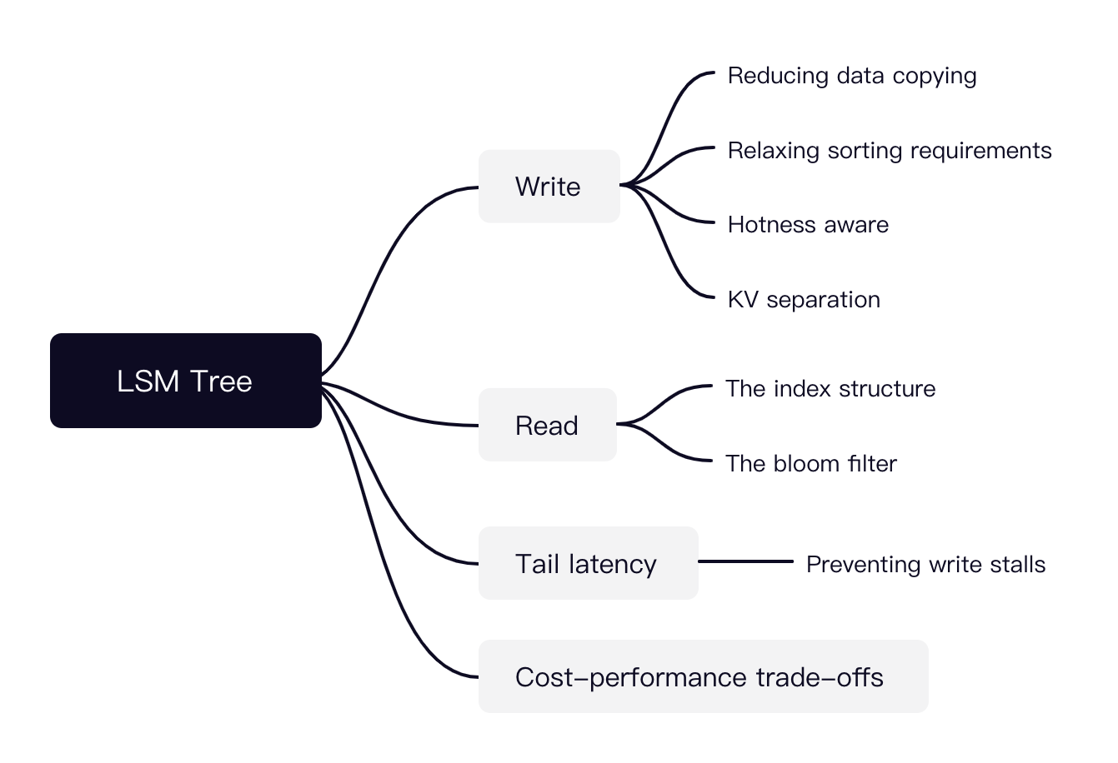
LSM Tree is a hot research topic today
Many possible directions

Slide 104
Distributed key-value storage
Make KV store distributed (see later lectures)
RPC + key-value storage = distributed key-value storage!
See the next lecture
We can also shard the data across multiple nodes
i.e., high scalability
Key challenge:
How to find the data?
E.g., consistent hashing
Other problems:
Fault tolerance (see later lectures)
Availability, replication & consistency (see later lectures)

Slide 105
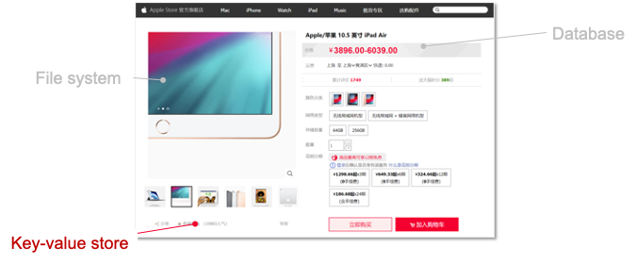
Summary of this lecture
Key-value store is an important component in computer systems
Typically built upon a filesystem to simplify disk hardware management
We show how KVS is evolved from log-structured file to the LSM tree
Log-structured file
Indexing
LSM Tree
Key-value Store
Key-value files
File system

