Slide 1


Serializability, OCC & Transaction
SE3331-1 (2024 Fall)
IPADS, Shanghai Jiao Tong University
https://www.sjtu.edu.cn

Slide 2

Review: Recovery with checkpoint
Checkpoint
T1
Crash
T2
T3
T4
T5
T1: do nothing
T2: redo its update based on the log entries
T3: redo its updates based on the log entries
T4: undo its updates based on the log in both CKP & log entries
T5: undo its updates based on the log entries

Slide 3
Review: The race condition problem
When two or more threads access shared data and at least one is write
Timing dependent error involving shared state
i.e., whether the scheduling will cause reading a non-atomic update state
Thread 0
Thread 1
Bank[Alice]
Thread 0
Thread 1
Bank[Alice]
0
0
Read acct
0
Read acct
0
Read acct
0
Increase
0
Increase
0
Write acct
10
Increase
0
Read acct
10
Write acct
10
Increase
10
Write acct
10
Write acct
20

Slide 4
Review: before-or-after atomicity (a.k.a, Isolation)
To prevent hazard produced by race condition, we need a group of reads/writes to be atomic
E.g., cannot see/overwrites the intermediate states of a concurrent action
A concurrent action may have multiple linearizable reads/writes
Before or after atomicity
Concurrent actions have the before-or-after property if their effect from the point of view of their invokers is as if the actions occurred either completely before or completely after one another

Slide 5



Review: Two-phase locking (2PL)
…
Fine-grained locking:
Each shared data has one lock
E.g., a lock for Alice & a lock for Bob
2PL locking rule:
The action must acquire the shared data’s lock before access it, and releases it after the data access finishes and release it until the action finishes
Bank = [
Alice: 0¥
Bob: 0¥
Lock = [

Slide 6
Review: Use 2PL to achieve before-or-after
2PL can guarantee before or after atomicity with serializability for TXs
Run actions T1, T2, .., TN concurrently, and have it "appears" as if they ran sequentially (we will prove it later)
Before or after atomicity also is usually termed as serializability
What does this
mean?
Before or after atomicity
Concurrent actions have the before-or-after property if their effect from the point of view of their invokers is as if the actions occurred either completely before or completely after one another

Slide 7
Review: Serializability has many types
Final-state serializability
A schedule is final-state serializable if its final written state is equivalent to that of some serial schedule
Conflict serializability
View serializability
Mostly widely used

Slide 8
Review: Conflict Serializability
Two operations conflict if (remind of the race condition ☺):
they operate on the same data object, and
at least one of them is write, and
they belong to different transactions (a single TX is assumed to be executed sequentially)
Conflict serializability
A schedule is conflict serializable if the order of its conflicts (the order in which the conflicting operations occur) is the same as the order of conflicts in some sequential schedule

Slide 9
Use Conflict Graph to determine the sequential schedule
Conflict Graph
Nodes are transactions, edges are directed
Edge between T_{i} and T_{j} if and only if:
T_{i} and T_{j} have a conflict between them, and
the first step in the conflict occurs in T_{i}
A schedule is conflict serializable if and only if:
It has an acyclic conflict graph
Notes:
If one of T1’s ope conflicts with one of T2’s op and T1 comes first, T1 -> T2

Slide 10
Init: x=0, y=0
T1
begin
read(x)
tmp = read(y)
write(y, tmp+10)
commit
T2
begin
write(x, 20)
write(y, 30)
commit
Possible sequential schedules
T1 -> T2: x=20, y=30
T2 -> T1: x=20, y=40
T2: write(x, 20)
T1: read(x)
T2: write(y, 30)
T1: tmp = read(y)
T1: write(y, tmp+10)
At end: x=20, y=40
x=0
T1: read(x)
T2: write(x, 20)
T2: write(y, 30)
T1: tmp = read(y)
T1: write(y, tmp+10)
At end: x=20, y=40
y=30

Slide 11
Conflicts
T2.1, T1.1
T2.2, T1.2
T2.2, T1.3
Conflict order for sequential schedules
T1.1 -> T2.1 T2.1 -> T1.1
T1.2 -> T2.2 or T2.2 -> T1.2
T1.3 -> T2.2 T2.2 -> T1.3
(T1 -> T2) (T2 -> T1)
T2: write(x, 20)
T1: read(x)
T2: write(y, 30)
T1: tmp = read(y)
T1: write(y, tmp+10)
T2 -> T1
T1: read(x)
T2: write(x, 20)
T2: write(y, 30)
T1: tmp = read(y)
T1: write(y, tmp+10)
-->
<--
T2 T1
It's final-state serializable,
not conflict serializable
Both at end: x=20, y=40

Slide 12
View Serializability
Time
T1 T2 T3
read(x)
write(x)
write(x)
write(x)
Conflict graph
T3
T2 T1
Cyclic -> Not conflict serializable
But compare it to running T1 then T2 then T3 (serially)
Final-state is fine (T3)
Intermediate reads are fine (T1 reads the initial value of x)

Slide 13
View Serializability
Informal definition
A schedule is view serializable if the final written state as well as intermediate reads are the same as in some serial schedule
Formally, for those interested
Two schedules S and S' are view equivalent if:
If T_{i} in S reads an initial value for X, so does T_{i} in S'
If T_{i} in S reads the value written by T_{j} in S for some X, so does T_{i} in S'
If T_{i} in S does the final write to X, so does T_{i} in S'
A schedule is view serializable if it is view equivalent to some serial schedule

Slide 14
Question
Why conflict serializability, given that it seems too strict?
Why not focus on view serializability? (Allow more interleaving, & is still correct )
Final-state Serializability
View
Serializability
Conflict
Serializability
⊃
⊃
Care the final state only
Care the final state as well as intermediate read
Care the final state as well as all the data dependency

Slide 15
Conflict Serializability VS. View Serializability
Conflict serializability is easy to test
i.e., check whether a graph is acyclic
View serializability is hard to test (likely NP-hard)
Conflict serializable schedules are easy to generate
Using concurrency control protocols. E.g., 2PL (two-phase-locking)
Conflict serializable schedules are also view serializable
No easy way to generate view schedules that allows for ones like the previous example
In most computer science domains, serializability ~= conflict serializability

Slide 16



Conflict Equivalence
=
conflict-equal
Schedule A
if
Schedule B
T1 → T2
T4 → T3
=
equal
Conflicts order A
Conflicts order B
If conflicts-order-A equals to conflicts-order-B,
then schedule-A conflict-equals to schedule-B

Slide 17
Use 2PL to achieve before-or-after
2PL can guarantee before or after atomicity
Run actions T1, T2, .., TN concurrently, and have it "appears" as if they ran sequentially, i.e., conflict serializability
2PL locking rule:
The action must acquire the shared data’s lock before access it and release it until the action finishes
Question
Why 2PL can generate conflict serializability?

Slide 18
Proof of 2PL
T1 and T2 conflict on x1
T2 and T3 conflict on x2
...
Tk and T1 conflict on x_k
Suppose 2PL does not generate conflict serializable schedule
Suppose the conflict graph produced by an execution of 2PL has a cycle, which without loss of generality, is:
T1 --> T2 --> ... --> Tk --> T1
Let the shared variable (the one that causes the conflict) between T_i and T_{i+1} be represented by x_i.
T1 acquires x1.lock
T2 acquires x1.lock and x2.lock
T3 acquires x2.lock and x3.lock
...
Tk acquires x_{k-1}.lock and x_k.lock
T1 acquires x_k.lock
T1 violates 2PL!
T1 acquires x1.lock
T1 releases x1.lock
...
...
...
T1 acquires x_k.lock
T1 acquires x1.lock
T1 releases x1.lock
T2 acquires x1.lock and x2.lock
...
Tk acquires x_{k-1}.lock and x_k.lock
T1 acquires x_k.lock

Slide 19
Question: can 2PL always guarantee conflict serializability?

Slide 20
Case study: the software department’s salary system
A system to manage the salary of the employers of the software department
Data to store: the employers
Operations
Update the salaries of a group of people
Print the status of a group of employers satisfying a condition
Add new employers
Others
Detailed system implementations
For simplicity, we use a simple linked list to store all the emplyers
The list is stored in-memory
Fault tolerance can be realized with logging

Slide 21
Implementing the software department’s salary system
Data layout
In-memory vector to storing all the employers
Each employer has a fine-grained lock to realize 2PL
database = std::List<Employer *>;
Struct Employer {
Lock lock;
string name;
double salary;
}

Slide 22
Employments
T1
Update emp (set salary=1.1*salary where salary >= 3000)
Print emp where salary > 3000
T2
Insert emp (
Xingda, 3100,
Yubin, 3100)
Xingda
3100
Yubin
3100
Haibo
3000
Rong
3000
Sees Xingda & Yubin but w/o updates
U1(H)
U1(R)
Ins(X)
Ins(Y)
R1(H)
R1(R)
R1(X)
R1(Y)
Time
Problem
If T1 sees Xingda & Yubin, it must have updated it
But T1 misses the insertions on the first updates

Slide 23
Phantom Problem
Issue
Only lock the things you touch is insufficient!
We must guarantee non-existence of any new ones!
Solutions
Predicate locking
Range locks in a B-tree index (e.g., assumes an index on salary), or lock entire table
Sometimes being ignored in practice
Two operations conflict → they access the same data item and at least one is a write
The data item is abstract, e.g., can be the entire database.
Our lock should capture all possible conflicts for before-or-after.

Slide 24
Question: can 2PL always guarantee conflict serializability?
We must ensure conflicts are properly coordinated w/ locks

Slide 25
Remaining issue: deadlock

Slide 26
Deadlock
Two-phase lock is pessimistic:
Before proceed, each TX must wait for conflicting TX to release the lock
What can happen if two TX are waiting for each other?
Fine-grained locking + 2PL
Transfer(bank, locks, a, b, amt):
Acquire(lock[b]
bank[b] += amt
Acquire(lock[a])
bank[a] -= amt
Release(lock[a])
Release(lock[b])
Audit(bank):
sum = 0
for acct in bank:
Acquire(locks[acct])
sum += bank[acct]
print(sum)
ReleaseAllLocks(...)

Slide 27
Deadlock: what if Thread 1 first acquires lock[a]?
Thread 0 (Transfer) | Thread 1 (Audit) | Bank[Alice] | Bank[bob] | Sum
 |  | 10 | 10 | 0
Acquire(lock[b]) | Acquire(lock[b]) | 10 | 10 | 0
Read(b) = 10 | Acquire(lock[b]) | 10 | 10 | 0
Write(b) = 20 | Acquire(lock[b]) | 10 | 20 | 0
Acquire(lock[a]) | Acquire(lock[b]) | 10 | 20 | 0
Read(a) = 10 | Acquire(lock[b]) | 10 | 10 | 0
Write(a) = 0 | Acquire(lock[b]) | 0 | 20 | 0
Release(lock[b]) | Acquire(lock[b]) | 0 | 20 | 0
 | Read(b) = 20 Acquire(lock[a]) Read(a) = 0 Release(lock[a]) | 0 0 0 0 | 20 20 20 20 | 20 20 20 20

Slide 28
Deadlock: what if Thread 1 first acquires lock[a]?
Thread 0 (Transfer) | Thread 1 (Audit) | Bank[Alice] | Bank[bob] | Sum
 |  | 10 | 10 | 0
Acquire(lock[b]) | Acquire(lock[a]) | 10 | 10 | 0

Slide 29
Deadlock: what if Thread 1 first acquires lock[a]?
Thread 0 (Transfer) | Thread 1 (Audit) | Bank[Alice] | Bank[bob] | Sum
 |  | 10 | 10 | 0
Acquire(lock[b]) | Acquire(lock[a]) | 10 | 10 | 0
Read(b) = 10 | Read(a) = 10 | 10 | 10 | 10

Slide 30
Deadlock: what if Thread 1 first acquires lock[a]?
Thread 0 (Transfer) | Thread 1 (Audit) | Bank[Alice] | Bank[bob] | Sum
 |  | 10 | 10 | 0
Acquire(lock[b]) | Acquire(lock[a]) | 10 | 10 | 0
Read(b) = 10 Acquire(lock[a]) | Read(a) = 10 Acquire(lock[b]) | 10 | 10 | 10

Slide 31
Deadlock: what if Thread 1 first acquires lock[a]?
Thread 0 (Transfer) | Thread 1 (Audit) | Bank[Alice] | Bank[bob] | Sum
 |  | 10 | 10 | 0
Acquire(lock[b]) | Acquire(lock[a]) | 10 | 10 | 0
Read(b) = 10 Acquire(lock[a]) Acquire(lock[a]) | Read(a) = 10 Acquire(lock[b]) Acquire(lock[b]) | 10 | 10 | 10
Question: can thread 0 or thread 1 finishes the execution?

Slide 32
Methods for resolving the deadlock
1. Acquire locks in a pre-defined order
Not support general TX: TX must know the read/write sets before execution
2. Detect deadlock by calculating the conflict graph
If there is a cycle, then there must be a deadlock
Abort one TX to break the cycle
High cost for detection
3. Using heuristics (e.g., timestamp) to pre-abort the TXs
May have false positive, or live locks
Prevention
Detection
Retry

Slide 33
Issues of 2PL
Deadlock
Typically, hard to prevent and detect in practice
Locking overhead (overhead to acquire the lock + wait for the lock release)
What are the root cause of the above issues of 2PL?
It pessimistically avoids race conditions

Slide 34
Can we run transaction optimistically?

Slide 35



Optimistic concurrency control
Executing TXs optimistically w/o acquiring the lock
Checks the results of TX before it commits
If violate serializability, then aborts & retries
First proposed in 1981, widely used today

Slide 36
OCC Executes a Transaction in 3 Phases
Phase 1: Concurrent local processing
Reads data into a read set
Buffers writes into a write set
Phase 2: Validation serializability in critical section
Validates whether serializability is guaranteed:
Has any data in the read set been modified?
Phase 3: Commit the results in critical section or abort
Aborts: aborts the transaction if validation fails
Commits: installs the write set and commits the transaction

Slide 37
OCC Executes a Transaction in 3 Phases
Before phase one, TX needs to allocate the execution context
Read-set & write set
...
tx.begin();
...
tx.read(A)
...
tx.commit();
...
Init read_set
Init write_set

Slide 38
OCC Executes a Transaction in 3 Phases
Phase 1:
Reads data into a read set
Buffers writes into a write set
This step should be atomic!
...
tx.begin();
...
tx.read(A)
...
tx.commit();
...
val_a = read(A)
read_set.add(val_a)

Slide 39
OCC Executes a Transaction in 3 Phases
Phase 1:
Reads data into a read set
Buffers writes into a write set
...
tx.begin();
...
tx.read(A)
tx.write(A)
tx.commit();
...
Write_set[A] = ..
if A in read_set:
read_set[A] = ..
Notes:
假设A之前没有被TX写过，即A只写一次

Slide 40
OCC Executes a Transaction in 3 Phases
Phase 1:
Reads data into a read set
Buffers writes into a write set
What about a second read?
Read from the read-set!
Why? Need to read my write
...
tx.begin();
...
tx.write(A)
tx.read(A)
tx.commit();
...
if A in read_set:
return read_set[A]
... // normal read

Slide 41
OCC Executes a Transaction in 3 Phases
Phase 2:
Validates whether serializability is guaranteed:
Has any data in the read set been modified?
...
tx.begin();
...
tx.read(A)
...
tx.commit();
...
for d in read_set:
if d has changed:
abort()

Slide 42
OCC Executes a Transaction in 3 Phases
Phase 3:
Aborts: aborts the transaction if validation fails
Commits: installs the write set and commits the transaction
...
tx.begin();
...
tx.read(A)
...
tx.commit();
...
for d in read-set:
if d has changed:
abort()
for d in write_set:
write(d)

Slide 43
OCC Executes a Transaction in 3 Phases
Phase 3:
Aborts: aborts the transaction if validation fails
Commits: installs the write set and commits the transaction
Phase 2 & 3 should execute in a critical section
Otherwise, what if a value has changed during validation?
...
tx.begin();
...
tx.read(A)
...
tx.commit();
...
Critical section
for d in read_set:
if d has changed:
abort()
for d in write_set:
write(d)

Slide 44
Why phase 2 & phase 3 must be in critical section?
Both TX:
A += 1
B += 1
Time
T1
T2
Read(A_{T0})
Phase #1
Read(B_{T0})
Read(A_{T0})
Read(B_{T0})
Phase #2
Validate(A_{T0})
Validate(B_{T0})
Validate(A_{T0})
Validate(B_{T0})

Slide 45
Why phase 2 & phase 3 must be in critical section?
Both TX:
A += 1
B += 1
Time
T1
T2
Read(A_{T0})
Phase #1
Read(B_{T0})
Read(A_{T0})
Read(B_{T0})
Phase #2
Validate(A_{T0})
What happen we execute phase #3?
Validate(B_{T0})
Validate(A_{T0})
Validate(B_{T0})
Phase #3
Write(A, A_{T0} + 1)
Write(A , A_{T0} + 1)

Slide 46
How to implement the critical section for phase 2 & 3?
Global lock may satisfy
The phase 2 & 3 are typically short
No TX logic is executed, only the validation
def validate_and_commit() // phase 2 & 3
global_lock.lock()
for d in read-set:
if d has changed:
abort()
for d in write-set:
write(d)
global_lock.unlock()

Slide 47
How to implement the critical section for phase 2 & 3?
Using two-phase locking
Allow more concurrency
What about the problem of deadlock?
def validate_and_commit() // phase 2 & 3
for d in read-set:
d.lock()
if d has changed:
abort() // abort will release all the held lock
for d in write-set:
d.lock()
write(d)
// release the locks
...

Slide 48
How to implement the critical section for phase 2 & 3?
Using two-phase locking
Allow more concurrency
Use sort to avoid deadlock; but can we do better?
Question: do we need to lock the read-set?
def validate_and_commit() // phase 2 & 3
for d in sorted(read-set + write-set):
d.lock()
for d in read-set:
if d has changed:
abort()
for d in write-set:
write(d)
// release the locks
...

Slide 49
How to implement the critical section for phase 2 & 3?
Observation (for the read-set):
If the validation passes, then it ”appears“ that a lock is held during
def validate_and_commit() // phase 2 & 3
for d in sorted(read-set + write-set):
d.lock()
for d in read-set:
if d has changed:
abort()
for d in write-set:
write(d)
// release the locks
...

Slide 50
How to implement the critical section for phase 2 & 3?
Observation (for the read-set):
If the validation passes, then it ”appears“ that a lock is held during
Question: is the following implementation correct?
def validate_and_commit() // phase 2 & 3
for d in sorted(write-set):
d.lock()
for d in read-set:
if d has changed:
abort()
for d in write-set:
write(d)
// release the locks
...

Slide 51

Problem: read-write conflict
T1:
A += B
T2:
B += A
Time
T1
T2
Read(A_{T0})
Phase #1
Read(B_{T0})
Read(A_{T0})
Read(B_{T0})
Missing the lock!
Phase #2
Lock(A)
Validate(B_{T0})
Lock(B)
Validate(A_{T0})
Write(A, A_{T0} + B_{To})
Write(B, A_{T0} + B_{To})

Slide 52
How to implement the critical section for phase 2 & 3?
Use two-phase locking + read validation
Only lock the write set, after that,
Check the read set has not changed & locked
def validate_and_commit() // phase 2 & 3 with before-or-after
for d in sorted(write-set):
d.lock()
for d in read-set:
if d has changed or d has been locked:
abort()
for d in write-set:
write(d)
// release the locks
...
Notes:
check完相当于放锁

Slide 53
OCC Advantages
Phase 1: Concurrent local processing
Reads data into a read set
Buffers writes into a write set
Phase 2: Validation in critical section
Validates whether serializability is guaranteed:
Has any data in the read set been modified?
Phase 3: Commit the results in critical section or abort
Aborts: aborts the transaction if validation fails
Commits: installs the write set and commits the transaction
Operates in private workspace; rare inter-thread synchronization (optimistic)

Slide 54
OCC Advantages
Phase 1: Concurrent local processing
Reads data into a read set
Buffers writes into a write set
Phase 2: Validation in critical section
Validates whether serializability is guaranteed:
Has any data in the read set been modified?
Phase 3: Commit the results in critical section or abort
Aborts: aborts the transaction if validation fails
Commits: installs the write set and commits the transaction
Needs synchronization (e.g., with lock), but usually very short at low contention

Slide 55
OCC Advantages
Use reads more than writes (for each read-only data access)
OCC (in the optimal case, i.e., no abort)
1 read to read the data value
1 read to validate whether the value has been changed or not (as well as locked)
2PL
1 operation to acquire the lock (typically an atomic CAS)
1 read to read the data value
1 write to release the lock
A single CPU write is atomic, no need to do the atomic CAS
Locking is costly especially compared to reads

Slide 56
Locking preliminary
Many implementation exists to achieve the best performance & scalability
Still an active topic in system research
We will focus on the basic design
The details (& advanced methods) will be left to the OS class
Basic impl: using a flag to indicate whether the log is hold
Acquire: read the current flag, if not locked, then set it as locked
Interestingly, acquiring the lock itself also requires before-of-after
Both threads will read the current lock status
If the status is not locked, update it to locked
What if two threads concurrently read an unlocked state?

Slide 57
Locking preliminary: atomic compare and swap
Hardware primitive to guarantee before-or-after atomicity
Compare-and-swap (on SPARC)
Compare-and-exchange (on x86)
Lock prefix to ensure an instruction is atomically executed on a memory address
1 int CompareAndSwap(int *ptr, int expected, int new) {// with the lock prefix
2 int actual = *ptr;
3 if (actual == expected)
4 *ptr = new;
5 return actual;
6 } // hardware ensures atomicity with the lock prefix
Notes:
x86 provides a “lock” prefix that tells the hardware: “don’t let anyone read/write the value until I’m done with it”
An instruction for atomic CAS
---
Dekker’s and Peterson’s Algorithms

Slide 58
Locking (Spin Lock) using Compare-and-swap
1 typedef struct __lock_t {
2 int flag;
3 } lock_t;
4
5 void init(lock_t *lock) {
6 // 0 indicates that lock is available, 1 that it is held
7 lock->flag = 0;
8 }
9
10 void lock(lock_t *lock) {
11 while (CompareAndSwap(&lock->flag, 0, 1) == 1)
12 ; // spin-wait (do nothing)
13 }
14
15 void unlock(lock_t *lock) {
16 lock->flag = 0;
17 }

Slide 59
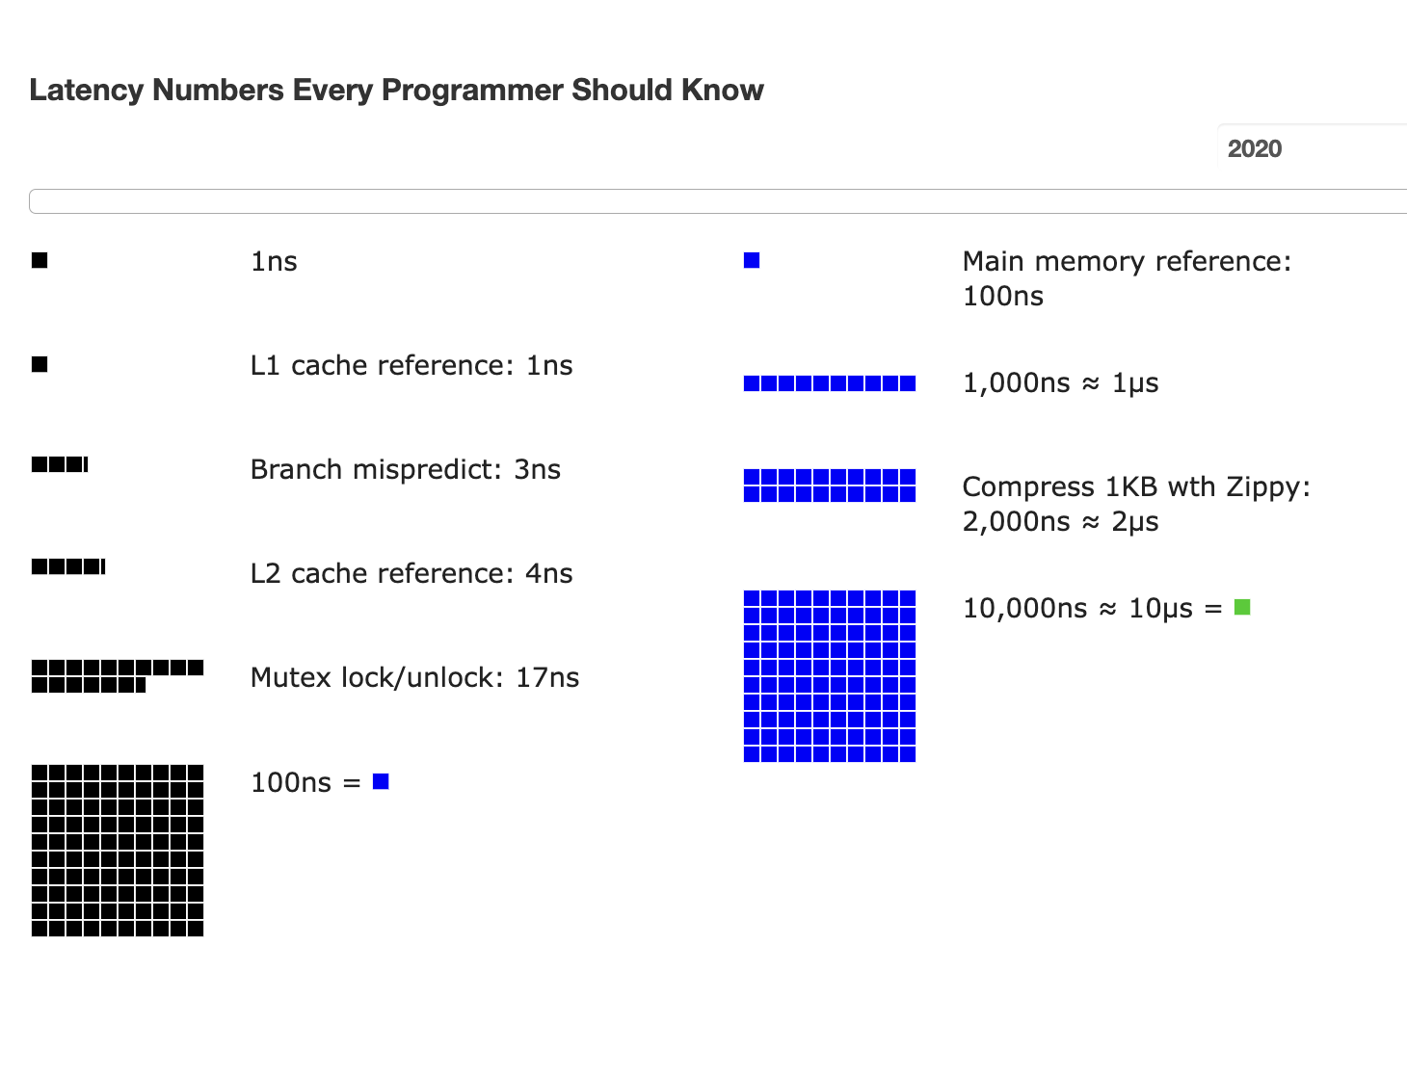
Atomic operations are costly for spin lock

Slide 60
Put it all together: OCC in an example
Tuple A in T1's read set has been changed by T2, thus T1 must be aborted.
Thread1
Thread2
T1:
B = A + B;
T2:
A = A * 1.1;
T2's read set remains unchanged, thus T2 is allowed to commit
BEGIN
BEGIN
T1's read set:
A (100)
B (100)
R(A);
R(A);
T2's read set:
A (100)
B (200)
R(B);
W(A);
T1's write set:
T2's write set:
A (110)
W(B);
Commit
Validation
Thread-local memory
Abort
Validation
Thread-local memory
Time
Database
storage
ID | Value
A | 110
B | 100
ID | Value
A | 100
B | 100

Slide 61
OCC's Problem: False Aborts
Some transactions aborted by OCC could have been allowed to commit without causing an unserializable schedule
Thread1
Thread2
T1:
B = A + B;
T2:
A = A * 1.1;
No cycle is formed
OCC only allows serialized execution of T2, T1, but is not able to recognize serialized execution of T1, T2.
T1 is falsely aborted
BEGIN
BEGIN
R(A);
rw
R(A);
R(B);
W(A);
W(B);
Commit
Abort

Slide 62
OCC's Problem: False Aborts
Some transactions aborted by OCC could have been allowed to commit without causing an unserializable schedule
Especially for TXs with a lot of reads
E.g., read a lot of items → large read set → easier to abort
May abort even under low-contention
Notes:
因为执行的时间很长，所以会abort

Slide 63
OCC’s Problem: livelock
Under high contention, OCC may continuously abort
Especially with large read/write sets, or long execution time
Transaction is executing, but no progress!

Slide 64
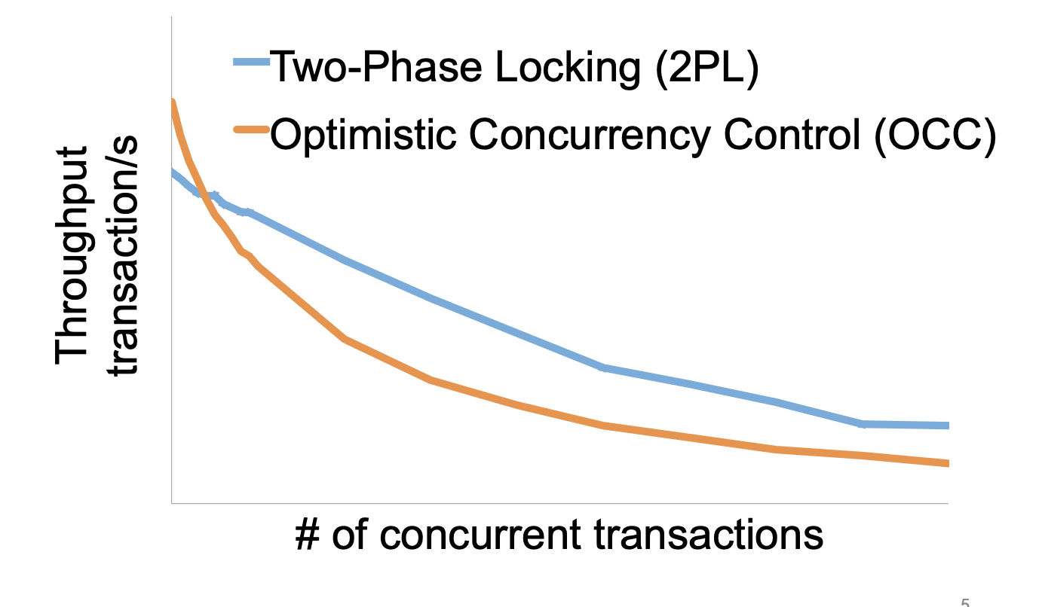
2PL vs. OCC: in a nutshell
Source: Extracting More Concurrency from Distributed Transactions [OSDI'14]

Slide 65
OCC and hardware transactional memory

Slide 66

Hardware Transactional Memory
A new CPU feature for writing multi-core concurrent programs
CPU guarantees the before-or-after atomicity of memory reads/writes
i.e., no race conditions & no need for 2PL & (Software-implemented) OCC!
Benefits: near zero costs if execute normally
Intel supports HTM named as RTM
Restricted Transactional Memory
First released in its Haswell processor
Other implementations also exist
E.g., ARM Transactional Memory Extension (TME)

Slide 67
A little introduction to RTM’s ISA
ISA support for transactional memory
Recall: Writing with TX is straightforward
Use TX.begin to mark when a TX starts
Use TX.commit to commit the TX
In RTM, the concept is similar (using new instructions)
Use xbegin to mark an RTM execution start
Use xend to mark an RTM end

Slide 68
Programming with RTM
If transaction starts successfully
Do work protected by RTM, and then try to commit
Fallback routine to handle abort event
If abort, system rollback to xbegin, return an abort code
Manually abort inside a transaction
if _xbegin() == _XBEGIN_STARTED:
if conditions:
_xabort()
critical code
_xend()
else
fallback routine

Slide 69
Programming with RTM
If an HTM transaction starts successfully
Do work protected by RTM, and then try to commit
Fallback routine to handle abort event
If abort, CPU rollbacks to line xbegin, return an abort code, and goto fallback
Manually abort inside a transaction
if _xbegin() == _XBEGIN_STARTED:
if conditions:
_xabort()
critical code (access x)
_xend()
else
fallback routine
Another process
x = 1

Slide 70
Programming with RTM
If an HTM transaction starts successfully
Do work protected by RTM, and then try to commit
Fallback routine to handle abort event
If abort, CPU rollbacks to line xbegin, return an abort code, and goto fallback
Manually abort inside a transaction
if _xbegin() == _XBEGIN_STARTED:
if conditions:
_xabort()
critical code
_xend()
else
fallback routine

Slide 71
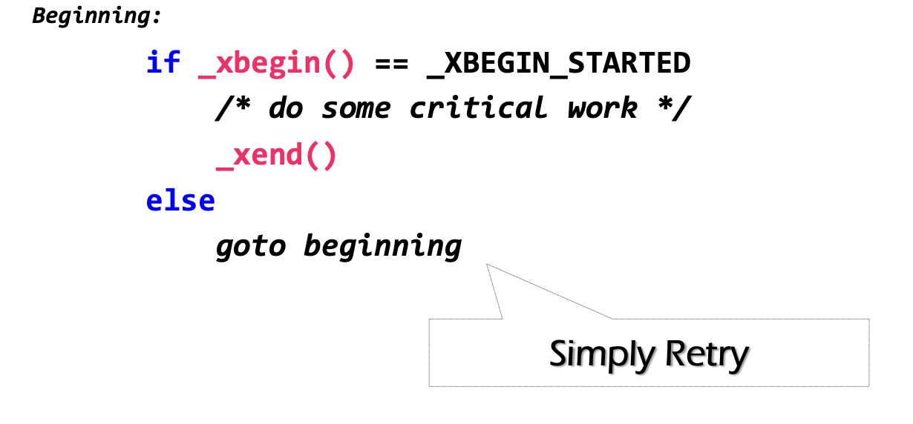
How to handle aborts? Can we use simple retry?
RTM provides new instruction set
xbegin(), xend() & xabort()
Problem: RTM cannot guarantee success

Slide 72
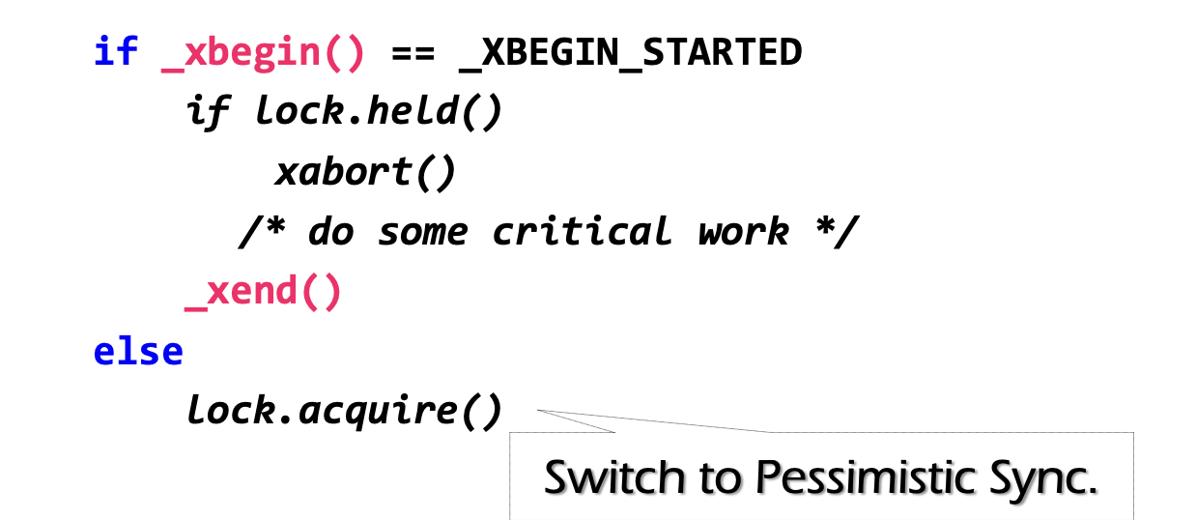
Can we use simple retry? No
Problem: RTM cannot guarantee success
Similar to OCC, code in RTM can be frequently aborted due to conflicts
Must switch to a fallback path after some reties (e.g., using a counter)
E.g., degrade to use lock in the fallback path (since it's not in a transaction)
check lock status to avoid conflict with fallback handlers on other CPU

Slide 73
Fun facts about the implementation of RTM
The benefits of RTM
Memory operations between xbegin() & xend()satisfy ACI properties
No need to implement OCC / 2PL manually
High performance if no abort happens
Drawbacks
Cannot guarantee success

Slide 74
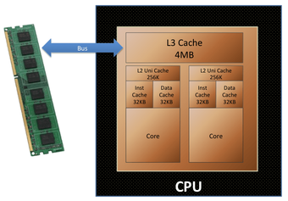
Why HTM cannot guarantee success?
Background: Intel implements RTM using OCC
Use CPU cache to track the read/write sets
How to detect conflicts? Based on cache coherence protocols
Key to high performance

Slide 75
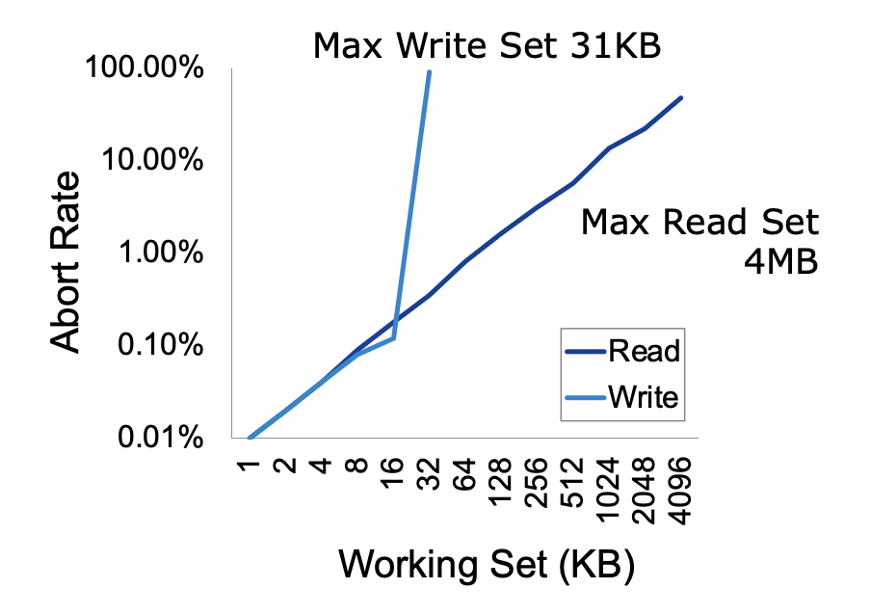
Why HTM cannot guarantee success? Limited working set
Reason: CPU has limited cache size
How big is the RTM read/write sets?
Depends on various factors
Hardware setup (e.g., CPU cache size)
Access pattern: read or write
L1 cache tracks all the writes
L2, or L3 to tracks all the reads

Slide 76
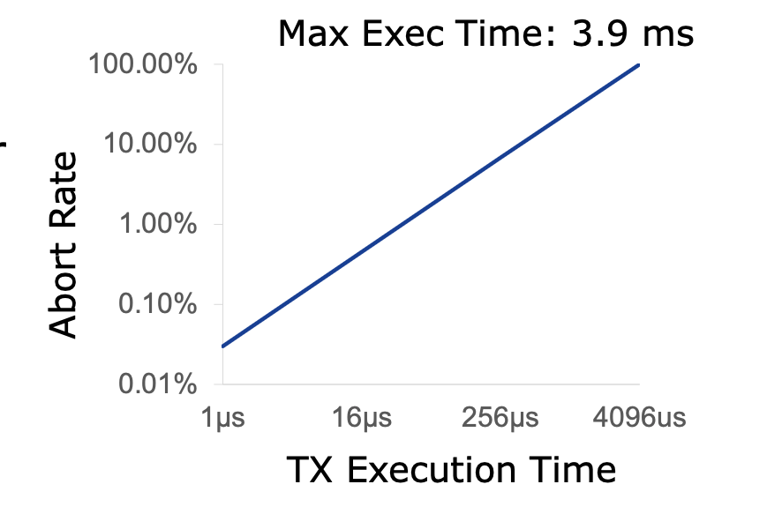
Why HTM cannot guarantee success? Affected by external events
HTM TX cannot run a very long time
The longer the execution, the higher the probability a TX aborts
Affected by external events
Network IO, interrupt, etc.

Slide 77
Some results of HTM on TXs
Naïve: using HTM to execute the in-memory transaction
Smallbank: transfer &. Audit
TPC-C: much complex, insert 10+ orders and update 10+ stocks
Silo@SOSP’13: the fastest in-memory OCC implementation

Slide 78
Short summary of HTM
Hardware support for transactional memory
Easy programming model for the programmer (no need to wrap transaction in read/write API of the transaction)
As long as the programmer do the in-memory computations, e.g., in-memory database
Good performance if using properly
No need for locking & atomic operations
However, the programmer should handle its pitfalls
It is an application of OCC (in the hardware)
OCC is a general technique that can be applied to many fields

Slide 79
A short summary of consistency so far with transactions

Slide 80

Widely used transaction (TX)s
Caching server
Caching server
…
Caching server
All can use TX to manager data!
e.g., FS meta data
Caching
Caching
Caching
Distributed caching
Database server
Database server
CDN
Users
Application #1
generate the page
Database
user, price
…
Database
user, price
Application server
Distributed database
Internet
Load
Balance
Application #2
add the order
File server
File server
File server
File:
image
File:
image
…
File:
image
Application server
…
…
Message queue
Distributed file system

Slide 81
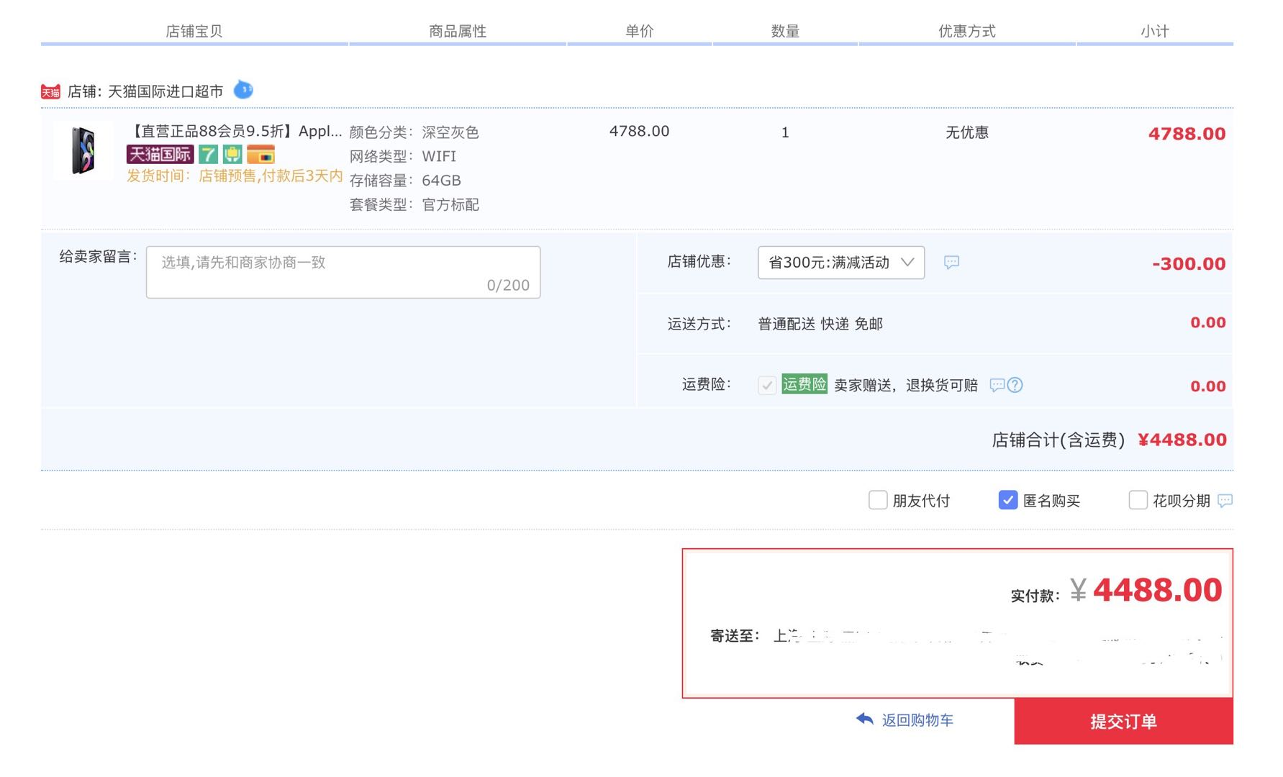
Widely used transaction (TX)s
if item.count > 0:
item.count -= 1
Cart.add(item)

Slide 82
What is TX?
An abstraction to manage the data
Data is also an abstract concept, can be arbitrary computing data. Concrete examples including:
Key-value store entries
File system metadata (e.g., directory,, inode, etc)
Processor’s metadata (e.g., child processors)
Look like similar program, with data managed by the TX system, and extra mark to denote the start/end of a TX

Slide 83

What a TX typically provide? ACID
The program btw { tx.begin() & tx.commit() } has the following properties:
A：Atomicity
C：Consistency
I：Isolation
D：Durability
...
tx.begin();
...
...
tx.commit();
...
ACID
Application program

Slide 84
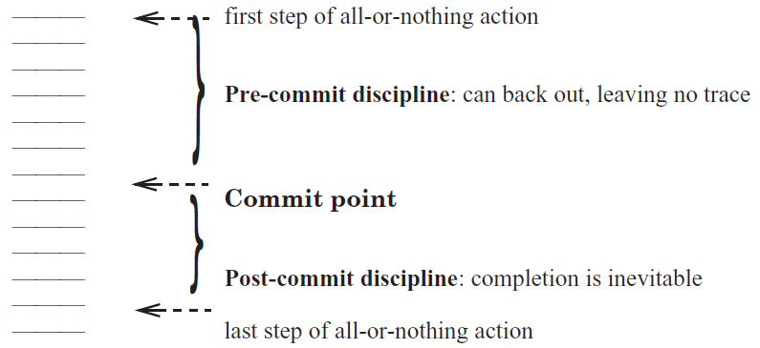
Atomicity: All-or-nothing

Slide 85
Isolation & Durability
Isolation: Two concurrently transactions are isolated
E.g., not viewing the intermediate results of another TX
Avoid the race conditions
Durability
Once a transaction is committed, its changes (e.g., writes) must durably stored to a persistent storage

Slide 86
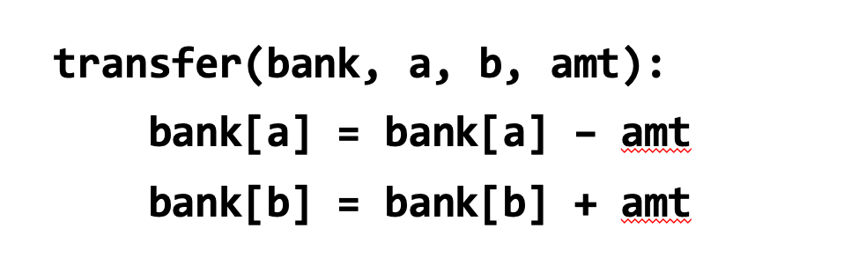
Consistency
Transaction must change the data from a consistent state to another
What is consistent is defined by the applications
E.g., transfer should leave the sum(bank[a] + bank[b]) unchanged
Transaction alone is not sufficient for application consistency
E.g., If the programmer writes the incorrect program.
bank[a] = bank[a] - amt * 2

Slide 87
Enforcing ACID properties (in the single-machine case)
Enforcing A & D:
Logging and recovery (see the last last lecture)
Enforcing C:
Database constraint system (not covered in this class)
Enforcing I:
Concurrency control methods (last & this lecture)

Slide 88
Review: Serialization
Goal: run transactions T1, T2, .., TN concurrently, and have it "appears" as if they ran sequentially
T1
begin
read(x)
tmp = read(y)
write(y, tmp+10)
commit
T2
begin
write(x, 20)
write(y, 30)
commit

Slide 89
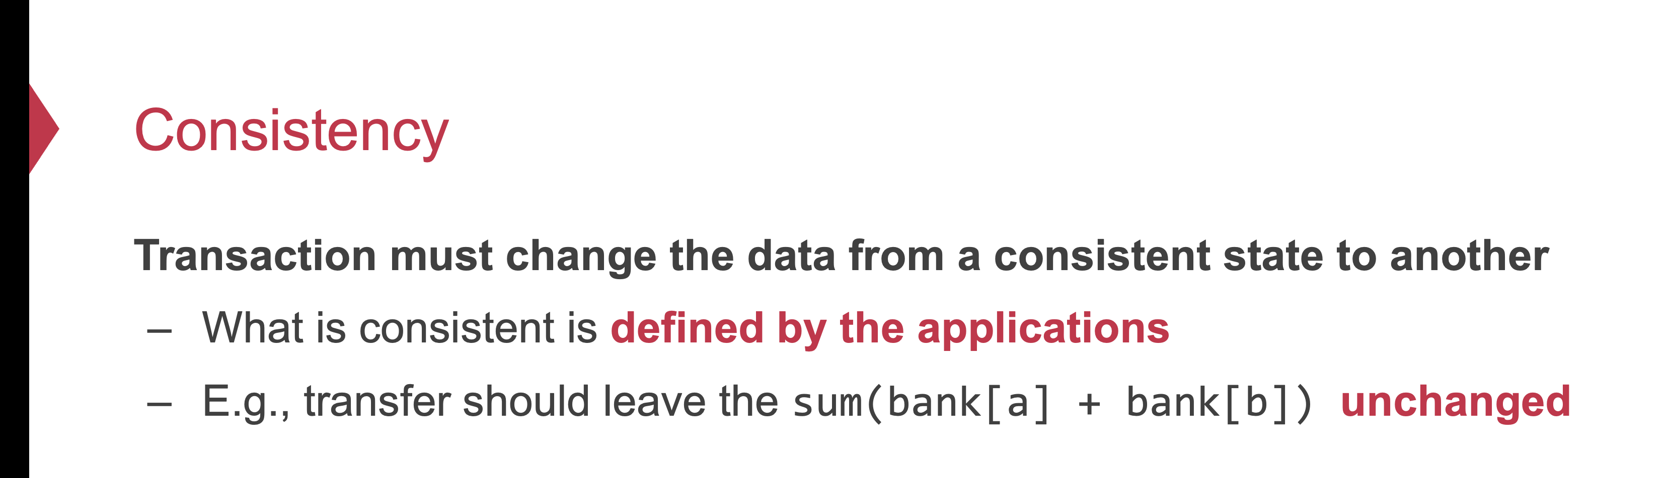
Why is isolation typically related to consistency?
Because it simplifies the programmer to enforce consistency
Recall: consistency depends on how the programmer writes the program

Slide 90
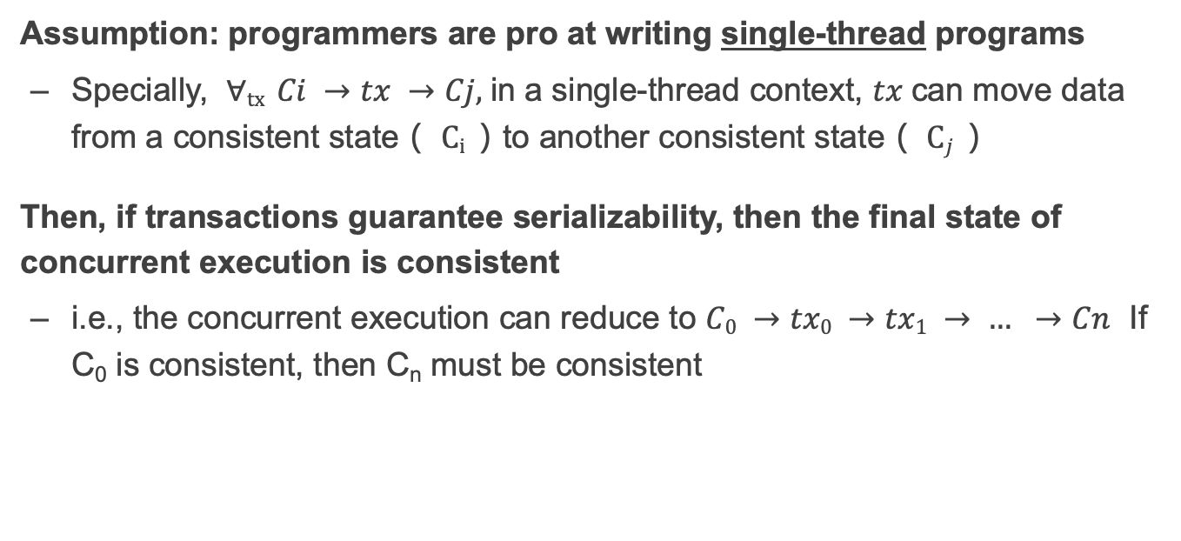
Why serializability is ideal?
Assumption: programmers are pro at writing single-thread programs
Specially, $∀tx Ci →tx →Cj,$in a single-thread context, $tx$can move data from a consistent state（ $Ci$）to another consistent state（ $Cj$）
Then, if transactions guarantee serializability, then the final state of concurrent execution is consistent
i.e., the concurrent execution can reduce to $C0 →tx0 →tx1 → … →Cn$ If C₀ is consistent, then C_{n} must be consistent

Slide 91
Why we need to use a TX?
Programmers can manually add logging & locking to their program
Can guarantee all-or-nothing and before-of-after
However, this is a typically bad idea
Question: what if the programmer falsely releases the lock (like the fine-grained lock example in our previous lecture?)
What if the programmer write the wrong logging & recovery mechanism?

Slide 92
Review of TX: an abstraction to ease data management
Handle failure atomicity (all-or-nothing) & race conditions (before-or-after)
Writing with TX is straightforward, the atomicity is left to the system
Use TX.begin to mark when a TX starts
Use TX.commit to commit the TX
Rewrite the data read/write with TX’s interface
E.g., bank[a] = bank[a] – amt
tx.write(a, tx.read(a) – amt);
transfer(bank, a, b, amt, tx):
tx.begin()
tx.write(b, tx.read(b) + amt);
tx.write(a, tx.read(a) – amt);
tx.commit()
transfer(bank, a, b, amt):
bank[b] = bank[b] + amt
bank[a] = bank[a] - amt
Program
Transaction

Slide 93
Summary
Transactions provide ACID properties
OCC & 2PL are basic protocols to provide serializability
Problem of 2PL: locking overhead & deadlock
Problem of OCC: False abort & livelock
Hardware transactional memory (HTM)
Advanced CPU features inspired by ACID properties of TXs
Commercial implementation of HTM uses OCC
Leads to several drawbacks
The cost of concurrency control can be reduced w/ relaxed isolation level
Snapshot Isolation (require global counter, not serializable)

