Slide 1


TCP Congestion Control & DNS
SE3331-1 (2024 Fall)
IPADS, Shanghai Jiao Tong University
https://www.sjtu.edu.cn
xx

Slide 2
The Design of DNS
Domain Name Service

Slide 3
DNS: Binding IP and Domain Name
Names: hostname strings
E.g., www.sjtu.edu.cn
Values: IP addresses
E.g., 202.120.2.119
Look-up algorithm
Resolves a hostname to an IP address so that your machine knows where to send packets

Slide 4
IP Address as a Type of Name
An IP address itself is a type of name
A structured name that is used to locate an object
Use IP address to identify the server
Recall your labs in ICS on socket
On Internet
The router will know where to send a packet with destination IP
Hostname has no such semantic
A router does not know how to send a packet to "baidu.com"

Slide 5
Why Not Just Using IP Address?
IPs are structured in a particular way for routing
You cannot choose your IP address as you wish
Note: usually an address cannot be picked
While you can choose your host names
IPs are not user-friendly enough

Slide 6
Questions on DNS
Q: Can a name have multiple values (IP addresses)?
Yes. This allows a web server to balance its load over multiple machines
Also allows a client to choice a nearest IP to access
Q: Can a single value have multiple names?
Yes. This allows server consolidation
Q: Can the value corresponding to a name change?
Yes. This allows to change the physical machine (with different IP) that stores the data without changing the hostname
Such changing is hidden to clients

Slide 7
Look-up Algorithm
At first, each machine kept a "hosts.txt" for address binding
E.g., "r900 202.120.224.83"
Using table look-up to resolve the binding
This method cannot scale in Internet
1984, four Berkeley students wrote BIND
Berkeley Internet Name Domain
Still the dominant DNS software in use

Slide 8
Distributing Responsibility
The binding
Too large to be stored on a single machine
Thus, the data are stored on many machines
As known as "name servers"
How to know which name server has a particular binding?
Solution: structure the hostname
Names have a hierarchy, e.g., com, net, gov, correspond to "zones"
Zones are mapped to name servers

Slide 9

Name Servers
The root zone
Maintained by ICANN, non-profit
The ".com" zone
Maintained by VeriSign, add for money
The ".sjtu.edu.cn" zone
Maintained by SJTU

Slide 10
DNS Hierarchy (a partial view)

Slide 11
Basic DNS Look-up Algorithm
Example: lookup IP of "ipads.se.sjtu.edu.cn"
Traverse the name hierarchy from the root
The root will tell us the "cn" name server IP,
which will tell us the "edu.cn" name server IP,
which will tell us the "sjtu.edu.cn" name server IP,
which will tell us the "se.sjtu.edu.cn" name server IP,
which finally tells us the "ipads.se.sjtu.edu.cn" IP
Such algorithm is called delegation

Slide 12
DNS Lookup

Slide 13
DNS Lookup

Slide 14
DNS Lookup

Slide 15
DNS Lookup

Slide 16
DNS Lookup

Slide 17
Context in DNS
Names in DNS are global (context-free)
A hostname means the same thing everywhere in DNS
Actually, it should be "ipads.se.sjtu.edu.cn."
A hostname is a list of domain names concatenated with dots
The root domain is unnamed, i.e., "." + blank

Slide 18
Fault Tolerant
Each zone can have multiple name servers
A delegation usually contains a list of name servers
If one name server is down, others can be used

Slide 19
Three Enhancements on Look-up Algorithm
1. The initial DNS request can go to any name server, not just the root server
Even on your own machine: /etc/hosts
You can specific name servers in /etc/resolv.conf
If no record, just return address of the root server
Q: what are the benefits?
Notes:
To minimize the load of the root server.

Slide 20
Three Enhancements on Look-up Algorithm
2. Recursion
A client asks a name server "www.baidu.com"
The name server does all the lookup through the tree and return the IP of Baidu to the client
Usually, a name server has a better network connection

Slide 21
DNS Request Process
a.root.net
a.root.net
names.edu
names.edu
NS: for edu
ns.iss.edu
ns.iss.edu
NS: for
Scholarly.edu
ginger.
Scholar.edu
ginger.
Scholar.edu
ginger.
Scholar.edu
AP: for
ginger.Scholar.edu
Name client
Name client
Non-Recursion
Recursion

Slide 22
Three Enhancements on Look-up Algorithm
3. Caching
DNS clients and name servers keep a cache of names
Your browser will not do two look-ups for one address
Cache has expire time limit
Controlled by a time-to-live parameter in the response itself
E.g., SJTU sets the TTL of www.sjtu.edu.cn to 24h
TTL (Time To Live)
Long TTL VS. short TTL
Q: what are the tradeoffs?

Slide 23
Combine These Enhancements
If:
Many machines at SJTU use the SJTU name server for their initial DNS query, and
The name server offers recursive querying and caching
Then:
The name server's cache will hold many bindings, and
Performance benefits from this large cache

Slide 24
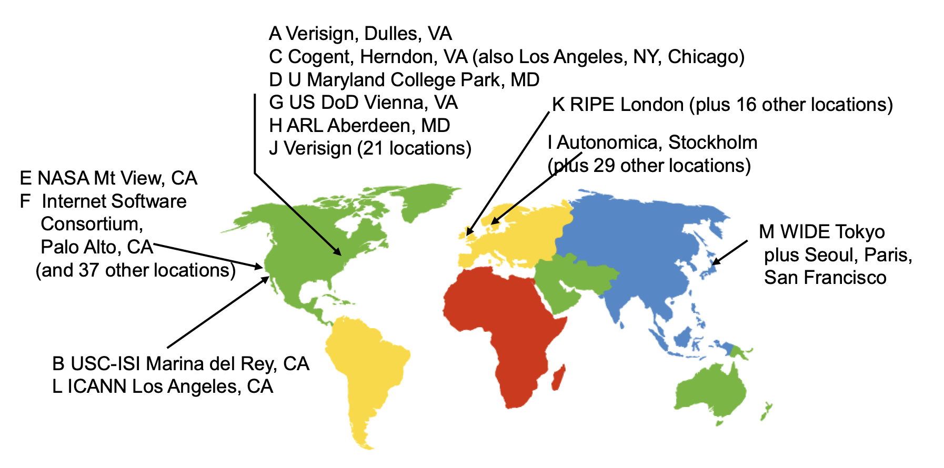
Other Features of DNS
At least two identical replica servers
80 replicas of the root name server in 2008
Replicas are placed separated around the world

Slide 25
Other Features of DNS
Organization's name server (e.g., SJTU)
Several replicas in campus
To enable communications within the organization
At least one out of the campus
To validate the address for outside world

Slide 26
Name Discovery in DNS (at the first place)
A client must discover the name of a nearby name server
Name discovery broadcast to ISP at first time
Ask network manager
Ask by email, Google, etc.

Slide 27
Comparing Hostname & Filename
They are both for more user friendly
File-name -> inode number
Host-name -> IP address
File-name and host-name are hierarchical; inode num and IP addr. are plane
They are both not a part of the object
File-name is not a part of a file (stored in directory)
Host-name is not a part of a website (stored on name server)
Name and value binding
File: 1-name -> N-values (no); N-name -> 1-value (yes)
DNS: 1-name -> N-values (yes); N-name -> 1-value (yes)

Slide 28
Behind the DNS Design
Why was DNS designed in this way?

Slide 29
Benefits of Hierarchical Design
Hierarchies delegate responsibility
Each zone is only responsible for a small portion
Hierarchies also limit interaction between modules
A type of de-centralization

Slide 30
Good Points on DNS Design
Global names (assuming same root servers)
No need to specific a context
DNS has no trouble generating unique names
The name can also be user-friendly
Scalable in performance
Simplicity: look-up is simple and can be done by a PC
Caching: reduce number of total queries
Delegation: many name severs handle lookups

Slide 31
Good Points on DNS Design
Scalable in management
Each zone makes its own policy decision on binding
Hierarchy is great here
Fault tolerant
If one name server breaks, other will still work
Duplicated name server for a same zone

Slide 32
Bad Points on DNS Design
Policy
Who should control the root zone, .com zone, etc.? Governments?
Significant load on root servers
Many DNS clients starts by talking to root server
Many queries for non-existent names, becomes a DoS attack
Security
How does a client know if the response is correct?
How does VeriSign know "change Amazon.com IP" is legal?

Slide 33
Naming Scheme
Naming: the glue of modules

Slide 34
Naming in General
ipads.se.sjtu.edu.cn – hostname
steven@apple.com - email
steven – username
EAX - x86 processor register name
main() - function name
WebBrowser - class name
/courses/cse/index.html - path name (fully-qualified)
index.html - path name (relative)
http://ipads.se.sjtu.edu.cn/courses/cse/index.html - URL
13918275839- Phone number
202.120.40.188 - IP Address

Slide 35
Naming a Disk
File name: /dev/sda1
As a special type of inode: device inode
8,0 as (major, minor)
PCI address (name): 19:00.0
SCSI storage controller: LSI Logic / Symbios Logic SAS1068E PCI-Express Fusion-MPT SAS (rev 08)

Slide 36
Naming for Modularity
Retrieval: e.g., using URL to get a web page
Sharing: e.g., passing an object reference to a function
Save space as well: only sending the name, not the object
Hiding: e.g., using a file name without knowing file system
Can support access control: use an object only if knowing its name
E.g., Windows has many undocumented API
User-friendly identifiers: e.g., “homework.txt” instead of 0x051DE540
Indirection: e.g., OS can move the location of the file data without notifying the user
Have you ever defragmented your hard driver?

Slide 37
Addresses as Names
Software uses these names in an obvious way
E.g., memory addresses
Hardware modules connected to a bus
Use bus addresses (a kind of name) for interconnection

Slide 38
Naming Schemes
A naming schemes contains three parts:
1. Set of all possible names
You cannot use ‘for’ as a variable in C
2. Set of all possible values
3. Look-up algorithm to translate a name into a value
or a set of values, or “none”

Slide 39
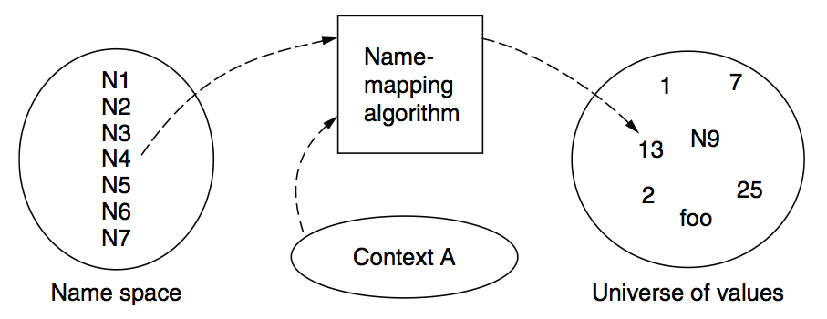
Naming Model

Slide 40
Naming Terminology
Binding – A mapping from a name to value
Unbind is to delete the mapping
A name that has a mapping is bound
A name mapping algorithm resolves a name

Slide 41
Naming Context
Type-1: context and name are separated
E.g., inode number’s context is the file system
Type-2: context is part of the name
E.g., xiayubin@sjtu.edu.cn
Name spaces with only one possible context are called universal name spaces
Example: credit card number, UUID, email address

Slide 42
Determining Context - 1
Hard code it in the resolver
Examples: Many universal name spaces work this way
Embedded in name itself
cse@sjtu.edu.cn:
Name = “cse”
Context = “sjtu.edu.cn”
/ipads.se.sjtu.edu.cn/courses/cse/README :
Name = “README”
Context = “/ipads.se.sjtu.edu.cn/courses/cse”

Slide 43
Determining Context - 2
Taken from environment (Dynamic)
Unix cmd: “rm foo”:
Name = “foo”, context is current dir
Question: how to find the binary of “rm” command?
Read memory 0x7c911109:
Name = “0x7c911109”,
Context is thread’s address space
Many errors in systems due to using wrong context

Slide 44
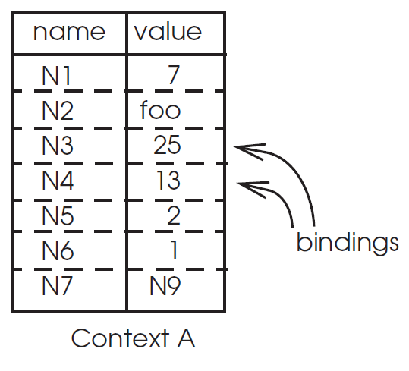
Name Mapping Algorithms - 1
Table lookup
Find name in a table
E.g., Phone book
Context: which table?
Implicit VS. explicit
Default context

Slide 45
Name Mapping Algorithms - 2
Recursive lookup
E.g., “/usr/bin/rm”
First find “usr” in “/”, then find “bin” in “/usr”, then “rm”
Each look-up process is the same
Multiple lookup
Recall: how to find “rm” without absolute name?
$PATH
E.g., “/usr/local/sbin:/usr/local/bin:/usr/sbin:/usr/bin:/sbin:/bin”
Look-up in a predefined list of context

Slide 46
Interpreter Naming API
value ← RESOLVE(name, context)
Return the mapping of name in the context
status ← BIND(name, value, context)
Establish a name to value mapping in the context
status ← UNBIND(name, context)
Delete name from context
list ← ENUMERATE(context)
Return a list of all bindings
result ← COMPARE(name1, name2)
Check if name1 and name2 are equal

Slide 47
FAQ of Naming Scheme - 1
What is the syntax of names?
What are the possible value?
What context is used to resolve names?
Who specifies the context?
Is a particular name global (context-free) or local?

Slide 48
FAQ of Naming Scheme - 2
Does every name have a value?
Or, can you have “dangling” names?
Can a single name have multiple values?
Does every value have a name?
Or, can you name everything?
Can a single value have multiple names?
Or, are there synonyms?
Can the value corresponding to a name change over time?

