Slide 1


P2P Network
SE3331-1 (2024 Fall)
IPADS, Shanghai Jiao Tong University
https://www.sjtu.edu.cn
xx

Slide 2
Content Distribution
Files on the Internet

Slide 3
Content Distribution
How to reduce load latency over Internet?
Especially for large files, e.g., images and videos
Client side
Many people from SJTU might access same web pages
Save bandwidth by caching a local copy
Server side
Not all clients use cache
Push data out to content distribution network (CDN)

Slide 4
Caching Examples
Web browser caches recently accessed files
E.g., allow "back" button to operate more efficiently
Web proxies cache recently accessed URLs
Save bandwidth/time when multiple people locally access same remote URL
DNS resolvers cache resource records (URL→IP)
NFS clients cache read/written data

Slide 5
Content Distribution Network (CDN)
Network of computers that replicate content across the Internet
Bringing content closer to requests
End users only use local (not shared) network capacity
Content providers actively pushes data into the network
Improve performance and reduce costs

Slide 6
Content Distribution Network (CDN)
Akamai as an example

Slide 7
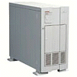

Server Selection Mechanism
Application
HTTP redirection
Advantages
Fine-grain control
Selection based on client IP address
Disadvantages
Extra round-trips for TCP connection to server
Overhead on the server
GET
Redirect
GET
OK

Slide 8
Server Selection Mechanism
Routing
Anycast routing
Advantages
No extra round trips
Route to nearby server
Disadvantages
Does not consider network or server load
Different packets may go to different servers
Used only for simple request-response apps
1.2.3.0/24
1.2.3.0/24

Slide 9
Server Selection Mechanism
Naming
DNS-based server selection
Advantages
Avoid TCP set-up delay
DNS caching reduces overhead
Relatively fine control
Disadvantage
Based on IP address of local DNS server
“Hidden load” effect
DNS TTL limits adaptation
1.2.3.4
DNS
query
1.2.3.5
local DNS server

Slide 10
How Akamai Uses DNS
cnn.com (content provider)
DNS root server
Akamai
cluster
Akamai global
DNS server
1
2
GET index.html
http://cache.cnn.com/foo.jpg
Akamai regional
DNS server
Nearby Akamai
cluster
End user

Slide 11
How Akamai Uses DNS
cnn.com (content provider)
HTTP
DNS TLD server
DNS lookup
cache.cnn.com
Akamai
cluster
Akamai global
DNS server
1
2
3
4
ALIAS:
g.akamai.net
Akamai regional
DNS server
Nearby Akamai
cluster
End user

Slide 12
How Akamai Uses DNS
cnn.com (content provider)
DNS TLD server
DNS lookup
g.akamai.net
Akamai
cluster
Akamai global
DNS server
5
1
2
3
4
6
Akamai regional
DNS server
ALIAS
a73.g.akamai.net
Nearby Akamai
cluster
End user

Slide 13
How Akamai Uses DNS
cnn.com (content provider)
DNS TLD server
Akamai
cluster
Akamai global
DNS server
5
1
2
3
4
6
Akamai regional
DNS server
7
DNS a73.g.akamai.net
8
Address
1.2.3.4
Nearby Akamai
cluster
End user

Slide 14
How Akamai Uses DNS
cnn.com (content provider)
DNS TLD server
Akamai
cluster
Akamai global
DNS server
5
1
2
3
4
6
Akamai regional
DNS server
7
8
9
Nearby Akamai
cluster
End user
GET /foo.jpg
Host: cache.cnn.com

Slide 15

How Akamai Uses DNS
cnn.com (content provider)
DNS TLD server
GET foo.jpg
11
12
Akamai
cluster
Akamai global
DNS server
5
1
2
3
4
6
Akamai regional
DNS server
7
8
9
Nearby Akamai
cluster
End user
GET /foo.jpg
Host: cache.cnn.com

Slide 16
How Akamai Uses DNS
cnn.com (content provider)
DNS TLD server
11
12
Akamai
cluster
Akamai global
DNS server
5
1
2
3
4
6
Akamai regional
DNS server
7
8
9
Nearby Akamai
cluster
End user
10

Slide 17
How Akamai Works: Cache Hit
cnn.com (content provider)
DNS TLD server
Akamai
cluster
Akamai global
DNS server
1
2
Akamai regional
DNS server
3
4
5
Nearby Akamai
cluster
End user
6

Slide 18
P2P Network

Slide 19
Downsides of Centralized Infrastructure
Centralized point of failure
High management costs
If one org has to host millions of files, etc.
Not suitable for many scenarios
E.g., cooperation between you and me
Lack ability to aggregate clients

Slide 20
P2P (Peer-to-peer): No central servers!
How to track nodes and objects in the system?
How do you find other nodes in the system?
How should data be split up between nodes?
How to prevent data from being lost?
How to keep it available?
How to provide consistency?
How to provide security? anonymity?

Slide 21
BitTorrent
Usage Model: Cooperative
User downloads file from someone using simple user interface
While downloading, BitTorrent serves file also to others
BitTorrent keeps running for a little while after download completes
3 Roles
Tracker: What peer serves which parts of a file
Seeder: Own the whole file
Peer: Turn a seeder once has 100% of a file
Notes:
** Challenges:
Tracking which peer has what
Handling high churn rates
Download rate proportional to upload rate

Slide 22
BitTorrent
Publisher a .torrent file on a Web server (e.g., suprnova.org)
URL of tracker, file name, length, SHA1s of data blocks (64-512Kbyte)
Tracker
Organizes a swarm of peers (who has what block?)
Seeder posts the URL for .torrent with tracker
Seeder must have complete copy of file
Peer asks tracker for list of peers to download from
Tracker returns list with random selection of peers
Peers contact peers to learn what parts of the file they have etc.
Download from other peers

Slide 23
A torrent file
{ 'announce': 'http://bttracker.debian.org:6969/announce',
'info': {
'name': 'debian-503-amd64-CD-1.iso',
'piece length': 262144, 'length': 678301696, 'pieces':
'841ae846bc5b6d7bd6e9aa3dd9e551559c82abc1...d14f1631d
776008f83772ee170c42411618190a4'
}
}

Slide 24
Which Piece to Download?
Different policies: Order of parts downloading
Strict?
Rarest first?
Random?
Parallel?
BitTorrent
Random for the first one
Rarest first for the rest
Parallel for the last one
Notes:
strict?
rarest first?
ensures that every piece is widely available
also helps with the seed and bootstrapping rapidly
won't retrieve the same piece multiple times from the seed
random?
avoid overloading seed when starting download
if peer has no piece, get as quickly as possible a piece so that it can upload
don't use rarest because it is likely only one peer has it
--> use random, can download subpieces in parallel
parallel download of same pieces?
avoid waiting on slowest

Slide 25
Drawback of BitTorrent
Rely on Tracker
Tracker is central component
Cannot scale to large number of torrents

Slide 26
Scalable Lookup: DHT
DHT: Distributed hash table
Used to find the node responsible for a key quickly
Distributed index: each node keeps a subset of the index
Typical DHT interface:
put(key, value)
get(key) -> value
Loose guarantees about keeping data alive
Notes:
Two options: find the data, find the node ID, who knows the data. focus on the latter.

Slide 27
P2P Implementation of DHT
Overlay Network
Partition hash table over n nodes
Not every node knows about all other n nodes
Route to find right hash table
Goals
log(n) hops
Guarantees about load balance

Slide 28
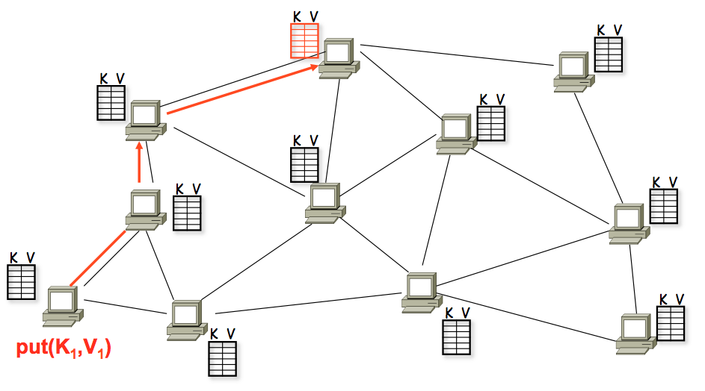
A DHT in Operation: put()

Slide 29
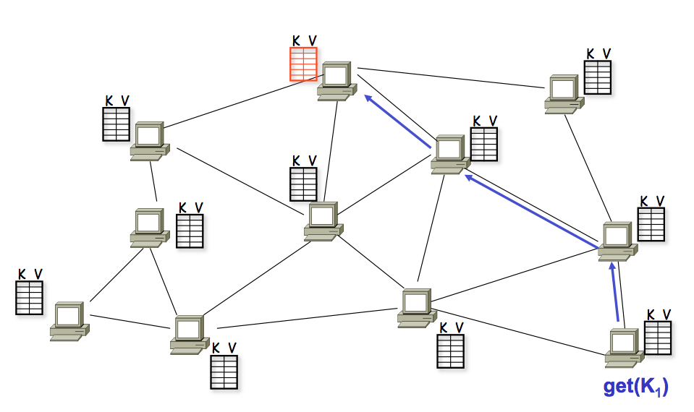
A DHT in Operation: get()

Slide 30
Chord Properties
Efficient: O(log(N)) messages per lookup
N is the total number of servers
Scalable: O(log(N)) state per node
Robust: survives massive failures

Slide 31
Chord IDs
Key identifier = SHA-1(key)
SHA-1 is a hash function
Node identifier = SHA-1(IP address)
Both are uniformly distributed
Both exist in the same ID space
How to map key IDs to node IDs? by mod?

Slide 32
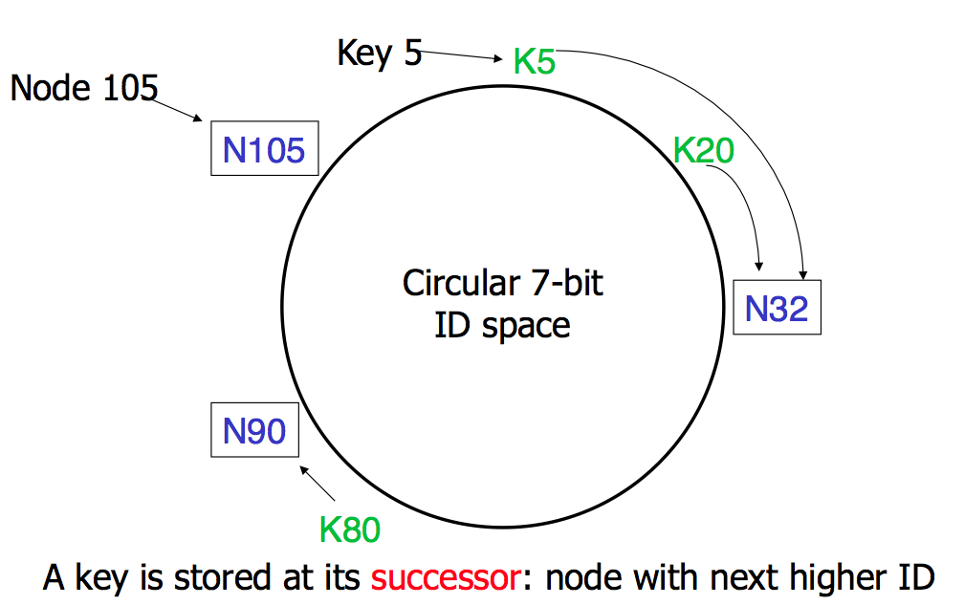
Consistent Hashing

Slide 33
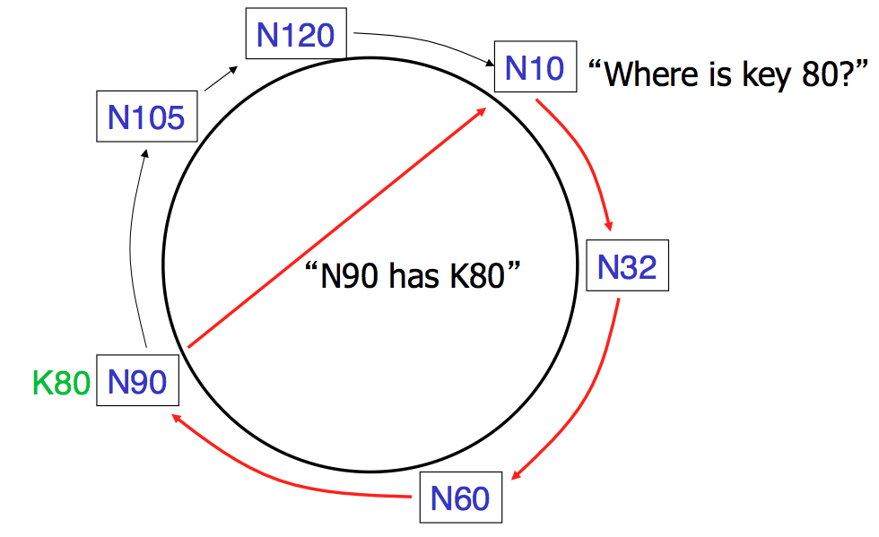
Basic Lookup

Slide 34
Simple Lookup Algorithm
Lookup(my-id, key-id)
n = my successor
if my-id < n < key-id
call Lookup(id) on node n // next hop
else
return my successor // done
Correctness depends only on successors

Slide 35
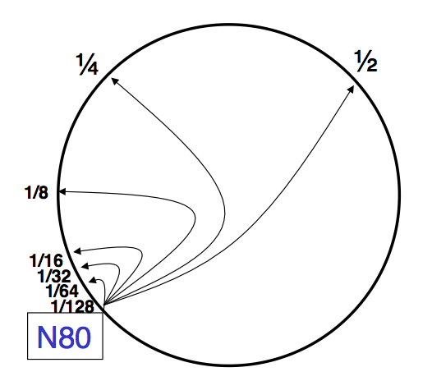
"Finger Table" allows log(N) lookups

Slide 36
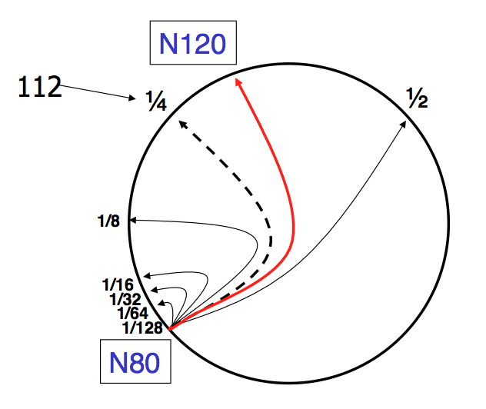
Finger i points to successor of n+2^{i}

Slide 37
Lookup with fingers
Lookup(my-id, key-id)
look in local finger table for
highest node n s.t. my-id < n < key-id
if n exists
call Lookup(id) on node n // next hop
else
return my successor // done

Slide 38
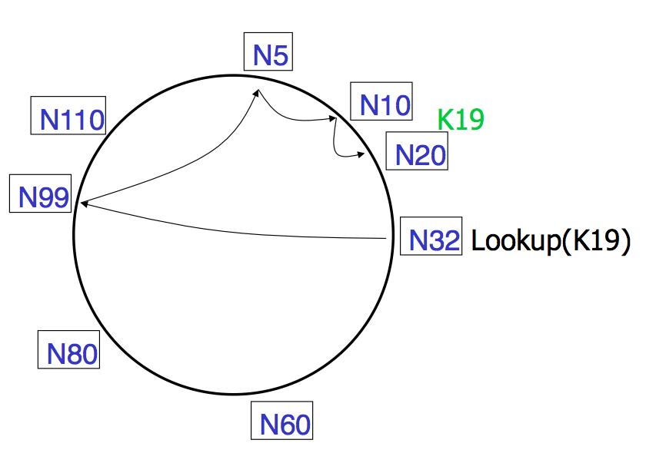
Lookups take O(log(N)) hops

Slide 39
Failures might cause incorrect lookup
N120
N10
N113
^{Lookup(90)}
N102
N85
N80
N80 doesn't know correct successor, so incorrect lookup

Slide 40
Solution: successor lists
Successor Lists
Each node knows r immediate successors
After failure, will know first live successor
Correct successors guarantee correct lookups
Guarantee is with some probability

Slide 41
Join (1)
N25
N36
1. Lookup(36)
N40
K30
K38

Slide 42
Join (2)
N25
N36
1. Lookup(36)
N40
K30
K38

Slide 43
Join (3)
N25
N36
K30
1. Lookup(36)
N40
K30
K38

Slide 44
Join (4)
N25
4. Set N25's successor pointer
N36
K30
N40
K30
K38
Update finger pointers in the background

Slide 45
Solution: successor lists
Successor List Length
Assume 1/2 of nodes fail
P(successor list all dead) = (1/2)^{r}
I.e. P(this node breaks the Chord ring)
Depends on independent failure
P(no broken nodes) = (1 – (1/2)^{r})^{N}
r = 2log(N) makes prob. = 1 – 1/N

Slide 46
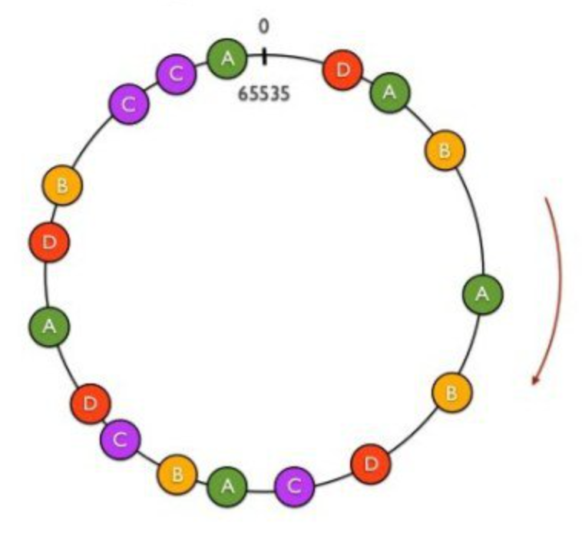
Virtual Nodes for Load Balance
Load balance could be a problem
Some nodes have most value
Solution: virtual nodes
Virtual nodes are distributed across the ring
One physical node can have multiple virtual nodes
More virtual nodes, better load balance

Slide 47
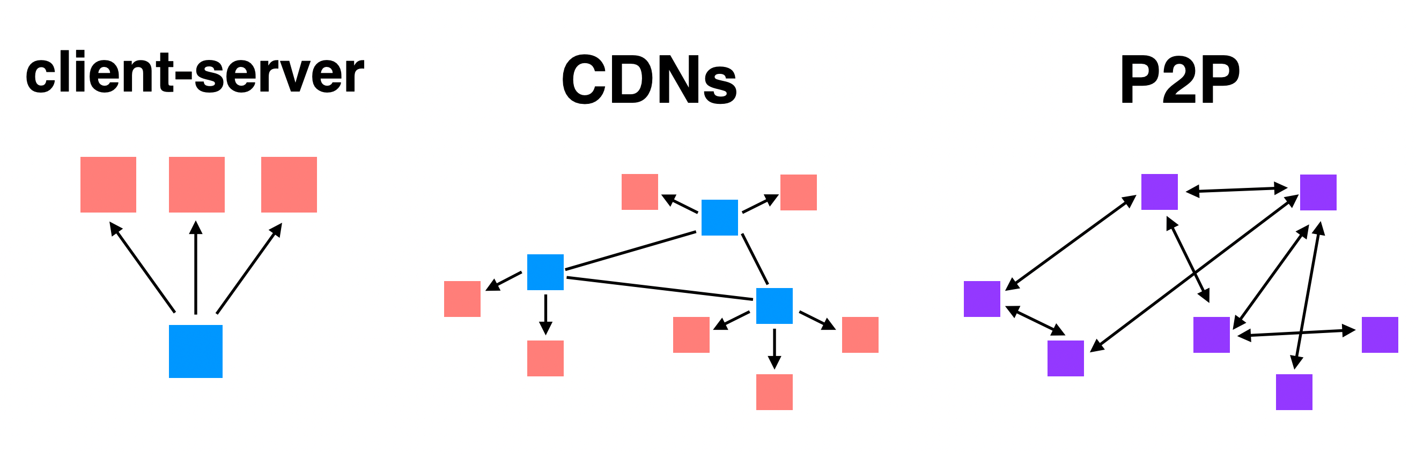
Summary: Different File Sharing Techniques

