Slide 1


The distributed (and parallel) programming on a single device & MapReduce
SE3331-1 (2024 Fall)
Xingda Wei, Yubin Xia
IPADS, Shanghai Jiao Tong University
https://www.sjtu.edu.cn
Credits: AI-sys Sp22, CMU15-418

Slide 2




Use distributed computing frameworks for complex queries
Each fits a common application scenario
One sit (typically) does not fit all!
Batch processing system
Spark, Hadoop, etc.
Graph processing system
GraphLab, etc.
Machine learning system
TensorFlow, Pytorch, etc.
Note that we can also use one for another
At the cost of programming effort and performance
Today’s focus

Slide 3
Example: batching processing
Suppose our web server records every requests in a log file
E.g., using nginx log format, a log record looks like this:
216.58.210.78 - - [27/Feb/2015:17:55:11 +0000] "GET /css/typography.css HTTP/1.1" 200 3377 "http://martin.kleppmann.com/" "Mozilla/5.0 (Macintosh; Intel Mac OS X 10_9_5) AppleWebKit/537.36 (KHTML, like Gecko) Chrome/40.0.2214.115 Safari/537.36"
Abstract format: $remote_addr - $remote_user [$time_local] "$request" $status $body_bytes_sent "$http_referer" "$http_user_agent"
Task (simple log analysis): how to find top five popular pages?

Slide 4
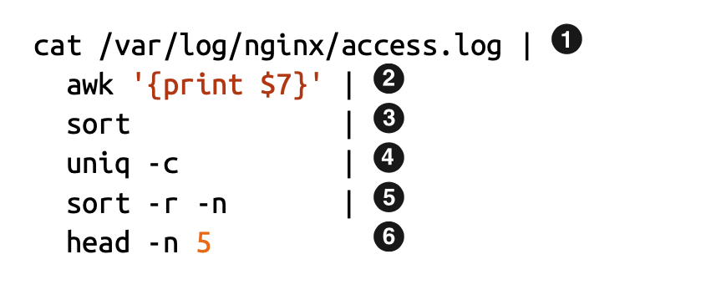
Old days: using command line to process the log
216.58.210.78 - - [27/Feb/2015:17:55:11 +0000] "GET /css/typography.css HTTP/1.1" 200 3377 "http://martin.kleppmann.com/" "Mozilla/5.0 (Macintosh; Intel Mac OS X 10_9_5) AppleWebKit/537.36 (KHTML, like Gecko) Chrome/40.0.2214.115 Safari/537.36"
Find top five most popular pages w/ command line tools

Slide 5
Use command line tools for batch processing
Find top five most popular pages
1
Read log file
4
Aggregate, with a counter for each line
Filter the line, pick the 7th token,
i.e., /css/typography.css
Sort again (using the counter)
2
5
3
Sort so that the same requests come together
6
Print 1-5 items

Slide 6
Does batch processing with command line tools scale?
Command line tools are mostly single-threaded, and single-machine
: scalability is restricted by the disk capacity
～ : restricted by single-thread computing power
～ : also restricted by the machine’s DRAM capacity
1
Scale using GFS
2
6
2
6

Slide 7

Scaling log processing using RPC: step #1
for w in workers:
execute_command(w,...) // parallelly
res = []
for machines in workers:
res.append(get_res(w))
.3
.4
…

Slide 8
From theory to reality
Strategy (in theory)
Step 1: decompose the file into M pieces, count top 5 concurrently
Step 2: merge the top 5 from all the others & calculate the final top 5
Step #1
How to decompose? How to assign threads to do chunks?
Try #1: RPC to M machines, run the program, each given a different file
Question
How can we collect the results from all the others?

Slide 9
Scaling log processing using RPC: step #2
for w in workers:
execute_command(w,...) // parallelly
res = []
for machines in workers:
res.append(get_res(w))
.3
.4
…

Slide 10
Building application with distributed computing: old days
Graduate Student
ML experts repeatedly solve the same parallel design challenges
Implement and debug complex parallel & distributed systems
Tune for a specific parallel platform
6 months later, a conference paper contains:
However, the resulting code will be difficult to maintain and extend
“We implemented ____ in parallel.”
couples computation task with distributed implementation

Slide 11
Challenges programmers facing
Communicating between two machines
can be simple, e.g., with RPC
But, what about 10,000 machines?
Sending data to/from nodes
Coordinating among nodes
Recovering from node failure
Optimizing for locality
Partition data to to enable more parallelism

Slide 12
Challenges programmers facing
Sending data to/from nodes
Coordinating among nodes
Recovering from node failure
Optimizing for locality
Partition data to to enable more parallelism
When can we collect computing results from all the computing nodes?

Slide 13
Challenges programmers facing
Sending data to/from nodes
Coordinating among nodes
Recovering from node failure
Optimizing for locality
Partition data to to enable more parallelism
Failure is common,
especially at large-scale

Slide 14
Challenges programmers facing
Sending data to/from nodes
Coordinating among nodes
Recovering from node failure
Optimizing for locality
Partition data to to enable more parallelism
Transferring data over network is usually much slower than local data access

Slide 15
Challenges programmers facing
Sending data to/from nodes
Coordinating among nodes
Recovering from node failure
Optimizing for locality
Partition data to to enable more parallelism
Reduce the bottleneck of sequential part

Slide 16
Idea: we build a framework to hide the above tasks
Goal
Reduce programmer’s effort in solving the above challenges
Challenges
What is the right abstraction? Thread & RPC is insufficient
More general, harder to provide the properties presented in the previous slide
E.g., if a thread fails, how can we know its progress?

Slide 17
MapReduce: Simplified Data Processing on Large Clusters

Slide 18
MapReduce: a distributed batch processing system
Created by Google (OSDI’04)
Jeffrey Dean and Sanjay Ghemawat
Inspired by LISP (function language)
Map (function, set of values)
Applies function to each value in the set
Reduce (function, set of values)
Combines all the values using a function (e.g., +)
(map #‘length’ (() (a) (a b) (a b c))) → (0 1 2 3)
(reduce #‘+’ (1 2 3 4 5)) → 15

Slide 19
MapReduce abstraction matches our requirements well
Sending data to/from nodes
Data is sent between Map & Reduce
Coordinating among nodes
Use the MapReduce semantic to coordinate
i.e.， only need to schedule the reducer after the mapper
Recovering from node failure
Via re-execution
Optimizing for locality
e.g., schedule the map and reduce on the same machine
Partition data to to enable more parallelism
Map on different parts of the data can be run in parallel, but what about reduce?

Slide 20
MapReduce Programming Interface
Map: (input shard) → intermediate (k/v pairs)
Partition the input data into M “shards”
Group all intermediate values associated with the same key
Pass them to the Reduce function
Reduce: intermediate (k/v pairs) → (results)
Partition the key space into R “pieces” using a Partition function
E.g., hash(key) mod R (unsorted)
Accept a key & a set of values
Merge these values to form result of the key
Notes:
Sort may be important. E.g., sometimes the output keys are URLs, and we want all entries for a single host to end up in the same output file.

Slide 21
MapReduce Programming Model
Allows user to process huge amounts of data on thousands of nodes
Framework for data-parallel computing
Programmers get simple yet restricted API
Users don’t have to worry about handling:
parallelization
data distribution
load balancing
fault tolerance

Slide 22

MapReduce Programming Model
Functionality
Parallelization
Data Distribution
Fault Tolerance
user
Load Balance

Slide 23
MapReduce Programming Model
Functionality
Two Primitives:
Map (input)
Parallelization
Data Distribution
MapReduce
Runtime
Reduce (key, values)
Fault Tolerance
user
Load Balance

Slide 24
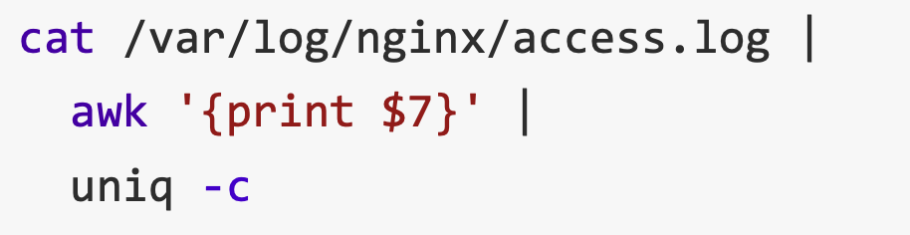
MapReduce example：Word count
Word Count: Count # occurrences of each word in a collection of documents
A simplified process of our previous log analysis example
1
2
3

Slide 25
MapReduce example：Word count
Word Count: Count the occurrences number of each word in a collection of documents
Map:
Parse data and emit each word with a count (1)
Reduce:
Reduce: sum together counts each key (words)
map (input) # a shard of file
for each word w in input
EmitIntermediate (w, “1”);
Reduce (String key, Iterator values)
int result = 0;
for each v in values
result += ParseInt (v);
emit (AsString (result));

Slide 26
MapReduce Programming Model
E.g., to find the most
popular keywords (热词)
Two Primitive:
Map (input)
for each word in input
emit (word, 1)
Word Count
Functionality
MapReduce
Runtime
Reduce (key, values)
int sum = 0;
for each value in values
sum += value;
emit (word, sum)
user

Slide 27
MapReduce Execution Flow
Map
Grab the relevant data from the source
User function gets called for each chunk of input
Map Worker
Reduce Worker
Reduce
Aggregate the results
User function gets called for each unique key

Slide 28
MapReduce Execution Flow
Map
Grab the relevant data from the source
User function gets called for each chunk of input
Partition
Identify which Reducers will handle which keys
Map partitions data to target Reducers
Map Worker
Reduce Worker
Sort
(Optional) Fetch the relevant partition data from all mappers
Sort by keys
Reduce
Aggregate the results
User function gets called for each unique key

Slide 29
MapReduce: The Complete Picture
Client
Master
assign tasks
Shard 0
Map Worker
IF
Shard 1
Shard 2
Reduce Worker
Output
File 1
M items
Shard 3
Map Worker
IF
R items
...
Reduce Worker
Output
File 2
Shard M-2
Shard M-1
Map Worker
IF
Input Files
Map Workers
Intermediate Files
Reduce Workers
Output Files
Notes:
具体到实现，以文件作为input

Slide 30
MapReduce: The Complete Picture
Step1: (Client/Master) split input files into chunks (shards)
Typically, 64MB
Why? Fit the GFS chunk size, so one RPC is sufficient to read the chunk
Shard 0
Shard 1
Shard 2
Shard 3
...
Shard M-1
Input Files
Divided into M shards

Slide 31
MapReduce: The Complete Picture
Step2: (remote) fork processes
Start up many copies of the program on cluster
1 master: scheduler & coordinator
Lots of workers
Idle workers are assigned either
Map tasks (each works on a shard)
Reduce tasks (each works on intermediate files)
Client
remote fork
Master
...
Map Worker
..
Map Worker
Reduce Worker
..
Reduce Worker

Slide 32
MapReduce: The Complete Picture
Step3: map task
Reads contents of the input shard assigned to it
Parses key/value pairs out of the input data
Passes each pair to a user-defined Map function
Produces intermediate key/value pairs
These are buffered in memory
read
Map Worker
Shard 2

Slide 33
MapReduce: The Complete Picture
Step4: create intermediate files
Intermediate k/v pairs buffered in memory and periodically written to the local disk
Partitioned into R regions by a Partition function
Default function: hash(key) mod R
Intermediate File
read
Map Worker
local write
partition 1
Shard 2
partition 2
partition R

Slide 34
MapReduce: The Complete Picture
Step5: sorting intermediate data
Notified by master about the location of intermediate files for its partition
Uses RPCs to read the data from the local disks of map workers
Sort keys from different intermediate files (like a merge sort)
=> All occurrences of the same key are grouped
Note: both mapper and reducer needs to do the sort
local write
remote read
Map Worker
Intermediate file
Reduce Worker
Map Worker
local write
Intermediate file
remote read
Reduce Worker

Slide 35
MapReduce: The Complete Picture
Step6: reduce task
Groups data with a unique intermediate key
User’s Reduce function is given the key and the set of intermediate values for that key
<key, (value1, value2, ...)>
The output is appended to an output file
Intermediate file
Intermediate file
remote read
Reduce Worker
write
Output
File 1
Intermediate file

Slide 36
MapReduce: The Complete Picture
Step7: return to user
When all map and reduce tasks have completed
Master wakes up the user program
The MapReduce call in the user program returns, and the program can resume execution
Output of MapReduce is available in R output files

Slide 37
MapReduce example in action：Word count
After Map
After Sort
After Reduce
Input file
[Intermediate]
It will be seen that this mere painstaking burrower and grub-worm of a poor devil of a Sub-Sub appears to have gone through the long Vaticans and streetstalls of the earth, picking up whatever random allusions to whales he could anyways find in any book whatsoever, sacred or profane. Therefore you must not, in every case at least, take the higgledy-piggledy whale statements, however authentic, in these extracts, for veritable gospel cetology. Far from it. As touching the ancient authors generally, as well as the poets here appearing, these extracts are solely valuable or entertaining, as affording a glancing bird's eye view of what has been promiscuously …
...
it 1
will 1
be 1
seen 1
that 1
this 1
mere 1
painstaking 1
burrower 1
and 1
grub-worm 1
of 1
a 1
poor 1
devil 1
of 1
a 1
sub-sub 1
…
...
a 1
a 1
aback 1
aback 1
abaft 1
abaft 1
abandon 1
abandon 1
abandon 1
abandoned 1
abandoned 1
abandoned 1
abandoned 1
abandoned 1
abandoned 1
abandoned 1
abased 1
abased 1
…
a 4736
aback 2
abaft 2
abandon 3
abandoned 7
abased 2
abasement 1
abashed 2
abate 1
abated 3
abatement 1
abating 2
abbreviate 1
abbreviation 1
abeam 1
abed 2
abednego 1
abel 1
abhorred 3
...
Map
Reduce

Slide 38
Other examples of MapReduce
Distributed grep
Search for words in lots of documents
Map: emit a line if it matches a given pattern
Reduce: just output the intermediate data
Count URL access frequency
Find the frequency of each URL in web logs
Map: process logs of web page access; output <URL, 1>
Reduce: add all values for the same URL

Slide 39
Other examples of MapReduce
Inverted index
Find what documents contain a specific word
Map: parse document, emit <word, doc-ID>
Reduce: sort the doc-ID for each word, and output <word, list(doc-ID)>
Reverse web-link graph
Find where page links come from
Map: output <target, source> for each link to target in a page source
Reduce: concatenate all source for each target, output <target, list(source)>
And more … (Please check the paper)

Slide 40
Recall, common challenges of Distributed Computing
Sending data to/from nodes
Coordinating among nodes
Recovering from node failure
Optimizing for locality
Partition the data to enable more parallelism
How does MapReduce handle these challenges?
Solved
Same for
all problems
Solved

Slide 41
Fault tolerance of MapReduce
Recall: machine failures are common in datacenters
A MapReduce job can possibly run on thousands of machines
Two choices made MapReduce easy in handling failures:
Programming model simplifies fault recovery
e.g., no side-effect: a map or a reduce can simply re-execute the computation to recover from failures
Builds on a reliable service (i.e., GFS)

Slide 42
Fault tolerance of MapReduce
Worker failure
Detection
Master pings each worker periodically via heartbeat
If no response is received within a certain time (timeout), the worker is marked as failed
Recovery
Map or reduce tasks given to this worker are reset back to the initial state and rescheduled for other worker (re-execution)
Robust: lost 1,600 of 1,800 machines once, but finished fine

Slide 43
Fault tolerance of MapReduce
Master failure
Master’s state is persisted to GFS
Recover master from GFS and continue
The state includes:
For each mapper & reduce: executing state: idle, in-progress or completed
Locations of intermediate files
The state is checkpointed to GFS in a periodically manner
i.e., no need to redo all the computation
Note that master is unlikely to fail, since there is only one!

Slide 44
Fault tolerance of MapReduce
Problem: bad records
Map/Reduce functions sometimes fail for some inputs
Best solution is to debug & fix, but not always possible
E.g., Bugs in the third-party library
MapReduce simply skips them
On segmentation fault:
Send UDP packet to master from signal handler
Include sequence number of record being processed
If master sees two failures for same record:
Next worker is told to skip the record

Slide 45
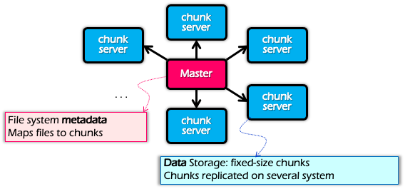
Optimization for Locality
Problem: the bandwidth of datacenter network (at that time) is scarce
If a Map worker reads all the data from the network, it would be slow
Google: Input and Output files are stored on GFS
Google File System (SOSP’03), see previous lectures
Each chunk is replicated on multiple servers (3)
A review of GFS architecture

Slide 46
Optimization for Locality
Problem: the bandwidth of datacenter network (at that time) is scarce
If Map worker reads all the data from the network, it would be slow
Google: Input and Output files are stored on GFS
Google File System (SOSP’03), see previous lectures
Each chunk is replicated on multiple servers (3)
MapReduce runs on GFS chunkservers
Collocate computation and storage
Master tries to schedule map workers on one of the nodes that has a copy of the input chunk it needs

Slide 47
Refinement: redundant execution
Some workers can be slower than others, aka, stragglers
Other jobs consuming resources on machine
Bad disks with soft errors transfer data slowly
Weird things: processor caches disabled ☹
Near end of phase, MapReduce spawn backup copies of tasks
Whichever one finishes first “wins” ☺
Dramatically shortens job completion time:“significantly reduces the time to complete large MapReduce operations ”(check the paper)

Slide 48
Summary of MapReduce
Get a lot of data from input files
Map
Parse & extract items of interest
Partition & Sort
Reduce
Aggregate results
Write results to output files
All the other issues, scheduling, fault-tolerance, data partitioning, are handled by the framework

Slide 49
Summary of MapReduce
The user does not need to care concurrency, fault-tolerant, data transfer, etc.
Effects: Reduce the user code burden and quality:
Sort: only needs 50 LoC
Indexing: reduce the code lines from 3800 LoC to 700LoC

Slide 50
Summary of MapReduce
MapReduce
Single device computing
Pros:
Easy to scale
Fault tolerant
Good performance (depends!)
Good for tasks that suits MapReduce, e.g., wordcount
Cons
Limited programming abstraction
Scalability
Ease of
programming
Performance
Consistency
Fault tolerance

