Slide 1


Privacy & Review
SE3331-1 (2024 Fall)
IPADS, Shanghai Jiao Tong University
https://www.sjtu.edu.cn
Notes:
Credits to Mike Freedman (COS 461) and others.

Slide 2
Secure Channel

Slide 3
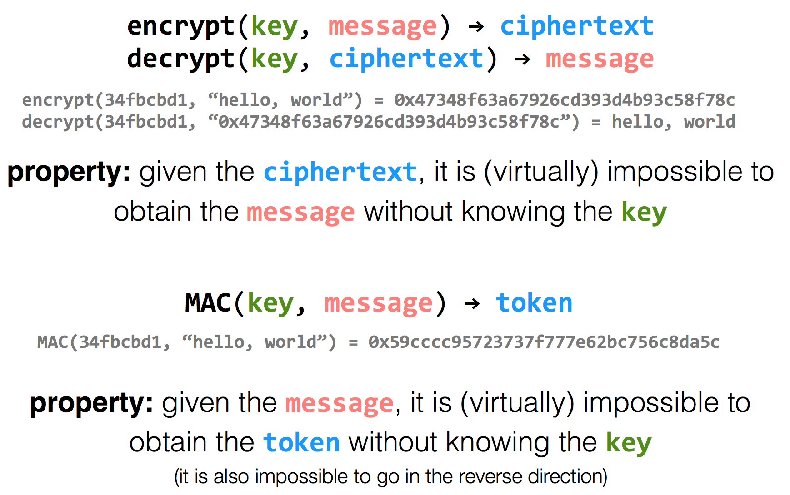
Encryption Properties

Slide 4
has k
has k
k=key
m=message
Alice
Bob
c = encrypt(k, m)
h = MAC(k, m)
c | h
m = decrypt(k, c)
MAC(k, m) == h ?

Slide 5
has k
has k
Alice
Eve
Bob
c = encrypt(k, m)
h = MAC(k, m)
c | h
m = decrypt(k, c)
MAC(k, m) == h ?
c | h
Problem: replay attacks (adversary could intercept a message, re-send it at a later time)
c | h

Slide 6
has k
has k
Alice
Bob
c = encrypt(k, m | seq)
h = MAC(k, m | seq)
c | h
m | seq = decrypt(k, c)
MAC(k, m | seq) == h ?

Slide 7
has k
has k
Alice
Eve
Bob
c = encrypt(k, m | seq)
h = MAC(k, m | seq)
c | h
m | seq = decrypt(k, c)
MAC(k, m | seq) == h ?
c | h
if reuse seq (e.g., date)
problem: reflection attacks (adversary could intercept a message, re-send it later in the opposite direction)
Notes:
But if receiver is also sending to the sender (i.e., if they're both sending), the receiver might use that sequence number. So adversary could replay in the other direction (a "reflection" attack) - Solution: Use different keys in each direction

Slide 8
has k_{a} & k_{b}
has k_{a} & k_{b}
Alice
Bob
c_{a} = encrypt(k_{a}, m_{a} | seq_{a})
h_{a} = MAC(k_{a}, m_{a} | seq_{a})
c_{a} | h_{a}
m_{a} | seq_{a} = decrypt(k_{a}, c_{a})
MAC(k_{a}, m_{a} | seq_{a}) == h_{a} ?
c_{b} = encrypt(k_{b}, m_{b} | seq_{b})
h_{b} = MAC(k_{b}, m_{b} | seq_{b})
c_{b} | h_{b}
m_{b} | seq_{b} = decrypt(k_{b}, c_{b})
MAC(k_{b}, m_{b} | seq_{b}) == h_{b} ?

Slide 9
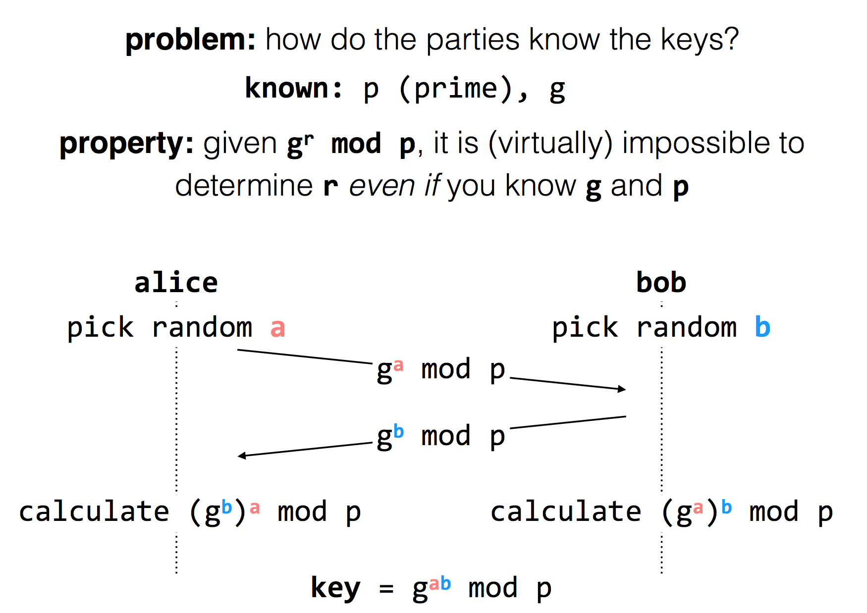
Diffie-Hellman
Key Exchange
(g^{b} mod p)ª mod p = g^{ab} mod p = (gª mod p)^{b} mod p
Notes:
g^i mod p ≠ g^j mod p （p为素数），其中i≠j且i, j介于1至(p-1)之间，则g为p的原根

Slide 10
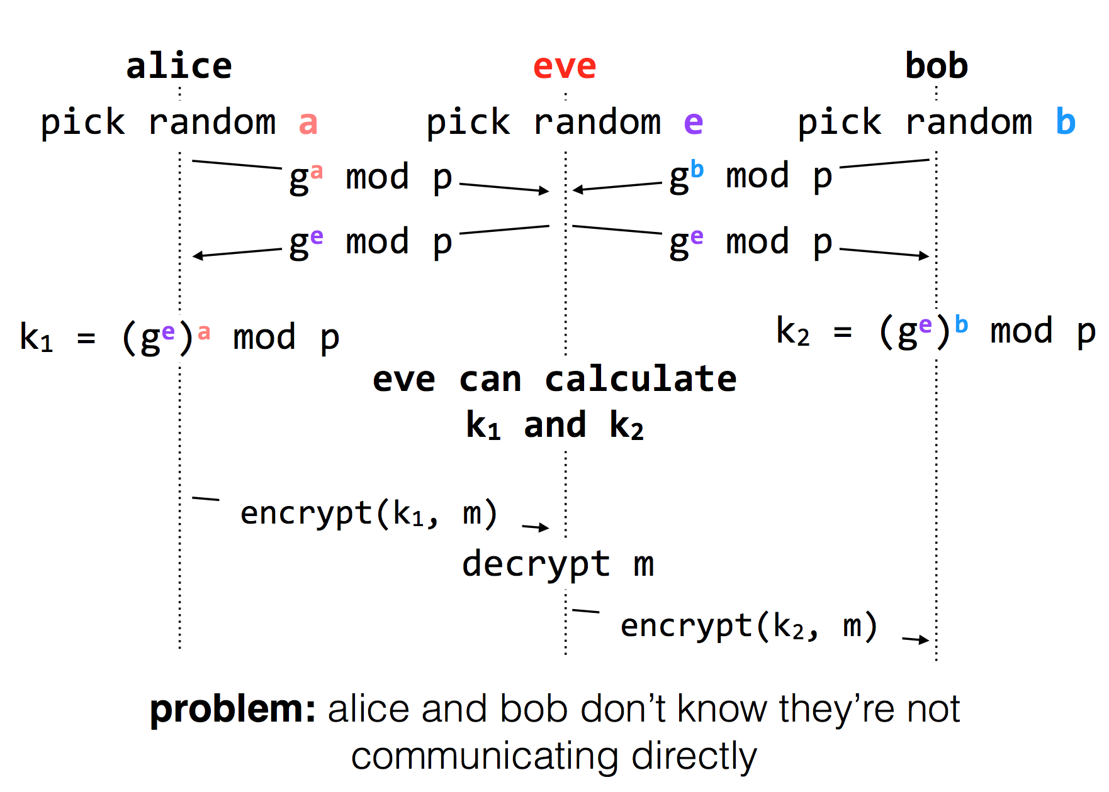
Diffie-Hellman Key Exchange & Man-in-the-Middle

Slide 11
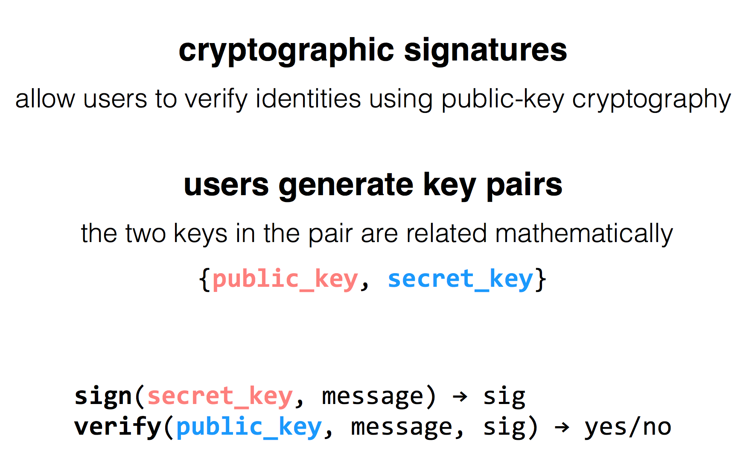
RSA Algorithm

Slide 12
Public Key Distribution
1. Alice remembers the key she used last time
Easy to implement
Effective against subsequent man-in-the-middle attacks
Doesn't protect against MITM attacks the first time around
Doesn't allow parties to change keys
2. Consult some authority that knows everyone's public key
Does not scale (client asks for a PK for every new name)
Alice needs server's public key beforehand

Slide 13
Public Key Distribution
3. Authority, but pre-compute responses
Authority creates signed messages: {Bob, PK_bob}_{SK_as}
Anyone can verify the authority signed this message, given PK_as
When Alice wants to talk to Bob, she needs a signed message from the authority, but it doesn't matter where this message comes from as long as the signature checks out
I.e., Alice could retrieve the message from a different server
This signed message is a certificate
More scalable

Slide 14
Review: Two Types of Encryption
Symmetric encryption
Single key (symmetric) is shared between parties, kept secret from everyone else
Ciphertext = (M)^K
Asymmetric encryption
Keys come in pairs, public and private
Secret: (M)^K-public
Authentic: (M)^K-private

Slide 15
Questions on Certificate Authorities
Who should run the certificate authority?
How does the browser get this list of CAs?
Generally they come with the browser
How does the CA build its table of names <-> public keys?
Have to agree on how to name principals, and
Need a mechanism to check that a key corresponds to a name
What if a CA makes a mistake?
Need a way to revoke certificates: Expiration date? Not useful for immediate problems
Publish certificate revocation list? Works in theory, not as well in practice
Query online server to check certificate freshness? Not a bad idea
Notes:
Alternative: avoid CAs by using public keys as names (protocols: SPKI/SDSI)
Works well for names that users do not have to remember/enter

Slide 16
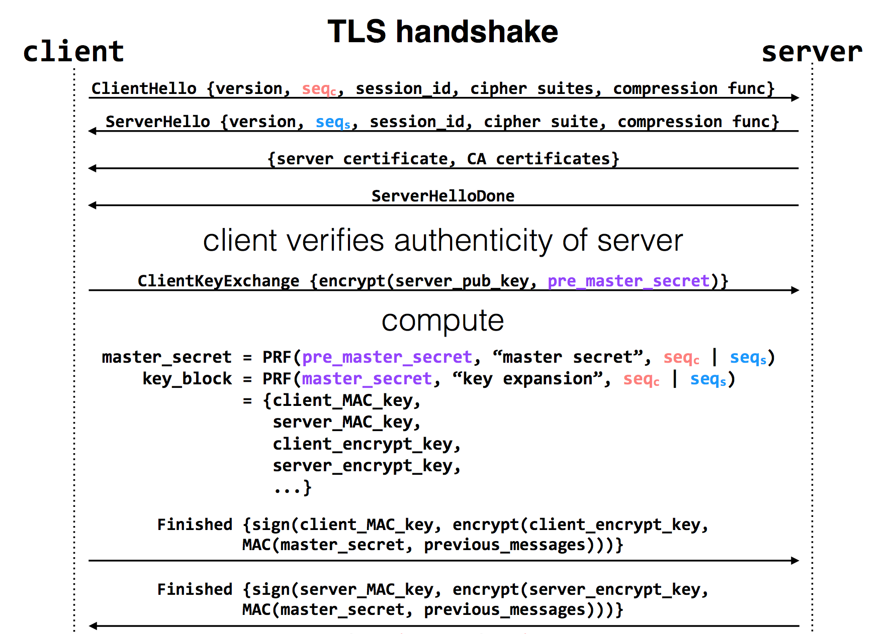
Notes:
pre-master-key is a random number
PRF: pseudo random function
Master key is a 48-byte sequence
https://crypto.stackexchange.com/questions/1139/what-is-the-purpose-of-four-different-secrets-shared-by-client-and-server-in-ssl

Slide 17
Privacy

Slide 18
Data Privacy
Data can be used everywhere
Risk management
Medicine
Recommended system
…
Data can be stolen easily
Everyone who uses your data can steal it

Slide 19
Data Privacy
What’s the target of data privacy system?
Allow data to be used, and protect it from being stolen
Today's contents
Basic data privacy method
ZKP, OT, HE, sMPC, TEE, DP
Systems which try to enforce data privacy

Slide 20
Common Attacks
An adversary may learn about data:
From ciphertext (ciphertext representation-based attack, e.g., order of values)
From prior knowledge of data distribution (frequency-count attack)
From knowledge of frequency of queries (workload-skew attack)
From the size of the output to a query (output-size attack)
From the access pattern used by the mechanism in answering a query (access-pattern attack)
From knowledge of queries that have executed (search-pattern attack)
Mix with adversarial background knowledge
Data Privacy compromised!!

Slide 21
OT
Oblivious Transfer

Slide 22


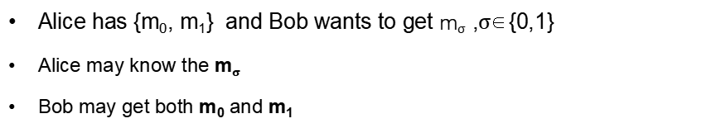
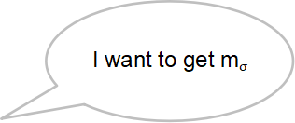
Problem
I have {m₀, m₁}
I want to get m$σ$
Alice
Bob
Alice has {m₀, m₁} and Bob wants to get m$σ$ ,$σ$∈{0,1}
Alice may know the m$σ$
Bob may get both m₀ and m₁

Slide 23
Oblivious Transfer (OT)
Introduced by Michael O. Rabin, 1981
Scenario: message transfer
A sender has a message list {m₀, m₁, … , m_{n}}
A receiver wants to get k target messages from sender
Properties: oblivious and secure
Oblivious: sender cannot know which messages are received
Secure: receiver can only get the target messages

Slide 24

1-out-of-2 OT
Scenario: RSA encryption
{m₀, m₁}
m$σ$ = ?
Alice
Bob
Generate 2 key pairs {K0_{pub}, K0_{prv}}, {K1_{pub}, K1_{prv}}
K0_{pub}, K1_{pub}
Generate a random number r
c ← Enc(Kσ_{pub}, r)
c
k₀ ← Dec(K0_{prv}, c)
k₁ ← Dec(K1_{prv}, c)
e₀ ← k₀ ⊕ m₀
e₁ ← k₁ ⊕ m₁
e₀, e₁
m_{σ} ← e_{σ} ⊕ r

Slide 25


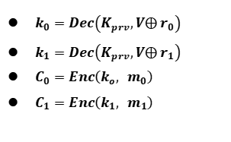

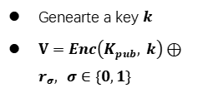

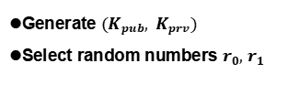
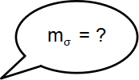
1-out-of-2 OT (Solution-2)
m$σ$ = ?
{m₀, m₁}
Alice
Bob
Generate ${(K}_{pub}, K_{prv})$
Select random numbers $r_{0},$ $r_{1}$
$$K_{pub}, r_{0},r_{1}$$
Genearte a key $k$
$V=Enc\left(K_{pub}, k\right)⊕r_{σ}, σ∈\{0,1\}$
$$V$$
$k_{0}=Dec\left(K_{prv},V⨁{ r}_{0}\right)$
$k_{1}=Dec\left(K_{prv},V⨁{ r}_{1}\right)$
$C_{0}=Enc\left(k_{o}, { m}_{0}\right)$
$C_{1}=Enc\left(k_{1}, { m}_{1}\right)$
$$C_{o},C_{1}$$
$m_{σ} =Dec\left(k, C_{σ}\right)$
Notes:
Alice分别用两个解密结果加密她的两份消息，将加密结果送给Bob （Ci=E(ki, mi) i=0,1）
Bob用k解密两份密文，得到需要的秘密 s

Slide 26
More OT Protocols
Different numbers of selected messages
1-out-of-2 OT
1-out-of-n OT
k-out-of-n OT
Implementation method
Non-adaptive OT
Adaptive OT
Publicly Verifiable OT
…

Slide 27
DP
Differential privacy

Slide 28


Problem
Name | Salary
Alice | 100
Bob | 80
Brown | 200
Tom | 120
SUM(Salary)
500
Alice can perform queries on Bob’s database, but cannot access a single database entry

Slide 29
Problem
Name | Salary
Alice | 100
Bob | 80
Brown | 200
Tom | 120
SUM(Salary) where Name == “Tom”
Reject
Alice can perform queries on Bob’s database, but cannot access a single database entry
Naïve method: reject Alice to access single entry

Slide 30
Problem
Tom has 120
Name | Salary
Alice | 100
Bob | 80
Brown | 200
Tom | 120
SUM(Salary)
500
SUM(Salary) where Name != “Tom”
380
Alice can perform queries on Bob’s database, but cannot access a single database entry
Naïve method: reject Alice to access single entry

Slide 31
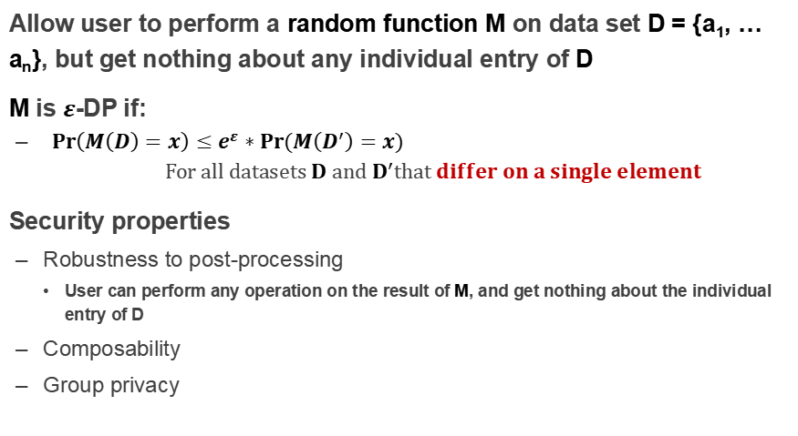
Differential privacy
Allow user to perform a random function M on data set D = {a₁, … a_{n}}, but get nothing about any individual entry of D
M is $ε$-DP if:
${Pr\left(M\left(D\right)=x\right)}≤e^{ε}∗Pr⁡(M\left(D^{′}\right)=x)$ $$For all datasets D and D^{′}that differ on a single element$$
Security properties
Robustness to post-processing
User can perform any operation on the result of M, and get nothing about the individual entry of D
Composability
Group privacy

Slide 32
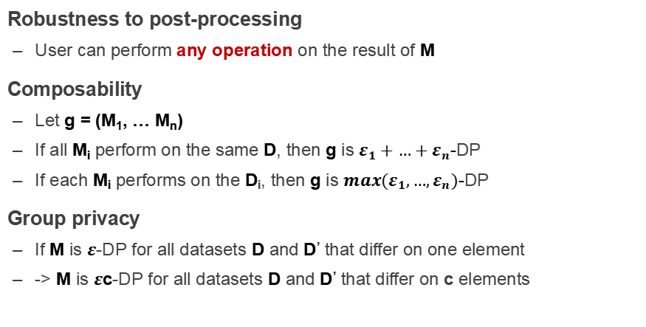
Properties of Differential privacy
Robustness to post-processing
User can perform any operation on the result of M
Composability
Let g = (M₁, … M_{n})
If all M_{i} perform on the same D, then g is $ε_{1}+…+ε_{n}$-DP
If each M_{i} performs on the D_{i}, then g is ${max(ε}_{1},…,ε_{n})$-DP
Group privacy
If M is $ε$-DP for all datasets D and D’ that differ on one element
-> M is $ε$c-DP for all datasets D and D’ that differ on c elements

Slide 33
How to Implement a DP Algorithm
Adding noisy to the function that we want to compute
Translate the function f to a random algorithm M
Existing Mechanism
Laplace mechanism
Gaussian mechanism
…

Slide 34
When DP is Enabled
…
Name | Salary
Alice | 100
Bob | 80
Brown | 200
Tom | 120
SUM(Salary)
~480
SUM(Salary) where Name != “Tom”
~480

Slide 35
Secret Sharing

Slide 36
Secret Sharing
Introduced by Adi Shamir, 1979
Key Insight: One point constructs infinite number of lines, two points construct only one line
Key Idea: Split a secret data into n shares, at least k shares can reconstruct the secret ((k,n)-SS)

Slide 37

Secret Sharing
Each part cannot learn the secret S
Secret-Share Creation:
(under the assumption that no part will collude)
share 1
part 1
share 2
secret data S
part 2
share 3
secret owner
share n
part 3
Mathematical operations
f(x) = S + a₁x + a₂x + ... + a_{k-1}x^{k-1}
…
part n

Slide 38
Secret Sharing
Each part cannot learn the secret S
Secret Reconstruction:
(under the assumption that no part will collude)
share 1
part 1
share 2
secret data S
part 2
share k
secret owner
part 3
Lagrange Interpolation
…
part n

Slide 39
Secret Sharing
Each part cannot learn the secret S
Secret Reconstruction:
(under the assumption that no part will collude)
share 1
part 1
secret data S
part 2
share 3
share k
secret owner
part 3
Lagrange Interpolation
…
part n

Slide 40
Pros and Cons
An information-theoretically secure protocol (unconditionally secure, independent of adversary's computational capabilities → quantum-safe)
Ideal assumption (At least k parts never collude)
Communication overhead

Slide 41
Secure MPC
Multi-Party Computing

Slide 42
secure Multi-Party Computation (sMPC)
We want to calculate
f(data₁, data₂)
I have data₁
I have data₂
Alice
Bob
Multiple parties (at least 2) work together to calculate a function
Enforce the data privacy for each party

Slide 43
Millionaire Problem
Money: Bob has i, Alice has j, i and j are between 1 to 10
Alice
Bob
Chose a random big integer x
K = enc{Key_{pub} of Bob, x}
Decrypt with Key_{prv} of Bob ten number: c+1, c+2...c+10, get y1, y2... y10
Chose a prime number p
Calculate d1 = y1 mod p, d2 = y2 mod p, ...
For n=i to 10, d_{n}++, other no change
c=K-j
d₁ to d₁₀
Check dj, if dj == x mod p, then i > j; else i <= j

Slide 44
secure Multi-Party Computation (sMPC)
Semi-honest adversary
Each party must follow the protocol
Generic protocol
Can securely compute any functionality
Multi-party computation
Secret sharing
2-party computation
GC(Garbled Circuits) + OT(Oblivious Transfer)

Slide 45
HE
Homomorphic Encryption

Slide 46

Problem
I have Data!
I have computing resource!
Data
Alice
Bob (cloud)
Alice wants to ask Bob (e.g., a cloud) to perform calculation on her data
Naïve method: Sending Data to Bob
Bob will get the data

Slide 47
Homomorphic Encryption (HE)
I have Data!
I have computing resource!
Alice
Bob (cloud)
CT=encrypt(Key, Data)
Function f()
CT'= Evaluate(f, CT) = Encrypt(Key, f(Data))
Get f(Data) = Decrypt(Key, CT')

Slide 48
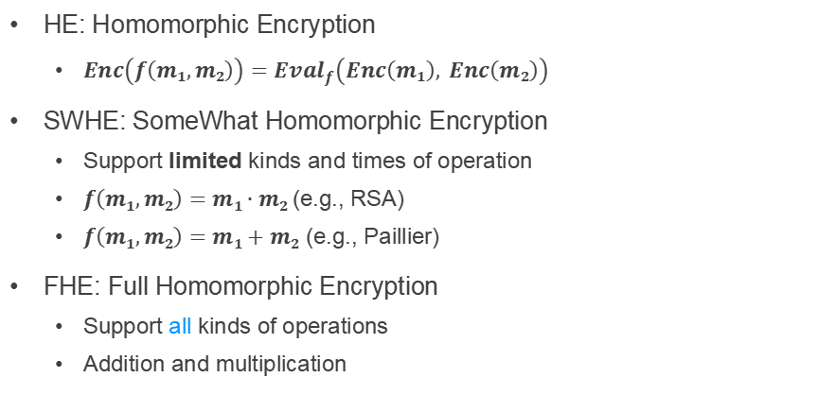
SWHE and FHE
HE: Homomorphic Encryption
$Enc\left(f\left(m1,m2\right)\right)={Eval}_{f}\left(Enc\left(m1\right), Enc\left(m2\right)\right)$
SWHE: SomeWhat Homomorphic Encryption
Support limited kinds and times of operation
$f\left(m1,m2\right)=m1∙m2$ (e.g., RSA)
$f\left(m1,m2\right)=m1+m2$ (e.g., Paillier)
FHE: Full Homomorphic Encryption
Support all kinds of operations
Addition and multiplication

Slide 49
TEE
Trusted Execution Environment

Slide 50
Problem
I have Data!
I have computing resource!
Data
Alice
Bob (cloud)
Alice wants to ask Bob (e.g., a cloud) to perform calculation on her data
Naïve method: Sending Data to Bob

Slide 51
Trusted Execution Environment (TEE)
I have Data!
I have computing resource and enclave!
Data
Alice
Bob (cloud)
Alice wants to ask Bob (e.g., a cloud) to perform calculation on her data
Naïve method: Sending Data to Bob
Bob cloud construct an enclave

Slide 52
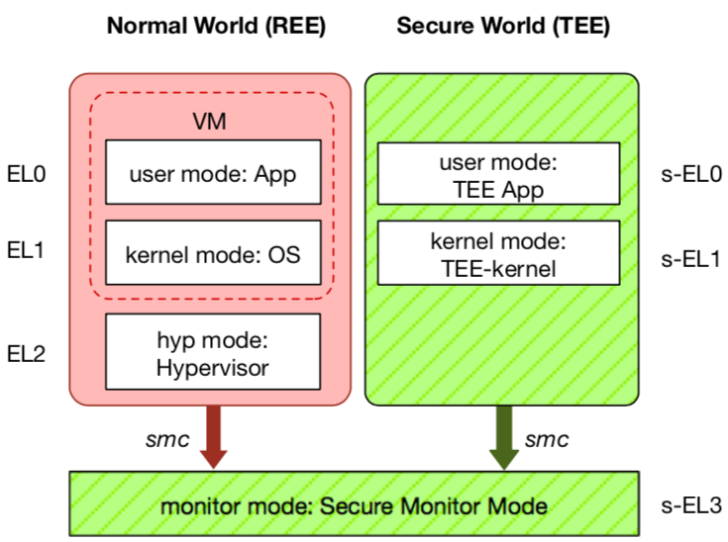
TEE: Trusted Execution Environment
Widely deployed on mobile devices
Every Android device must deploy TEE
Mostly based on ARM TrustZone
An isolated & privileged environment
TEE can access all DRAM & peripherals
REE cannot access TEE's resources
Designed to be secured and small
For security-critical tasks (e.g., fingerprint checker, mobile payment, etc.)
Notes:
Before presenting virtualization of TEE, let me introduce TEE a little bit.
TEE is short for xxx. It has been widely deployed on mobile devices. Thanks to Google, now every Android phone needs to have TEE to pass Google's test.
On mobile phone, most TEE are based on ARM TrustZone.
TrustZone divides one system to two worlds: xxx and xxx.
The normal world, aka REE, runs rich OS like Android or iOS. It has three layers: one for hypervisor, one for kernel and one for application.
The secure world, aka TEE, has three layers: one for TEE OS and one for TEE applications.
There is a special layer, called monitor mode or s-EL3, is used for switching between the two worlds. It is also part of the secure world but share the same privilege with s-EL1.
The switching is done through smc instruction.
The green part is TEE, which is an isolated environment with higher privileged than the REE.
It means that xxx
The TEE is designed to xxx, its typical usage is xxx.

Slide 53
Two Features of TEE
1. Isolated execution
Minimal TCB: system software is not trusted
E.g., OS and hypervisor
Some can prevent physical attacks
With memory encryption
2. Remote attestation
Prove itself to the end users
Usually use SSL to establish a secure channel over network

Slide 54
Different TEEs
Software TEE
VM-based TEE
Same privilege protection
ARM TrustZone
Intel SGX
AMD SME/SEV
SANCTUM
Notes:
However, the openness also leads to fragmentation.
Nowadays, there are many different kinds of TEE OS, from different venders.
Also, many other implementations based on OP-TEE.
This is not a good news for trusted app developers, since they need to port and trust.

Slide 55
Process of Bug Report

Slide 56
Process of fixing a bug/vulnerability
1 发现
2 汇报
Based on a real case (Credit: Fan Yang)
CVE-2020-10757
Linux commit 5c7fb56e5e3f
Phase-1: finding a bug
Survey whether the bug has been found
Simply the process of re-producing bug
Evaluate the seriousness, if belongs to security, offer an exploit
Provide a patch if you have one.
3 处理
4 公开
TCB: Yourself

Slide 57
Fix the Bug
1 发现
2 汇报
3 处理
4 公开
Phase-2: Report
Not security bug：kernel mailing list, bugzilla
Security bug：security@kernel.org
Require a CVE id (Common Vulnerability and Exposures List)
Not public yet
CVE status is RESERVED
public
Non-public
TCB: Mailing list + Yourself

Slide 58
Fix the Bug
1 发现
2 汇报
3 处理
4 公开
Phase-3: handle the bug
Related developers and maintainers join the discussion
TCB: Related developers + Mailing list + Yourself

Slide 59
Fix the Bug
1 发现
2 汇报
3 处理
4 公开
Phase-3: handle the bug
Patch proposing and discussion

Slide 60
Fix the Bug
1 发现
2 汇报
3 处理
4 公开
Phase-3: handle the bug
Test and patch review

Slide 61
Fix the Bug
1 发现
2 汇报
3 处理
4 公开
Phase-3.5：Embargo Period （可选）
discuss with maintainers of distributions, prepare to fix
Why not just fix it?
Submit a patch in public mailing list means public
Prevent distributions not fix the bugs in time
Decide whether embargo period is needed: evaluate
3.5 Embargo

Slide 62

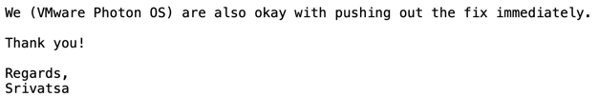
Fix the Bug
1 发现
2 汇报
3 处理
4 公开
Phase-3.5：Embargo Period
You can negociate Embargo Period
3.5 Embargo
TCB: Distributions + Related developers + Mailing list + Yourself

Slide 63

Fix the Bug
1 发现
2 汇报
3 处理
4 公开
3.5 Embargo
Phase-4: Public
Merge to mainstream
Backport to related stable versions
Publish to public mailing list, security group
E.g., oss-security@lists.openwall.com
Update CVE status to public
TCB: All!

