Slide 1

Summer Training Project Presentation
on
"SmartCredit: AI-Powered Loan Default Prediction & Risk Scoring System"
NAME - SHIVAM KESHARI
ROLL NO. - (2302840100210)
College : United Institute of Technology
Session : 2026-2027

Slide 2
Table of Content
Introduction
Objectives
Technology Used
Data Flow Diagram
Features & Dashboard
Future Work
Conclusion
References

Slide 3
Introduction
• SmartCredit is a machine-learning application designed to evaluate loan default risk and borrower creditworthiness.
• It analyzes financial, demographic, and behavioral factors including income, credit score, DTI ratio, and assets.
• It helps banks and NBFCs identify high-risk applicants early and minimize Non-Performing Assets (NPAs).
• The system provides real-time default probability, granular risk tiers (Low/Medium/High), and recommended safe loan limits.
Problem Statement
In banking and NBFCs, manual credit underwriting is slow, labor-intensive, and prone to human subjectivity. Unsound loan sanctions directly lead to increased loan defaults and non-performing assets (NPAs), jeopardizing institutional liquidity.
The proposed SmartCredit – AI-Powered Loan Default Prediction & Risk Scoring System leverages machine learning to automate underwriting, evaluate default probability accurately, and assign transparent risk categories. It empowers lenders to make rapid, objective, and risk-adjusted credit decisions.

Slide 4
Objectives
To predict loan approval and default risk using trained machine learning classification models.
To analyze critical financial determinants such as Debt-to-Income (DTI) ratio, CIBIL score, and savings.
To identify high-risk applicants early and protect lenders against financial default losses (NPAs).
To categorize applicants into actionable risk tiers (Low, Medium, High) with safe loan amount limits.
To provide a user-friendly, interactive Streamlit web dashboard for real-time credit underwriting.

Slide 5
Technology Used
Technology | Purpose
Python | Core programming language for ML pipeline and backend
Streamlit | Interactive multi-page web application & user interface
Pandas | Data ingestion, hygiene checking, and data preprocessing
NumPy | Vectorized numerical transformations and ratio computations
Scikit-Learn | Model training (Logistic, Tree, Random Forest) & metrics
Machine Learning | Credit risk classification & minimal cost-complexity pruning

Slide 6
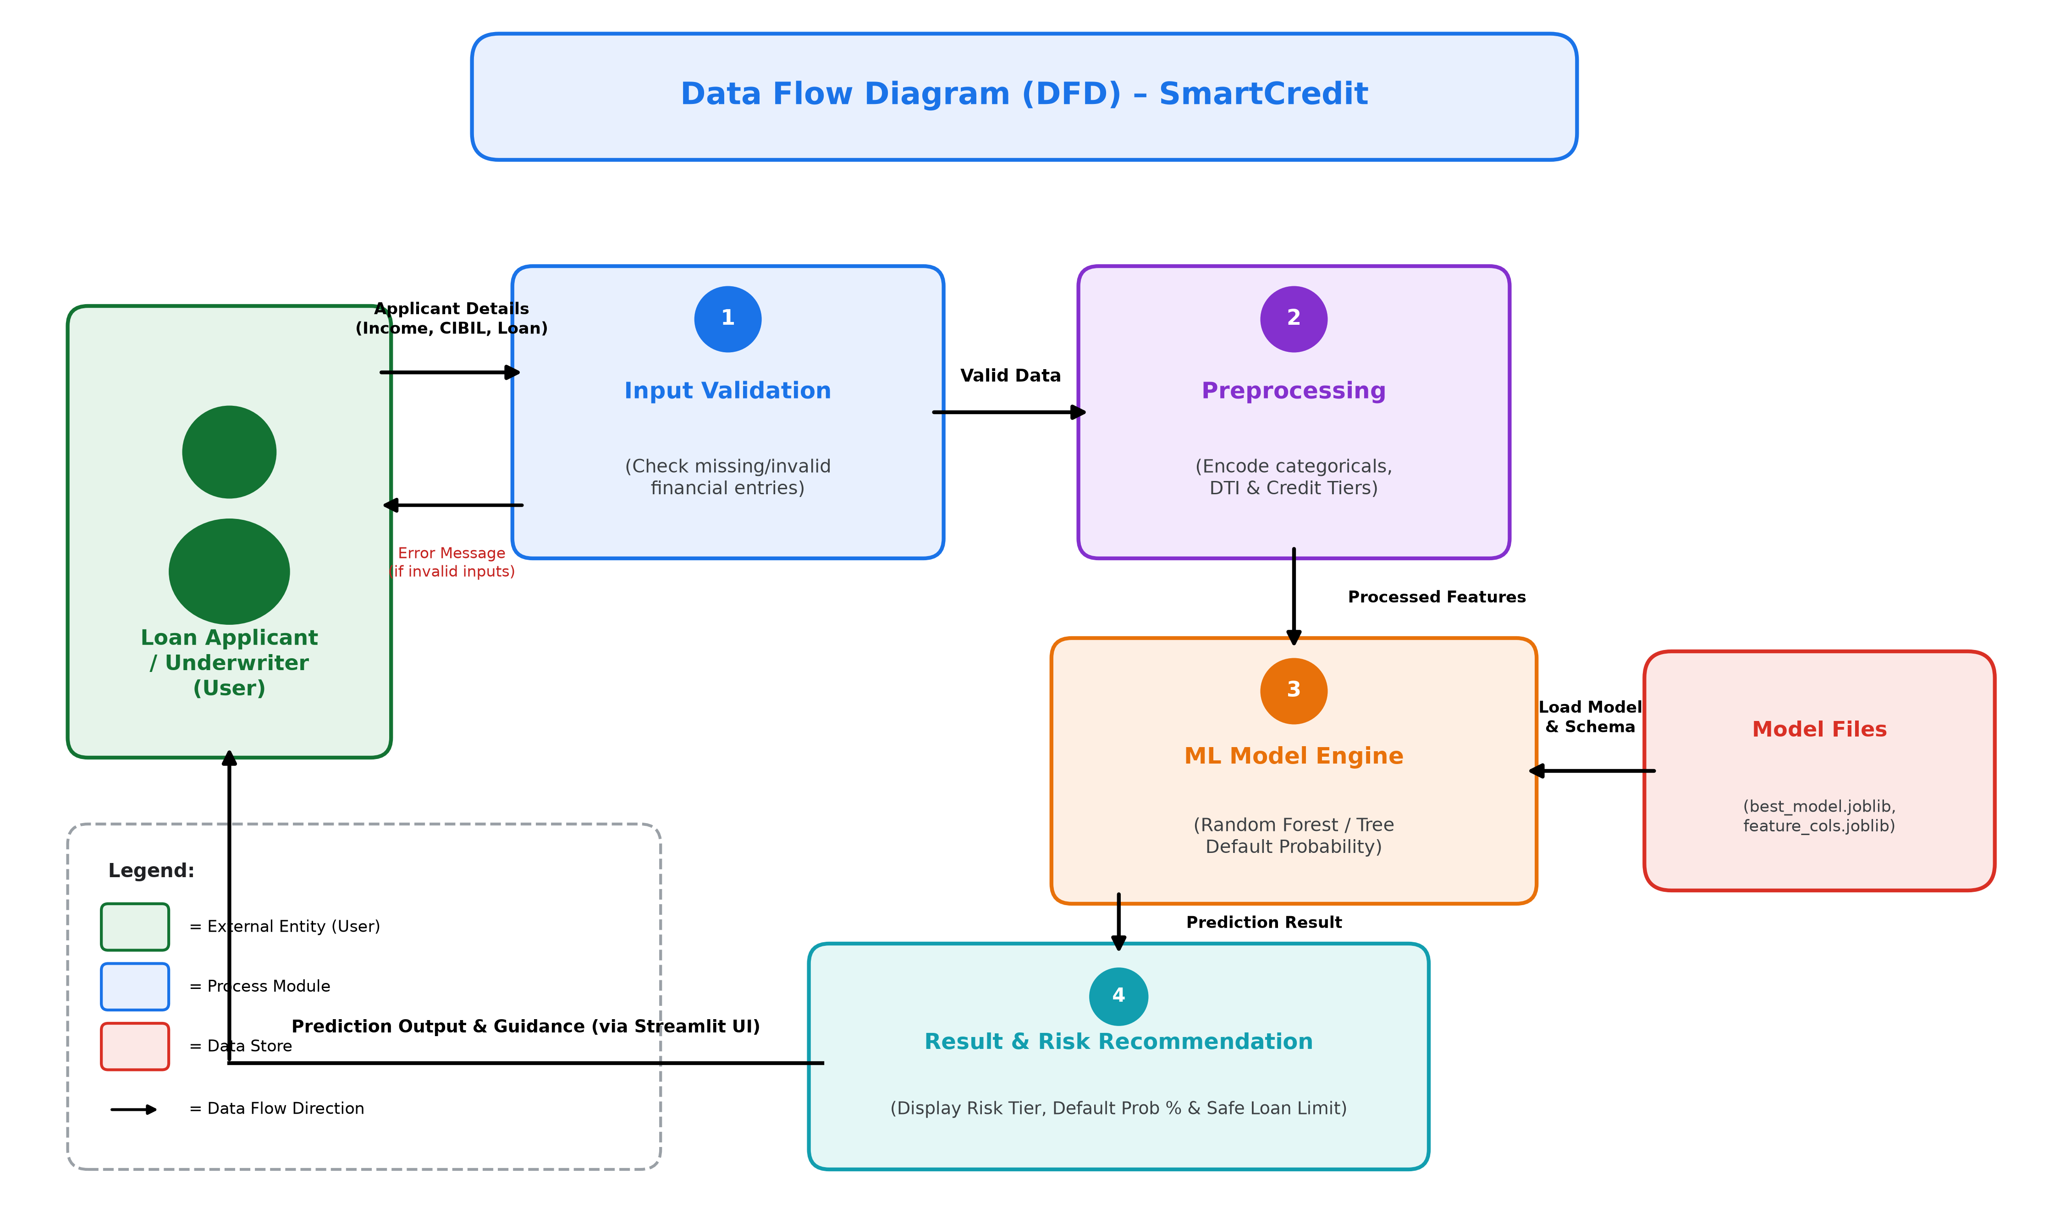
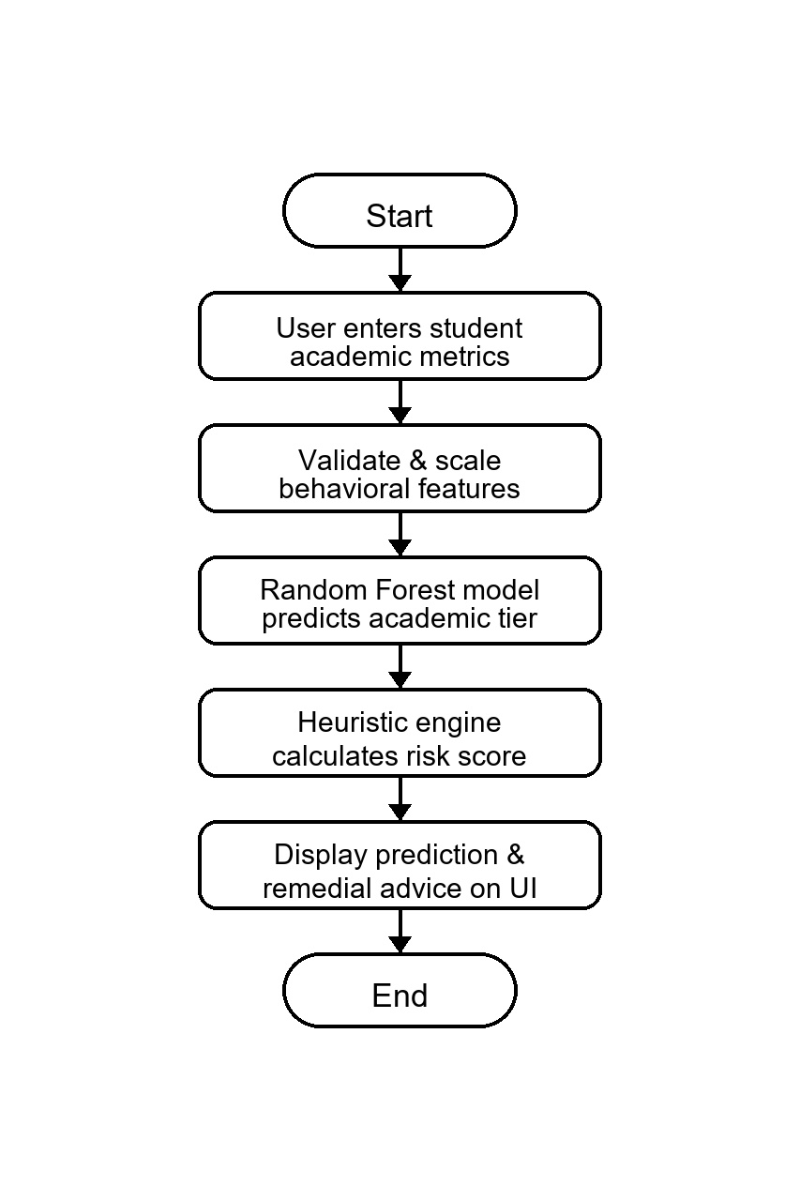
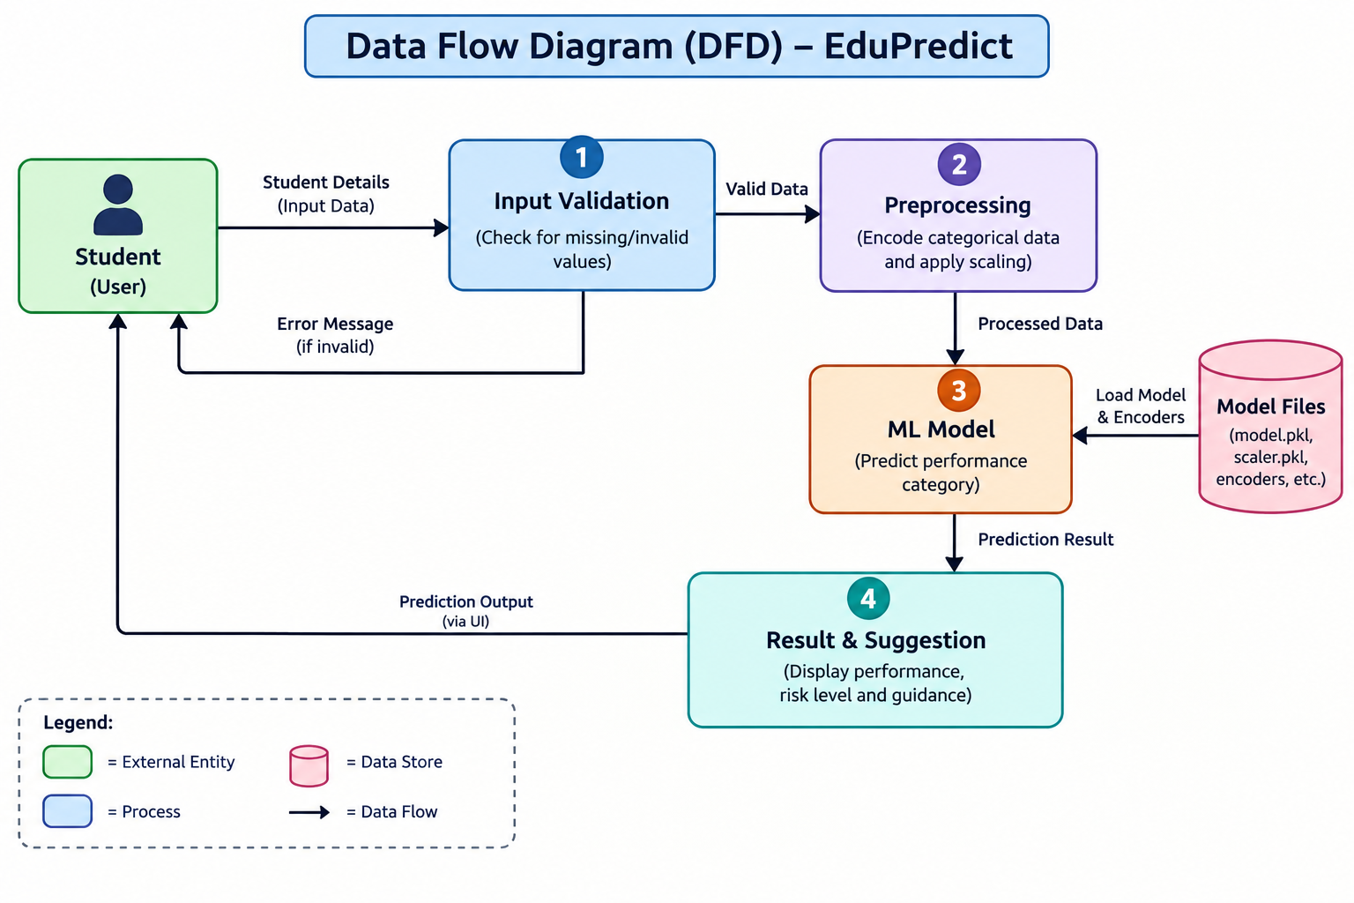
Data Flow Diagram

Slide 7
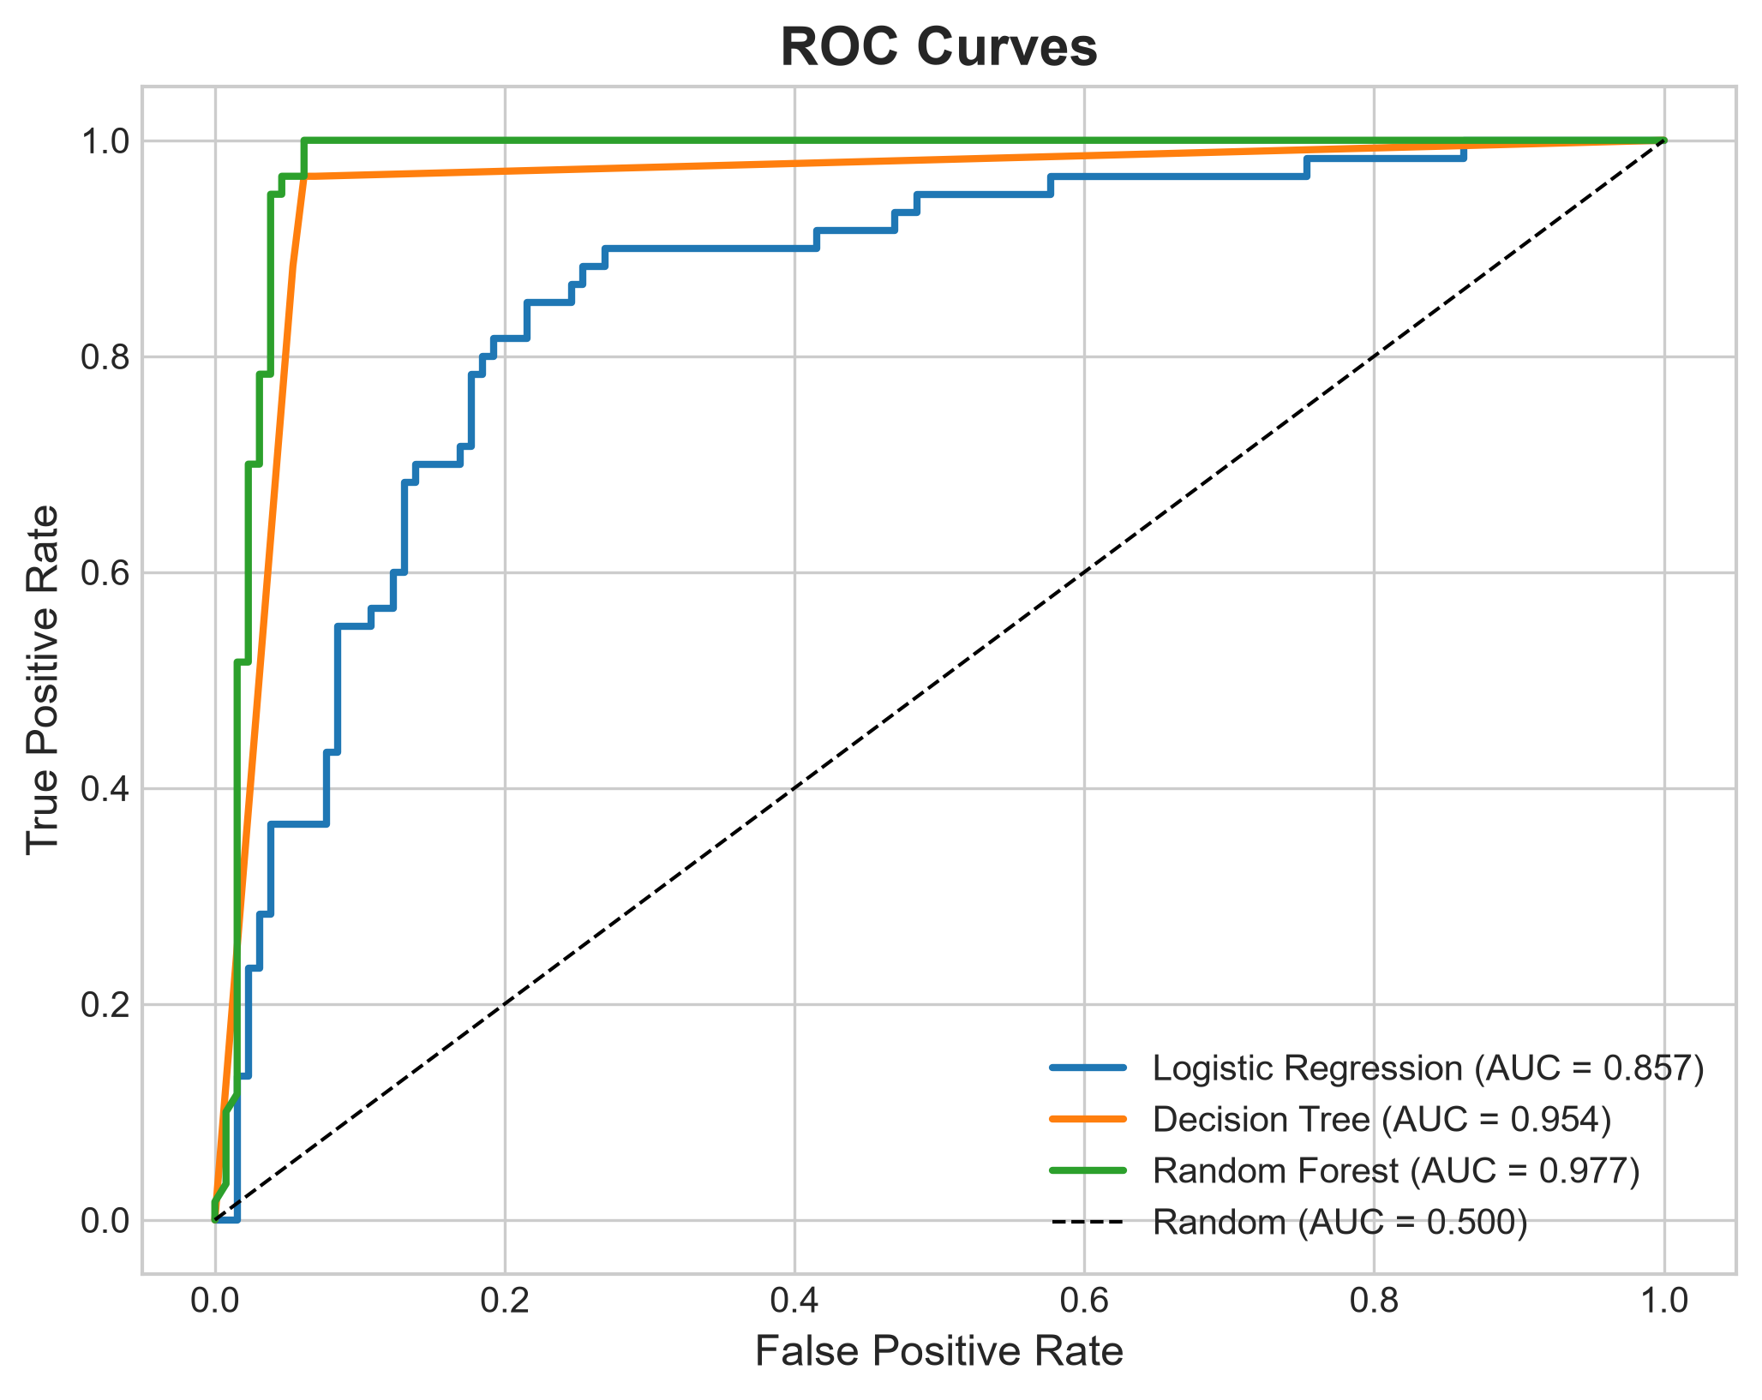
Features & Dashboard
Real-Time Credit Prediction: Instant evaluation of loan approval probability in under 1 second.
Granular Risk Tiers: Automated tagging into Low Risk (🟢), Medium Risk (🟡), and High Risk (🔴).
Safe Loan Recommendation: Algorithmic calculation of maximum safe sanction amount based on DTI.
Interactive EDA Portal: Multi-tab distribution curves, CIBIL boxplots, and correlation heatmaps.
Model Benchmark Suite: Side-by-side performance ledger, confusion matrices, and ROC curves.

Slide 8
Future Scope
Integrate alternative data sources such as utility payments, GST returns, and open banking APIs.
Incorporate Explainable AI (XAI) using SHAP and LIME for transparent credit denial justifications.
Implement automated PDF credit underwriting report generation with digital risk certificate.
Deploy the application onto cloud platforms (Streamlit Community Cloud / AWS ECS) for multi-branch access.
Enhance data security, encryption standards, and regulatory compliance (RBI / Fair Lending mandates).

Slide 9
Conclusion
SmartCredit demonstrates the practical application of Machine Learning in FinTech credit risk evaluation.
It successfully integrates financial, demographic, and leverage metrics into a unified predictive model.
The Random Forest model achieved a 95.8% accuracy and 100% recall, minimizing costly False Negatives.
The interactive Streamlit dashboard provides transparent risk tiers, probability metrics, and safe limits.
The system acts as a reliable decision-support intelligence tool, accelerating institutional underwriting.

Slide 10
References
Loan Approval Benchmark Dataset — Historical Retail Banking Credit Risk Records.
Scikit-Learn Documentation — Minimal Cost-Complexity Pruning & Random Forest (scikit-learn.org).
Streamlit Documentation — Multi-page Web Applications & Interactive Widgets (docs.streamlit.io).
Pandas & NumPy Documentation — Data Cleaning, Imputation & Vector Operations (pandas.pydata.org).
Leo Breiman, Jerome Friedman et al. — Classification and Regression Trees (CART Theory).
Reserve Bank of India (RBI) / Basel III Framework — Guidelines on Credit Risk & NPA Management.

Slide 11
Thank You

