Slide 1
Table of Content
1. Introduction & Problem Statement
2. Objectives & Goals
3. Technology Stack & Architecture
4. Data Flow Diagram (DFD Level-1)
5. Compilation Lifecycle & Flowchart
6. Key UI Features & Innovations
7. Engineering Challenges Solved
8. Future Scope & Conclusion

Slide 2
Introduction & Problem Statement
• CodeEditor Pro is a high-performance in-browser web playground for live HTML5, CSS3, and JavaScript authoring.
• It eliminates local build configurations and terminal servers, executing entire frontend pipelines in-memory.
• Provides instantaneous visual feedback with debounced compiling, sandboxed iframes, and an in-editor terminal.
• Features starter design templates, dynamic line-gutter sync, tab key indentation, and local persistence.
Problem Statement:
Traditional in-browser editors suffer from memory leaks caused by appending unbounded <style> and <script> tags to the preview document on every keystroke. CodeEditor Pro solves these vulnerabilities through debounced lifecycle management, secure iframe.srcdoc sandboxing, and postMessage terminal interception.

Slide 3
Project Objectives
1. To build a zero-dependency, ultra-fast client-side code editor running natively in modern web browsers.
2. To implement safe iframe.srcdoc sandboxing that prevents security cross-origin leaks while allowing script execution.
3. To engineer a 350ms debounced compilation lifecycle preventing CPU throttling and memory accumulation.
4. To integrate a real-time virtual developer console that intercepts console.log, warnings, and unhandled errors.
5. To optimize developer ergonomics with Tab indentation, line gutters, starter templates, and export capabilities.

Slide 4
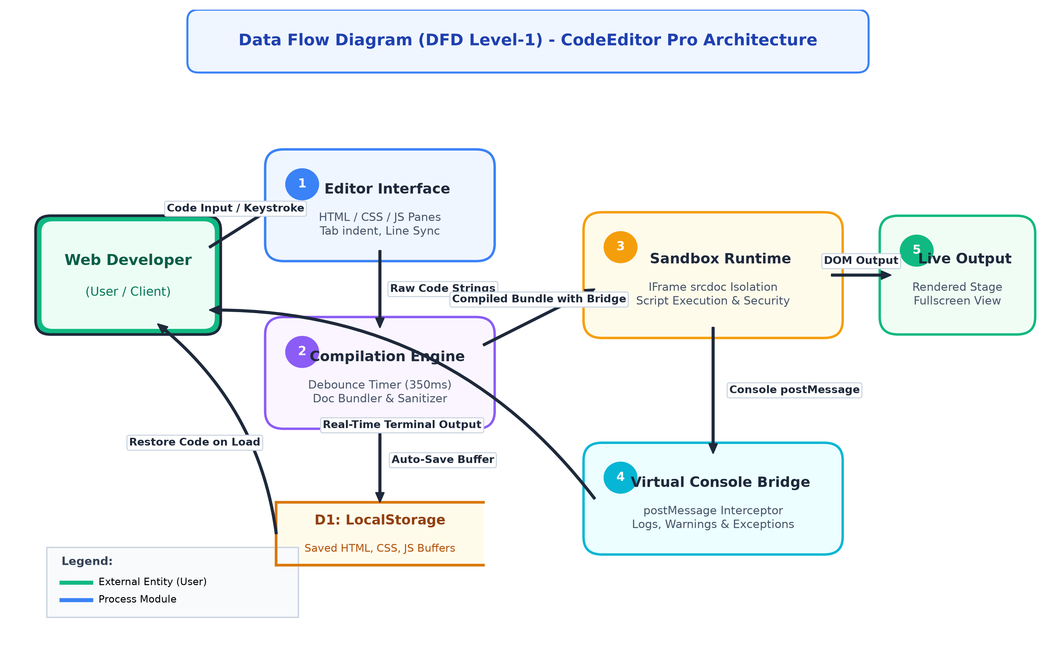
Data Flow Diagram (DFD Level-1)

Slide 5
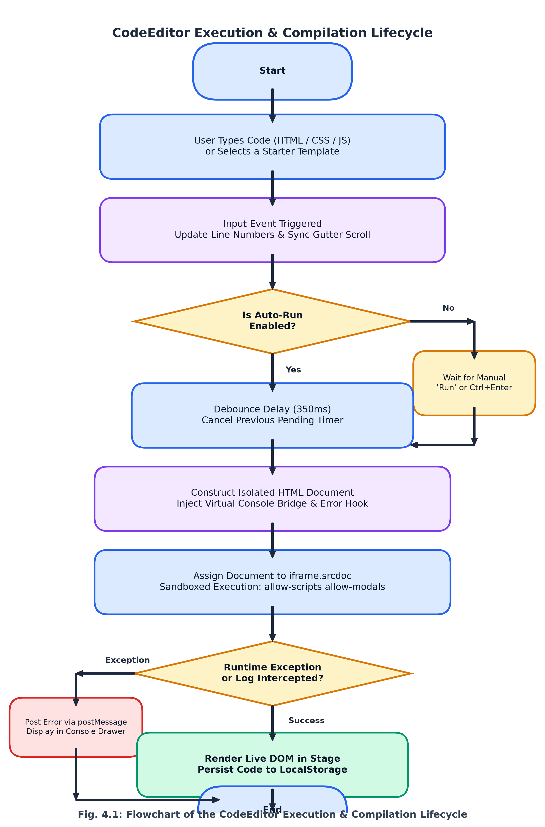
Compilation & Execution Lifecycle Flowchart

Slide 6
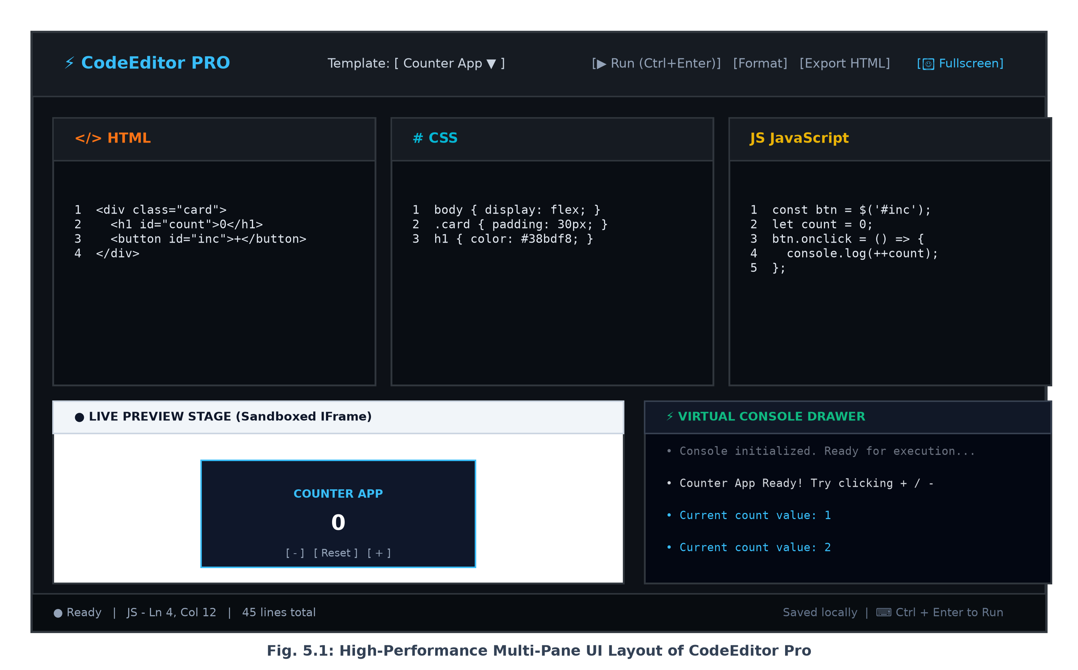
User Interface & Dashboard Architecture

Slide 7
Thank You
CodeEditor Pro — Questions & Discussion

