Slide 1
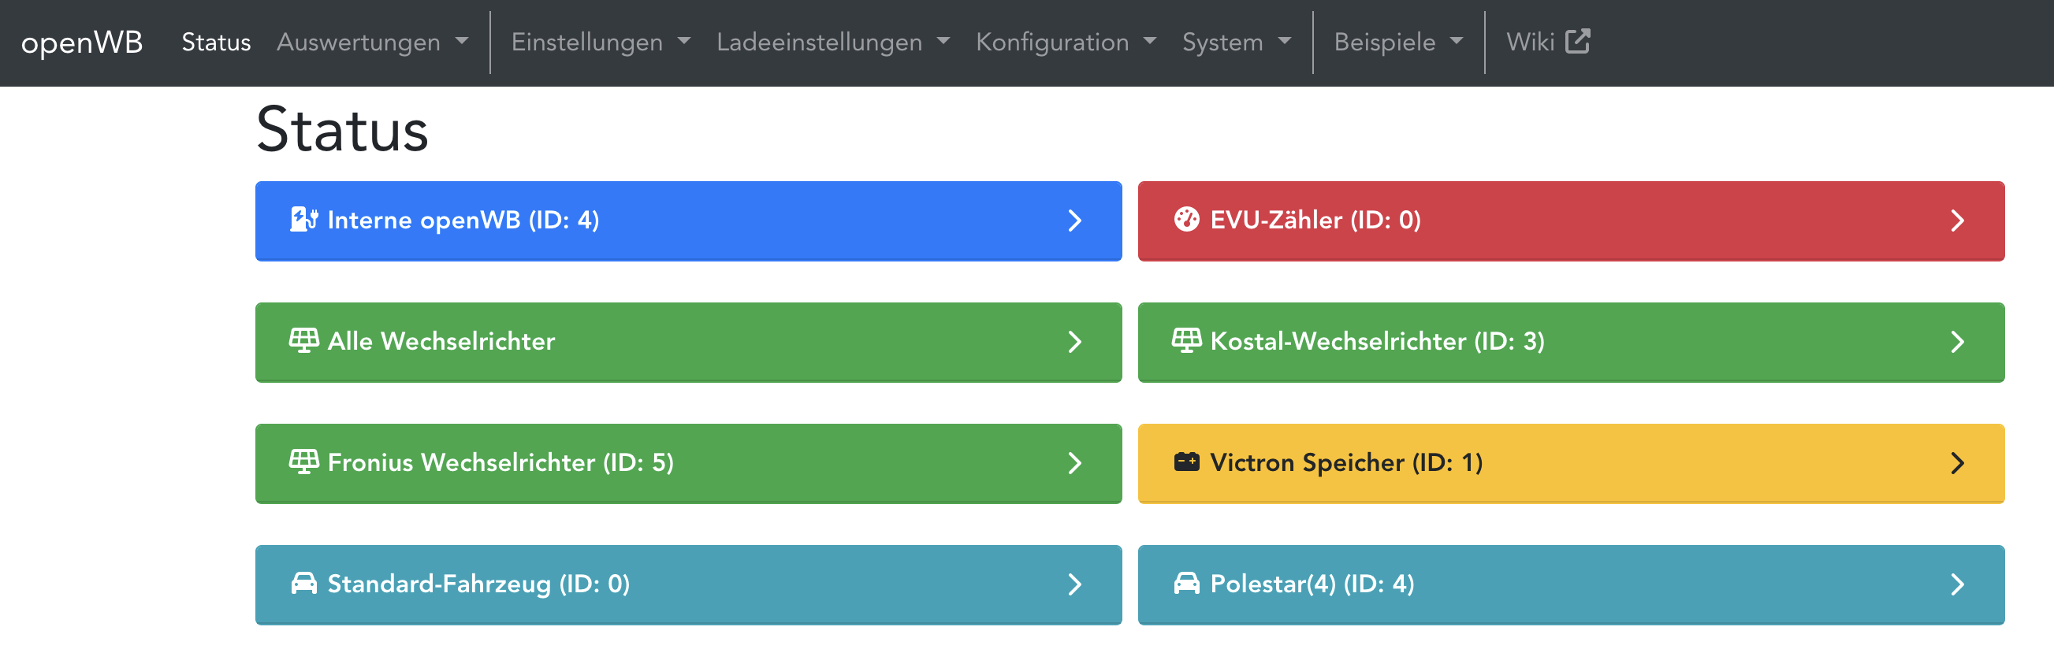
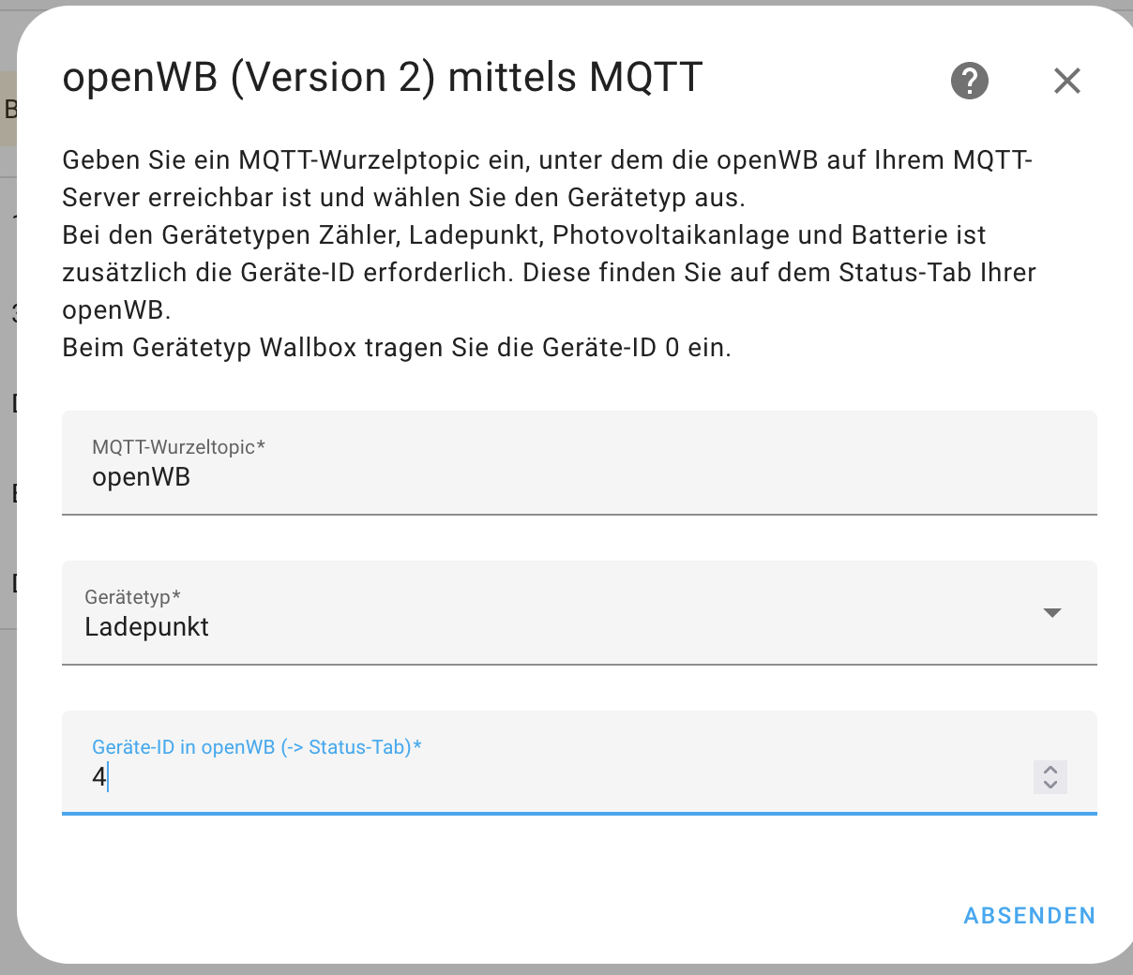
EN: MQTT root topic
EN: Chargepoint
EN: Device ID

