Slide 1
Architecture of Enterprise Applications 3
WebSocket
Haopeng Chen
REliable, INtelligent and Scalable Systems Group (REINS)
Shanghai Jiao Tong University
Shanghai, China
http://reins.se.sjtu.edu.cn/~chenhp
e-mail: chen-hp@sjtu.edu.cn

Slide 2
Contents and Objectives
Contents
  Introduction to WebSocket
  WebSocket Programming Model
  WebSocket Samples
Objectives
  能够根据系统需求，分析前后端之间适用于异步通信机制的业务场景，并设计并实现基于WebSocket的实现方案

Slide 3
WebSocket
WebSocket is an application protocol that provides full-duplex communications between two peers over the TCP protocol.
  In the traditional request-response model used in HTTP, the client requests resources and the server provides responses.
  The exchange is always initiated by the client; the server cannot send any data without the client requesting it first.
  The WebSocket protocol provides a full-duplex communication channel between the client and the server.
  Combined with other client technologies, such as JavaScript and HTML5, WebSocket enables web applications to deliver a richer user experience.

Slide 4
Introduction to WebSocket
In a WebSocket application, the server publishes a WebSocket endpoint and the client uses the endpoint's URI to connect to the server.
  The WebSocket protocol is symmetrical after the connection has been established:
    The client and the server can send messages to each other at any time while the connection is open, and they can close the connection at any time.
    Clients usually connect only to one server, and servers accept connections from multiple clients.
The WebSocket protocol has two parts:
  handshake and data transfer.

Slide 5
Introduction to WebSocket
The client initiates the handshake by sending a request to a WebSocket endpoint using its URI.
  The handshake is compatible with existing HTTP-based infrastructure:
    web servers interpret it as an HTTP connection upgrade request.
  An example handshake from a client looks like this:
  GET /path/to/websocket/endpoint HTTP/1.1
  Host: localhost
  Upgrade: websocket
  Connection: Upgrade
  Sec-WebSocket-Key: xqBt3ImNzJbYqRINxEFlkg==
  Origin: http://localhost
  Sec-WebSocket-Version: 13

Slide 6
Introduction to WebSocket
The client initiates the handshake by sending a request to a WebSocket endpoint using its URI.
  The handshake is compatible with existing HTTP-based infrastructure:
    web servers interpret it as an HTTP connection upgrade request.
  An example handshake from the server in response to the client looks like this:
  HTTP/1.1 101 Switching Protocols
  Upgrade: websocket
  Connection: Upgrade
  Sec-WebSocket-Accept: K7DJLdLooIwIG/MOpvWFB3y3FE8=

Slide 7
Introduction to WebSocket
The server applies a known operation to
  the value of the Sec-WebSocket-Key header to generate the value of the Sec-WebSocket-Accept header.
The client applies the same operation to
  the value of the Sec-WebSocket-Key header, and the connection is established successfully if the result matches the value received from the server.
The client and the server can send messages to each other after a successful handshake.

Slide 8
Introduction to WebSocket
WebSocket endpoints are represented by URIs that have the following form:
  ws://host:port/path?query
  wss://host:port/path?query
  The ws scheme represents an unencrypted WebSocket connection, and
  the wss scheme represents an encrypted connection.
  The port component is optional;
    the default port number is 80 for unencrypted connections and
    443 for encrypted connections.
  The path component indicates the location of an endpoint within a server.
  The query component is optional.

Slide 9
Creating WebSocket Applications
The Java API for WebSocket consists of the following packages:
  The javax.websocket.server package contains annotations, classes, and interfaces to create and configure server endpoints.
  The javax.websocket package contains annotations, classes, interfaces, and exceptions that are common to client and server endpoints.
WebSocket endpoints are instances of the javax.websocket.Endpoint class.
  The Java API for WebSocket enables you to create two kinds of endpoints: programmatic endpoints and annotated endpoints.
    To create a programmatic endpoint, you extend the Endpoint class and override its lifecycle methods.
    To create an annotated endpoint, you decorate a Java class and some of its methods with the annotations provided by the packages above.
  After you have created an endpoint, you deploy it to an specific URI in the application so remote clients can connect to it.

Slide 10
Creating and Deploying a WebSocket Endpoint
The process for creating and deploying a WebSocket endpoint:
  Create an endpoint class.
  Implement the lifecycle methods of the endpoint.
  Add your business logic to the endpoint.
  Deploy the endpoint inside a web application.
The process is slightly different for programmatic endpoints and annotated endpoints

Slide 11
Programmatic Endpoints
EchoEndpoint
  public class EchoEndpoint extends Endpoint {
  @Override
  public void onOpen(final Session session, EndpointConfig config)
  {
  session.addMessageHandler(
  new MessageHandler.Whole<String>() {
  @Override
  public void onMessage(String msg) {
  try {
  session.getBasicRemote().sendText(msg);
  } catch (IOException e) { ... }
  }
  });
  }
  }

Slide 12
Programmatic Endpoints
To deploy this programmatic endpoint, use the following code in your Java EE application:
  ServerEndpointConfig.Builder.create(EchoEndpoint.class, "/echo").build();
When you deploy your application, the endpoint is available at ws://<host>:<port>/<application>/echo;
  for example, ws://localhost:8080/echoapp/echo.

Slide 13
Annotated Endpoints
EchoEndpoint
  @ServerEndpoint("/echo")
  public class EchoEndpoint {
  @OnMessage
  public void onMessage(Session session, String msg) {
  try {
  session.getBasicRemote().sendText(msg);
  } catch (IOException e) { ... }
  }
  }

Slide 14
Annotated Endpoints
Annotation | Event | Example
OnOpen | Connection opened. | @OnOpen public void open(Session session, EndpointConfig conf) { }
OnMessage | Message received. | @OnMessage public void message (Session session, String msg) { }
OnError | Connection error. | @OnError public void error(Session session, Throwable error) { }
OnClose | Connection closed. | @OnClose public void close(Session session, CloseReason reason) { }

Slide 15
Sending Messages to All Peers Connected to an Endpoint
Send messages
  @ServerEndpoint("/echoall")
  public class EchoAllEndpoint {
  @OnMessage
  public void onMessage(Session session, String msg)
  {
  try {
  for (Session sess : session.getOpenSessions()) {
  if (sess.isOpen())
  sess.getBasicRemote().sendText(msg);
  }
  } catch (IOException e) { ... }
  }
  }

Slide 16
Receiving Messages
Receive messages
  @ServerEndpoint("/receive")
  public class ReceiveEndpoint {
  @OnMessage
  public void textMessage(Session session, String msg)
  { System.out.println("Text message: " + msg); }
  @OnMessage
  public void binaryMessage(Session session, ByteBuffer msg)
  { System.out.println("Binary message: " + msg.toString()); }
  @OnMessage
  public void pongMessage(Session session, PongMessage msg)
  {
  System.out.println("Pong message: " +
  msg.getApplicationData().toString());
  }
  }

Slide 17
An example
ETFEndPoint.java
  @ServerEndpoint("/dukeetf")
  public class ETFEndpoint {
  private static final Logger logger =
  Logger.getLogger("ETFEndpoint");
  static Queue<Session> queue = new ConcurrentLinkedQueue<>();
  public static void send(double price, int volume) {
  String msg = String.format("%.2f, %d", price, volume);
  try {
  for (Session session : queue) {
  session.getBasicRemote().sendText(msg);
  logger.log(Level.INFO, "Sent: {0}", msg);
  }
  } catch (IOException e) {
  logger.log(Level.INFO, e.toString());
  }
  }

Slide 18
An example
ETFEndPoint.java
  @OnOpen
  public void openConnection(Session session) {
  queue.add(session);
  logger.log(Level.INFO, "Connection opened.");
  }
  @OnClose
  public void closedConnection(Session session) {
  queue.remove(session);
  logger.log(Level.INFO, "Connection closed.");
  }
  @OnError
  public void error(Session session, Throwable t) {
  queue.remove(session);
  logger.log(Level.INFO, t.toString());
  logger.log(Level.INFO, "Connection error.");
  }
  }

Slide 19
An example
ETFListener.java
  @WebListener
  public class ETFListener implements ServletContextListener {
  private Timer timer = null;
  public void contextInitialized(ServletContextEvent event) {
  timer = new Timer(true);
  event.getServletContext().log("The Timer is started");
  timer.schedule(new ReportBean(event.getServletContext()), 0, 1000);
  event.getServletContext().log("The task is added");
  }
  }

Slide 20
An example
ReportBean.java
  public class ReportBean extends TimerTask {
  private ServletContext context = null;
  private Random random = new Random();
  private double price = 100.0;
  private int volume = 300000;
  public ReportBean(ServletContext context)
  { this.context = context; }
  public void run() {
  context.log("Task started");
  price += 1.0*(random.nextInt(100)-50)/100.0;
  volume += random.nextInt(5000) - 2500;
  ETFEndpoint.send(price, volume);
  context.log("Task ended");
  }
  }

Slide 21
An example
Index.html
  <html>
  <head>
  <title>Duke's WebSocket ETF</title>
  <script type="text/javascript">
  var wsocket;
  function connect() {
  wsocket = new WebSocket
  ("ws://localhost:8080/WebSocketSamples/dukeetf");
  wsocket.onmessage = onMessage;
  }
  function onMessage(evt) {
  var arraypv = evt.data.split(",");
  document.getElementById("price").innerHTML = arraypv[0];
  document.getElementById("volume").innerHTML = arraypv[1];
  }
  window.addEventListener("load", connect, false);
  </script>
  </head>

Slide 22
An example
Index.html
  <body>
  <h1>Duke's WebSocket ETF</h1>
  <table>
  <tr>
  <td width="100">Ticker</td>
  <td align="center">Price</td>
  <td id="price"
  style="font-size:24pt;font-weight:bold;">--.--</td>
  </tr>
  <tr>
  <td style="font-size:18pt;font-weight:bold;"
  width="100">DKEJ</td>
  <td align="center">Volume</td>
  <td id="volume" align="right">--</td>
  </tr>
  </table>
  </body>
  </html>

Slide 23
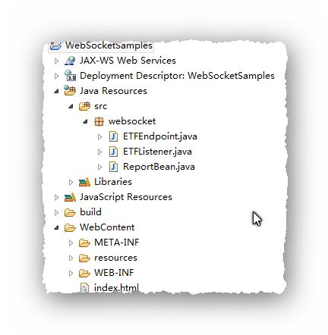
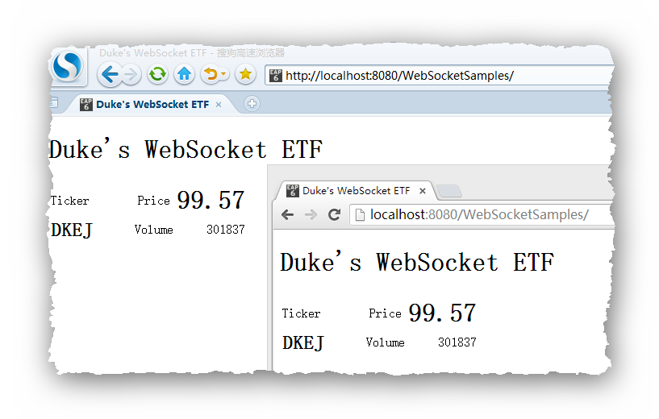
An example

Slide 24
Using Encoders and Decoders
The Java API for WebSocket provides
  support for converting between WebSocket messages and custom Java types using encoders and decoders.
  An encoder takes a Java object and produces a representation that can be transmitted as a WebSocket message;
    for example, encoders typically produce JSON, XML, or binary representations.
  A decoder performs the reverse function: it reads a WebSocket message and creates a Java object.
  This mechanism simplifies WebSocket applications, because it decouples the business logic from the serialization and deserialization of objects.

Slide 25
Encoders
Implement one of the following interfaces:
  Encoder.Text<T> for text messages
  Encoder.Binary<T> for binary messages
  public class MessageATextEncoder implements Encoder.Text<MessageA> {
  @Override
  public void init(EndpointConfig ec) { }
  @Override
  public void destroy() { }
  @Override
  public String encode(MessageA msgA) throws EncodeException {
  // Access msgA's properties and convert to JSON text...
  return msgAJsonString;
  }
  }

Slide 26
Encoders
Then, add the encoders parameter to the ServerEndpoint annotation as follows:
  @ServerEndpoint(
  value = "/myendpoint",
  encoders = {
  MessageATextEncoder.class,
  MessageBTextEncoder.class } )
  public class EncEndpoint { ... }
Now you can send MessageA and MessageB objects as WebSocket messages using the sendObject method as follows:
  MessageA msgA = new MessageA(...);
  MessageB msgB = new MessageB(...);
  session.getBasicRemote.sendObject(msgA);
  session.getBasicRemote.sendObject(msgB);

Slide 27
Decoders
Implement one of the following interfaces:
  Decoder.Text<T> for text messages
  Decoder.Binary<T> for binary messages
  public class MessageTextDecoder implements Decoder.Text<Message> {
  @Override
  public void init(EndpointConfig ec) { }
  @Override
  public void destroy() { }
  @Override
  public Message decode(String string) throws DecodeException {
  // Read message...
  if ( /* message is an A message */ ) return new MessageA(...);
  else if ( /* message is a B message */ ) return new MessageB(...);
  }
  @Override
  public boolean willDecode(String string) {
  // Determine if the message can be converted into either a
  // MessageA object or a MessageB object...
  return canDecode;
  }
  }

Slide 28
Decoders
Then, add the decoders parameter to the ServerEndpoint annotation as follows:
  @ServerEndpoint(
  value = "/myendpoint",
  encoders = {
  MessageATextEncoder.class,
  MessageBTextEncoder.class }
  decoders = { MessageTextDecoder.class }
  )
  public class EncEndpoint { ... }
Now define a method in the endpoint class that receives MessageA and MessageB objects as follows:
  @OnMessage public void message(Session session, Message msg) {
  if (msg instanceof MessageA) {
  // We received a MessageA object...
  else if (msg instanceof MessageB) {
  // We received a MessageB object... }
  }

Slide 29
Handling Errors
To designate a method that handles errors in an annotated WebSocket endpoint, decorate it with @OnError:
  @ServerEndpoint("/testendpoint")
  public class TestEndpoint {
  ...
  @OnError
  public void error(Session session, Throwable t)
  {
  t.printStackTrace();
  ...
  }
  }

Slide 30
Using WebSocket in Spring Application
pom.xml
<dependency>
<groupId>org.webjars</groupId>
<artifactId>webjars-locator-core</artifactId>
</dependency>
<dependency>
<groupId>org.webjars</groupId>
<artifactId>sockjs-client</artifactId>
<version>1.0.2</version>
</dependency>
<dependency>
<groupId>org.webjars</groupId>
<artifactId>stomp-websocket</artifactId>
<version>2.3.3</version>
</dependency>
<dependency>
<groupId>org.webjars</groupId>
<artifactId>bootstrap</artifactId>
<version>3.3.7</version>
</dependency>
<dependency>
<groupId>org.webjars</groupId>
<artifactId>jquery</artifactId>
<version>3.1.1-1</version>
</dependency>

Slide 31
Using WebSocket in Spring Application
HelloMessage.java
      package com.example.messagingstompwebsocket;
      public class HelloMessage {
      private String name;
      public HelloMessage() {
      }
      public HelloMessage(String name) {
      this.name = name;
      }
      public String getName() {
      return name;
      }
      public void setName(String name) {
      this.name = name;
      }
      }
The service will accept messages that contain a name in a STOMP message whose body is a JSON object.
  {
  "name": "Fred"
  }
Notes:
STOMP(流文本定向消息协议)

Slide 32
Using WebSocket in Spring Application
Greeting.java
      package com.example.messagingstompwebsocket;
      public class Greeting {
      private String content;
      public Greeting() {
      }
      public Greeting(String content) {
      this.content = content;
      }
      public String getContent() {
      return content;
      }
      }
Upon receiving the message and extracting the name, the service will process it by creating a greeting and publishing that greeting on a separate queue to which the client is subscribed.
  {
  "content": "Hello, Fred!"
  }

Slide 33
Using WebSocket in Spring Application
GreetingController.java
      package com.example.messagingstompwebsocket;
      import org.springframework.messaging.handler.annotation.MessageMapping;
      import org.springframework.messaging.handler.annotation.SendTo;
      import org.springframework.stereotype.Controller;
      import org.springframework.web.util.HtmlUtils;
      @Controller
      public class GreetingController {
      @MessageMapping("/hello")
      @SendTo("/topic/greetings")
      public Greeting greeting(HelloMessage message) throws Exception {
      Thread.sleep(1000); // simulated delay
      return new Greeting("Hello, " + HtmlUtils.htmlEscape(message.getName()) + "!");
      }
      }
In Spring’s approach to working with STOMP messaging, STOMP messages can be routed to @Controller classes.

Slide 34
Using WebSocket in Spring Application
WebSocketConfig.java
  package com.example.messagingstompwebsocket;
  import org.springframework.context.annotation.Configuration;
  import org.springframework.messaging.simp.config.MessageBrokerRegistry;
  import org.springframework.web.socket.config.annotation.EnableWebSocketMessageBroker;
  import org.springframework.web.socket.config.annotation.StompEndpointRegistry;
  import org.springframework.web.socket.config.annotation.WebSocketMessageBrokerConfigurer;
  @Configuration
  @EnableWebSocketMessageBroker
  public class WebSocketConfig implements WebSocketMessageBrokerConfigurer {
  @Override
  public void configureMessageBroker(MessageBrokerRegistry config) {
  config.enableSimpleBroker("/topic");
  config.setApplicationDestinationPrefixes("/app");
  }
  @Override
  public void registerStompEndpoints(StompEndpointRegistry registry) {
  registry.addEndpoint("/gs-guide-websocket").withSockJS();
  }
  }
Now that the essential components of the service are created, you can configure Spring to enable WebSocket and STOMP messaging.

Slide 35
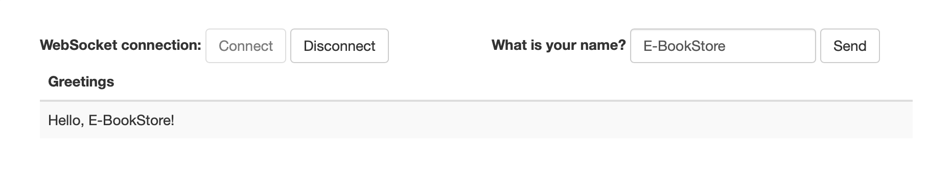
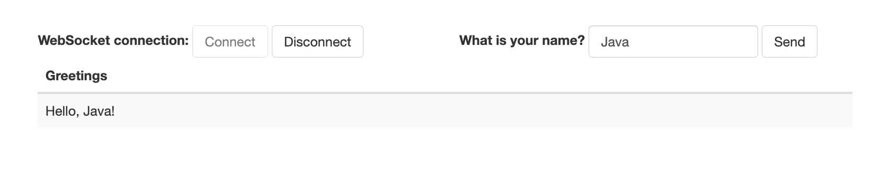
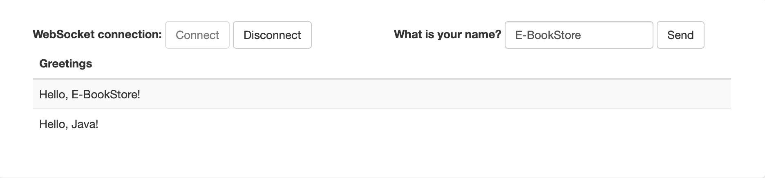
Using WebSocket in Spring Application
index.html

Slide 36
Using WebSocket in Spring Application
app.js
  var stompClient = null;
  function setConnected(connected) {
  $("#connect").prop("disabled", connected);
  $("#disconnect").prop("disabled", !connected);
  if (connected) {
  $("#conversation").show();
  }
  else {
  $("#conversation").hide();
  }
  $("#greetings").html("");
  }
  function connect() {
  var socket = new SockJS('/gs-guide-websocket');
  stompClient = Stomp.over(socket);
  stompClient.connect({}, function (frame) {
  setConnected(true);
  console.log('Connected: ' + frame);
  stompClient.subscribe('/topic/greetings', function (greeting) {
  showGreeting(JSON.parse(greeting.body).content);
  });
  });
  }
function disconnect() {
if (stompClient !== null) {
stompClient.disconnect();
}
setConnected(false);
console.log("Disconnected");
}
function sendName() {
stompClient.send("/app/hello", {}, JSON.stringify({'name': $("#name").val()}));
}
function showGreeting(message) {
$("#greetings").append("<tr><td>" + message + "</td></tr>");
}
$(function () {
$("form").on('submit', function (e) {
e.preventDefault();
});
$( "#connect" ).click(function() { connect(); });
$( "#disconnect" ).click(function() { disconnect(); });
$( "#send" ).click(function() { sendName(); });
});

Slide 37
Transfer with WebSocket
WebSocketConfig.java
    @Configuration
    public class WebSocketConfig {
    @Bean
    public ServerEndpointExporter serverEndpointExporter(){
    return new ServerEndpointExporter();
    }
    }

Slide 38
Transfer with WebSocket
WebSocketServer.java
@ServerEndpoint("/websocket/transfer/{userId}")
@Component
public class WebSocketServer {
private static final ConcurrentHashMap<String, Session> SESSIONS
= new ConcurrentHashMap<>();
public void sendMessage(Session toSession, String message) {
if (toSession != null) {
try {
toSession.getBasicRemote().sendText(message);
} catch (IOException e) {
e.printStackTrace();
}
} else {
System.out.println("对方不在线");
}
}
public void sendMessageToUser(String user, String message) {
System.out.println(user);
Session toSession = SESSIONS.get(user);
sendMessage(toSession, message);
System.out.println(message);
}
@OnMessage
public void onMessage(String message) {
System.out.println("服务器收到消息：" + message);
}
@OnOpen
public void onOpen(Session session, @PathParam("userId") String userId) {
if (SESSIONS.get(userId) != null) {
return;
}
SESSIONS.put(userId, session);
System.out.println(userId + "上线了，当前在线人数：" + COUNT);
}
@OnClose
public void onClose(@PathParam("userId") String userId) {
SESSIONS.remove(userId);
System.out.println(userId + "下线了，当前在线人数：" + COUNT);
}
@OnError
public void onError(Session session, Throwable throwable) {
System.out.println("发生错误");
throwable.printStackTrace();
}
}

Slide 39
Transfer with WebSocket
BankListener.java
    public class BankListener {
    @Autowired
    private WebSocketServer ws;
    @KafkaListener(topics = "topic1", groupId = "group_topic_test")
    public void topic1Listener(ConsumerRecord<String, String> record) {
    String[] value = record.value().split(",");
    bankService.transfer(value[0], value[1], Integer.valueOf(value[2]));
    kafkaTemplate.send("topic2", "key", "Done");
    }
    @KafkaListener(topics = "topic2", groupId = "group_topic_test")
    public void topic2Listener(ConsumerRecord<String, String> record) {
    String value = record.value();
    System.out.println(value);
    ws.sendMessageToUser("Tom","Done");
    }
    }

Slide 40
Transfer with WebSocket
App.js
  import './App.css';
  import $ from 'jquery'
  var socket;
  function setConnected(connected) {
  $("#connect").prop("disabled", connected);
  $("#disconnect").prop("disabled", !connected);
  if (connected) {
  $("#conversation").show();
  }
  else {
  $("#conversation").hide();
  }
  $("#greetings").html("");
  }
  function showGreeting(message) {
  $("#greetings").append("<tr><td>" + message + "</td></tr>");
  }

Slide 41
Transfer with WebSocket
App.js
function openSocket() {
if (typeof (WebSocket) == “undefined”) {
alert(“您的浏览器不支持WebSocket”);
} else {
if (socket != null) {
return;
}
var userId = document.getElementById('name').value;
var socketUrl = "ws://localhost:8080/websocket/transfer/" + userId;
console.log(socketUrl);
setConnected(true);
socket = new WebSocket(socketUrl);
//打开事件
socket.onopen = function () {
console.log("websocket已打开");
//socket.send("这是来自客户端的消息" + location.href + new Date());
};
//获得消息事件
socket.onmessage = function (msg) {
var serverMsg = "收到服务端信息：" + msg.data;
console.log(serverMsg);
//发现消息进入 开始处理前端触发逻辑
showGreeting(msg.data);
};
//关闭事件
socket.onclose = function () {
console.log("websocket已关闭");
};
//发生了错误事件
socket.onerror = function () {
console.log("websocket发生了错误");
}
}
}

Slide 42
Transfer with WebSocket
App.js
function closeSocket() {
if (socket === undefined || socket === null) {
alert("请先连接");
return;
}
socket.close();
socket = null;
setConnected(false);
}
function sendMessage() {
if (socket === undefined || socket === null) {
alert("请先连接");
return;
}
if (typeof (WebSocket) == "undefined") {
console.log("您的浏览器不支持WebSocket");
} else {
console.log("您的浏览器支持WebSocket");
var msg = JSON.stringify({'userId': $("#name").val()});
console.log(msg);
// socket.send(msg);
$.ajax({
type: "get",
url: "http://localhost:8080/send",
dataType: 'jsonp' //【jsonp进行跨域请求 只支持get】
});
}
}
$(function () {
$("form").on('submit', function (e) {
e.preventDefault();
});
$( "#connect" ).click(function() { openSocket(); });
$( "#disconnect" ).click(function() { closeSocket(); });
$( "#send" ).click(function() { sendMessage(); });
});

Slide 43
Transfer with WebSocket
App.js
function App() {
return (
<div className="App">
<div id="main-content" className="container">
<div className="row">
<div className="col-md-6">
<form className="form-inline">
<div className="form-group">
<label htmlFor="connect">WebSocket connection:</label>
<button id="connect" className="btn btn-default”
type="submit">Connect</button>
<button id="disconnect" className="btn btn-default”
type="submit" disabled="disabled">Disconnect
</button>
</div>
</form>
</div>
<div className="col-md-6">
<form className="form-inline">
<div className="form-group">
<label htmlFor="name">What is your name?</label>
<input type="text" id="name" className="form-control"
placeholder="Your name here..."/>
</div>
<button id="send" className="btn btn-default" type="submit">Send</button>
</form>
</div>
</div>
<div className="row">
<div className="col-md-12">
<table id="conversation"
className="table table-striped">
<thead>
<tr>
<th>Greetings</th>
</tr>
</thead>
<tbody id="greetings">
</tbody>
</table>
</div>
</div>
</div>
</div>
);
}
export default App;

Slide 44
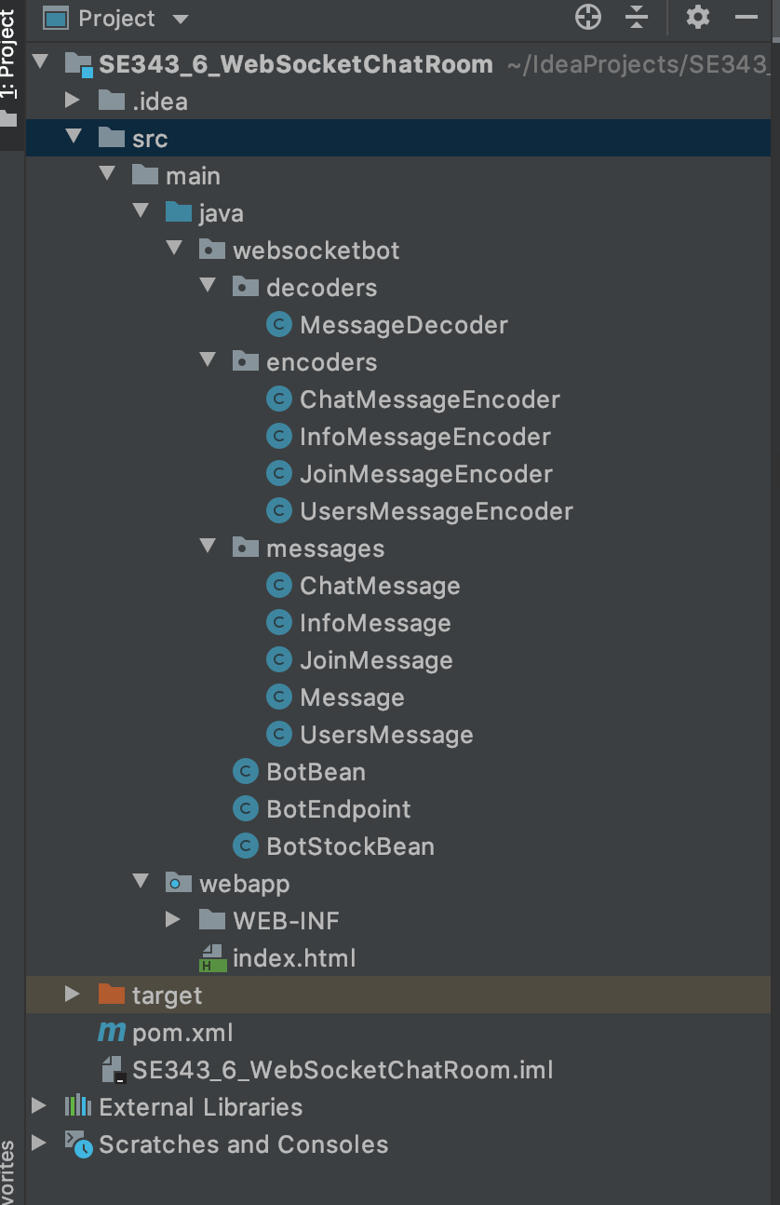
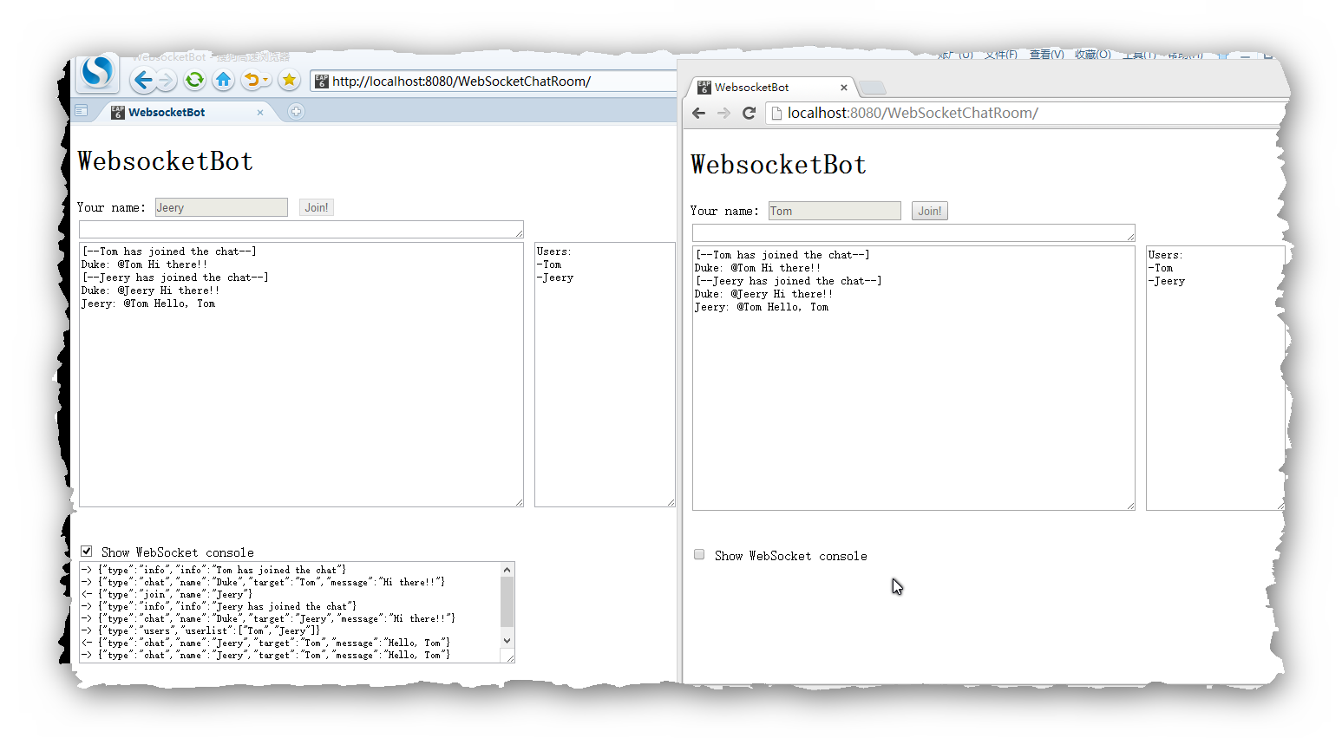
An example - Chatroom

Slide 45
An example - Chatroom
index.html
  <html xmlns="http://www.w3.org/1999/xhtml">
  <head>
  <title>WebsocketBot</title>
  <script type="text/javascript">
  var wsocket; // Websocket connection
  var userName; // User's name
  var textarea; // Chat area
  var wsconsole; // Websocket console area
  var userlist; // User list area
  function connect() {
  textarea = document.getElementById("textarea");
  wsconsole = document.getElementById("wsconsole");
  userlist = document.getElementById("userlist");
  wsocket = new WebSocket(
  "ws://localhost:8080/WebSocketChatRoom/websocketbot");
  wsocket.onmessage = onMessage;
  document.getElementById("name").focus();
  document.getElementById("consolediv").style.visibility ='hidden';
  }

Slide 46
An example - Chatroom
index.html
  function onMessage(evt) {
  var line = "";
  var msg = JSON.parse(evt.data);
  if (msg.type === "chat") {
  line = msg.name + ": ";
  if (msg.target.length > 0)
  line += "@" + msg.target + " ";
  line += msg.message + "\n";
  textarea.value += "" + line;
  } else if (msg.type === "info") {
  line = "[--" + msg.info + "--]\n";
  textarea.value += "" + line;
  } else if (msg.type === "users") {
  line = "Users:\n";
  for (var i=0; i < msg.userlist.length; i++)
  line += "-" + msg.userlist[i] + "\n";
  userlist.value = line;
  }
  textarea.scrollTop = 999999;
  wsconsole.value += "-> " + evt.data + "\n";
  wsconsole.scrollTop = 999999;
  }

Slide 47
An example - Chatroom
index.html
  function sendJoin() {
  var input = document.getElementById("input");
  var name = document.getElementById("name");
  var join = document.getElementById("join");
  var jsonstr;
  if (name.value.length > 0) {
  var joinMsg = {};
  joinMsg.type = "join";
  joinMsg.name = name.value;
  jsonstr = JSON.stringify(joinMsg);
  wsocket.send(jsonstr);
  name.disabled = true;
  join.disabled = true;
  input.disabled = false;
  userName = name.value;
  wsconsole.value += "<- " + jsonstr + "\n";
  wsconsole.scrollTop = 999999;
  }
  }

Slide 48
An example - Chatroom
index.html
  function sendMessage(evt) {
  var input = document.getElementById("input");
  var jsonstr;
  var msgstr;
  if (evt.keyCode === 13 && input.value.length > 0) {
  var chatMsg = {};
  chatMsg.type = "chat";
  chatMsg.name = userName;
  msgstr = input.value;
  chatMsg.target = getTarget(msgstr.replace(/,/g, ""));
  chatMsg.message = cleanTarget(msgstr);
  chatMsg.message =
  chatMsg.message.replace(/(\r\n|\n|\r)/gm,"");
  jsonstr = JSON.stringify(chatMsg);
  wsocket.send(jsonstr);
  input.value = "";
  wsconsole.value += "<- " + jsonstr + "\n";
  wsconsole.scrollTop = 999999;
  }
  }

Slide 49
An example - Chatroom
index.html
  function checkJoin(evt) {
  var name = document.getElementById("name");
  var input = document.getElementById("input");
  if (evt.keyCode === 13 && name.value.length > 0) {
  sendJoin();
  input.focus();
  }
  }
  function getTarget(str) {
  var arr = str.split(" ");
  var target = "";
  for (var i=0; i<arr.length; i++) {
  if (arr[i].charAt(0) === '@') {
  target = arr[i].substring(1,arr[i].length);
  target = target.replace(/(\r\n|\n|\r)/gm,"");
  }
  }
  return target;
  }

Slide 50
An example - Chatroom
index.html
  function cleanTarget(str) {
  var arr = str.split(" ");
  var cleanstr = "";
  for (var i=0; i<arr.length; i++) {
  if (arr[i].charAt(0) !== '@')
  cleanstr += arr[i] + " ";
  }
  return cleanstr.substring(0,cleanstr.length-1);
  }
  function showHideConsole() {
  var chkbox = document.getElementById("showhideconsole");
  var consolediv = document.getElementById("consolediv");
  if (chkbox.checked)
  consolediv.style.visibility = 'visible';
  else
  consolediv.style.visibility = 'hidden';
  }
  window.addEventListener("load", connect, false);
  </script>
  </head>

Slide 51
An example - Chatroom
index.html
  <body>
  <h1>WebsocketBot</h1>
  Your name: <input id="name" type="text" size="20" maxlength="20"
  onkeyup="checkJoin(event);"/>
  <input type="submit" id="join" value="Join!"
  onclick="sendJoin();"/><br/>
  <textarea id="input" cols="70" rows="1" disabled="true"
  onkeyup="sendMessage(event);"></textarea><br/>
  <textarea id="textarea" cols="70" rows="20"
  readonly="true"></textarea>
  <textarea id="userlist" cols="20" rows="20"
  readonly="true"></textarea>
  <br/><br/><br/>
  <input id="showhideconsole" type="checkbox"
  onclick="showHideConsole();"/>
  Show WebSocket console<br/>
  <div id="consolediv"><textarea id="wsconsole" cols="80" rows="8"
  readonly="true" style="font-size:8pt;"></textarea></div>
  </body>
  </html>

Slide 52
An example - Chatroom
BotEndPoint.java
  @ServerEndpoint(
  value = "/websocketbot",
  decoders = { MessageDecoder.class },
  encoders = { JoinMessageEncoder.class, ChatMessageEncoder.class,
  InfoMessageEncoder.class, UsersMessageEncoder.class }
  )
  public class BotEndpoint {
  private static final Logger logger = Logger.getLogger("BotEndpoint");
  private static Queue<Session> mySession = new ConcurrentLinkedQueue<>();
  @OnOpen
  public void openConnection(Session session) {
  mySession.add(session);
  logger.log(Level.INFO, "Connection opened.");
  }

Slide 53
An example - Chatroom
BotEndPoint.java
  @OnMessage
  public void message(final Session session, Message msg) {
  if (msg instanceof JoinMessage) {
  JoinMessage jmsg = (JoinMessage) msg;
  session.getUserProperties().put("name", jmsg.getName());
  session.getUserProperties().put("active", true);
  logger.log(Level.INFO, "Received: {0}", jmsg.toString());
  sendAll(session, new InfoMessage(jmsg.getName() + " has
  joined the chat"));
  sendAll(session, new ChatMessage("Duke", jmsg.getName(),
  "Hi there!!"));
  sendAll(session, new UsersMessage(this.getUserList(session)));
  } else if (msg instanceof ChatMessage) {
  final ChatMessage cmsg = (ChatMessage) msg;
  logger.log(Level.INFO, "Received: {0}", cmsg.toString());
  sendAll(session, cmsg);
  }
  }

Slide 54
An example - Chatroom
BotEndPoint.java
  @OnClose
  public void closedConnection(Session session) {
  session.getUserProperties().put("active", false);
  if (session.getUserProperties().containsKey("name")) {
  String name =
  session.getUserProperties().get("name").toString();
  sendAll(session, new InfoMessage(name +
  " has left the chat"));
  sendAll(session, new UsersMessage(this.getUserList(session)));
  }
  logger.log(Level.INFO, "Connection closed.");
  }
  @OnError
  public void error(Session session, Throwable t) {
  logger.log(Level.INFO, "Connection error ({0})", t.toString());
  }

Slide 55
An example - Chatroom
BotEndPoint.java
  public synchronized void sendAll(Session session, Object msg) {
  try {
  for (Session s : session.getOpenSessions()) {
  if (s.isOpen()) {
  s.getBasicRemote().sendObject(msg);
  logger.log(Level.INFO, "Sent: {0}", msg.toString());
  }
  }
  } catch (IOException | EncodeException e) {
  logger.log(Level.INFO, e.toString());
  }
  }
  public List<String> getUserList(Session session) {
  List<String> users = new ArrayList<>();
  for (Session s : session.getOpenSessions()) {
  if (s.isOpen()&&(boolean) s.getUserProperties().get("active"))
  users.add(s.getUserProperties().get("name").toString());
  }
  return users;
  }
  }

Slide 56
An example - Chatroom
Message.java
  public class Message {}
  ChatMessage.java
  public class ChatMessage extends Message {
  private String name;
  private String target;
  private String message;
  public ChatMessage(String name, String target, String message) {
  this.name = name;
  this.target = target;
  this.message = message;
  }
  ……
  public String getMessage() { return message; }
  public void setMessage(String message) { this.message = message; }
  ……
  }

Slide 57
An example - Chatroom
UserMessage.java
  public class Message {}
  public class UsersMessage extends Message {
  private List<String> userlist;
  public UsersMessage(List<String> userlist) {
  this.userlist = userlist;
  }
  public List<String> getUserList() { return userlist; }
  ……
  }
  JoinMessage.java
  public class JoinMessage extends Message {
  private String name;
  public JoinMessage(String name) { this.name = name; }
  public String getName() { return name; }
  ……
  }

Slide 58
An example - Chatroom
InfoMessage.java
  public class InfoMessage extends Message {
  private String info;
  public InfoMessage(String info) {
  this.info = info;
  }
  public String getInfo() {
  return info;
  }
  /* For logging purposes */
  @Override
  public String toString() {
  return "[InfoMessage] " + info;
  }
  }

Slide 59
An example - Chatroom
ChatMessageEncoder.java
  public class ChatMessageEncoder implements Encoder.Text<ChatMessage> {
  @Override
  public void init(EndpointConfig ec) { }
  @Override
  public void destroy() { }
  @Override
  public String encode(ChatMessage chatMessage) throws EncodeException
  {
  StringWriter swriter = new StringWriter();
  try (JsonGenerator jsonGen = Json.createGenerator(swriter)) {
  jsonGen.writeStartObject()
  .write("type", "chat")
  .write("name", chatMessage.getName())
  .write("target", chatMessage.getTarget())
  .write("message", chatMessage.getMessage())
  .writeEnd();
  }
  return swriter.toString();
  }
  }

Slide 60
An example - Chatroom
JoinMessageEncoder.java
  public class JoinMessageEncoder implements Encoder.Text<JoinMessage> {
  @Override
  public void init(EndpointConfig ec) { }
  @Override
  public void destroy() { }
  @Override
  public String encode(JoinMessage joinMessage) throws EncodeException
  {
  StringWriter swriter = new StringWriter();
  try (JsonGenerator jsonGen = Json.createGenerator(swriter)) {
  jsonGen.writeStartObject()
  .write("type", "join")
  .write("name", joinMessage.getName())
  .writeEnd();
  }
  return swriter.toString();
  }
  }

Slide 61
An example - Chatroom
InfoMessageEncoder.java
  public class InfoMessageEncoder implements Encoder.Text<InfoMessage> {
  @Override
  public void init(EndpointConfig ec) { }
  @Override
  public void destroy() { }
  @Override
  public String encode(InfoMessage joinMessage) throws EncodeException
  {
  StringWriter swriter = new StringWriter();
  try (JsonGenerator jsonGen = Json.createGenerator(swriter)) {
  jsonGen.writeStartObject()
  .write("type", "info")
  .write("info", joinMessage.getInfo())
  .writeEnd();
  }
  return swriter.toString();
  }
  }

Slide 62
An example - Chatroom
UsersMessageEncoder.java
  public class UsersMessageEncoder implements Encoder.Text<UsersMessage> {
  @Override
  public void init(EndpointConfig ec) { }
  @Override
  public void destroy() { }
  @Override
  public String encode(UsersMessage usersMessage) throws
  EncodeException {
  StringWriter swriter = new StringWriter();
  try (JsonGenerator jsonGen = Json.createGenerator(swriter)) {
  jsonGen.writeStartObject()
  .write("type", "users")
  .writeStartArray("userlist");
  for (String user : usersMessage.getUserList())
  jsonGen.write(user);
  jsonGen.writeEnd().writeEnd();
  }
  return swriter.toString();
  }
  }

Slide 63
An example - Chatroom
MessageDecoder.java
  public class MessageDecoder implements Decoder.Text<Message> {
  private Map<String,String> messageMap;
  @Override
  public void init(EndpointConfig ec) { }
  @Override
  public void destroy() { }
  /* Create a new Message object if the message can be decoded */
  @Override
  public Message decode(String string) throws DecodeException {
  Message msg = null;
  if (willDecode(string)) {
  switch (messageMap.get("type")) {
  case "join":
  msg = new JoinMessage(messageMap.get("name"));
  break;
  case "chat":
  msg = new ChatMessage(messageMap.get("name"),
  messageMap.get("target"),
  messageMap.get("message"));
  }
  } else {
  throw new DecodeException(string, "[Message] Can't decode.");
  }
  return msg;
  }

Slide 64
An example - Chatroom
MessageDecoder.java
  @Override
  public boolean willDecode(String string) {
  boolean decodes = false;
  messageMap = new HashMap<>();
  JsonParser parser = Json.createParser(new StringReader(string));
  while (parser.hasNext()) {
  if (parser.next() == JsonParser.Event.KEY_NAME) {
  String key = parser.getString();
  parser.next();
  String value = parser.getString();
  messageMap.put(key, value);
  }
  }
  Set keys = messageMap.keySet();
  if (keys.contains("type")) {
  switch (messageMap.get("type")) {
  case "join":
  if (keys.contains("name"))
  decodes = true;
  break;
  case "chat":
  String[] chatMsgKeys = {"name", "target", "message"};
  if (keys.containsAll(Arrays.asList(chatMsgKeys)))
  decodes = true;
  break;
  }
  }
  return decodes;
  }
  }

Slide 65
An example - Chatroom
BotEndpoint.java
  @ServerEndpoint(
  value = "/websocketbot",
  decoders = { MessageDecoder.class },
  encoders = { JoinMessageEncoder.class, ChatMessageEncoder.class,
  InfoMessageEncoder.class, UsersMessageEncoder.class }
  )
  public class BotEndpoint {
  @OnOpen
  public void openConnection(Session session) {
  logger.log(Level.INFO, "Connection opened.");
  }
  @OnMessage
  public void message(final Session session, Message msg) {
  logger.log(Level.INFO, "Received: {0}", msg.toString());
  if (msg instanceof JoinMessage) {
  JoinMessage jmsg = (JoinMessage) msg;
  session.getUserProperties().put("name", jmsg.getName());
  session.getUserProperties().put("active", true);
  logger.log(Level.INFO, "Received: {0}", jmsg.toString());
  sendAll(session, new InfoMessage(jmsg.getName() + " has joined the chat"));
  sendAll(session, new ChatMessage("Duke", jmsg.getName(), "Hi there!!"));
  sendAll(session, new UsersMessage(this.getUserList(session)));
  } else if (msg instanceof ChatMessage) {
  final ChatMessage cmsg = (ChatMessage) msg;
  logger.log(Level.INFO, "Received: {0}", cmsg.toString());
  sendAll(session, cmsg);
  }
  }

Slide 66
An example - Chatroom
BotEndpoint.java
  @OnClose
  public void closedConnection(Session session) {
  session.getUserProperties().put("active", false);
  if (session.getUserProperties().containsKey("name")) {
  String name = session.getUserProperties().get("name").toString();
  sendAll(session, new InfoMessage(name + " has left the chat"));
  sendAll(session, new UsersMessage(this.getUserList(session)));
  }
  logger.log(Level.INFO, "Connection closed.");
  }
  @OnError
  public void error(Session session, Throwable t) {
  logger.log(Level.INFO, "Connection error ({0})", t.toString());
  }
  public synchronized void sendAll(Session session, Object msg) {
  try {
  for (Session s : session.getOpenSessions()) {
  if (s.isOpen()) {
  s.getBasicRemote().sendObject(msg);
  logger.log(Level.INFO, "Sent: {0}", msg.toString());
  }
  }
  } catch (IOException | EncodeException e) {
  logger.log(Level.INFO, e.toString());
  }
  }

Slide 67
An example - Chatroom
BotEndpoint.java
  public List<String> getUserList(Session session) {
  List<String> users = new ArrayList<>();
  for (Session s : session.getOpenSessions()) {
  if (s.isOpen() && (boolean) s.getUserProperties().get("active"))
  users.add(s.getUserProperties().get("name").toString());
  }
  return users;
  }
  }
  }

Slide 68
An example - Chatroom

Slide 69
References
The Java EE 8 Tutorial
  https://javaee.github.io/tutorial/toc.html
Java API for WebSocket
  https://javaee.github.io/tutorial/websocket.html
The dukeetf2 Example Application
  https://javaee.github.io/tutorial/websocket011.html
The websocketbot Example Application
  https://javaee.github.io/tutorial/websocket012.html
Java EE 8 Tutorial Examples
  https://github.com/javaee/tutorial-examples
Using WebSocket to build an interactive web application
  https://spring.io/guides/gs/messaging-stomp-websocket/
springboot整合websocket两种方式
  https://blog.csdn.net/qq_35249342/article/details/119324967

Slide 70

Thank You!

