Slide 1
Architecture of Enterprise Applications 22
GraphQL
Haopeng Chen
REliable, INtelligent and Scalable Systems Group (REINS)
Shanghai Jiao Tong University
Shanghai, China
http://reins.se.sjtu.edu.cn/~chenhp
e-mail: chen-hp@sjtu.edu.cn

Slide 2
Contents and Objectives
Contents
  GraphQL
Objectives
  能够掌握GraphQL编程模型

Slide 3

GraphQL
A query language for your API
  GraphQL is a query language for APIs and a runtime for fulfilling those queries with your existing data.
  GraphQL provides a complete and understandable description of the data in your API, gives clients the power to ask for exactly what they need and nothing more, makes it easier to evolve APIs over time, and enables powerful developer tools.
  https://graphql.org/

Slide 4
GraphQL
GraphQL is a query language for your API, and a server-side runtime for executing queries using a type system you define for your data.
  GraphQL isn't tied to any specific database or storage engine and is instead backed by your existing code and data.
  A GraphQL service is created by defining types and fields on those types, then providing functions for each field on each type.
type Query {
me: User
}
type User {
id: ID
name: String
}
function Query_me(request) {
return request.auth.user
}
function User_name(user) {
return user.getName()
}

Slide 5
GraphQL
After a GraphQL service is running (typically at a URL on a web service),
  it can receive GraphQL queries to validate and execute.
  The service first checks a query to ensure it only refers to the types and fields defined, and then runs the provided functions to produce a result.
{
me {
name
}
}
{
"me": {
"name": "Luke Skywalker"
}
}

Slide 6
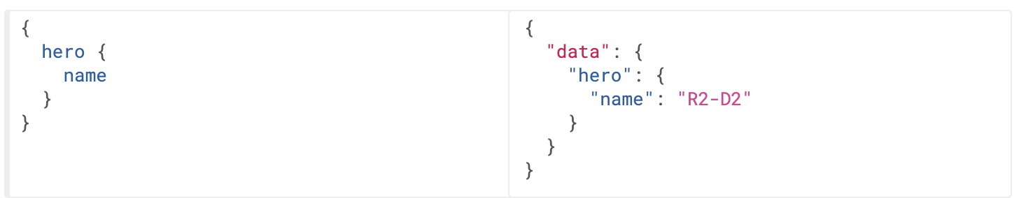
Queries and Mutations
Fields
  At its simplest, GraphQL is about asking for specific fields on objects.

Slide 7
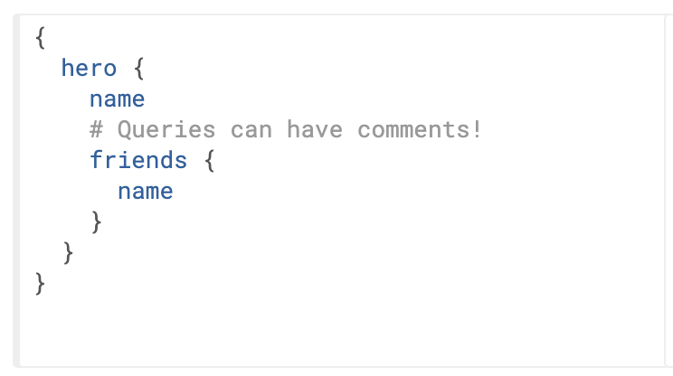
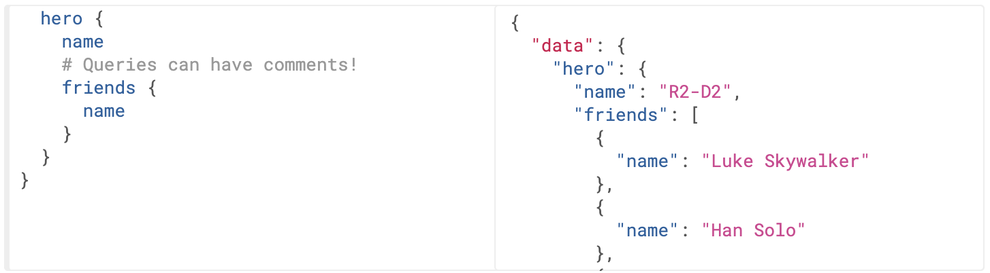
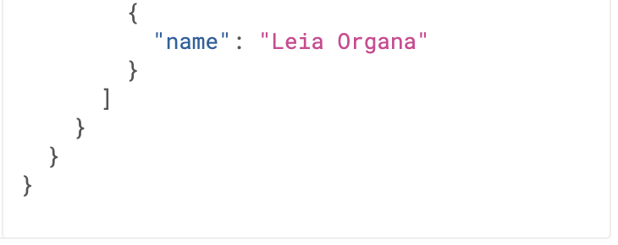
Queries and Mutations
Fields
  GraphQL queries can traverse related objects and their fields, letting clients fetch lots of related data in one request, instead of making several roundtrips as one would need in a classic REST architecture.

Slide 8
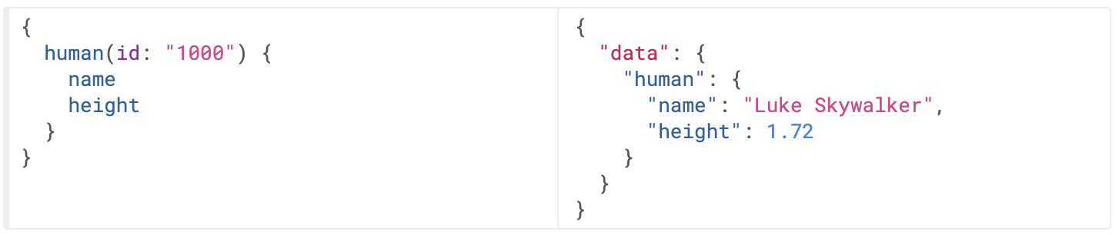
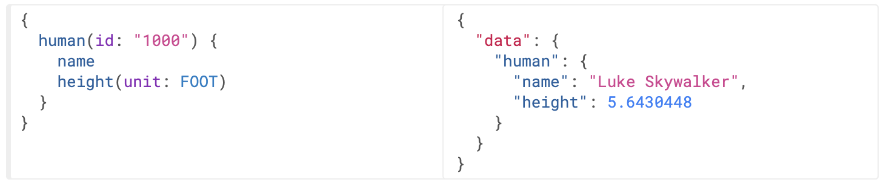
Queries and Mutations
Arguments
  in GraphQL, every field and nested object can get its own set of arguments, making GraphQL a complete replacement for making multiple API fetches.

Slide 9
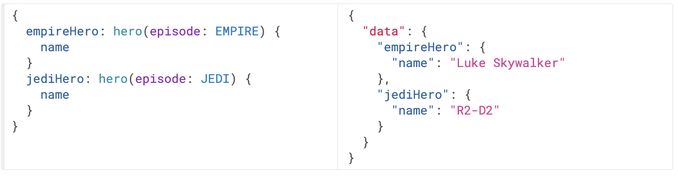
Queries and Mutations
Aliases
  The two hero fields would have conflicted, but since we can alias them to different names, we can get both results in one request.

Slide 10
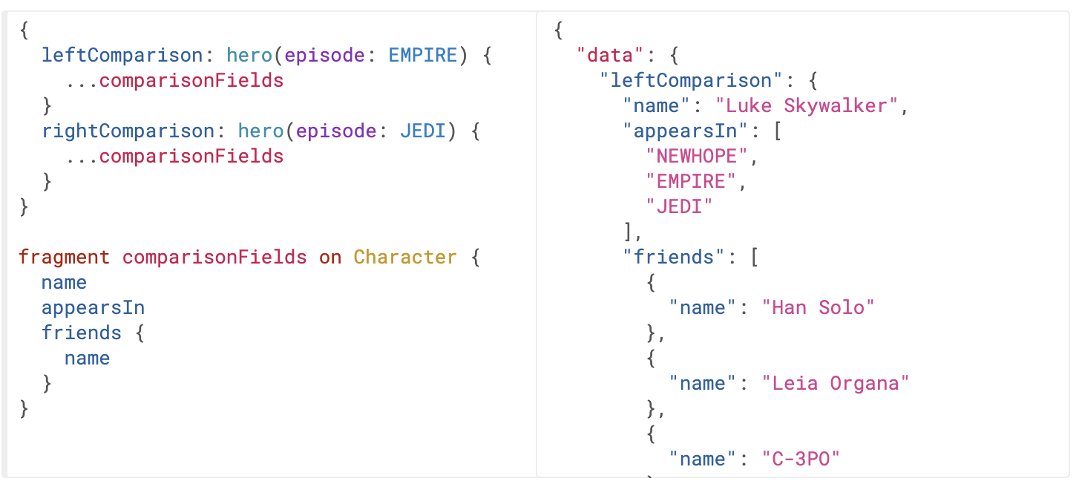
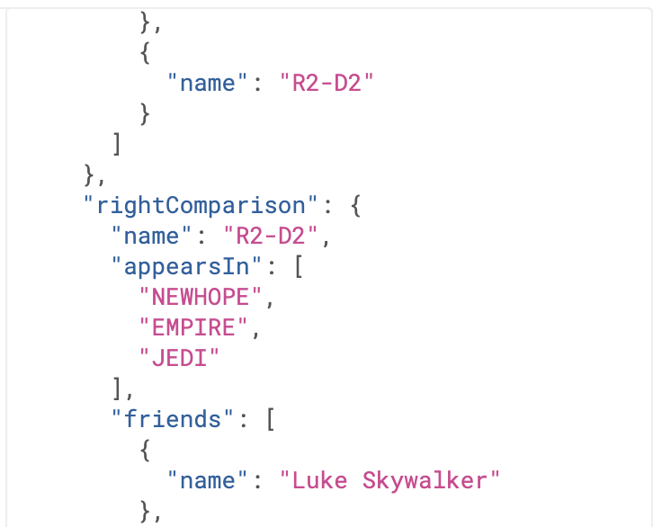
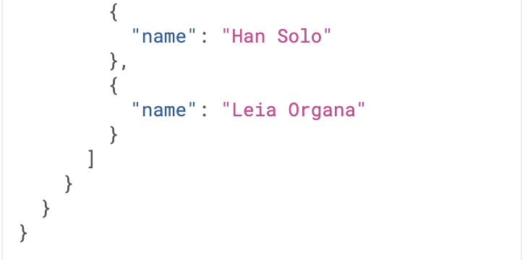
Queries and Mutations
Fragments
  Fragments let you construct sets of fields, and then include them in queries where you need to.

Slide 11
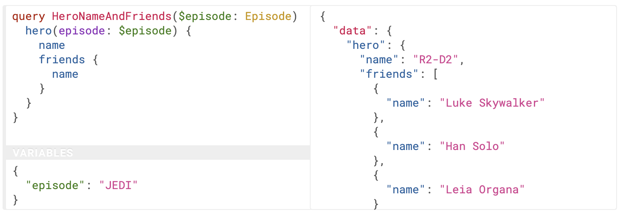
Queries and Mutations
Variables
  GraphQL has a first-class way to factor dynamic values out of the query, and pass them as a separate dictionary. These values are called variables.

Slide 12
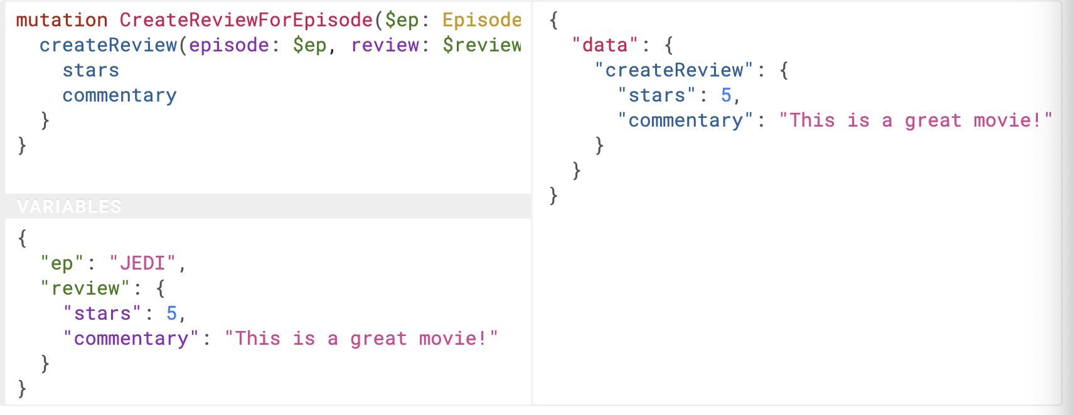
Queries and Mutations
Mutations
  GraphQL is similar - technically any query could be implemented to cause a data write.
  Note how createReview field returns the stars and commentary fields of the newly created review.

Slide 13
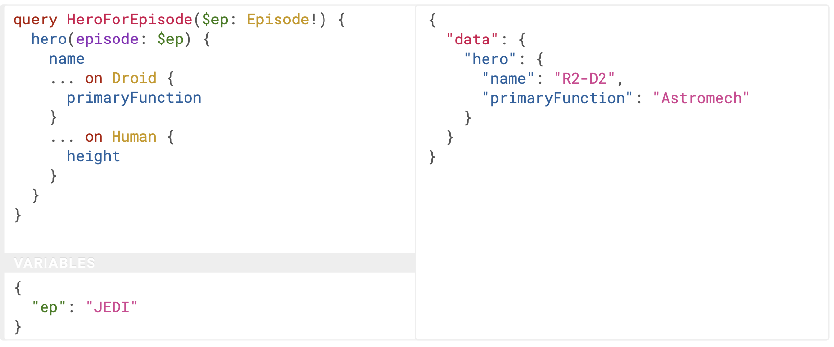
Queries and Mutations
Inline Fragments
  If you are querying a field that returns an interface or a union type, you will need to use inline fragments to access data on the underlying concrete type.

Slide 14
Getting started with Spring for GraphQL
Spring for GraphQL and Spring Web.
<dependency>
<groupId>org.springframework.boot</groupId>
<artifactId>spring-boot-starter-graphql</artifactId>
</dependency>
<dependency>
<groupId>org.springframework.boot</groupId>
<artifactId>spring-boot-starter-web</artifactId>
</dependency>

Slide 15
Getting started with Spring for GraphQL
Query.graphql
query bookDetails {
bookById(id: "book-1") {
id
name
pageCount
author {
firstName
lastName
}
}
}

Slide 16
Getting started with Spring for GraphQL
Response in JSON
{
"bookById "
: { "id":"book-1",
"name":"Effective Java",
"pageCount":416,
"author": {
"firstName":"Joshua",
"lastName":"Bloch"
}
} }

Slide 17
Getting started with Spring for GraphQL
Schema.graphql
type Query {
bookById(id: ID): Book
}
type Book {
id: ID
name: String
pageCount: Int
author: Author
}
type Author {
id: ID
firstName: String
lastName: String
}

Slide 18
Getting started with Spring for GraphQL
Book.java
public record Book (String id, String name, int pageCount, String authorId) {
private static List<Book> books = Arrays.asList(
new Book("book-1", "Effective Java", 416, "author-1"),
new Book("book-2", "Hitchhiker's Guide to the Galaxy", 208, "author-2"),
new Book("book-3", "Down Under", 436, "author-3")
);
public static Book getById(String id) {
return books.stream()
.filter(book -> book.id().equals(id))
.findFirst()
.orElse(null);
}
}

Slide 19
Getting started with Spring for GraphQL
Author.java
public record Author (String id, String firstName, String lastName) {
private static List<Author> authors = Arrays.asList(
new Author("author-1", "Joshua", "Bloch"),
new Author("author-2", "Douglas", "Adams"),
new Author("author-3", "Bill", "Bryson")
);
public static Author getById(String id) {
return authors.stream()
.filter(author -> author.id().equals(id))
.findFirst()
.orElse(null);
}
}

Slide 20
Getting started with Spring for GraphQL
BookController.java
@Controller
public class BookController {
@QueryMapping
public Book bookById(@Argument String id) {
return Book.getById(id);
}
@SchemaMapping
public Author author(Book book) {
return Author.getById(book.authorId());
}
}

Slide 21
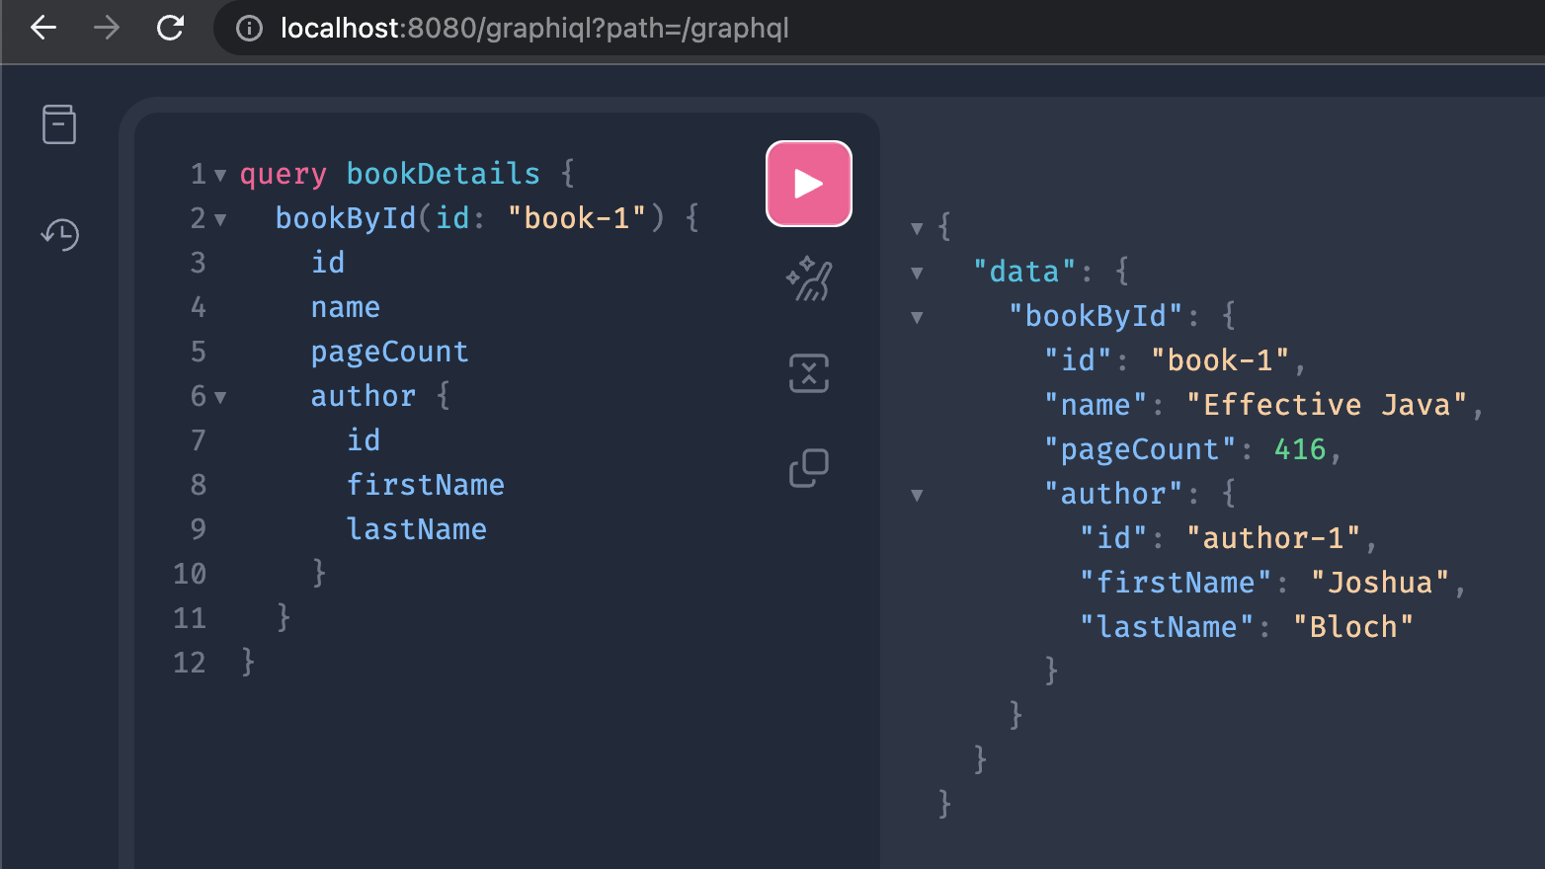
Getting started with Spring for GraphQL
http://localhost:8080/graphql

Slide 22
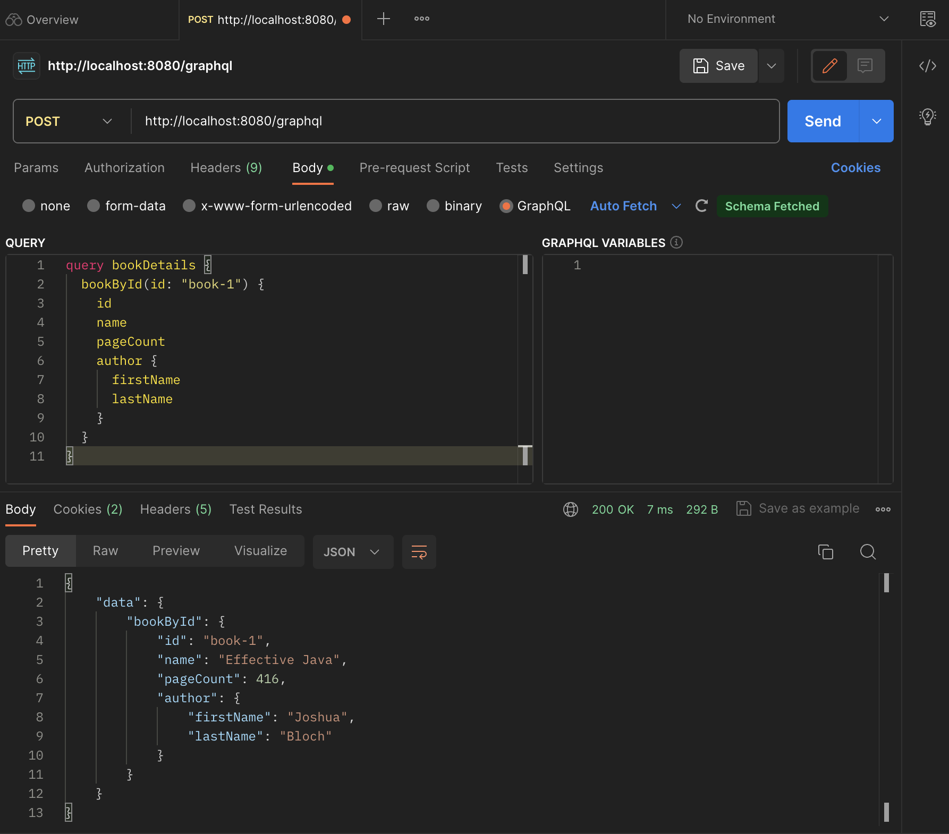
Sending GraphQL via Postman

Slide 23
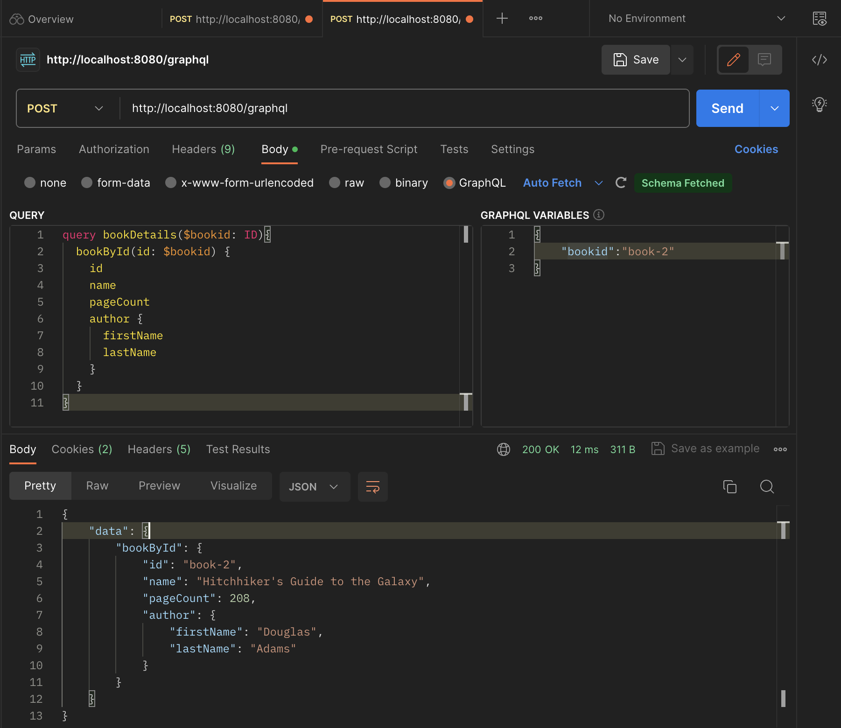
Sending GraphQL via Postman
Notes:
{
}

Slide 24
References
GraphQL
  https://graphql.org/
Building a GraphQL service
  https://spring.io/guides/gs/graphql-server/
Postman使用 GraphQL 查询
  https://postman.org.cn/sending-requests/supported-api-frameworks/graphql/

Slide 25
Architecture of Enterprise Applications 22 gRPC
Haopeng Chen
REliable, INtelligent and Scalable Systems Group (REINS)
Shanghai Jiao Tong University
Shanghai, China
http://reins.se.sjtu.edu.cn/~chenhp
e-mail: chen-hp@sjtu.edu.cn

Slide 26
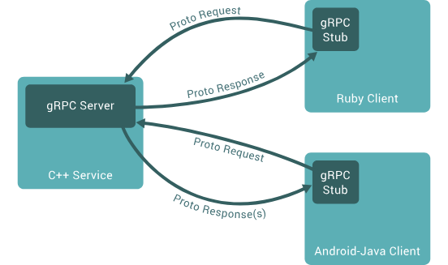

gRPC
A high performance, open source universal RPC framework
  In gRPC, a client application can directly call a method on a server application on a different machine as if it were a local object, making it easier for you to create distributed applications and services.
  https://grpc.io/

Slide 27
gRPC
By default,
  gRPC uses Protocol Buffers, Google’s mature open source mechanism for serializing structured data (although it can be used with other data formats such as JSON).
The first step when working with protocol buffers is to define the structure for the data you want to serialize in a proto file:
  this is an ordinary text file with a .proto extension.
  Protocol buffer data is structured as messages, where each message is a small logical record of information containing a series of name-value pairs called fields. Here’s a simple example:
message Person {
string name = 1;
int32 id = 2;
bool has_ponycopter = 3;
}

Slide 28
gPRC
Then,
  once you’ve specified your data structures, you use the protocol buffer compiler protoc to generate data access classes in your preferred language(s) from your proto definition.
  These provide simple accessors for each field, like name() and set_name(), as well as methods to serialize/parse the whole structure to/from raw bytes.
  So, for instance, if your chosen language is C++, running the compiler on the example above will generate a class called Person. You can then use this class in your application to populate, serialize, and retrieve Person protocol buffer messages.

Slide 29
gPRC
You define gRPC services in ordinary proto files,
  with RPC method parameters and return types specified as protocol buffer messages:
// The greeter service definition.
service Greeter {
// Sends a greeting
rpc SayHello (HelloRequest) returns (HelloReply) {}
}
// The request message containing the user's name.
message HelloRequest {
string name = 1;
}
// The response message containing the greetings
message HelloReply {
string message = 1;
}

Slide 30
Core Concepts
Service definition
  Like many RPC systems, gRPC is based around the idea of defining a service, specifying the methods that can be called remotely with their parameters and return types.
service HelloService {
rpc SayHello (HelloRequest) returns (HelloResponse);
}
message HelloRequest {
string greeting = 1;
}
message HelloResponse {
string reply = 1;
}

Slide 31
Core Concepts
gRPC lets you define four kinds of service method:
  Unary RPCs where the client sends a single request to the server and gets a single response back, just like a normal function call.
  Server streaming RPCs where the client sends a request to the server and gets a stream to read a sequence of messages back.
  The client reads from the returned stream until there are no more messages.
  gRPC guarantees message ordering within an individual RPC call.
rpc SayHello(HelloRequest) returns (HelloResponse);
rpc LotsOfReplies(HelloRequest) returns (stream HelloResponse);

Slide 32
Core Concepts
gRPC lets you define four kinds of service method:
  Client streaming RPCs where the client writes a sequence of messages and sends them to the server, again using a provided stream.
  Once the client has finished writing the messages, it waits for the server to read them and return its response. Again gRPC guarantees message ordering within an individual RPC call.
  Bidirectional streaming RPCs where both sides send a sequence of messages using a read-write stream.
  The two streams operate independently, so clients and servers can read and write in whatever order they like: for example, the server could wait to receive all the client messages before writing its responses, or it could alternately read a message then write a message, or some other combination of reads and writes. The order of messages in each stream is preserved.
rpc LotsOfGreetings(stream HelloRequest) returns (HelloResponse);
rpc BidiHello(stream HelloRequest) returns (stream HelloResponse);

Slide 33
Using the API
Starting from a service definition in a .proto file, gRPC provides protocol buffer compiler plugins that generate client- and server-side code.
  On the server side, the server implements the methods declared by the service and runs a gRPC server to handle client calls. The gRPC infrastructure decodes incoming requests, executes service methods, and encodes service responses.
  On the client side, the client has a local object known as stub (for some languages, the preferred term is client) that implements the same methods as the service. The client can then just call those methods on the local object, and the methods wrap the parameters for the call in the appropriate protocol buffer message type, send the requests to the server, and return the server’s protocol buffer responses.

Slide 34
Synchronous vs. asynchronous
Synchronous RPC calls that
  block until a response arrives from the server are the closest approximation to the abstraction of a procedure call that RPC aspires to.
  On the other hand, networks are inherently asynchronous and in many scenarios it’s useful to be able to start RPCs without blocking the current thread.
The gRPC programming API in most languages comes in both synchronous and asynchronous flavors.

Slide 35
Hello World
Spring Boot gRPC Server Project - helloworld.proto
// The request message containing the user's name.
message HelloRequest {
string name = 1;
}
// The response message containing the greetings
message HelloReply {
string message = 1;
}
syntax = "proto3";
option java_multiple_files = true;
option java_package = "org.sjtu.se.se3353_22_grpc";
option java_outer_classname = "HelloWorldProto";
// The greeting service definition.
service Simple {
// Sends a greeting
rpc SayHello(HelloRequest) returns (HelloReply) { }
rpc StreamHello(HelloRequest) returns (stream HelloReply) { }
}

Slide 36
Hello World
Spring Boot gRPC Server Project - GrpcServerService.java
@Service
class GrpcServerService extends SimpleGrpc.SimpleImplBase {
private static Log log = LogFactory.getLog(GrpcServerService.class);
@Override
public void sayHello(HelloRequest req, StreamObserver<HelloReply> responseObserver) {
log.info("Hello " + req.getName());
if (req.getName().startsWith("error")) {
throw new IllegalArgumentException("Bad name: " + req.getName());
}
if (req.getName().startsWith("internal")) {
throw new RuntimeException();
}
HelloReply reply = HelloReply.newBuilder().setMessage("Hello ==> " + req.getName()).build();
responseObserver.onNext(reply);
responseObserver.onCompleted();
}

Slide 37
Hello World
Spring Boot gRPC Server Project - GrpcServerService.java
@Override
public void streamHello(HelloRequest req, StreamObserver<HelloReply> responseObserver) {
log.info("Hello " + req.getName());
int count = 0;
while (count < 10) {
HelloReply reply = HelloReply.newBuilder().setMessage("Hello(" + count + ") ==> " + req.getName()).build();
responseObserver.onNext(reply);
count++;
try {
Thread.sleep(1000L);
} catch (InterruptedException e) {
Thread.currentThread().interrupt();
responseObserver.onError(e);
return;
}
}
responseObserver.onCompleted();
}
}

Slide 38
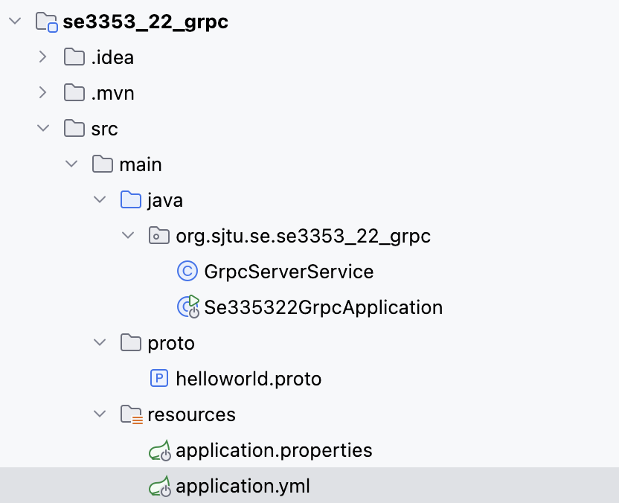
Hello World
Spring Boot gRPC Server Project - Se335322GrpcApplication.java
@SpringBootApplication
public class Se335322GrpcApplication {
public static void main(String[] args) {
SpringApplication.run(Se335322GrpcApplication.class, args);
}
}
application.yml
  grpc:
  server:
  port: 9090
  client:
  local-grpc-server:
  address: "static://localhost:9090"
  negotiationType: plaintext

Slide 39
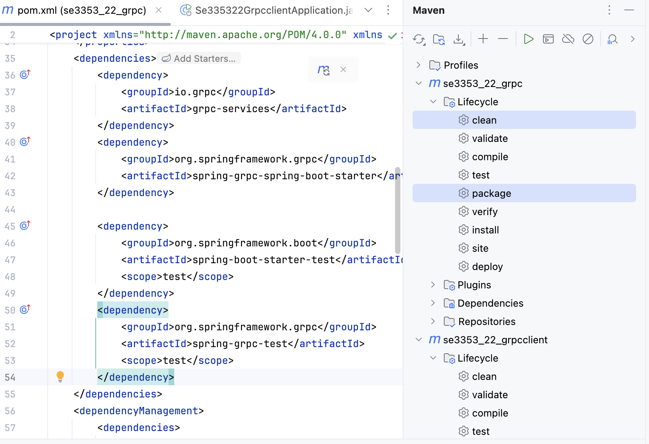
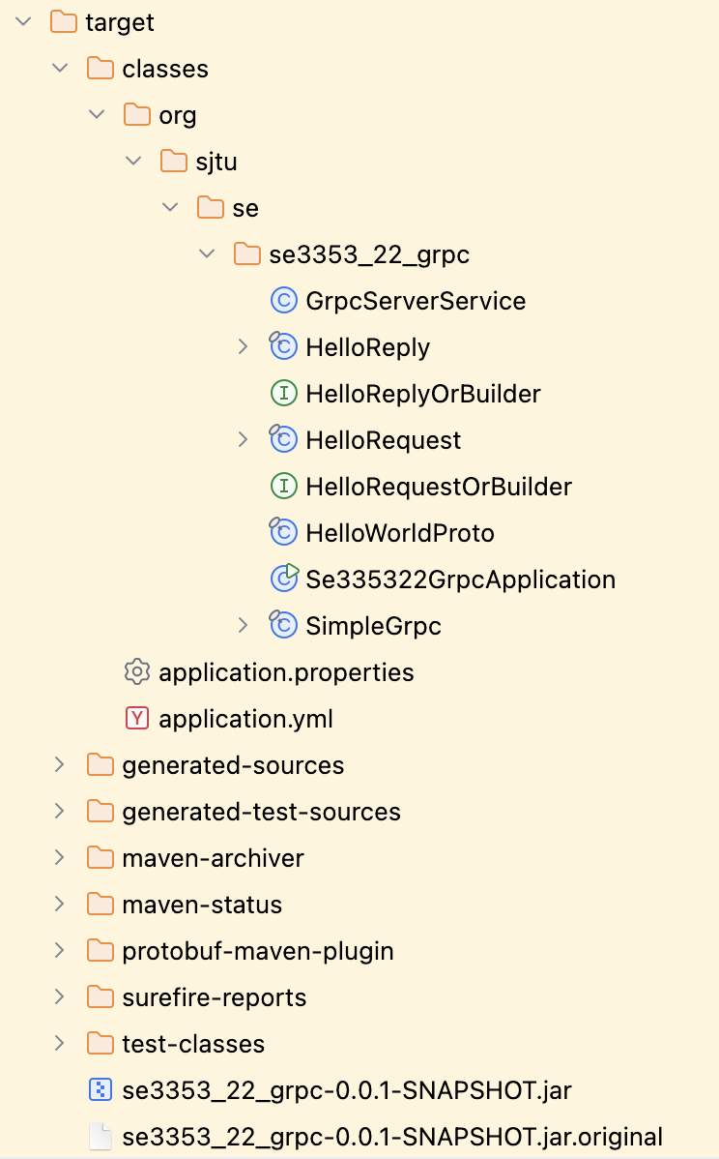
Hello World
Spring Boot gRPC Server Project – pom.xml

Slide 40
Hello World
Spring Boot gRPC Client Project - helloworld.proto
// The request message containing the user's name.
message HelloRequest {
string name = 1;
}
// The response message containing the greetings
message HelloReply {
string message = 1;
}
syntax = "proto3";
option java_multiple_files = true;
option java_package = "org.sjtu.se.se3353_22_grpc";
option java_outer_classname = "HelloWorldProto";
// The greeting service definition.
service Simple {
// Sends a greeting
rpc SayHello(HelloRequest) returns (HelloReply) { }
rpc StreamHello(HelloRequest) returns (stream HelloReply) { }
}

Slide 41
Hello World
Spring Boot gRPC Client Project - Se335322GrpcclientApplication.java
@SpringBootApplication
public class Se335322GrpcclientApplication {
public static void main(String[] args) {
SpringApplication.run(Se335322GrpcclientApplication.class, args);
}
@Bean
SimpleGrpc.SimpleBlockingStub stub(GrpcChannelFactory channels) {
return SimpleGrpc.newBlockingStub(channels.createChannel("local"));
}
@Bean
public CommandLineRunner runner(SimpleGrpc.SimpleBlockingStub stub) {
return args -> {
System.out.println(stub.sayHello(HelloRequest.newBuilder().setName("Alien").build()));
};
}}

Slide 42
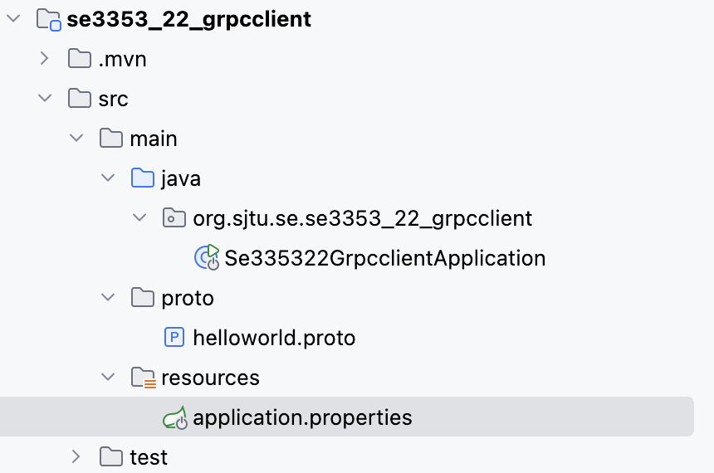
Hello World
Spring Boot gRPC Client Project – application.properties
spring.application.name=grpc-client
spring.grpc.client.default-channel.address=static://0.0.0.0:${launched.grpc.port:9090}
#logging.level.org.springframework.experimental.boot.server.exec=debug

Slide 43
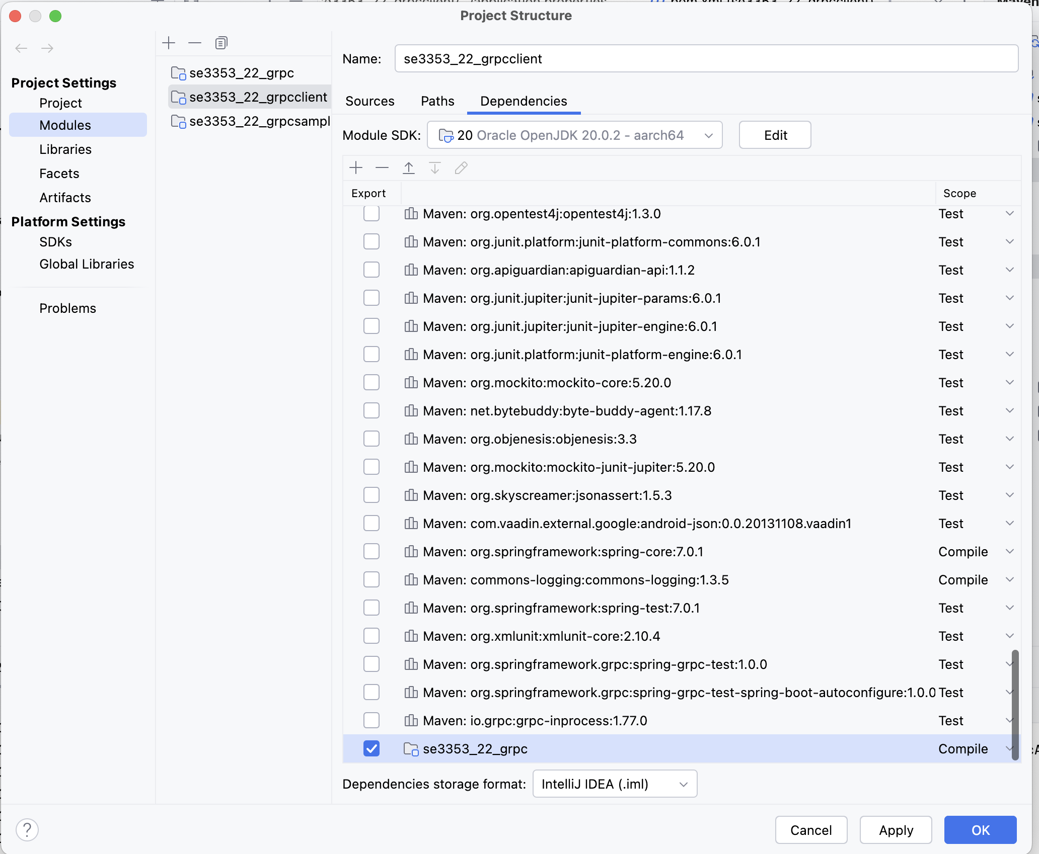
Hello World
Spring Boot gRPC Client Project – dependency

Slide 44
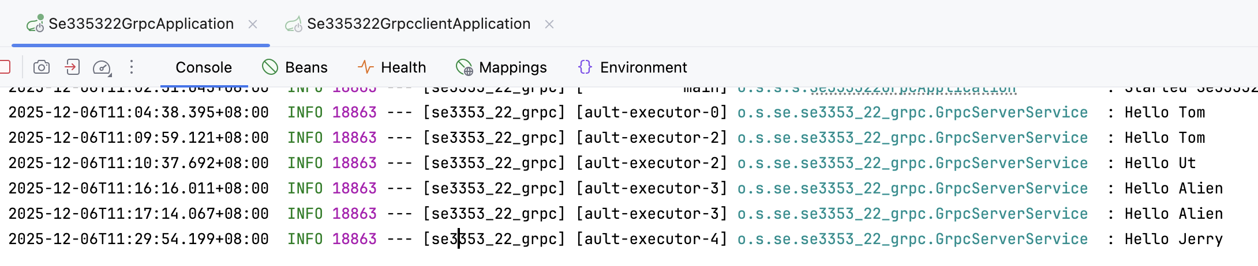
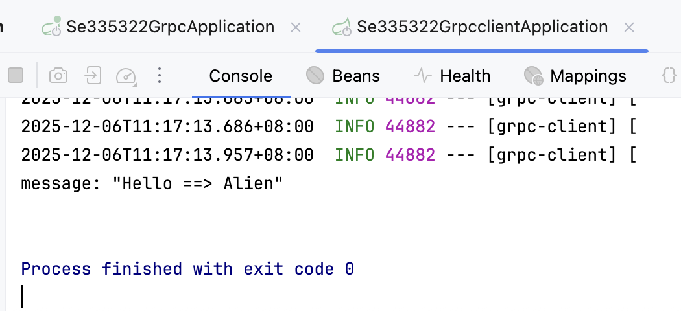
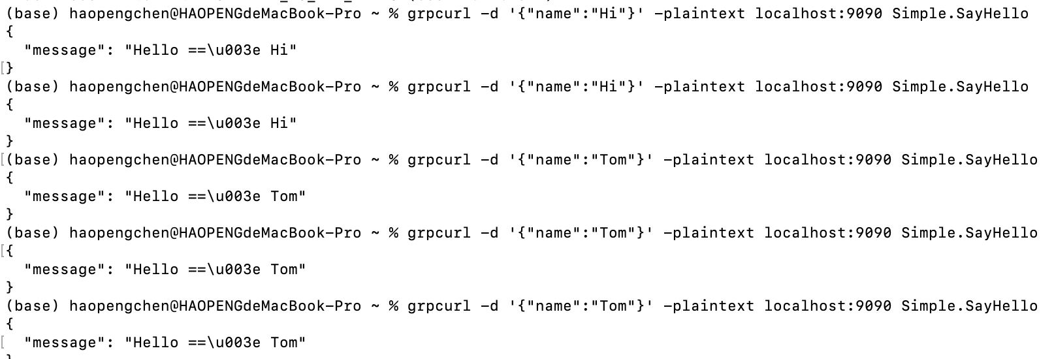
Hello World
grpcurl -d '{"name":"Hi"}' -plaintext localhost:9090 Simple.SayHello

Slide 45
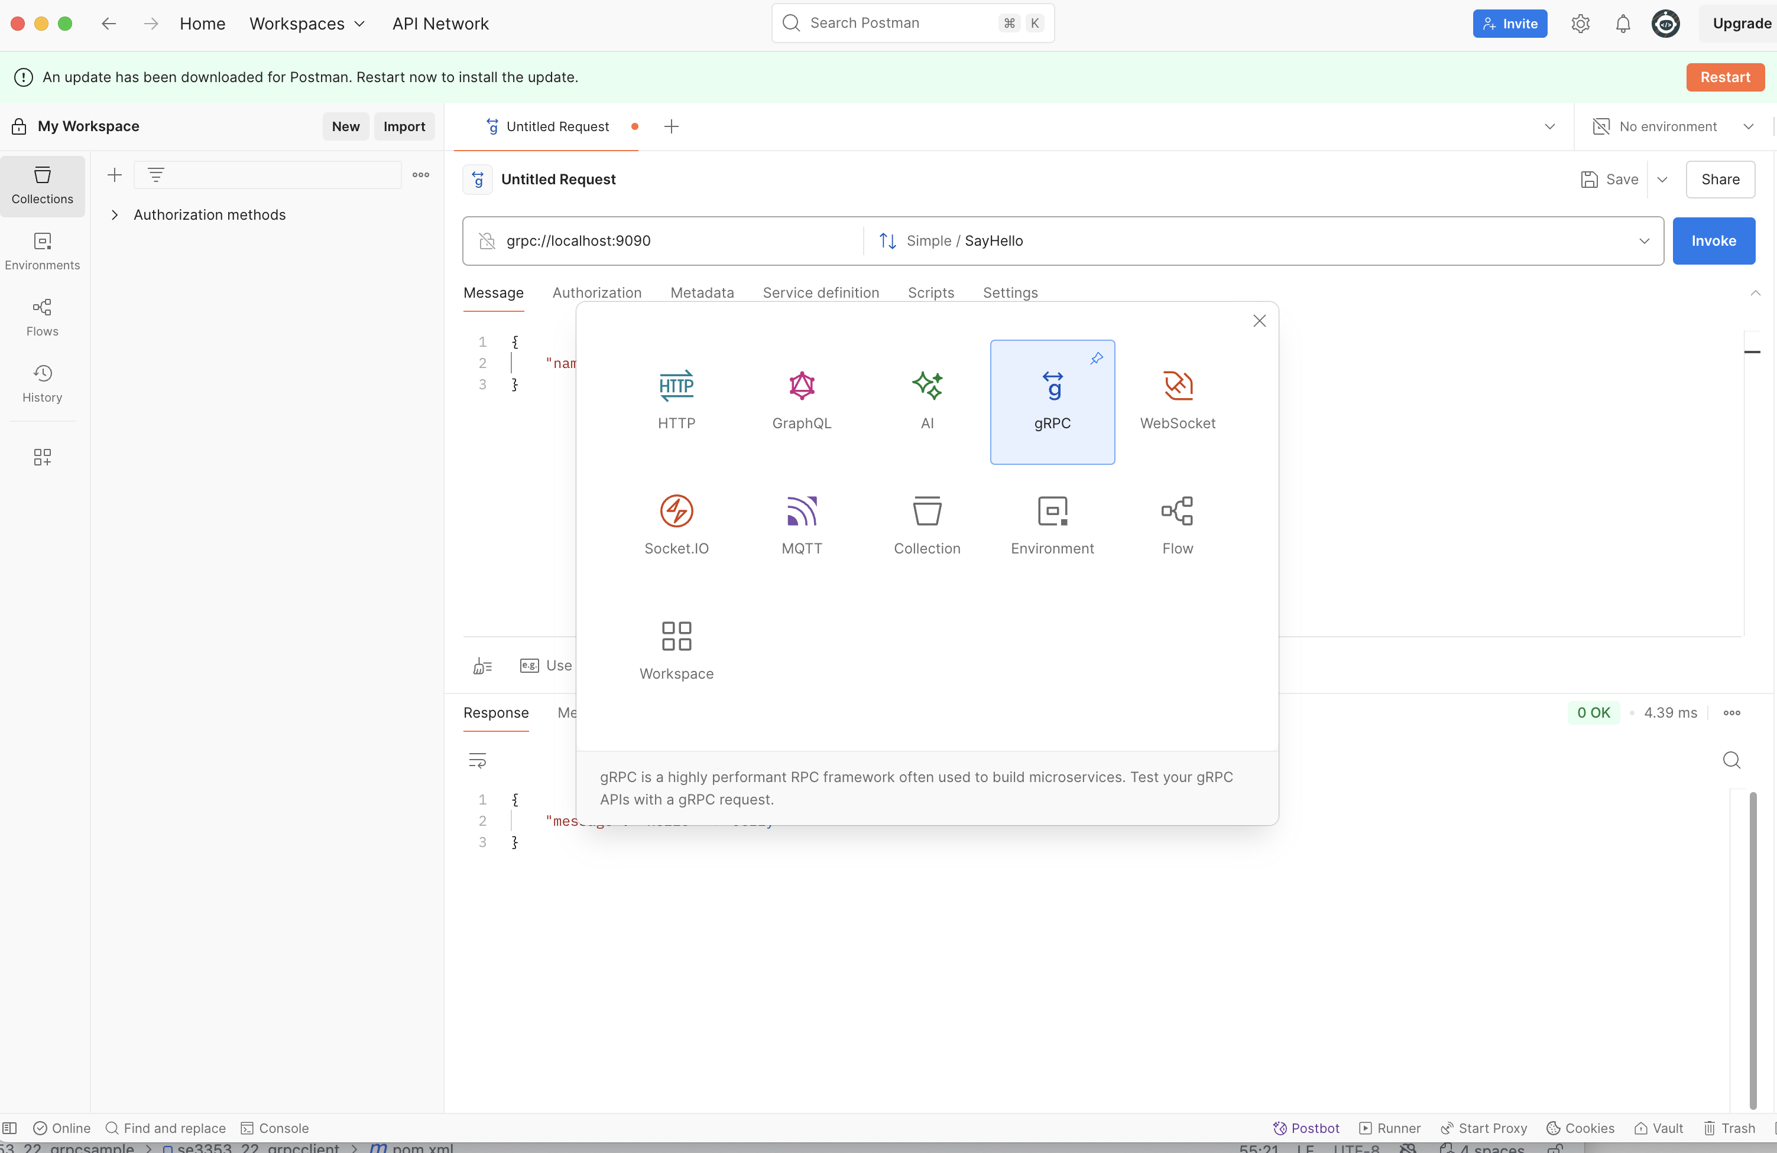
Hello World
Postman

Slide 46
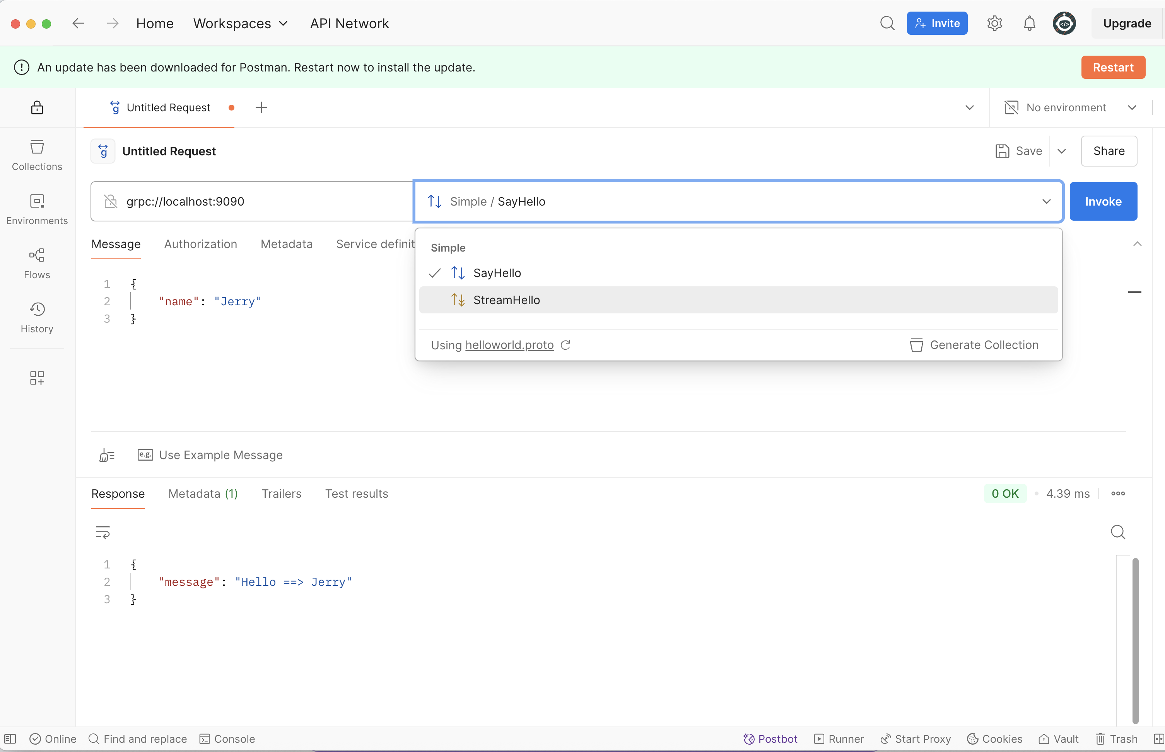
Hello World
Postman

Slide 47
References
gRPC
  https://grpc.io/
spring-grpc
  https://github.com/spring-projects/spring-grpc/tree/main
Spring gRPC
  https://docs.spring.io/spring-grpc/reference/index.html

Slide 48

Thank You!

