Slide 1
Architecture of Enterprise Applications 2
Messaging - kafka
Haopeng Chen
REliable, INtelligent and Scalable Systems Group (REINS)
Shanghai Jiao Tong University
Shanghai, China
http://reins.se.sjtu.edu.cn/~chenhp
e-mail: chen-hp@sjtu.edu.cn

Slide 2
Contents and Objective
Contents
  Kafka
    Introduction
    Quick start
    Communication with Kafka
Objective
  能够根据系统需求，使用Kafka消息中间件来实现异步通信，包括跨编程语言的通信

Slide 3

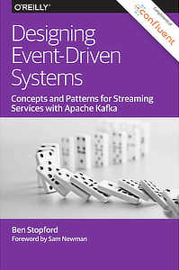
Apache Kafka Resource
from：https://kafka.apache.org/books-and-papers
Apache Kafka Quick Start
  https://kafka.apache.org/quickstart

Slide 4
Apache Kafka
http://kafka.apache.org
Apache Kafka
  is an open-source distributed event streaming.
  To publish (write) and subscribe to (read) streams of events, including continuous import/export of your data from other systems.
  To store streams of events durably and reliably for as long as you want.
  To process streams of events as they occur or retrospectively.

Slide 5
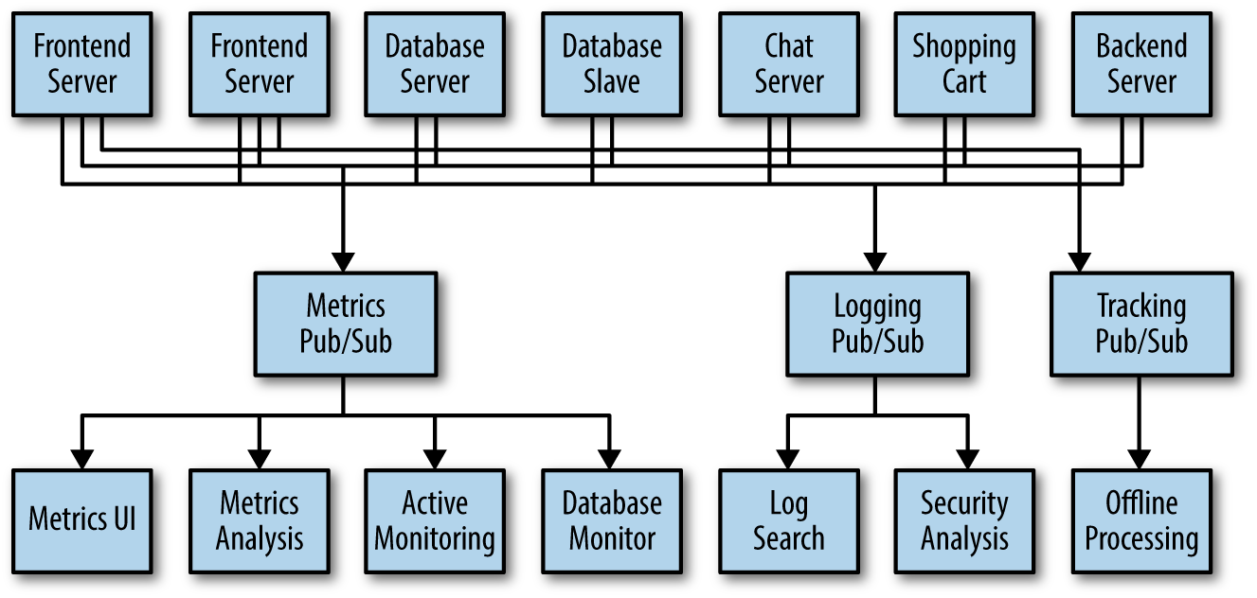
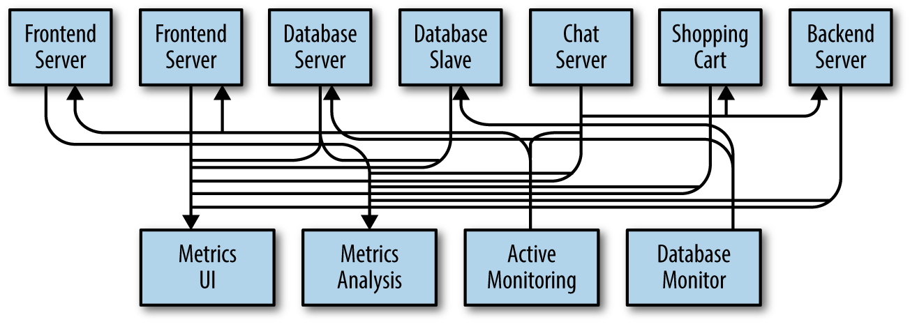
Publish/Subscribe Messaging

Slide 6
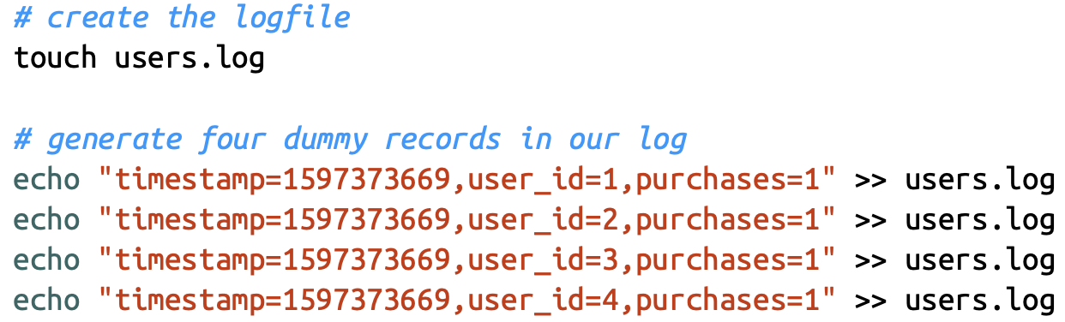
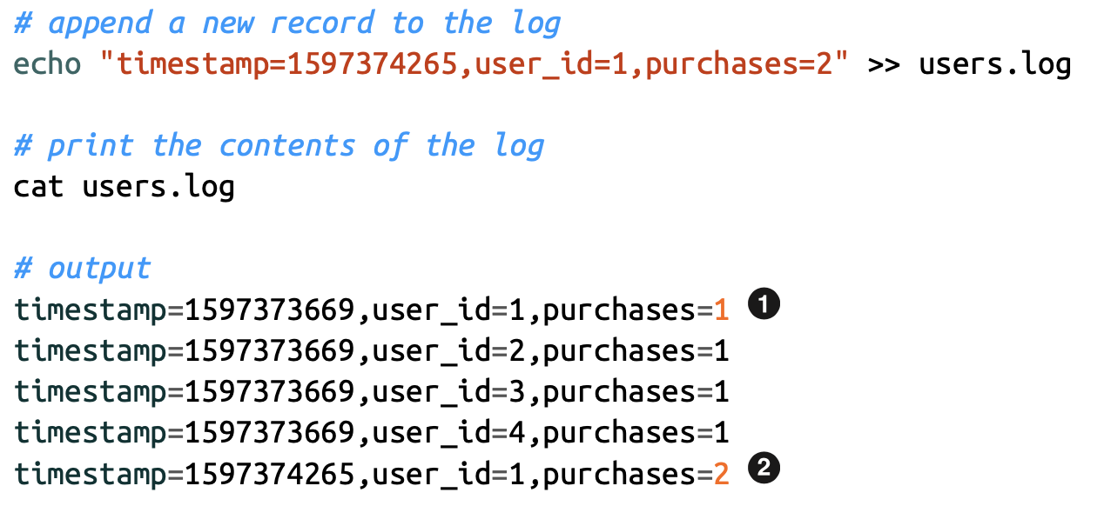
How Are Streams Stored?
Logs are append-only data structures that capture an ordered sequence of events.

Slide 7
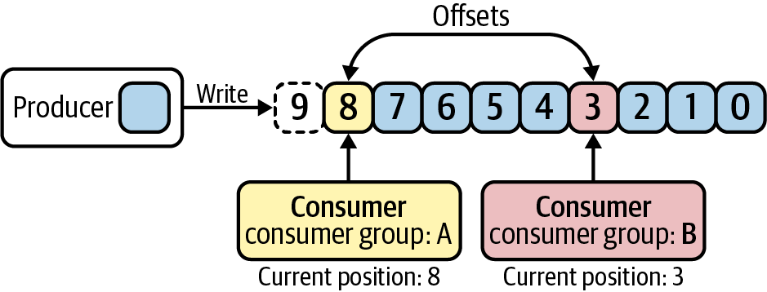
Offset
Kafka refers to the position of each entry in its distributed log as an offset.
  multiple consumer groups can each read from the same log, and maintain their own positions in the log/stream they are reading from.

Slide 8
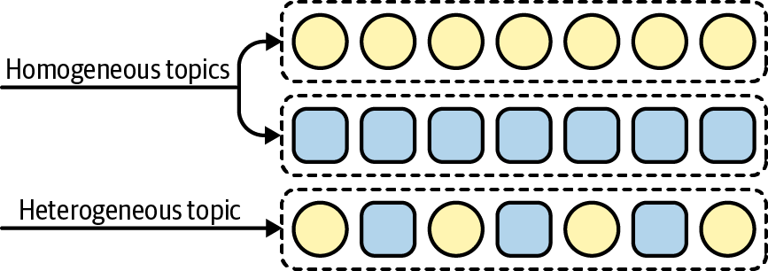
Topics and Partitions
Topics
  homogeneous topics that contain only one type of data, or heterogeneous topics that contain multiple types of data

Slide 9
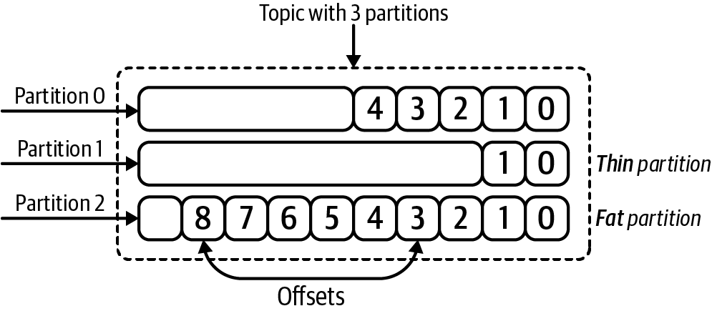
Topics and Partitions
Kafka topics are broken into smaller units called partitions.
  Partitions are individual logs where data is produced and consumed from
  The number of partitions for a given topic is configurable, and having more partitions in a topic generally translates to more parallelism and throughput

Slide 10
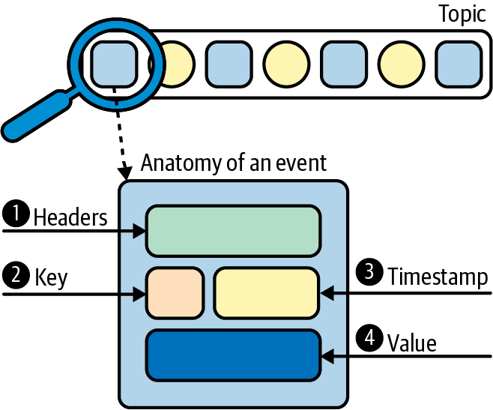
Events
An event is a timestamped key-value pair that records something that happened.
  Application-level headers contain optional metadata about an event.
  Keys are also optional, but play an important role in how data is distributed across partitions.
  Each event is associated with a timestamp.
  The value contains the actual message contents, encoded as a byte array.

Slide 11
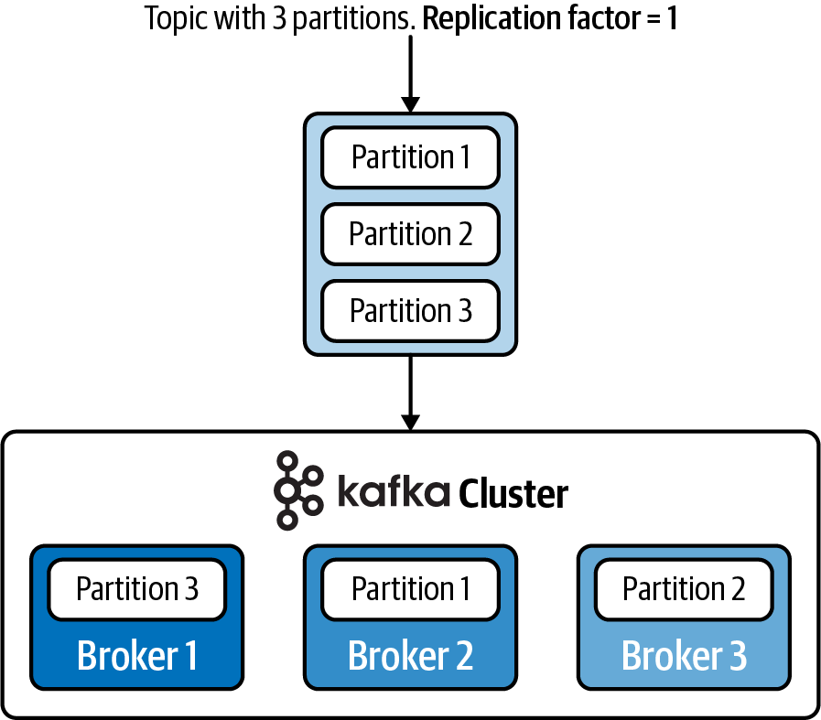
Kafka Cluster and Broker
Kafka operates as a cluster, and multiple machines, called brokers, are involved in the storage and retrieval of data.
  Kafka clusters can be quite large, and can even span multiple data centers and geo‐ graphic regions.

Slide 12
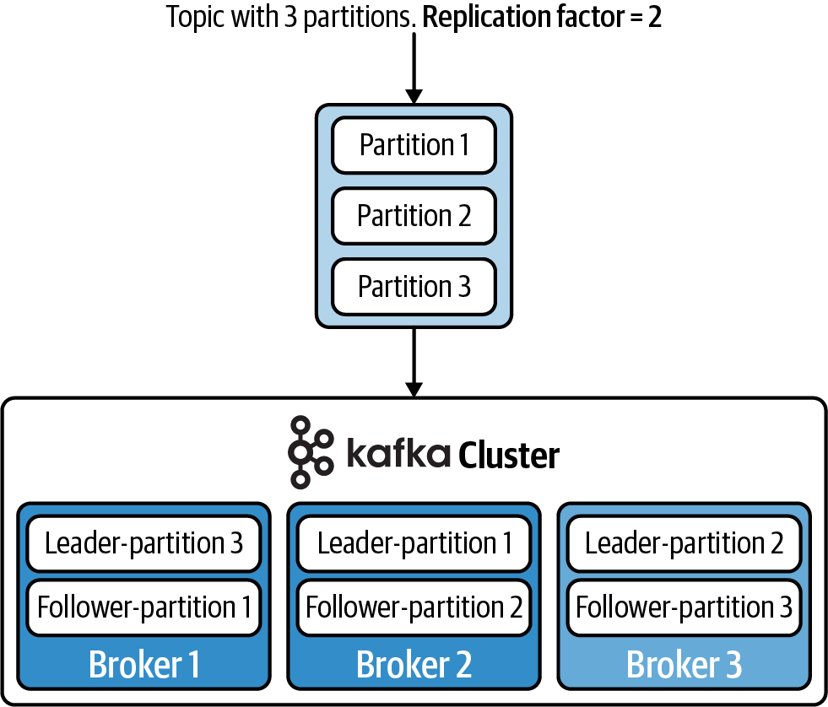
Kafka Cluster and Broker
To achieve fault tolerance and high availability, you can set a replication factor when configuring the topic.

Slide 13
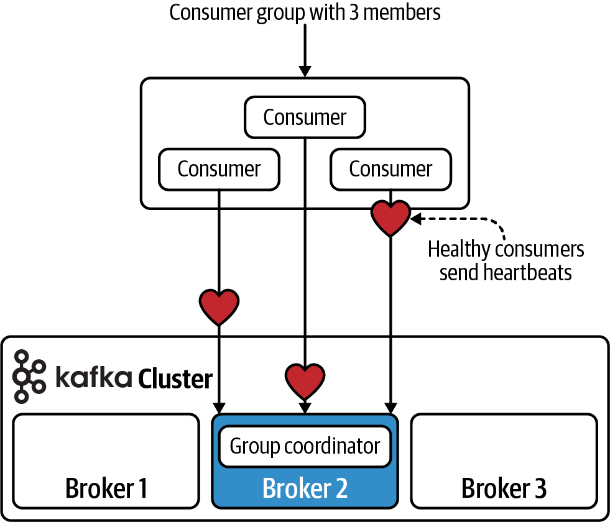
Customer Groups
Consumer groups are made up of multiple cooperating consumers, and the member‐ ship of these groups can change over time.
  every consumer group is assigned to a special broker called the group coordinator, which is responsible for receiving heartbeats from the consumers, and triggering a rebalance of work whenever a consumer is marked as dead.

Slide 14
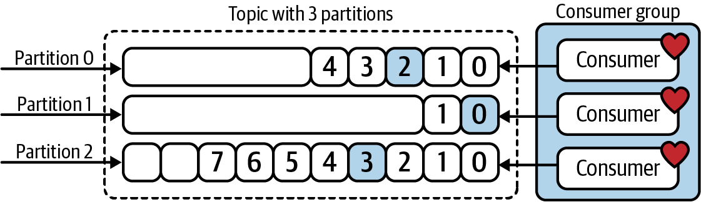
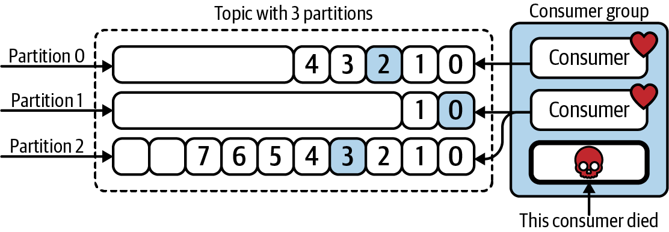
Customer Groups
Every active member of the consumer group is eligible to receive a partition assignment.

Slide 15
Apache Kafka Core APIs
Kafka has four core APIs:
  The Producer API allows an application to publish a stream of records to one or more Kafka topics.
  The Consumer API allows an application to subscribe to one or more topics and process the stream of records produced to them.
  The Streams API allows an application to act as a stream processor, consuming an input stream from one or more topics and producing an output stream to one or more output topics, effectively transforming the input streams to output streams.
  The Connector API allows building and running reusable producers or consumers that connect Kafka topics to existing applications or data systems. For example, a connector to a relational database might capture every change to a table.

Slide 16
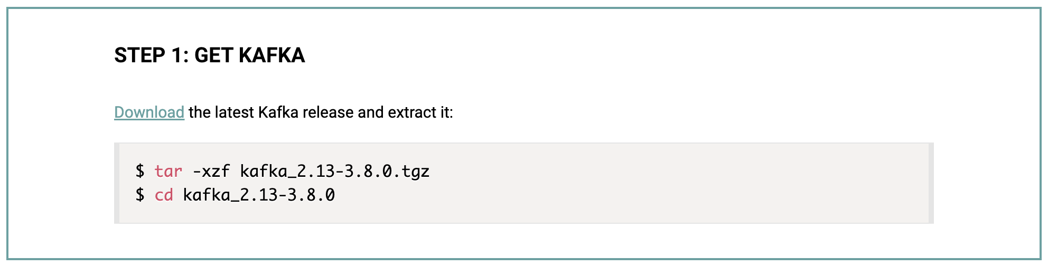
Kafka - Quickstart
Quickstart
  https://kafka.apache.org/quickstart
Notes:
cd kafka_2.13-3.8.0

Slide 17
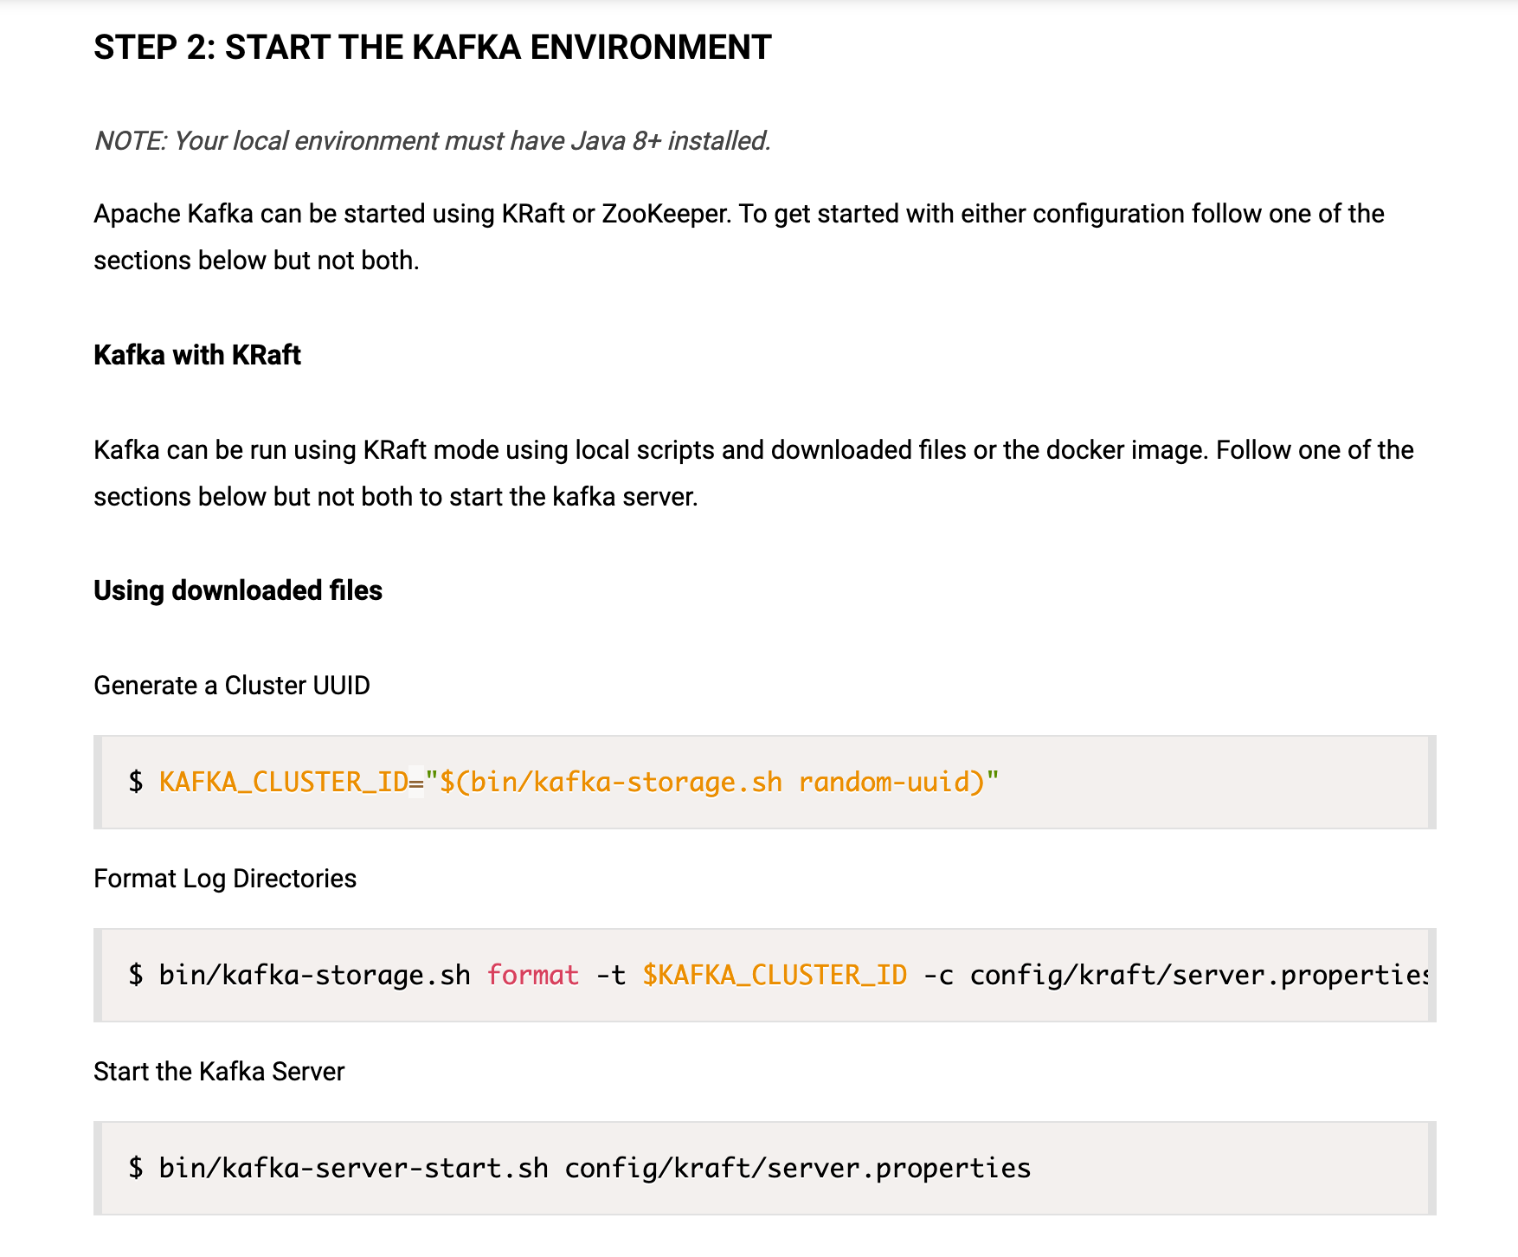
Kafka - Quickstart
Notes:
$ KAFKA_CLUSTER_ID="$(bin/kafka-storage.sh random-uuid)"
$ bin/kafka-storage.sh format -t $KAFKA_CLUSTER_ID -c config/kraft/server.properties
$ bin/kafka-server-start.sh config/kraft/server.properties

Slide 18
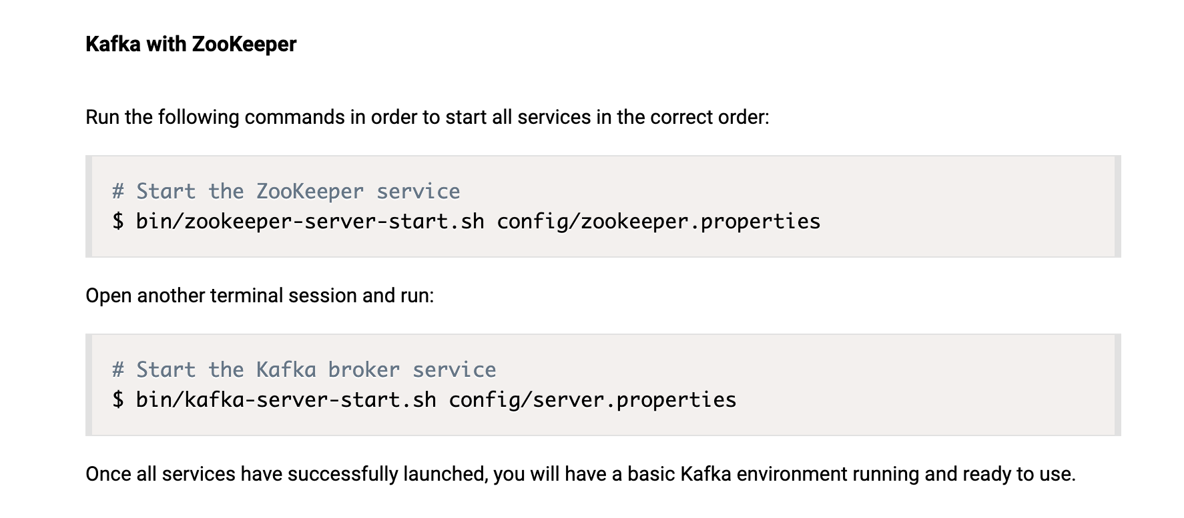
Kafka - Quickstart
bin/zkServer.sh start
conf/zoo.cfg
admin.serverPort = 8888
Notes:
$ bin/zookeeper-server-start.sh config/zookeeper.properties
$ bin/kafka-server-start.sh config/server.properties

Slide 19
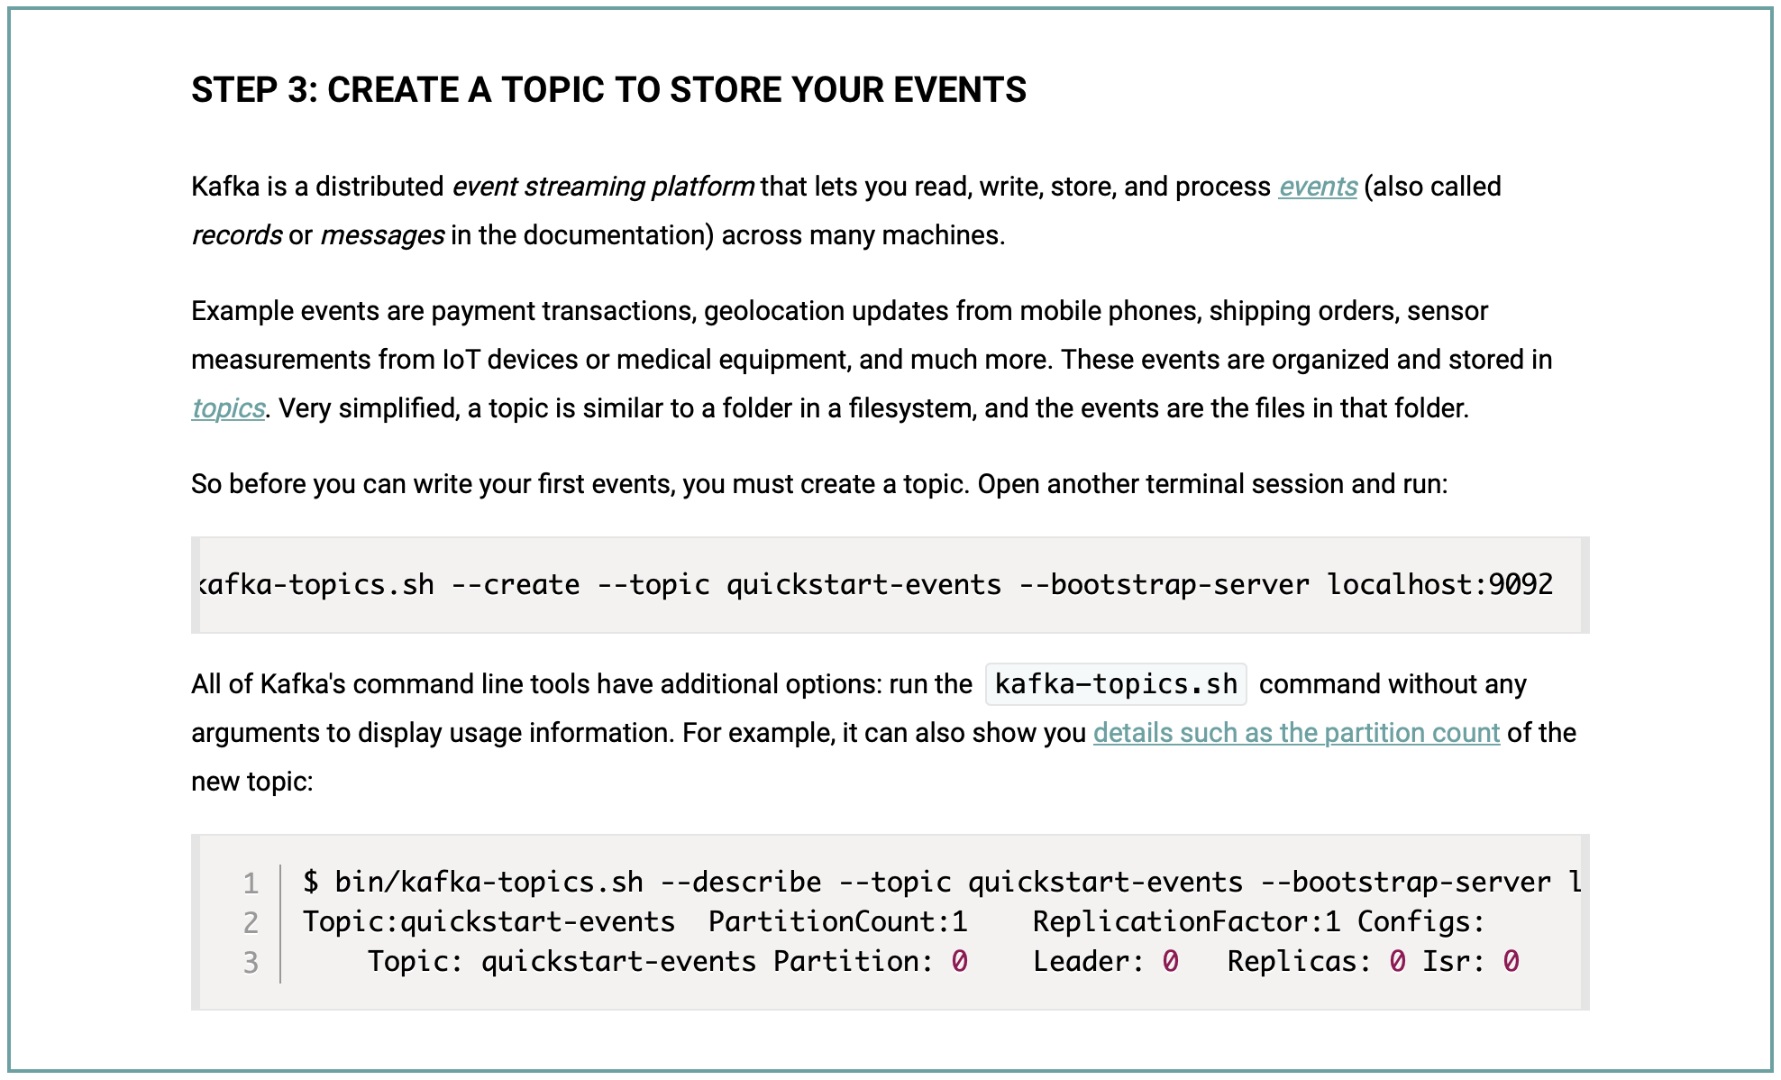

Kafka - Quickstart
Notes:
bin/kafka-topics.sh --create --topic quickstart-events --bootstrap-server localhost:9092
bin/kafka-topics.sh --describe --topic quickstart-events --bootstrap-server localhost:9092

Slide 20
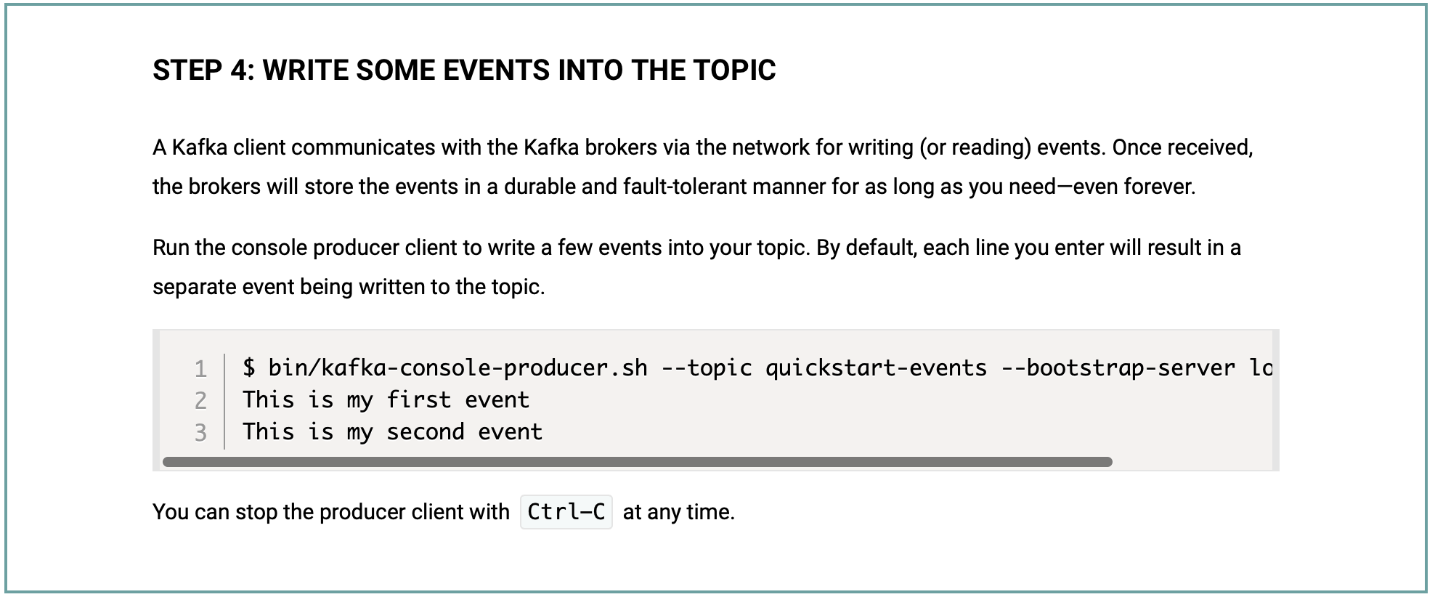

Kafka - Quickstart
Notes:
bin/kafka-console-producer.sh --topic quickstart-events --bootstrap-server localhost:9092

Slide 21
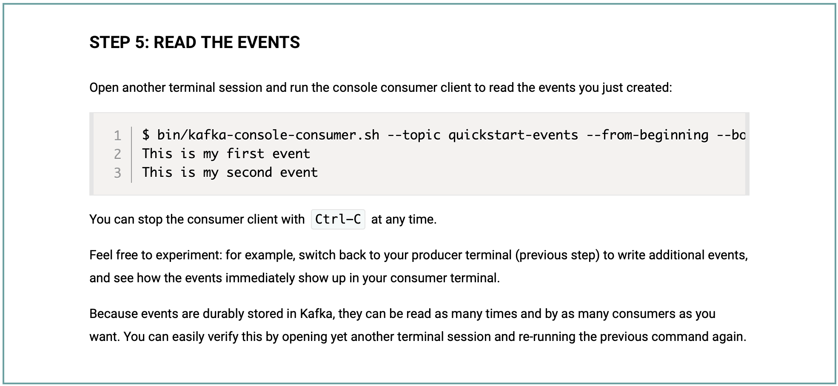

Kafka - Quickstart
Notes:
bin/kafka-console-consumer.sh --topic quickstart-events --from-beginning --bootstrap-server localhost:9092

Slide 22
Apache Kafka
Access Kafka with Java
  To use Producer API and Consumer API, you can use the following maven dependency:
    <dependency>
    <groupId>org.apache.kafka</groupId>
    <artifactId>kafka-clients</artifactId>
    <version>3.8.0</version>
    </dependency>

Slide 23
Apache Kafka
KafkaPro.java
public class KafkaPro {
public static void main(String[] args) throws Exception {
Properties props = new Properties();
props.put("bootstrap.servers", "localhost:9092");
props.setProperty("transactional.id", "my-transactional-id");
Producer<String, String> producer = null;
try {
producer = new KafkaProducer<String, String>(props, new StringSerializer(), new StringSerializer());
producer.initTransactions();
producer.beginTransaction();
for (int i = 0; i < 100; i++)
producer.send(new ProducerRecord<>("test", Integer.toString(i), "Message " + Integer.toString(i)));
producer.commitTransaction();
} catch (ProducerFencedException e) {
producer.close();
} catch (OutOfOrderSequenceException e) {
producer.close();
} catch (AuthorizationException e) {
producer.close();
} catch (KafkaException e) {
producer.abortTransaction();
}
producer.close();
}
}

Slide 24
Apache Kafka
KafkaCon.java
public class KafkaCon {
public static void main(String[] args) throws Exception {
Properties props = new Properties();
props.setProperty("bootstrap.servers", "localhost:9092");
props.setProperty("group.id", "test");
props.setProperty("enable.auto.commit", "true");
props.setProperty("auto.commit.interval.ms", "1000");
props.setProperty("key.deserializer", "org.apache.kafka.common.serialization.StringDeserializer");
props.setProperty("value.deserializer", "org.apache.kafka.common.serialization.StringDeserializer");
KafkaConsumer<String, String> consumer = new KafkaConsumer<>(props);
consumer.subscribe(Arrays.asList("test"));
while (true) {
ConsumerRecords<String, String> records = consumer.poll(Duration.ofMillis(100));
for (ConsumerRecord<String, String> record : records)
System.out.printf("offset = %d, key = %s, value = %s%n", record.offset(), record.key(), record.value());
}
}
}
Notes:
bin/zkServer.sh start
bin/kafka-server-start.sh config/server.properties

Slide 25
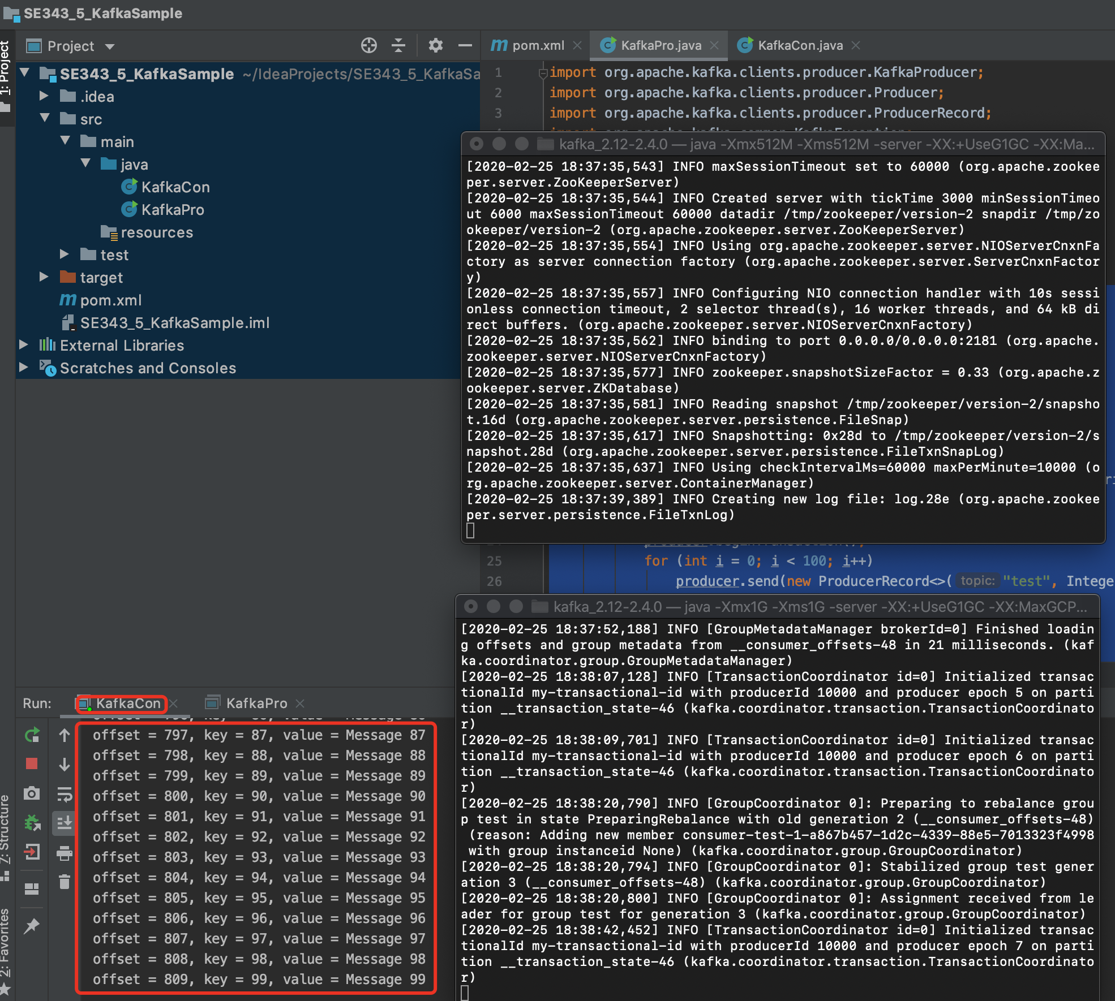
Apache Kafka

Slide 26
Spring for Kafka
Consumer
@SpringBootApplication
public class ConsumerApplication {
public static void main(String[] args) {
SpringApplication.run(ConsumerApplication.class, args);
}
@Bean
public NewTopic topic() {
return TopicBuilder.name("topic1")
.partitions(10)
.replicas(1)
.build();
}
@KafkaListener(id = "myId", topics = "topic1")
public void listen(String in) {
System.out.println(in);
}
}

Slide 27
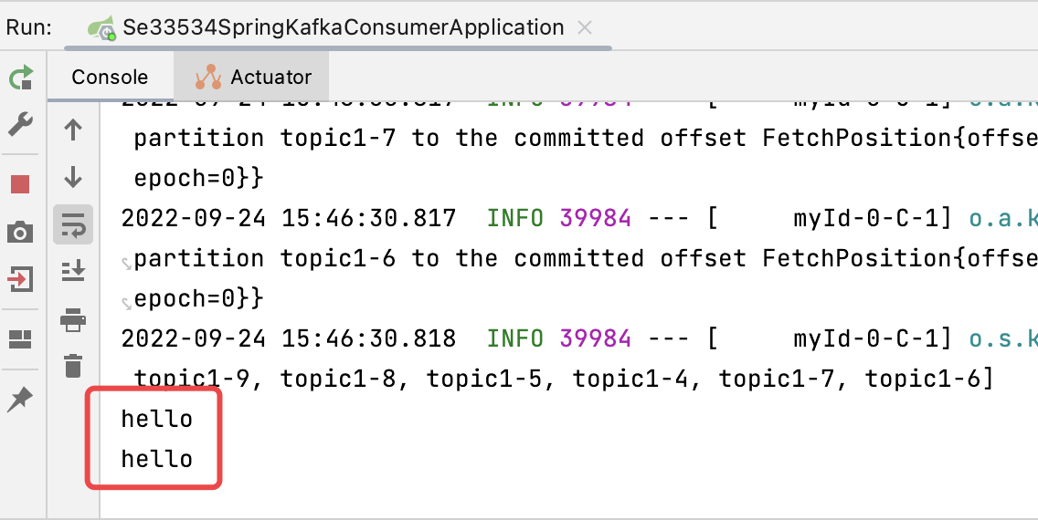
Spring for Kafka
Producer
@SpringBootApplication
public class KafkaProducerApplication {
public static void main(String[] args) {
SpringApplication.run(ProducerApplication.class, args);
}
@Bean
public NewTopic topic() {
return TopicBuilder.name("topic1")
.partitions(10)
.replicas(1)
.build();
}
@Bean
public ApplicationRunner runner(KafkaTemplate<String, String> template) {
return args -> {
template.send("topic1", "hello");
};
}
}

Slide 28
Place Order with Kafka
BankController
@RestController
public class BankController {
@Autowired
private KafkaTemplate<String, String> kafkaTemplate;
@RequestMapping("/send")
public void send() {
String data = "Tom,Jerry,80";
kafkaTemplate.send("topic1", "key", data);
System.out.println(data);
}
}

Slide 29
Place Order with Kafka
BankListener
@Component
public class BankListener {
@Autowired
private BankService bankService;
@KafkaListener(topics = "topic1", groupId = "group_topic_test")
public void topicListener(ConsumerRecord<String, String> record) {
String[] value = record.value().split(",");
bankService.transfer(value[0], value[1], Integer.valueOf(value[2]));
}
}

Slide 30
Place Order with Kafka
SQL Script
  DROP TABLE IF EXISTS `bank`;
  CREATE TABLE `bank` (
  `account` varchar(45) NOT NULL,
  `balance` int DEFAULT NULL,
  PRIMARY KEY (`account`)
  ) ENGINE=InnoDB DEFAULT CHARSET=utf8mb4 COLLATE=utf8mb4_0900_ai_ci;

Slide 31
References
Apache Kafka Quick Start
  https://kafka.apache.org/quickstart
Spring for Apache Kafka
  https://docs.spring.io/spring-kafka/reference/kafka.html
如何轻松在SpringBoot中正确配置并运行Kafka
  https://blog.csdn.net/Eternal_Blue/article/details/125293622
详细解决zookeeper启动占用8080端口方法
  https://blog.csdn.net/tianynnb/article/details/128617174

Slide 32

Thank You!

