Slide 1


From single to distributed: inode-based File System
SE3331-1 (2025 Fall)
Yubin Xia / Xingda Wei
IPADS, Shanghai Jiao Tong University
https://www.sjtu.edu.cn

Slide 2

Different storage systems to support different services
Scalable Database
Scalable file system
Scalable
Key-value store

Slide 3

Each click needs thousands of servers to cooperate
Caching server
Caching server
…
Caching server
Caching
Caching
Caching
Distributed caching
Database server
Database server
CDN
Users
Application #1
generate the page
Database
user, price
…
Database
user, price
Application server
Distributed database
Internet
Load
Balance
Application #2
add the order
File server
File server
File server
File:
image
File:
image
…
File:
image
Application server
…
…
Message queue
Distributed file system

Slide 4
Single-node inode-based filesystem
Notes:
Paul barham: tensorflow, pathway

Slide 5
Large-scale websites are built from distributed systems
While distributed systems are built from components on a single node
  File system runtimes, etc.
Caching server
Caching server
Caching server
…
Caching
Caching
Caching
Distributed caching
Database server
Database server
CDN
Users
Application #1
generate the page
Database
user, price
…
Database
user, price
Application server
Distributed database
Internet
Load
Balance
Application #2
add the order
File server
File server
File server
File:
image
File:
image
…
File:
image
Application server
…
…
Message queue
Distributed file system

Slide 6
What is a file?
Storage as files
File is the most nature way to store the data
A file has two key properties:
  It is durable & has a name
  It is a high-level version of the memory abstraction
System layer implements files using modules from hardware layer
  Divide-and-conquer strategy
  Makes use of several hidden layers of machine-oriented names (addresses), one on another, to implement files
  Maps user-friendly names to these files

Slide 7
The Big Picture
User
App-1
App-2
App-3
OPEN("a.txt", "rw")
READ(…)
WRITE(…)
…
File System
Kernel
Disk Driver
Read(block-addr, buf)
Write(block-addr, buf)
Hardware
Memory
Disk
(4TB = 2³⁰ x 4KB blocks^{[1]})
[1] The block size depends on the device type, e.g., can be 512B, 256 & many others

Slide 8
What does the disk driver’s abstraction?
State: sectors (e.g., 512B or 4KB)
  Sector is the smallest amount of unit read/write by the disk
APIs: quite complex, but can be simplified as
  Read (block_idx : integer) -> Sector
  Write (block_idx : integer, data : Sector)
But, it mismatches with the file system
  E.g., functionality mismatch: we want to store a file (much) larger than the sector size

Slide 9
The basic file system abstraction
The abstract state stored on the disk
  File we described before
APIs on the states
  READ (‘name’, offset, sz) -> Array of data
  WRITE (‘name’, offset, sz, data)
The data can be arbitrary size (up to a limit)

Slide 10
A Naive File System
Each file occupies one continuous range of sectors?
  Use sector index as file name, e.g., 107, 113
  Every file write will either append or reallocate
What are the problems?
101
102
103
104
105
106
107
108
109
110
111
112
113
114
115
116
117
118
119
120

Slide 11
Problems
How to find the free sectors on the disk?
  With brute force scan? Hurt performance
What if we want to enlarge a file?
  May move huge numbers of sectors. Hurt performance
What if we want to name file using strings?
  E.g., CSE-03 inodefs.pptx
What if we want to do authentications on the file?
  Must implement by the user itself. Hurt usability or scarify security
Many others …

Slide 12
Abstraction: API of UNIX File System
OPEN, READ, WRITE, APPEND, SEEK, CLOSE
FSYNC
STAT, CHMOD, CHOWN
RENAME, LINK, UNLINK, SYMLINK
MKDIR, CHDIR, CHROOT
MOUNT, UNMOUNT
….

Slide 13
inode: 7 software layers

Slide 14
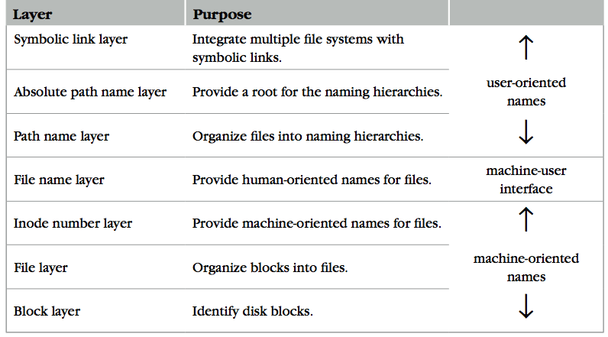
The Naming Layers of the UNIX FS (version 6)
Notes:
TODO: redraw

Slide 15
L1: Block Layer
Block num
Disk
Block
Block: the basic unit of data management of the filesystem
  >= sector size. Allowing a flexible management of the hardware resource, e.g., managing many sectors is complex or may hurt performance
Mapping: block number -> block data
Question: why we need block instead of sectors?
  Allowing a more flexible configuration of metadata used to manage the disk data
  E.g., 4KB block = 4 continuous sectors (1KB), so the metadata overhead (e.g., which sectors belonging to a file) is reduced by 4
procedure BLOCK_NUMBER_TO_BLOCK(integer b)-> block
return devices[b]
Notes:
Cause amplification
Can hide data in the large block
- assumption: we can modify the file system to give some backdoor

Slide 16
L1: Block Layer
Block num
Disk
Block
Block: the basic unit of data management of the filesystem
  >= sector size. Allowing a flexible management of the hardware resource, e.g., managing many sectors is complex or may hurt performance
Mapping: block number -> block data
Question: how to determine the right block size?
  Trade-off between efficiency & utilization
  E.g., internal fragmentation
procedure BLOCK_NUMBER_TO_BLOCK(integer b)-> block
return devices[b]
Notes:
Cause amplification
Can hide data in the large block
- assumption: we can modify the file system to give some backdoor

Slide 17

L1: Block Layer
Block num
Disk
Block
Block: the basic unit of data management of the filesystem
  >= sector size. Allowing a flexible management of the management unit, e.g., how many data units to manage
Mapping: block number -> block data
How to know the size of block?
  How to know which block is free?
  These metadata will also be stored on the same disk
  Super block!
procedure BLOCK_NUMBER_TO_BLOCK(integer b)-> block
return devices[b]

Slide 18
Super Block
Block num
Disk
Block
One superblock per file system
  Kernel reads superblock when mount the FS
Superblock contains:
  Size of the blocks
  Number of free blocks
  A list of free blocks
  Other metadata of the file system (including inode info, talked later)
0
1
…
n - 1
Boot
block
Super
block
Notes:
Naïve solution: linked list
2GB for data management.

Slide 19
L1: Block Layer
Block num
Disk
Block
Use a bitmap to track the free blocks
  1 byte ~= 8bit
  A simple brute force method, but works well in various scenarios
File blocks
0
1
…
n - 1
Boot
block
Super
block
Bitmap for free blocks
Notes:
Mitmap: 31MB of data

Slide 20
L2: File Layer
File
(inode)
Block num
Disk
Block
File requirements
  A file is a linear array of bytes of arbitrary length
  Store items that are larger than one block
  May grow or shrink over time
inode (index node)
  A container for metadata about the file
  Record which blocks belong to each file
Question: where the inode should be stored?
  We can only use the disk block. What is the problem?
struct inode
integer block_nums[N]
integer size
Notes:
4KB, 4B block id => 4MB file max supported

Slide 21
inode for Larger Files
File
(inode)
Block num
Disk
Block
block
indirect block
double indirect block
triple indirect block
Data
Data
Data
Data
an inode
Data
Data
Notes:
with a 512 byte block size, and 4 byte block pointers, each indirect block can consist of 128 (512 / 4) pointers.
For one double indirect block: (128*128*512) / (1024*1024)
页表的indirection vs. block indirection

Slide 22
L2: File Layer
File
(inode)
Block num
Disk
Block
Given an inode, can map a block index number (of a file) to a block number (of a disk)
  Index number: e.g., the 3rd block of a file is number 78
procedure INODE_TO_BLOCK(integer offset, inode i)-> block
o <- offset / BLOCKSIZE
b – INDEX_TO_BLOCK_NUMBER(i,o)
return BLOCK_NUMBER_TO_BLOCK(b)
procedure INDEX_TO_BLOCK_NUMBER(inode i, integer index)-> integer // Simplified!
return i.block_nums[index]

Slide 23
L3: inode Number Layer
Inode num
File
(inode)
Block num
Disk
Block
Mapping: inode number -> inode
inode table: at a fixed location on storage
  inode number is the index of inode table
  Track which inode number are in use, e.g. free list, a field in inode
Think: can we use other layouts for the inode table? (see lab1)
procedure INODE_NUMBER_TO_INODE(integer num)-> inode
return inode_table[num]
0
1
…
n - 1
Boot
block
Super
block
Bitmap for free blocks
Inode table

Slide 24
Put Layers so far Together
Inode num
File
(inode)
Block num
Disk
Block
procedure INODE_NUMBER_TO_BLOCK(integer offset, integer inode_number)-> block
inode i = INODE_NUMBER_TO_INODE(inode_number)
o <- offset / BLOCKSIZE
b <- INDEX_TO_BLOCK_NUMBER(i,o)
return BLOCK_NUMBER_TO_BLOCK(b)
inode number is sufficient to operate a file. However,
  inode numbers are convenient names only for computer
A file needs a more user-friendly name!

Slide 25
L4: File Name Layer
File
name
Inode num
File
(inode)
Block num
Disk
Block
File name
  Hide metadata of file management
  Files and I/O devices
Mapping
  Mapping table is saved in directory
  Default context: current working directory
    Context reference is an inode number
  Question: where can we store the directory?
    Method: the current working directory is also a file
struct inode
integer block_nums[N]
integer size
integer type
Overview of a directory inode content
File name | inode num
helloworld.txt | 12
cse2021.md | 73
procedure name_to_inode(string filename, integer dir)-> integer
return LOOKUP(dir, filename)

Slide 26
LOOKUP in a Directory
File
name
Inode num
File
(inode)
Block num
Disk
Block
procedure LOOKUP(string filename, integer dir)-> integer
block b
inode i = INODE_NUMBER_TO_INODE(dir)
if i.type != DIRECTORY then return FAIURE
for offset from 0 to i.size – 1 do
b <- INODE_NUMBER_TO_BLOCK(offset, dir)
if STRING_MATCH(filename, b) then
return INODE_NUMBER(filename, b)
offset <- offset + BLOCKSIZSE
return FAILURE
Overview of a directory inode content
File name | inode num
helloworld.txt | 12
cse2021.md | 73
Name comparing method: STRING_MATCH
  LOOKUP(”cse2021", dir) will return 73
Fun fact:
  Max length of a file name is 14 bytes in UNIX version 6 (what does it mean? Why?)

Slide 27
LOOKUP in a Directory
File
name
Inode num
File
(inode)
Block num
Disk
Block
procedure LOOKUP(string filename, integer dir)-> integer
block b
inode i = INODE_NUMBER_TO_INODE(dir)
if i.type != DIRECTORY then return FAIURE
for offset from 0 to i.size – 1 do
b <- INODE_NUMBER_TO_BLOCK(offset, dir)
if STRING_MATCH(filename, b) then
return INODE_NUMBER(filename, b)
offset <- offset + BLOCKSIZSE
return FAILURE
Overview of inode content
Name comparing method: STRING_MATCH
  LOOKUP(”cse2021", dir) will return 73
Next problem:
  What if there are too many files in a directory?
File name | inode num
helloworld.txt | 12
cse2021.md | 73

Slide 28
L5: Path Name Layer
File
name
Inode num
File
(inode)
Block num
Disk
Block
Path name
Hierarchy of directories and files (i.e., add indexing)
  Structured naming: E.g. "projects/paper"
Context: the working directory dir
procedure PATH_TO_INODE_NUMBER(string path, integer dir)-> integer
if PLAIN_NAME(path)return NAME_TO_INODE_NUMBER(path,dir)
else
dir <- LOOKUP(FIRST(path), dir)
path <- REST(path)
return PATH_TO_INODE_NUMBER(path,dir)

Slide 29
Links
File
name
Inode num
File
(inode)
Block num
Disk
Block
Path name
LINK: create shortcut for long names
  LINK("Mail/inbox/new-assignment", "assignment")
  Turns strict hierarchy into a directed graph
    Users cannot create links to directories -> acyclic graph
  Different filenames, same inode number
UNLINK
  Remove the binding of filename to inode number
  If UNLINK last binding, put inode/blocks to a free-list
    A reference counter is needed

Slide 30
Links
File
name
Inode num
File
(inode)
Block num
Disk
Block
Path name
Reference count
  An inode can bind multiple file names
  +1 when LINK, -1 when UNLINK
  A file will be deleted when reference count is 0
Question
  What if there is a cycle?
struct inode
integer block_nums[N]
integer size
integer type
integer refcnt

Slide 31

No Cycle for LINK
File
name
Inode num
File
(inode)
Block num
Disk
Block
Path name
x
x
x
a
a
a
25:1
25:2
25:1
b
c
b
c
b
/a/b is a directory
The refcnt of a is 1
a's inode num is 25
LINK ("/a/b/c", a")
Cause a cycle!
Refcnt of a is 2
UNLINK ("/a")
Refcnt of a is 1, so the inode 25 is not deleted
Now inode 25 is dis-connected from graph
No one can get it!
Think:
Why deleting a directory requires
to delete all the files in it first?

Slide 32
Links
File
name
Inode num
File
(inode)
Block num
Disk
Block
Path name
Reference count
  An inode can bind multiple file names
  +1 when LINK, -1 when UNLINK
  A file will be deleted when reference count is 0
  No cycle allowed
    To achieve so, we simply require the link cannot link a directory
    Except for '.' and '..'
struct inode
integer block_nums[N]
integer size
integer type
integer refcnt
Notes:
. 不会有refcount的问题
.. ：必须存在，因为要返回上一级。 只能在上一级的context执行。

Slide 33
Renaming - 1
File
name
Inode num
File
(inode)
Block num
Disk
Block
Path name
Text edit usually save editing file in a temp file
  Edit in .a.txt.swp, then rename .a.txt.swp to a.txt
What if the computer fails between 1 & 2?
  The file to_name will be lost, which will surprise the user
  Need atomic action (in later lectures)
1 UNLINK(to_name)
2 LINK(from_name, to_name)
3 UNLINK(from_name)

Slide 34
Renaming - 2
File
name
Inode num
File
(inode)
Block num
Disk
Block
Path name
1 LINK(from_name, to_name)
2 UNLINK(from_name)
Weaker specification without atomic actions
  1. Changes the inode number in for to_name to the inode number of from_name
  2. Removes the directory entry for from_name
If fails between 1 & 2
  Must increase reference count of from_name's inode on recovery
If to_name already exists
  It will always exist even if the machine fails between 1 & 2

Slide 35
L6: Absolute Path
Name Layer
Absolute path
File
name
Inode num
File
(inode)
Block num
Disk
Block
Path name
HOME directory
  Every user has a default working directory (HOME) after login
  Problem: no sharing of files between users
Introducing the root directory
  A universal context for all users
  A well-known name: '/'
  Both '/.' and '/..' are linked to '/'
procedure GENERATEPATH_TO_INODE_NUMBER(string path)-> integer
if path[0] = “/” return PATH_TO_INODE_NUMBER(path,1)
else return PATH_TO_INODE_NUMBER(path, wd)

Slide 36
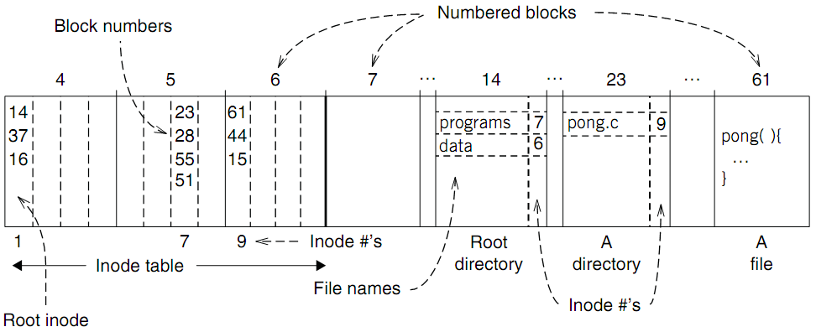
An Example: Find Blocks of "/programs/pong.c"

Slide 37
An Example: Find Blocks of "/programs/pong.c"
'/' root directory: inode is 1

Slide 38
An Example: Find Blocks of "/programs/pong.c"
Find the first directory in '/' by block number

Slide 39
An Example: Find Blocks of "/programs/pong.c"
Find '/programs' by comparing name

Slide 40
An Example: Find Blocks of "/programs/pong.c"
Find '/programs' inode by its inode number 7

Slide 41
An Example: Find Blocks of "/programs/pong.c"
Find the first file in '/programs/'

Slide 42
An Example: Find Blocks of "/programs/pong.c"
Find '/programs/pong.c' by comparing its name

Slide 43
An Example: Find Blocks of "/programs/pong.c"
Find inode of '/programs/pong.c' by the inode number 9

Slide 44
An Example: Find Blocks of "/programs/pong.c"
Find block number of '/programs/pong.c'

Slide 45
An Example: Find Blocks of "/programs/pong.c"
Find data of block 61 by its block number
  And data of block 44 & 15

Slide 46
Directly Dump a Directory
$ ls -ai temp
7536909 . 7530417 .. 7536939 a 7536940 b 7536941 c 7536942 d
$ echo “obase=16;7536909;7530417;7536939;7536940;7536941;7536942" | bc
73010D 72E7B1 73012B 73012C 73012D 73012E
$ sudo /sbin/debugfs /dev/sda1
debugfs 1.43.4 (31-Jan-2017)
debugfs: dump temp temp.out
debugfs: quit
$ xxd temp.out
0000000: 0d01 7300 0c00 0102 2e00 0000 b1e7 7200 ..s...........r.
0000010: 0c00 0202 2e2e 0000 2b01 7300 0c00 0101 ........+.s.....
0000020: 6100 0000 2c01 7300 0c00 0101 6200 0000 a...,.s.....b...
0000030: 2d01 7300 0c00 0101 6300 0000 2e01 7300 -.s.....c.....s.
0000040: c40f 0101 6400 0000 0000 0000 0000 0000 ....d...........
0000050: ...
Notes:
-i: print inode number
-a including all files, including the hidden one

Slide 47
Directly Dump a Directory
struct ext4_dir_entry {
uint32_t inode_number;
uint16_t dir_entry_length;
uint8_t file_name_length;
uint8_t file_type;
char name[EXT4_NAME_LEN];
}
0d01 7300 0c00 0102 2e00 0000
b1e7 7200 0c00 0202 2e2e 0000
2b01 7300 0c00 0101 6100 0000
2c01 7300 0c00 0101 6200 0000
2d01 7300 0c00 0101 6300 0000
2e01 7300 c40f 0101 6400 0000
File Type
0x0: Unknown
0x1: Regular file
0x2: Directory
0x3: Character device file
0x4: Block device file
0x5: FIFO
0x6: Socket
0x7: Symbolic link
0d01 7300 0c00 0102 2e00 0000
0d01 7300: inode number
0c00: entry length is 12 bytes
01: file name length is 1 byte
01: file type is regular file
2e00 0000: file name (2e -> ".")
Notes:
The ASCII character for 0x2E is the period or dot (.).

Slide 48
L7: Symbolic
Link Layer
Symbolic link
Absolute path
File
name
Inode num
File
(inode)
Block num
Disk
Block
Path name
Name files on other disks
  Inode is different on other disks
  Supports to attach new disks to the name space
Two options
  Make inodes unique across all disks (not good)
  Create synonyms for the files on the other disks
Introducing layer 7: soft link (symbolic link)
  SYMLINK
  Add another type of inode

Slide 49
Directly Dump a Symbolic Link
$ ln -s "/tmp/abc" s-link
$ ls –l s-link
7536945 lrwxrwxrwx 1 xiayubin 8 Sep 20 08:01 s-link -> /tmp/abc
$ readlink s-link
/tmp/abc
$ cat s-link
cat: slink: No such file or directory
$ echo "hello, world" > /tmp/abc
$ cat s-link
hello, world
What does "8" means?
File size

Slide 50
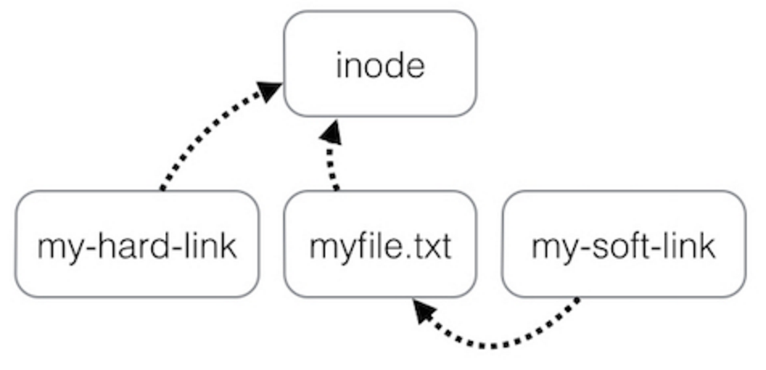
Two Types of Links (Synonyms)
By inode number
By inode number
By file name

Slide 51
Sidebar: Notice the Context Change
Another interesting behavior of soft link
  There is a directory: "/Scholarly/programs/www"
  The root directory contains a soft link
    "/CSE-web" -> "/Scholarly/programs/www"
  Run following commands
    cd CSE-web
    cd ..
  What is the current directory? Why?
    ".." is resolved in a new default context: by bash, not file system

Slide 52
Sidebar: Notice the Context Change
The bash tries to be "human-friendly"
  When you cd /into/a/symlink/, the shell remembers the old location (in $OLDPWD) and will use that directory when you cd .. under the assumption that you want to return to the directory you were just in
If you want to use the real .., then you must also use "cd -P .."
The -P option says to use the physical directory
structure instead of following symbolic links (see
also the -P option to the set built-in command);
the -L option forces symbolic links to be followed.
$ cd
$ cd a/b/symlink
$ cd -P ..
$ pwd -P
/home/sarnold
$

Slide 53
Summary of File System's 7 Layers
File name is not part of a file
  Name is not a part of an inode
  Name is data of a directory, and metadata of a file system
  One inode can have several names (hard links)
Hard links are equal
  If a file has two names, both are links (instead of "a link and a name")
Directory size is small
  Only mapping from name to inode number
  The term "folder" is somewhat misleading

