Slide 1
Catan Monte Carlo Simulation
Xinmai Xuan xinmaix2

Slide 2
Agenda
Introduction of Catan
Strategy
Validation
Hypothesis
Experiment and Predictions
Simulation

Slide 3
Introduction
16 tiles(terrains), 5 resources, 2 dice, 2-4 Players
Catan, formerly known as Settlers of Catan, is a strategic board game designed by Klaus Teuber and first published in 1995. The game is set on an island called Catan, where players take on the roles of settlers trying to build and develop their settlements by acquiring and trading resources. The base game is played on a modular board consisting of hexagonal tiles representing five different resources: brick, wood, sheep, wheat, and ore, along with a desert tile that produces no resources. In addition, there are number tokens and harbors placed on the board, which play a role in resource production and trading.

Slide 4
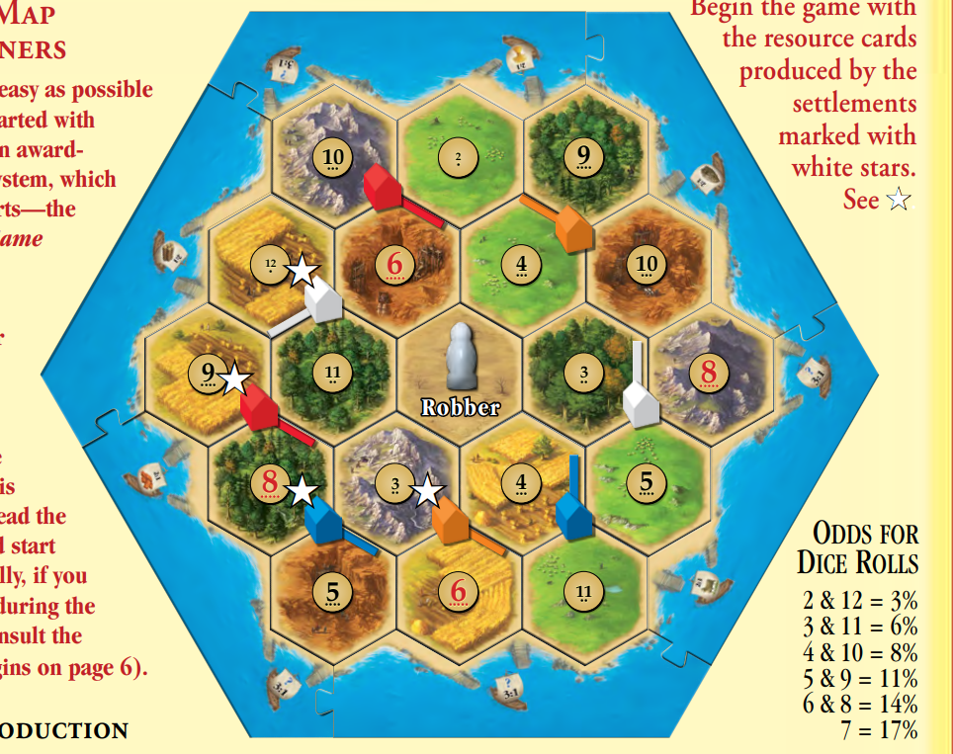
Catan Board
Basic Elements
Terrains
Harbor
Points

Slide 5
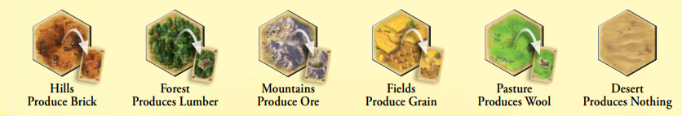
Catan Board
Types of Terrain:
Hills: Generate Brick
Forest: Generate Lumber
Mountains: Generate Ore
Fields: Generate Grain
Pasture: Generate Wool
Desert: Generate None

Slide 6
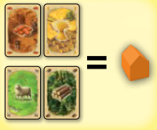
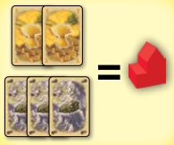
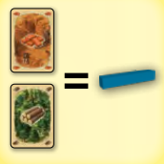
How To Build
Resources Needed:
Settlement: 5 in total
Brick(1), Lumber(1), Wool(1), Grain(1)
City: Must upgrade from settlement, 4 in total
Ore(3), Grain(2)
Road: 15 in total
Brick(1), Lumber(1)

Slide 7
Each Turn
Check whether player reaches the required vp point
Roll 2 dices
Get the Dice Number
Get Resources
Get resources based on dice number
Trade
Trade with / without harbor to get demand resources
Build based on strategy
Build buildings(roads, settlement, city) based on strategy
VP checker

Slide 8
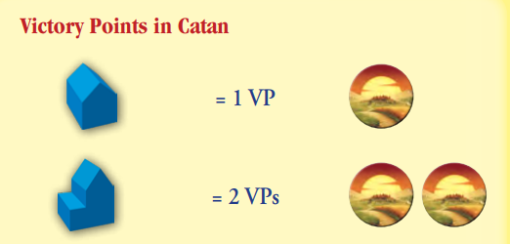
Get Victory Points
Settlements – 1 vp
City – 2 vps

Slide 9
How To win
The time you have or reach 10 victory points (or other) on your turn, the game ends immediately.
How many points the red player owns?

Slide 10

How To win
The time you have or reach 10 victory points (or other) on your turn, the game ends immediately.
How many points the red player owns?

Slide 11
How To win
The time you have or reach 10 victory points (or other) on your turn, the game ends immediately.
How many points the red player owns?

Slide 12
Class In Project
Point
def __init__(self, idx):
self.idx = 0
self.neighbors = []
Terrain
def __init__(self, resource, num, point_li):
self.resource = resource
self.num = num
self.point = point_li

Slide 13
Class In Project
Player
def __init__(self):
self.vp = 0 # victory points
self.reachable_points = [] # points connected via roads
self.settlements = []
self.cities = []
self.resources_list = [0, 0, 0, 0, 0]
self.road_num = 0
self.strategy = ""

Slide 14
Class In Project
ResourceDict
def __init__(self, resource_type: str):
self.needed_dict = {0: 1, 1: 1} if resource_type == "road" else {0: 1, 1: 1, 3: 1, 4: 1} if \
resource_type == "settlement" else {2: 3, 3: 2}
self.resource_list = [2, 3, 4] if resource_type == "road" else [2] if \
resource_type == "settlement" else [0, 1, 4]
self.target_list = [0, 1] if resource_type == "road" else [0, 1, 3, 4] if \
resource_type == "settlement" else [2, 3]
RecordList
ResRecoder

Slide 15
Class In Project
RecordList
def __init__(self, vp_rec, set_rec, city_rec, road_rec, brick_rec, lum_rec, ore_rec, grain_rec, wool_rec):
self.vp_rec = vp_rec
self.set_rec = set_rec
self.city_rec = city_rec
self.road_rec = road_rec
self.brick_rec = brick_rec
self.lum_rec = lum_rec
self.ore_rec = ore_rec
self.grain_rec = grain_rec
self.wool_rec = wool_rec

Slide 16
Class In Project
ResRecoder
def __init__(self, used_round, gamePass):
self.used_round = used_round
self.gamePass = gamePass

Slide 17
Strategies
How would players act
Settlement Prefer
City Prefer
Harbor Prefer

Slide 18
Settlement Prefer Strategy
Try to build a settlement if its possible.
Would consider upgrading a settlement to a city if the player run out of settlement quota.

Slide 19
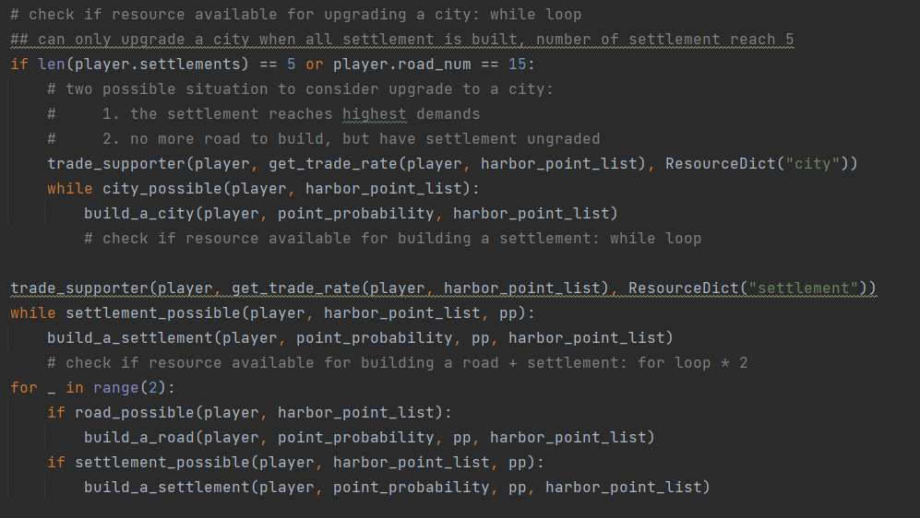
Settlement Prefer Strategy

Slide 20
City Prefer Strategy
Try to upgrade a city if its possible.
Would consider building a settlement if the player run out of city quota or all current settlement were upgrade to city.

Slide 21
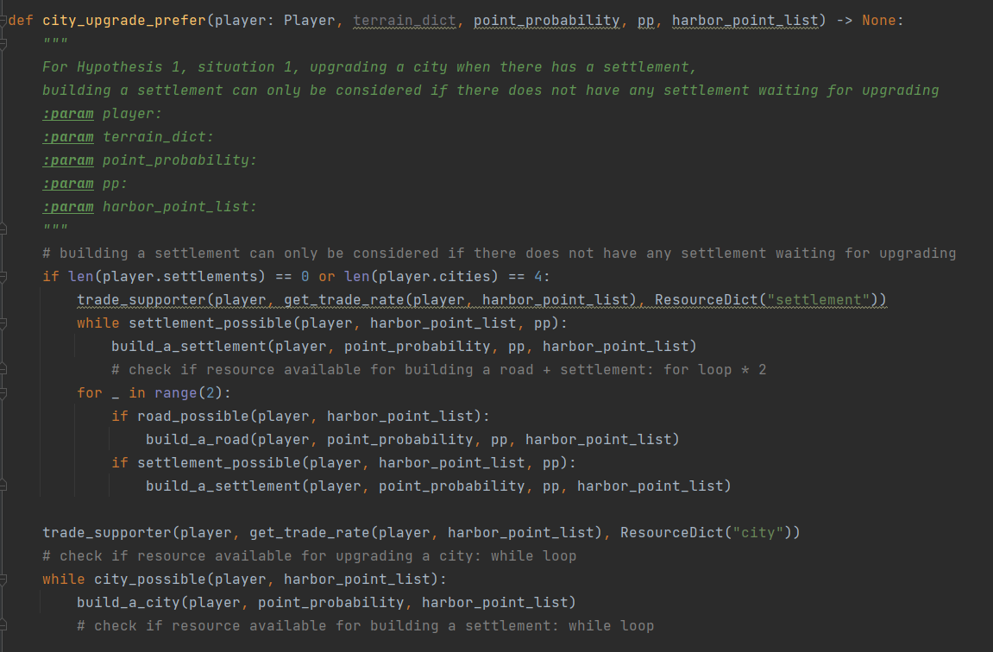
City Prefer Strategy

Slide 22
Harbor Prefer Strategy
Find the latest Harbor
Store the latest route to the latest harbor
Do nothing until build a settlement on the latest harbor
After building a settlement on the harbor, act as Settlement prefer strategy.

Slide 23
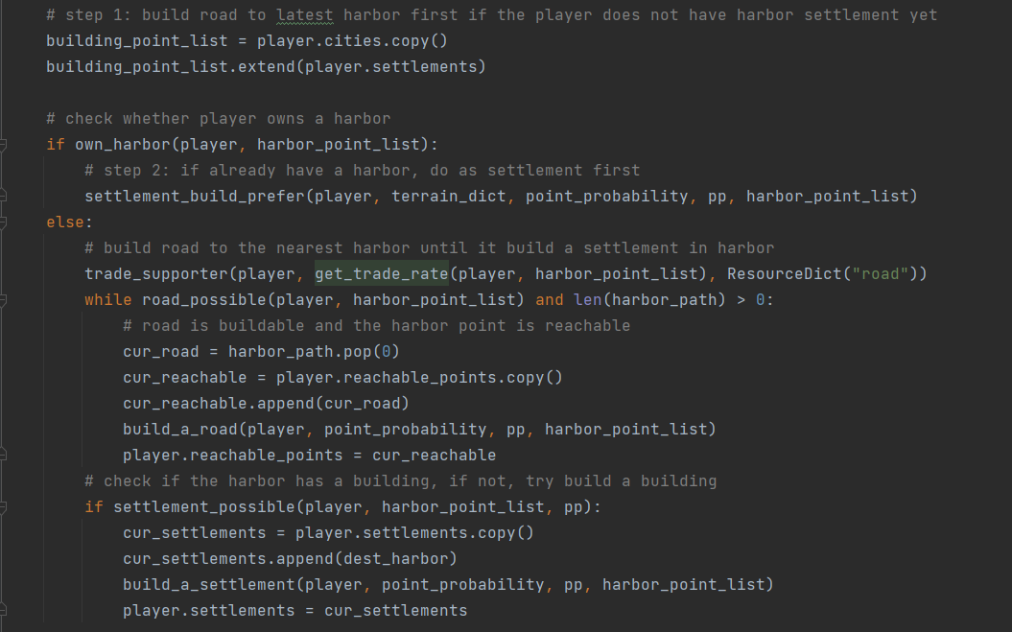
Harbor Prefer Strategy

Slide 24
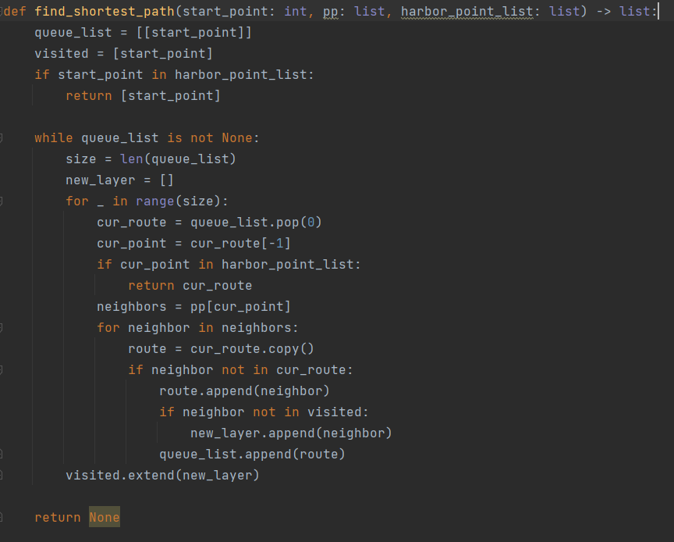
Harbor Prefer Strategy – Find Path

Slide 25
Prerequisite for Using Monte Carlo
Rerun and Independence
Aggregate Statistics
Experiment & Predictions
Every simulation act on a new board.
Players would play on boards with same resources distribution but different boards for each simulation.
The turn number is stored at each hypothesis. Since it generates a whole bunch of data, those data would get process and a mean value would used to see the trends.
Experiments would used to verify hypothesis.

Slide 26
Basic Assumptions
Player would only choose the point has the highest probability as the default point
Player would only build roads to the neighbor point has the highest probability unless on harbor prefer action
Player would trade based on their demands even cannot build at this round
All harbors in this simulations are universal harbors
If rolling 7, player would throw resource that not used in is strategy

Slide 27
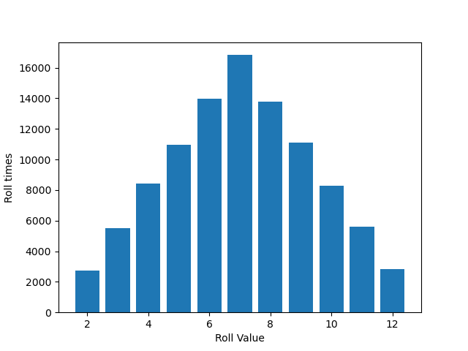
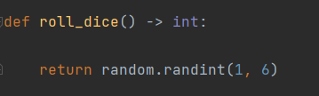
Validating
Dice Throwing

Slide 28
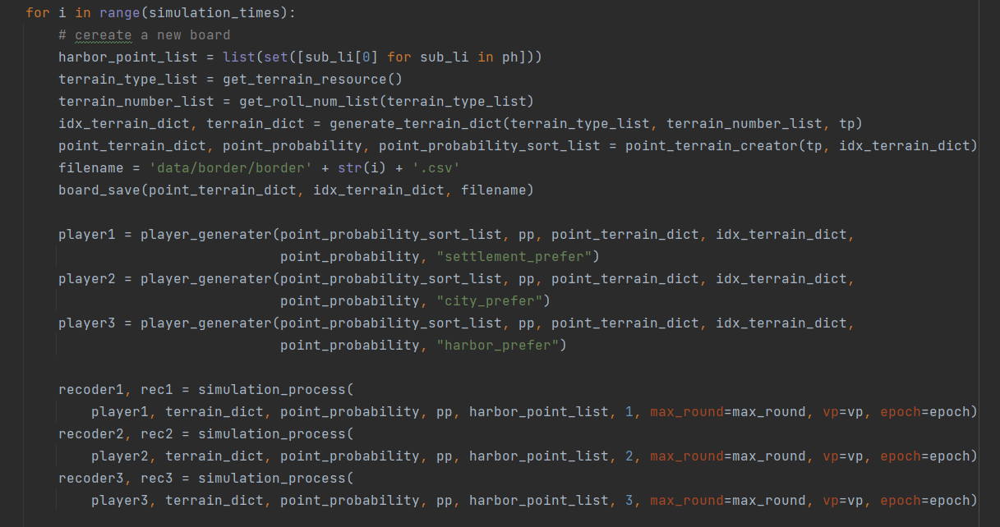
Simulation Code

Slide 29
Hypothesis
Hypothesis 1:
Assume upgrading a city can help get the required vp points faster than case 2 building a new settlement.
Hypothesis 2:
Assume getting a particular port can help get the required vp points faster than upgrading a city which could help get more resources.

Slide 30
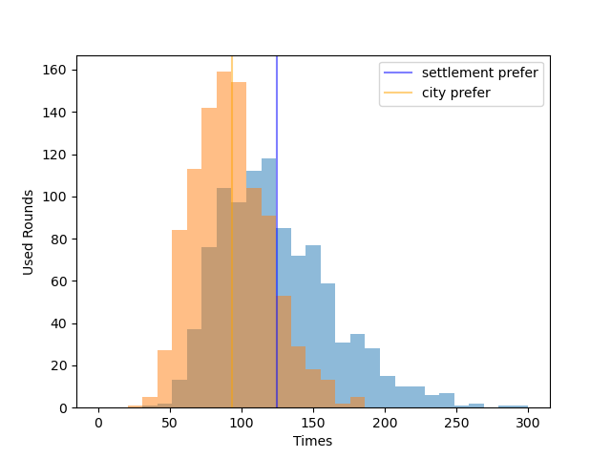
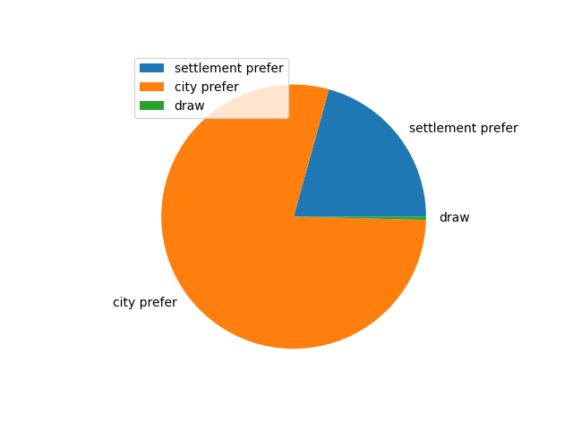
Hypothesis 1
Assume upgrading a city can help get the required vp points faster than case 2 building a new settlement.
It is more rewarding accepting city preference strategy rather than using settlement prefer strategy.

Slide 31
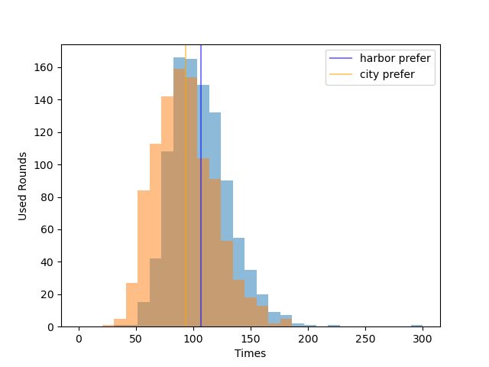
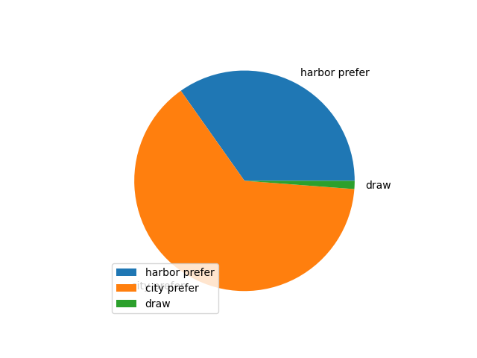
Hypothesis 2
Assume getting a particular port can help get the required vp points faster than upgrading a city which could help get more resources.
It is more rewarding accepting city preference strategy rather than using harbor prefer strategy.

Slide 32
Conclusion
We Accept both hypothesis based on previous experiment.
For player, adopting a city upgrading prefer strategy would get required victory points faster than other strategy.
https://github.com/S1monXuan/2023Spr_projects_catan_simulation

Slide 33
Citations
Catan Universe - Changelog 2.3.2 - Steam News. 19 Apr. 2023, store.steampowered.com/news/app/544730/view/5978007465995605824?l=english.
Catan. “Catan.” Wikipedia, 11 Apr. 2023, en.wikipedia.org/wiki/Catan.
“Game Rules.” CATAN, www.catan.com/understand-catan/game-rules.
Wikipedia contributors. “Breadth-first Search.” Wikipedia, 27 Feb. 2023, en.wikipedia.org/wiki/Breadth-first_search.

Slide 34
Thank you
Xinmai Xuan
xinmaix2
xinmaix2@illinois.edu

