Slide 1

Database Systems
22.10.2024
HS 2024
P0: Project Idea
Group 10
Jiri Käser
Mathieu Groenen

Slide 2



Datasets
Datasets
Item usage
Player performance
Game outcome
Time dependant
cosmetic prices
Esta (Esports Trajectories & Actions)
99.1 GB
JSON
Steam API
1.8 GB
JSON

Slide 3





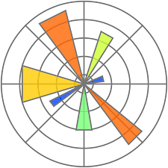


Tools
Tools

Slide 4
Analysis
Esta (Esports Trajectories & Actions)
Player behaviour, positioning and strategies
Steam API
Cosmetics price fluctuations coupled to events
Influence of player and team performance on cosmetic price fluctuations during and outside of tournaments

