Slide 1

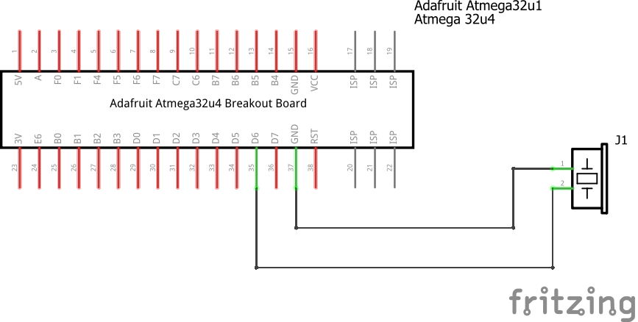
Piezo Buzzer Module
Description
This buzzer module can be used to build alarm/doorbell DIY circuits. It’s useful whenever you need audio feedback in a project.
Specifications
Colour | Black
Material | PCB
Voltage | 5.0 VDC
Operation Range | 3.0-8.0 VDC(20mA 5VDC)
Frequency | 2.3kHz 5VDC

Slide 2
const uint8_t BUZZ = 12;
void setup() {
Serial.begin(115200);
Serial.println("Started.");
pinMode(BUZZ, OUTPUT);
}
void playTone(int toneLength, int delay1, int delay2) {
for (int i = 0; i < toneLength; i++) {
digitalWrite(BUZZ, HIGH);
delay(delay1);
digitalWrite(BUZZ, LOW);
delay(delay2);
}
}
void loop() {
// active buzzer frequency output
playTone(100, 1, 1);
delay(2000);
// lower pitch
playTone(100, 5, 2);
delay(2000);
// high pitch
playTone(100, 2, 5);
delay(2000);
// lower pitch but louder
playTone(50, 10, 1);
delay(2000);
delay(3000);
}

