Slide 1

Customer Churn Analysis
MACHINE LEARNING ANALYST

Slide 2

Project Work Overview
Key Activities and Achievements
Main Activities
Methodology Highlights
Explored variable correlations
Selected 3 ML algorithms(Logistic Regression, Random Forest, Gradient Boosting)
Trained models effectively
Evaluated performance metrics
Implemented cross-validation
Analyzed algorithm performance
Optimized model parameters
Visualized data insights

Slide 3

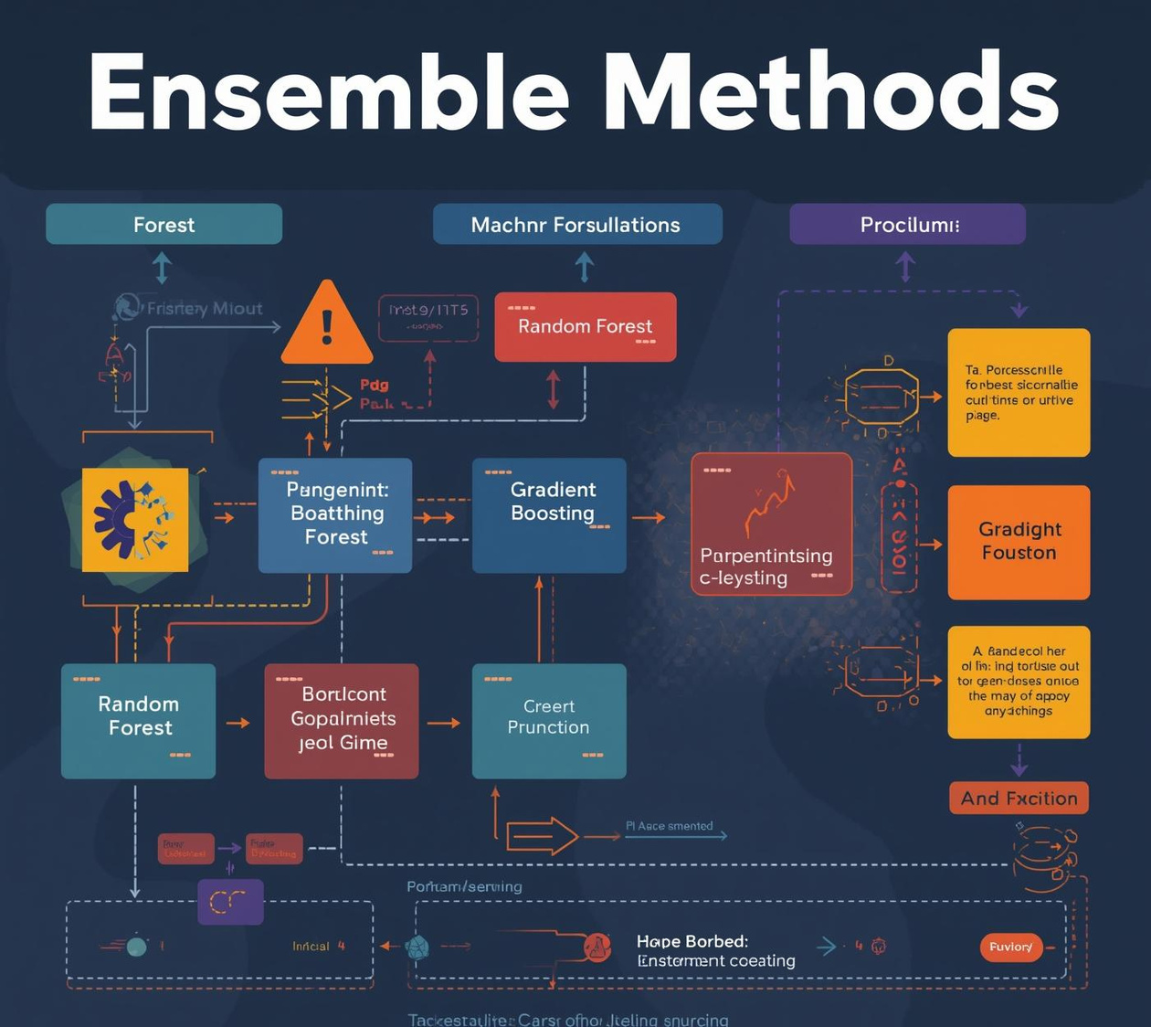
Learning Outcomes
Course Completion
Ensemble Methods
Completed all 10 topics in MLCourse.ai
Mastered techniques for combining models effectively

Slide 4
Best Models: Random Forest and XGBOOST
Most accurate model used
Accuracy: 98% and 98%
Percentage of correct predictions
ROC-AUC: 0.9841 and 0.9868
Measure of model performance

