Slide 1
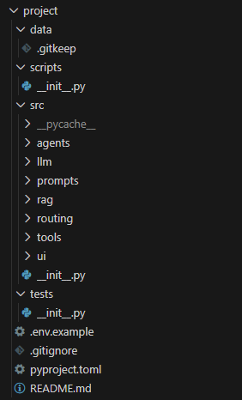
1. Project Setup
How to Run
streamlit run src/ui/app.py
Project Structure

Slide 2
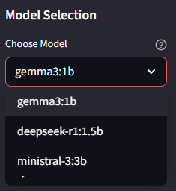
2. Multi-LLM Client
Abstract base class «BaseLLMClient» for consistent model interaction
Support for 3 local models via Ollama:
gemma3:1b - Fast, lightweight (1B parameters)
deepseek-r1:1.5b - Balanced performance (1.5B parameters)
ministral-3:3b - High quality output (3B parameters)

Slide 3
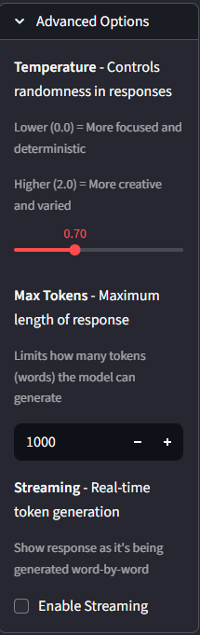
Streaming Support:
Word-by-word response display
Improved user experience for long responses
Configuration Panel (Advanced Options):
Temperature (0.0-2.0): Creativity vs. determinism control
Max Tokens (100-4000): Response length limitation
Streaming Toggle: Enable/disable real-time generation

Slide 4
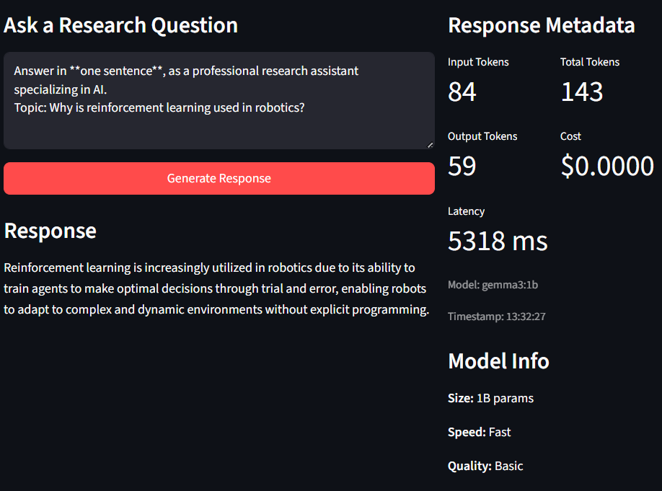
Resource Tracking
Token Usage Monitoring: Input/output token estimation
Cost Calculation: Per-request cost tracking (currently $0 for local models)
Latency Measurement: Response time in milliseconds
Metadata Persistence: Timestamp, model name, performance metrics

Slide 5
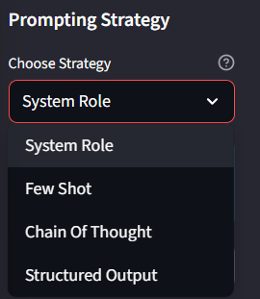
3. Prompt Strategies
System Role Prompting
system: "You are an expert research assistant specializing in academic literature analysis,summarization, and report generation."
Characteristics:
Clear role definition and direct instructions
Minimal overhead, fastest processing
Best for: Straightforward queries, quick responses
Use Case: "Summarize the key findings of this paper"

Slide 6
Few-Shot Learning
Example: User: summarize transformer architectures Ai: key findings:1. ; 2. … User: Research gaps in climate modeling Ai: Main gaps: 1. ; 2. …
Characteristics:
Provide 2-3 examples
Model learns expected output format and style
Best for: Consistent formatting, domain-specific responses
Use Case: Complex analysis requiring specific structure

Slide 7
Chain-of-Thought
Example: Step 1: Identify core methodology components Step 2: Evaluate strengths and limitations
Step 3: Compare with alternative approaches Step 4: Draw conclusions
Characteristics:
Prompts model to show reasoning process
Breaks complex problems into small parts
Best for: multi-step reasoning, analytical tasks
Use Case: Analyze the implications of this research methodology

Slide 8
Structured Output (JSON Mode)
1)Make brief overwiew 2)Place key points 3)Make detailed explanation 4)sources 5)place confidence(high/medium/low)
Characteristics:
Enforces JSON schema for parseable responses
Guaranteed data structure for downstream processing
Best for: Integration with other systems, data extraction
Use Case: Building knowledge graphs, automated report generation

Slide 9
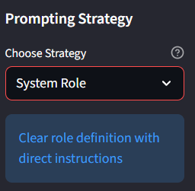
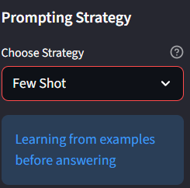
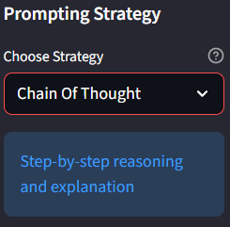
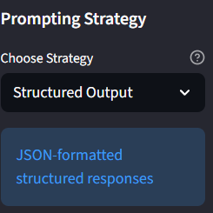
UI Implementation:
Strategy Selector Dropdown with real-time description display:
Runtime strategy changes without page reload
Strategy description shown as info tooltip
Stored in conversation history for analysis

Slide 10
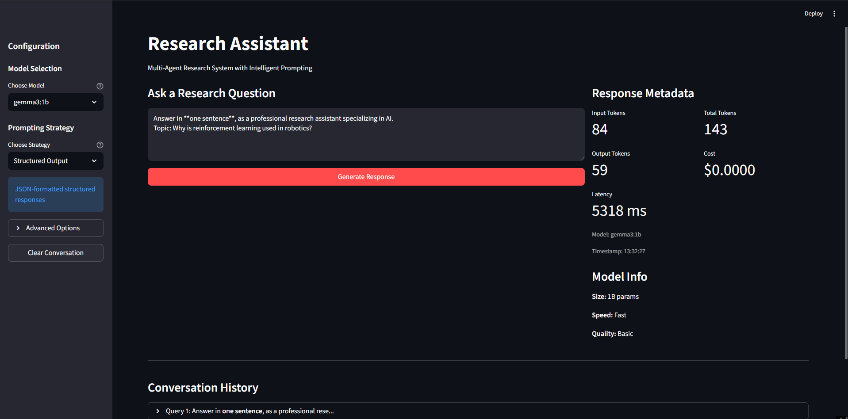
4. Interface
For interface I choose Streamlit

Slide 11
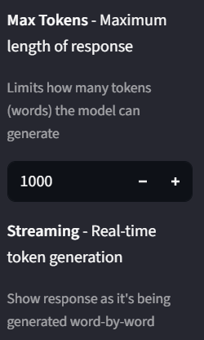
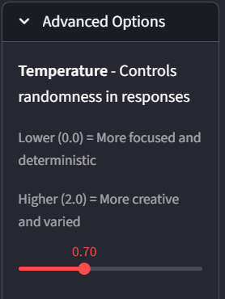
Advanced Options
Temperature (0.0 - 2.0)
Max Tokens (100 - 4000)
Controls randomness and creativity of responses
Limits maximum response length
0.0-0.3 - Focused, deterministic
0.4-0.8 - Balanced creativity
0.9-2.0 - High creativity

Slide 12
5. What I Learned
Technical Skills
Working with local LLMs via Ollama API
Creating unified interface using abstract classes
Prompt Engineering
4 different prompting strategies and when to use them
Temperature impact on quality and creativity
Few-shot learning for desired format
Chain-of-Thought for complex reasoning

