Slide 1
Home
Kubeka BS 217010763
CSC3A Mini Project

Slide 2
Outline
Introduction
Problem
Solution
Value
Conclusion

Slide 3
Introduction
The system models a scenario of allocating coal to the power stations. By finding path.
The system the shows the connections between each PowerStation and route made
It allows power suppliers to allocate coal to desired station

Slide 4
Problem
Allocate coal by finding path
A lot of suppliers face difficulty, in allocating their suppliers on time to Eskom resulting in load shedding
I do not know of any similar solutions, hence I thought of the idea

Slide 5
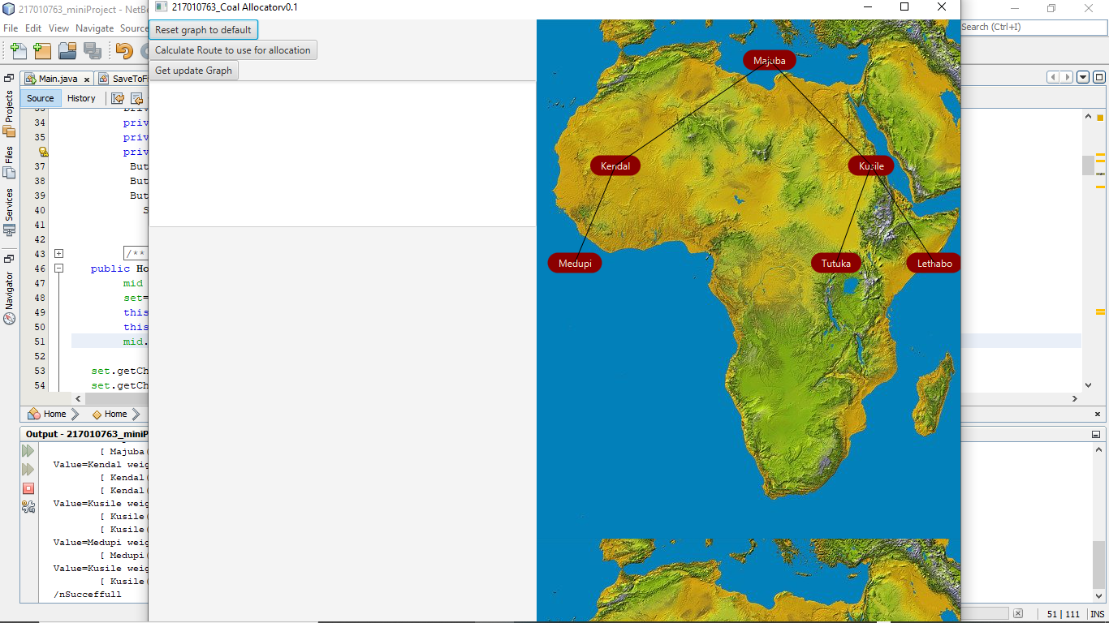
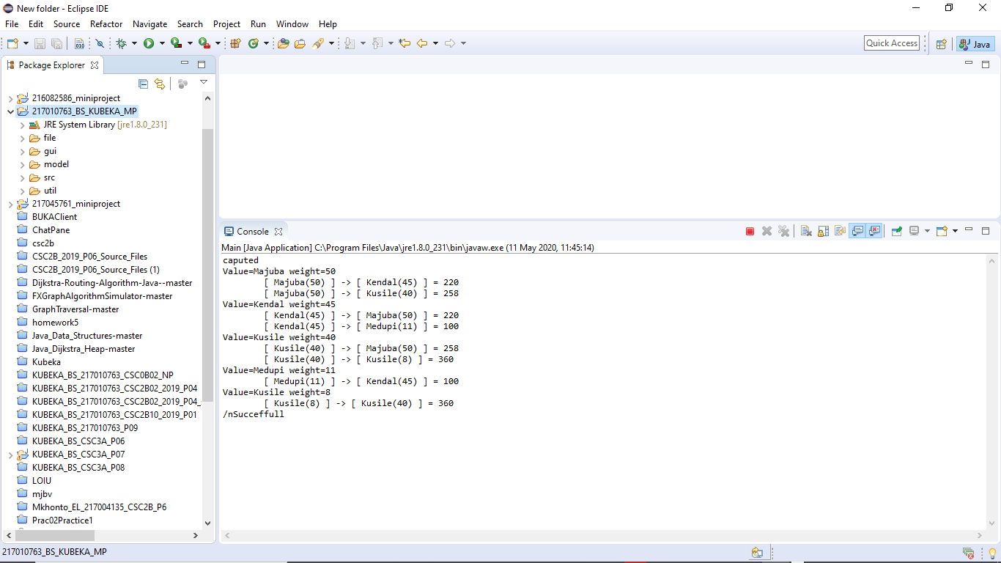
Solution
A graph representation

Slide 6
Solution
First you left click on canvas and drag to desired location. To add a node/power station
Specify it details along with the edge/route then its added
To move it press AND hold right mouse click

Slide 7
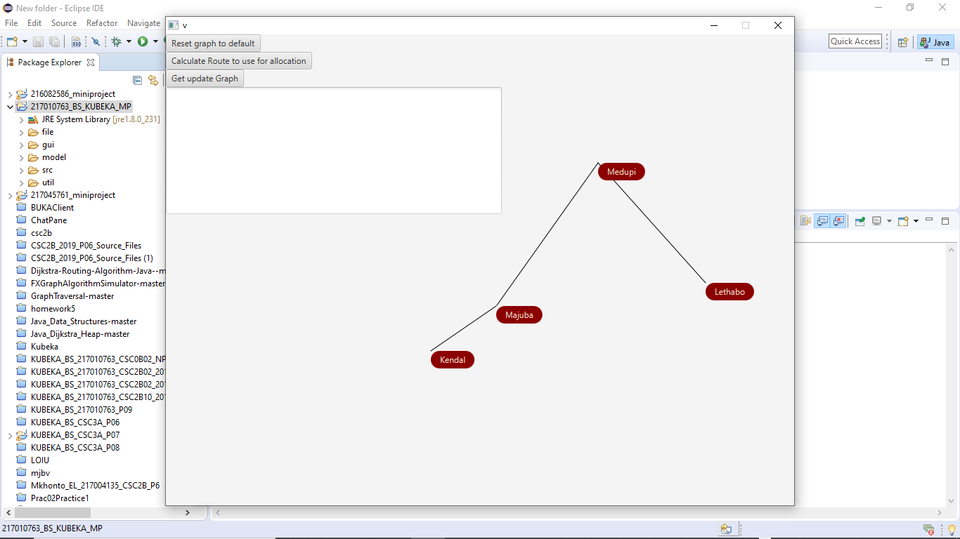
Solution
To remove click on right click, to drag hold right click

Slide 8
Value
I found out that allowing suppliers to allocate coal on time on a least cost route is viable solution to fixing outage issues
For coal to be delivered on time to desired power stations

