Slide 1

Reducing Excessive Journaling Overhead in Mobile Devices with Small-Sized NVRAM
Junghoon Kim¹, Changwoo Min¹², and Young Ik Eom¹
¹Sungkyunkwan University, Korea
²Samsung Electronics, Korea

Slide 2
Outline
Background
Motivation
System Design
Evaluation
Conclusion

Slide 3
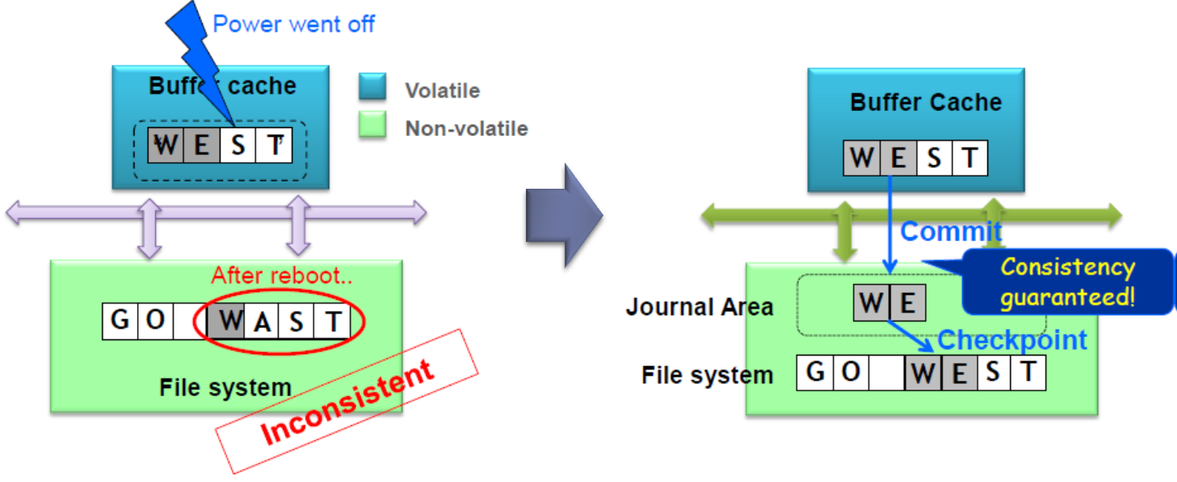
Journaling
Reliability issue
Sudden power failure incurs file system inconsistency
Journaling as a solution
Prevent data inconsistency through write-twice
Ext3/4, ReiserFS, XFS, btrFS …

Slide 4

Journaling overhead in mobile devices
SQLite
Generates approximately 80% of writes in mobile devices
frequently calls fsync system call to guarantee data consistency
The frequent fsync calls incur the excessive journaling
NAND flash storage
Used for secondary storage in mobile devices
Asymmetric read/write latency
Limited program/erase (P/E) cycles
Excessive journaling is the major source of
degrading performance and shortening lifetime!

Slide 5
motivation

Slide 6


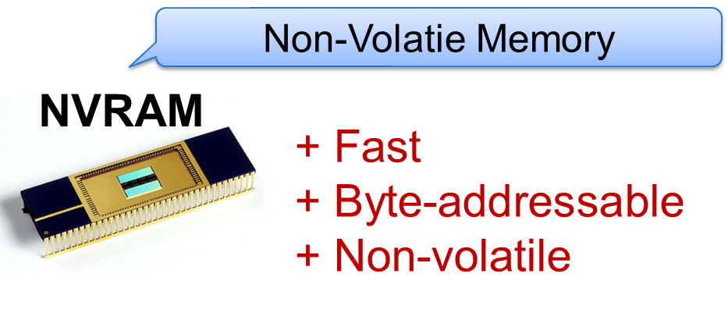
NVRAM as a solution

Slide 7
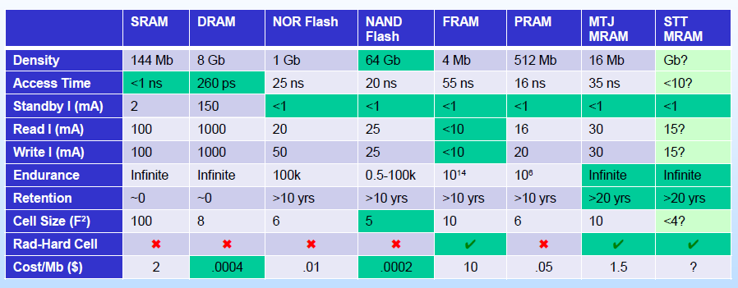
NVRAM as a solution?
NVRAM technology
In the short term, there are limitations for whole storage system to be replaced with NVRAM
Limited density
High cost

Slide 8
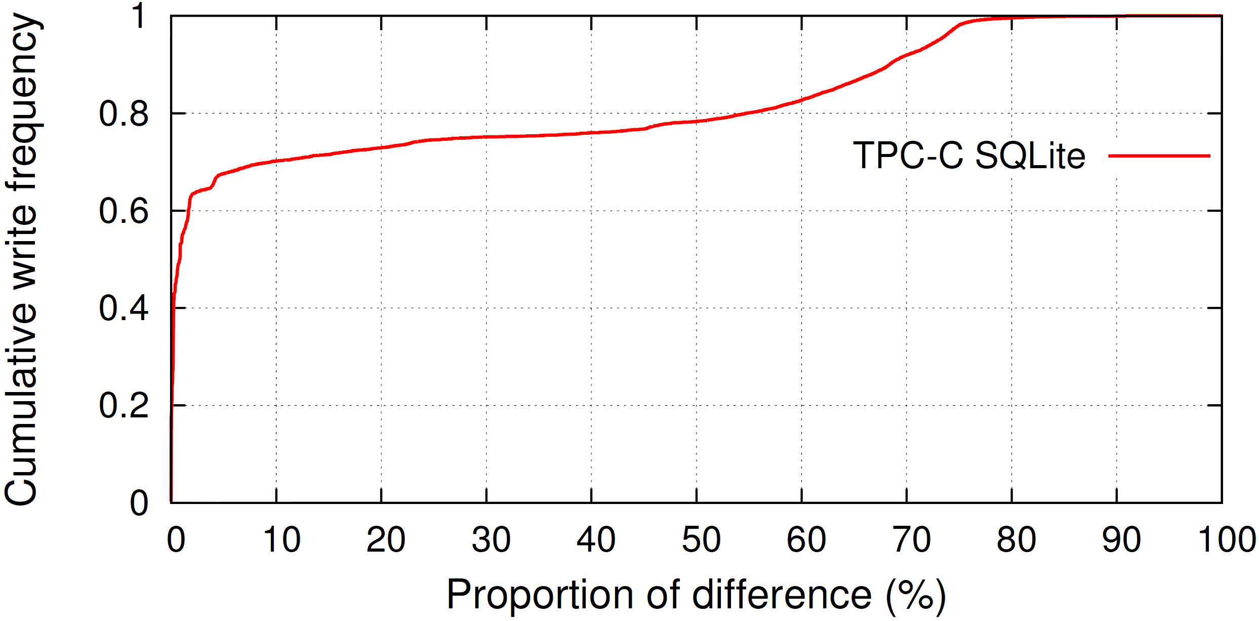
Motivation
TPC-C SQLite analysis
Cumulative distribution of the difference between updated and original block
More than 70% of updated blocks have less than 10% difference
Most updates are very small

Slide 9
System design

Slide 10
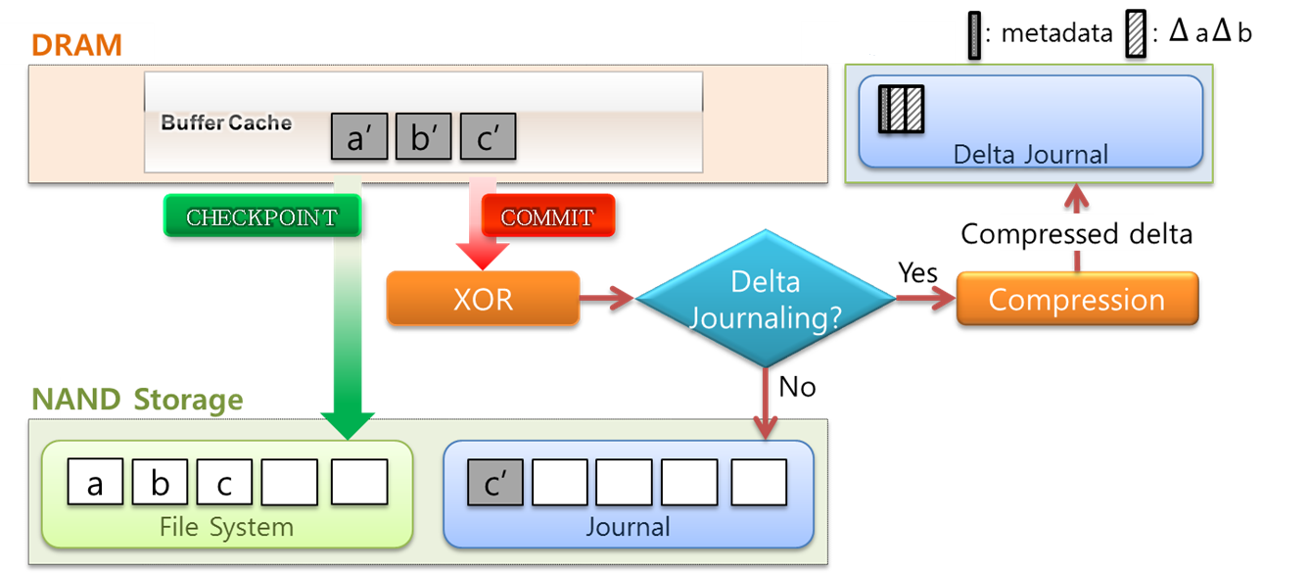
System Architecture
Delta Journaling
To reduce the excessive journaling overhead
Use small-sized NVRAM as the compressed delta journal area
NVRAM

Slide 11
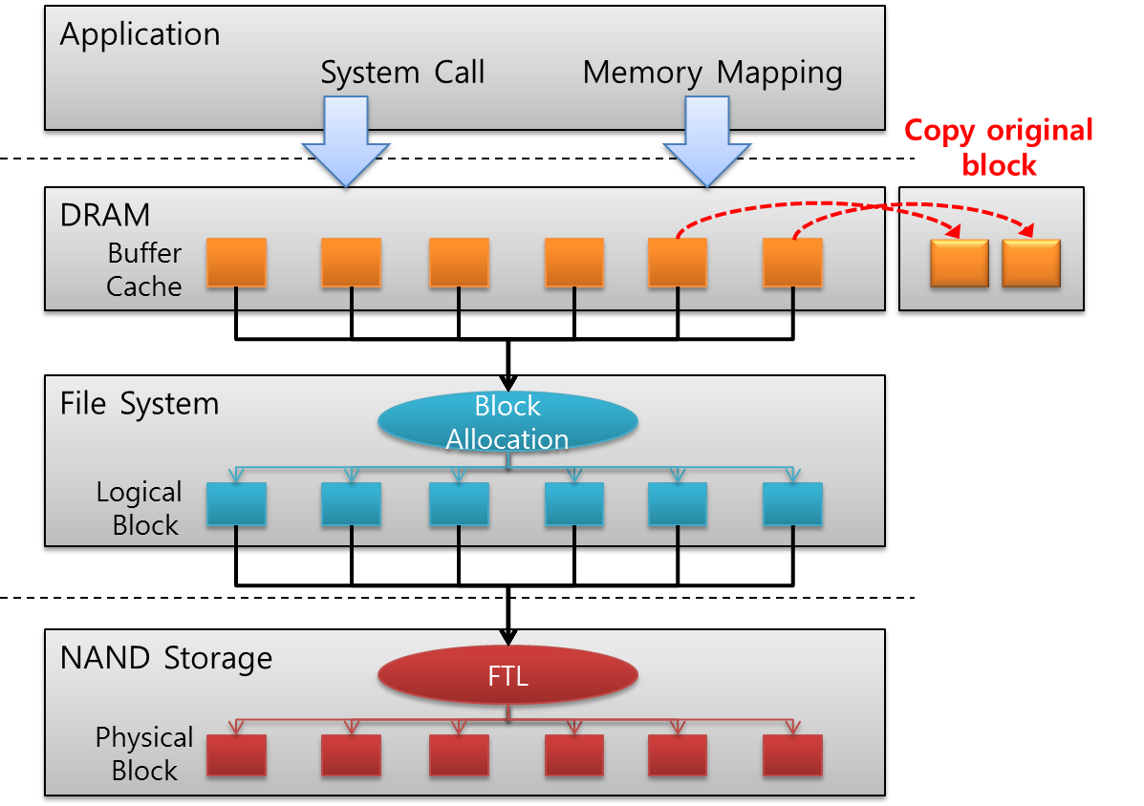
Delta Journaling
Difference capturing
Captures the difference in bit-wise by using XOR operation
Maintaining original blocks in DRAM memory
Copies original block before making modification

Slide 12
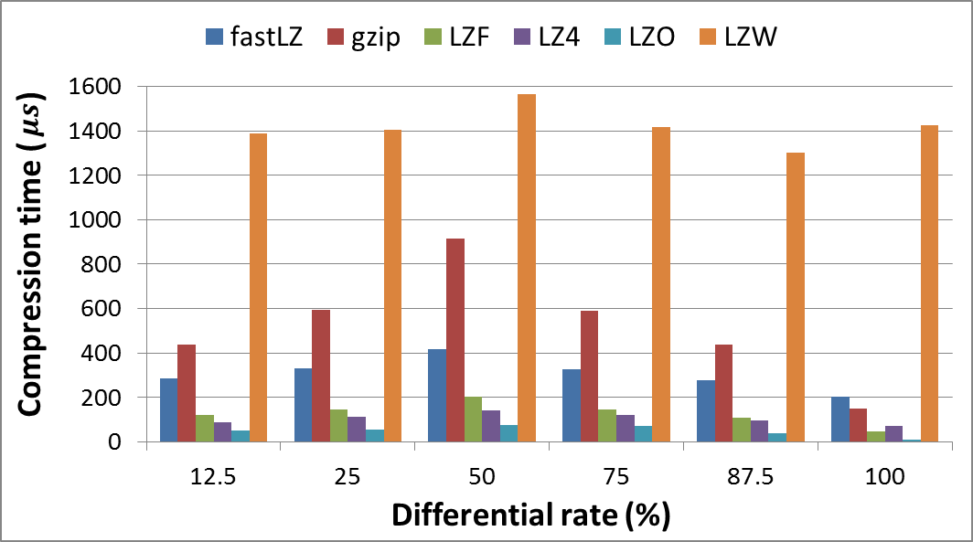
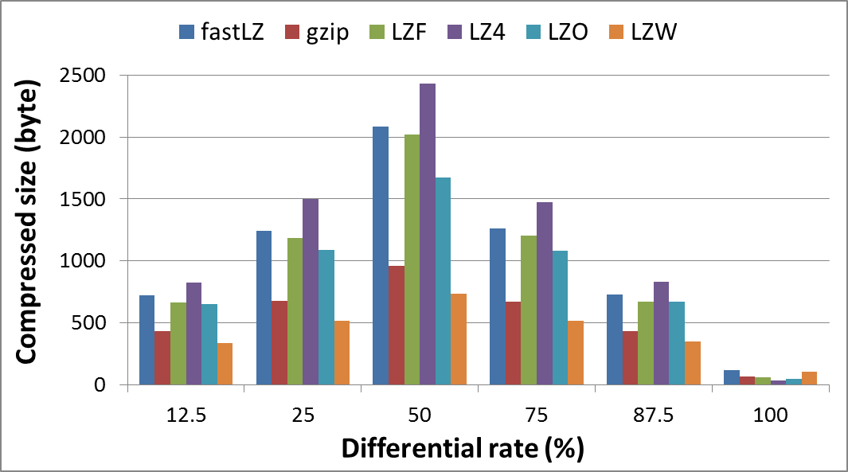
Delta Journaling
Delta compression
If the difference meets certain criteria, a differential data block is compressed and then stored in the NVRAM
Using LZO lossless compression algorithm
Good trade-off between compression time and compression ratio

Slide 13
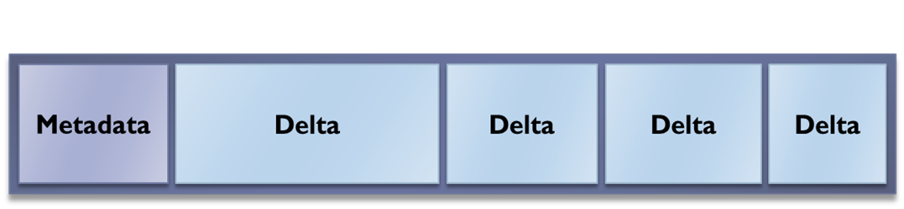
Delta Journaling
NVRAM management
To restore the file system to consistent state
Reflecting journaled data into their home locations
In case of a delta in NVRAM
Journaled data is calculated by XOR operation between its original block and decompressed delta
Metadata
Journal transaction number
Home location
Offset
Length
Deltas
NVRAM

Slide 14
evaluation

Slide 15
Prototype Evaluation
Experimental setup
Hardware
CPU
Dual-core mobile processor
Memory
2 GB DRAM
SCM
16 MB of the DRAM is used for delta journal region
NAND flash storage
16 GB A-Data microSD
Commit period
5 seconds (default)
Checkpointing
A fourth of either journal or delta journal area is filled
Five minutes (default)

Slide 16
Prototype Evaluation
Synthetic workloads
256 MB and 512 MB overwrites with various proportions of difference
DJ outperforms EXT4 by 16.8 times and 2.3 times in 256 MB and 512 MB overwrites, respectively
TPC-C SQLite
DJ achieved about 20% improvement in tpmC
The number of journal writes in NAND flash is reduced by 58%

Slide 17
Conclusion
Delta Journaling
For reducing the excessive journaling overhead in mobile devices
Stores a commit block as a compressed delta in the small-sized NVRAM only when the compressed delta is small enough
Can improve the performance and the lifetime of NAND flash storage with only 16 MB NVRAM
Future work
Optimizing our prototype implementation
Finding out optimal threshold of NVRAM for checkpointing
Extending targets for delta journaling
Journal descriptor block
Journal commit block

Slide 18
THANK YOU! QUESTIONS?

