Slide 1



Input Data Pipeline Analysis of TensorFlow Models
FnU Sachin

Slide 2
Overview
To understand how deep learning models interact with underlying hardware such as storage systems, CPUs, GPUs.
To identify bottlenecks in the data loading path for deep learning models.
To identify the potential solution/optimizations to resolve the bottlenecks and to enhance model performance.
To understand the emerging storage solutions such as SmartSSD that comes with integrated Xilinx FPGA to accelerate data intensive operations.
To identify ways to integrate SmartSSD solution with existing deep learning models.
2

Slide 3
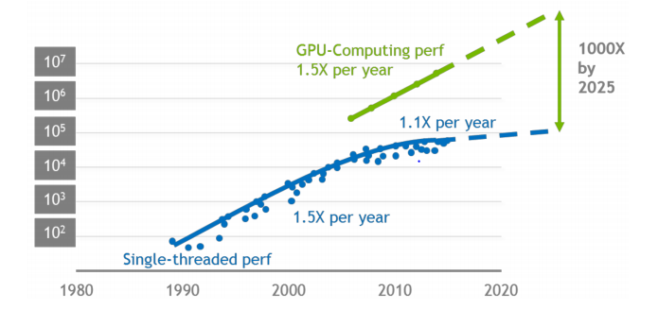
Background
Increasing difference in computing performance of GPU and CPU and infeasibility of CPU scaling result in increasing preprocessing stalls. This trend motivates us to consider offloading preprocessing onto an accelerator.
If CPU pre-processing speed is less than GPU ingestion speed, GPU starves for new pre-processed data.
GPU performance has been improving 1.5x every year. However, CPU performance improvement has been saturated for a decade.
Larger performance gap means that GPU will be idle for longer amount of time and the entire DL training will be stalled.
Source: Nvidia
3

Slide 4
Basic Definitions
Batch Size: It represents the number of samples of input dataset that are processed before the model is updated.
Epoch: It represents the number of times the learning algorithm will be executed to work though entire dataset.
ETL: It stands for Extract, Transform and Load. It defines the steps of data loading process in deep learning framework.
RGB Image: An RGB image, contains three individual planes of colors red, blue and green. The color of each pixel is determined by the combination of the red, green, and blue intensities stored in each color plane at the pixel's location.
4

Slide 5
Presentation Outline
Data Pipeline
TensorFlow Input Pipeline
Preprocessing Steps
Deep Residual Models
Experimental Setup
Experimental Analysis
Optimizations
Conclusion
5

Slide 6
01
Data Pipeline
Introduction to the concept of data pipeline.
Various pipeline stalls.
6

Slide 7
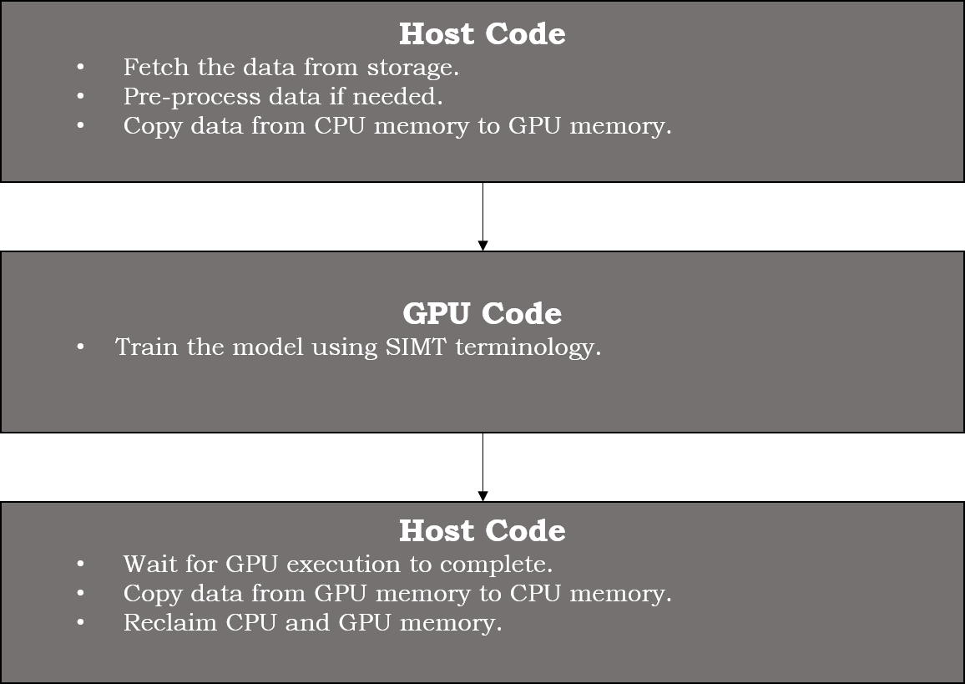
Data Movement between Host and Device
7

Slide 8
Data Pipeline Stages
Fetching data from local/remote storage. Depends on storage media. (I/O bound)
Pre-processing the fetched data. Depends upon available CPU cores (CPU bound).
Processing final data using compute cluster. (GPU bound)
8

Slide 9
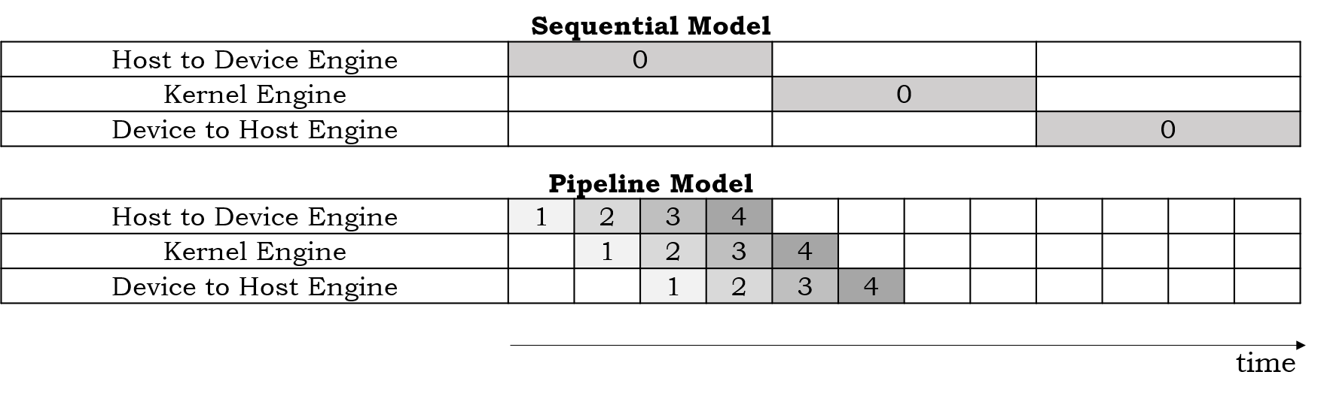
Sequential vs Pipeline Data Model
Sequential Model waits till one execution unit completes its execution.
Pipeline Model achieves efficiency by overlapping various execution unit’s operations.
9

Slide 10
Data Pipeline Stalls
Due to several stages in pipeline, delay at any stage will cause stall in pipeline.
Fetch stall occurs due to delay in fetching the data from storage media. These types of stalls make data intensive process I/O bound.
Prep stall occurs due to delay in pre-processing of the fetched data. These types of stalls make data intensive process CPU bound.
Fetch and Prep stall are collectively called Data stalls.
10

Slide 11
Presentation Outline
Data Pipeline
TensorFlow Input Pipeline
Preprocessing Steps
Deep Residual Models
Experimental Setup
Experimental Analysis
Optimizations
Conclusion
11

Slide 12
02
TensorFlow Data Pipeline
How TensorFlow implements data pipeline.
12

Slide 13
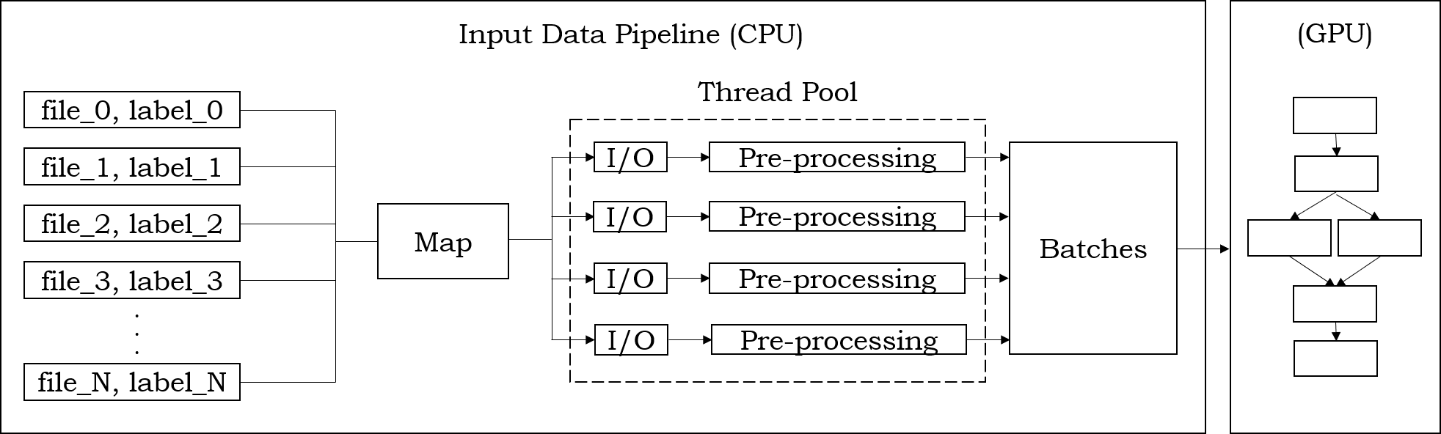
TensorFlow Input Data Pipeline
TensorFlow implements input pipelines by creating iterators to parse the datasets.
TensorFlow provides a thread pool to parallelize fetching and preprocessing operations.
13

Slide 14
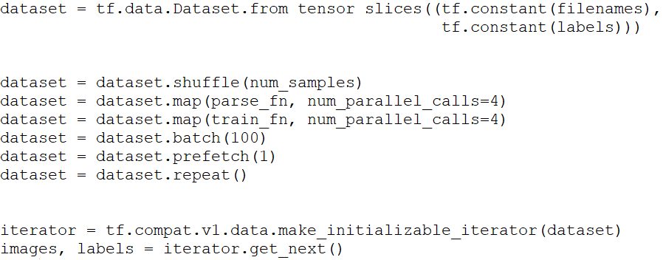
TensorFlow Input Data Pipeline
TensorFlow implements pipeline by creating iterators to parse dataset.
TensorFlow provides a thread pool to parallelize fetching and preprocessing operations.
Extract
Transform
Load
14

Slide 15
Presentation Outline
Data Pipeline
TensorFlow Input Pipeline
Preprocessing Steps
Deep Residual Models
Experimental Setup
Experimental Analysis
Optimizations
Conclusion
15

Slide 16
03
Preprocessing
Analysis of pre-processing steps required for training image classification models.
16

Slide 17
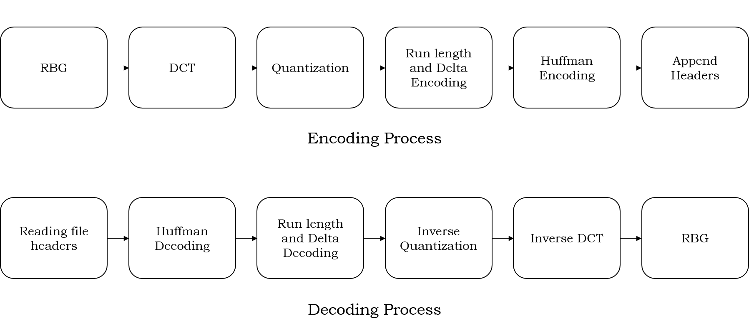
JPEG Decoding
JPEG is an image compression format.
JPEG images need to be decoded (to get RGB planes) before using it in deep learning model.
17

Slide 18
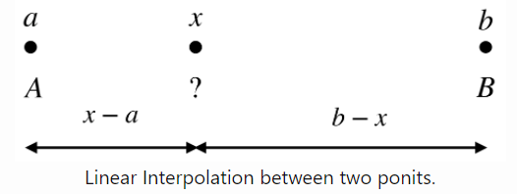
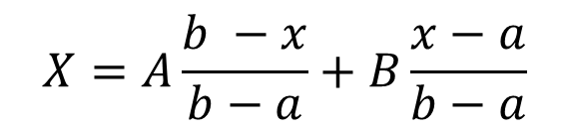
Image Resizing
TensorFlow, by default, uses Bilinear Interpolation for resizing the images.
Linear Interpolation computes a weighted average of the values associated with the two points.
Linear Interpolation can be transformed to Bilinear Interpolation considering linear interpolation in both x and y axis.
$$X=A\frac{b −x}{b−a}+B\frac{x−a}{b−a}$$
18

Slide 19
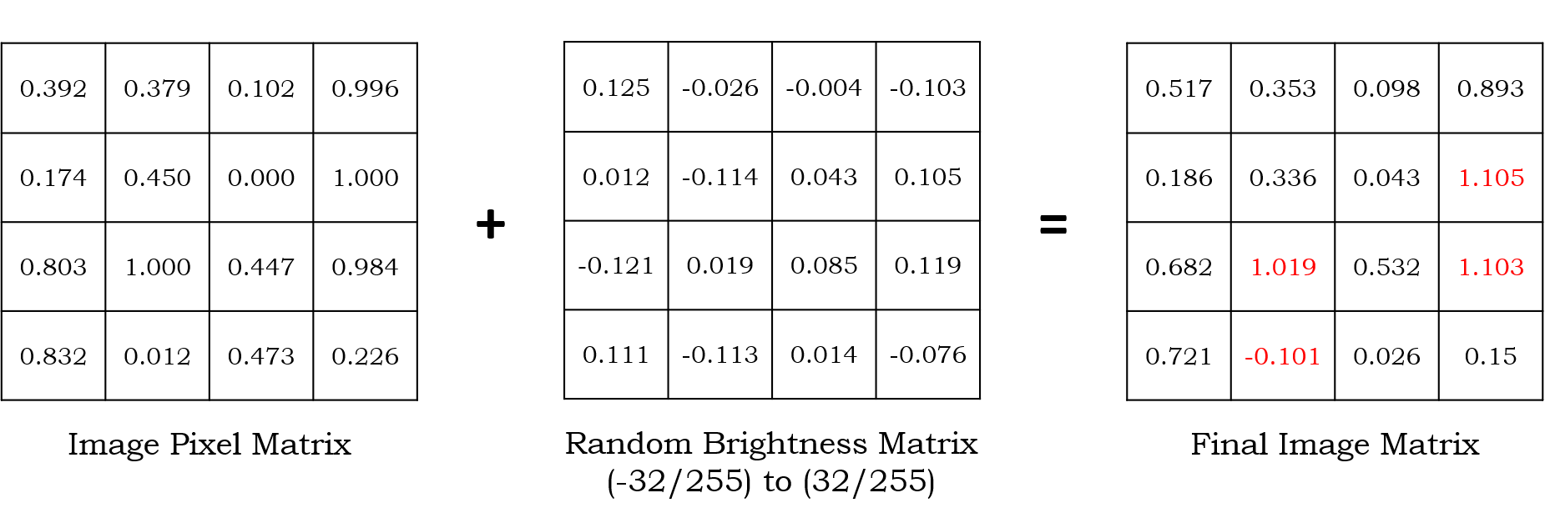
Random Brightness
Adjusting image brightness to be randomly brighter and darker
Required if a model may be required to perform in a variety of light settings.
Important to consider the maximum and minimum of brightness.
19

Slide 20
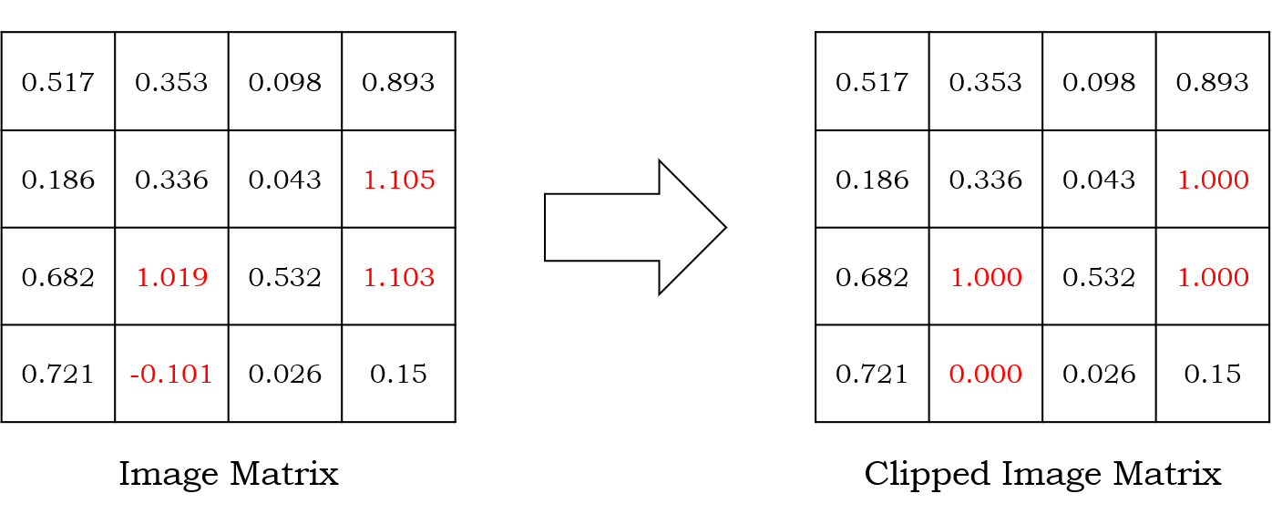
Image Clipping
Required to make sure that every pixel value is normalized and lies in certain range.
20

Slide 21
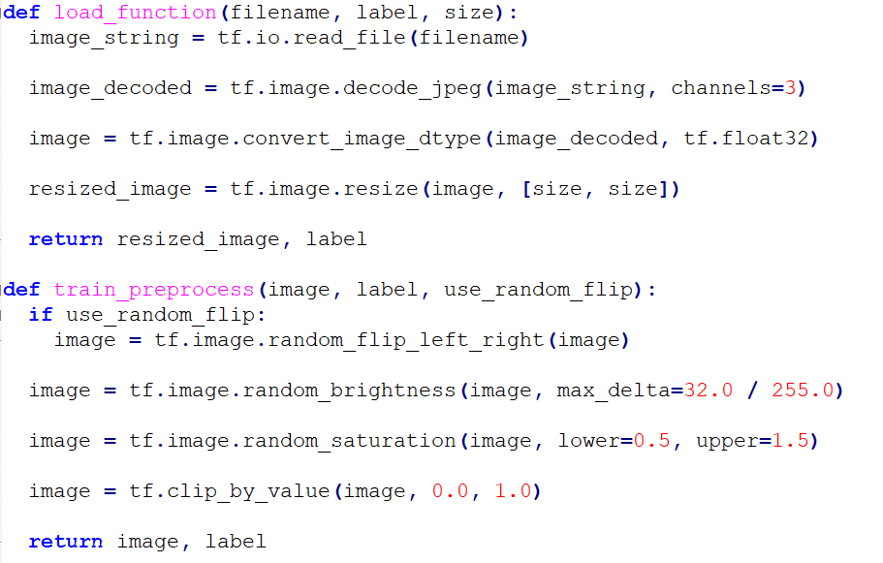
TensorFlow Code for Preprocessing Steps
21

Slide 22
Presentation Outline
Data Pipeline
TensorFlow Input Pipeline
Preprocessing Steps
Deep Residual Models
Experimental Setup
Experimental Analysis
Optimizations
Conclusion
22

Slide 23
04
Deep Residual Models
Understanding Deep Residual models for image classification
Why these models are better than CNNs
23

Slide 24
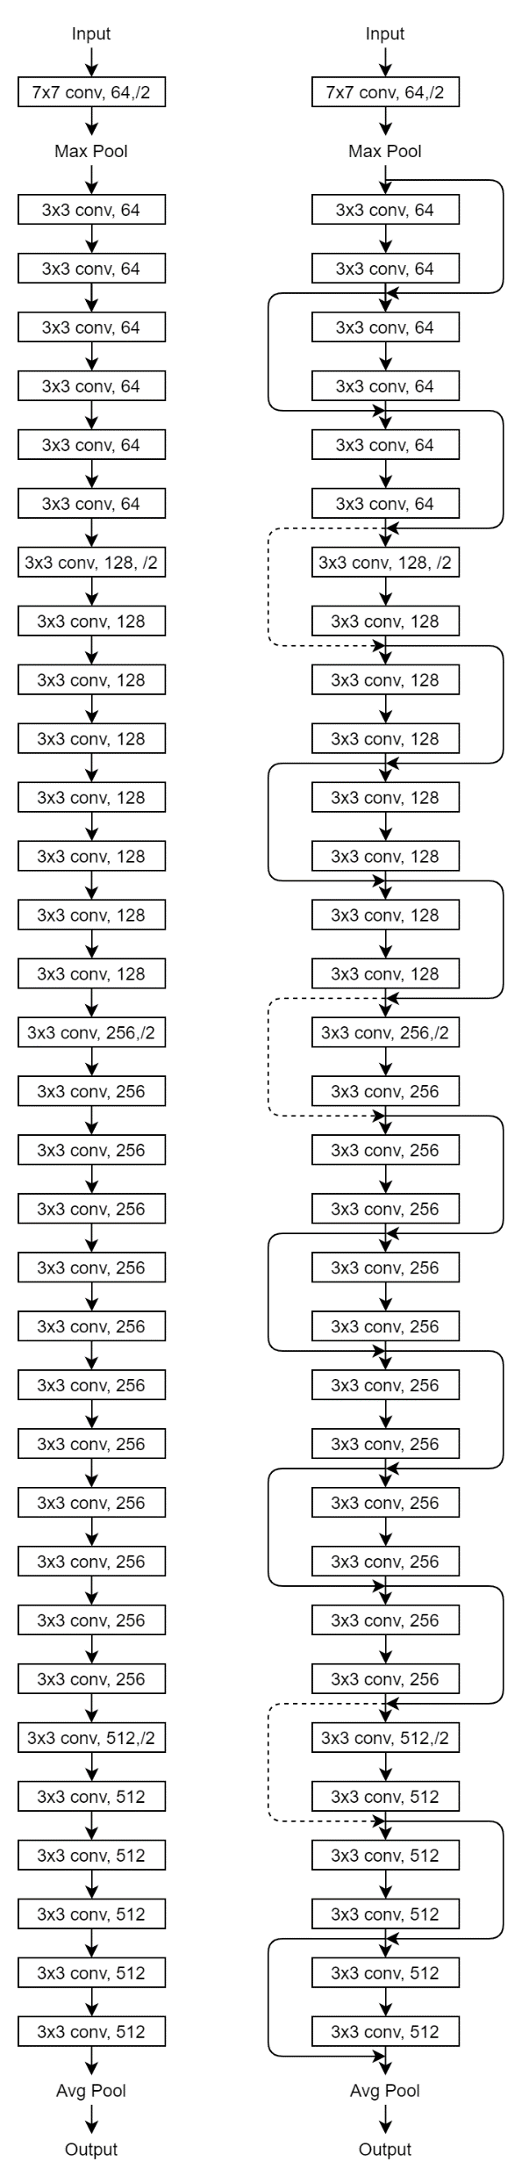
CNN Model vs Deep Residual Model
Residual Model
CNN Model
24

Slide 25
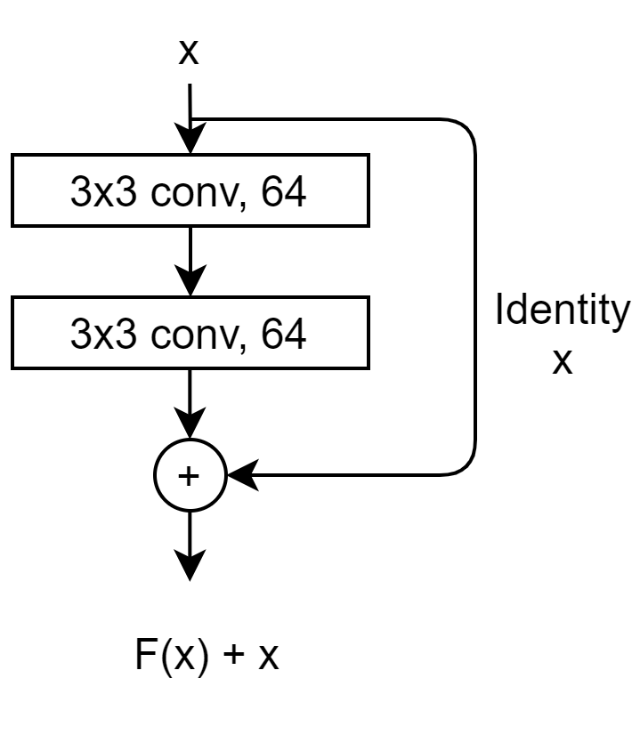
Skip Connection
Skip connection helps to transfer the error terms during backpropagation to the initial model layers.
Skip connection is an identity function, which is very easy for neural networks to learn.
Residual models are preferred over CNN model because of their ability to make the parameter updates to initial layers even in very deep models.
25

Slide 26
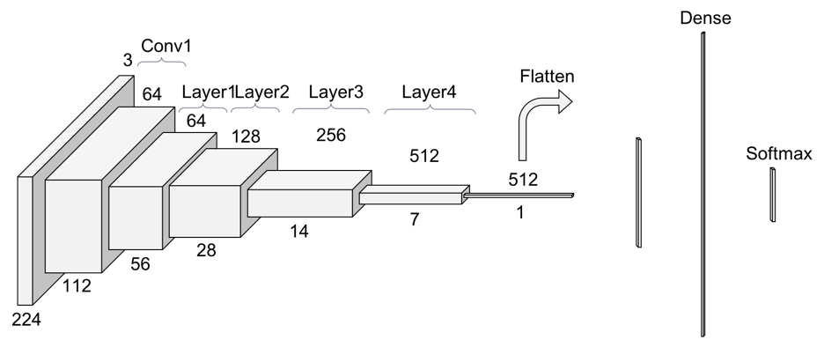
Residual Model
Each layer in Residual network decrease the dimensionality of the input vector.
Dimensionality reduction is achieved by either kernel stride or by pooling layers.
Each block of layers tends to learn certain number of feature sets in the input vector.
Residual models are preferred over CNN model because Residual models are capable of learning valuable features even in deep convolutional network.
26

Slide 27
Presentation Outline
Data Pipeline
TensorFlow Input Pipeline
Preprocessing Steps
Deep Residual Models
Experimental Setup
Experimental Analysis
Optimizations
Conclusion
27

Slide 28
05
Experimental Setup
Hardware/Software used for analysis.
28

Slide 29
Hardware
CPU
Intel(R) Core(TM) i7 8564U CPU with 4 CPU cores
32 GB RAM
100 GB of SSD (SATA)
GPU
Nvidia Tesla V100-SXM2-16GB
16 GB global memory, supports both L1 (128 KB for each SM) and L2 caches (6 MB)
5120 CUDA cores and supports CUDA 7.0 (with OpenCL 1.2)
29

Slide 30


Software
TensorFlow 2.4.1
CUDA® 11.0 GPU toolkit
cuDNN 8.0.4
Tensorboard 2.0
ImageNet Dataset
14,197,122 unique images
2000 unique image classes
Raw images in JPEG format
30

Slide 31
Presentation Outline
Data Pipeline
TensorFlow Input Pipeline
Preprocessing Steps
Deep Residual Models
Experimental Setup
Experimental Analysis
Optimizations
Conclusion
31

Slide 32
05
Experimental Analysis of Data Pipeline
Performance of TensorFlow models and pipelines.
32

Slide 33
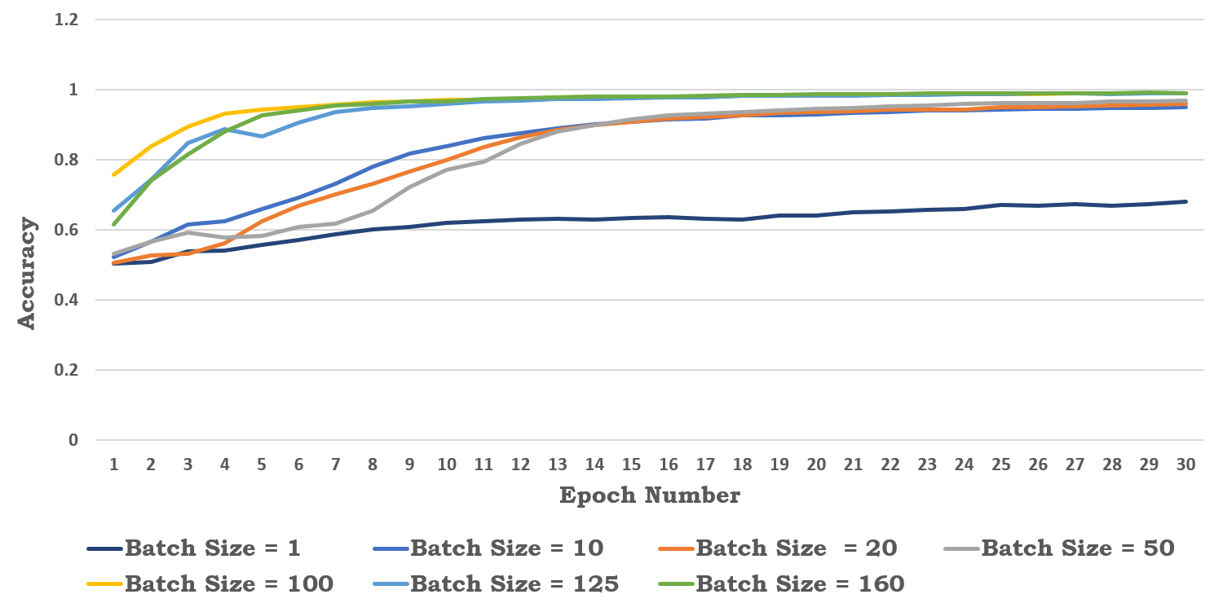
Resnet50 Model Accuracy
Smaller batch size doesn't achieve high accuracy, for instance batch size equal to 1. This is because of overfitting.
As batch size is increased, the accuracy of model increases.
As the batch size increases, the higher accuracy is achieved in lesser number of epochs.
However, the batch size supported by GPU depends upon factors such as global GPU memory, size of the training model.
33

Slide 34
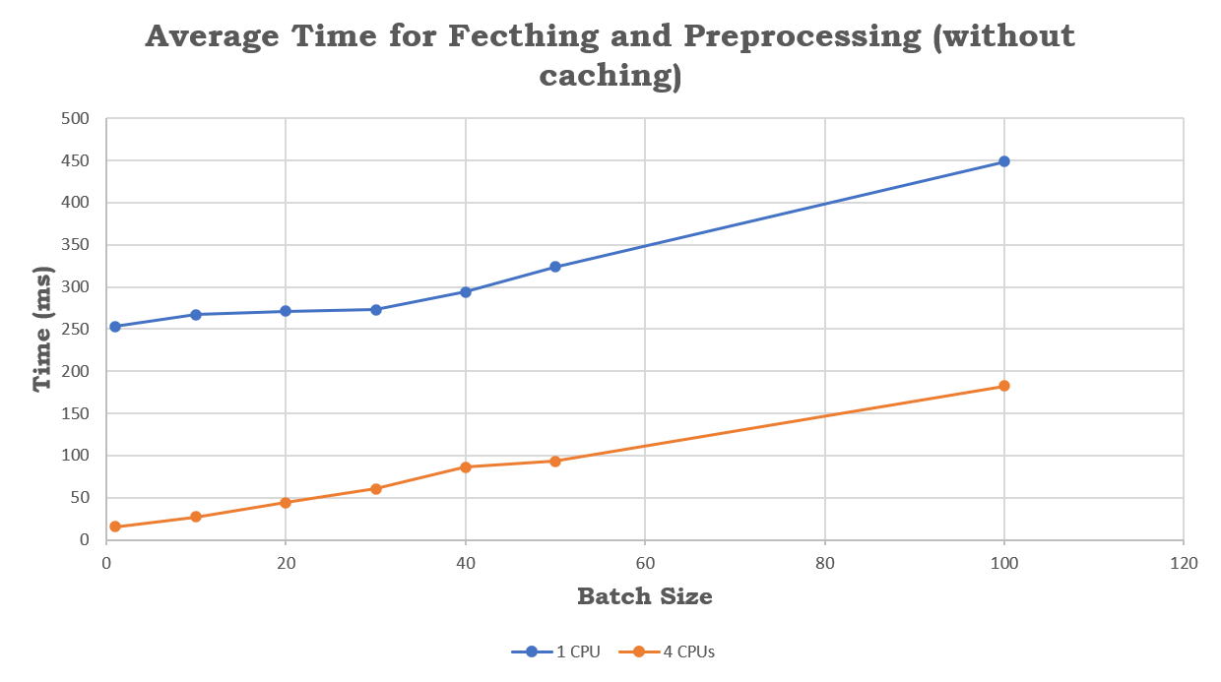
Average Fetching and Preprocessing Time
For this measurement, page caches are flushed to make sure no raw data is cached.
Graph shows significant improvement in fetching and preprocessing latencies with more number of I/O worker threads.
This indicates that CPU is a bottleneck, when CPU is doing both fetching and preprocessing operations.
34

Slide 35
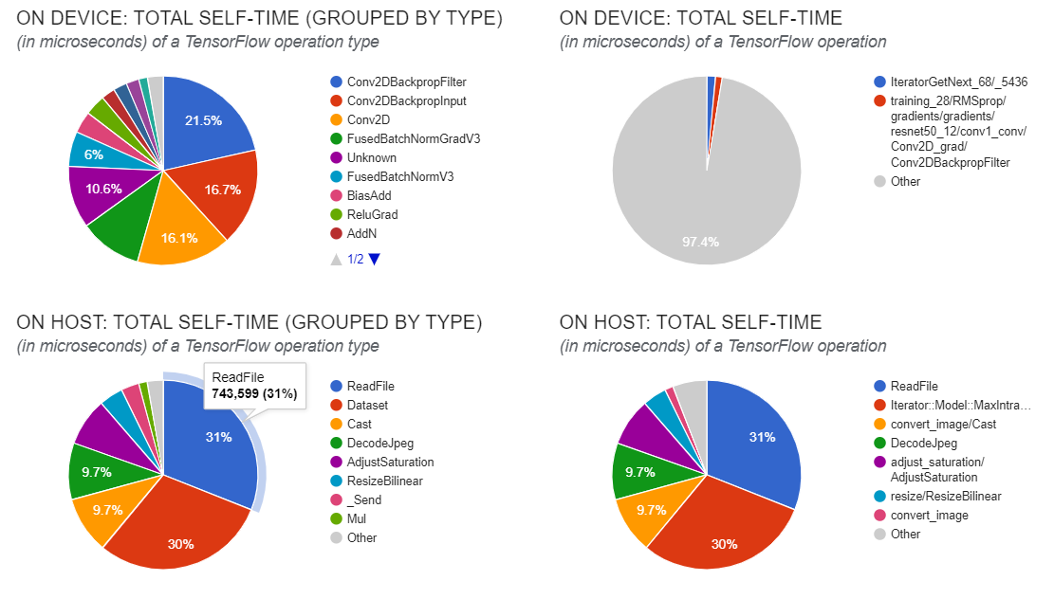
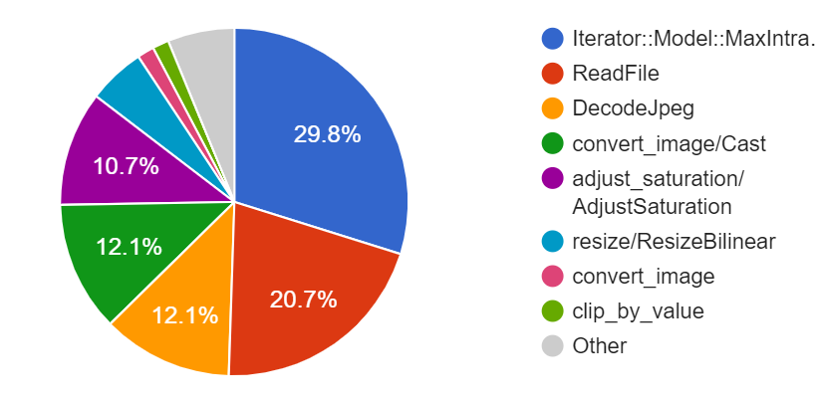
Breakdown of CPU/GPU time
~20% of the average total time is spent in directly accessing an image from SSD.
Rest ~80% of time is spent for shuffling data, preprocessing data and creating batches.
~50% of CPU time is spent on preprocessing operations such as $DecodeJpeg$, $ResizeBilinear$, $AdjustSaturation$ etc.
35

Slide 36
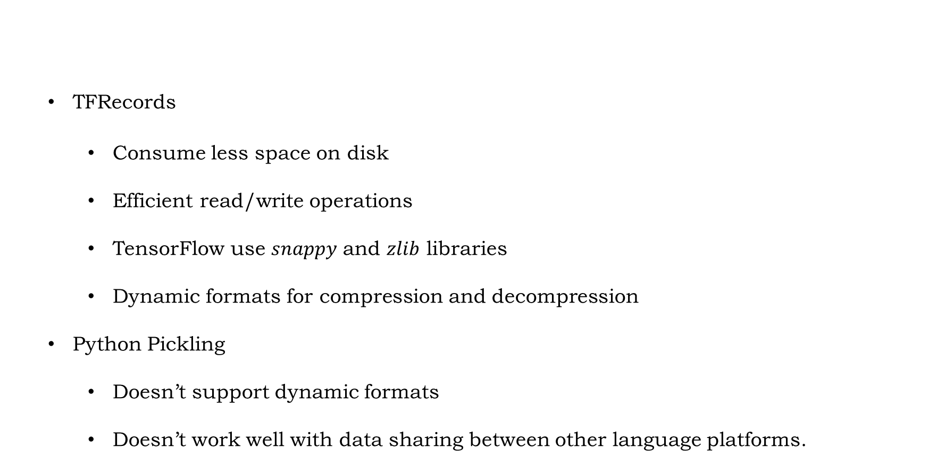
TFRecords
Consume less space on disk
Efficient read/write operations
TensorFlow use $snappy$ and $zlib$ libraries
Dynamic formats for compression and decompression
Python Pickling
Doesn’t support dynamic formats
Doesn’t work well with data sharing between other language platforms.
Data Compression
36

Slide 37
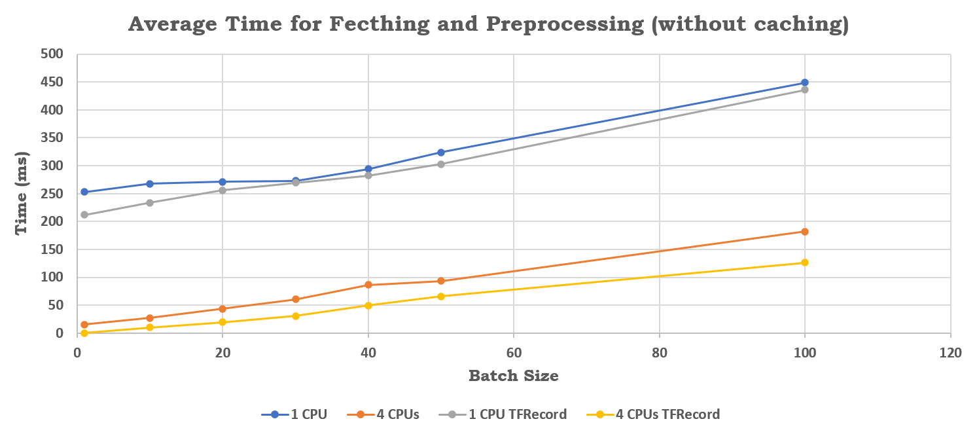
Performance of Data Pipeline with Compressed Data
Using compressed TFRecords in place of raw input images, the average time for fetching and preprocessing decreases.
However, the difference is not significant as compared to the average latencies in case of raw input images.
37

Slide 38
Memory Requirement for various Dataset formats
Using TFRecord format, ~45% disk space is saved.
Using Python Pickle format, ~28% of disk space is saved.
Compressed dataset saves a lot of space on NV Memory, however its impact on the overall model performance is very small.
38

Slide 39
Presentation Outline
Data Pipeline
TensorFlow Input Pipeline
Preprocessing Steps
Deep Residual Models
Experimental Setup
Experimental Analysis
Optimizations
Conclusion
39

Slide 40
06
Optimizations
How the preprocessing can be realistically moved to SSDs?
Ways to mitigate various bottlenecks in the pipeline design.
40

Slide 41
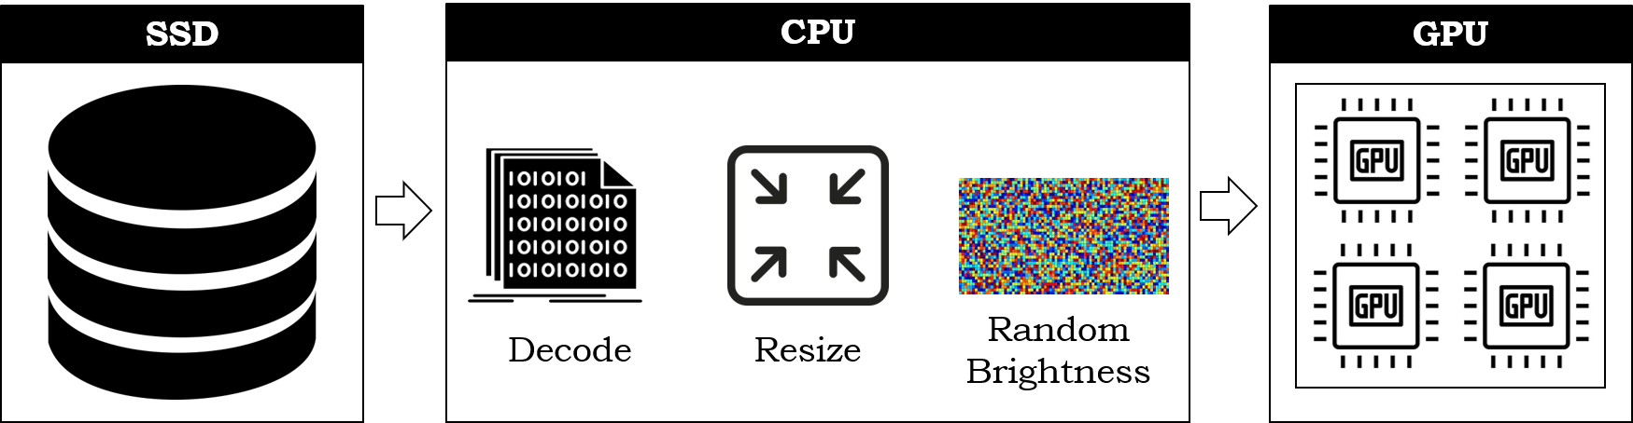
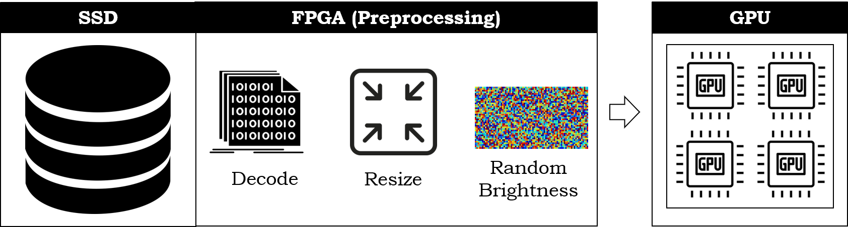
Moving the preprocessing steps to SmartSSD FPGA
41

Slide 42
Following preprocessing steps can be moved to SmartSSD FPGA:
Pico JPEG Decoder – Implementation by Intel using OpenCL.
Bilinear Interpolation – Implemented to extract RGB planes individually and resize each plane.
Adding random brightness – Implemented using a pseudo-random number generator provided by stdlib.
Normalization and Clipping – Implemented to convert integer pixel values to float type values between 0 and 1.
42

Slide 43
Average Time for Preprocessed and Raw Input Images
Data is preprocessed offline.
Data pipeline is fed with preprocessed data instead of raw JPEG images.
Graph shows the CPU execution overhead caused by the preprocessing steps in input pipeline.
Significant improvement in performance of input pipeline as the preprocessing steps are offloaded.
43

Slide 44
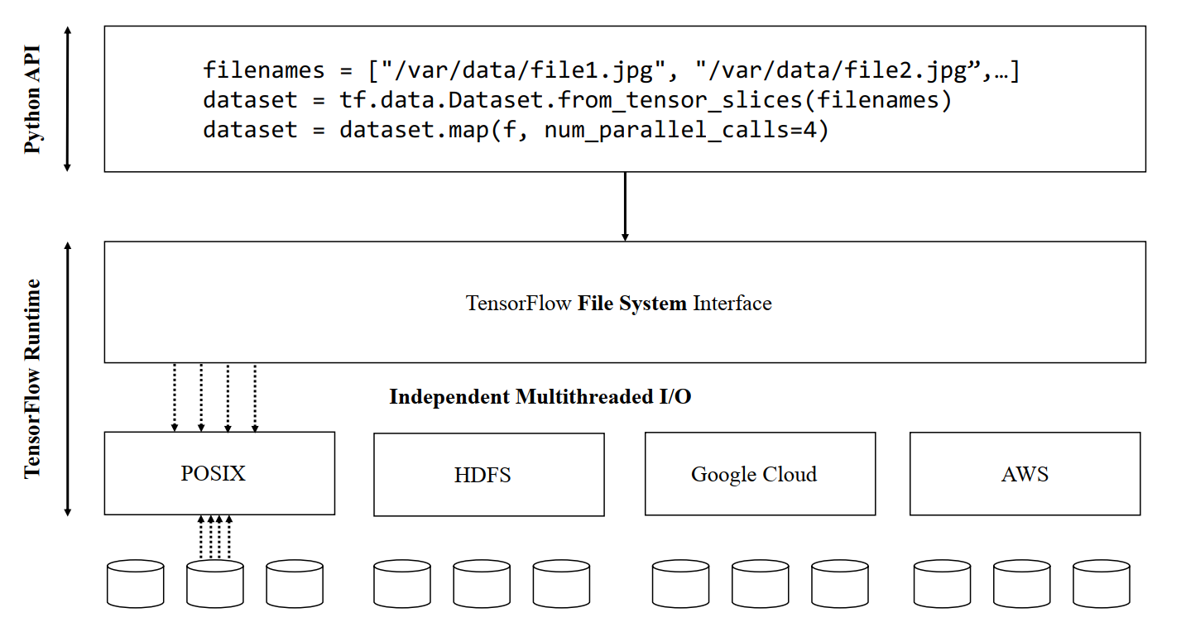
Custom Filesystem Integration
44

Slide 45
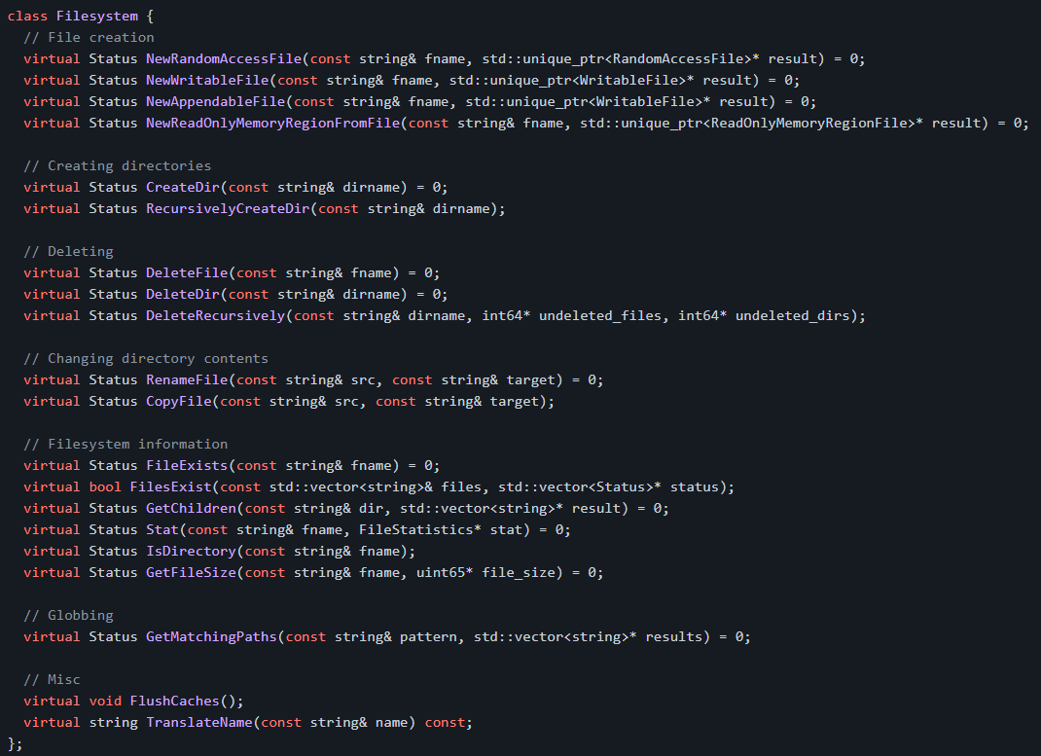
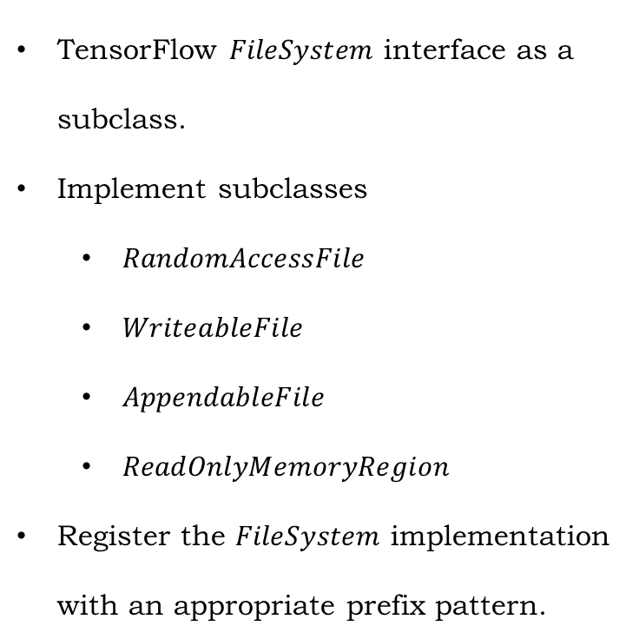
TensorFlow Filesystem Class
TensorFlow $FileSystem$ interface as a subclass.
Implement subclasses
$RandomAccessFile$
$WriteableFile$
$AppendableFile$
$ReadOnlyMemoryRegion$
Register the $FileSystem$ implementation with an appropriate prefix pattern.
https://github.com/tensorflow/tensorflow/blob/master/tensorflow/core/platform/default/posix_file_system.cc
45

Slide 46
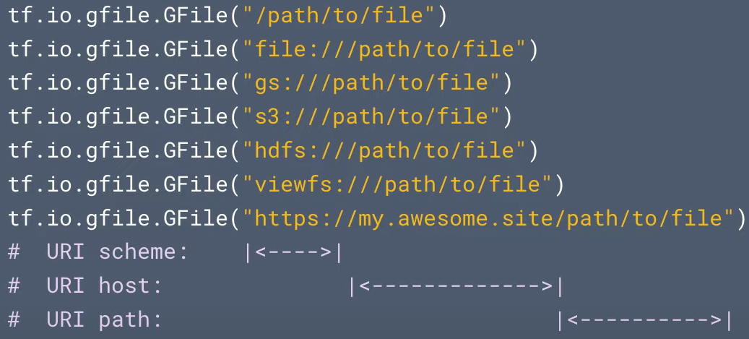
TensorFlow Filesystem Class
Files are identified by URI (Uniform Resource Identifier)
$$[<scheme>://[<host>]]<filename>$$
46

Slide 47
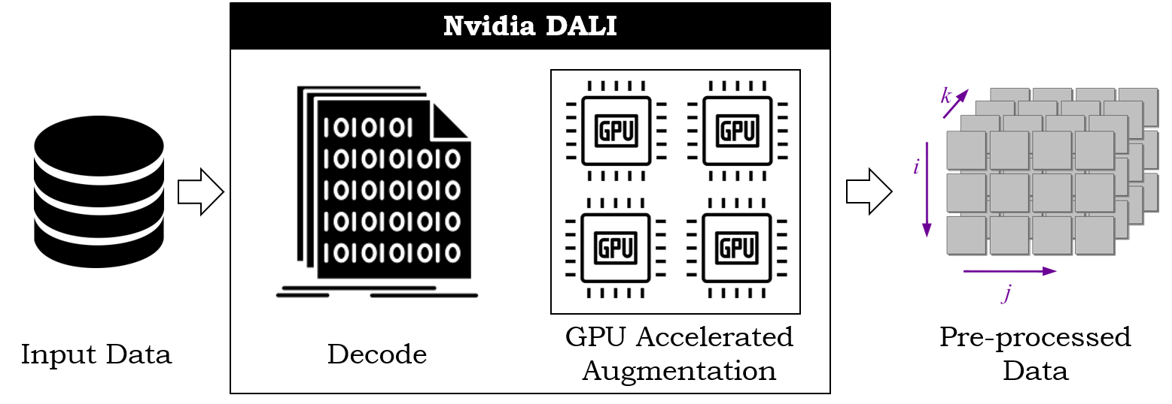
Nvidia DALI
Provides Python APIs.
Supports LMDB, RecordIO, TFRecord, COCO, JPEG, JPEG 2000, WAV, FLAC, OGG, H.264, VP9 and HEVC.
Supports CPU and GPU execution.
Allows direct data path between storage and GPU memory with GPUDirect Storage.
Nvidia DALI Preprocessing
47

Slide 48
Presentation Outline
Data Pipeline
TensorFlow Input Pipeline
Preprocessing Steps
Deep Residual Models
Experimental Setup
Experimental Analysis
Optimizations
Conclusion
48

Slide 49
06
Conclusion
Summary of outcomes of the project.
49

Slide 50
Analyzed various stages of end-to-end machine learning model to understand
Input data pipeline and various stalls associated with it.
Resnet model and how its trained.
Performance of various stages of input data pipeline and identifying the bottlenecks.
Studied the feasibility to ensure the integration of SmartSSD solution with existing Deep Learning frameworks
By understanding the provision of loading the custom filesystem with TensorFlow runtime.
By understanding the individual steps executed by DL frameworks for preprocessing image datasets.
50

Slide 51
Implemented preliminary code for FPGA implementation following preprocessing steps:
Decode JPEG image
Resize RGB image planes
Normalization and adding random brightness
Clipping
This project presents a preliminary analysis of a potential solution to reduce the CPU bottlenecks in future by using SmartSSD solutions. This is essential for the performance of deep learning models as GPU are getting more and more efficient, however CPU efficiencies are almost stagnant for over a decade.
51

Slide 52
Thank You

