Slide 1



Alleviating Garbage Collection Interference through Spatial Separation in All Flash Arrays
Jaeho Kim, Kwanghyun Lim*, Youngdon Jung,
Sungjin Lee, Changwoo Min, Sam H. Noh
*Currently with Cornell Univ.
Notes:
I'm Jaeho Kim from Virginia Tech. I’m happy to be here to introduce our work today.
The title of this talk is Alleviating Garbage Collection Interference through Spatial Separation in All Flash Array.
This is joint work with Kwanghyun Lim, Youngdon Jung, Prof. Sunjin Lee, Prof. Chanwoo Min, Prof. Sam Noh.
Let me start.

Slide 2
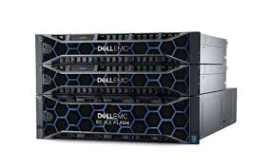
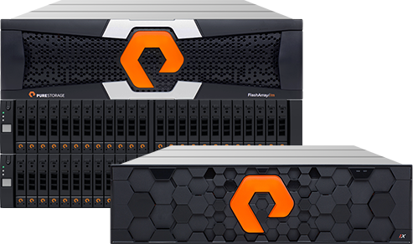
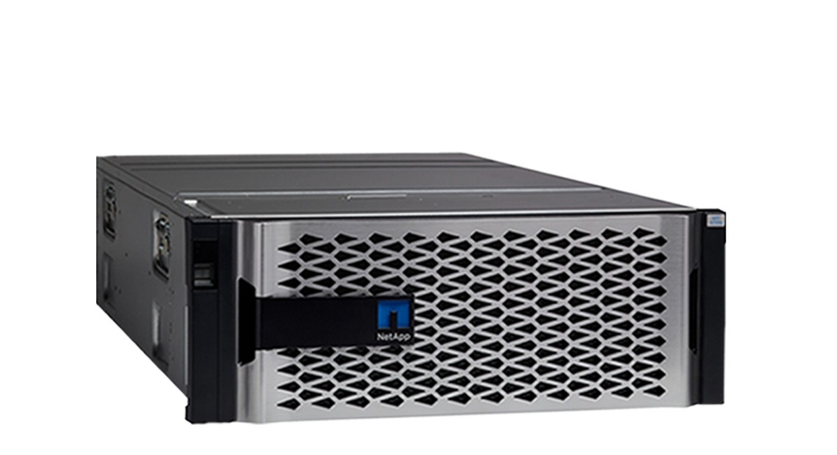
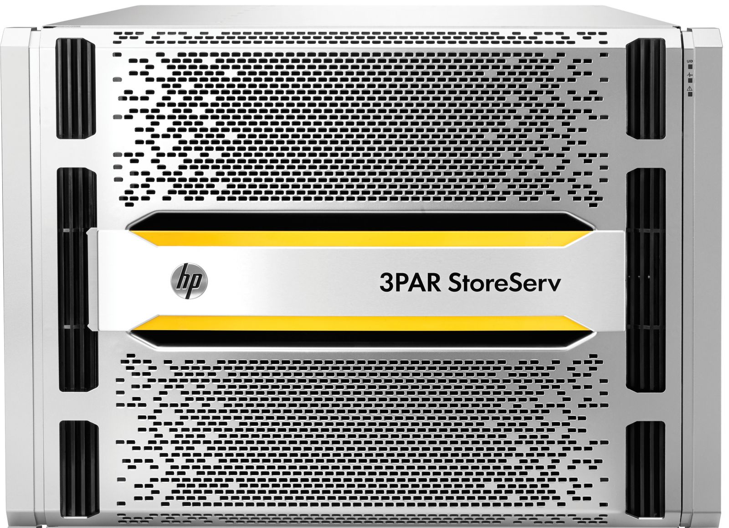
All Flash Array (AFA)
Storage infrastructure that contains only flash memory drives
Also called Solid-State Array (SSA)
https://images.google.com/
https://www.purestorage.com/resources/glossary/all-flash-array.html
Notes:
All Flash Array is storage infrastructure that contains only flash memory drives.
It is also called Solid State Array.

Slide 3

Example of All Flash Array Products (1 brick or node)
 | EMC XtremIO | HPE 3PAR | SKHynix AFA
Capacity | 36 ~ 144 TB | 750 TB | 552 TB
Number of SSDs | 18 ~ 72 | 120 | 576
Network Ports | 4~8 x 10Gb iSCSI | 4~12 x 16Gb FC | 3 x Gen3 PCIe
Aggregate Network Throughput | 5 ~ 10 GB/s | 8 ~ 24 GB/s | 48 GB/s
A: EMC XtremIO X2 Specification
B: HPE 3PAR StoreServ Specification
C: Performance Analysis of NVMe SSD-Based All-flash Array Systems. [ISPASS’18]
https://www.flaticon.com/
Notes:
Here are example of all flash array products.
Typically, one storage node is composed of a large number of SSDs and multiple network ports.

Slide 4

SSDs for Enterprise
Manufacturer | Product Name | Seq. Read Throughput | Seq. Write Throughput | Capacity
Intel | DC P4800X | 2.5 GB/s | 2.2 GB/s | 1.5 TB
 | DC D3700 | 2.1 GB/s | 1.5 GB/s | 1.6 TB
 | DC P3608 | 5 GB/s | 3 GB/s | 4 TB
Samsung | PM1725b | 6.3 GB/s | 3.3 GB/s | 12.8 TB
 | PM983 | 3.2 GB/s | 2 GB/s | 3.8 TB
Intel: https://www.intel.com/content/www/us/en/products/memory-storage/solid-state-drives/data-center-ssds.html
Samsung: https://www.samsung.com/semiconductor/ssd/enterprise-ssd/
Notes:
Let me show you a list of enterprise SSDs currently on the market.
As you can see, sequential read and write performance are in the few GB/sec range.
Actually, it's fairly high performance.

Slide 5
Bandwidth Trends for Network and Storage Interfaces
Infiniband
Storage throughput increases quickly
Storage isn’t bottleneck anymore
PCIe 5
400GbE
Infiniband
PCIe 4
200GbE
Infiniband
100GbE
40GbE
PCI-3
SAS-4
10GbE
SATA3
SAS-3
SATA Exp.
SATA2
SAS-2
2016
Interfaces: https://en.wikipedia.org/wiki/List_of_interface_bit_rates#Local_area_networks
SATA: https://en.wikipedia.org/wiki/Serial_ATA
PCIe: https://en.wikipedia.org/wiki/PCI_Express
Notes:
I’m going to show you bandwidth trends for network and storage interfaces.
X-axis shows years and y-axis is bandwidth.
[Click]
As you can see, network interface bandwidth increases fast. [Click]
Storage interface bandwidth grow even faster.
[Click]
So, we can say storage throughput increases quickly and storage isn’t bottleneck anymore in a system.

Slide 6
Example of All Flash Array Products (1 brick or node)
Throughput of a few high-end SSDs can easily saturate the network throughput
 | EMC XtremIO | HPE 3PAR | SKHynix AFA
Capacity | 36 ~ 144 TB | 750 TB | 552 TB
Number of SSDs | 18 ~ 72 | 120 | 576
Network Ports | 4~8 x 10Gb iSCSI | 4~12 x 16Gb FC | 3 x Gen3 PCIe
Aggregate Network Throughput | 5 ~ 10 GB/s | 8 ~ 24 GB/s | 48 GB/s
A: EMC XtremIO X2 Specification
B: HPE 3PAR StoreServ Specification
C: Performance Analysis of NVMe SSD-Based All-flash Array Systems. [ISPASS’18]
Notes:
Let’s see again all flash array products.
[Click]
If we configure an All Flash Array using these high-performance SSDs, throughput of a few high-end SSDs can easily saturate the network throughput.

Slide 7
Current Trends and Challenges
Performance of SSDs is fairly high
Throughput of a few SSDs easily saturates network bandwidth of a AFA node
Trends
Garbage Collection (GC) of SSD is still performance bottleneck in AFA
What is an ideal way to manage an array of SSDs with the current trends?
Challenges
Notes:
Let me summarize current trends and challenges for this work.
Performance of SSDs is fairly high.
Total throughput of a few SSDs easily saturates network bandwidth of a All Flash Array node.
However, garbage collection of SSD is still performance bottleneck in All Flash Array.
So, what is an ideal way to manage an array of SSDs with the current trends?
Before introducing our solution, I’ll give you a brief comparison of previous solutions.

Slide 8
Traditional RAID Approaches
Traditional RAID employs in-place update for serving write requests
High GC overhead inside SSD due to random write from the host
APP
Random writes
OS
RAID 4/5
In-place write
Limitations
Random writes
Previous solutions
Harmonia [MSST’11]
HPDA [TOS’12]
GC-Steering [IPDPS’18]
AFA
GC
SSD
SSD
SSD
SSD
Notes:
This is a typical system layers with a traditional RAID.
[Click]
Traditional RAIDs employ in-place updates for serving write requests.
By doing this, [Click]
It is susceptible to performance drop due to high GC overhead inside SSDs because of random writes from the host.
There were previous solutions to optimize traditional RAID approaches, but they have some limitations.

Slide 9
Log-(based) RAID Approaches
Log-based RAID employs log-structured writes to reduce GC overhead inside SSD
Log-structured writes involve host-level GC, which relies on idle time
If no idle time, GC will cause performance drop
APP
Random writes
OS
Log-RAID
GC
Log-structured write
Sequential writes
AFA
Previous solutions
SOFA [SYSTOR’14]
SRC [Middleware’15]
SALSA [MASCOTS’18]
Limitations
SSD
SSD
SSD
SSD
Notes:
To overcome the drawback of traditional RAID, log-based RAIDs have been studied.
[Click]
Log-based RAID employs log-structured writes to reduce GC overhead inside SSDs.
However, log-structured writes involve host-level GC.
[Click]
The GC relies on idle time. If there is no idle time, GC will cause a performance drop.
This is a well-known drawback of log-structured write.
[Click]
There were also several previous solutions, but they still have limitations.

Slide 10
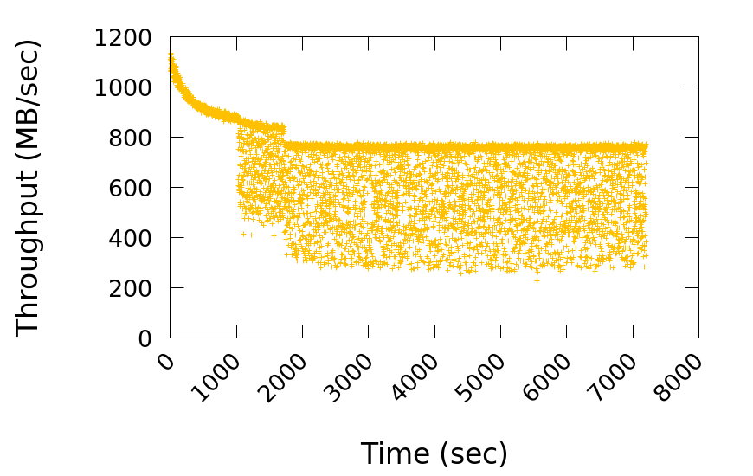

Performance of a Log-based RAID
Configuration
Consist of 8 SSDs (roughly 1TB capacity)
Workload
Random write requests continuously for 2 hours
How can we avoid this performance variation
due to GC in All Flash Array?
GC starts here
Interference between GC I/O and user I/O
Notes:
Now, we consider the performance of a typical Log-based RAID, where it consists of 8 SSDs.
For workload, we use random write requests continuously for 2 hours.
Here is a performance result.
X-axis is time and y-axis is throughput.
We observed that GC starts at around thousand seconds.
After GC, performance fluctuates due to interference between GC and user I/O. [Paus 2 seconds]
So, how can we avoid performance variation due to GC in All Flash Array. [Paus 2 seconds]

Slide 11

Our Solution (SWAN)
SWAN (Spatial separation Within an Array of SSDs on a Network)
Goals
Provide sustainable performance up to network bandwidth of AFA
Alleviate GC interference between user I/O and GC I/O
Find an efficient way to manage an array of SSDs in AFA
Approach
Minimize GC interference through SPATIAL separation
Image: https://clipartix.com/swan-clipart-image-44906/
Notes:
Our solution is SWAN, which stands for Spatial separation Within an Array of SSDs on a Network.
We have three goals in this work.
The first, we provide sustainable throughput up to network bandwidth of All Flash Array.
Second, we alleviate GC interference between user I/O and GC I/O.
The last one, we find an efficient way to manage an array of SSDs in All Flash Array.
Our approach is to minimize GC interference through spatial separation.

Slide 12
Our Solution: Brief Architecture of SWAN
Log-based RAID:
Temporal separation
between GC and
user I/O
SWAN:
Spatial separation between GC and user I/O
APP
Divide an array of SSDs into front-end and back-end like 2-D array
Called, SPATIAL separation
Employ log-structured writes
GC effect is minimized by spatial separation
Random writes
OS
SWAN
Reduced GC effect
VS.
Log-structured
write
Spatial
Separation
Append-only manner
AFA
SSD
SSD
SSD
SSD
SSD
SSD
Front-end
Back-end
Notes:
Here is a brief architecture of SWAN.
We divides an array of SSDs into front-end and back-end like a two-dimensional array.
[Click] We call it spatial separation.
[Click] We employ log-structured writes to make append-only manner.
[Click] The garbage collection effect is minimized by this spatial separation.
Our work focuses on how to implement spatial separation in All Flash Array.
And we compare temporal separation and spatial separation in terms of performance and efficiency.

Slide 13
Architecture of SWAN
Spatial separation
Front-end: serve all write requests
Back-end: perform SWAN’s GC
Log-structured write
Segment based append only writes, which is flash friendly
Mapping table: 4KB granularity mapping table
Implemented in block I/O layer
where I/O requests are redirected from the host to the storage
Notes:
Here is an architecture of SWAN.
For spatial separation, the front-end server all write requests while back-ends perform SWAN’s GC.
SWAN employs segment based append only write which is flash friendly manner.
And we maintains host-level mapping table as well.
SWAN is implemented in block I/O layer.

Slide 14
Example of Handling I/O in SWAN
SSD
W
R
Write
req.
Read
req.
Block I/O Interface
W1
R7
W3
R8
Logical Volume
W1
W3
R7
R8
… | W1 |  | W3 |  |  | R7 | R8 | …
Physical Volume
W1
W3
Logging
… | W1 | W3 |  |  | …
Segment
Front-end
Back-end
Back-end
W1
R7
SSD
like RAID parallelism
W3
R8
SSD
Parity
SSD
Notes:
I'm going to give you an example of how to handle I/O requests in SWAN.
[Click] SWAN receives all I/O requests from block I/O interface.
[Click*2] And it maintains logical and physical volumes to manage an array of SSDs.
[Click] Let’s assume that read and write requests arrive at the block I/O interface. Red circles are write requests and green circles are read requests.
[Click] All requests are placed on the logical volume according to their logical block number.
[Click] Write requests are appended to a segment and distributed across SSDs with parity in the front-end like RAID parallelism.
In case of read requests, it will be served by any of SSDs holding the requested blocks.

Slide 15
Procedure of I/O Handling (1/3)
W
P
Write
Parity
Front-end absorbs all write requests in append-only manner
To exploit full performance of SSDs
Write Req.
Front-end
Back-end
Back-end
W
SSD
SSD
parallelism unit
Segment
SSD
SSD
W
P
SSD
SSD
Append only
(a) First - phase
Notes:
I’m going to talk about procedure of I/O handling more details.
Let's assume that there are one front-end and two back-end and each of them consist of three SSDs.
[Click*3]
Front-end absorbs all writes with append-only manner to exploit full performance of SSDs.

Slide 16
Procedure of I/O Handling (2/3)
W
P
Write
Parity
When the front-end becomes full
Empty back-end becomes front-end to serve write requests
Full front-end becomes back-end
Again, new front-end serves write requests
Write Req.
Front-end becomes full
Front-end
Back-end
Back-end
Back-end
Front-end
SSD
SSD
W
Segment
SSD
SSD
Segment
Segment
W
SSD
SSD
P
(a) Second - phase
Notes:
[Click]
When the front-end becomes full, the write pointer moves to the next empty back-end.
[Click *4] Empty back-end becomes front-end to serve write requests.
[Click *3] And full front-end becomes back-end.
Again, front-end serves write requests.

Slide 17
Procedure of I/O Handling (3/3)
W
P
GC
TRIM
Write
Parity
When there is no more empty back-end
SWAN’s GC is triggered to make free space
SWAN chooses a victim segment from one of the back-ends
SWAN writes valid blocks within the chosen back-end
Finally, the victim segment is trimmed
SWAN GC
Write Req.
All write requests and GC are spatially separated
Back-end
Back-end
Front-end
Ensure writing a segment sequentially inside SSDs
W
SSD
SSD
W
Segment
SSD
SSD
Segment
W
Segment
Segment
Segment
Segment
W
P
SSD
SSD
P
TRIMmed
(a) Third - phase
Notes:
Once the front-end becomes full again, the write pointer move to the next empty back-end. [Click *2]
When there is no more empty back-end, SWAN’s GC is trigged to make free space.
SWAN choose a victim segment from one of back-end and writes valid blocks within the chosen back-end.
[Click*3] Finally, the victim segment is trimmed. This is an important for SWAN. TRIM ensures writing a segment sequentially inside SSDs.
Therefore, all write requests and GC are spatially separated.

Slide 18
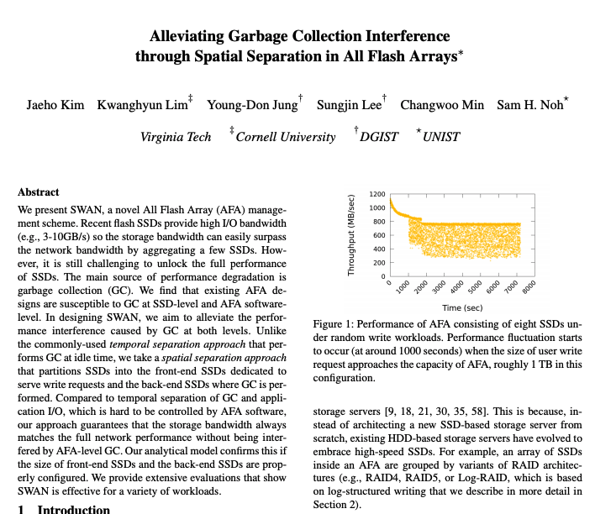
Feasibility Analysis of SWAN
Analytic model of SWAN GC
How many back-ends in AFA ?
SWAN GC
How many SSDs in front-end?
SSD
SSD
SSD
SSD
SSD
SSD
Front-end
Back-end
Back-end
Please refer to our paper for details!
Notes:
We conducted a feasibility analysis of SWAN.
In the analysis, we provide several design choices such as, how many SSDs per front-end and how many back-ends?
In addition, we present an analytic model of SWAN GC.
Please refer to our paper for details.

Slide 19
Evaluation Setup
Environment
Dell R730 server with Xeon CPUs and 64GB DRAM
Up to 9 SATA SSDs are used (up to 1TB capacity)
Open channel SSD for monitoring internal activity of an SSD
Target Configurations
RAID0/4: Traditional RAID
Log-RAID0/4: Log-based RAID
SWAN0/4: Our solution
Workloads
Micro-benchmark: Random write request
YCSB C benchmark
No parity | 1 parity per stripe
RAID0 | RAID4
Log-RAID0 | Log-RAID4
SWAN0 | SWAN4
Please refer to paper for more results!
Notes:
Now, I’ll explain our evaluation setup.
We use a typical server with up to 9 SSDs.
We also use an open channel SSD for monitoring internal activity of an SSD.
[Click] We compare SWAN with traditional RAID and Log-based RAID.
[Click] Note that 0 and 4 in the name of each scheme indicate the presence or absence of parity for recovery.
[Click] We used micro-benchmarks and YCSB benchmark.
We show selected results. You can refer to paper for the rest results.

Slide 20
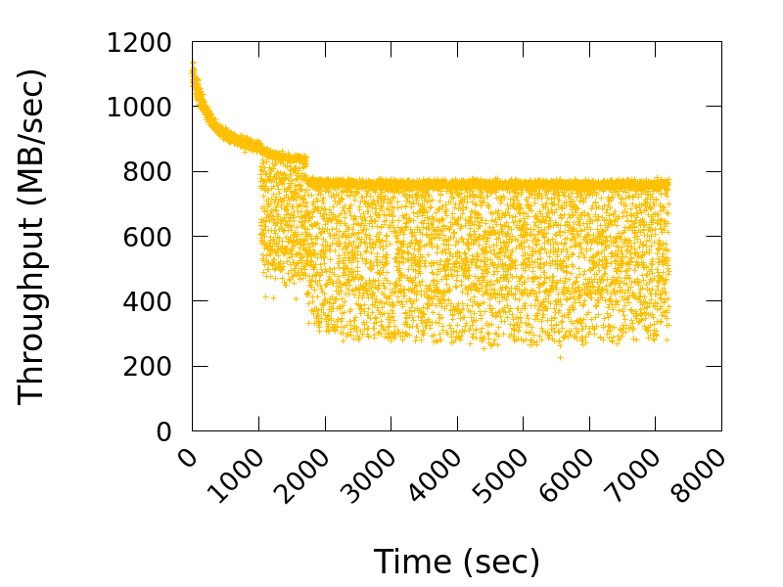
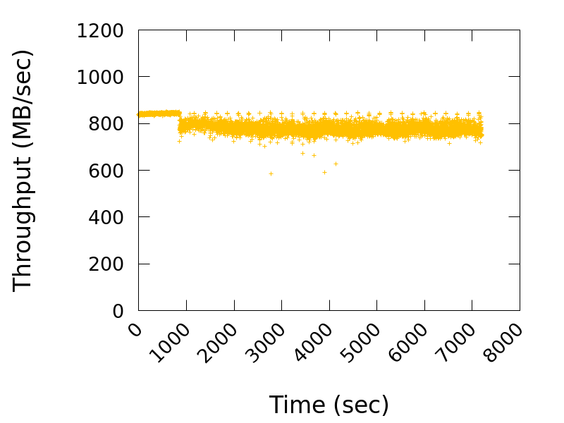
Random Write Requests for 2 Hours (8KB Sized Req.)
GC starts here
GC starts here
Interference between GC I/O and user I/O
Log-RAID0
SWAN0
Notes:
Now, I am going to show you results of random write performance for Log-RAID0 and SWAN0.
In case of Log-RAID0, after GC starts, we observed a significant performance variation due to interference between GC I/O and user I/O.
On the other hand, SWAN shows consistent performance even GC starts.
Let’s take a closer look at performance results.

Slide 21

Analysis of Log-RAID’s Write Performance
Write throughput
GC starts here:
All SSDs involved in GC
Read throughput
SSD 1
Red lines increases while blue lines drop down since GC incurs read and write operations
SSD 2
GC starts here
SSD 3
SSD 4
SSD 5
SSD 6
Performance fluctuates as all SSDs are involved in GC
SSD 7
Log-RAID0
SSD 8
User observed throughput
Notes:
I’m going to show you an analysis of Log-RAID’s write performance.
In the experiment, we used 8 SSDs.
Both left and right graphs shows the throughput of Log-RAID0.
[Click] In the left figure, we show individual throughput of all SSDs.
[Click] The last row is user observed throughput.
The blue line indicates write throughput while the red line is read throughput.
[Click] After GC starts, red line increases and blue line drops down since GC incurs reads and writes.
Performance fluctuates as all SSDs are involved in GC.

Slide 22
Analysis of SWAN’s Write Performance
GC starts here
Only one back-end is involved in GC
Write throughput
Read throughput
Front-end
Back-end
SSD 1
GC starts here
SSD 2
Front-end
SSD 3
This pattern continues
SWAN separates write requests and GC
SSD 4
Front-end
SSD 5
SSD 6
Front-end
Configuration
SSD 7
SWAN has 1 front-end and 4 back-ends
Front/back-ends consists of 2 SSDs
SSD 8
User observed throughput
Notes:
Now, I’m going to show you an analysis of SWAN’s write performance.
For this experiment, SWAN has 1 front-end and 4 back-ends. And each of them consist of 2 SSDs.
[Click] We also measured the individual throughput of all SSDs.
[Click] The last row is user observed throughput.
As you can see in the left side figure, the front-end only serves write requests.
[Click] Around thousand second, one of back-end starts GC while front-end handles write requests.
As you can see, only one back-end is involved in GC.
[Click]
This pattern continues when requests arrives.
We observed that SWAN separates write requests and GC.

Slide 23
Read Tail Latency for YCSB-C
SWAN4 shows the shortest read tail latency
RAID4 and Log-RAID4 suffers long tail latency
Spatial separation is effective for handling read requests as well
Notes:
We also measured read tail latency for YCSB-C benchmark.
We observed that SWAN4 shows the shortest latency while Log-RAID4 and RAID4 suffers long tail latency due to GC interference.
It shows spatial separation is effective for handling read requests as well.

Slide 24
Benefits with Simpler SSDs
SWAN can saves cost and power consumption w/o compromising performance by adopting simpler SSDs
Smaller DRAM size
Smaller over-provisioning space (OPS)
Block or segment level FTL instead of page-level FTL
SWAN sequentially writes data to segments and TRIMs a large chunk of data in the same segment at once
Notes:
SWAN has also benefits with simper SSDs.
SWAN can saves cost and power consumption w/o compromising performance by adopting simpler SSDs such as, …
This is because SWAN ….

Slide 25
Conclusion
Provide full write performance of an array of SSDs up to network bandwidth limit
Alleviate GC interference through separation of I/O induced by application and GC of All Flash Array
Introduce an efficient way to manage SSDs in All Flash Array
Thanks for attention!
Q&A
Notes:
Now, I’m going to conclude our talk.

Slide 26
Backup slides

Slide 27
Handling Read Requests in SWAN
Recent updated data might be served at page cache or buffer
Falling in front-end
Give a highest priority to read requests
Falling in GC back-end
Preempt GC then serve read requests
Falling in idle back-ends
Server immediately read requests

Slide 28
GC overhead inside SSDs
GC overhead should be very low inside SSDs because
We write all the data in a segment-based append-only manner
Then give TRIMs to ensure writing a segment sequentially inside SSDs

Slide 29
Previous Solutions
Traditional
RAID
Solutions | Write Strategy | How Separate User & GC I/O | Disk Organization
Harmonia [MSST’11] | In-place write | Temporal (Idle time) | RAID-0
HPDA [IPDPS’10] | In-place write | Temporal | RAID-4
GC-Steering [IPDPS’18] | In-place write | Temporal | RAID-4/5
SOFA [SYSTOR’14] | Log write | Temporal | Log-RAID
SALSA [MASCOTS’18] | Log write | Temporal | Log-RAID
Purity [SIGMOD’15] | Log write | Temporal | Log-RAID
SWAN (Proposed) | Log write | Spatial | 2D Array

