Slide 1

An Efficient Buffer Replacement Algorithm for NAND Flash Storage Devices
Dong Hyun Kang, Changwoo Min, Young Ik Eom
Sungkyunkwan University, Korea
MASCOTS 2014

Slide 2
NAND Flash Storage Devices
NAND flash storage devices (e.g., eMMC, microSD card, and SSD) are rapidly replacing hard disk drives (HDDs) in modern computing systems
Mobile devices, laptops, and servers
Technical merits
No mechanical parts
Low access latency
Low power consumption
Shock resistance
Potentially uniform random access time

Slide 3
Two Remaining Problems
As flash density increase, the lifetime rapidly decreases
Single-level Cell (SLC): 100K ~ 1M
Multi-level Cell (MLC): 5K ~ 10K
Triple-level Cell (TLC): 1K
Random writes significantly decrease performance and lifetime
Random writes are several times slower than sequential writes
Random writes generate more hidden writes inside NAND flash storage devices
As a result, the lifetime can be significantly reduced by random write

Slide 4
Why Buffer Replacement Algorithm
Buffer Replacement algorithm
It receives I/O requests directly from applications
It transforms the requests into a suitable I/O request stream for storage devices.
Flash-aware buffer replacement algorithms
Asymmetric read & write cost
Write patterns
CFLRU
: S.-Y Park et al.
2005
FAB
: H. Jo et al.
2006
2007
2008
BPLRU
: H. Kim et al.
LRU-WSR
: H. Jung et al.
2009
2010
LB-CLOCK
: B. Debnath et al.
FOR
: Y. Lv et al.
2011
2012
2013
Sp.Clock
: H. Kim et al.

Slide 5
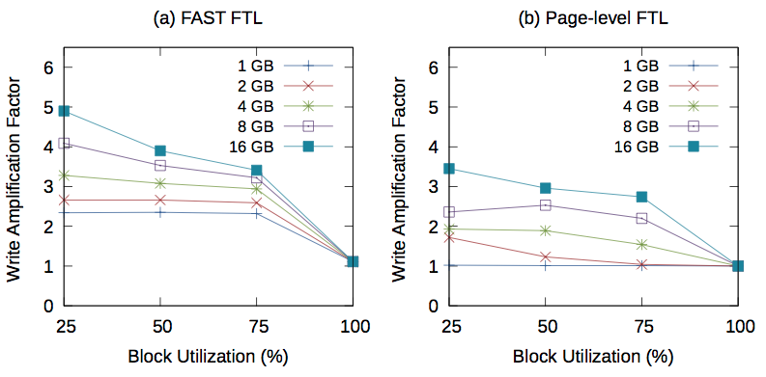
What Flash-friendly Write Are
Results of FTL simulator according to block utilizations for different synthetic traces
If the request of the random write are same as flash block size, such write requests invalidate whole flash block inside NAND flash storage
Since all pages in a flash block are invalidated together, traces with 100% block utilization have an ideal WAF with no hidden write overhead

Slide 6
TS-CLOCK: Temporal and Spatial Locality-aware CLOCK
Overview
Maximize cache hit ratio
TS-CLOCK extends a well-known CLOCK replacement algorithm
Consider asymmetric read and write cost
TS-CLOCK prefers to evict clean pages over dirty pages
Minimize hidden writes inside NAND flash storage
TS-CLOCK shapes evicted dirty pages to flash-friendly write patterns
TS-CLOCK can improve write performance and extend lifetime of
NAND flash storage devices

Slide 7
TS-CLOCK: Temporal and Spatial Locality-aware CLOCK
Page management
All pages are managed by the basic rules of CLOCK algorithm
Dirty block tree
Dirty pages are managed by dirty block trees according to their logical sector number
Size of dirty block tree is set to erase block size of NAND Flash storage
When a page becomes a dirty page, the page is inserted its dirty block tree
P
P
P
P
P
P
P
P
P
P
P
P
T-hand
P
P
P
P
P
P
[Dirty block 1]
[Dirty block 2]
P
P
P
[Circular list]
[Red-black tree]

Slide 8
TS-CLOCK: Temporal and Spatial Locality-aware CLOCK
Reference count
Each page maintains a reference count to give each page a different level of opportunity to stay in the buffer cache.
Clean page
The reference count of clean page is always set to 1(Second Chance) for clean-first eviction
Dirty page
The reference count of dirty page is differently set to its utilization of dirty block tree
Pages belonging to small utilization dirty block stay longer in buffer cache.
Utilization | Chance
0% ~ 25% | 4 (Fifth Chance)
25% ~ 50% | 3 (Fourth Chance)
50% ~ 75% | 2 (Third Chance)
75% ~ 100% | 1 (Second Chance)

Slide 9
TS-CLOCK: Temporal and Spatial Locality-aware CLOCK
Replacement policy
If circular list is full, a victim page is selected by two hands for reclaiming a free page.
Victim page selection
t-hand first scans pages in a circular list and decrements its reference count by 1 for selecting a victim page
Victim page eviction
If a victim page is clean, it is immediately evicted from the circular list
If a victim page is dirty, s-hand scans dirty pages in dirty block tree by their sector numbers until a page with reference count of 0 is found.
While the s-hand scans dirty pages, it does not decrement a reference count
a dirty page in dirty block tree is evicted instead of a victim page for flash-friendly write patterns
A new page is inserted to the position of the t-hand

Slide 10
TS-CLOCK: Temporal and Spatial Locality-aware CLOCK
Example for clean page eviction
Time 1
Time 2
*
*
31
67
16
53
67
16
*
*
13
14
13
14
50
6
50
6
t-hand
t-hand
65
3
65
3
*
68
*
68
66
23
66
23
s-hand
Legend
clean page
dirty page
*
A reference count is zero.
(a) Initial stat
(b) Cache miss: Page 53
If t-hand selects a clean page as the victim page,
it is evicted for a new page

Slide 11
TS-CLOCK: Temporal and Spatial Locality-aware CLOCK
Example for dirty page eviction
Time 2
Time 3
*
*
*
*
67
53
67
16
53
67
53
67
28
53
16
*
*
13
14
13
16
13
16
13
14
50
*
*
50
6
50
6
14
50
14
t-hand
t-hand
t-hand
t-hand
65
3
65
3
65
6
65
6
*
68
68
23
3
23
3
66
23
23
68
68
65
65
s-hand
68
68
s-hand
Legend
*
s-hand
66
clean page
*
*
67
67
dirty page
*
A reference count is zero.
(c) Cache miss: Page 28
If t-hand selects a dirty page as the victim page,
s-hand selects another dirty page in dirty block tree and
the page pointed by s-hand is evicted instead of the victim page

Slide 12
Evaluation
Setup
Buffer replacement simulator
LRU, CLOCK, Linux2Q, CFLRU, FAB, LB-CLOCK, and Sp.Clock
FTL simulator
Page-level FTL
Hybrid FTL (FAST)
Real-world workload
Type | Workload | Read (MB) | Write (MB) | Write Range (MB)
Mobile | Video Streaming | 0.2 | 1514.4 | 266.6
Mobile | Mixed Applications | 526.9 | 413.2 | 133.0
Server | File Server | 7252.8 | 5880.1 | 14568.2
Server | TPC-C | 1129.2 | 2357.6 | 15124.4

Slide 13
Evaluation
Replaying workload
To measure the real performance of each replacement algorithm, we replayed read/write request in the results of each replacement algorithm on real devices with the O_DIRECT option.
Native Command Queuing (NCQ) is enabled.
NAND Flash storage devices
 | Storage-A | Storage-B | Storage-C
Manufacturer | Patriot | Adata | Samsung
Type | microSD card | microSD card | SSD
Capacity | 16 GB | 16 GB | 120 GB
Erase Block Size | 4 MB | 4 MB | 24 MB
Flash Memory | MLC | MLC | TLC

Slide 14
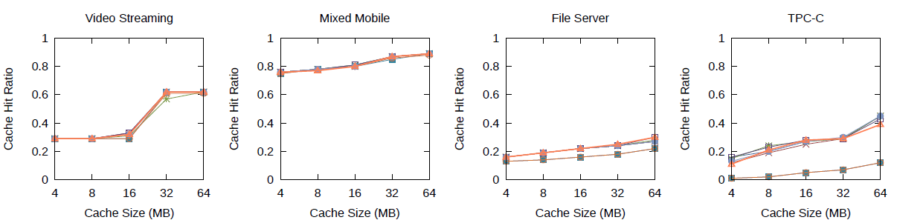
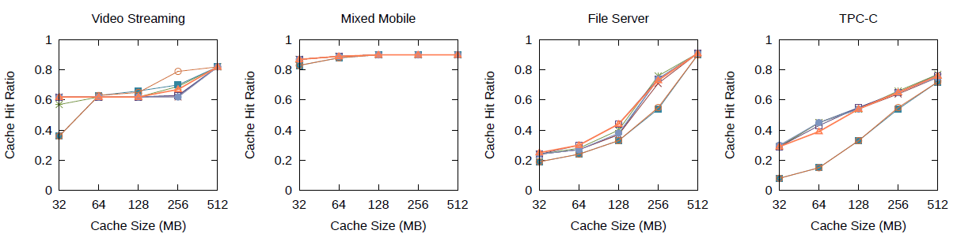
Cache Hit Ratio
Erase block size (4 MB)
Erase block size (24 MB)

Slide 15
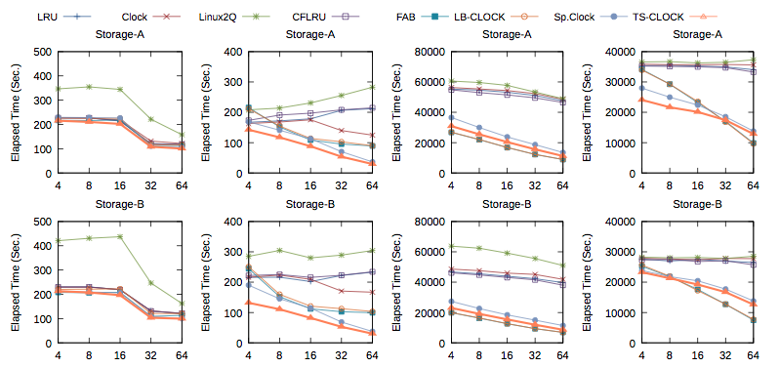
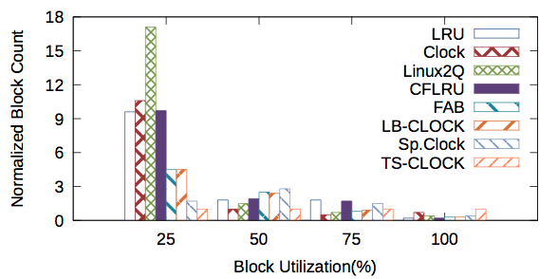
Elapsed Time
Micro SD card
Write pattern strongly affects performance on
low-end NAND flash storage devices

Slide 16
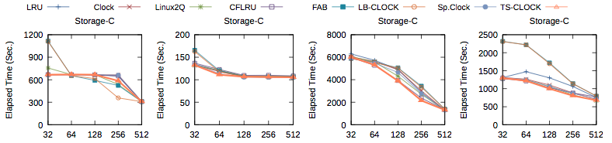
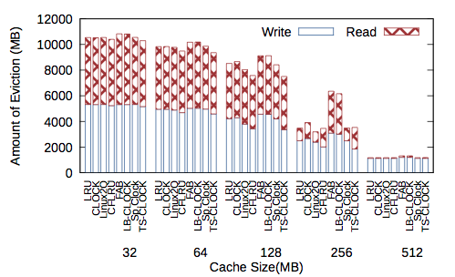
Elapsed Time
SSD

Slide 17
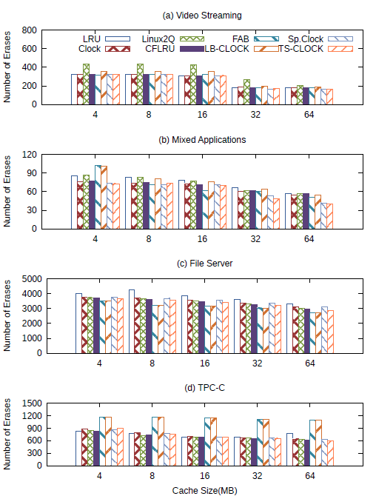
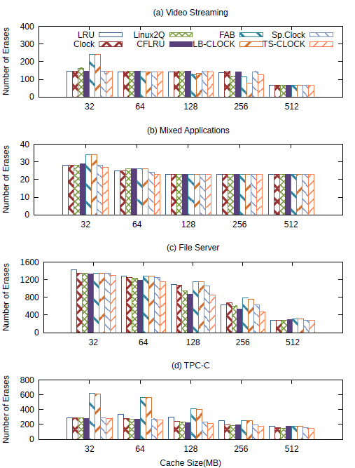
Lifetime
FAST FTL
Page-level FTL

Slide 18
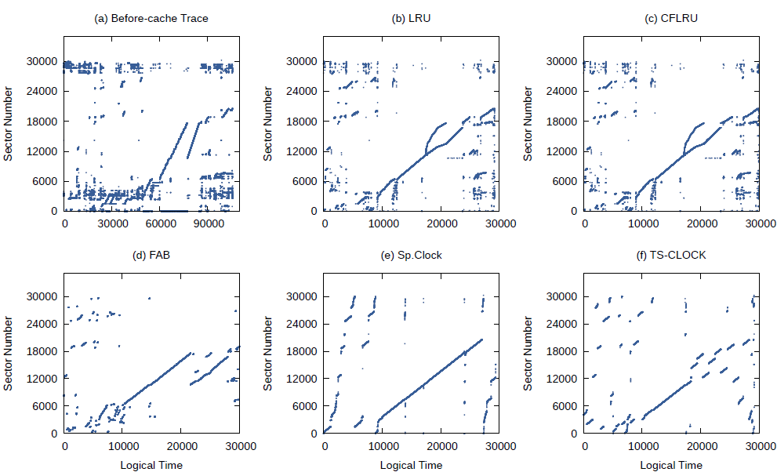
Patterns for Results of Simulator

Slide 19
Conclusion
Random write on NAND Flash storage devices reduce both performance and lifetime
We present a novel buffer replacement algorithm
It extends the CLOCK algorithm to take benefits of temporal locality
It consider both asymmetric read and write cost and flash-friendly write pattern to improve write performance and extend limited lifetime
We show that TS-CLOCK considerably outperforms existing flash-aware replacement schemes and prolongs the lifetime of NAND flash storage devices

Slide 20
Thank you! Questions?

