Slide 1
Multicore Scalability through Asynchronous Work
Ajit Mathew
Master’s Thesis Defense

Slide 2
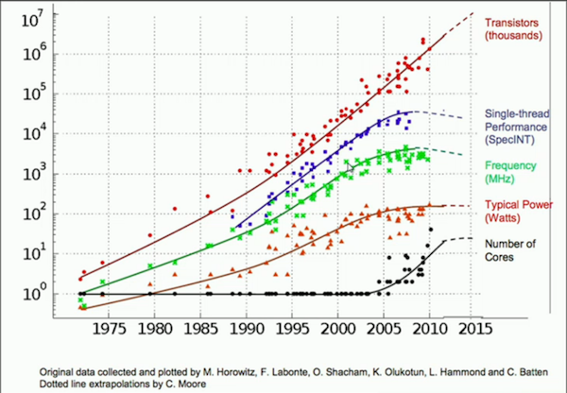
Why multicore scalability is important?
Moore’s
Law
Clock Speed Saturates
Rise of Multi-core

Slide 3
Free Lunch is Over
We entered Multi-Core Era in around 2005
To improve software performance, program needs to be parallelized
In other words:
Parallelize or Perish

Slide 4
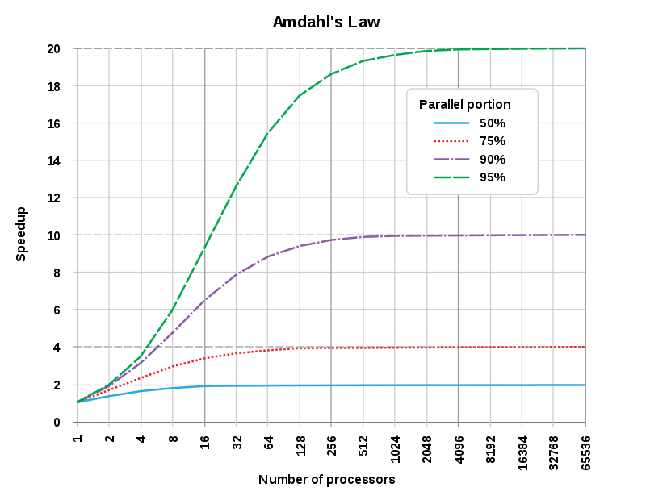
Performance in Multi-Core Era
Amdhal’s Law:
Performance in multi-cores is limited by the portion of program that cannot be parallelized (called sequential section or critical section)
Adding more processors does not improve performance

Slide 5


Key Idea
Problem:
Adding more processor does not improve performance
Solution:
Use extra processor to do work to reduce sequential section.

Slide 6
Asynchronous Work for scalability
Idea: Perform tasks which are necessary for consistency in critical section and perform non-necessary task outside the critical section using background threads.
Example:
free() is an expensive operation
Freeing memory in critical section is unnecessary
Use a garbage collector to free memory

Slide 7
Contribution
My thesis explores how asynchronous work can be used to improve scalability in multicores
The thesis presents two systems built on the idea of asynchronous work

Slide 8
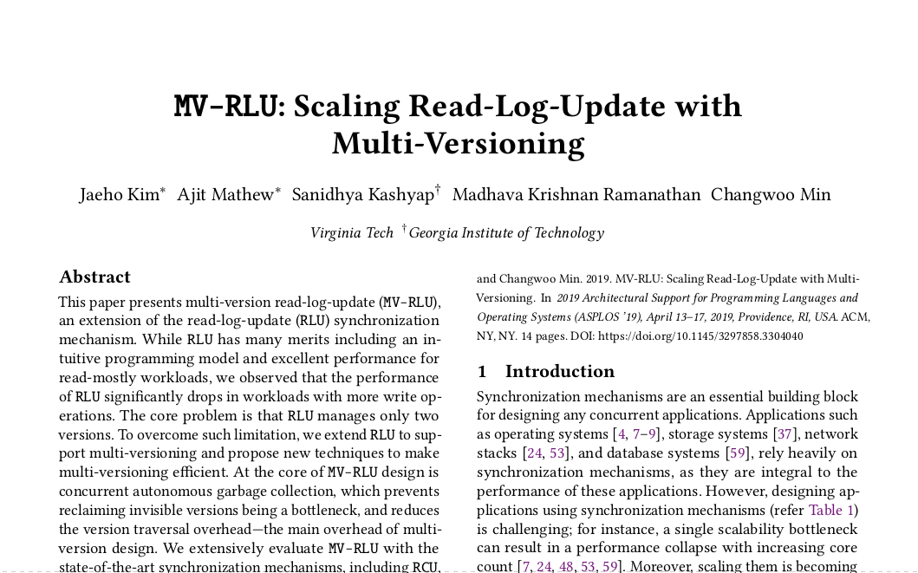
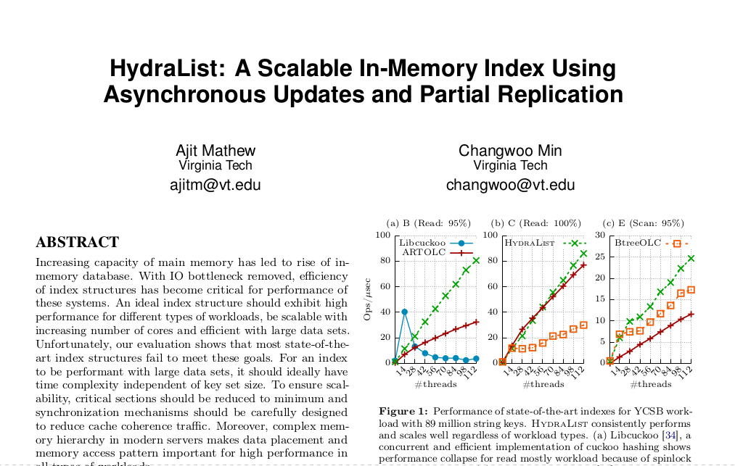
MV-RLU & Hydralist
ASPLOS, 2019
Under Submission
Torgersen Research Excellence Award 2019

Slide 9
MV-RLU: Scaling Read-Log-Update with Multi-Versioning

Slide 10





Synchronization mechanisms are essential​
A single scalability bottleneck in synchronization mechanism can result in a performance collapse with increasing core count​ [Boyd-Wickizer,2010]
Scalability of program depends on scalability of underlying synchronization mechanism
Notes:
Synchronization mechanisms are essential building blocks of today’s application. Researchers at MIT have shown that a single scalability bottleneck of synchronization mechanism can cause performace collapse at high core count. Hence it can be said that scalability of a program depends on the underlying synchronization algorithm, This make search for new scalable SM an interesting problem

Slide 11


Core count continues to rise….

Slide 12
Can synchronization mechanisms scale at high core count?
Ideal
Scaling
Saturation
Notes:
Let us consider a microbenchmark of concurrent lockfree hash table with 10% updates with 10k elements. Here the throuput is shown in the y axis in MOPS and threads in the x axis. Ideally the performance should show linear scaling. But the performance of lock free hash table saturates at about 120 core. The reason for this saturation is non scalable garbage collection

Slide 13


Read Copy Update (RCU)
Widely used in Linux kernel
Readers never block
Multi-pointer update is difficult
A
B
C
B
B’

Slide 14
Read-Log-Update (RLU) [Matveev’15]
Readers do not block
Allow multi-pointer update
Key idea: Use global clock and per thread log to make updates atomically visible
Notes:
An improvement over RCU is RLU or read log update. In RLU readers do not block but RLU provides better programmability as it allows multi-pointer updates. It is able to do so ..

Slide 15
Even RCU and RLU does not scale
Saturation
Performance Collapse
Notes:
Even non linearizable algorithms like RCU which is highly used in linux kernel does not scale and it’s performance saturates at about 100 cores. RLU which is similar to RCU in that it provides synchronization free reads and better programmability through multi-pointer update shows performance collapse at moderately high core count. Since RLU has excellent properties making it scalable is an interesting problem

Slide 16
Why does not RLU scale?
Legend
Object
Version of Object
Header
Waiting
Reclaim!
A
B
C
D
B’
Per thread version log
Synchronous waiting due to restriction on number of versions per object is bottleneck in RLU design
Notes:
To understand why RLU does not scale let us consider a RLU based concurrent linked list. A thread modifies node B which in turn creates a new version of B. Then another thread tries to modify B but is not allowed to proceed because RLU restricts the number of simultaneous versions of an object to two. So the second thread has to reclaim the older version of object B for which it will wait for rlu threads to exit the critical section. This synchronous waiting

Slide 17
How to scale RLU?
Problem:
Restriction in number of versions causes synchronous waiting
Solution:
Remove restriction on number of version == Multi-Versioning

Slide 18
Scaling RLU through Multi-Versioning
Multi-Version Read-Log-Update (MV-RLU)
Allows multiple version to exists at same time
Removes synchronous waiting from critical path
Scaling Multi-versioning
Scalable Timestamp allocation
Concurrent and autonomous garbage collection
MV-RLU shows 4-8x performance improvement with KyotoCabinet

Slide 19
Design: Overview
A
Master Object
Per thread version log
A’’
(55)
Copy Object
Version Chain
Per thread version log
A’
(25)
Copy Object
Commit Timestamp
Notes:
In MVRLU, object which we call master object can have zero or more versions which we call copy object. Copy objects store the timestamp of when they were created. Copy objects also store the pointer of the next older version creating a version chain. Copy objects are stored in the per version thread log of the thread that created it. Master object store the head of the version chain.

Slide 20
Updates in MV-RLU
A
B
C
D
No synchronous waiting
B’’
(55)
Per thread version log
B’
(25)
Per thread version log
Notes:
To understand how MVRLU prevent synchronous waiting let us see how updates are done in MV-RLU. Consider a MVRLU based concurrent linked list. A threads udates node B which creates a new copy object of B with timestamp 25. Another thread then updates B, which creates another copy object. Because MVRLU does not restrict the number of versions of an object, the second thread does not need to synchronize with other reader/writer threads in the critical section.

Slide 21
Reads in MV-RLU
Reader note the global clock at start of critical section
read clock = 35
A
B
C
D
35 < 55
read clock > version commit timestamp
B’’
(55)
Per thread version log
35 > 25
B’
(25)
Per thread version log
Notes:
Since MV-RLU supports multiple version of the same data, reads are slightly more involved. When a reader enters a critical section, it reads the global clock to get a read clock. Then it traverses the version chain to find the first node which statisfies the propert read clock is less than version timestamp.

Slide 22
Memory is limited!
Thread 1
Log Full!
Garbage Collection is needed
Reclaim obsolete version
Should be scalable
Per Thread Log
Used

Slide 23
Detecting obsolete version
Quiescent State based Reclamation (QSBR)
Grace Period: Time interval between which each thread has been outside critical section at least once
Grace Period detection is delegated to a special thread

Slide 24
Reclaiming Obsolete version
Concurrent Reclamation
Every thread reclaims it’s own log
Cache friendly
Scales with increasing number of threads

Slide 25
Triggering Garbage Collection
Ideally, triggers should be workload agnostic
Two conditional Trigger or Watermark
Capacity Watermark
Dereference Watermark

Slide 26
Writers block when log is full
Thread 1
Start GC.
I will wait
Per Thread Log
Used
Notes:
In mv-rlu, when writers performs updates, it uses log space and eventually the log will be full after which the thread will wait for garbage collection to reclaim log space.

Slide 27
Writers block when log is full
Log about to get full. Start GC
Thread 1
Start GC.
I will wait
Thread 1
Capacity Watermark
Per Thread Log
Used
Notes:
Instead, if the thread triggers garbage collection when the log utilization crosses a certain threshold, it can continue doing useful work and hopefully, GC can reclaim log space before the log fills up. This threshold is called capacity water mark.

Slide 28
Prevent log from filling up using capacity watermark
Writers block when log is full
To prevent blocking, start GC when log is almost full
Capacity Watermark
Trigger GC when a thread’s log is about to get full
Works well in write heavy workload

Slide 29
GC Example
Okay! Here is the last GP
Done
Done
I need GC
zzz…
Grace period detector thread
Thread 1
Thread 2
Thread 3
Capacity Watermark
Per Thread Log:
Used

Slide 30
More detail
Scalable timestamp allocation
Version Management
Proof of correctness
Implementation details

Slide 31
Outline
Background
Design
Evaluation
Conclusion

Slide 32
Evaluation Question
Does MV-RLU scale?
What is the impact of our proposed approaches?
What is its impact on real-world workloads?

Slide 33
Evaluation Platform
8 socket, 448 core server
Intel Xeon Platinum 8180
337 GB Memory
Linux 4.17.3

Slide 34
Microbenchmark
150x speedup over RLU
(Higher is better)
1K element, load factor: 1

Slide 35
Factor Analysis
2x
4x
2x
GC is bottleneck
Million Operations Per Second

Slide 36
Key Value Benchmark
8x speedup over RLU

Slide 37
Conclusion
MV-RLU: Scaling RLU through Multi-Versioning
Multi-Versioning removes synchronous waiting
Concurrent and autonomous garbage collection
MV-RLU show unparallel performance for a variety of benchmark.
https://github.com/cosmoss-vt/mv-rlu

Slide 38
Hydralist
A Scalable In-Memory Index Using Asynchronous Update and Partial Replication

Slide 39
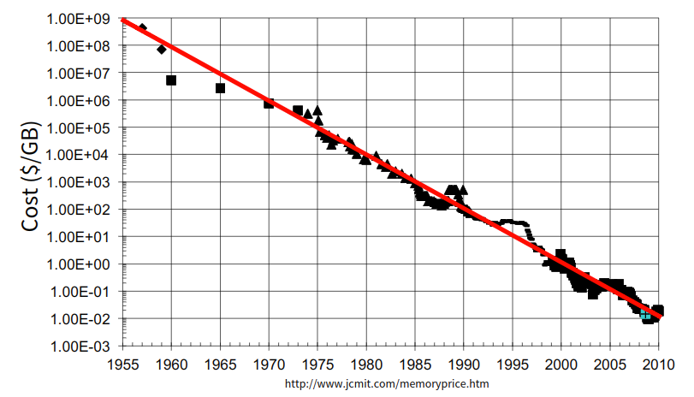
Trends in Memory Capacity
Price of DRAM has been reducing

Slide 40
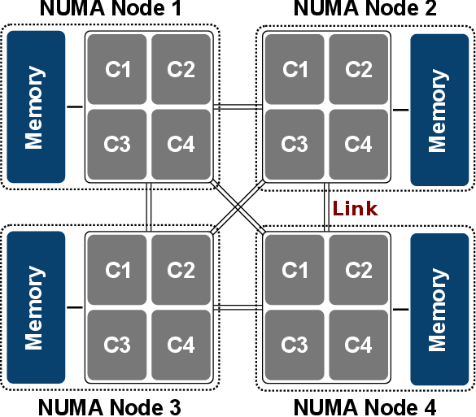
Non-Uniform Memory Architecture
http://www.iue.tuwien.ac.at/phd/weinbub/dissertationsu16.html

Slide 41





Rise of In-Memory Storage
Larger and cheaper memory has allowed databases to store their data and meta-data in memory
I/O bottlenecks caused due to slow disk reads

Slide 42
Index is the new bottleneck
Since data is in memory, IO bottlenecks caused due to expensive disk accesses are avoided.
Significant efforts on optimizing query execution has allowed compiled transactions to remove overhead of buffer management, latching, etc.
A recent study of contemporary in-memory database systems shows that index lookup can contributes up to 94% of query execution time.[Kocberber, MICRO’13]

Slide 43
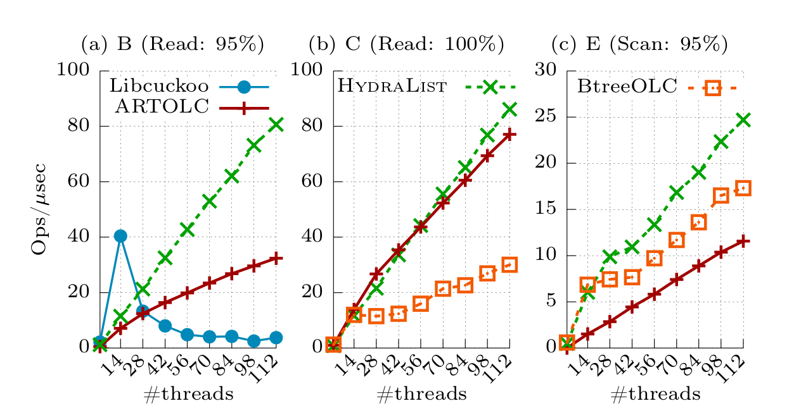
Motivation
Same SM but ART has efficient time complexity
Btree has cache efficient scan
Libcuckoo uses spinlock

Slide 44
Designing new Index Structure
Efficient Time Complexity
Low synchronization overhead
Efficient Data Placement
Cache Efficiency and NUMA Awareness

Slide 45
Key Idea
Most index structure can be decomposed into two components:
Data Layer: Stores key and value pair
Search Layer: Stores partial keys or a subset of keys which allows to accelerate search of keys in data layer.
If we modify the search algorithm of a key, we can allow inconsistency between search layer and data layer. This makes it possible to update search layer asynchronously.

Slide 46
Example: B+Tree
13
Search
Layer
7
23
31
43
2
3
5
7
11
13
17
19
23
29
13
17
19
23
29
Data Layer

Slide 47
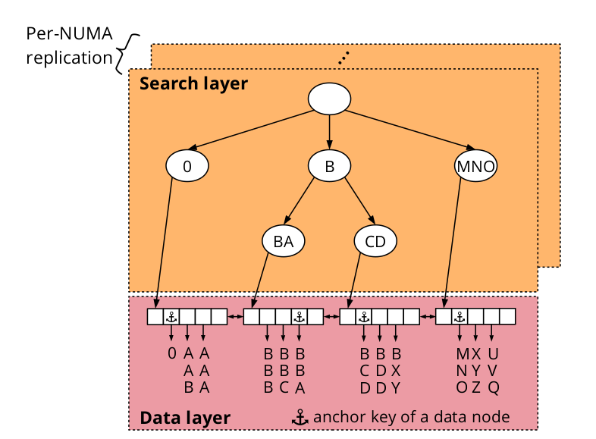
Hydralist Design

Slide 48
Searching in Hydralist
Searching the search layer (Jump Node)
Searching the data layer (Target Node)
Search within a data node

Slide 49
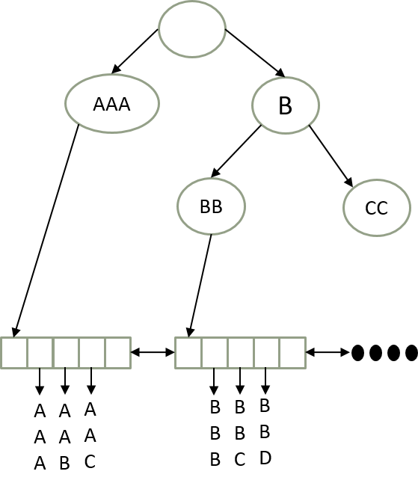
Insert in Hydralist
Insert Key: BAA
Find anchor key closest to BAA
Check if current node is the target node.
If not traverse, data layer

Slide 50
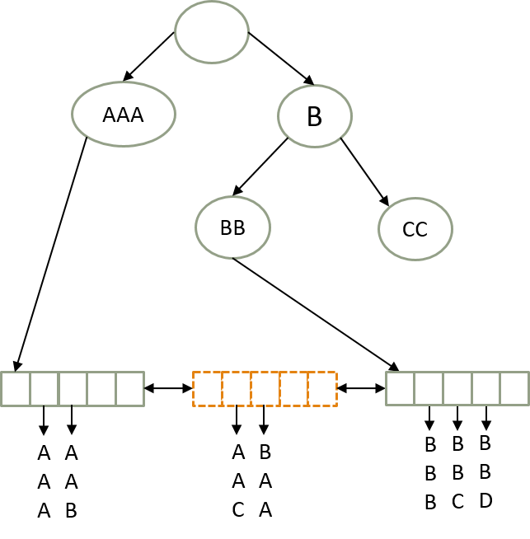
Insert in Hydralist
Insert Key: BAA
Find anchor key closest to BAA
Check if current node is the target node.
If not traverse, data layer
Target Node is full so split

Slide 51
Concurrent Search
Search Key: AAC
Still visible to new thread, even though Search Layer is not update

Slide 52
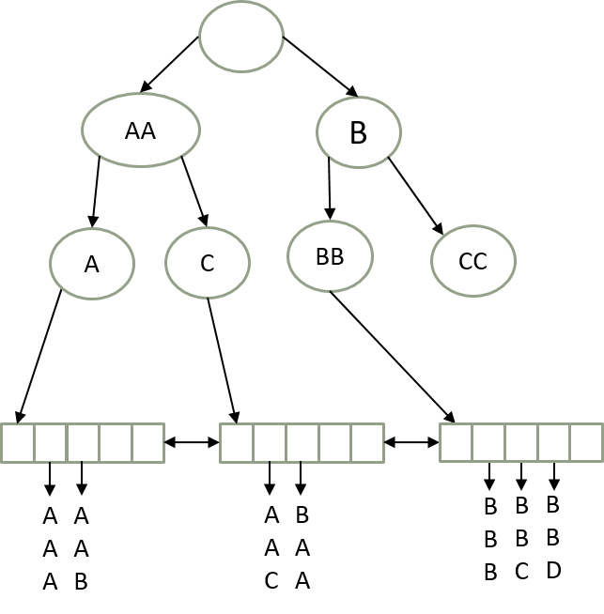
Finally Search Layer is Updated
Anchor key of new node is inserted into search layer

Slide 53
How search layer is updated
Each thread has a operation log or OpLog
When a thread splits/merges a node, it adds the operation to OpLog
Also adds timestamp, anchor key of the node
Combiner thread
A background thread which combines all Oplogs periodically
Sorts operations according to time stamps
Updater thread
Background thread which applies merged log to search layer
This is done asynchronously
Does not affect the consistency of the index
NUMA replication
Search layer can be made NUMA-local by assigning per NUMA-updater thread

Slide 54
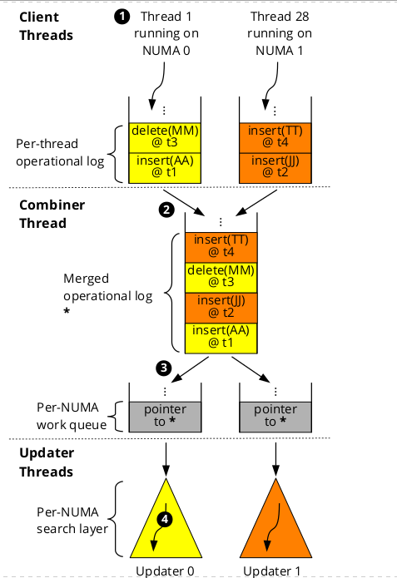
Search Layer Update

Slide 55
Other Details
Design of data node
Storing key hash instead of sorted keys
SIMD to accelerate search within node
Optimistic locking

Slide 56
Evaluation
Intel Xeon Platinum 8180 Server
112 Cores
YCSB Benchmark
89 Million string keys (email addresses)
50 million operations

Slide 57
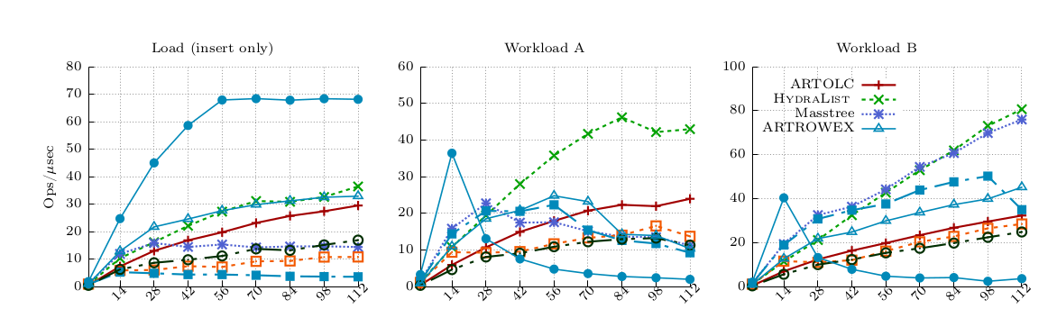
YCSB

Slide 58
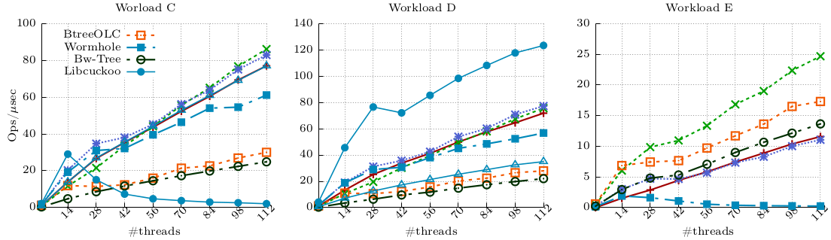
YCSB

Slide 59
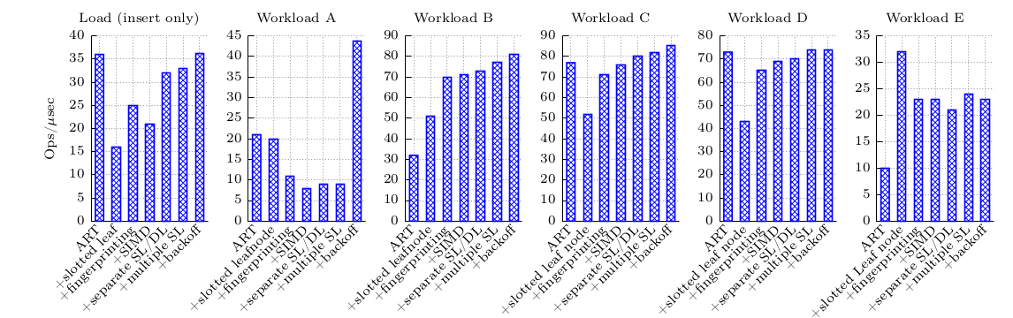
Factor Analysis

Slide 60
Conclusion
Multicore scaling is difficult because of unprecedented levels of parallelism
Possible solution: Asynchronous Work.
Will require redesigning algorithm to allow delegation
MV-RLU: a new scalable synchronization mechanism
Modification: Add multi-versioning to RLU
Result: Remove synchronous waiting from critical path
Hydralist: a new scalable index structure
Modification: Separate Search Layer and Data Layer and modify search algorithm
Result: Remove update to search layer from critical path

Slide 61
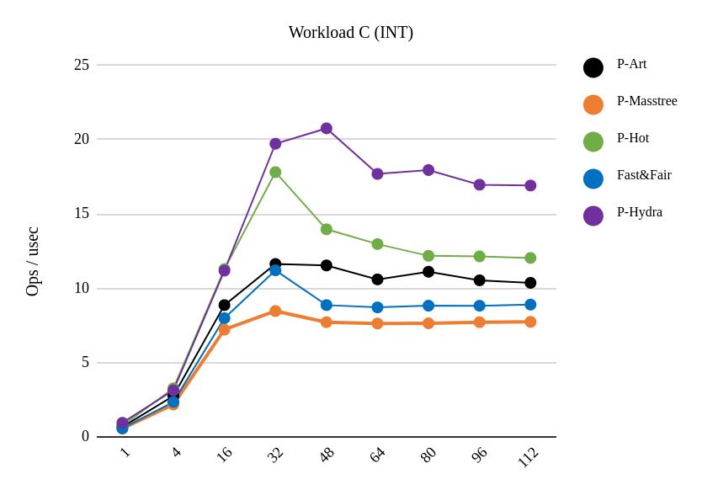
Future Work
Timestone: MV-RLU for NVM (Accepted at ASPLOS, 2020)
NVM-Hydralist: Preliminary Performance is better than other index
RDMA-Hydralist

Slide 62
Multi-pointer update
A
B
C
D
B’
(∞)
Per thread version log
B’
(55)
D’
(55)
D’
(∞)

Slide 63
Snapshot Isolation
MVRLU Serializable Snapshot Isolation
SSI works well for any application which can tolerate stale read
RCU is widely used which means lot of application for MV-RLU

Slide 64
Log size
Memory in computer systems is increasing
Persistent memory can increase total main memory significantly
Log size is a tuning parameter.

Slide 65
AA
B
A
C
BB
CC
A
A
A
A
A
B
A
A
C
B
A
A
B
B
B
B
B
C
B
B
D

